Slide 1


Week 1 Content
Chapters:
11, 18-21
Professor Marpole

Slide 2

Chapter 18
Adrenergic Drugs

Slide 3
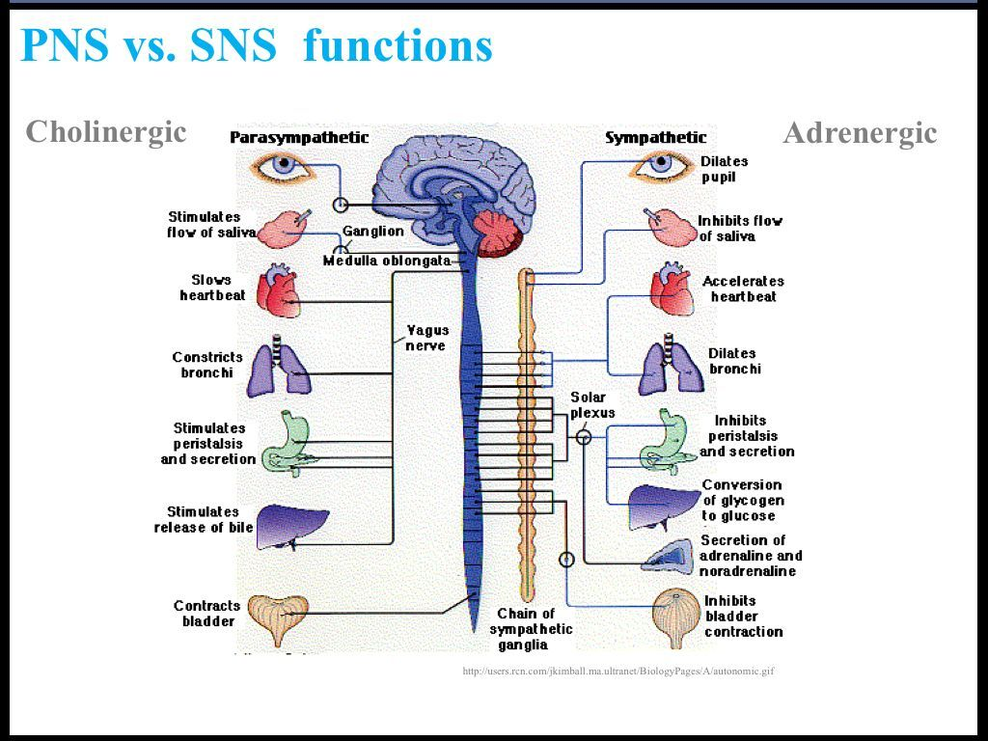

Slide 4
Adrenergic Drugs
Drugs that stimulate the sympathetic nervous system (SNS)
Also known as:
  Adrenergic agonists
  Sympathomimetics
Mimic the effects of the SNS neurotransmitters (catecholamines)
  Norepinephrine (NE)
  Epinephrine (EPI)
  Dopamine

Slide 5
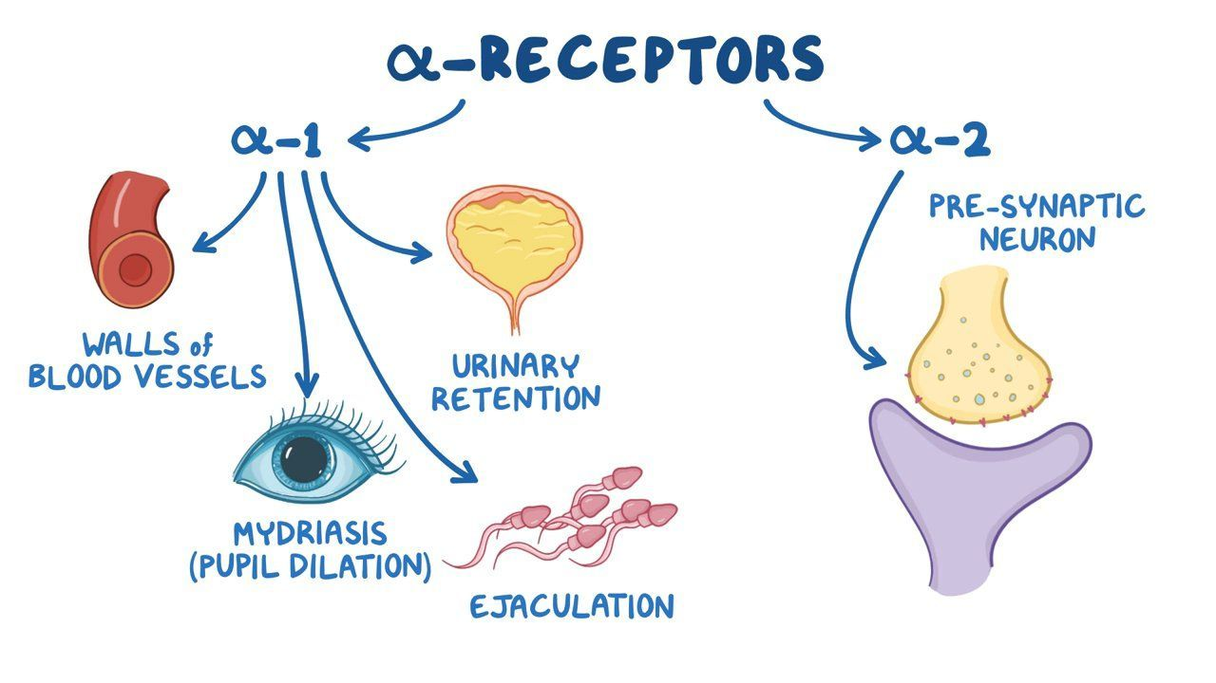

Slide 6
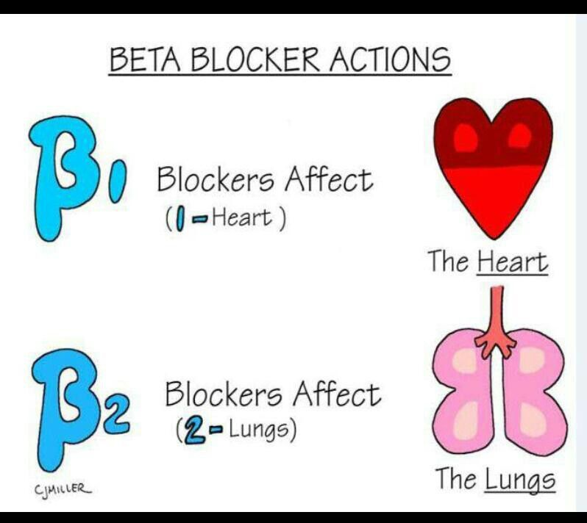

Slide 7
Adrenergic Drugs:
Mechanism of Action
Direct-acting Sympathomimetic
Binds directly to the receptor and causes a physiologic response
Indirect-acting Sympathomimetic
Causes release of catecholamine from storage sites (vesicles) in nerve endings
Catecholamine then binds to receptors and causes a physiologic response
Mixed-acting Sympathomimetic
Directly stimulates the receptor by binding
to it and
Indirectly stimulates the receptor by causing
the release of stored neurotransmitters from
vesicles in the nerve endings

Slide 8
Drug Effects
Stimulation of alpha-adrenergic receptors on smooth muscles results in:
  Vasoconstriction of blood vessels
  Relaxation of GI smooth muscles (decreased motility)
  Constriction of bladder sphincter
  Contraction of uterus
  Male ejaculation
  Contraction of pupillary muscles of the eye (dilated pupils)
Stimulation of beta₁-adrenergic receptors on the myocardium, atrioventricular (AV) node, and sinoatrial (SA) node results in cardiac stimulation
  Increased force of contraction (positive inotropic effect)
  Increased heart rate (positive chronotropic effect)
  Increased conduction through AV node (positive dromotropic effect)

Slide 9
Drug Effects
Stimulation of beta₂-adrenergic receptors on the airways results in
  Bronchodilation (relaxation of the bronchi)
Other effects of beta₂-adrenergic stimulation
  Uterine relaxation
  Glycogenolysis in the liver
  Increased renin secretion in the kidneys
  Relaxation of GI smooth muscles (decreased motility)

Slide 10
Respiratory
Treatment of a wide variety of illnesses & conditions
Respiratory Indications
  Bronchodilators: drugs that stimulate beta₂-adrenergic receptors of bronchial smooth muscles, causing relaxation, resulting in bronchodilation
  Examples: albuterol, ephedrine, epinephrine, formoterol, levalbuterol, metaproterenol, pirbuterol, and salmeterol
Treatment of nasal congestion
  Intranasal (topical) application causes constriction of dilated arterioles and reduction of nasal blood flow, thus decreasing congestion.
  Alpha₁-adrenergic receptors
  Examples: ephedrine, naphazoline, oxymetazoline, phenylephrine, and tetrahydrozoline

Slide 11
Optic & Bladder
Opthalmic Indications
  Temporary relief of conjunctival congestion (eyes)
    Alpha-adrenergic receptors
    Examples: epinephrine, naphazoline, phenylephrine, tetrahydrozoline
  Reduction of intraocular pressure and dilation of pupils: treatment of open-angle glaucoma
    Alpha-adrenergic receptors
    Examples: epinephrine and dipivefrin
Overactive Bladder Indications
  Relaxes the detrusor muscle during the storage phase of the bladder fill cycle
  Increases bladder storage capacity
  Mirabegron (Myrbetriq)

Slide 12
Cardiac
Cardiovascular Indications
  Vasoactive Adrenergics (Pressors, Inotropes)
    Also called cardioselective sympathomimetics
    Used to support the heart during cardiac failure or shock; various alpha and beta receptors affected
      Examples: Dobutamine, Ephedrine, Fenoldopam, Midodrine

Slide 13
Contraindications to Adrenergic Drugs
Known drug allergy
Severe hypertension

Slide 14
Adverse Effects
Alpha-adrenergic:
  Headache, restlessness, excitement, insomnia, euphoria
  Chest pain, vasoconstriction, reflexive bradycardia, palpitations, dysrhythmias
  Anorexia, dry mouth, nausea, vomiting, taste changes
Beta-adrenergic drugs:
  Mild tremors, headache, nervousness, dizziness
  Increased heart rate, palpitations, fluctuations of blood pressure
  Sweating, nausea, vomiting, muscle cramps

Slide 15
Toxicity and Management of Overdose
Toxicity can occur from excessive CNS stimulation
  Seizures
  Intracranial bleeding due to extreme elevation of blood pressure
    Effective treatment: rapid acting sympatholytic drug
Short half-lives, thus effects are short-lived
Symptom management and support the respiratory and cardiac systems
Cholinergic Drugs are primary reversal of symptoms

Slide 16

Vasoactive Adrenergics: Epinephrine
Endogenous vasoactive catecholamine
Acts directly on both the alpha- and beta-adrenergic receptors of tissues innervated by the SNS
Prototypical nonselective adrenergic agonist
Administered in emergency situations to help cause contraction of the heart
One of the primary vasoactive drugs used in many advanced cardiac life support protocols

Slide 17
Vasoactive Adrenergics: Norepinephrine (Levophed)
Stimulates alpha-adrenergic receptors
Causes vasoconstriction
Direct-stimulating beta-adrenergic effects on the heart (beta₁-adrenergic receptors)
No stimulation to beta₂-adrenergic receptors of the lung
Treatment of hypotension and shock
Administered by continuous infusion

Slide 18
Vasoactive Adrenergics: Phenylephrine (Neo-Synephrine)
Works almost exclusively on the alpha-adrenergic receptors
Used primarily for short-term treatment to raise blood pressure in patients in shock
Control of supraventricular tachycardias
Vasoconstriction in regional anesthesia
Topical ophthalmic drug
Nasal decongestant (Sudafed)

Slide 19
Nursing Implications: Assessment
Assess for allergies, asthma, and history of hypertension, cardiac dysrhythmias, and other cardiovascular disease.
Assess renal, hepatic, and cardiac function before treatment.
Perform baseline assessment of vital signs, peripheral pulses, skin color, temperature, and capillary refill; include postural blood pressure and pulse.
Follow administration guidelines carefully.

Slide 20


Nursing Implications
Intravenous (IV) administration
  Check IV site often for infiltration
  Use clear IV solutions
  Use an infusion pump
  Infuse drug slowly to avoid dangerous cardiovascular effects
  Monitor cardiac rhythm
With chronic lung disease
  Instruct patients to avoid factors that exacerbate their condition.
  Encourage fluid intake (up to 3000 mL/day) if permitted (WHY?)
  Educate patients about proper dosing, use of equipment (metered-dose inhaler, spacer, nebulizer), and equipment care.
  Educate on appropriate use of inhalers (rescue versus maintenance).
Overuse of nasal decongestants may cause rebound nasal congestion or ulcerations.
Avoid over-the-counter and other medications because of possible interactions.

Slide 21
Nursing Implications
Administering two adrenergic drugs together may precipitate severe cardiovascular effects such as tachycardia or hypertension
Monitor for therapeutic effects (cardiovascular uses)
  Decreased edema
  Increased urinary output
  Return to normal vital signs
  Improved skin color and temperature
  Increased LOC
Monitor for therapeutic effects (asthma)
  Return to normal respiratory rate
  Improved breath sounds, fewer crackles
  Increased air exchange
  Decreased cough
  Less dyspnea
  Improved blood gases
  Increased activity tolerance

Slide 22
Chapter 19
Adrenergic-Blocking Drugs

Slide 23
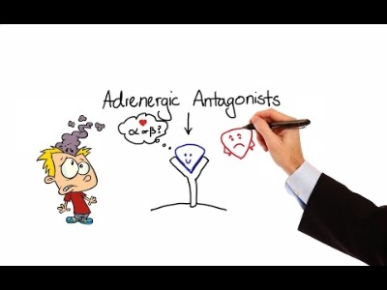

Slide 24
Adrenergic Blockers
Bind to adrenergic receptors but inhibit or block stimulation of the sympathetic nervous system (SNS)
Have the opposite effect of adrenergic drugs
Inhibit—or lyse—sympathetic stimulation
Also known as:
  Adrenergic antagonists
  Sympatholytics
  Alpha blockers, beta blockers, or alpha-beta blockers
Classified by the type of adrenergic receptor they block
  Alpha₁ and alpha₂ receptors
  Beta₁ and beta₂ receptor

Slide 25
Mechanism of Action and Drug Effects: Alpha Blockers
Cause both arterial and venous dilation, reducing peripheral vascular resistance and blood pressure (BP)
Used to treat hypertension
Effect on receptors on prostate gland and bladder decreases resistance to urinary outflow, thus reducing urinary obstruction and relieving effects of benign prostatic hyperplasia (BPH).

Slide 26
Indications: Alpha Blockers
Used to control and prevent hypertension in patients with pheochromocytoma
Raynaud’s disease, acrocyanosis, and frostbite
Phentolamine
  Quickly reverses the potent vasoconstrictive effects of extravasated vasopressors such as norepinephrine or epinephrine
  Restores blood flow and prevents tissue necrosis

Slide 27
Alpha Blockers: Adverse Effects
Body system | Adverse effects
Cardiovascular | Palpitations, orthostatic hypotension, tachycardia, edema, chest pain
CNS | Dizziness, headache, anxiety, depression, weakness, numbness, fatigue
Gastrointestinal | Nausea, vomiting, diarrhea, constipation, abdominal pain
Other | Incontinence, dry mouth, pharyngitis

Slide 28
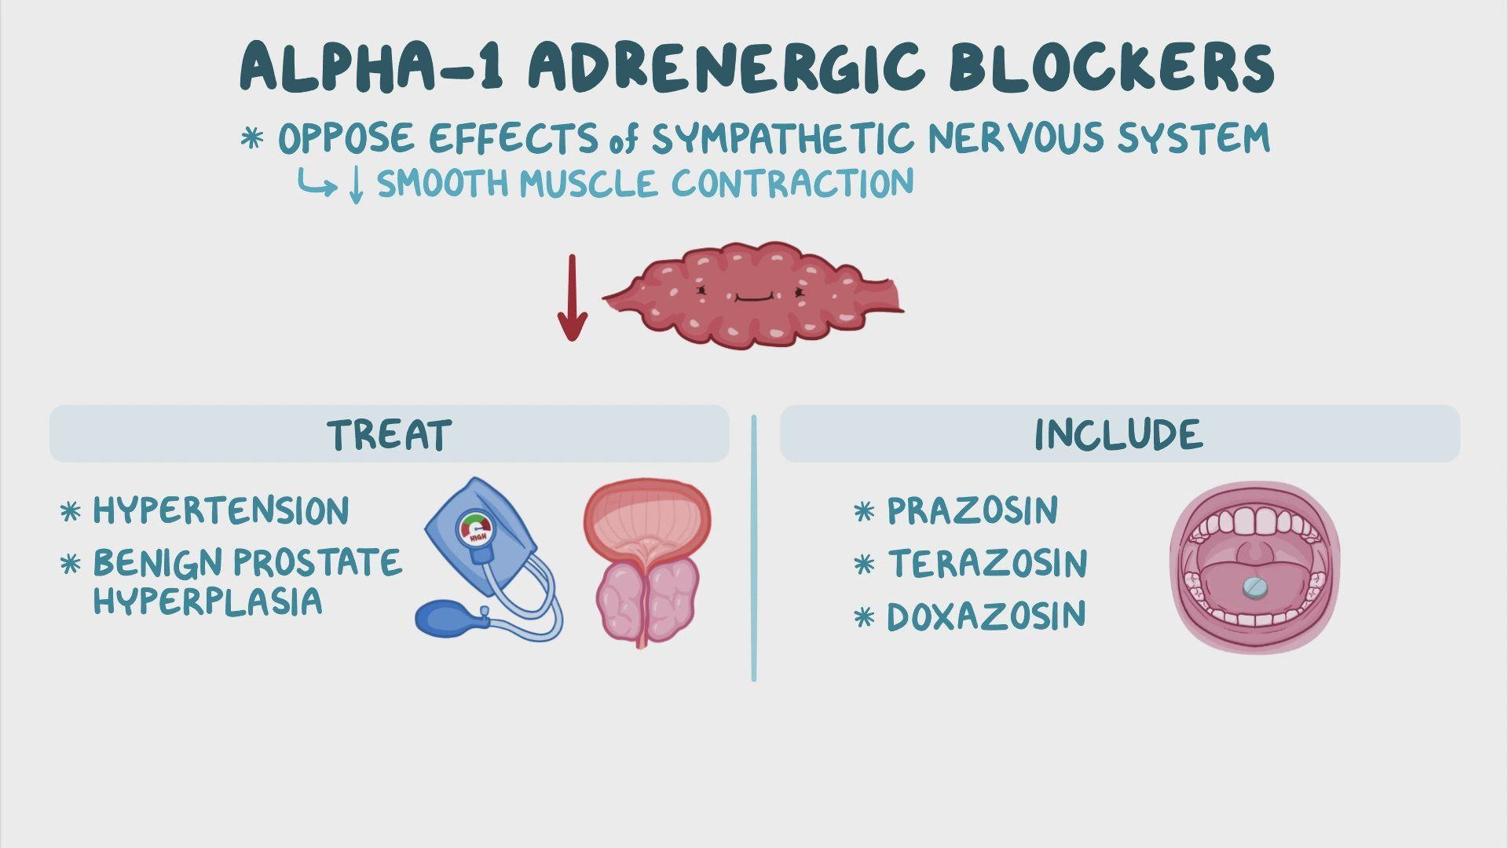

Slide 29
Contraindications
Known allergies
Peripheral vascular disease (inability for blood to return from peripherals due to narrowing of veins)
Hepatic/renal disease
Coronary artery disease (as BP drops, HR increases)
Peptic ulcer
Sepsis

Slide 30
Common Alpha Blockers
Phenoxybenzamine HCl (Dibenzyline)
Phentolamine (Generic)
Prazosin (Minipress)
Terazosin (Hytrin)
Alfuzosin (Uroxatral)
Tamsulosin (Flomax)
Doxazosin (Cardura)

Slide 31
Tamsulosin (Flomax)
Alpha blocker used primarily to treat benign prostatic hyperplasia (BPH); is exclusively indicated for male patients however, can be used in female patients with kidney stones
Contraindications: known drug allergy and concurrent use of erectile dysfunction drugs such as sildenafil
Adverse effects: headache, abnormal ejaculation, rhinitis, and others

Slide 32
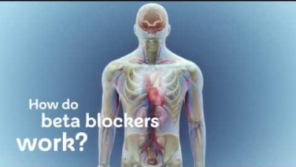
Beta Blockers
Block stimulation of beta receptors in
the SNS
Compete with norepinephrine and epinephrine (decreases amount that can be used)
Can be selective or nonselective
  Cardioselective beta blockers or beta₁-blocking drugs
  Nonselective beta blockers block both beta₁ and beta₂ receptors.
Beta₂ receptors are located primarily on the smooth muscles of the bronchioles and blood vessels.

Slide 33
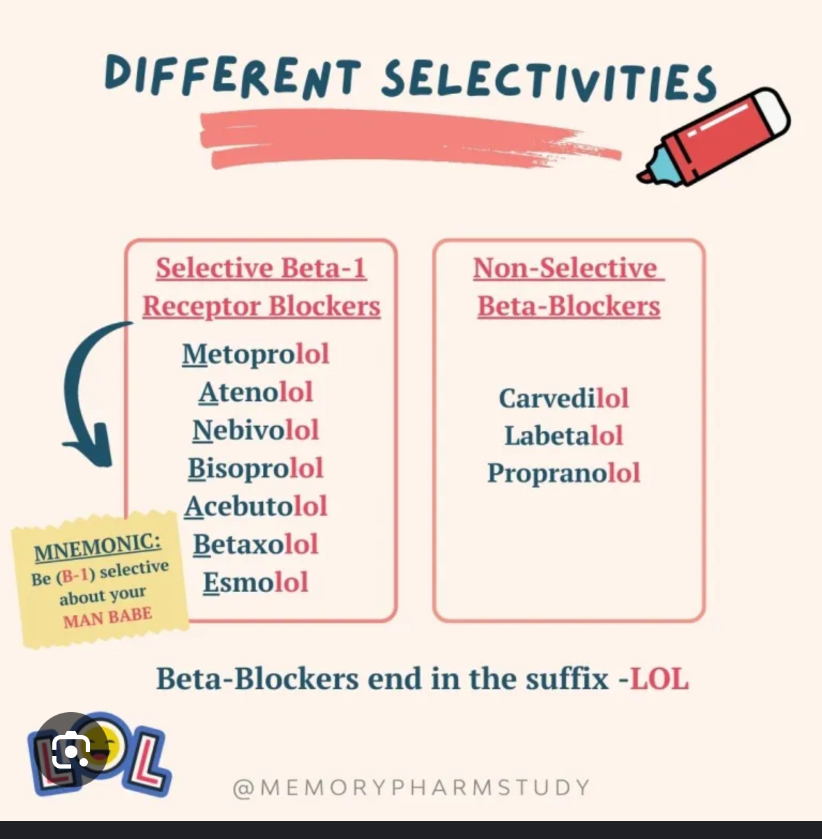
Beta Blockers:
Mechanism of Action
Cardioselective beta blockers (beta₁)
  Reduce SNS stimulation of the heart
  Decrease heart rate
  Prolong sinoatrial (SA) node recovery
  Slow conduction rate through the AV node
  Decrease myocardial contractility, thus reducing myocardial oxygen demand
Nonselective beta blockers (beta₁ and beta₂)
  Cause same effects on heart as cardioselective beta blockers
  Constrict bronchioles, resulting in narrowing of airways and shortness of breath
  Produce vasoconstriction of blood vessels (treat tachycardia)

Slide 34
Beta Blockers: Indications
Angina
  Decreases demand for myocardial oxygen
Cardioprotective
  Inhibits stimulation from circulating catecholamines
  Used in patients who have had a MI
Dysrhythmias
  Class II antidysrhythmic
Migraine headache
  Lipophilicity allows entry into CNS.
Antihypertensive
  Ability to reduce SNS stimulation of the heart, reducing heart rate and force of myocardial contraction
Heart failure
Glaucoma (topical use)

Slide 35
Beta Blockers: Contraindications
Known drug allergy
Uncompensated heart failure
Cardiogenic shock
Heart block, bradycardia
Pregnancy
Severe pulmonary disease
Raynaud’s disease

Slide 36
Beta Blockers: Adverse Effects
Nonselective beta blockers may interfere with normal responses to hypoglycemia (tremor, tachycardia, nervousness).
  May mask signs and symptoms of hypoglycemia
  Use with caution in patients with diabetes mellitus

Slide 37
Beta Blockers:
Toxicity and Management of Overdose
Symptomatic and supportive care
Atropine for bradycardia
Cardiac pacing
Vasopressors for severe hypotension
Hemodialysis to enhance elimination in severe overdoses

Slide 38
Adrenergic-Blocking Drugs:
Nursing Implications
Assess for allergies and history of COPD, hypotension, cardiac dysrhythmias, bradycardia, heart failure, and other cardiovascular problems.
  Any pre-existing condition that might be exacerbated by the use of these drugs might be a contraindication to their use.
Remember that alpha blockers may precipitate hypotension.
Remember that some beta blockers may precipitate bradycardia, hypotension,
heart block, heart failure, and bronchoconstriction.

Slide 39
Adrenergic-Blocking Drugs:
Nursing Implications
Avoid over-the-counter medications because of possible interactions.
Possible drug interactions may occur with
  Antacids (aluminum hydroxide type)
  Antimuscarinics or anticholinergics
  Diuretics and cardiovascular drugs
  Neuromuscular blocking drugs
  Oral hypoglycemic drugs
Encourage patients to take medications as prescribed.
Instruct patients that these medications should never be stopped abruptly.
Inform patients to report constipation or the development of urinary hesitancy or bladder distention.

Slide 40
Adrenergic-Blocking Drugs:
Nursing Implications
Teach patients to change positions slowly to prevent or minimize postural hypotension.
Instruct patients to avoid caffeine (excessive irritability).
Instruct patients to avoid alcohol ingestion and hazardous activities until blood levels become stable.
Instruct patients to notify their physicians if palpitations, dyspnea, nausea, or vomiting occurs.
Monitor for adverse effects.
Monitor for therapeutic effects.
  Decreased chest pain in patients with angina
  Return to normal BP and heart rate
  Other specific effects, depending on the use

Slide 41
Beta-Blocking Drugs:
Nursing Implications
Rebound hypertension or chest pain may occur if this medication is discontinued abruptly.
Instruct patients to notify their physicians if they become ill and unable to take medication.
Inform patients that they may notice a decrease in tolerance for exercise (dizziness and fainting may occur with increased activity) and have patients notify their physicians if these problems occur.
Inform patients to report the following to their physicians.
  Weight gain of more than 2 lb in 1 day or 5 lb in 1 week
  Edema of the feet or ankles
  Shortness of breath
  Excessive fatigue or weakness
  Syncope or dizziness

Slide 42
Chapter 20
Cholinergic Drugs

Slide 43
Cholinergic Drugs
Drugs that stimulate the parasympathetic nervous system (PSNS)
  The PSNS is the opposing system to
  the sympathetic nervous system (SNS).
Also known as cholinergic agonists or parasympathomimetics
Mimic effects of the PSNS neurotransmitter acetylcholine (ACh)

Slide 44
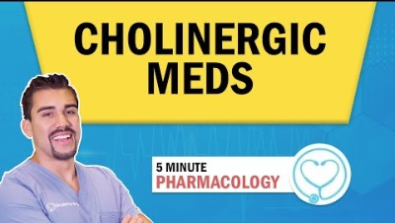

Slide 45
Cholinergic Drugs:
Mechanism of Action
Mimic the effects of acetylcholine (ACh) (contracts smooth muscles, dilates blood vessels, increases bodily secretions, and slows heart rate)
Direct-acting cholinergic agonists
  Bind to cholinergic receptors, activating them
Indirect-acting cholinergic agonists
  Also known as cholinesterase inhibitors
  Inhibit the enzyme acetylcholinesterase, which breaks down ACh
  Results in more ACh available at the receptors

Slide 46
Cholinergic Drugs:
Mechanism of Action and Drug Effects
Effects seen when PSNS is stimulated
After binding, permeability of the cell changes allowing flow of calcium and sodium into the cells.
  Results in depolarization of cell membrane and stimulation of the effector organ
The PNS is the “rest and digest” system.
  Sympathetic nervous system: “flight or fight”
Stimulate intestine and bladder
  Increased gastric secretions
  Increased gastrointestinal motility
  Increased urinary frequency
Stimulate pupils
  Constriction (miosis)
  Reduced intraocular pressure
Increased salivation and sweating

Slide 47
Cholinergic Drugs:
Mechanism of Action and Drug Effects
Cardiovascular effects
  Decreased heart rate
  Vasodilation
Respiratory effects
  Bronchial constriction, narrowed airways (less need for O2)
At recommended doses, cholinergics primarily affect muscarinic receptors (various locations).
At high doses, cholinergics stimulate nicotinic receptors.
Desired effects are from muscarinic receptor stimulation.
Many undesirable effects are caused by stimulation of nicotinic receptors.

Slide 48
Cholinergic Drugs: Contraindications
Known drug allergy
GI or genitourinary (GU) tract obstruction
Bradycardia
Defects in cardiac impulse conduction
Hyperthyroidism
Epilepsy
Hypotension
Chronic obstructive pulmonary disease
Parkinson’s disease

Slide 49
Cholinergic Drugs:
Adverse Effects
Adverse effects are a result of overstimulation of the PSNS.
Cardiovascular
  Bradycardia, hypotension, syncope, conduction abnormalities (AV block and cardiac arrest)
Central nervous system
  Headache, dizziness, convulsions, ataxia
Gastrointestinal
  Abdominal cramps, increased secretions, nausea, vomiting
Respiratory
  Increased bronchial secretions, bronchospasms
Other
  Lacrimation, sweating, salivation, miosis

Slide 50
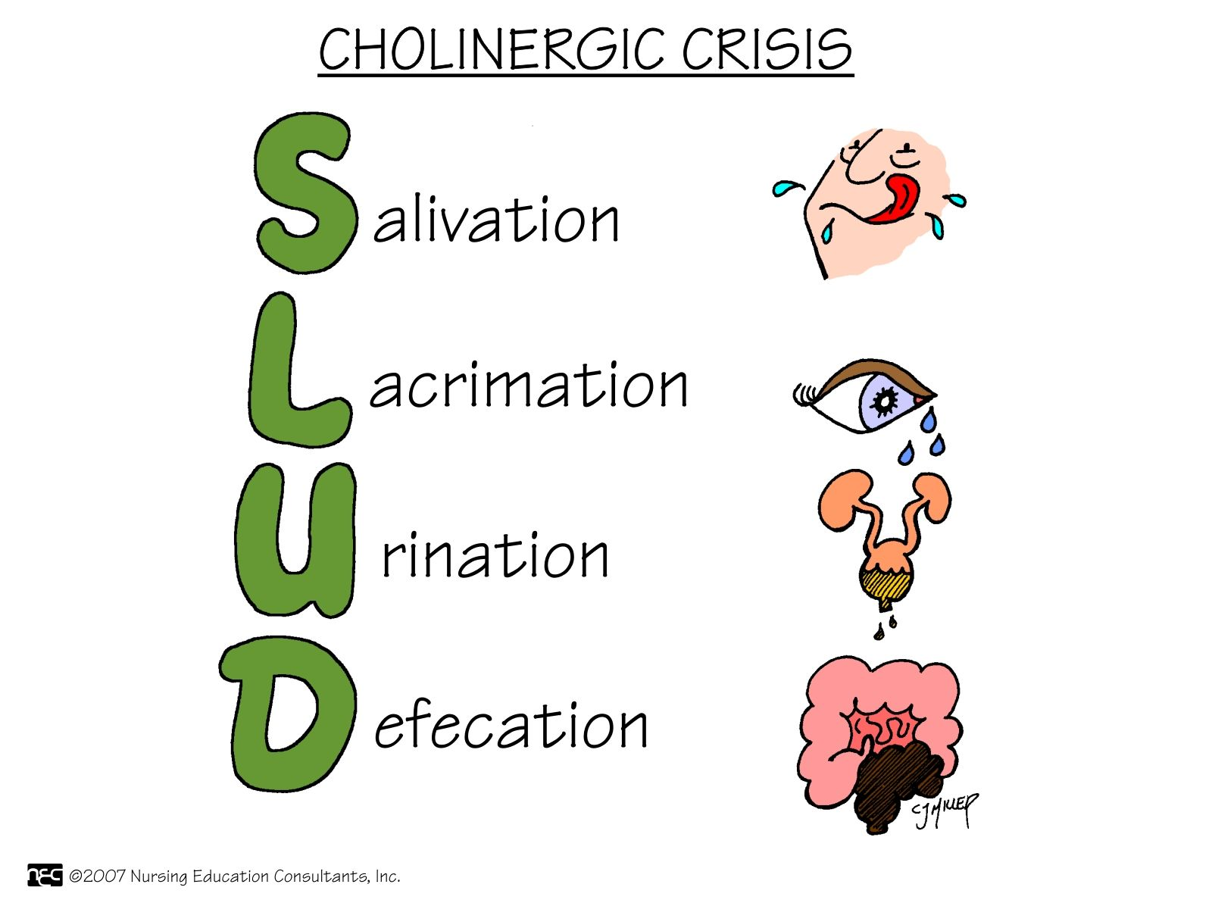
Toxicity and Management of Overdose:
Cholinergic Crisis
Circulatory collapse, hypotension, bloody diarrhea, shock, and cardiac arrest
SLUDGE, which stands for salivation, lacrimation, urinary incontinence, diarrhea, GI cramps, and emesis
Early signs
  Abdominal cramps, salivation, flushing of the skin, nausea, and vomiting, transient syncope, transient complete heart block, dyspnea, and orthostatic hypotension

Slide 51
Cholinergic Crisis
Treatment in early phase: atropine, a cholinergic antagonist
Treatment of severe cardiovascular reactions or bronchoconstriction: epinephrine, an adrenergic agonist

Slide 52
Cholinergic Drugs: Interactions
Anticholinergics, antihistamines, sympathomimetics
  Antagonize cholinergic drugs, resulting in decreased responses
Other cholinergic drugs may cause toxicity

Slide 53
Pyridostigmine (Mestinon)
Indirect-acting cholinergic drugs that work to increase ACh by inhibiting acetylcholinesterase
Use: myasthenia gravis
Edrophonium (Tensilon): indirect-acting cholinergic drug that is used to diagnose myasthenia gravis. It can also be used to differentiate between myasthenia gravis and cholinergic crisis.

Slide 54
Cholinergic Drugs:
Nursing Implications
Note that these drugs will stimulate the PNS and mimic the action of ACh.
Assess for allergies, presence of GI or GU obstructions, asthma, peptic ulcer disease,
and coronary artery disease.
Perform baseline assessment of vital signs and systems overview.

Slide 55
Cholinergic Drugs:
Nursing Implications
Medications should be taken as ordered
and not abruptly stopped.
Doses should be spread evenly apart
to optimize the effects of the medication.
Overdosing can cause life-threatening problems. Patients should not adjust dosages unless directed by their health care provider.

Slide 56
Cholinergic Drugs:
Nursing Implications
Encourage patients with myasthenia gravis to take medication 30 minutes before eating to help improve chewing and swallowing.
When cholinergic drugs are prescribed for Alzheimer’s disease, be honest with caregivers and patients that the drugs are for management of symptoms (not a cure).
Therapeutic effects of anti-Alzheimer’s drugs may not occur for up to 6 weeks.

Slide 57
Cholinergic Drugs:
Nursing Implications
Atropine is the antidote for cholinergics, and it should be available in the patient’s room for immediate use if needed.
Patients should notify their physicians if they experience muscle weakness, abdominal cramps, diarrhea, or difficulty breathing.
Monitor for therapeutic effects
  Alleviated signs and symptoms of myasthenia gravis
  In postoperative patients with decreased GI peristalsis, monitor for:
    Increased bowel sounds
    Passage of flatus
    Occurrence of bowel movements

Slide 58
Cholinergic Drugs:
Nursing Implications
Monitor for therapeutic effects
  In patients with urinary retention or hypotonic bladder, urination should occur within 60 minutes of bethanechol administration.
  In patients with Alzheimer’s disease:
    Improvement in symptoms
    Improvement in mood and decrease in confusion
Monitor for adverse effects

Slide 59
Chapter 21
Cholinergic-Blocking Drugs

Slide 60
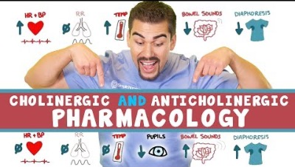
Cholinergic-Blocking Drugs
Drugs that block or inhibit the actions of acetylcholine (ACh) in the parasympathetic nervous system (PNS)
Also known as anticholinergics, parasympatholytics, and antimuscarinic drugs

Slide 61
Cholinergic-Blocking Drugs:
Mechanism of Action
Competitive antagonists
Compete with ACh for binding at muscarinic receptors in the PNS
  As a result, ACh is unable to bind to the receptor site and cause a cholinergic effect.
When these drugs bind to receptors, they inhibit nerve transmission at these receptors.

Slide 62
Contraindications
Known drug allergy
Angle-closure glaucoma (exacerbate the problem)
Acute asthma or other respiratory distress
Myasthenia gravis
Acute cardiovascular instability
GI or GU tract obstruction (e.g., benign prostatic hyperplasia [BPH])

Slide 63
Adverse Effects
Body system | Adverse effects
Cardiovascular | Increased heart rate, dysrhythmias
CNS | CNS excitation, restlessness, irritability, disorientation, hallucinations, delirium
Eye | Dilated pupils (causing blurred vision), increased intraocular pressure
GI | Decreased salivation, decreased gastric secretions, decreased motility (causing constipation)
GU | Urinary retention
Glandular | Decreased sweating
Respiratory | Decreased bronchial secretions

Slide 64
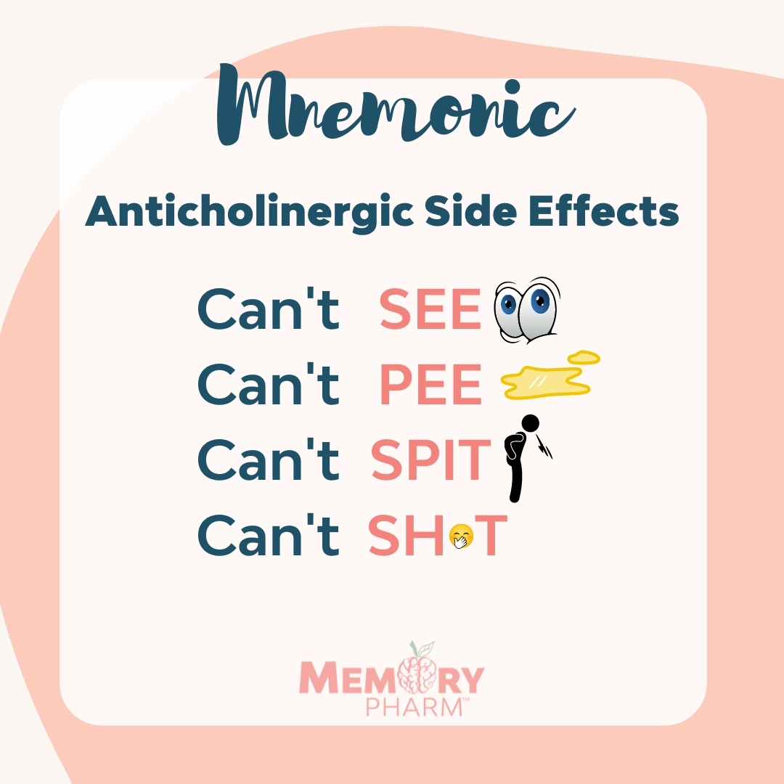

Slide 65
Toxicity and Overdose
Symptomatic and supportive therapy
Continuous electrocardiographic monitoring
Activated charcoal
Treatment of shock
Physostigmine

Slide 66
Atropine
Naturally occurring antimuscarinic
Uses: bradycardia, ventricular asystole, antidote for anticholinesterase inhibitor toxicity or poisoning, and preoperatively to reduce salivation and GI secretions
Contraindications: angle-closure glaucoma, advanced hepatic and renal dysfunction, hiatal hernia associated with reflux esophagitis, intestinal atony, obstructive GI or GU conditions, and severe ulcerative colitis

Slide 67
Dicyclomine (Bentyl)
Synthetic antispasmodic cholinergic blocker
Uses: functional disturbances of GI motility such as irritable bowel syndrome
Contraindications: known hypersensitivity to anticholinergics, angle-closure glaucoma, GI tract obstruction, myasthenia gravis, paralytic ileus, GI atony, and toxic megacolon

Slide 68
Glycopyrrolate (Robinul)
Synthetic antimuscarinic drug
Blocks receptor sites in the autonomic nervous system that control the production of secretions
Use: preoperatively to reduce salivation and excessive secretions in the respiratory and GI tracts
Contraindications: hypersensitivity, angle-closure glaucoma, myasthenia gravis, GI or GU tract obstruction, tachycardia, myocardial ischemia, hepatic disease, ulcerative colitis, and toxic megacolon

Slide 69
Oxybutynin (Ditropan)
Synthetic antimuscarinic drug
Uses: overactive bladder and antispasmodic for neurogenic bladder associated with spinal cord injuries and congenital conditions such as spina bifida
Contraindications: drug allergy, urinary or gastric retention, and uncontrolled angle-closure glaucoma

Slide 70
Scopolamine
Naturally occurring cholinergic blocker
Uses: prevention of motion sickness and to help prevent postoperative, postanesthesia nausea and vomiting
Contraindications: angle-closure glaucoma, advanced hepatic and renal dysfunction, hiatal hernia associated with reflux esophagitis, intestinal atony, obstructive GI or GU conditions, and severe ulcerative colitis
Adverse effects: drowsiness, dry mouth, and blurred vision
Using scopolamine with CNS depressants or alcohol may increase sedation.

Slide 71
Tolterodine (Detrol)
Muscarinic receptor blocker
Uses: urinary frequency, urgency, and urge incontinence caused by bladder (detrusor) overactivity
Newer drugs for this purpose include solifenacin (Vesicare), darifenacin (Enablex), trospium (Sanctura), and fesoterodine (Toviaz).
  Newer drugs are associated with a much lower incidence of dry mouth, partly because of their pharmacologic specificity for the bladder as opposed to the salivary glands.

Slide 72
Cholinergic-Blocking Agents:
Nursing Implications
Keep in mind that these drugs block the action of ACh in the PSNS.
Assess for allergies, presence of BPH, urinary retention, glaucoma, tachycardia, myocardial infarction, heart failure, hiatal hernia, and GI or GU obstruction.
Perform baseline assessment of vital signs and systems overview.

Slide 73
Cholinergic-Blocking Agents:
Nursing Implications
Medications should be taken exactly as prescribed to have the maximum therapeutic effect.
Overdosing can cause life-threatening problems.
Blurred vision will cause problems with driving or operating machinery.
Patients may experience sensitivity to light and may want to wear dark glasses or sunglasses.
When giving ophthalmic solutions, apply pressure to the inner canthus to prevent systemic absorption.

Slide 74
Cholinergic-Blocking Agents:
Nursing Implications
Dry mouth may occur; can be handled by chewing gum, frequent mouth care, and hard candy.
Patients should check with the physician before taking any other medication, including over-the-counter medications.
Antidote for atropine overdose is physostigmine.
Anticholinergics taken by older adult patients may lead to higher risk for heatstroke because of the effects on heat-regulating mechanisms.
Teach patients to limit physical exertion and avoid high temperatures and strenuous exercise.
Emphasize the importance of adequate fluid and salt intake.

Slide 75
Cholinergic-Blocking Agents:
Nursing Implications
Patients should report the following symptoms to their physician: urinary hesitancy or retention, constipation, tachycardia, palpitations, tremors, confusion, sedation, hallucinations, and decreased sweating (leading to hot, dry skin).
Monitor for therapeutic effects.
  For patients with Parkinson’s disease:
  fewer tremors and decreased salivation
  and drooling
  For patients with urologic problems: improved urinary patterns, less hypermotility, increased time between voiding
Monitor for adverse effects.

Slide 76
Chapter 11
Anesthesia

Slide 77
Anesthetics
Drugs that reduce or eliminate pain by depressing nerve function in the central nervous system (CNS) and peripheral nervous system

Slide 78
Anesthesia
A state of reduced neurologic function
Three types
  General anesthesia: complete loss of consciousness and loss of body reflexes, including paralysis of respiratory muscles
  Local anesthesia: no paralysis of respiratory function; elimination of pain sensation in the tissues innervated by anesthetized nerves
  Monitored anesthesia care (MAC): local anesthesia along with sedation and analgesia

Slide 79
General Anesthetics
Inhalational anesthetics
  Volatile liquids or gases that are vaporized in oxygen and inhaled
Parenteral anesthetics
  Administered intravenously
Adjunct anesthetics
  Drug that enhances clinical therapy when used simultaneously with another drug

Slide 80
Indications
General anesthetics are used during surgical procedures to produce:
  Unconsciousness
  Skeletal muscular relaxation
  Visceral smooth muscle relaxation
Rapid onset; quickly metabolized
Also used in electroconvulsive therapy treatments for depression

Slide 81
Dexmedetomidine (Precedex)
Alpha₂-adrenergic receptor agonist
Dose-dependent sedation, decreased anxiety, and analgesia without respiratory depression
Use: procedural sedation, surgeries of short duration
Short half-life, and the patient awakens quickly upon withdrawal of the drug
Sedation of mechanically ventilated patients in the intensive care unit (ICU)

Slide 82
Ketamine
Intravenous administration use for both general anesthesia and moderate sedation
Can be given IM or subcutaneously
Rapid onset of action
Low incidence of reduction of cardiovascular, respiratory, and bowel function
Adverse effects: disturbing psychomimetic effects, including hallucinations

Slide 83
Nitrous Oxide
“Laughing gas”
Only inhaled gas currently used as a general anesthetic
Weakest of the general anesthetic drugs
Used primarily for dental procedures or as a supplement to other, more potent anesthetics

Slide 84
Propofol (Diprivan)
Parenteral general anesthetic
Used for the induction and maintenance of general anesthesia
Sedation for mechanical ventilation in ICU settings
Lower doses: sedative-hypnotic for moderate sedation
Monitor triglycerides if administered with total parenteral nutrition
Some states prohibit administration by nurses.

Slide 85
Moderate Sedation
Also called conscious sedation or procedural sedation
Does not cause complete loss of consciousness and does not normally cause respiratory arrest
Combination of an IV benzodiazepine (e.g., midazolam) or propofol and an opiate analgesic (e.g., fentanyl or morphine)
Anxiety and sensitivity to pain are reduced, and the patient cannot recall the procedure.

Slide 86
Moderate Sedation
Preserves the patient’s ability to maintain own airway and to respond to verbal commands
Used for diagnostic procedures and minor surgical procedures that do not require deep anesthesia
Rapid recovery time and greater safety profile than general anesthesia

Slide 87
Local Anesthetics
Also called regional anesthetics
Used to render a specific portion of the body insensitive to pain
Interfere with nerve impulse transmission to specific areas of the body
Do not cause loss of consciousness

Slide 88
Lidocaine
Amide class of local anesthetics
Most commonly used local anesthetic
Can be combined with epinephrine
Used for:
  Infiltration
  Nerve block
Also available topically

Slide 89
Neuromuscular blocking agents
Purpose
  Depolarizing agents: Succinylcholine
    Mimics Ach by binding with cholinergic receptors causing sustained depolarization
  Nondepolarizing agents: Pancuronium, Vecuronium, Rocuronium
    Block Ach receptors resulting in muscle relaxation and hypotension
Reversal agent: neostigmine
Therapeutic Effects
  Adjunct to sedation effects to promote muscle relaxation
  Seizure Control
  Control spontaneous respiratory movement with client intubated
Complications
  Respiratory arrest
  Hypotension
  Malignant hyperthermia – dantrolene
  Muscle pain
  Hyperkalemia
  Pregnancy Category C

Slide 90
Neuromuscular Blocking Drugs: Depolarizing Drugs
Succinylcholine
  Works similarly to neurotransmitter acetylcholine (ACh), causing depolarization
  Metabolism is slower than Ach; therefore, as long as succinylcholine is present, repolarization cannot occur.
  Result: flaccid muscle paralysis

Slide 91
Administering Muscle Relaxants
Check before:
  Level of consciousness, cognition, skeletal muscle reactivity, ask about seizure disorders, obtain a list of all drugs the patient takes, assess vital signs
Check after:
  Level of consciousness, cognition, skeletal muscle reactivity, blood pressure and other vitals, especially when changing positions

Slide 92
Administering Muscle Relaxants
Teaching priorities:
  Only take on a short-term basis, do not drink alcohol or operate dangerous equipment or cars, take with food or milk, monitor for reactions with other drugs, avoid the sun
Life span considerations:
  Pregnancy and lactation—most not recommended
  Older adults—none are recommended
Notes:
Methocarbamol and cyclobenzaprine can be used during pregnancy.

