Slide 1

Week 2 Content
By Professor Marpole

Slide 2
Content Overview
Neurological
Mental Health

Slide 3
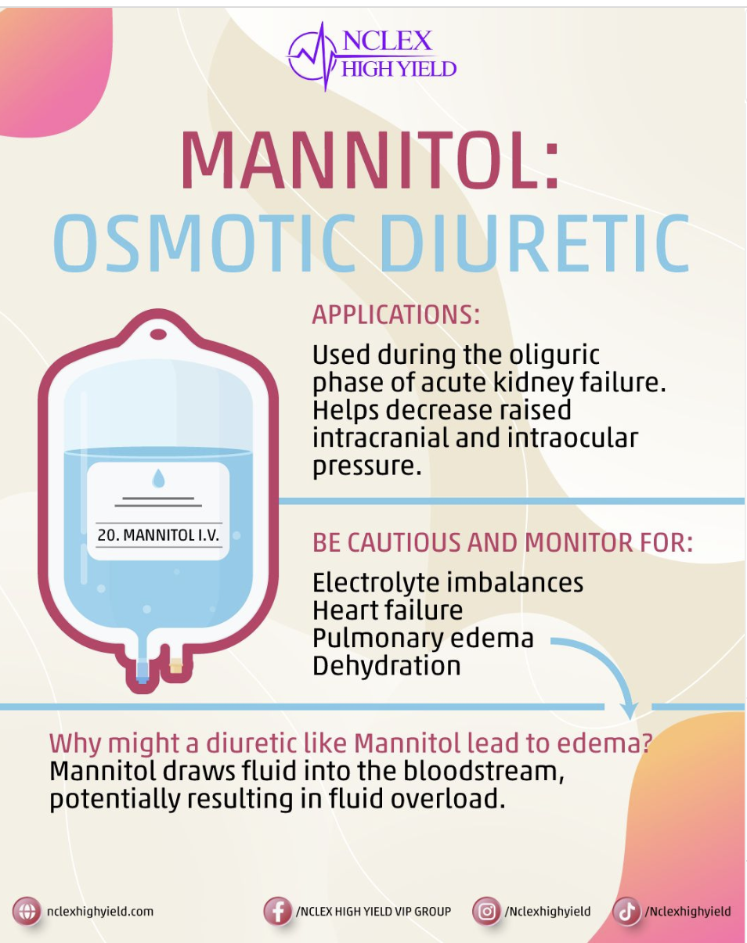
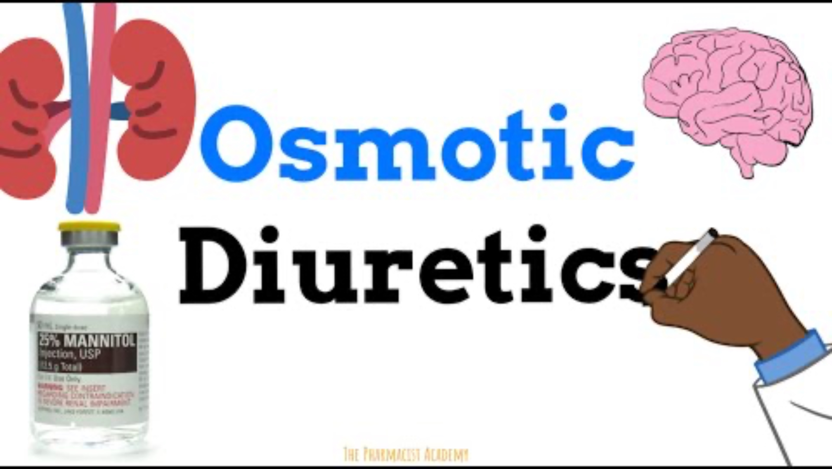
Mannitol

Slide 4
Antiepileptics
Drugs:
  Phenobarbital
  Primidone
  Phenytoin
  Carbamazepine
  Valproic Acid (Valproate)
  Lamotrigine (Lamictal)
  Pregabalin (Lyrica)
  Gabapentin
  Lacosamide

Slide 5
Issues Related to Drug Therapy for Psychiatric Problems
Check before:
  Complete list of patient’s current drugs
  Establish baseline vital signs
  Assess risk for falls
  Assess IV site for patency
  Assess mental status, suicidal thoughts
Check after:
  Monitor blood pressure abnormal heart rhythms
  Monitor for dizziness, drowsiness
  Reassess mental status
Notes:
Drug therapy is extremely important in the management of psychiatric problems.
Place patients on suicide precautions if needed.

Slide 6
Issues Related to Drug Therapy for Psychiatric Problems
Teaching priorities:
  Take drugs exactly as prescribed, immediately report side effects
  Keep follow-up appointments
  Avoid activities requiring alertness
  Change positions slowly
  Avoid alcohol
  Tell about drugs before surgery
  Wear a medical alert bracelet
Notes:
Remind women of childbearing age to notify their prescriber if they are pregnant, plan to become pregnant, or are breastfeeding.
Never take a double dose of these drugs.
Alcohol may increase drowsiness and CNS depression.

Slide 7
CNS Depressants
Sedatives – drugs that have an inhibitory effect on the CNS where their main goal is to reduce:
  Nervousness
  Excitability
  Irritability
Hypnotics – higher potency than sedatives with a goal to cause sleep
  Any sedative can become a hypnotic with a high enough dose – this implies, a sedative can have more than one therapeutic goal!
    We call these drugs - Sedative-Hypnotics and these drugs are:
      Barbiturate, Benzodiazepines, and miscellaneous that do not fall under a category

Slide 8

Anxiety & PTSD
Conditions Covered: GAD, OCD, social anxiety disorder, PTSD
Goal of Therapy: relaxation and calm mind
Drug Classes
  Benzodiazepines
  Atypical anxiolytic / nonbarbiturate anxiolytic
  SSRI

Slide 9
CNS Depressants: Benzodiazepines
Depress CNS activity by affecting the hypothalamic, thalamic, and limbic systems within the brain
Benzodiazepine Receptors (GABA) are the binding site for these medications to hyperpolarize the cells which can allow for a decrease in movement of impulses
Therapeutic Effects include calming effect of CNS, decrease in agitation / anxiety, reduction of excessive sensory overload, and to promote skeletal relaxation
Adverse Effects – headache, drowsiness, dizziness, cognitive impairment, vertigo, lethargy
Sedative-Hypnotics – medications that can do both drug actions
Anxiolytic (anti-anxiety)

Slide 10
Anxiolytics: Benzodiazepines
Purpose: enhance the inhibitory effects of gamma-aminobutyric acid (GABA) in the CNS. Relief from anxiety occurs rapidly following administration
  GABA is an antagonist; meaning it blocks (inhibits) the binding of other neurotransmitters in the brain that can cause anxiety. This inhibition also allows for the brain to relax (think slow down).
Therapeutic Uses: GAD, panic disorders, PTSD, dissociative disorders, seizures, insomnia, muscle spasms, alcohol withdrawal, induction of anesthesia, amnesia
Drugs:
  Diazepam (Valium)
  Lorazepam (Ativan)
  Chlordiazepoxide
  Clorazepate
  Oxazepam
  Clonazepam (Klonopin)
Complications:
  CNS Depression
  Amnesia
  Sedation
  Toxicity: drowsiness, lethargy, confusion, hypotension, respiratory arrest, cardiac arrest

Slide 11
Anxiolytics: Benzodiazepines
Contraindications:
  Pregnancy Risk D
  Controlled Substance – highly addicting
  Sleep Apnea, respiratory depression, and glaucoma
  Avoid in older adults
  Alcohol and other CNS depressants
  Grapefruit juice
  High fatty meals
  Cannot drive or operative heavy machinery
Nursing Implications:
  Reversal Agent: Flumazenil (Romazicon)
  Monitor vital signs for safe administration range and evaluation range
  Administer with meals if GI upset occurs
  Administration at bedtime is preferred due to sedation effects
  Do not chew ER tablets
  Avoid overdose
  Assess for anxiety prior to giving
Withdrawal Effect:
  Only occur following decrease in administration following long-term use of medication

Slide 12
CNS Depressants: Nonbenzodiazepine
Purpose: binds to serotonin and dopamine receptors, but the exact anti-anxiety mechanism is unknown. Slow onset of effects therefore not meant for acute episodes but a daily medication for maintenance.
Therapeutic Uses:
  Panic Disorders
  Social Anxiety Disorders
  OCD
  PTSD
  GAD
Drug: Buspirone
Complications: dizziness, nausea, h/a, lightheadedness, agitation & constipation
HIGH ALERT: suicidal ideations
Contraindications:
  Pregnancy Risk B
  Older adults
  Liver and Renal problems
  Concurrent use of MAOIs and for 14 days post-MAOI discontinuation (HTN crisis)
Interactions:
  Erythromycin, ketoconazole, St. John’s wart, grapefruit juice
  Take with meals is GI upset occurs
  Slow onset of action – lower risk for addiction

Slide 13
CNS Depressants: Nonbenzodiazepine
Zolpidem (Ambien)
  Shorter-acting nonbenzodiazepine hypnotic typically used for PRN incidences of anxiety or at night as a sleeping aide
  Lower incidence on daytime sleepiness
    Beneficial to elderly

Slide 14
CNS Depressants: Barbiturates
Originally developed for the treatment of insomnia and sedative effects, used commonly for off label use (side effects) such as sleepiness
Due to high addiction and ease in habit forming with a low therapeutic index, benzos are more commonly prescribed
MOA is similar to benzos by increasing the effects of GABA in the brainstem
Due to high risk of abuse, most barbiturates are utilized only for surgical procedures and control of seizures
Can cause severe kidney or liver disease avoid with any contraindicated pre-existing condition; avoid with pregnancy
Main adverse effect: reduction in REM which can cause agitation and increased stress

Slide 15
CNS Depressants: Barbiturates
Pentobarbital
  Prototype drug for barbiturates
  Long-acting
  Used most commonly for prevention of seizures
Phenobarbital
  Long-active
  Most commonly used for prevention of seizures
DOES NOT MIX WELL WITH OTHER DRUGS

Slide 16
CNS Depressants:
Muscle Relaxants
Therapeutic goal is to relieve pain associated with skeletal muscle spasms
Work by directly binding to skeletal muscle or acting on the CNS resembling GABA
Adverse Effects: euphoria, lightheadedness, dizziness, fatigue, and muscle weakness
Avoid with benzodiazepines and alcohol
Drugs:
  Baclofen (Lioresal)
  Cyclobenzaprine (Flexeril)
  Methocarbamol (Robaxin)

Slide 17
Nursing Implications
Observation of vital signs during administration for a continuous administration is important
For PO medications, vital signs prior to administration is important
Avoid with alcohol and other medications that can cause CNS decline
Rebound insomnia can occur up to 4 weeks following discontinuation
If taking for seizure prevention – ensure seizure precautions are in place
Decrease dosage of drug may be needed as patient ages

Slide 18
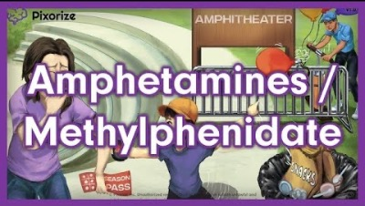

Slide 19
CNS Stimulants
Any drug that can stimulate a specific area of the brain or spinal cord
Sympathomimetic drugs (adrenergic)
  Dopamine
  Norepinephrine
  Serotonin
Amphetamines
Serotonin Agonists
Xanthines
Therapeutic Uses: ADHD, anti-narcoleptic, anti-migraine, anorexiants (appetite suppressant)

Slide 20
CNS Stimulants:
ADHD
Attention Deficit Hyperactivity Disorder (ADHD)
  Amphetamines such as methylphenidate (Ritalin) and amphetamine and dextroamphetamine (Adderall)
    Stimulate areas of the brain associated with mental alertness
    Decrease fatigue and drowsiness
    Relaxation of bronchial smooth muscle causing increased RR and tachycardia
    Contraindication: cardiac abnormalities including HTN, arrythmias, and angina
  Nonamphetamines
    Pemoline and Modafinil
      Commonly used to improve wakefulness in patients with daytime sleepiness or brain injury
    Lisdexamfetamine (Vyvanse)

Slide 21
CNS Stimulants:
ADHD
Adverse Effects:
  Varying effects dependent upon dose of medication and duration of action
  Cardiac – palpitations, tachycardia, hypertension, angina, dysrhythmias
  Mood – nervousness, restlessness, anxiety, insomnia
  GI/GU – nausea, vomiting, diarrhea, dry mouth (dehydration), and increased urinary frequency

Slide 22
CNS Stimulants:
Anorexiants
Any substance that can suppress the appetite
  Phentermine (lonamin)
  Methamphetamine (Desoxyn)
MOA: suppress appetite control center in brain, increases metabolic rate, mobilization of adipose tissue, enhanced cellular glucose uptake and reduction in fat absorption
Indications: obesity only defined by BMI (medical diagnosis)
Contraindications: cardiovascular disease, HTN, hyperthyroidism, eating disorders, MAOI usage
Adverse Effects: HTN, tachycardia, anxiety, agitation, dizziness, headache

Slide 23
CNS Stimulant:
Antimigraine Drugs
Antimigraine drugs (serotonin agonists & triptans)
  Sumatriptan (Imitrex)
  Almotriptan (Axert)
  Eletriptan (Relpax)
  Naratriptan (Amerge)
  Rizatriptan (Maxalt)
  Zolmitriptan (Zomig)
  Frovatriptan (Frova)

Slide 24
CNS Stimulant:
Antimigraine Drugs
MOA: stimulate receptors in the cerebral arteries causing vasoconstriction reducing symptoms of a headache caused by high pressure
Adverse Effects:
  Vasoconstriction
  Injection site irritation if given in IV form
  Tingling and flushing feeling caused by neuropathy
Very well tolerated, only contraindication is if patient has decreased perfusion to brain, resulting in poor intracranial blood flow

Slide 25
CNS Stimulant:
Serotonin Receptor Agonist
Used to treat migraine headaches
Relief takes a few hours due to PO and SQ administration (only forms)
Sumatriptan (Imitrex)
  Original prototype drug
  Well tolerated with minimal side effects

Slide 26
CNS Stimulants:
Nursing Implications
Last daily dose should be 4-6 hours prior to bedtime to avoid insomnia
Take on any empty stomach to increase absorption
If a child is taking medication, a growth chart is recommended to ensure growth delay is not occurring
Avoid any source of extra caffeine
Frequent monitoring of HR and BP with initial administration of medication to ensure patient can tolerate medication
Check for contraindications

Slide 27
Antiepileptic Drugs
Also known as anticonvulsants; goal is to control or prevent seizures while maintaining an acceptable (to patient) quality of life
Therapy is lifelong and can consist of a combination of drugs that can change throughout a lifetime as tolerance can occur
ALL DRUGS MUST have serum drug level monitored frequently (dependent on stage of medication administration)
List of drugs: phenytoin, phenobarbital, carbamazepine, levetiracetam
MOA is not fully known

Slide 28
Antiepileptic Drugs
Pharmacological effect of drugs:
  Reduction in nerve stimulation
  Suppress transmission of impulses from one nerve to another (decreases sensitivity)
Indications:
  Prevention or control of seizure / epileptic activity
  Long-term maintenance therapy needed with acute exacerbation therapy possibly needed
Many adverse effects which differ per drug; black box warning: suicidal ideations
Drug to drug interactions are numerous and are not generally tolerated with others

Slide 29
Antiepileptic Drug:
Phenytoin
Used as a first line drug for epilepsy
Therapeutic drug range: 10 – 20 ug/mL
Protein bound drug (hypoproteinemia can cause subtherapeutic effect)
Many drug interactions – avoid with drugs that can impact hematological conditions

Slide 30

Antiepileptic Drugs

Slide 31
Antiepileptic Drug:
Levetiracetam (Keppra)
Adjunct therapy for partial seizures and prevention of seizures with head injuries including brain bleeds
Low adverse effects

Slide 32
Antiepileptic Drug:
Valproic Acid
Treatment of generalized seizures, bipolar disorder, and controlling partial seizures
  Highly protein bound
  Adverse effects: drowsiness, GI disturbances, tremor, weight gain, hair loss, hepatotoxicity, pancreatitis

Slide 33
Antiepileptic Drug:
Lamotrigine (Lamictal)
Also used for the treatment of bipolar disorder
Used for simple or complex partial seizures
Contraindications: drug allergy
Common adverse effects: relatively minor CNS and GI symptoms and possible Stevens-Johnson syndrome

Slide 34
Antiepileptic Drugs:
Nursing Indications
Assess for liver failure or impairments (ALT, AST, Alk Phos)
Assess CBC for baseline Hbg, Platelet, RBC, and WBC
Oral drugs for maintenance should be administered the same time daily
Do not want to hold drug if patient is NPO, contact MD for direction to give or alternative form
IV forms MUST be administered according to manufacturer’s instruction including time of infusion to avoid complications
If patient has seizure on medication – journal needs to be kept to log duration, triggered factors, and adverse effects
Do not abruptly stop medication
Adverse effects to monitor: mental status changes, visual problems, sore throat

Slide 35


Slide 36
Antiparkinson Drugs
There is no curative treatment for PD, only supportive treatment or medications to slow progression
Nonpharmacologic Treatment:
  PT
  OT
  SLP
PD – imbalance of dopamine and acetylcholine; therefore most medications impact dopamine receptors or acetylcholine receptors

Slide 37
Antiparkinson Drug:
MAOI
Monoamine Oxidase Inhibitors (MAOIs)
  Breakdown catecholamines in the CNS, primarily the brain
More information later in powerpoint

Slide 38
Antiparkinson Drugs:
Dopamine Modulator
Amantadine (Symmetrel)
  Causes a release of dopamine and other catecholamines from their stored sites to increase frequency
  Blocks reuptake of dopamine in the nerve fibers
  Resulting in higher levels of dopamine to bind to receptors
  This drug is commonly given in early diagnosis, but only works for about 12 months
  Adverse effects: dizziness, insomnia, nausea
  Avoid with cholinergic drugs due to possible cholinergic crisis

Slide 39
Antiparkinson Drugs:
Dopamine Modulator
Bromocriptine (Parlodel)
  Works by activating presynaptic dopamine receptors to produce more dopamine
  Used alongside Carbidopa-Levodopa to reduce amount of levodopa needed and prolong effects of medication
  Adverse effects: GI upset, dyskinesias, insomnia
  Avoid with adrenergic drugs

Slide 40
Antiparkinson Drugs:
Levodopa
Levodopa
  Converted into dopamine once it has been taken up by the dopaminergic terminal
  ONLY works with patients who still have a functioning nerve terminal
    Typically for 5-10 years post initial diagnosis
  Adverse effects: confusion, involuntary movements, GI distress, hypotension, cardiac dysrhythmias
Carbidopa (combination therapy)
  Commonly used with Levodopa to treat side effects such as nausea
  Take on empty stomach

Slide 41
Antiparkinson Drugs:
Nursing Implications
Assess baseline mental status, neurological exam, including mobility/gait
  Facial expressions and movement
  Speech
  Dysphagia
  Rigidity of extremities
Administer all drugs with food except Carbidopa-Levodopa
Encourage increase in water intake (3L per day)
Avoid MAOIs with levodopa
Do not discontinue abruptly

Slide 42
Psychotherapeutic Drugs
Used to treat a variety of emotional and mental health disorders
Majority of drugs do not have a clear MOA and are prescribed for off label effects
Theory of MOA includes changes in neurotransmitters such as dopamine, epinephrine, serotonin, and GABA
Therapeutic Uses:
  Anxiety
  Affective Disorders
  Psychoses

Slide 43
Psychotherapeutic Drugs:
Anxiolytic Drugs
Benzodiazepines are most common (see previous slides)
  Alprazolam (Xanax)
  Diazepam (Valium)
  Lorazepam (Ativan)
Buspirone (Buspar)
  Atypical Anxiolytic with an unknown MOA
  Lacks sedative effects of those listed above
  Adverse effects: blurred vision, headache, nausea

Slide 44

Psychotherapeutic Drugs:
Mood-Stabilizing Drugs

Slide 45
Lithium Carbonate
Purpose: produces neurochemical changes in the brain including serotonin receptor blockage. There is evidence that this drug can decrease neuronal atrophy and increase in neuronal growth.
Therapeutic Uses:
  Bipolar
Drug:
  Lithium Carbonate
Complications:
  GI distress: n/v/d
    Administer with meals or milk
  Fine hand tremors
  Polyuria, mild thirst
  Weight gain
  Renal toxicity
  Goiter and hypothyroidism
  Bradydysrhythmia, hypotension, and electrolyte imbalances

Slide 46
Lithium Carbonate
Lithium Toxicity:
  <1.5: diarrhea, nausea, vomiting, thirst, polyuria, muscle weakness, fine hand tremor, slurred speech, lethargy
  1.5 – 2.0: GI distress, mental confusion, poor coordination, coarse tremors, sedation
  2.0 – 2.5: extreme urine / fluid loss, tinnitus, involuntary extremity movements, blurred vision, ataxia, seizures, hypotension requiring medication support
  >2.5: oliguria, seizures, rapid progression of manifestations leading to coma or death
Nursing Implications:
  Maintenance level: 0.6 – 1.2
  Monitor for organ failure as mentioned above
Contraindications:
  Pregnancy Risk D
  Renal dysfunction
  Heart disease
  Sodium depletion
  Dehydration
  Old adults
  Those with hypothyroidism, seizure disorders, or diabetes
Interactions:
  Diuretics
  NSAIDs
  Anticholinergics

Slide 47

Antipsychotics
Antipsychotics
  First Generation
    Haldol
    Chlorpromazine
  Second & Third Generation
    Risperidone
    Olanzapine
    Quetiapine (Seroquel)
    Clozapine
    Aripiprazole (Abilify)

Slide 48
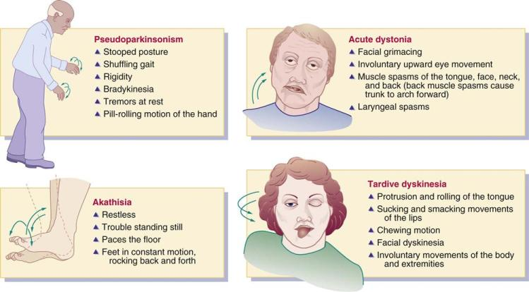
Extrapyramidal Symptoms

Slide 49
ATI Practice
A nurse is reviewing laboratory findings and notes that a client’s lithium level is 2.1 mEq/L. Which of the following is an appropriate action by the nurse?
  Perform immediate gastric lavage
  Prepare the client for hemodialysis
  Administer an additional oral dose of lithium
  Request a stat repeat of the laboratory result
A nurse is caring for a client who has a new prescription for lithium carbonate. When teaching the client about ways to prevent lithium toxicity, the nurse should advise the client to do which of the following?
  Avoid the use of acetaminophen for headaches
  Restrict intake of foods rich in sodium
  Decrease fluid intake to less than 1500mL daily
  Limit aerobic activity in hot weather

Slide 50
ATI Practice
A nurse is assessing a client who takes lithium carbonate for the treatment of bipolar disorder. The nurse should identify which of the following findings is a possible indication of toxicity to this medication?
  Severe hypertension
  Coarse tremors
  Constipation
  Muscle spasms
A nurse is caring for a client who has a new prescription for valproic acid. The nurse should instruct the client to have which of the following blood laboratory tests completed periodically? (SATA)
  Thrombocyte count
  Glucose
  Amylase
  LFTs
  Potassium

Slide 51
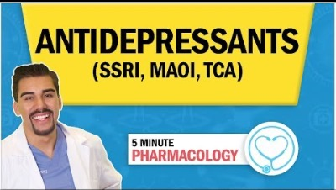
Psychotherapeutic Drugs:
Antidepressant Drugs

Slide 52
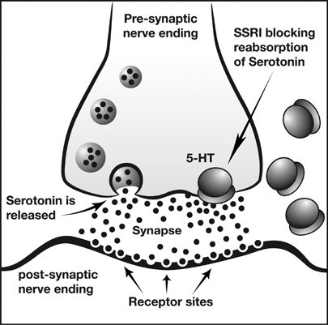
Selective Serotonin Reuptake Inhibitors (SSRI)
Purpose: selectively inhibits serotonin reuptake, allowing more serotonin to stay at the junction of the neurons (more abundance of neurotransmitter). Does not block reuptake of dopamine and norepinephrine.
Therapeutic Uses:
  GAD, panic disorders, OCD, social anxiety, PTSD, dissociative disorders, & depression
Drugs:
  Paroxetine (Paxil) – prototype drug
  Sertraline (Zoloft)
  Citalopram (Celexa)
  Escitalopram (Lexapro)
  Fluoxetine (Prozac)
  Fluvozamine
Notes:
VERY IMPORTANT to be able to recognize these as SSRI’s

Slide 53
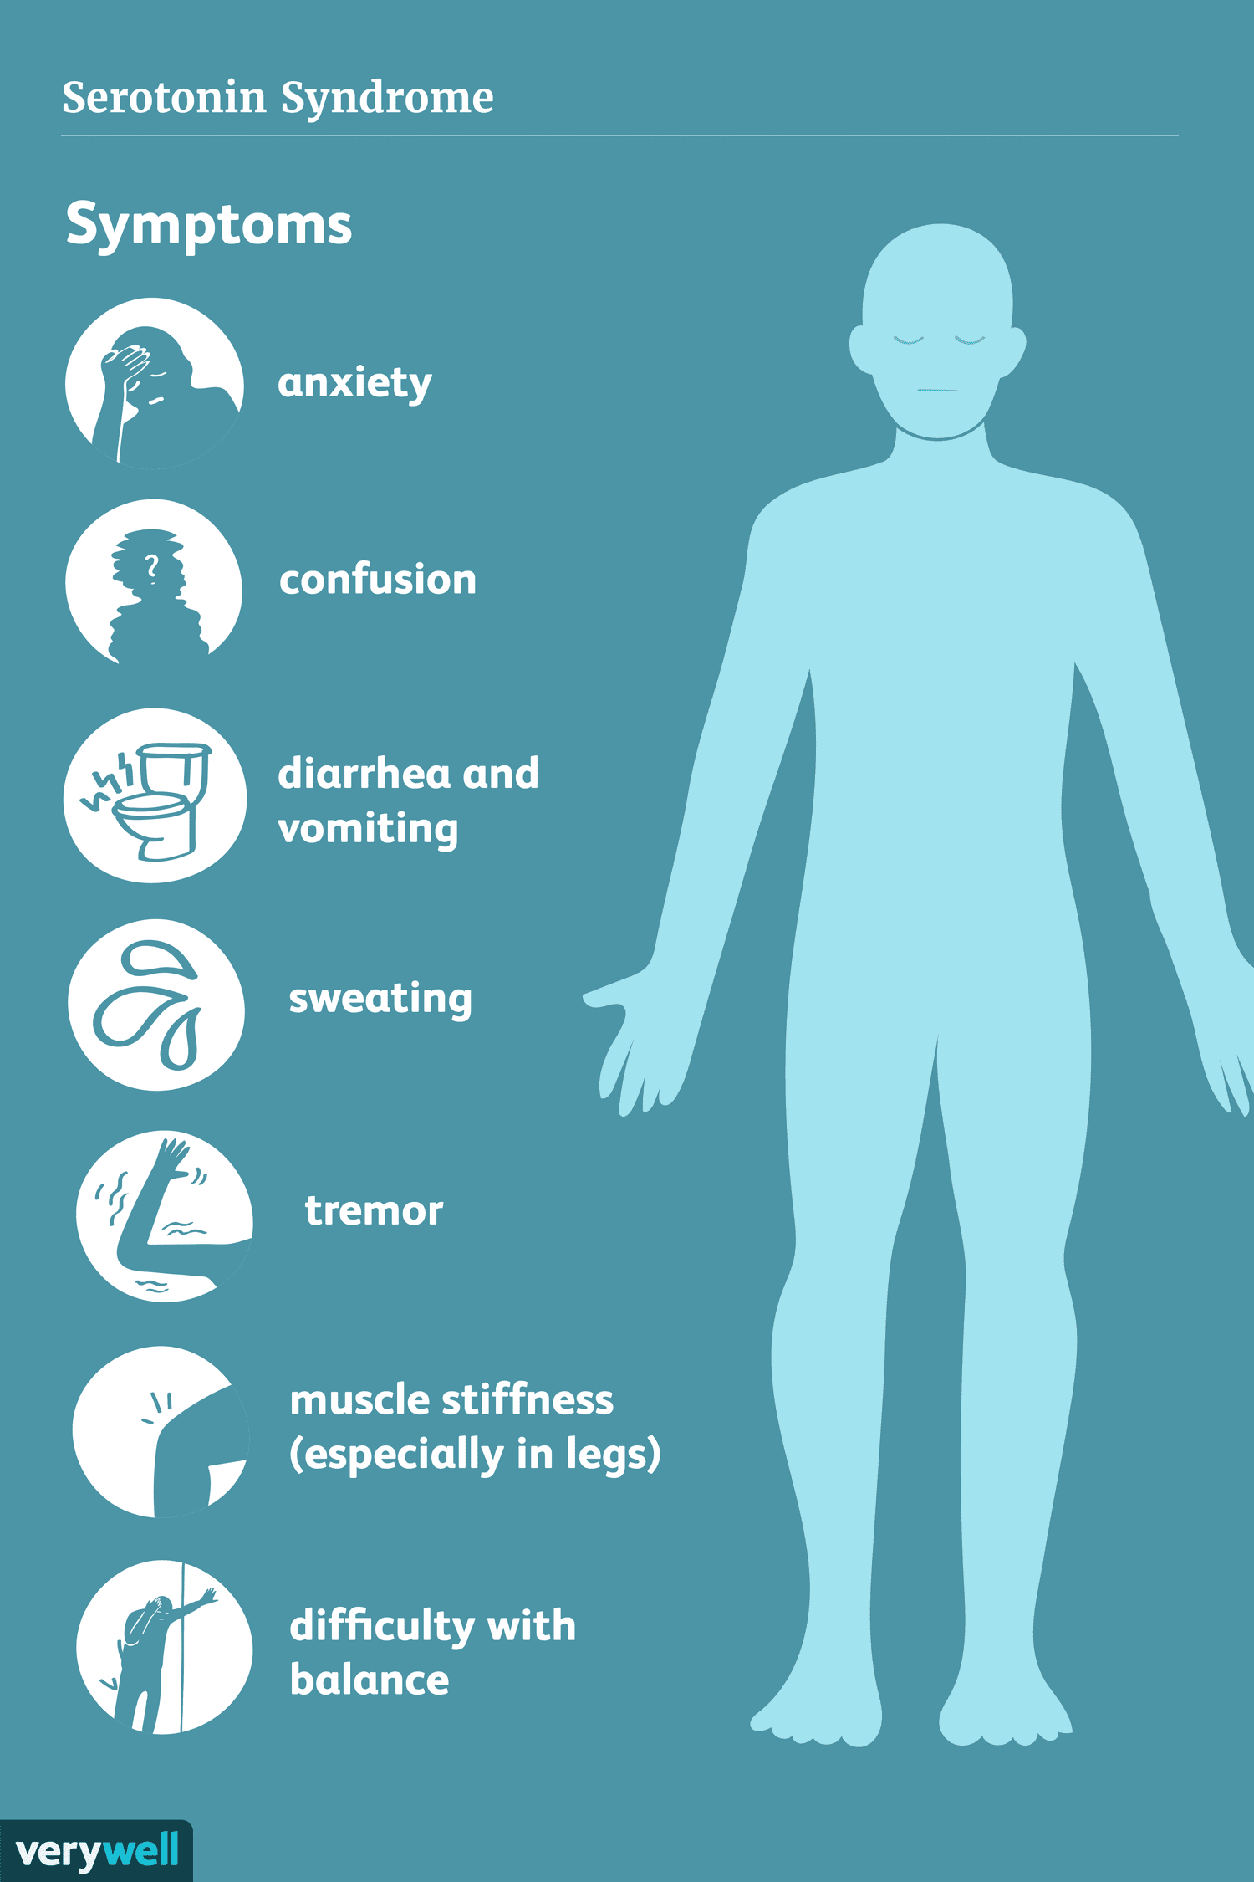
Serotonin Syndrome (Adverse Effect)

Slide 54
Selective Serotonin Reuptake Inhibitors (SSRI)
Complications:
  Nausea, diaphoresis, tremor, fatigue, and drowsiness can occur in the first few weeks but will resolve
  Long-term effects: insomnia, h/a, sexual dysfunction are most common reason for patients self-discontinuing medication
  Weight Increase
  GI Bleeding
  Hyponatremia
  Serotonin Syndrome
  Grinding of Teeth (bruxism)
  Withdrawal Syndrome
  Suicidal Ideation
  Postural Hypotension
Contraindications:
  St. John’s Wort
  MAOIs
  TCAs
  Antiplatelet and anticoagulants concurrent use can increase bleeding
Nursing Implications:
  Education to report sexual dysfunction, there are therapies that can help control dysfunction
  Always administer with food
  Therapeutic effects can take up to a month or longer
  Take at same time daily (morning preferably)
  Don’t abruptly stop taking medication

Slide 55
ATI Practice
A nurse working in an emergency department is caring for a client who has suspected benzodiazepine toxicity. Which of the following actions is the nurses’ priority?
  Administer flumazenil
  Identify the client’s level of orientation
  Infuse IV fluids
  Prepare the client for gastric lavage
A nurse is teaching a client who has a new prescription for escitalopram (Lexapro) for treatment of generalized anxiety disorder (GAD). Which of the following statements by the client indicates understanding of the teaching?
  “I should take the medication on an empty stomach”
  “I will follow a low-sodium diet while taking this medication”
  “I need to discontinue this medication slowly”
  ”I should not crush this medication before swallowing”

Slide 56
ATI Practice
A nurse is providing teaching to a client who has a new prescription for buspirone to treat anxiety. Which of the following information should the nurse include?
  “Take this medication on an empty stomach”
  “Expect optimal therapeutic effects within 24 hours”
  “Take this medication when needed for anxiety”
  “This medication has a low risk for dependency”
A nurse is teaching a client who has obsessive-compulsive disorder and has a new prescription for paroxetine (Prozac). Which of the following instructions should the nurse include?
  “It can take several weeks before you feel like the medication is helping”
  “Take the medication just before bedtime to promote sleep”
  “You should take the medication when needed for obsessive urges”
  “Monitor for weight gain while taking this medication”

Slide 57
Selective-Norepinephrine Reuptake Inhibitor (SNRI)
Complications:
  Nausea, anorexia, weight loss
  Headache, insomnia, anxiety
  HTN and tachycardia
  Dizziness
  Withdrawal symptoms
  Risk for suicide in children and adolescents
  Sexual dysfunction
  Serotonin syndrome
Contraindications:
  Pregnancy Risk C
  Avoid with SSRIs, TCA, MAOIs (2 weeks prior)
  NSAIDs and anticoagulants can increase bleeding
  Alcohol
  Glaucoma
Purpose: SNRIs block the reuptake of norepinephrine as well as serotonin with effects similar to SSRIs
Therapeutic Uses:
  Depression
  GAD
  Social Anxiety Disorder
  Panic Disorders
  Pain: fibromyalgia, osteoarthritis, LBP, diabetic neuropathy
Drugs:
  Venlafaxine (Effexor) - prototype
  Duloxetine (Cymbalta)
  Levomilnacipran
  Desvenlafaxine

Slide 58
Tricyclic Antidepressants (TCAs)
Contraindications:
  Pregnancy Risk C
  Orthostatic hypotension
  Anticholinergic effects (think dry and fast)
  Sedation
  Toxicity: cholinergic blockage (cardiac toxicity: dysrhythmias, mental confusion, agitation, followed by potential seizures and coma)
  Decreased seizure threshold
  Excessive sweating
Nursing Implications:
  Therapeutic Effects can take 14 days or longer
  Monitor for suicide ideations
  Avoid in patients with seizure activity who also have history of MI
  Caution with: DM, CAD, liver/kidney/respiratory conditions, BPH, hyperthyroidism
Purpose: block the reuptake of norepinephrine and serotonin in the synaptic space, thereby intensifying the effects of these neurotransmitters
Therapeutic Uses:
  Depression
  Neuropathic pain
  Fibromyalgia (first line treatment)
  Anxiety
  ADHD and Bipolar
Drugs:
  Amitriptyline - prototype
  Imipramine
  Clomipramine
  Nortriptyline

Slide 59
Monoamine Oxidase Inhibitors (MAOIs)
Purpose: block MAOI enzymes in the brain, thereby increasing the amount of norepinephrine, dopamine, serotonin, and tyramine available.
Therapeutic Uses:
  Depression
  Bulimia nervosa
  Panic disorders
  GAD
  OCD
  PTSD
Drugs:
  Phenelzine (Nardil) - prototype
  Isocarboxazid
  Tranylcypromine
Contraindications:
  Anxiety and bipolar can be exacerbated
  Hypertensive Crisis
  Pregnancy Risk C
  Avoid concurrent use with SSRIs
  Pheochromocytoma
  CHF
  Severe renal insufficiency
  Cardiovascular and cerebral vascular disorders
Nursing Implications:
  Drug may take up to a 3 months to reach therapeutic effects
  Assess for suicide ideations
  Take medication daily as prescribed, avoid sudden discontinuation

Slide 60

Monoamine Oxidase Inhibitors (MAOIs)
Interactions:
  OTC decongestants and cold remedies
  TCAs: HTN crisis
  SSRIs: serotonin syndrome
  Anti-HTN: enhance hypotension
  Meperidine
  Tyramine rich foods: HTN crisis
    Aged cheese, pepperoni, salami, avocados, figs, bananas, smoked fish, soups, soy sauce, protein dietary supplements, beer and red wine
  Concurrent use with vasopressors: HTN
  General anesthesia

Slide 61
Administering Antidepressant Drugs
Check before:
  Ask about family history of depression, usual bowel movements, fluid intake, diet, St. John’s wort
  For TCAs, ask about smoking
Check after:
  Reassess mental status; watch for side effects, adverse effects, or allergic reactions; assess for suicidal thoughts
Teaching priorities:
  Are not a cure, take 1 to 8 weeks for symptoms to improve
  Discontinue gradually
  Frequent mouthwashes can decrease dry mouth
Notes:
Wellbutrin may be prescribed as Wellbutrin SR, the sustained-release form, which is administered in two doses at least 8 hours apart. Wellbutrin XL extended-release tablets should be taken once a day in the morning. Wellbutrin SR and XL tablets should be swallowed whole and never chewed, divided, or crushed.
Explain that the prescriber may start with a low drug dose and gradually increase it until therapeutic antidepressant effects are achieved.
Teach that symptoms of this syndrome include confusion, agitation, restlessness, stomach disturbances, sudden elevated temperature, extremely high blood pressure, and severe seizures.

Slide 62
ATI Practice
A nurse is caring for a client who has a new prescription for phenelzine for the treatment of depression. Which of the following indicates that the client has developed an adverse effect of this medication?
  Orthostatic hypotension
  Hearing loss
  GI bleeding
  Weight loss
A nurse is providing teaching to a client who has a new prescription for amitriptyline for treatment of depression. Which of the following should the nurse include in the teaching? (SATA)
  Expect therapeutic effects in 24 to 48 hours
  Discontinue the medication after a week of improved mood
  Change positions slowly to minimize dizziness
  Decrease dietary fiber intake to control diarrhea
  Chew sugarless gum to prevent dry mouth

Slide 63
ATI Practice
A nurse is providing discharge teaching to a client who has a new prescription for fluoxetine for posttraumatic stress disorder. Which of the following statements should the nurse include in the teaching?
  ”You can have a decrease desire for intimacy while taking this medication”
  “You should take this medication at bedtime to help promote sleep”
  “You will have fewer urinary adverse effects if you urinate just before taking this medication”
  “You’ll need to wear sunglasses when outdoors due to the light sensitivity caused by this medication”
A nurse is caring for a client who has depression and a new prescription for venlafaxine. The nurse should monitor the client for which of the following manifestations as an adverse effect of this medication? (SATA)
  Mydriasis
  Dizziness
  Decreased libido
  Alopecia
  Hypotension

