Slide 1
Week 3 Content
Respiratory Drugs

Slide 2
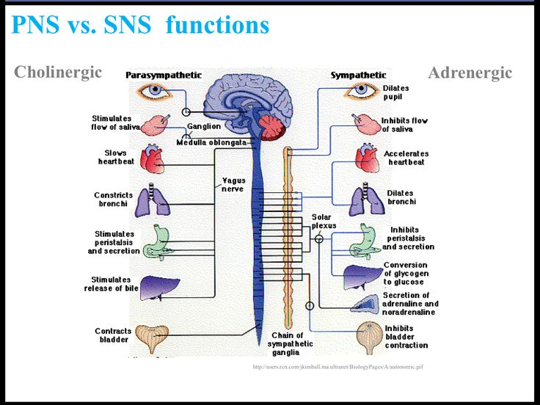
Overview
Bronchodilators
  These drugs relax bronchial smooth muscle, which causes dilation of the bronchi and bronchioles that are narrowed as a result of the disease process.
  Two classes: beta-adrenergic agonists & anticholinergics

Slide 3
Anticholinergics
Ipratropium and Tiotropium
MOA: blocks muscarinic receptors of the bronchi resulting in bronchodilation
Adverse effects: hoarseness and dry mouth

Slide 4
Bronchodilators: Beta-Adrenergic Agonists
Short-acting beta agonist (SABA) inhalers
  Albuterol (Ventolin, ProAir)
  Levalbuterol (Xopenex)
  Pirbuterol (Maxair)
  Terbutaline (Brethine)
  Metaproterenol (Alupent)
Long-acting beta agonist (LABA) inhalers
  Arformoterol (Brovana)
  Formoterol (Foradil, Perforomist)
  Salmeterol (Serevent)

Slide 5
Bronchodilators: SABA
Used during acute phase of asthmatic attacks
Quickly reduce airway constriction and restore normal airflow
Agonists, or stimulators, of the adrenergic receptors in the sympathetic nervous system
  Sympathomimetics

Slide 6
Beta-Adrenergic Agonists: Interactions
Diminished bronchodilation when nonselective beta blockers are used
Tachycardia & HTN
Reduces histamine
Tremors can occur
Monitor patients with diabetes; an increase in blood glucose levels can occur.
Avoid with MAOIs and TCA (anti-depressive)

Slide 7
Beta-Adrenergic Agonists:
Albuterol (Proventil)
Short-acting beta₂-specific bronchodilating beta agonist
Most commonly used drug in this class
Must not be used too frequently
Oral and inhalational use
Inhalational dosage forms include metered-dose inhalers (MDIs) as well as solutions for inhalation.

Slide 8
Nonbronchodilating Respiratory Drugs
Leukotriene receptor antagonists (montelukast, zafirlukast, and zileuton)
Corticosteroids (beclomethasone, budesonide, dexamethasone, flunisolide, fluticasone, ciclesonide, and triamcinolone)

Slide 9
Leukotriene Receptor Antagonists (LTRAs)
Nonbronchodilating
Newer class of asthma medications
Currently available drugs
  Montelukast (Singulair)
  Zafirlukast (Accolate)
  Zileuton (Zyflo)
Main adverse effects: headache and diarrhea
Use caution with liver disease

Slide 10
LTRAs: Mechanism of Action
Leukotrienes are substances released when a trigger, such as cat hair or dust, starts a series of chemical reactions in the body.
Leukotrienes cause inflammation, bronchoconstriction, and mucus production.
Result: coughing, wheezing, shortness
of breath
LTRAs prevent leukotrienes from attaching to receptors on cells in the lungs and in circulation.
Inflammation in the lungs is blocked, and asthma symptoms are relieved.

Slide 11
LTRAs: Drug Effects
By blocking leukotrienes:
  Prevent smooth muscle contraction of the
  bronchial airways
  Decrease mucus secretion
  Prevent vascular permeability
  Decrease neutrophil and leukocyte infiltration
  to the lungs, preventing inflammation

Slide 12
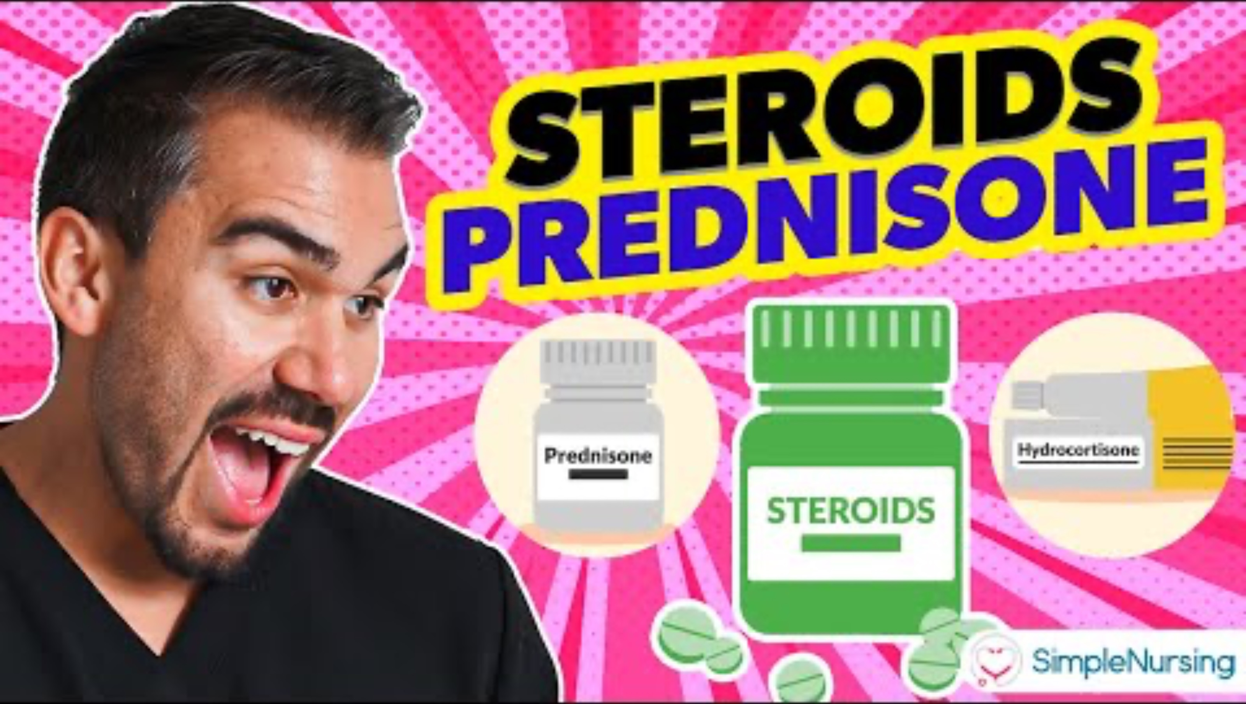
Corticosteroids (Glucocorticoids)
Antiinflammatory properties
Used for chronic asthma
Do not relieve symptoms of acute asthma attacks
May be administered IV
Oral or inhaled forms
  Inhaled forms reduce systemic effects.
May take several weeks before full
effects are seen

Slide 13
Corticosteroids: Mechanism of Action
Stabilize membranes of cells that release harmful bronchoconstricting substances
  These cells are called leukocytes, or white
  blood cells.
Increase responsiveness of bronchial smooth muscle to beta-adrenergic stimulation
Dual effect of both reducing inflammation and enhancing the activity of beta agonists
Corticosteroids have also been shown to restore or increase the responsiveness of bronchial smooth muscle to beta-adrenergic receptor stimulation, which results in more pronounced stimulation of the beta₂ receptors by beta agonist drugs such as albuterol.

Slide 14
Inhaled Corticosteroids: Indications
Primary treatment of bronchospastic disorders to control the inflammatory responses that are believed to be the cause of these disorders
Persistent asthma
Often used concurrently with the beta-adrenergic agonists
Systemic corticosteroids are generally used only to treat acute exacerbations, or severe asthma.
IV corticosteroids: acute exacerbation of asthma or other COPD

Slide 15
Inhaled Corticosteroids: Contraindications
Drug allergy
Not intended as sole therapy for acute asthma attacks
Hypersensitivity to glucocorticoids
Patients whose sputum tests positive for Candida organisms
Patients with systemic fungal infection

Slide 16
Inhaled Corticosteroids: Adverse Effects
Pharyngeal irritation
Coughing
Dry mouth
Oral fungal infections
Systemic effects are rare because low doses are used for inhalation therapy.

Slide 17
Nursing Implications
Encourage clients to take measures that promote a generally good state of health so as to prevent, relieve, or decrease symptoms of COPD.
  Avoid exposure to conditions that precipitate bronchospasm (allergens, smoking, stress, air pollutants).
  Adequate fluid intake
  Compliance with medical treatment
  Avoid excessive fatigue, heat, extremes in temperature, and caffeine.

Slide 18
Nursing Implications
Perform a thorough assessment before beginning therapy, including:
  Skin color
  Baseline vital signs
  Respirations (should be between 12 and 24 breaths/min)
  Respiratory assessment, including pulse oximetry
  Sputum production
  Allergies
  History of respiratory problems
  Other medications
  Smoking history

Slide 19
Nursing Implications
Teach clients to take bronchodilators exactly as prescribed.
Ensure that clients know how to use inhalers and MDIs and have clients demonstrate use of the devices.
Monitor for adverse effects.

Slide 20
Nursing Implications
Monitor for therapeutic effects:
  Decreased dyspnea
  Decreased wheezing, restlessness, and anxiety
  Improved respiratory patterns with return to normal rate and quality
  Improved activity tolerance
  Decreased symptoms and increased ease of breathing

Slide 21
Nursing Implications: LTRAs
Ensure that the drug is being used for chronic management of asthma, not acute asthma.
Teach the patient the purpose of the therapy.
Improvement should be seen in about 1 week.
Advise clients to check with prescriber before taking OTC or prescribed medications to determine drug interactions.
Assess liver function before beginning therapy and throughout.
Teach clients to take medications every night on a continuous schedule even if symptoms improve.

Slide 22
Nursing Implications:
Inhaled Corticosteroids
Teach clients to gargle and rinse the mouth with lukewarm water afterward to prevent the development of oral fungal infections.
If a beta agonist bronchodilator and corticosteroid inhaler are both ordered, the bronchodilator should be used several minutes before the corticosteroid to provide bronchodilation before administration of the corticosteroid.
Teach clients to monitor disease with a peak flow meter.
Encourage use of a spacer device to ensure successful inhalations.
Teach client how to keep inhalers and nebulizer equipment clean after use.

Slide 23
Inhalers: Patient Education
For any inhaler prescribed, ensure that the client is able to self-administer the medication.
  Provide demonstration and return demonstration.
  Ensure that the client knows the correct time intervals for inhalers.
  Provide a spacer if the client has difficulty coordinating breathing with inhaler activation.
  Ensure that the client knows how to keep track of the number of doses in the inhaler device.

Slide 24
ATI Practice
A nurse is teaching a client who has a new prescription for beclomethasone. Which of the following instructions should the nurse include?
  “Rinse your mouth after each use of this medication”
  “Limit fluid intake while taking this medication”
  “Increase your intake of vitamin B12”
  “You can take the medication as needed”
A nurse is providing instructions to a client who has a new prescription for albuterol and beclomethasone inhalers for the control of asthma. Which of the following instructions should the nurse include in the teaching?
  Take the albuterol at the same time each day
  Administer the albuterol inhaler prior to using the beclomethasone inhaler
  Use beclomethasone if experiencing an acute episode
  Avoid shaking the beclomethasone before use

Slide 25
ATI Practice
A nurse is providing instructions to a client who has a new prescription for albuterol, PO. Which of the following instructions should the nurse include?
  “You can take this medication to abort an asthma attack”
  “Tremors are an adverse effect of this medication”
  “Prolonged use of this medication can cause hyperglycemia”
  “This medication can slow skeletal growth rate”
A nurse is teaching a client who has a prescription for long-term use of oral prednisone for treatment of chronic asthma. The nurse should instruct the client to monitor for which of the following manifestations as an adverse effect of this medication?
  Weight gain
  Nervousness
  Bradycardia
  Constipation

Slide 26

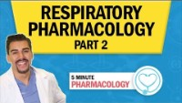
Nurse Mike Videos

Slide 27

Antitubercular Drugs

Slide 28
Antitubercular Drugs
First-line drugs :
  Isoniazid (INH): primary drug used
  Rifapentine
  Ethambutol
  Rifabutin
  Pyrazinamide (PZA)
  Rifampin
  Streptomycin

Slide 29
Antitubercular Drug Therapy: Considerations
Major effects of drug therapy: reduction of cough and therefore, reduction of the infectiousness of the patient
Normally occurs within 2 weeks of the initiation of drug therapy if TB strain is drug sensitive
Most cases of TB can be cured.
Successful treatment: several antibiotic drugs for at least 6 months and sometimes for as long as 12 months
Perform drug-susceptibility testing on the first Mycobacterium spp. that is isolated from a patient specimen to prevent the development of MDR-TB.
Even before the results of susceptibility tests are known, begin a regimen with multiple antitubercular drugs (to reduce the chances of development of resistance).
Adjust drug regimen after the results of susceptibility testing are known.
Monitor patient compliance closely during therapy.
Problems with successful therapy occur because of patient nonadherence to drug therapy and the increased incidence of drug-resistant organisms.

Slide 30
Mechanism of Action
Three groups:
  Protein wall synthesis inhibitors: streptomycin, kanamycin, capreomycin, rifampin, rifabutin, others
  Cell wall synthesis inhibitors: cycloserine, ethionamide, INH
  Other mechanisms of action: ethambutol, INH, PAS, ethionamide

Slide 31
Antitubercular Therapy
Effectiveness depends on:
  Type of infection (adjust based on specificity)
  Adequate dosing
  Sufficient duration of treatment
  Adherence to drug regimen
  Selection of an effective drug combination
Problems:
  Drug-resistant organisms
  Drug toxicity
  Patient nonadherence
MDR-TB: changes may need to be made half way through

Slide 32
Isoniazid
Drug of choice for TB
Resistant strains of Mycobacterium emerging
Metabolized in the liver through acetylation—watch for “slow acetylators”
Used alone or in combination with other drugs
Contraindicated with liver disease

Slide 33
Rifabutin , Rifampin, and Rifapentine
Rifamycin antibiotic
Also used to treat infections caused by non-TB mycobacterial species
Adverse effects: turns urine, feces, saliva, skin, sputum, sweat, and tears a red-orange-brown color
Oral use only

Slide 34
Adverse Effects
INH: peripheral neuropathy, hepatotoxicity
Ethambutol: retrobulbar neuritis, blindness
Rifampin: hepatitis; discoloration of urine, stools, and other body fluids

Slide 35
Nursing Implications
Obtain a thorough medical history and assessment.
Perform liver function studies in patients who are to receive INH or rifampin
(especially in older patients and those who use alcohol daily).
Assess for contraindications to the various drugs, conditions for cautious use, and potential drug interactions.
Patient education is critical.
Therapy may last for up to 24 months.
Take medications exactly as ordered at the same time every day.
Emphasize the importance of strict adherence to regimen for improvement of condition or cure.

Slide 36
Nursing Implications
Patient education is critical.
Remind patients that they are contagious during the initial period of their illness—instruct in proper hygiene and prevention of the spread of infected droplets.
Teach patients to take care of themselves, including getting adequate nutrition and rest.
Patients should not consume alcohol while taking these medications or take other medications, including over-the-counter medications, unless they check with their prescribers.
Rifampin causes oral contraceptives to become ineffective; another form of birth control is needed.

Slide 37
Nursing Implications
Patients who are taking rifampin should be told that their urine, stool, saliva, sputum, sweat, or tears may become reddish orange; even contact lenses may be stained.
Pyridoxine may be needed to combat neurologic adverse effects associated with INH therapy.
Oral preparations may be given with meals to reduce gastrointestinal upset even though recommendations are to take them 1 hour before or 2 hours after meals.

Slide 38
Nursing Implications
Monitor for adverse effects.
  Instruct patients on the adverse effects that should be reported to the prescriber immediately.
  These include fatigue, nausea, vomiting, numbness and tingling of the extremities, fever, loss of appetite, depression, and jaundice.
Monitor for therapeutic effects.
  Decrease in symptoms of TB, such as cough
  and fever
  Laboratory study results (culture and sensitivity tests)
  and chest radiographs should confirm clinical findings.
  Watch for lack of clinical response to therapy, indicating possible drug resistance.

Slide 39
ATI Practice
A nurse is caring for a client who has diabetes mellitus, pulmonary tuberculosis, and a new prescription for isoniazid. Which of the following supplements should the nurse expect to administer to prevent an adverse effect of INH?
  Ascorbic acid
  Pyridoxine
  Folic acid
  Cyanocobalamin
A nurse is teaching a client who has active TB about the treatment regimen. The client asks why four different medications are necessary. Which of the following responses should the nurse make?
  “Four medications decrease the risk for a severe allergic reaction”
  “Four medications reduce the chance that the bacteria will become resistant”
  “Four medications reduce the risk for adverse effects”
  “Four medications decrease the chance of having a positive tuberculin skin test”

Slide 40
Chapter 36 –
Antihistamines, Decongestants, Antitussives, and Expectorants

Slide 41
Antihistamines
Drugs that directly compete with histamine for specific receptors sites (antagonistic effect)
  H1 (histamine 1) – more airway emphasis
  H2 (histamine 2) – more GI emphasis
Histamine is a major mediator in many allergic disorders that causes inflammation
Histamine 1 antagonists
  Allegra, Claritin, Zyrtec, diphenhydramine (Benadryl)
  Properties include: antihistamine, anticholinergic, sedative
Histamine 2 antagonists
  Pepcid

Slide 42
Antihistamines: Contraindications
Known drug allergy
Narrow-angle glaucoma
Cardiac disease, hypertension
Kidney disease
Bronchial asthma, chronic obstructive pulmonary disease (COPD)
Sole drug therapy during acute asthmatic attacks
  Albuterol or epinephrine indicated for acute asthma attacks
Peptic ulcer disease
Seizure disorders
Benign prostatic hyperplasia (BPH)
Pregnancy

Slide 43
Antihistamines: Adverse Effects
Anticholinergic (drying) effects: most common
  Dry mouth
  Difficulty urinating
  Constipation
  Changes in vision
Drowsiness
  Mild drowsiness to deep sleep

Slide 44
Decongestants
Adrenergic, Anticholinergic & Corticosteroids
MOA – constrict blood vessels to nasal passageway preventing fluid that can cause mucus

Slide 45
Oral Decongestants
Prolonged decongestant effects but delayed onset
Effect less potent than topical
No rebound congestion
Exclusively adrenergics
Example: pseudoephedrine (Sudafed)

Slide 46
Nasal Decongestants:
Mechanism of Action
Site of action: blood vessels surrounding nasal sinuses
Adrenergics
  Constrict small blood vessels that supply upper respiratory tract structures
  As a result, these tissues shrink, and nasal secretions in the swollen mucous membranes are better able to drain.
Nasal steroids
  Antiinflammatory effect
  Work to turn off the immune system cells involved in the inflammatory response
  Decreased inflammation results in decreased congestion.

Slide 47
Nasal Decongestants:
Indications
Relief of nasal congestion associated with:
  Acute or chronic rhinitis
  Common cold
  Sinusitis
  Hay fever
  Other allergies
May also be used to reduce swelling of the nasal passage and facilitate visualization of the nasal or pharyngeal membranes before surgery or diagnostic procedures

Slide 48
Nasal Decongestants:
Contraindications
Drug allergy
Narrow-angle glaucoma
Uncontrolled cardiovascular disease, hypertension
Diabetes and hyperthyroidism
History of cerebrovascular accident or transient ischemic attacks
Long-standing asthma
BPH
Diabetes

Slide 49
Antitussives
Drugs used to reduce cough
Opioid and / or nonopioid
Only used for nonproductive cough
Nonopioids
  Dextromethorphan (Delsym)
  Benzonatate (traditional cough drop)

Slide 50
Antitussives:
Mechanism of Action
Opioids
  Suppress the cough reflex by direct action on the cough center in the medulla
  Analgesia, drying effect on the mucosa of the respiratory tract, increased viscosity of respiratory secretions, reduction of runny nose and postnasal drip
  Examples
    Codeine
    Hydrocodone
Nonopioids
  Dextromethorphan (DXM)
    Same MOA

Slide 51
Expectorant
Drugs that promote expectoration of mucus
  Guaifenesin (Mucinex)
Use in caution with asthmatics due to similar effect of Adrenergic drugs
S/S: dehydration

Slide 52
Expectorants:
Mechanisms of Action
Reflex stimulation
  Drug causes irritation of the GI tract.
  Loosening and thinning of respiratory tract secretions occur in response to this irritation.
Direct stimulation
  The secretory glands are stimulated directly to increase their production of respiratory tract fluids.
Final result: thinner mucus that is easier to remove

Slide 53
Expectorants:
Nursing Implications
Expectorants should be used with caution in older adults and patients with asthma or respiratory insufficiency.
Patients taking expectorants should receive more fluids, if permitted, to help loosen and liquefy secretions.
Report a fever, cough, or other symptoms lasting longer than 1 week.
Monitor for intended therapeutic effects.

