Slide 1
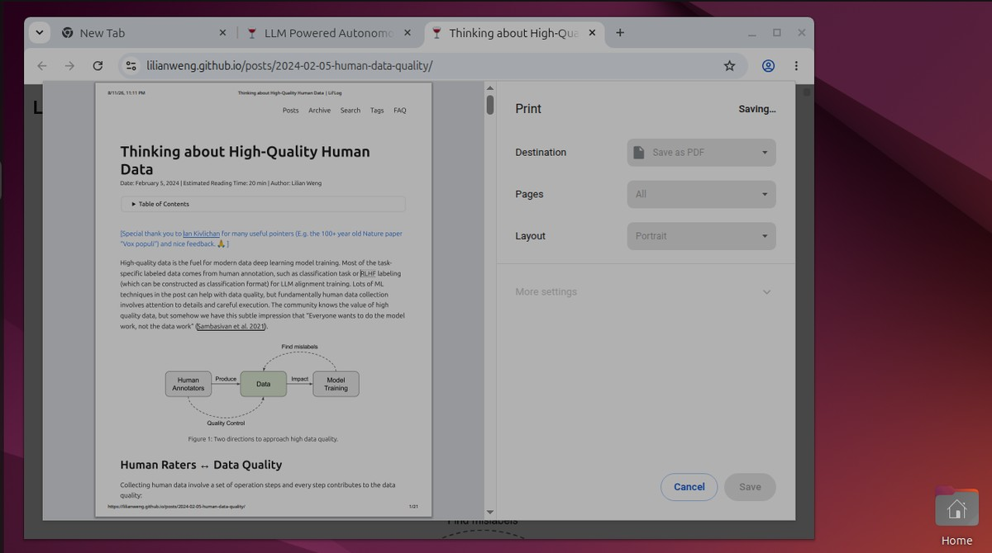
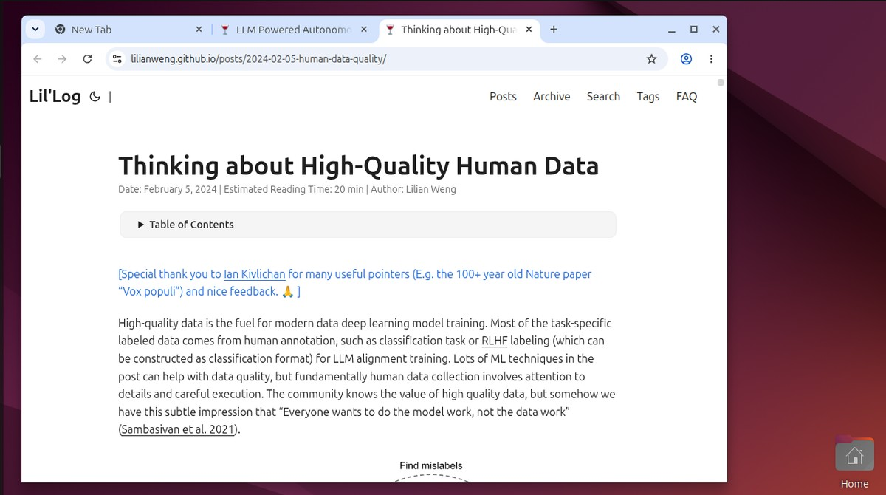
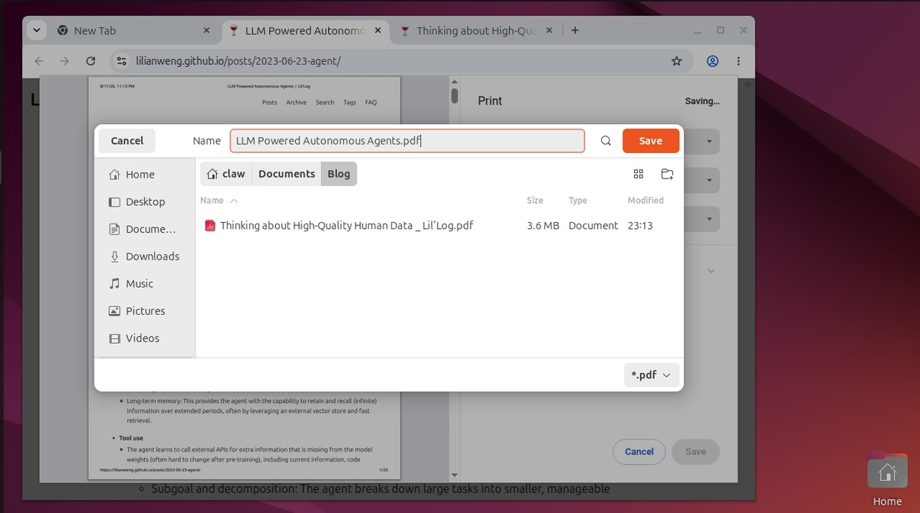
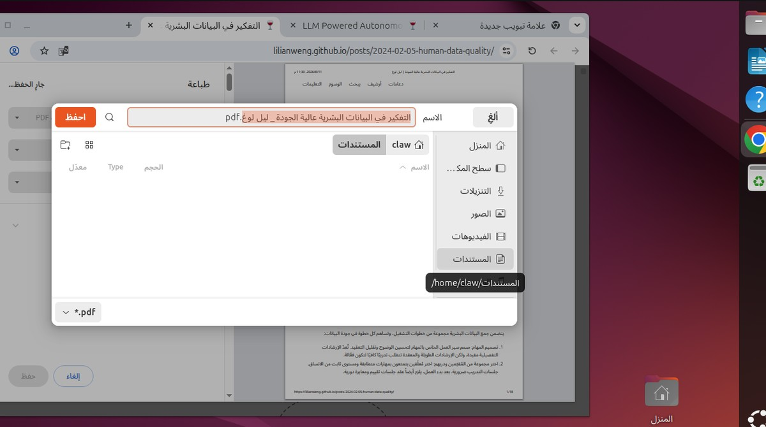
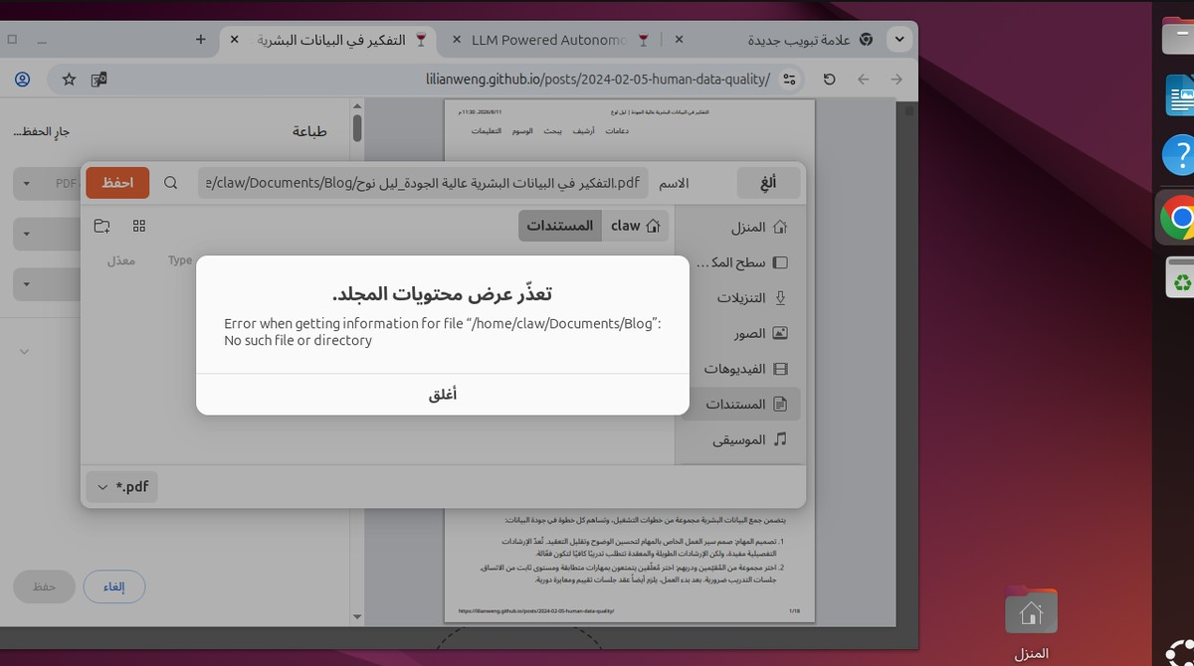
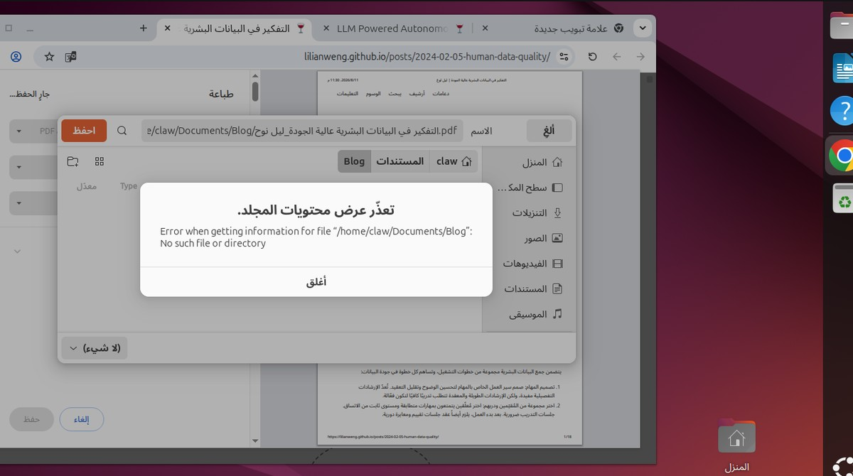







Example task: save two open blog posts as PDFs
English machine
English instruction
›
›
PASS
“Please download the blogs opening now in PDF format and save them in their title to /home/user/Documents/Blog.”
Arabic instruction (human translated)
Print, save as PDF
Creates Documents/Blog, saves the first article
Saves the second article, done at step 21
يرجى تنزيل المدوّنات المفتوحة الآن بصيغة PDF وحفظها بعناوينها في المسار:
Arabic machine
/home/user/Documents/Blog
›
›
FAIL
The same task is also translated to Egyptian, Syrian, Qatari, Sudanese and Algerian Arabic.
Types the path /home/user/Documents/Blog
The folder is called المستندات, so “folder not found”
Same error at step 50, no PDFs saved
How it works
Tasks
Translation
Two machines
Agent
Evidence
Checker
Result
171 tasks from OSWorld, ClawBench and Terminal-Bench, plus 50 new Arabic tasks
Translated by humans to MSA and 5 dialects: Egyptian, Syrian, Qatari, Sudanese, Algerian
English VM
Arabic VM
Sees screenshots and navigates with the mouse and keyboard
Everything is recorded. The final request is captured but not sent.
Checks the recorded evidence. No LLM judge.
Pass or fail for each language

Slide 2










What the agent sees and does
The two machines
How we grade
One screenshot per step
Checker
1360 × 768. No page source, no accessibility tree, no hints.
One per task. It looks at the saved files, the application state or the captured request. No LLM judge.
English VM
Arabic VM
Mouse
English interface
Arabic interface, keyboard and folder names, right to left
click, double click, drag, scroll
PASS
FAIL
EVAL_ERROR
Both machines start from the same image and the same files. Only the system language differs.
Keyboard
EVAL_ERROR means something on our side broke (setup, recorder, checker, API). Those runs are thrown out and rerun. They are never counted as a model failure.
type, press key
Recording
Every screenshot, every action and every network request is saved for each run.
Pairs
Control
Each task in English is compared with the same task in Arabic. When one language passes and the other fails, the pair is rerun 3 times and checked by hand before it counts.
wait, done
Real websites, no side effects
For payments, applications and posts, a proxy captures the final request and does not send it. The captured request is the evidence.
Audit
Budget
Every pass is checked against its screenshots. Every fail gets a reason.
Each task has a fixed step and time limit (for example 150 steps or 30 minutes). The same limit is used for both languages and every model.
Frozen instructions
A test fails if any instruction changes. Numbers, IDs and quoted text are the same in every language.

