Slide 1
Sankara iRecords
Eye-Health Tracker for Children in India
Francis Cuenca and Amy Truong
www.scu.edu
SCHOOL OF ENGINEERING

Slide 2

Introduction
Background:
  Sankara Eye is a U.S. based outreach organization
  Operates and manages eye care hospitals in India
  Primarily for families with low income

Slide 3
Introduction (cont.)
Problem:
  Need a user-friendly and efficient system to keep track of children’s eye health records
Current Solution:
  Sankara Eye field screeners manually fill out a form for each child by hand
Our Solution:
  Mobile application to automate recording eye health records through speech recognition

Slide 4
Requirements
Functional Requirements:
  Store school and student information into the database
  Remove school and student information into the database
  Categorize students by the school they attend
  Input information by keyboard input or by speech
  Automatically update the age of each student based on their birth date
  Automatically update the grade of each student every year
  Authenticate the user before allowing access to sensitive information

Slide 5
Requirements (cont.)
Non-Functional Requirements:
  Portable to different mobile platforms
  Fast and responsive
  Easy to use
  Intuitive

Slide 6
Requirements (cont.)
Design Constraint:
  Currently hosted on the Santa Clara University design center server

Slide 7
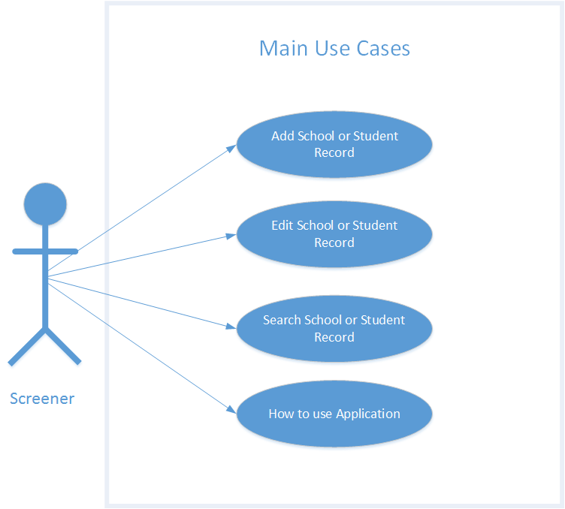
Use Cases

Slide 8
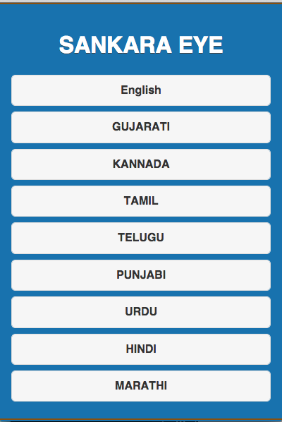
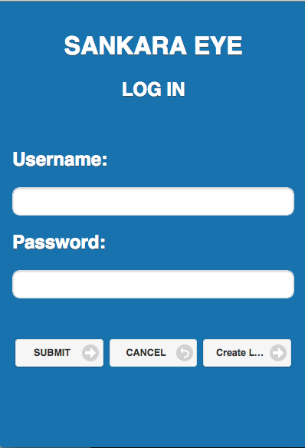
Conceptual Model

Slide 9
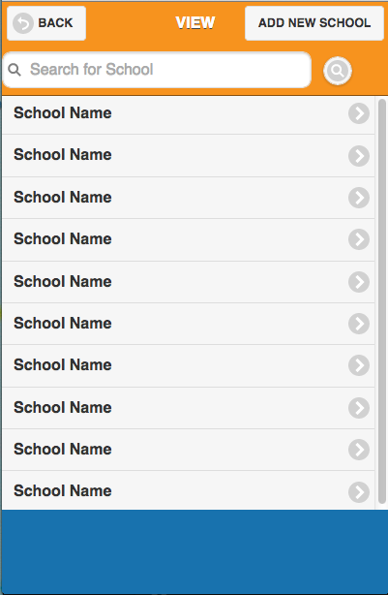
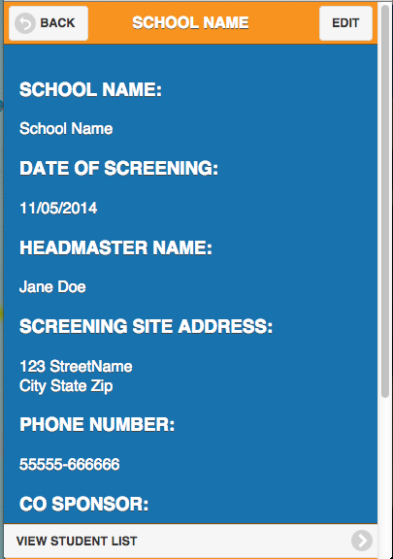
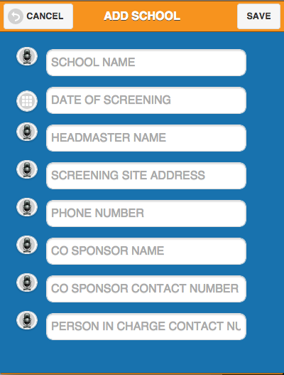
Conceptual Model

Slide 10
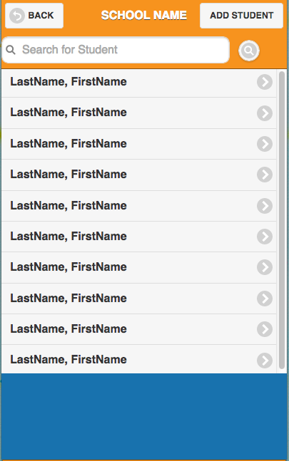
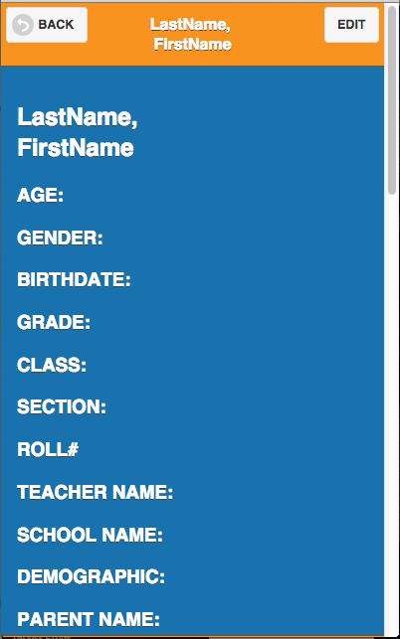
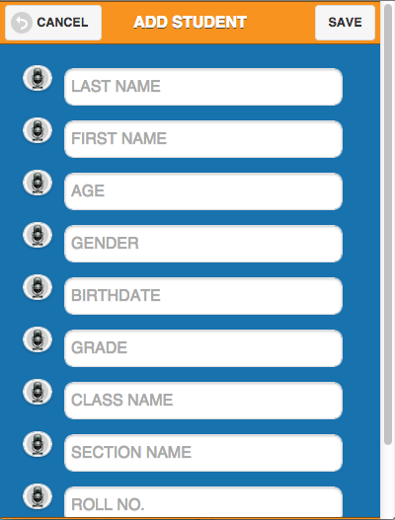
Conceptual Model

Slide 11
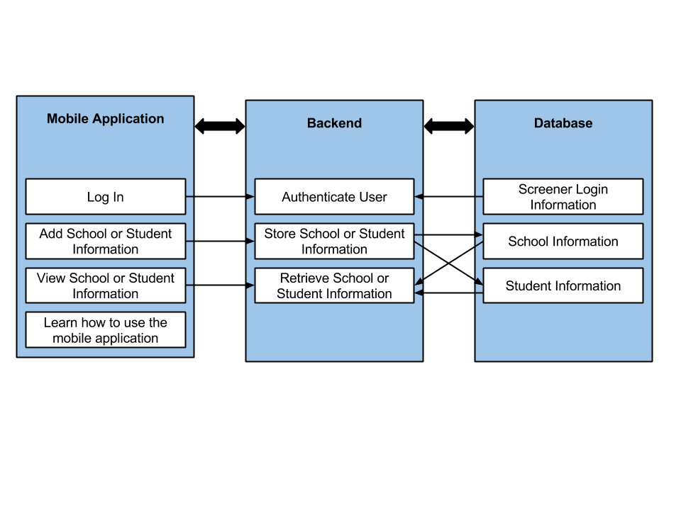
System Diagram

Slide 12
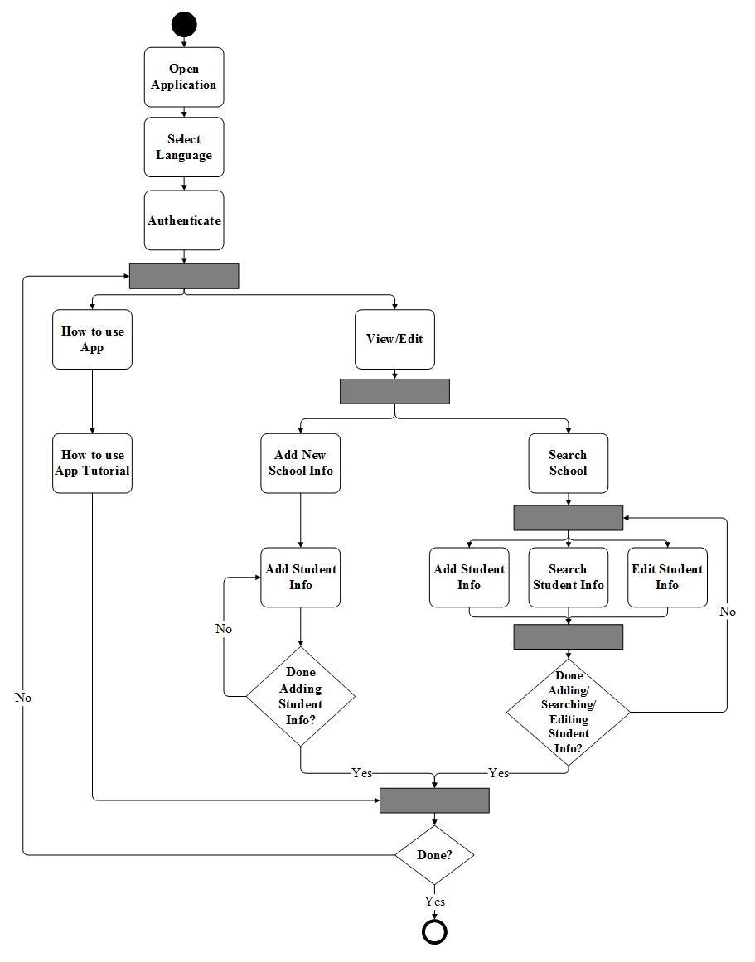
Activity Diagram

Slide 13
Technologies Used
HTML
  Markup Language
CSS
  Style Sheet Language
JavaScript
  Client-side scripting language for websites
jQuery Mobile
  JavaScript library and a touch optimized web framework

Slide 14
Technologies Used (cont.)
MySQL
  Open-source relational database management system
PhoneGap
  Framework that will allow us to build a cross-platform mobile application
PHP
  Server-side scripting language for web development
GitHub
  Version control system

Slide 15
Design Rationale
Mobile application
??

Slide 16
Test Plan
Unit Testing
  Language Selection
  Authentication
  Adding school or student information
  Editing school or student information
Integration Testing
  Database design, speech recognition, authentication, and translation.
Acceptance Testing

Slide 17
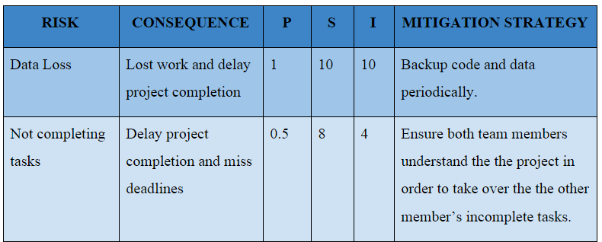
Project Risks

Slide 18
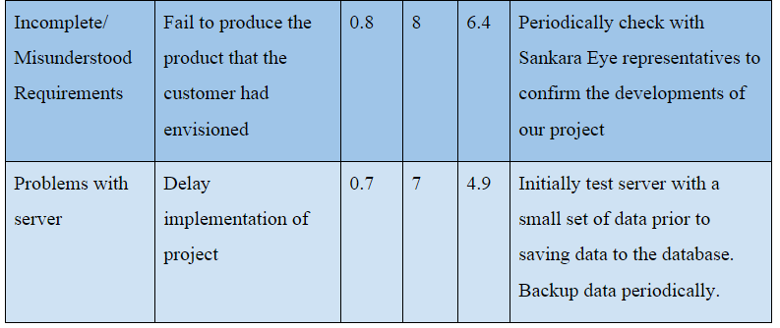
Project Risks (cont.)

Slide 19
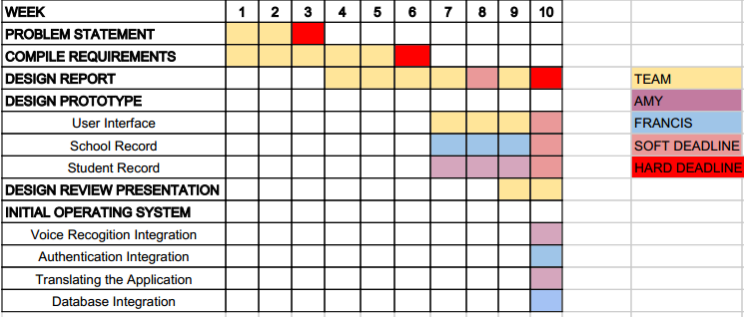
Development Timeline (Fall)

Slide 20
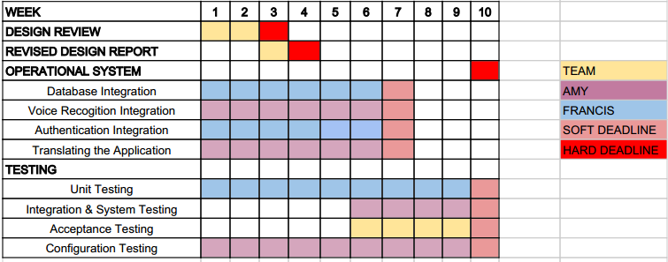
Development Timeline (Winter)

Slide 21

Development Timeline (Spring)

Slide 22

Questions?

