Slide 1
金融數據分析與應用
2024.1126

Slide 2
課程內容
期中考結果
重要概念
指標建構
Goodhart法則
TEJ
Python 程式撰寫

Slide 3
課程進度
11/26 TEJ抓資料、Python介紹
12/3 Yahoo!Finance抓資料、GitHub、企業指標計算
12/10 FRED總體指標1
12/17 FRED總體指標2
12/24 期末考
12/31 自主學習週

Slide 4
期中考結果

Slide 5
次數分配
類別 | 平均數 | 標準差 | Max of 分數
非管院或經濟 | 68.17 | 18.12 | 95.00
管院或經濟 | 76.82 | 17.43 | 100.00
Total | 71.83 | 18.18 | 100.00

Slide 6
重要概念
2. 指標解讀
成長率
受到基期大小影響
原始
數據
受到規模 (絕對數字)影響
比率
分子項 與 分母項的性質

Slide 7
數據的性質
壞的數據 | 中性的數據 (標準化) | 好的數據
費用 成本 短期負債 總負債 … | 總資產 總負債 總股東權益 總銷貨收入 … | 收入 利潤 總股東權益 …
指標要越高越好，還是越低越好??

Slide 8
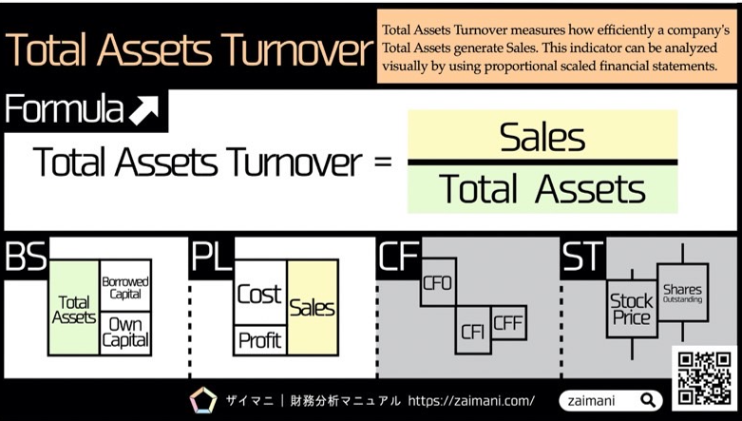
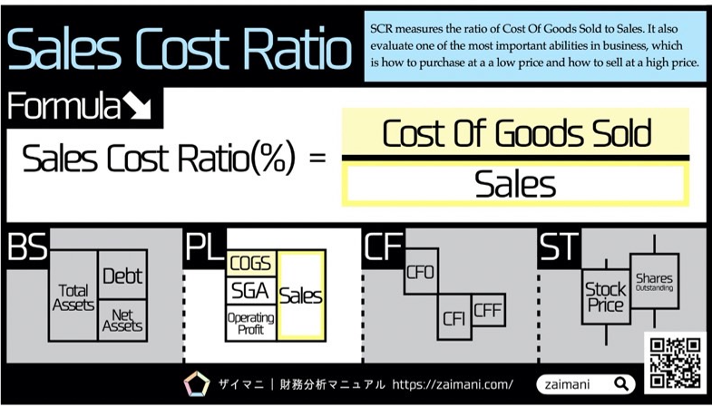
比較一下

Slide 9
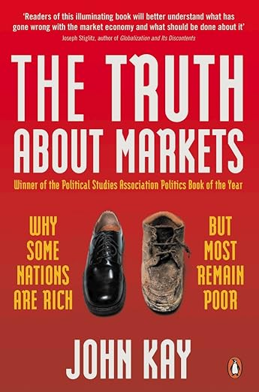
Goodhart法則
中央政府必須專注在一些想像的關鍵變數上。
但是，這些變數會受制於「古德哈特法則」─
被批准為目標的任何評量，本身的原意就會因此改變
https://www.amazon.com/Truth-About-Markets-Countries-Others/dp/0140296727

Slide 10
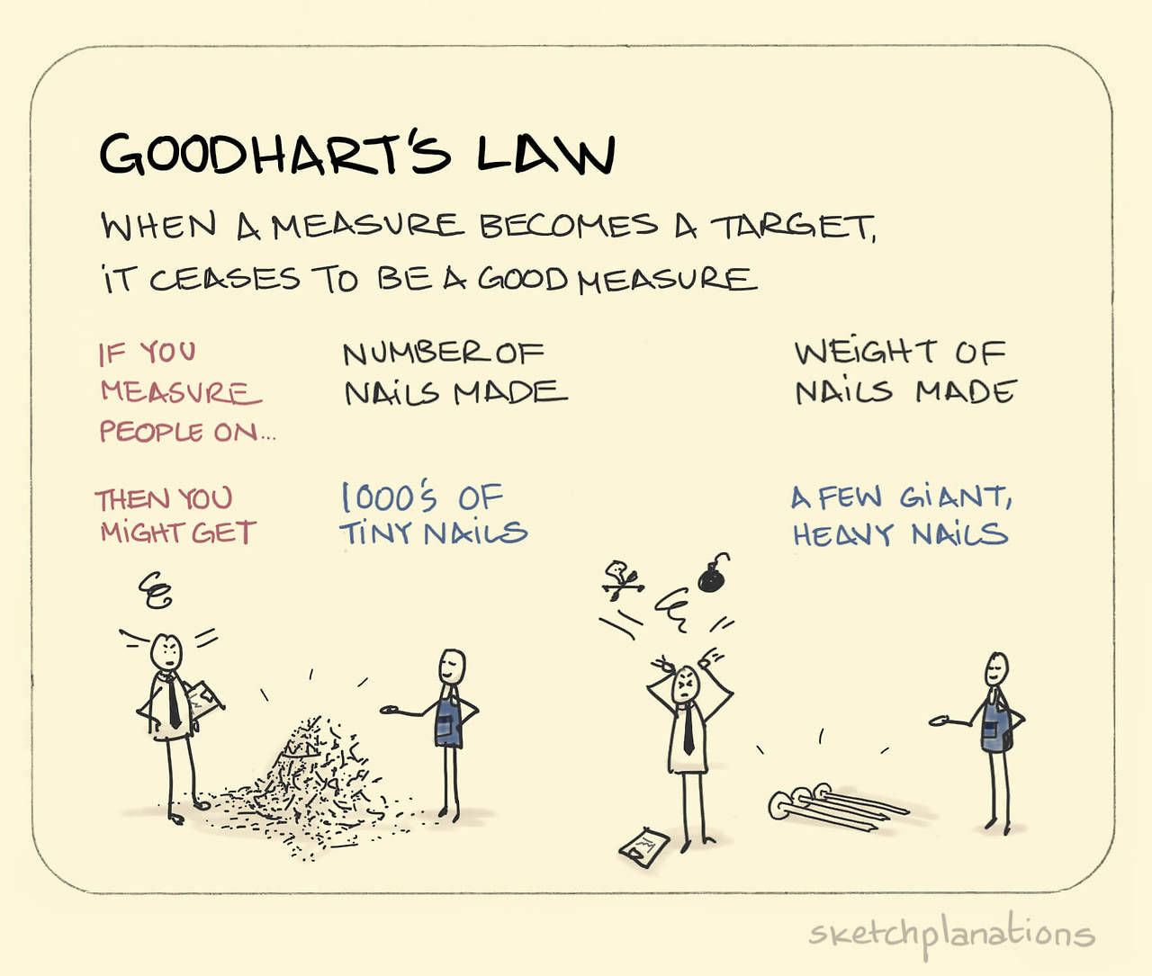
Goodhart法則
◎ 犯罪率作為治安指標、利用抓到害蟲的數量作為補助依據
◎ Theoretically, if doctors are rated based on the number of lives they save, they will be incentivized to refuse to treat patients who have a high chance of dying.
◎Because it shows that the focus of kids, teachers as well as parents has shifted from actually imparting education to getting good scores in exams- a perfect example of Goodhart’s law at work.
https://prranshu.com/4-examples-of-the-profound-ways-in-which-goodharts-law-subtly-affects-your-life/

Slide 11
Goodhart法則
Goodhart’s Law is pervasive in commodity markets and explains why much of the official data on production, consumption and trade flows is incomplete at best and inaccurate at worst.
From the moment the Organization of the Petroleum Exporting Countries (OPEC) started to agree production allocations, also known as “quotas”, in the early 1980s, members were suspected of misreporting their output.
OPEC members’ own self-reported output numbers became so unreliable that the organisation came to rely on independent media estimates, commonly described as “secondary sources”, to assess compliance.
Members had been cheating even before the introduction of production allocations. In the 1970s, OPEC tried to control the market by specifying minimum selling prices, leading to a system to secret discounts.
https://www.refinitiv.com/perspectives/market-insights/sanctions-enforcement-and-goodharts-law/

Slide 12
如何解決Goodhart問題
◎ Divide and conquer – develop a range of KPIs that work together. It’s easy to work out how to stretch the definition of one or two targets to game the system, it’s a lot harder when there are several of them. So try to develop your KPIs strategically, foreseeing how they’ll be used, so that they cover all scenarios. A balanced scorecard approach works well here.
◎ Be clear and complete – leave no wiggle room. The clearer and more complete your KPIs are, the less people will be able to misinterpret them to their advantage in ways you didn’t foresee. So make sure you haven’t left any gaps that could be exploited.
◎ Measure and control. Make sure that you have the appropriate governance and controls in place to monitor your KPIs and make sure that they’re working as you intended.
◎ Finally, you can look to the experts for help. Let organisations who specialise in BI help you develop effective KPIs, leaving you to concentrate on what you do best.
https://trulyintelligent.business/strategy/using-goodharts-law/

Slide 13
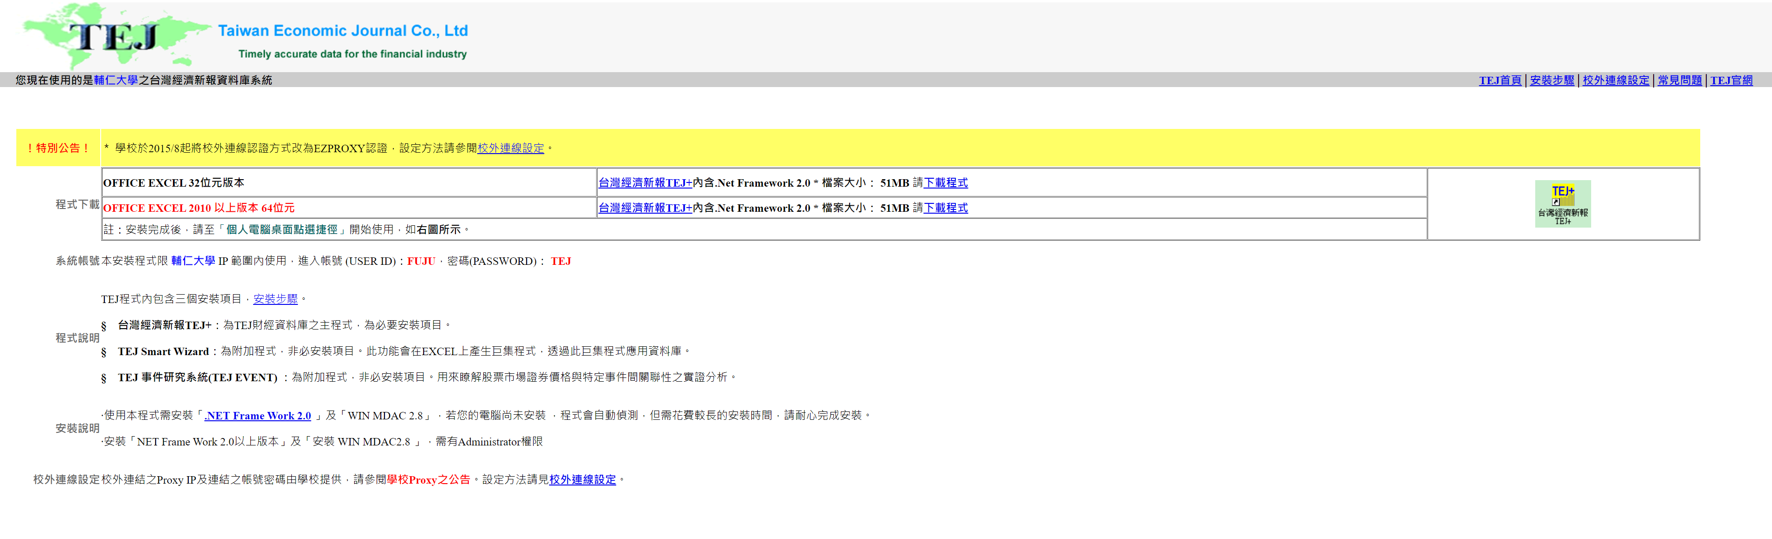
TEJ安裝
http://140.136.208.107/download/index.htm

Slide 14

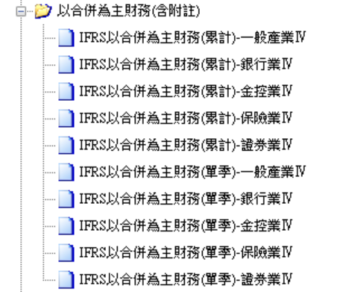

Slide 15

(1) 公司：選取兩家公司，如台泥、亞泥
(2) 欄位：選取資產負債表所有欄位
(3) 日期：選取2023年12月
(4) 選取多股
(5)儲存成「資產負債表.xlsx」檔
(6) 欄位：選取資產負債表所有欄位
(7)儲存成「損益表.xlsx」檔

Slide 16
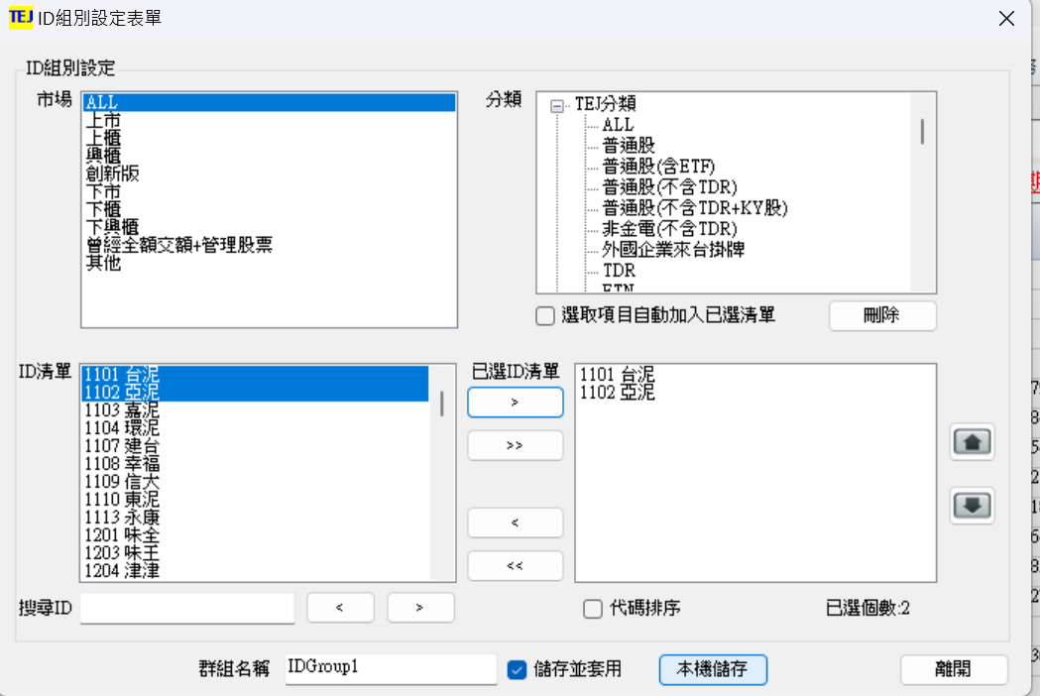
(1)公司

Slide 17
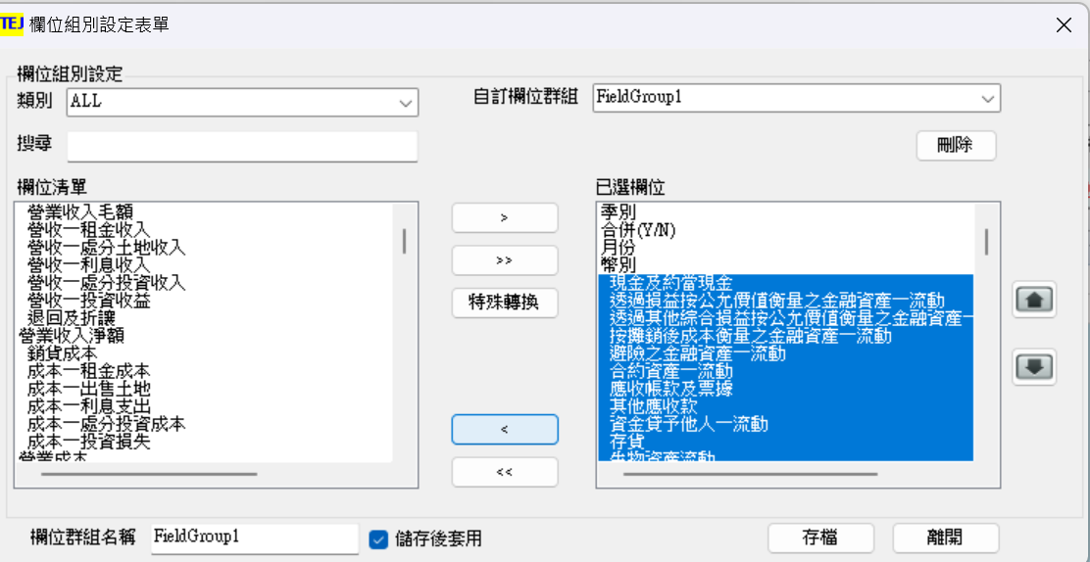
(2)欄位，先清空預設欄位

Slide 18
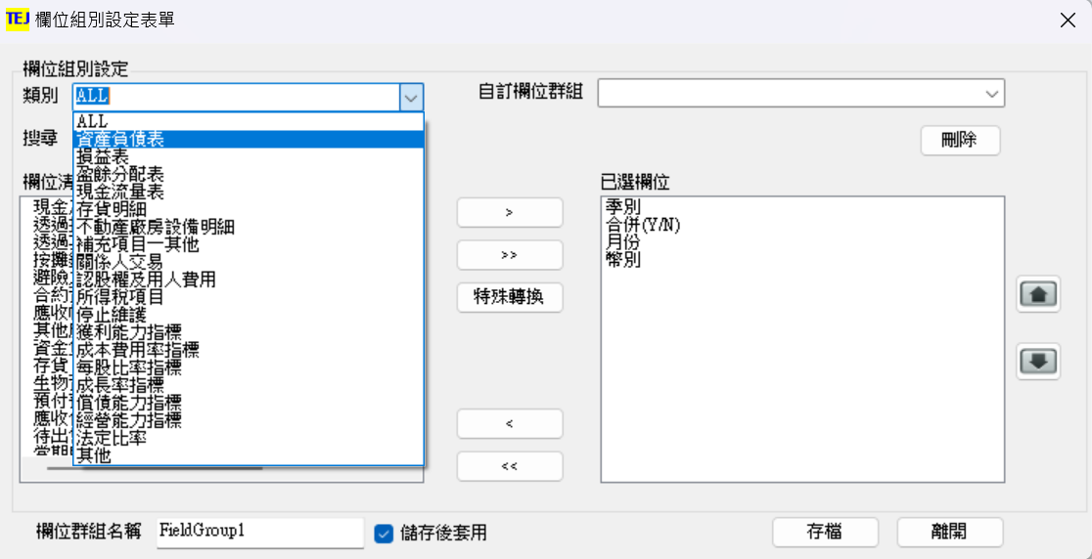
(2)欄位，先清空預設欄位

Slide 19
(2)欄位，到「類別」下拉式選單 選取資產負債表

Slide 20
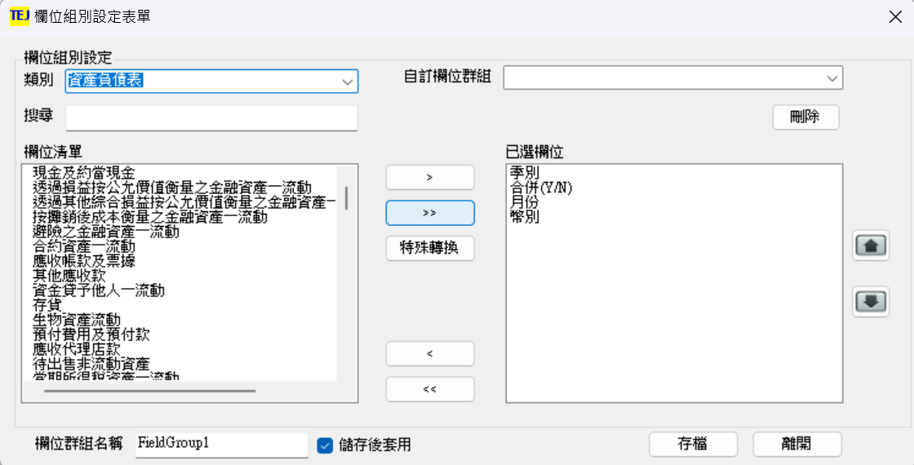
(2)欄位，將資產負債表欄位右移

Slide 21
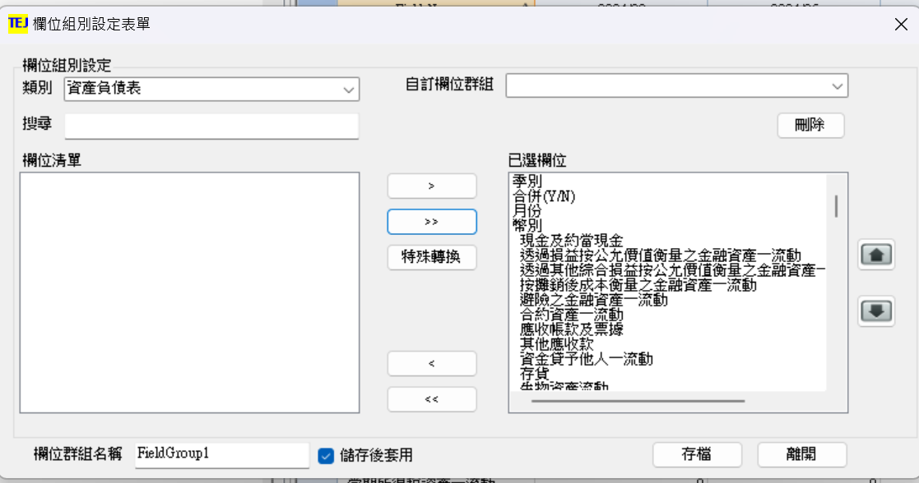
(2)欄位，最後畫面，按下存檔

Slide 22
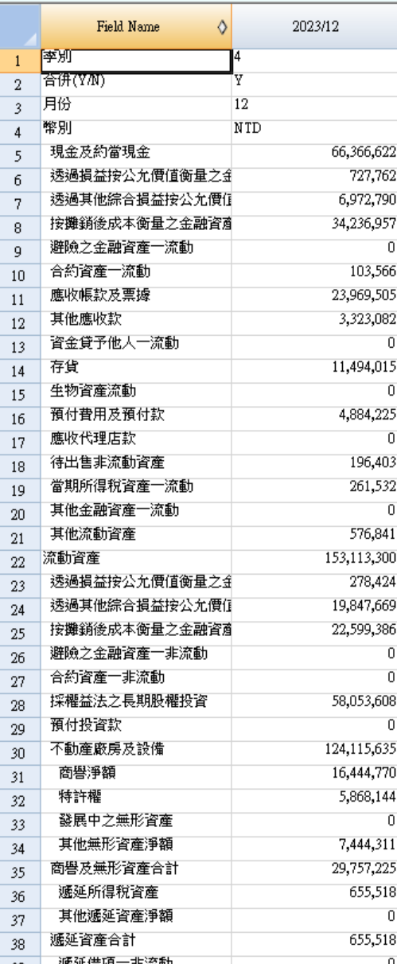
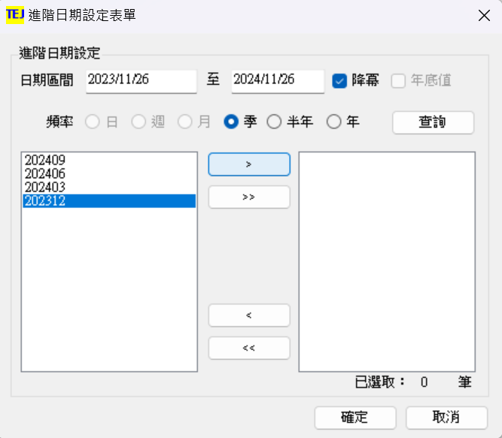
(3) 日期：選取202312

Slide 23
(4) 選取多股
◎選取多股時，資料時間會跑掉，需要再重新設置

Slide 24
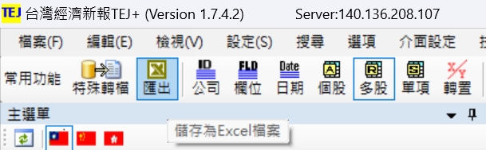
(5) 匯出

Slide 25
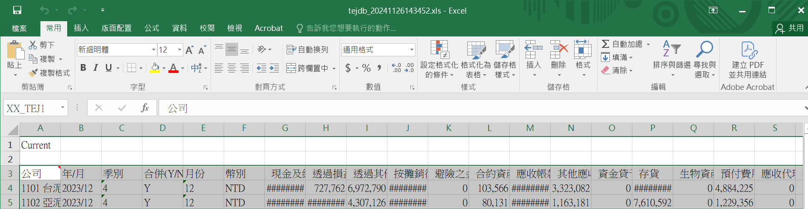
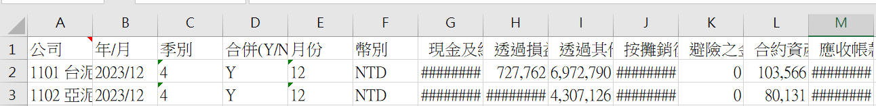
(5)匯出：刪除第一列與第二列 儲存成「資產負債表.xlsx」

Slide 26
(6)(7)
請自行調整欄位，選出損益表的項目，並匯出儲存

Slide 27
後續內容~~~
有了這麼多資料，要怎樣進行分析?

Slide 28
Python 程式撰寫

Slide 29
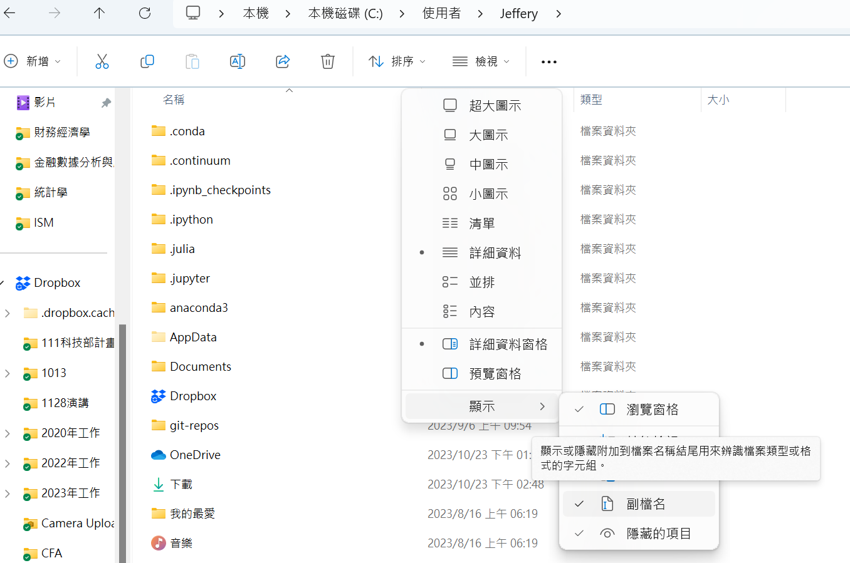
注意事項
開啟顯示已知檔案的副檔名

Slide 30
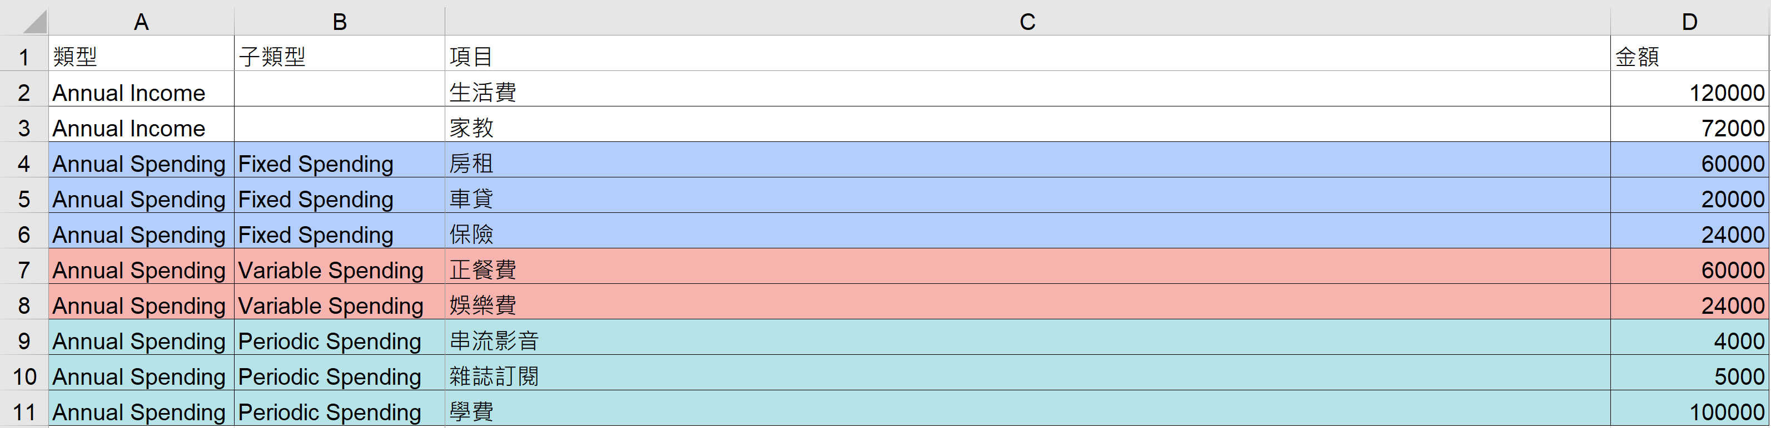
Hw 計算底線 (Bottom Line) 或稱淨利
1. 準備好自己的資料或excel檔

Slide 31
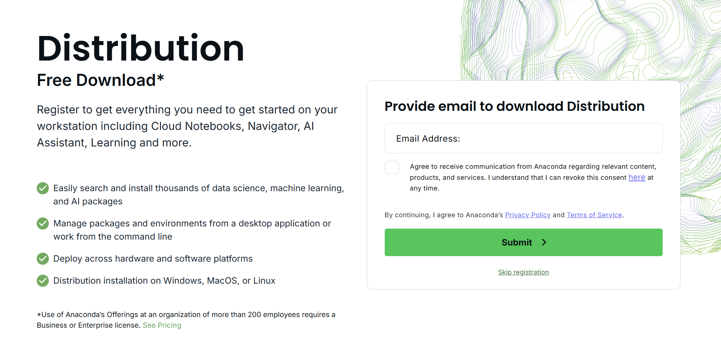
Hw 計算底線 (Bottom Line) 或稱淨利
2. 安裝Anaconda 或使用Google Colab

Slide 32
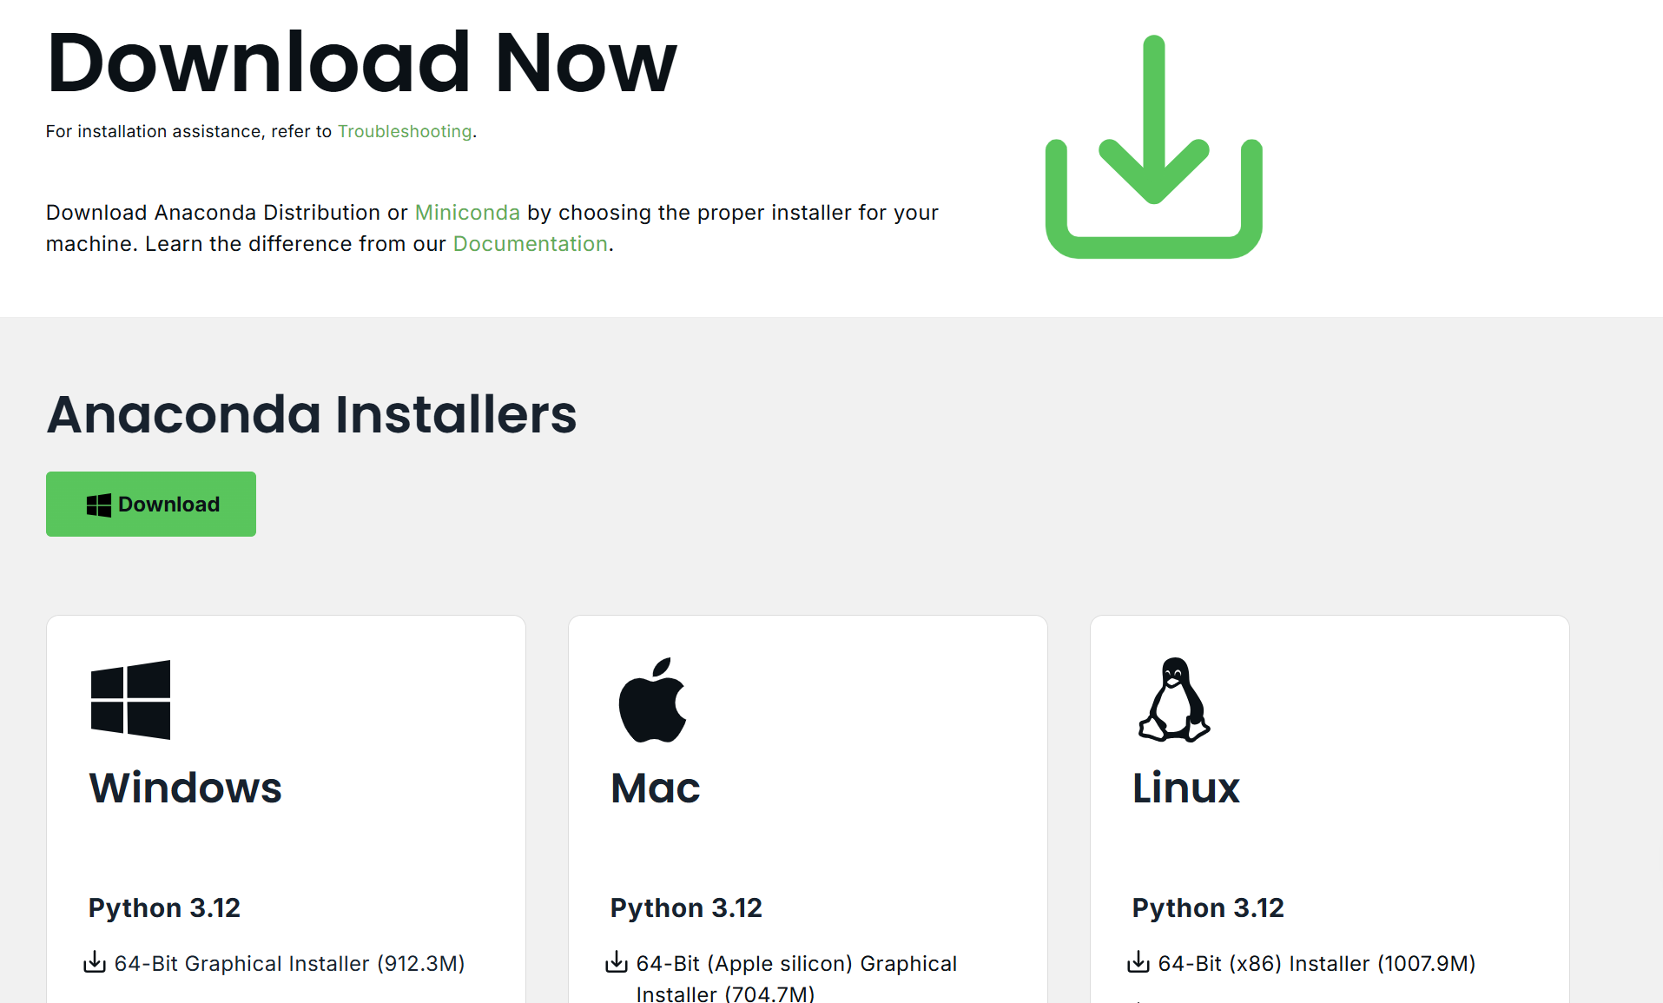
安裝Anaconda

Slide 33
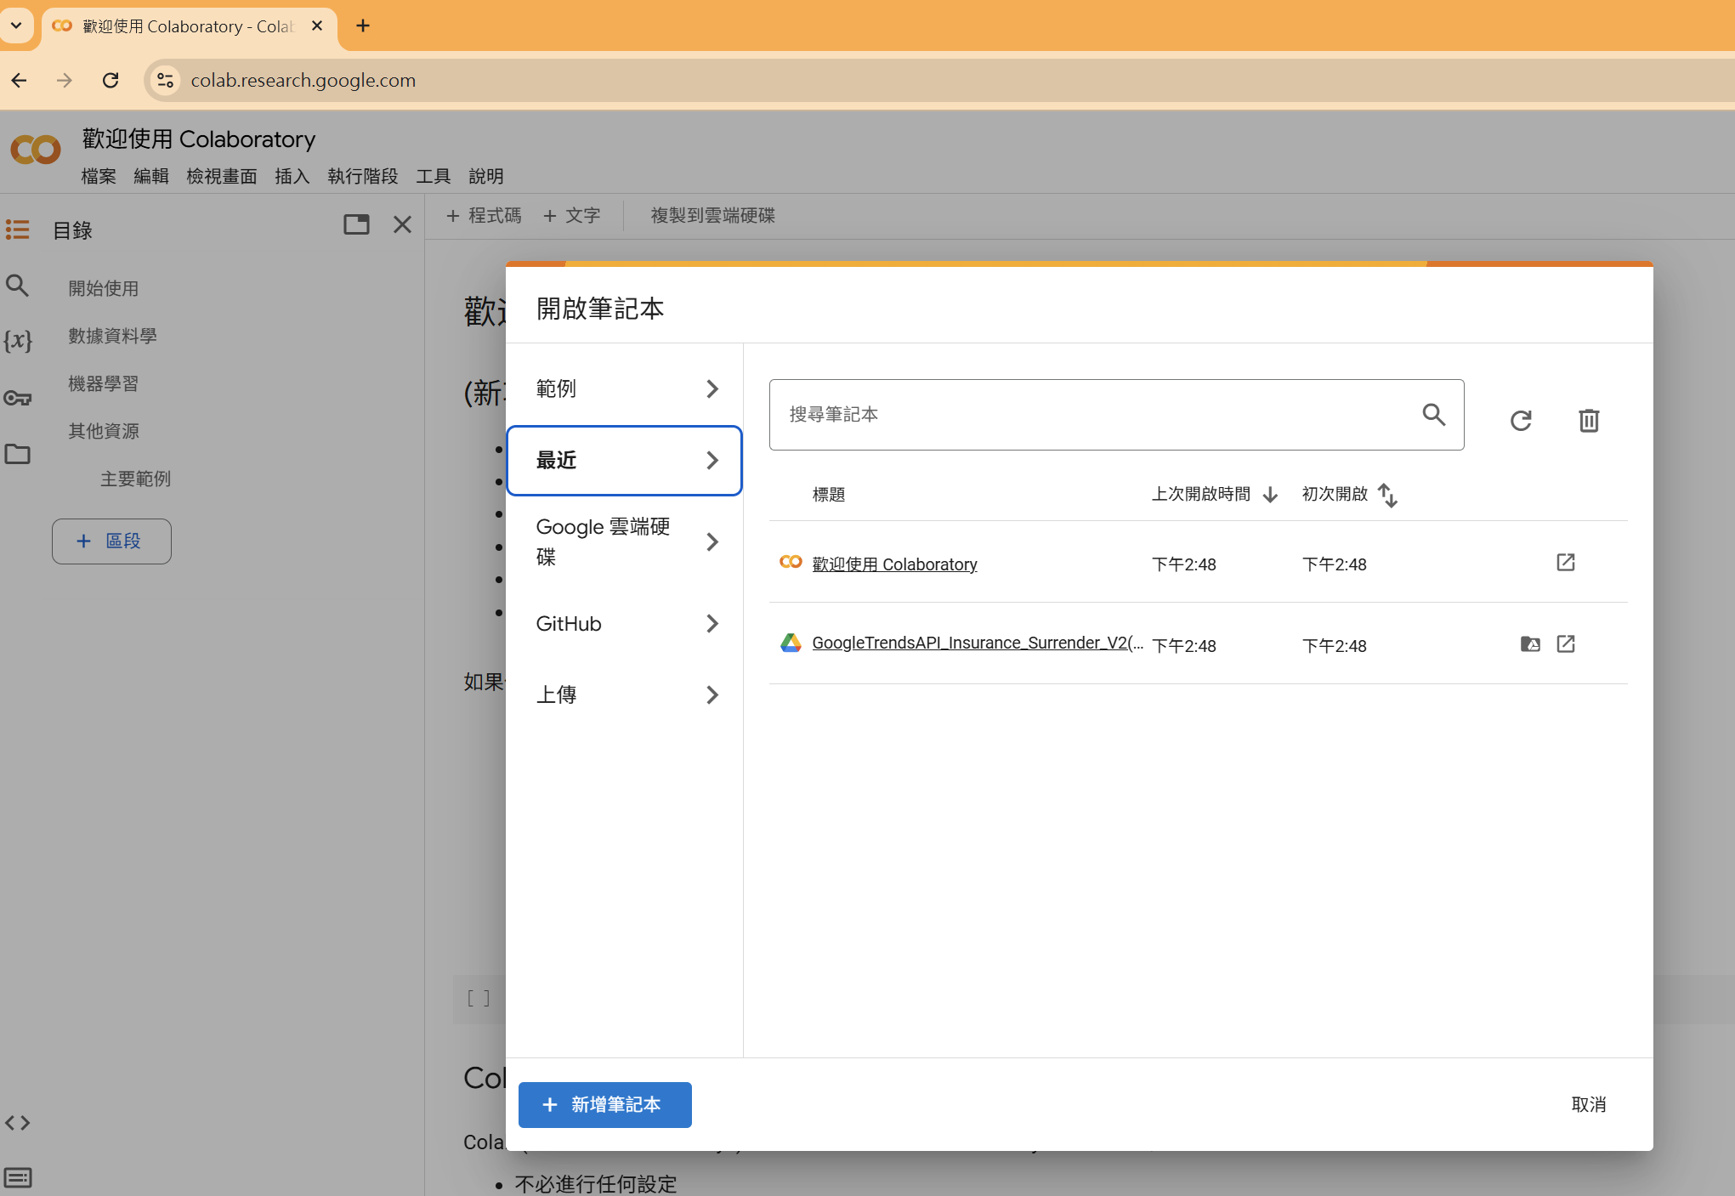
使用Google Colab

Slide 34
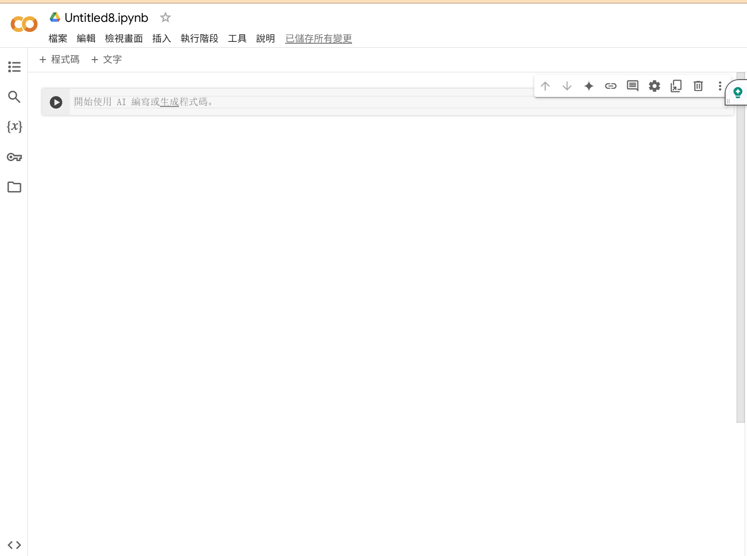
使用Google Colab

Slide 35
無法使用excel檔 (income and spending.ipynb)
import pandas as pd
data = {
"類型": ["Annual Income", "Annual Income", "Annual Spending", "Annual Spending", "Annual Spending", "Annual Spending", "Annual Spending", "Annual Spending", "Annual Spending", "Annual Spending"],
"子類型": ["", "", "Fixed Spending ", "Fixed Spending", "Fixed Spending", "Variable Spending", "Variable Spending", "Periodic Spending", "Periodic Spending", "Periodic Spending"],
"項目": ["生活費", "家教", "房租", "車貸", "保險", "正餐費", "娛樂費", "串流影音", "雜誌訂閱", "學費"],
“金額": [120000, 72000, 60000, 20000, 24000, 60000, 24000, 4000, 5000, 100000]
}
df = pd.DataFrame(data)

Slide 36
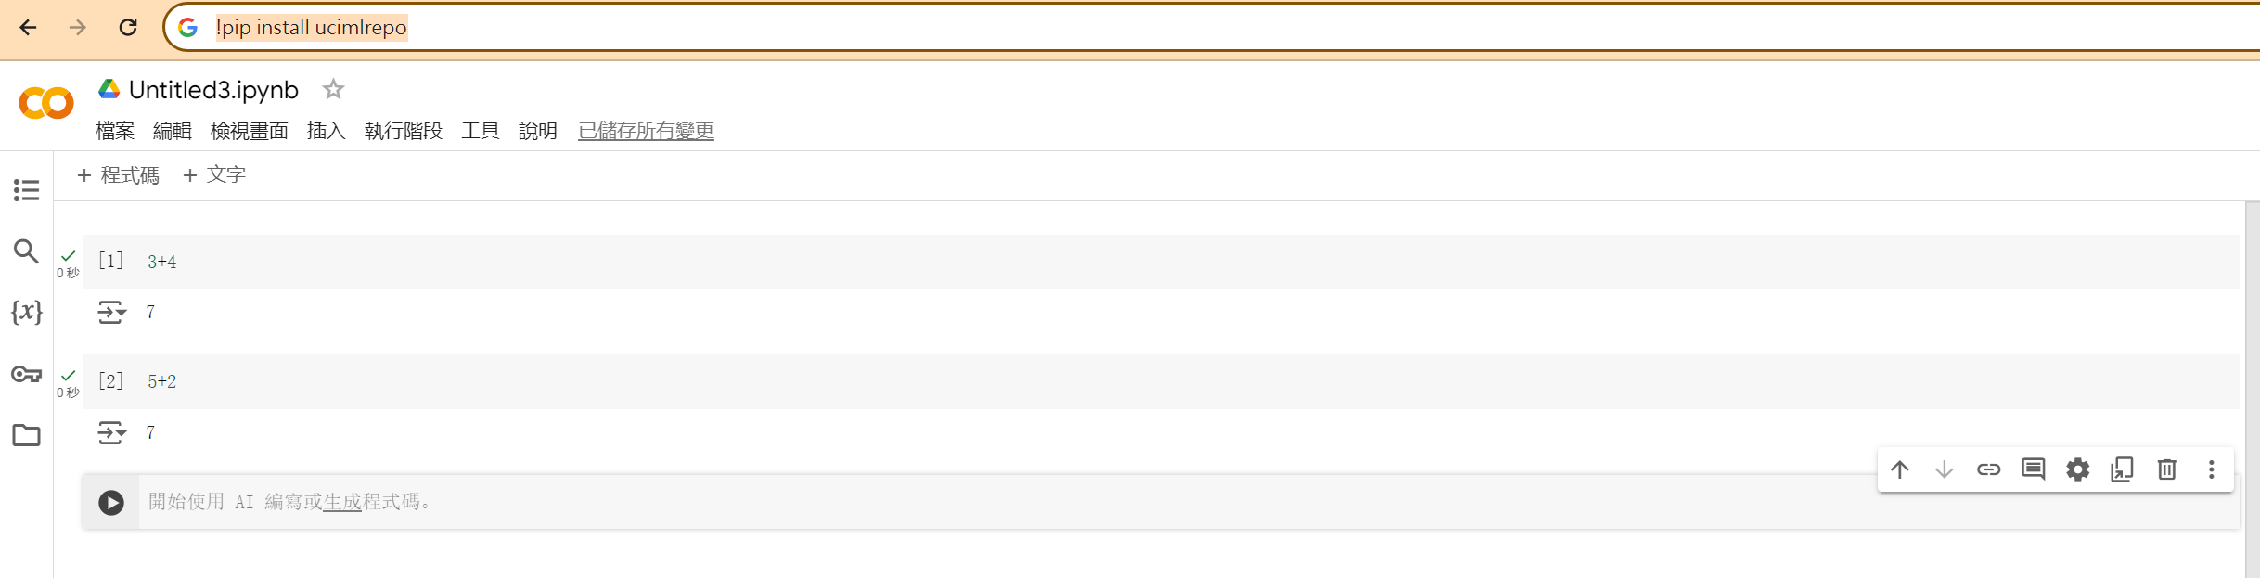
Copy and Paste??

Slide 37

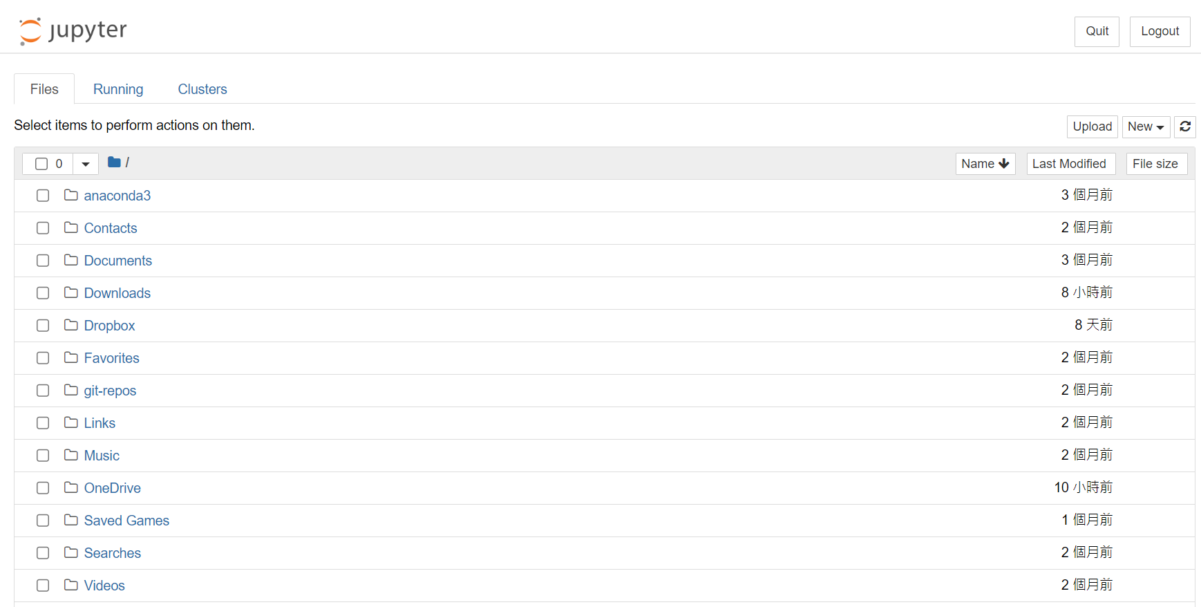
計算底線 (Bottom Line) 或稱淨利
3. 開啟Jupyter Notebook
其資料夾路徑預設為「使用者」資料夾內

Slide 38
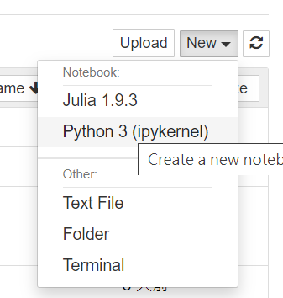
計算底線 (Bottom Line) 或稱淨利
4. 點選NEW，準備寫入程式

Slide 39
Hw1計算底線 (Bottom Line) 或稱淨利
輸入下方程式碼：
指令 | 說明
import pandas as pd df1 = pd.read_excel("C:/~/資產負債表.xlsx") df1 | 下載資產負債表，並儲存於df1變數
df1.columns | 顯示df1欄位
df2 = pd.read_excel("C:/~/損益表.xlsx") df2 | 下載損益表，並儲存於df2變數
df2.columns | 顯示df2欄位
df_sum.loc["Annual Income"] - df_sum.loc["Annual Spending"] | 計算底線。注意loc的用法

Slide 40
LOC (LABEL)
 | A | B | C | D
A | [“A“, “A“]
B
C
D
[ : , [“A“, “B“]]
https://zhuanlan.zhihu.com/p/129898162

Slide 41
ILOC (INDEX)
0 | 1 | 2 | 3
 | A | B | C | D
0 | [0,0] | [0,1]
1
2
3

Slide 42
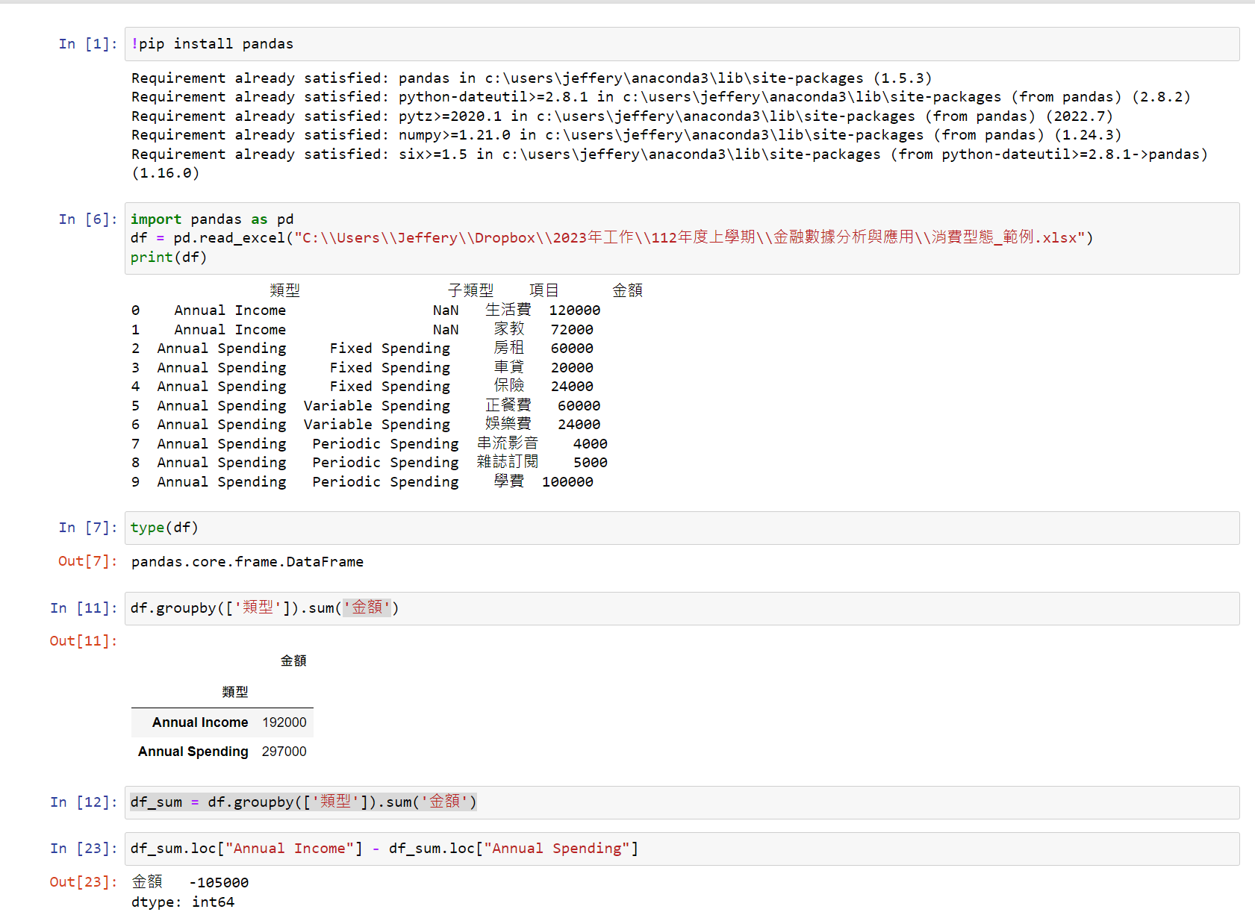
Hw1 計算底線 (Bottom Line) 或稱淨利

Slide 43
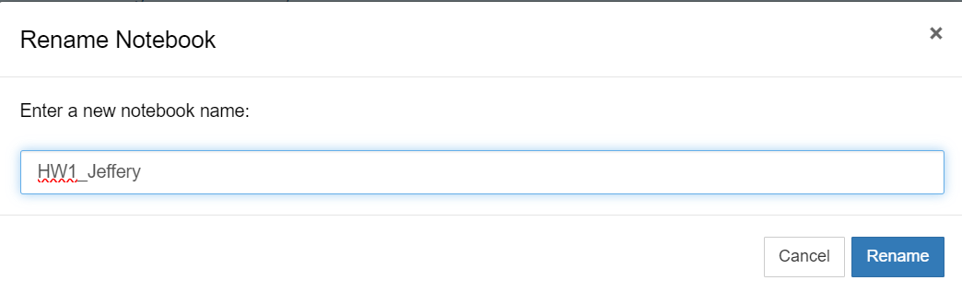
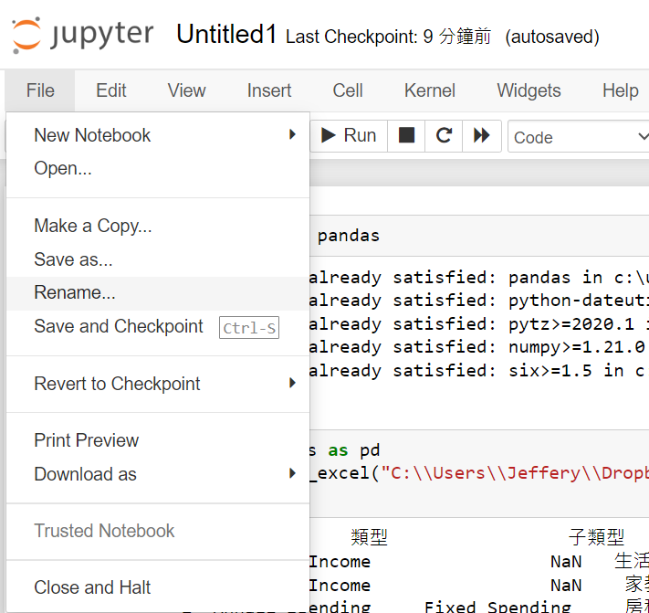
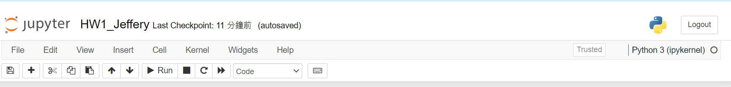
Hw1 計算底線 (Bottom Line) 或稱淨利
修改檔案名稱

Slide 44
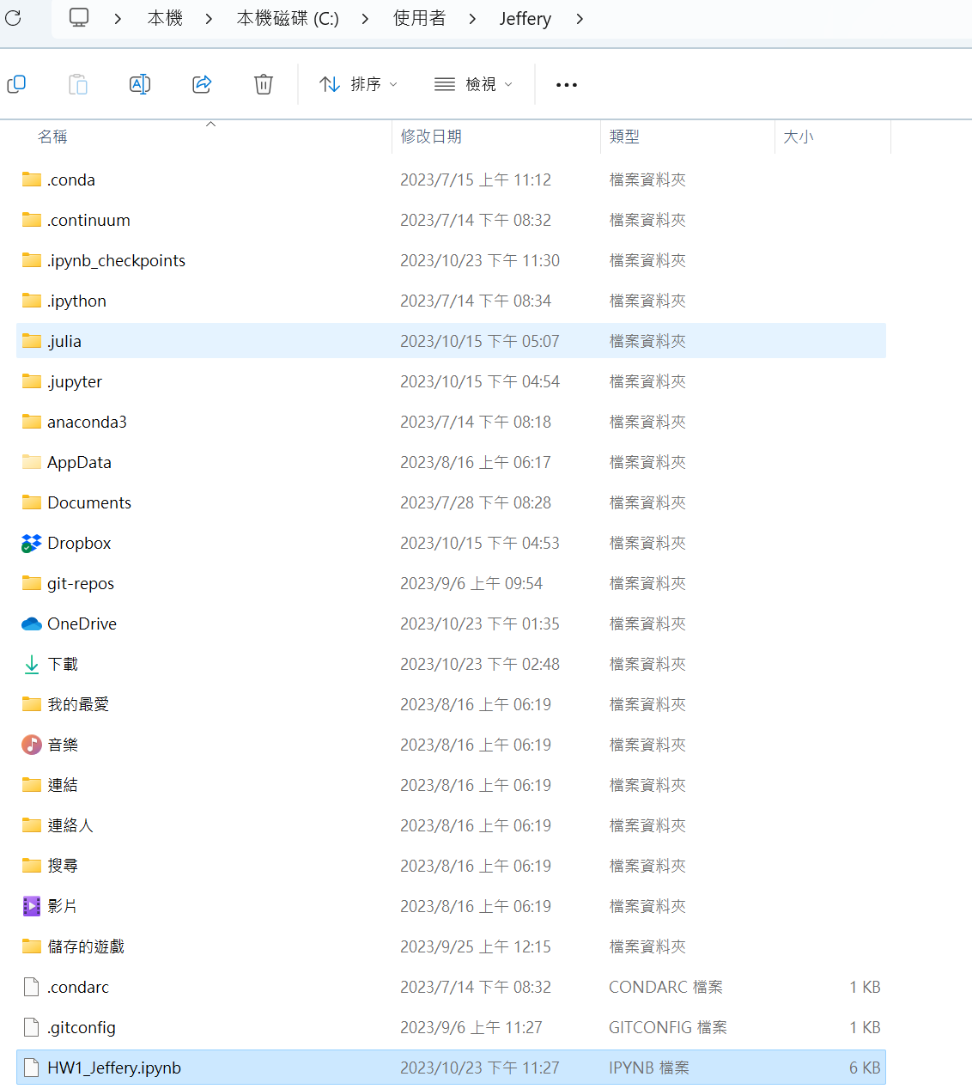
Hw計算底線 (Bottom Line) 或稱淨利
上傳TronClass
1. 程式運算結果的螢幕截圖
2. 程式碼檔上傳
3. 資料檔

Slide 45
Next week (12/3)
1. 試著在家裡安裝Anaconda!
2. GitHub
3. Obtain data from Yahoo! Finance

