Slide 1
HOW2 guide
Python as an alternative
to Excel

Slide 2
Why should you move away from excel?
Excel is not built with actuaries in mind
How can you be sure your formulae are correct?
Excel is computationally inefficient
Make your life easier through automation

Slide 3
“Reported error rates suggest that the confidence that is often placed in spreadsheets is misplaced. Studies consistently show error rates approaching 100% when measured by spreadsheets, or 10% when measured by unique formulae within each spreadsheet [Pryor A]. A recent study of project financing spreadsheets found errors in all 30 spreadsheets analysed, with up to 25% of unique formulae containing errors [Lawrence]. The error rates that are typically found are consistent with other data on human errors [Panko]. There is some evidence that better development practices, including rigorous code inspection, can help to reduce the number of errors.
Anecdotal evidence suggests that errors in spreadsheets can result in large monetary losses: for example, $24m (Canadian) because of a pasting error, $70m (US) due to a modelling error and $1.2bn down to “an honest mistake”.[Pryor B, Eusprig].”
Actuaries excel: but what about their software?
Other pertinent articles:
Several Reasons Excel Should Not Be Your Production-Level Actuarial System
Spreadsheets - the Ageing Actuary’s Friend
Python vs Excel
Pandas vs Excel
9 Reasons Excel Users Should Consider Learning Programming

Slide 4
A Brief Introduction to python syntax
PARAMETER
PASSING
def exampleFunction(actualVar1, actualVar2):
actualVar1 = actualVar1 + 2
print(“inside function: ” + str(actualVar1))
print(“inside function: ” + str(actualVar2))
return actualVar1
Calling the function
var1 = 1
var2 = 33
var3 = exampleFunction(var1, var2)
print(var1)
print(var2)
print(var3)
Output from the function
Inside function: 3
Inside function: 33
1
33
3

Slide 5
A Brief Introduction to python syntax
INDENTATION
exampleFunction(actualVar1, actualVar2):
actualVar1 = actualVar1 + 2
for i in range(3):
if (i / 2) == 1:
print(i)

Slide 6
A Brief Introduction to python syntax
# COMMENTS
# Single line comment
“““This is a
Multi-line comment”””

Slide 7
A Brief Introduction to python
VARIABLE NAMING CONVENTIONS
Be consistent
Be descriptive
Camel Case underwritingYear
Snake case
underwriting_year
Hungarian Notation
sUnderwritingYoA

Slide 8
How to program
Google things!
Other people will have likely had the same issues – Stack Overflow
Functions aren’t always intuitive - Refer to the documentation
Talk yourself through your code – understand what you are writing

Slide 9
Useful resources
18 Pandas Functions to Replace Excel with Python (and be happy forever)
Python Beginners Guide
Python Tutorial
Stack Overflow
Pandas User Guide
W3Schools Python Tutorial
W3Schools Pandas Tutorial

Slide 10
The how2 guide
A modular, and heavily commented step-by-step guide on how you would recreate triangles and graphs using pandas.
Pandas is a python package created for data manipulation and analysis.

Slide 11
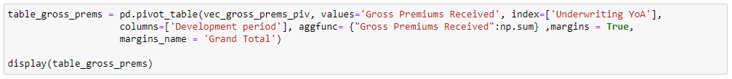
Triangles in Pandas
Built-in function to create pivot tables

Slide 12
Triangles in Pandas
The name of the DataFrame to retrieve data from
The name of the column to show values for
The column to be the index
Adds an extra row and column displaying totals
Sums up values with the same key (means we can have a total)
The values in this column will be the columns in the new pivot table

Slide 13
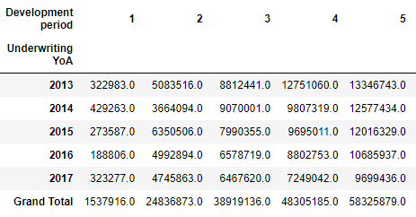
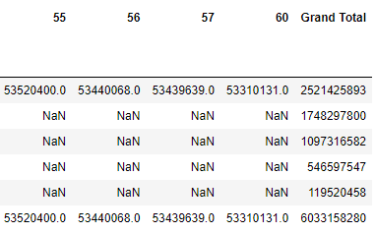
Triangles in Pandas

Slide 14
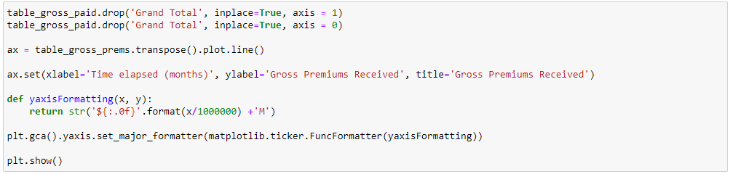
Graphs in pandas
Easily remove extraneous columns (we don’t want to plot the Totals)
Create the graph (transpose the DataFrame so the correct columns are plotted
Add titles to the graph
A function to improve the formatting of values on the y axis
Display the graph we plotted

Slide 15
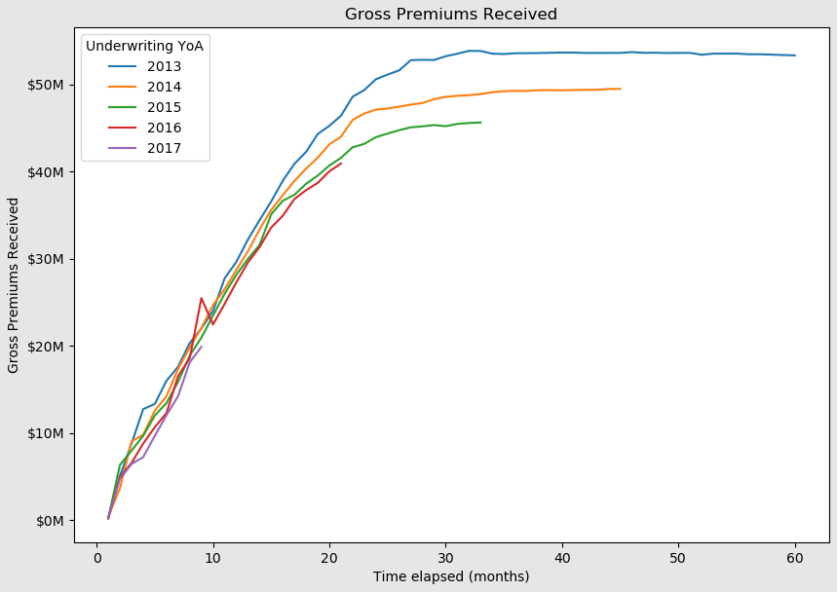
Graphs in pandas

