Slide 1
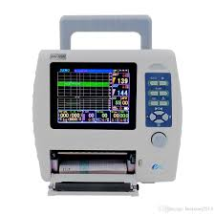
Cardiotocography
Evaluating fetal status to avoid surgical intervention
Firasath Ali Khan
ADM Project

Slide 2
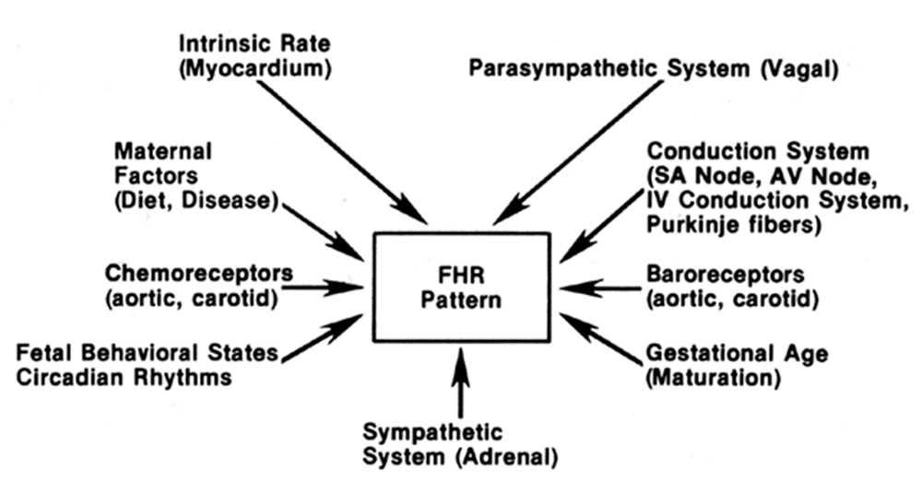
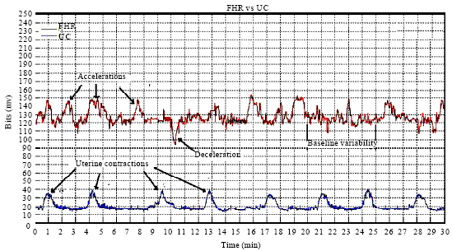
Introduction
It is the most common diagnostic technique to evaluate maternal and fetal well-being during pregnancy and before delivery.
Cardio - Fetal Heart beat.
Toco - Uterine contractions.
Graphy - Recording.

Slide 3
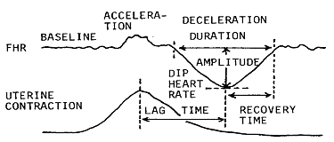
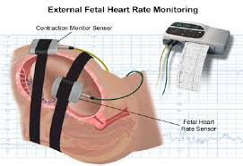
CARDIOTOCOGRAM
Device used to record cardiotocograph is called cardiotocogram (CTG).
The interpretation of the information provided by CTG is not standardized.
CTG is used to monitor uterine contractions and four fetal heart rate features:
- Baseline heart rate- Baseline abnormalities in the heart rate (Brady or Tachycardia).
- Variability.
- Accelerations and decelerations.
- Response to stimuli .

Slide 4
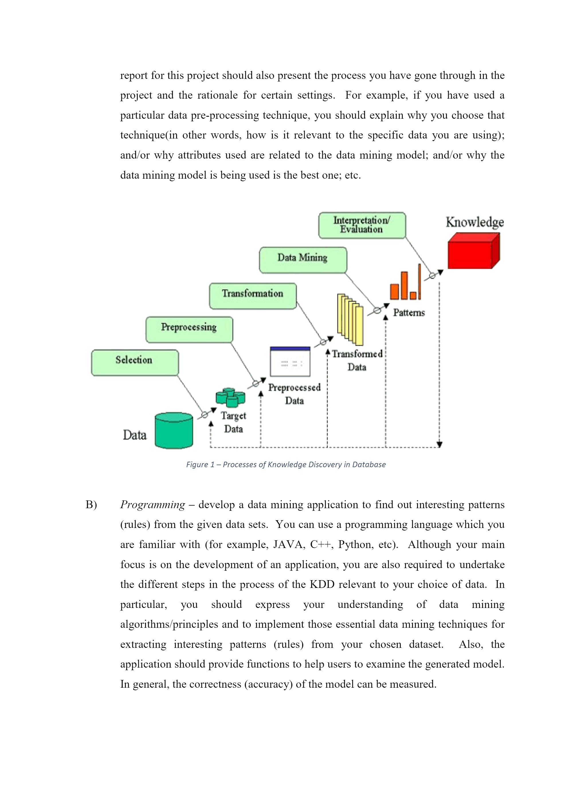
Steps USED to analyze data

Slide 5
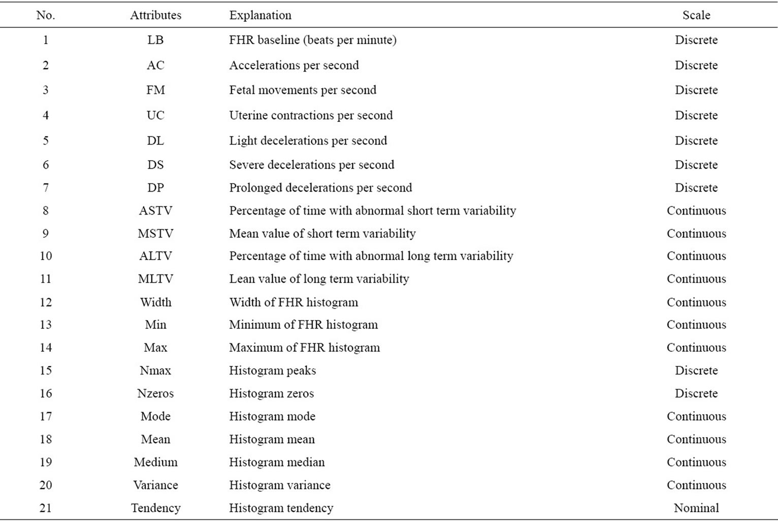
About the Data
Metrics considered by obstetricians for NSP classification
The dataset includes a total of 2126 samples and 40 attributes. The output was classified by 3 expert Obstetricians and a consensus classification label was assigned to each of them.
S.No | Class Values | Class Description
1 | N | Normal
2 | S | Suspect
3 | P | Pathological
Source: http://archive.ics.uci.edu/ml/datasets/Cardiotocography?iframe=true&width=100%&height=100%

Slide 6

Statement of the problem
An improper CTG measure could suggest possibility of having
to deliver through Caesarean section. Hence to ensure
accurate prediction of fetal well-being the CTG needs to be appropriately interpreted.
Abstract : Assessing cardiotocography is crucial in that it leads to identifying fetuses which suffer from lack of oxygen, i.e. hypoxia. This situation is defined as fetal distress and requires fetal intervention in order to prevent fetus death or other neurological disease caused by hypoxia.

Slide 7

Data Analysis
Data pre-processing: Removing variables such as date, filename, class , text etc.
Models Created:
Decision tree, Multinomial regression, Bagging and Randomforest

Slide 8
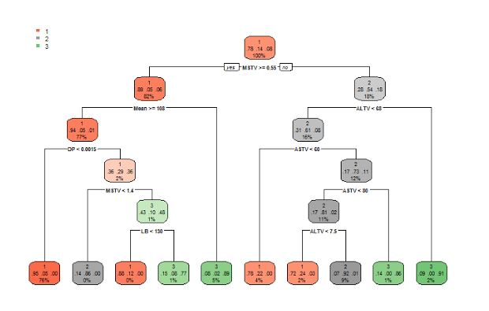
Decision Tree
After Pruning with cp value.
Validated using k-fold cross validation.

Slide 9
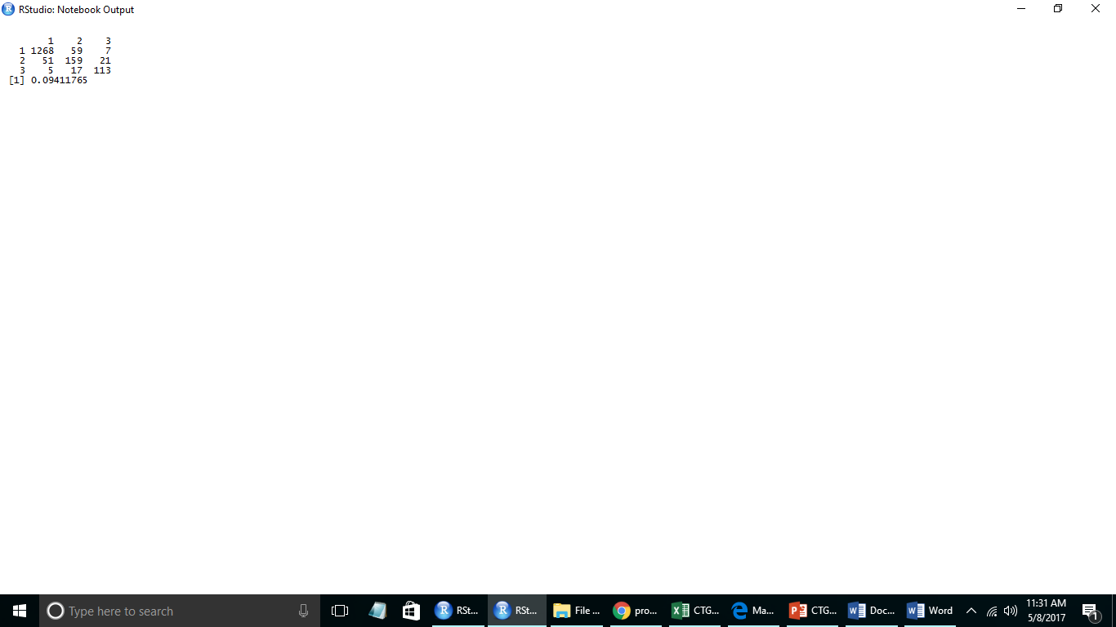
Multinomial regression
To predict the nominal output variables.
Misclassification error 9.4%

Slide 10
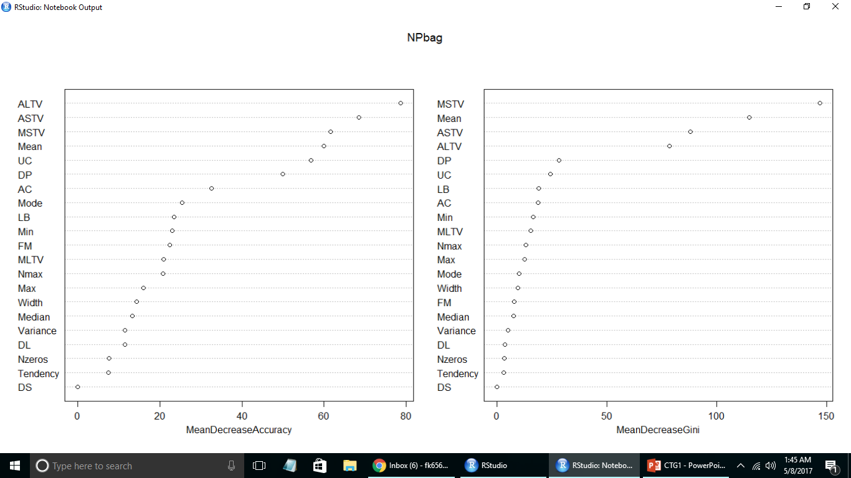
Bagging Model
I have taken all my Independent variables at each split.
Out of Bag error is 6.18%.

Slide 11
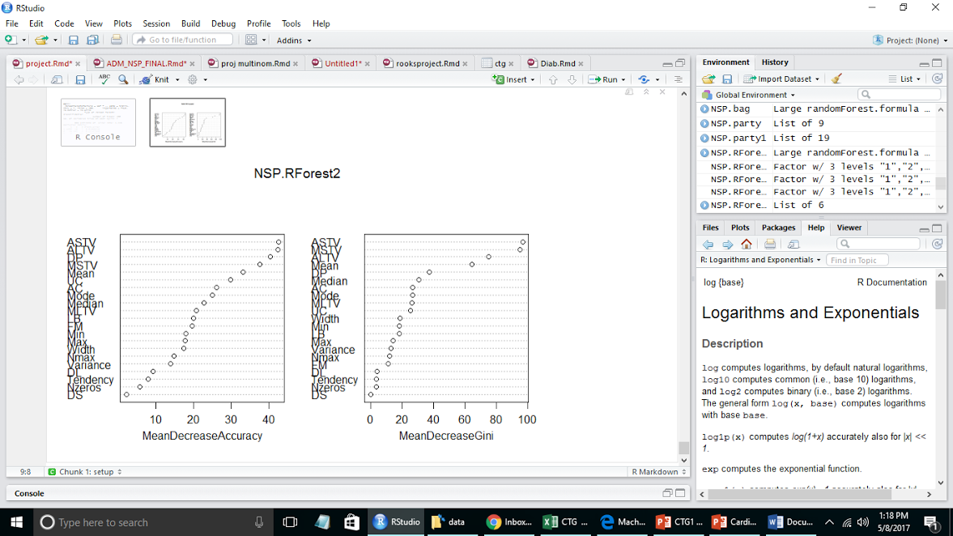
RandomForest
Tried different parameters when choosing for randomforest.
mtry - 3, 4, 6, 7 and
trees - 350, 400, 600 and 700.
Out of Bag error rate is 5.29%

Slide 12
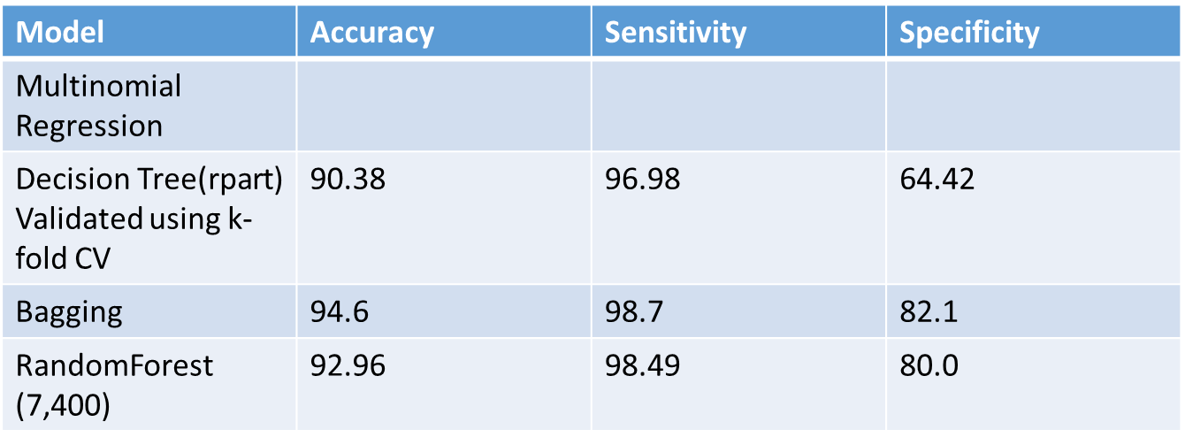
comparing Accuracy models

Slide 13

Preferred Model
Bagging Model

Slide 14
Recommendations
The correct determination of state of fetus is especially important for early intervention of required cases, i.e. fetal distress or preventing unnecessary surgeries.
Most people are often prone to make mistakes during analysis or, possibly, when trying to establish relationships between multiple features. This makes it difficult for them to find solutions to certain problems. The discussed models can be successfully applied to these problems.
These models can also aid in improving the efficiency of systems and the designs of machines.
Variables such as - Percentage of time with abnormally short and abnormally long term Variability (ASTV and ALTV), Uterine contractions (UC) are Important and Doctors need to be more careful when looking at their readings.

Slide 15


