Slide 1
Command line interface (CLI) introduction
Barcoding MSc course 2025

Slide 2
Introduction

Slide 3
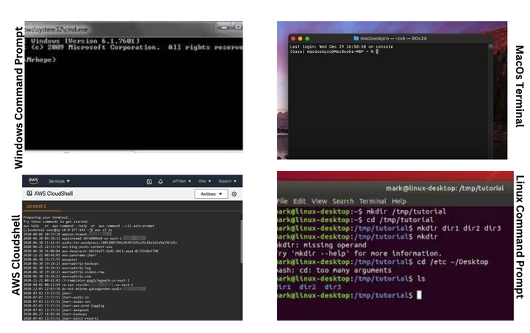
The basics
Early days of computer usage:
Interactions were done by using commands (words)
No way to visually navigate folder (no graphycal user interface – GUI available)
Aliases: command line prompt, terminal
Features: text based, every operation system (OS) has access to it
Interpreters: Bash, Zsh, PowerShell
source: freecodecamp.com

Slide 4
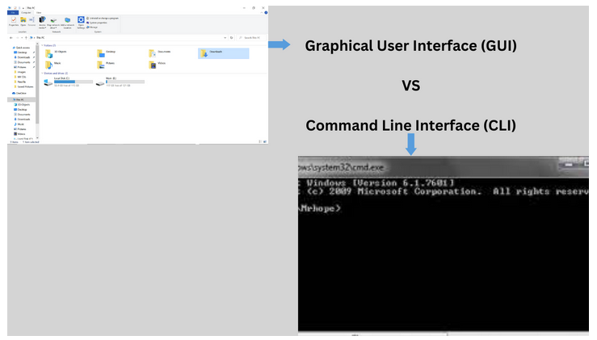
source: freecodecamp.com

Slide 5
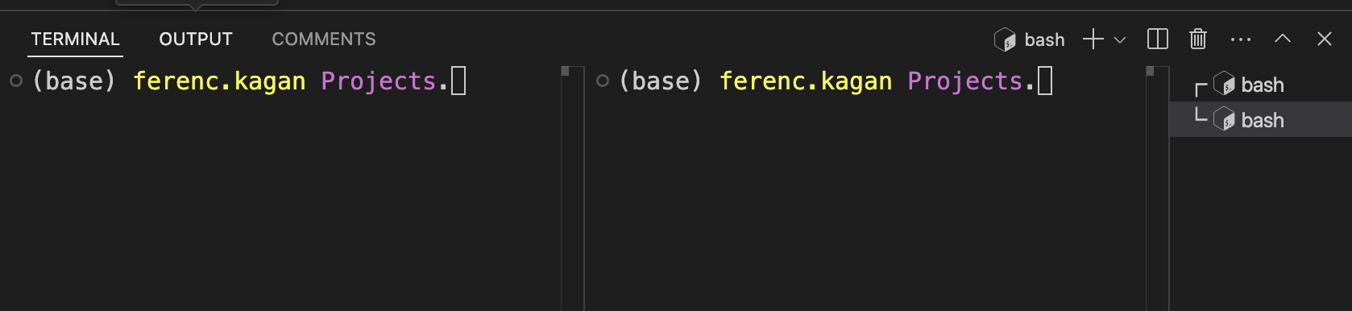
The basics
conda environment currently in use
prompt
user
current location
Tab 1
Tab 2

Slide 6
Shell good-to-knows
Shortcuts
Ctrl+r: Reverse search through your command history. Kinda like pushing the up arrow with search.
Ctrl+c: kill/interrupt the current running process.
Ctrl+d: Close your current terminal. Same as typing exit but way shorter.
Ctrl+a: Move the cursor to the beginning of the line
Ctrl+e: Move the cursor to the end of the line
Extensions
# Brace expansion
$echo sp{el,il,al}l
spell spill spall
# Glob patterns
*.txt # Match all txt files
sales202?.csv # Match this decade's sales data files

Slide 7
The basics
# Who is using the terminal?
whoami
# Where am I located?
pwd
# What is present in my current location?
ls
# Get help for command usage
man ls
General syntax of a command:
command [OPTIONS] arguments

Slide 8
The basics
Exercise:
Print out the content of your current location in a long format.
Add to it a print out in a human readable format (i.e. size of the file should be human readable).
Add to it a sorting according to time.
Hint: use the man

Slide 9
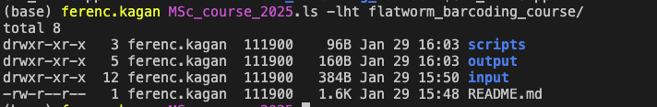
The basics
permissions
# links
user
group
size
date modified
name

Slide 10
Permissions
# Possible values for columns 1:
# - = file
# d = directory
# l = symbolic link
# Possible values for the rest:
# r = read
# w = write
# x = execute
-rw-r--r--
# Explanation:
# - = file
# rw- = read, write permission for owner
# r-- = read permission for group
# r-- = read permission for other

Slide 11
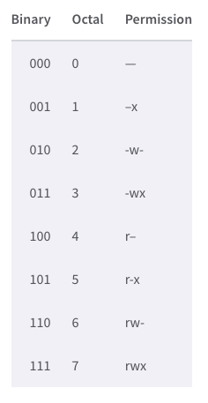
Changing permissions
# General usage of chmod
chmod WHO[+,-,=]PERMISSIONS FILENAME
# Example to add permission 1
chmod g+w,o-rw,a+x ~/example-file.txt
# Example to add permission 2
chmod 750 ~/example.txt
# Example to remove permission
chmod g-rx, o+rx example.txt
source: linode.com

Slide 12
Navigating the file system
# Where am I?
pwd
# Where could I go?
ls
# How can I move there?
cd input/
# Special cases
cd ~
# Searching function
find ./ -type f –name *.py # Find python scripts

Slide 13
Note on paths
# One can use absolute paths:
ls /Users/ferenc.kagan/Documents/Projects/
# Or one can use relative paths:
ls ../
ls ./
# One can combine multiple relative paths
ls ../../
# Root directory encoding
ls /
# Home directory encoding
ls ~
# Symbolic links
ln –s ~/example_file.txt ./

Slide 14
File handling
# Copying files or directories
cp ~/exmaple1.txt ./
cp ~/*.csv ../
cp –r ~/example_directory/ ./
# Moving and renaming files
mv ~/example1.txt ./
mv example1.txt example1_renamed.txt
mv ~/*.csv data/
mv –n example1.txt data/ # -n to prevent overwriting
# Removing files or directories
rm bad_file.txt
rm –r bad_directory/
# Creating files/directories
touch example1.txt
mkdir example_directory

Slide 15
File interactions – viewing whole file
# Print out file content in the terminal
cat example1.txt
# View file content interactively
less example1.txt
# Combine files
cat example1.txt example2.txt > combined.txt

Slide 16
File interactions – viewing parts of file
# View start/end of file
head –n10 example1.txt
tail –n10 example1.txt
# Filter rows of the file for viewing
grep “pattern to search” example1.txt
# Filter columns of the file for viewing
cut –f2 example1.tsv

Slide 17
File interactions – manipulating content
# Sort file content
sort example1.txt
sort –r example1.txt
# Remove duplicate rows
uniq example1.txt
# Replace text pattern
sed –i “s/toReplace/ReplacedText/g” example1.txt

Slide 18
Stiching commands together
# Redirecting output
head –n5 example1.txt > example1_head.txt
# Redirecting input
tail –n5 < example1.txt
# Combining redirections
head –n5 < example1.txt > example1_head.txt
# Stitching command together (piping)
head –n5 example1.txt | tail –n 1

Slide 19
Wrap up
Exercise:
Create new directory and copy your file there
Change working directory to you created directory
Remove original file
Rename new file
Filter rows from new file for “apple”
Reverse the filtering for “pie”
Extract only counts from the file and sort them, remove duplicates
Replace all bananas to apples

