Slide 1
BRITISH AIRWAYS
CUSTOMER RATINGS ANALYSIS AND INSIGHTS

Slide 2
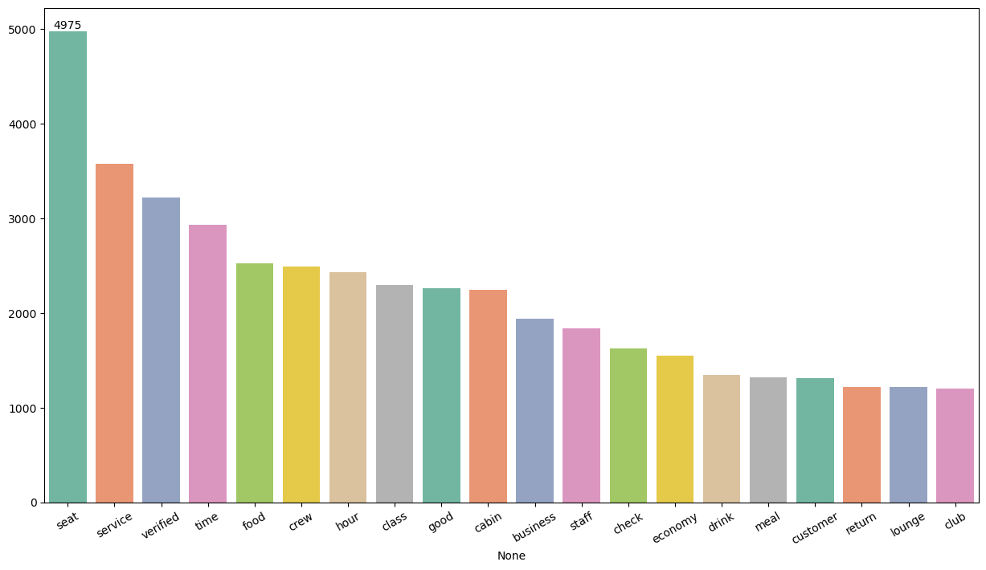
KEY METRICS
Rating: 4.44/10
Countries: 70
Total reviews: 4396
All customers liked cabin crew service and staff, general economy seats. Most of them travelled in business class.
Focus on – Economy class service, seats, enhance inflight entertainment experience and importantly delays. Enhance the experience of business class, it seems customers want value for money. Improve customer service on refund requests and process.

Slide 3
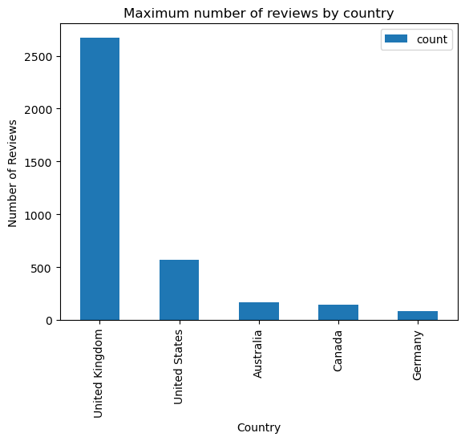
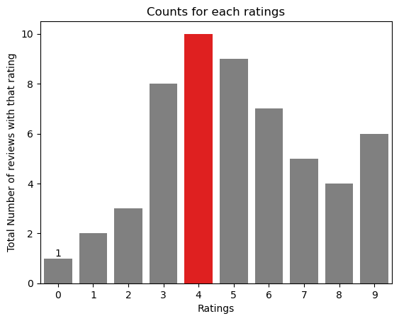
REVIEWS BY COUNTRIES

Slide 4
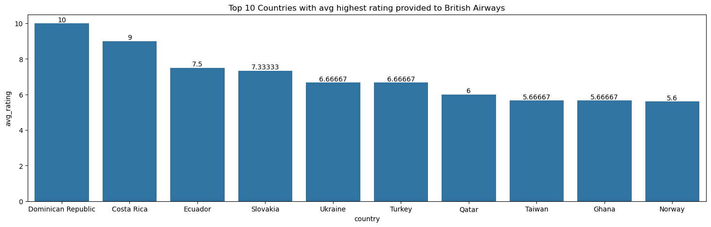
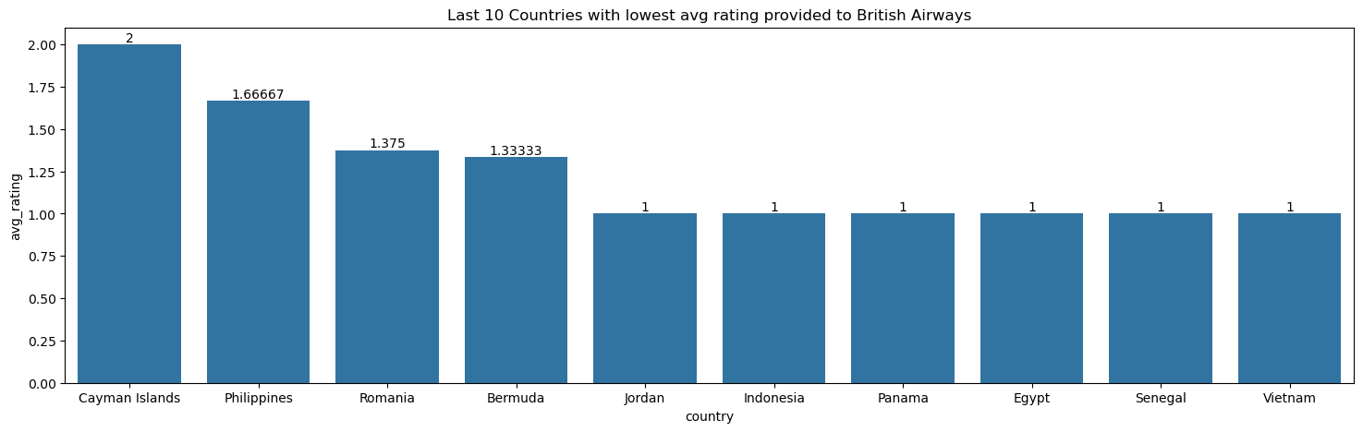
TOP 10 COUNTRIES WITH HIGHEST AND LOWEST RATING PROVIDED

Slide 5
WHAT CUSTOMERS ARE HAPPY AND UNSATISFIED ABOUT
(BY RATING CLASSES)
7-10 ratings:
Comfortable seats, good inflight entertainment, descent food quality.
4-6 ratings:
Small entertainment screen, long passport check queue, bad business class experience.
1-3 ratings:
Congested middle seat and small screen while they liked the seats and the food.

