Slide 1
BRITISH AIRWAYS
PREDICTIVE MODEL

Slide 2
PREDICTIVE MODEL RESULTS
Recall Rate: 60%
Precision: 61%
Accuracy: 62%
Chance of predicting true successful bookings.
Will be predicted as actually completed bookings out of all successfully completed bookings.
Accuracy of the model predicting successful or incomplete booking.
66% Chance of predicting true incomplete bookings correctly.
We are concerned with not predicting the successful bookings correctly. Imbalance dataset drives higher accuracy but it does not accurately predict the successful bookings.
Dataset was balanced with 8k labelled as incomplete bookings and 7k as complete bookings.

Slide 3
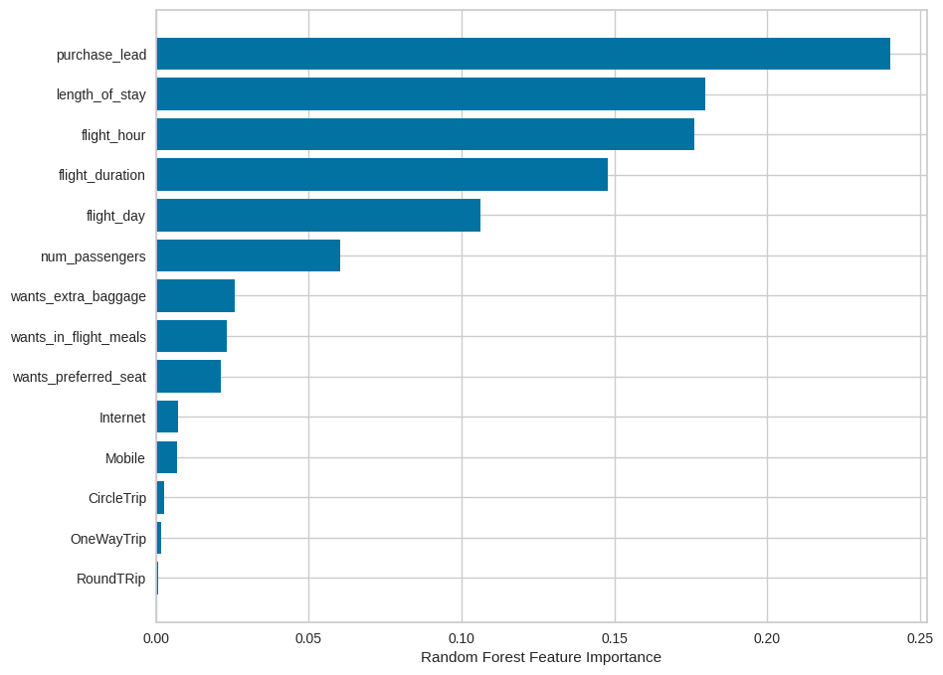
PREDICTIVE MODEL RESULTS
Top features that can drive successful flight bookings.

