Slide 1
Numerical Interpretation
Numerical Integration
18011680 박성준
18011690 이정안

Slide 2
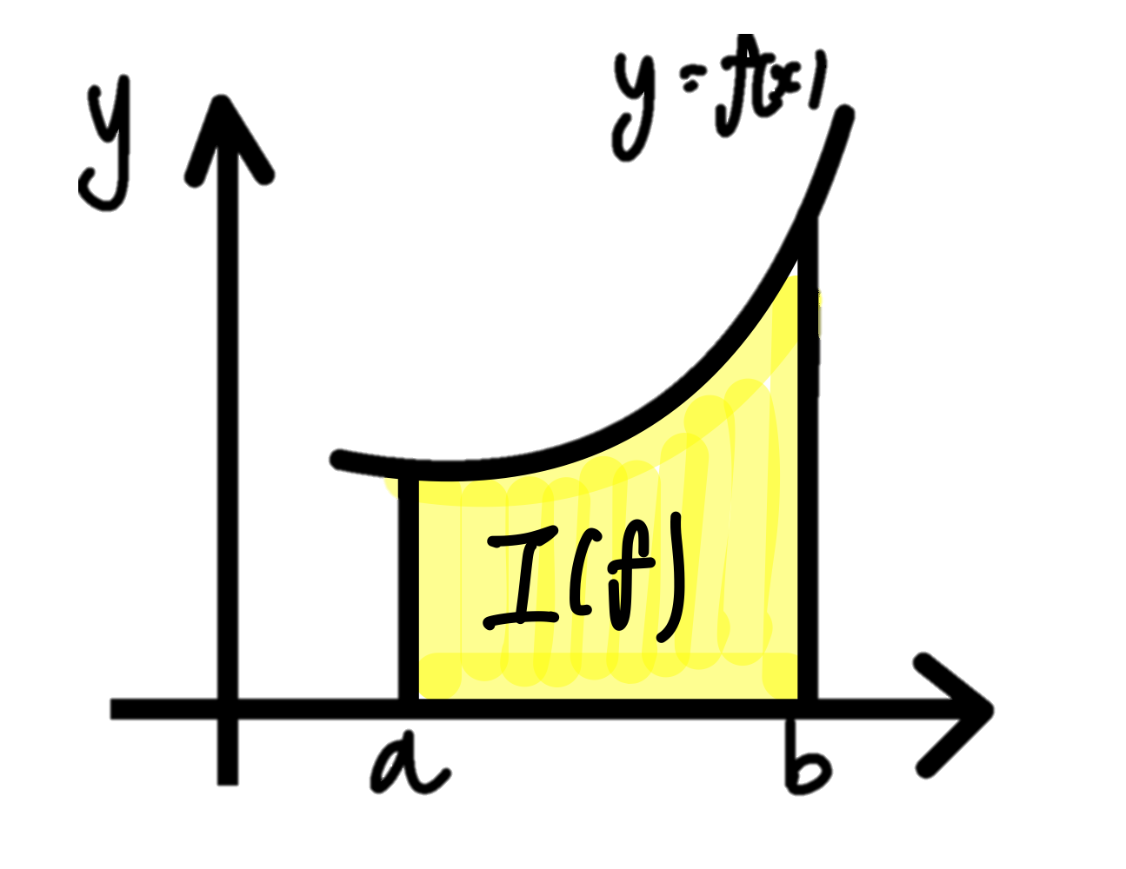
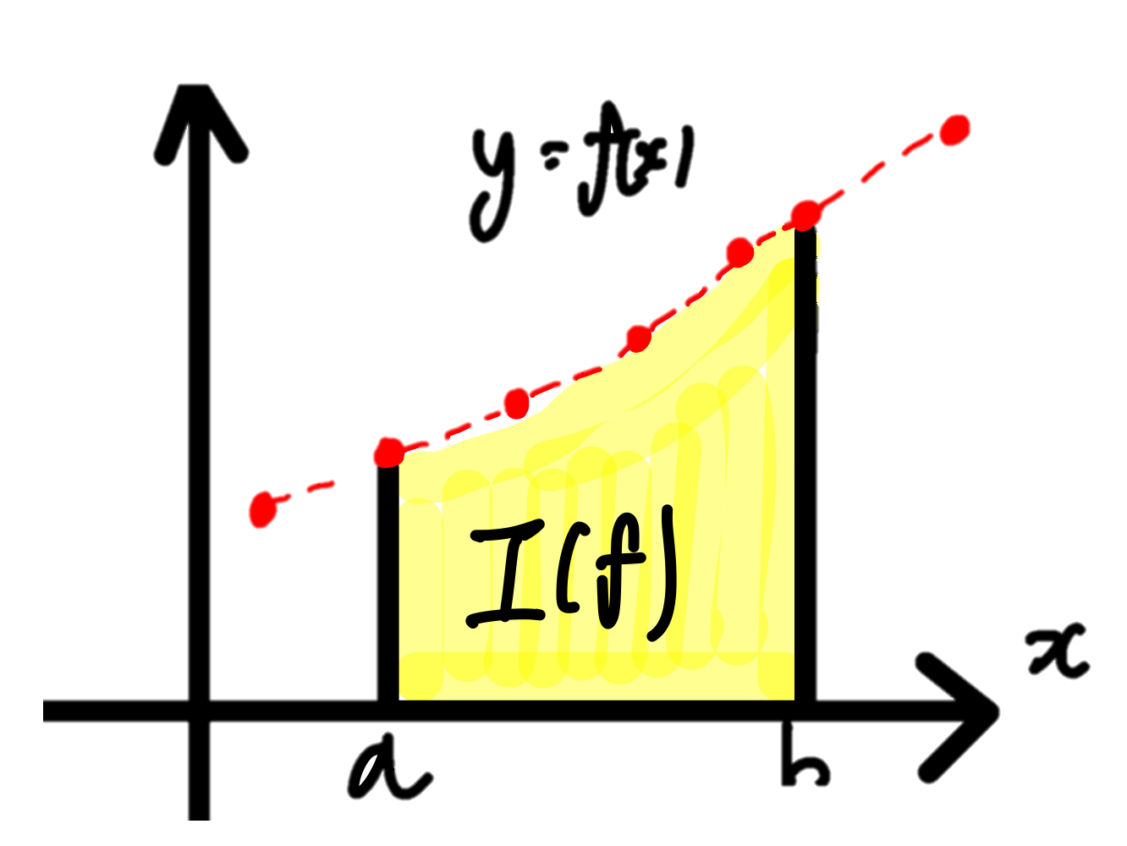
Why use numerical integration?
Discrete real-world data obtained through experiments or observations is often challenging to analytically integrate due to its complexity.
As a result, numerical integration is used to approximate the integral and obtain an estimation, providing a practical solution despite not yielding exact values.

Slide 3
There are two parts of numerical integration
Newton-cotes formulas
Gaussian Quadrature

Slide 4
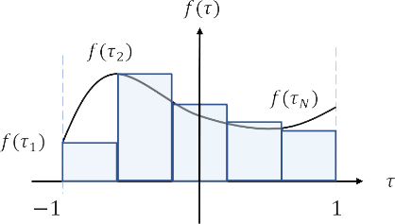
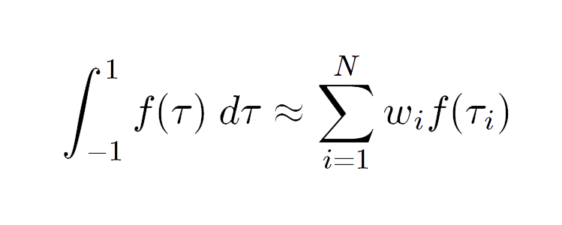
Gaussian Quadrature
It is a numerical integration method that calculates the weighted sum of function values over a specific interval

Slide 5
Newton-cotes formulas
Trapezoid Rule
Newton-cotes closed formulas
Simpson Rule
Newton-cotes closed formulas
Mid-point Rule
Newton-cotes open formulas

Slide 6
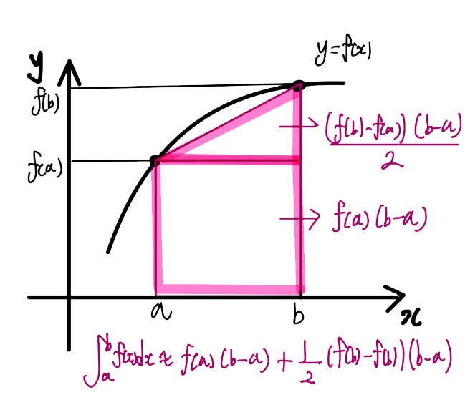
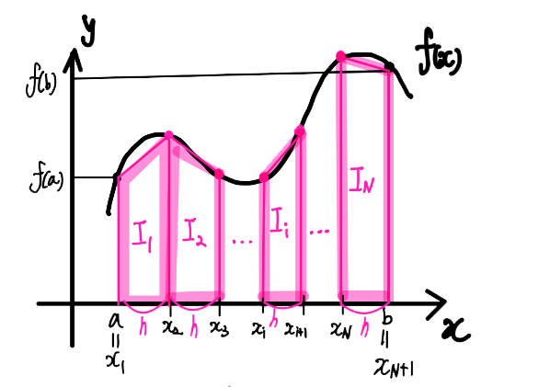
Trapezoid Rule
Explanation
The method involves integrating the area under the function that is formed by connecting two points with a linear interpolating polynomial, which is a first-degree polynomial.
To reduce errors, the integration interval is divided into smaller segments for calculation. This is known as the composite trapezoidal rule.

Slide 7
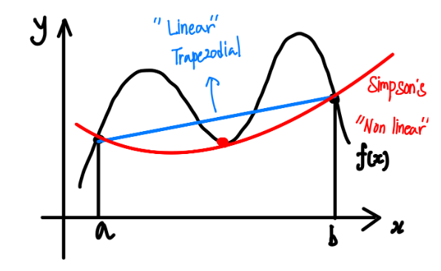
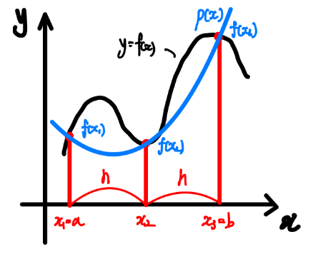
Simpson Rule
Explanation
The method involves integrating the area under the function that is formed by connecting points with a quadratic or cubic interpolating polynomial, which are second-degree or third-degree polynomials, respectively.
Numerical integration based on second-degree interpolating polynomials is called Simpson's 1/3 rule, while numerical integration based on third-degree interpolating polynomials is referred to as Simpson's 3/8 rule.

Slide 8
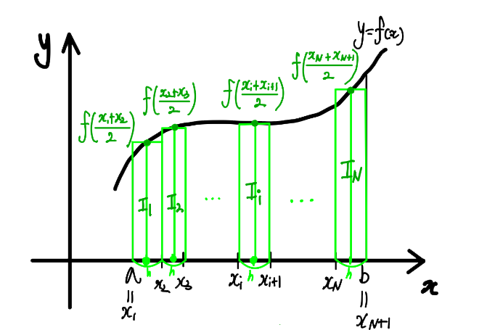
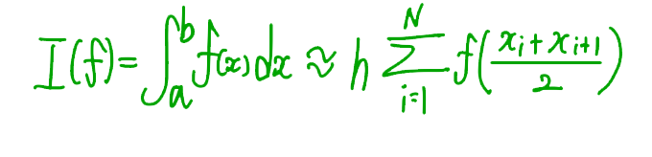
Mid-point Rule
Explanation
The method involves calculating the area of rectangles formed by using the function values at the midpoints of each interval as the height, without considering the function values at the left and right endpoints.

Slide 9
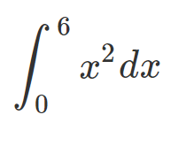
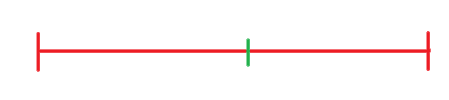
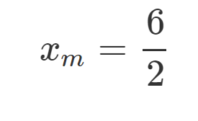
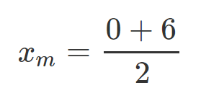




Question: Using the mid-point rule to approximate the integral
Example
0
6
Solution: by mid-point rule, we have
Exact value = 72

Slide 10







Question: Using the mid-point rule to approximate the integral
Example
Two point formula
Solution: by mid-point rule, we have

Slide 11
END

