Slide 1
Persistent Data Structures &
Finger Trees
Fun Club / Haskell User Group – Dec 13th, 2012
Frederic Kettelhoit

Slide 2
Functional Data Structures
Functional languages emphasize immutablity
  We cannot just update data structures in place
  Return a new version after every change
  We could copy the whole data structure every time
    Very inefficient

Slide 3
Persistent Data Structures
When modified: preserve previous versions
  immutable, always return new versions
Re-use unchanged parts of the old version
Example: (Singly) linked lists

Slide 4
Linked Lists

Slide 5
Linked Lists

Slide 6
Doubly Linked List
Persistent?

Slide 7
Doubly Linked List
Not persistent!

Slide 8
Finger Trees
Many properties of doubly linked lists
  cons/head/tail on both sides (deque)
Customizable through monoids, can act as:
  Random Access Sequence, Max-Priority Queue, Sorted Set, ...
Good upper bounds for most operations
Persistent

Slide 9
Upper Bounds
head/tail in amortized time O(1)
  left and right
cons/snoc in amortized time O(1)
concat in time O(log (min m n))
split in time O(log (min m n))

Slide 10
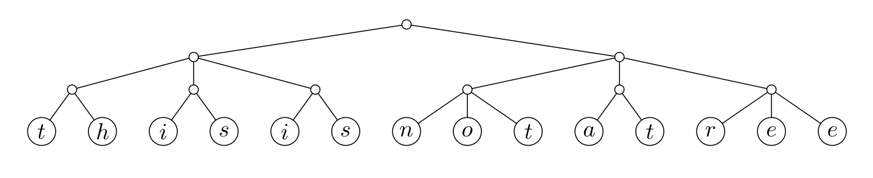
2-3 Tree

Slide 11
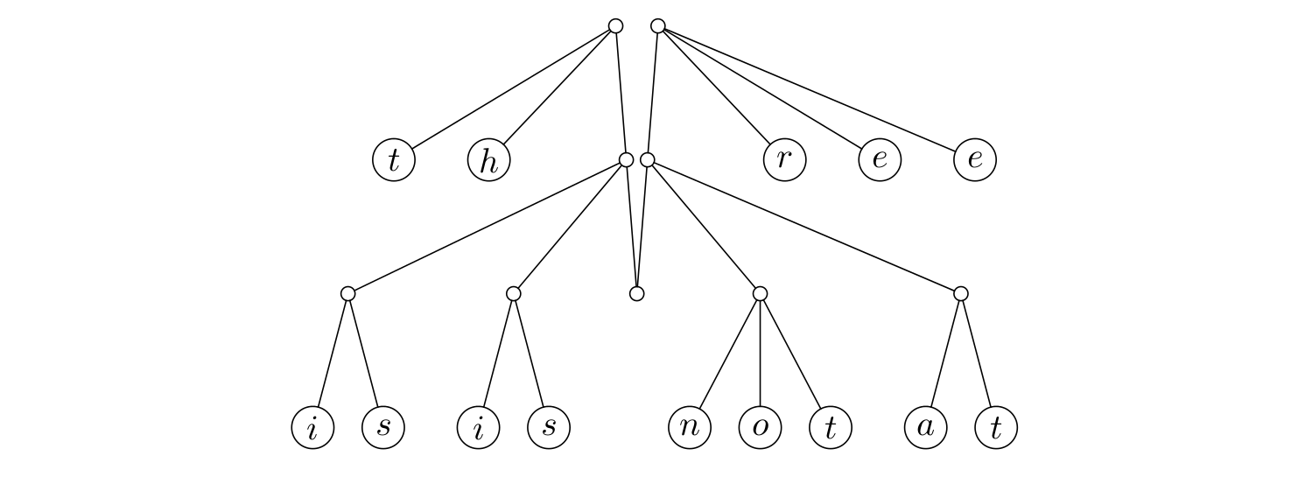
2-3 Finger Tree

Slide 12
Finger Trees in Haskell
data FingerTree a = Empty
| Single a
| Deep (Digit a) (FingerTree (Node a)) (Digit a)
type Digit a = One a
| Two a a
| Three a a a
| Four a a a a
data Node a = Node2 a a
| Node3 a a a

Slide 13
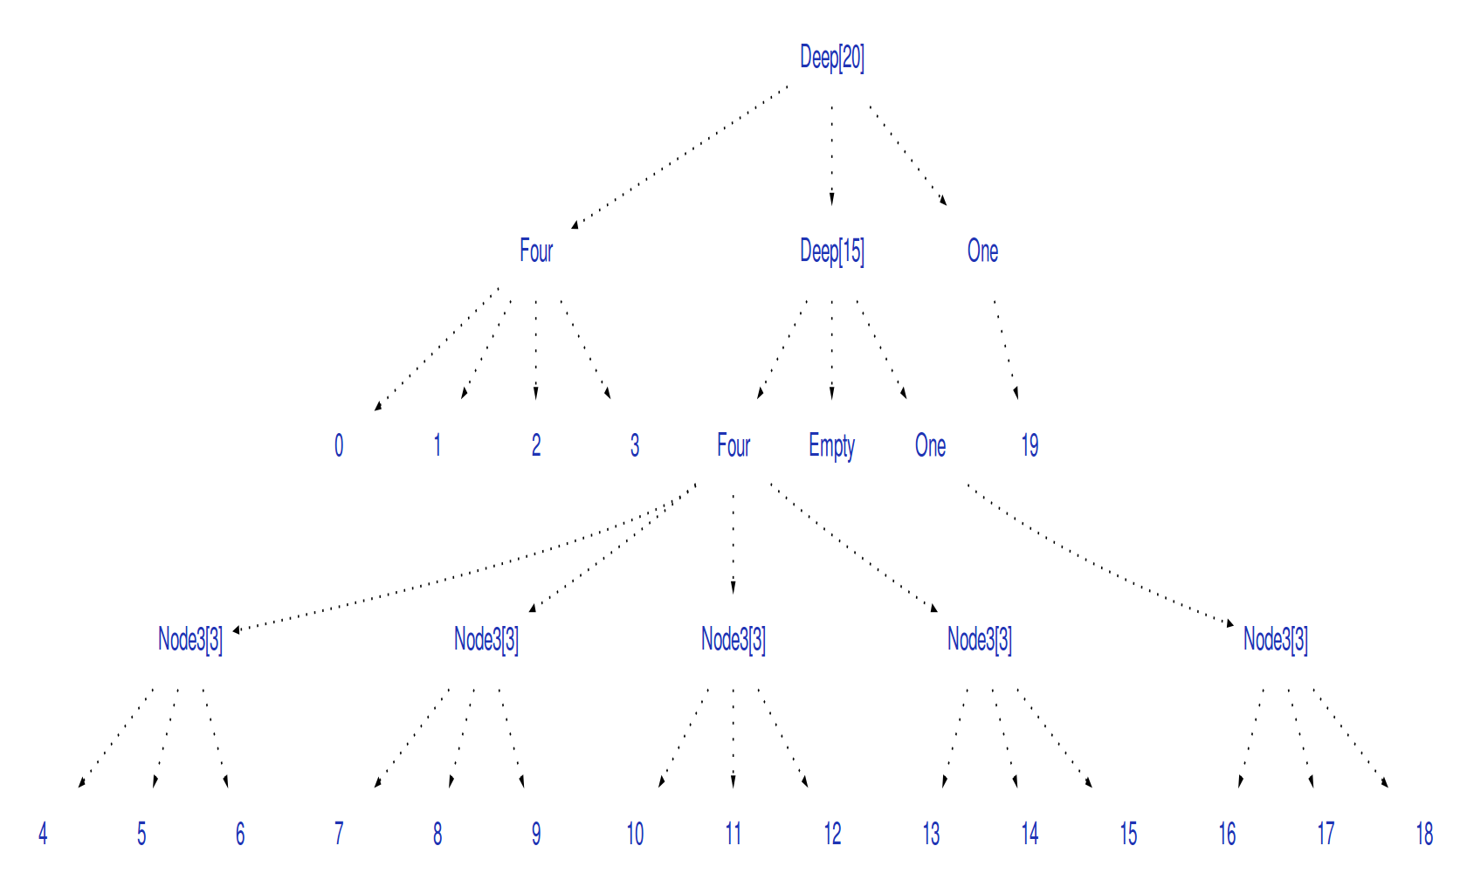

Slide 14
cons
cons :: a -> FingerTree a -> FingerTree a
cons a Empty = Single a
cons a (Single b) = Deep (One a) Empty (One b)
cons a (Deep (One b) m sf) = Deep (Two a b) m sf
cons a (Deep (Two b c) m sf) = Deep (Three a b c) m sf
cons a (Deep (Three b c d) m sf) = Deep (Four a b c d) m sf
cons a (Deep (Four b c d e) m sf)
= Deep (Two a b) (cons (Node3 c d e) m) sf
O(log n) worst case, O(1) amortized
One, Two Three: Safe
Four: Dangerous
(for the other side everything is simply swapped)

Slide 16
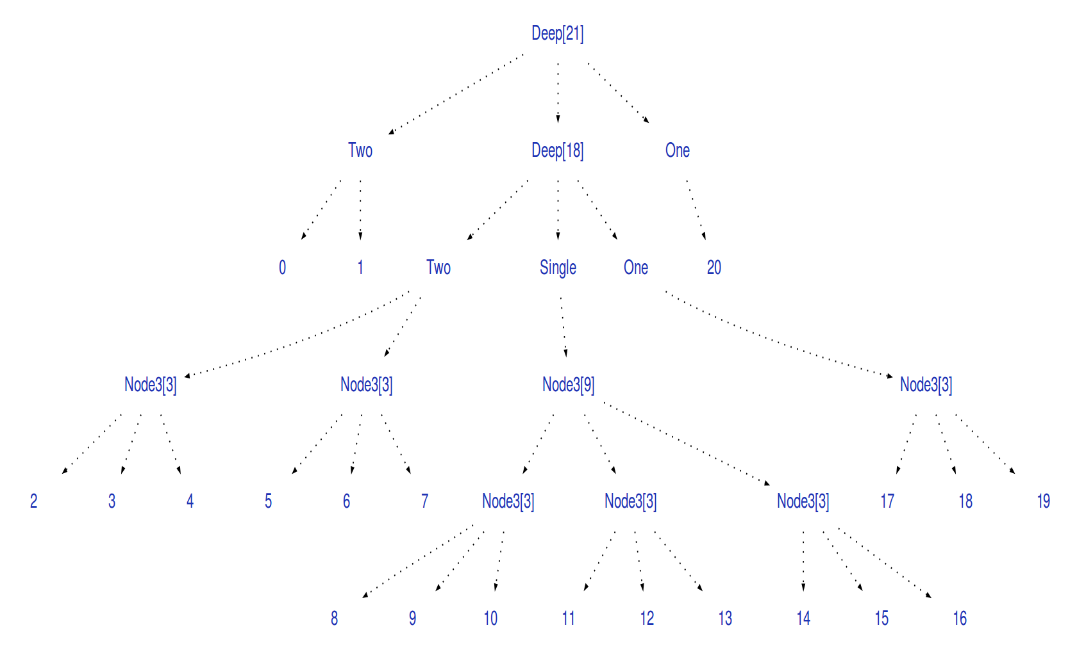

Slide 17
concat
app3 :: FingerTree a -> [a] -> FingerTree a -> FingerTree a
app3 Empty ts xs = cons' ts xs
app3 xs ts empty = snoc' xs ts
app3 (Single x) ts xs = cons x (cons' ts xs)
app3 xs ts (Single x) = snoc (snoc' xs ts) x
app3 (Deep pr1 m1 sf1) ts (Deep pr2 m2 sf2)
= Deep pr1 (app3 m1 (nodes sf1 ++ ts ++ pr2) m2) sf2
nodes :: [a] -> [Node a]
nodes [a, b] = [Node2 a b]
nodes [a, b, c] = [Node3 a b c]
nodes [a, b, c, d] = [Node2 a b, Node2 c d]
nodes (a : b : c : xs) = Node3 a b c : nodes xs
concat :: FingerTree a -> FingerTree a -> FingerTree a
concat xs ys = app3 xs [] ys
concat in Zeit O(log (min m n))

Slide 18
Customization using Monoids
A Monoid is a structure with 2 operations
Monoid Law:
And for the non-Category Theorists:
  (Monoid = binary associative operation + identity)
  For example: + and 0
Finger Trees can be customized using Monoids
mempty :: a
mappend :: a -> a -> a
mappend mempty x = x
mappend x mempty = x
mappend x (mappend y z) = mappend (mappend x y) z

Slide 19
Customization using Monoids
Every node contains an additional Monoid annotation with the value:
  Empty = Identity of Monoid
  Single a = ||a||
  Deep pr m sf = mappend (mappend ||pr|| ||m||) ||sf||
Example: Size Monoid
  Empty = 0
  Single a = ||a|| = (1 for primitive elements)
  Deep pr m sf = ||pr|| + ||m|| + ||sf|| (number of elements in the tree)

Slide 20
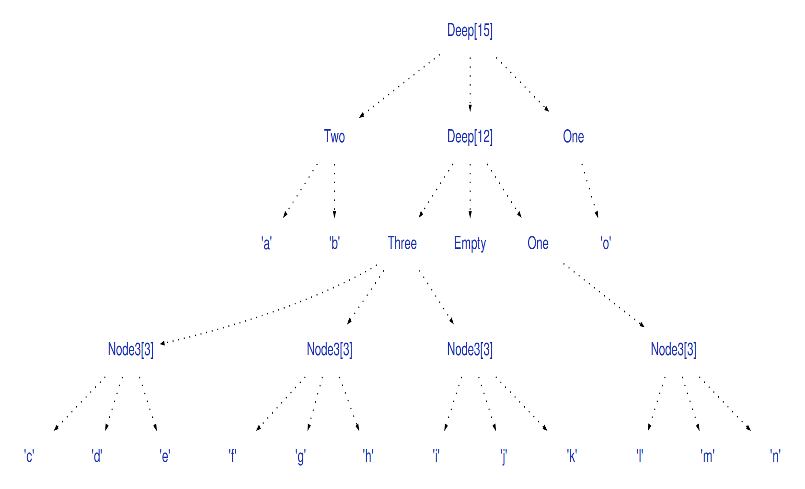

Slide 23
0

Slide 24
0

Slide 25
0

Slide 26
0
1

Slide 27
0
1

Slide 28
0
1

Slide 29
0
1

Slide 30
13
0
1

Slide 31
13
0
1

Slide 32
13
0
1

Slide 33
13
0
1
4

Slide 34
13
0
1
4

Slide 35
13
0
1
4

Slide 36
13
0
1
4
7

Slide 37
13
0
1
4
7

Slide 38
13
0
1
4
7

Slide 39
13
0
1
4
7
10

Slide 40
13
0
1
4
7
10

Slide 41
13
0
1
4
7
10
8

Slide 42
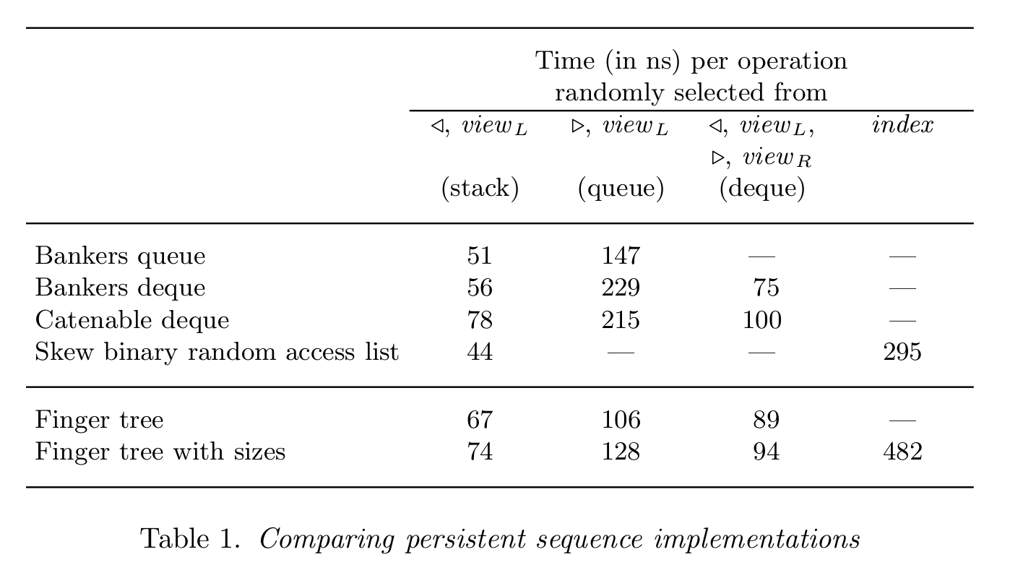
Finger Trees in Comparison

Slide 43
Resources
The original paper:
  http://www.soi.city.ac.uk/~ross/papers/FingerTree.html
Finger Trees in Haskell:
  http://www.haskell.org/ghc/docs/latest/html/libraries/containers/Data-Sequence.html
Finger Trees in Clojure:
  https://github.com/clojure/data.finger-tree

