Slide 1
REDE
CPqD
192.168.3.2
REDE SIMULADOR
192.168.3.1
192.168.11.1
192.168.13.1
192.168.13.2
192.168.10.1
192.168.10.2
192.168.11.2
R1
R2
R5
R6
1/1
1/0
2/0
1/0
2/0
1/0
192.168.5.1
2/0
1/1
192.168.9.1
1/1
192.168.12.1
1/1
192.168.4.240
192.168.7.1
192.168.4.241
192.168.4.244
192.168.4.246
192.168.5.2
192.168.4.242
192.168.7.2
192.168.4.243
192.168.9.2
192.168.4.245
192.168.12.2
192.168.4.247
1/0
1/0
1/0
1/1
R3
1/1
1/1
R4
1/1
R7
2/0
1/0
R8
2/1
192.168.6.1
192.168.6.2
192.168.15.1
192.168.8.1
192.168.8.2
192.168.14.1
192.168.14.2
1/0
192.168.15.2
1/1
192.168.4.248
R9
1/1
R10
192.168.4.250
192.168.16.1
2/0
192.168.17.1
192.168.17.2
192.168.16.2
1/0
R11
Endereço loopback
192.168.4.249
Endereço rede

Slide 2
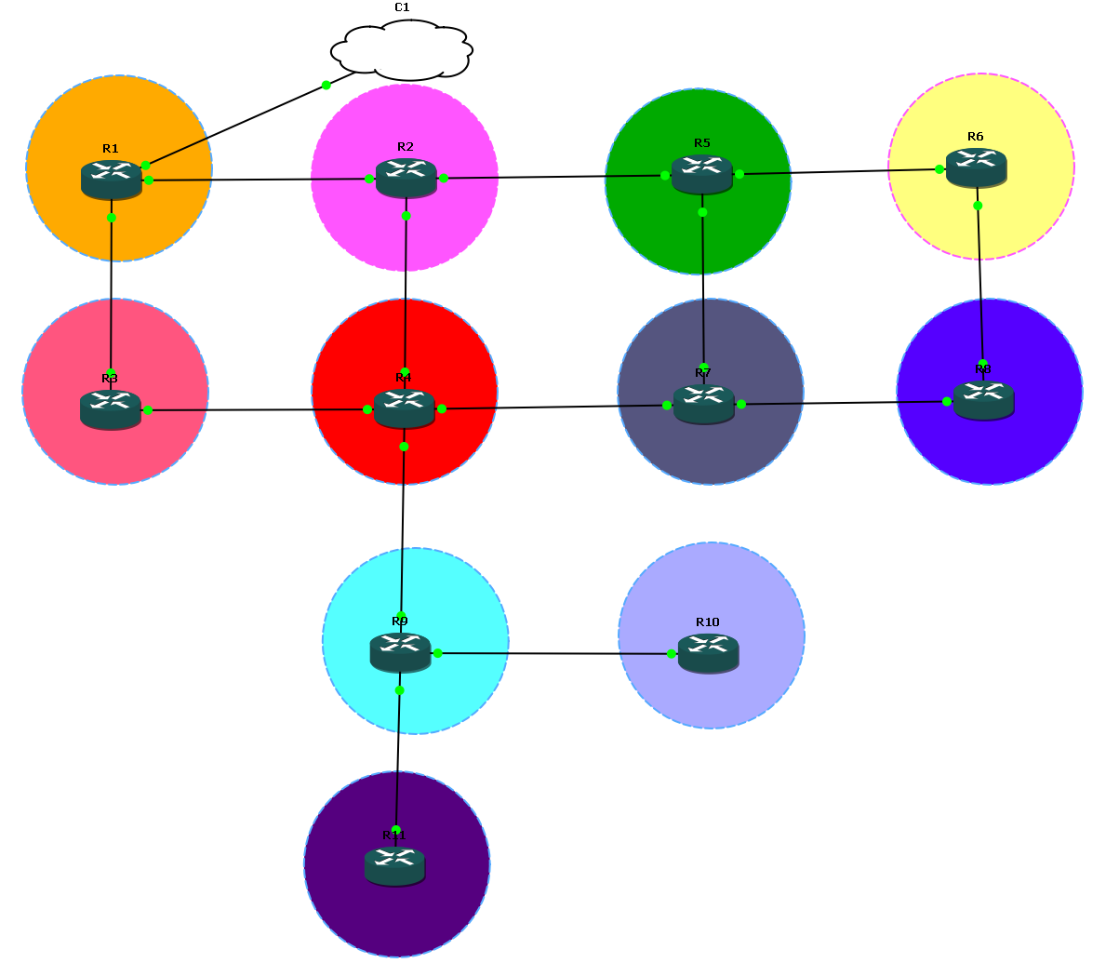
Rede no simulador GNS3

