Slide 1
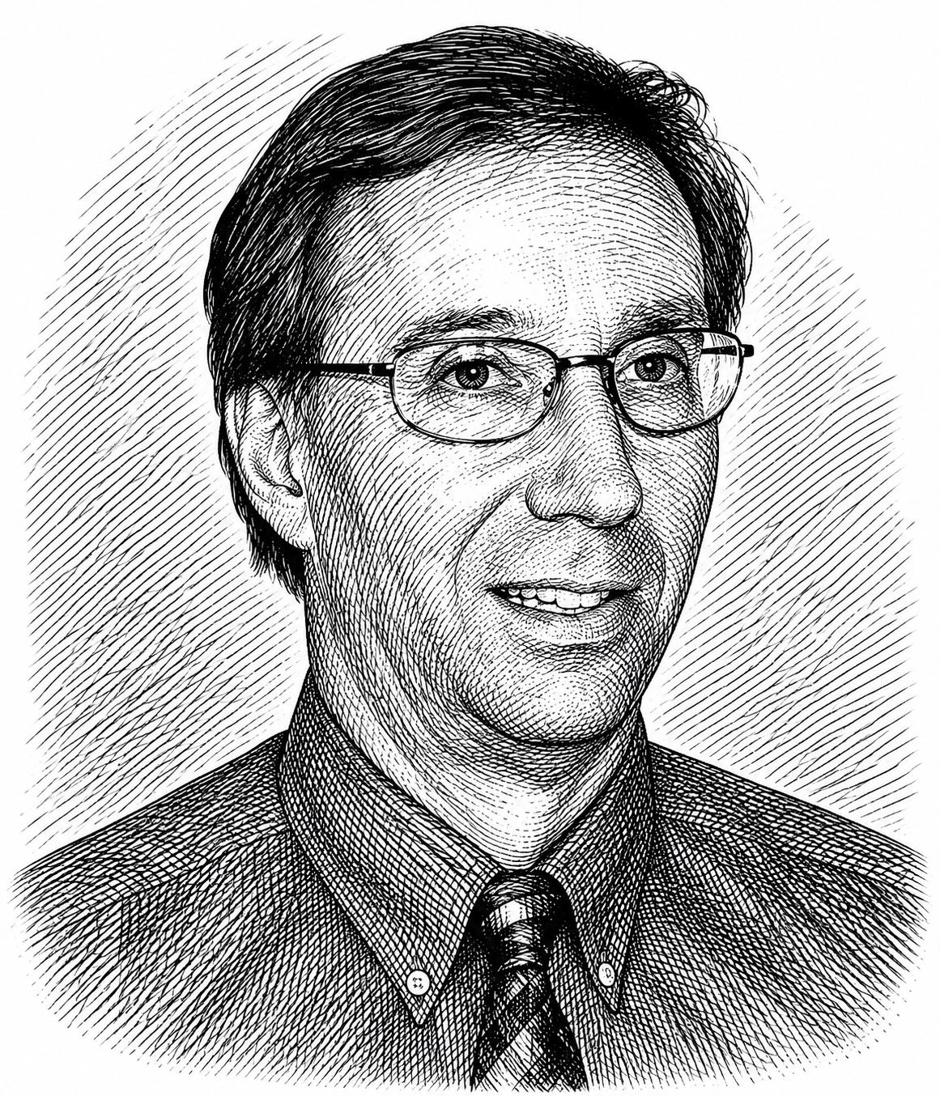

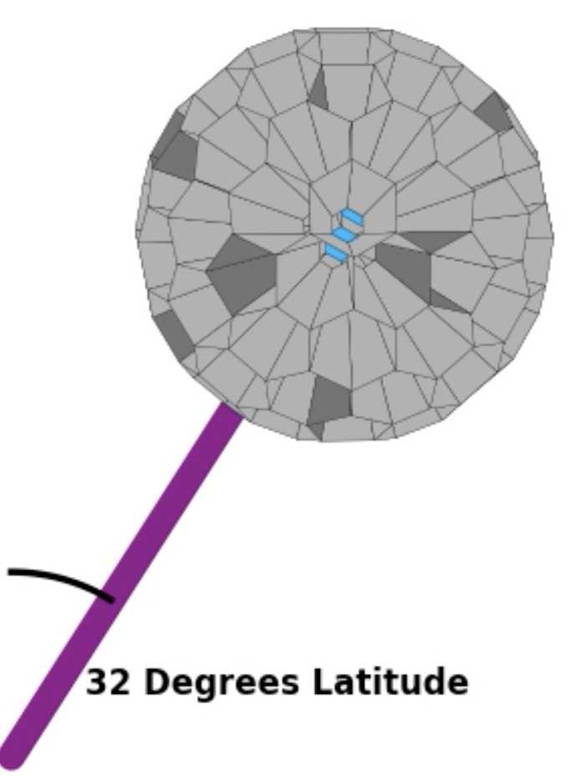
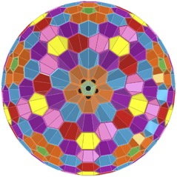
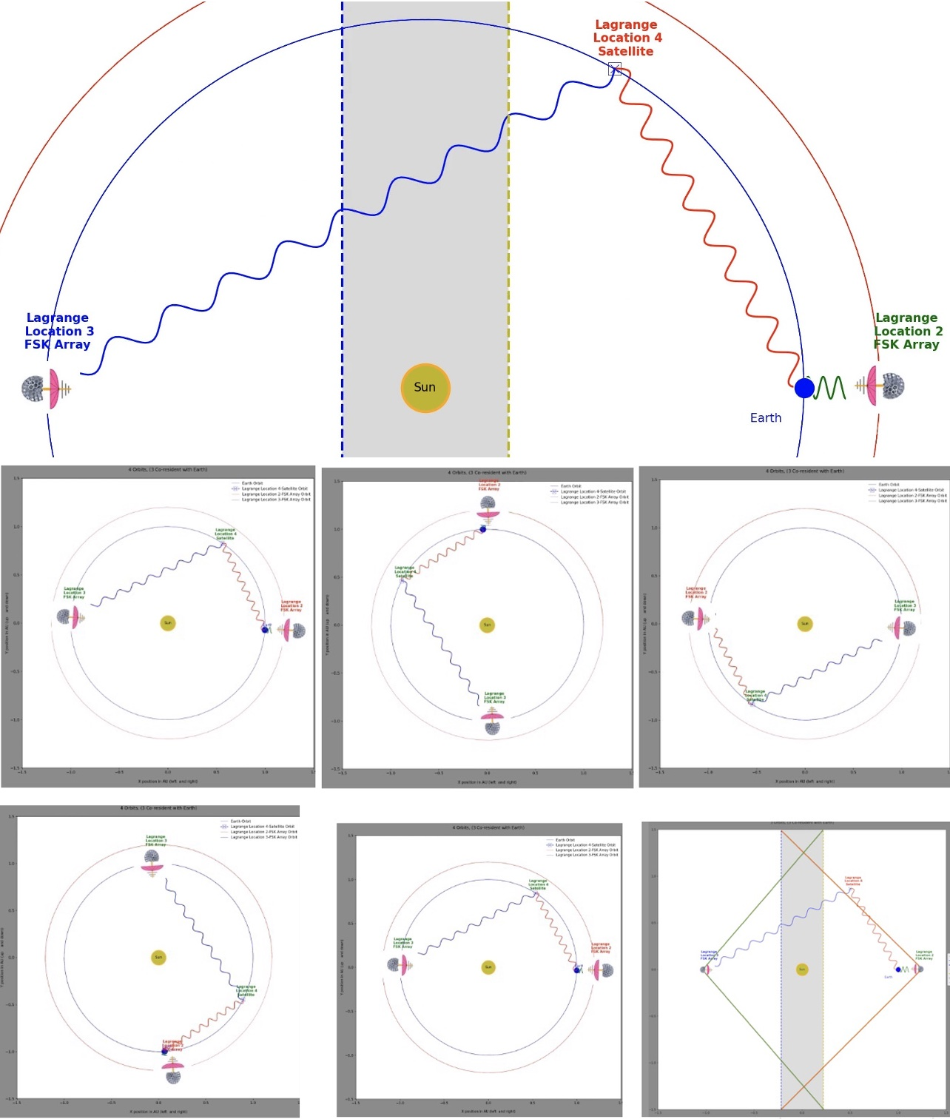
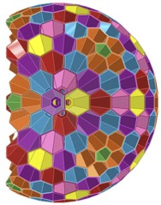
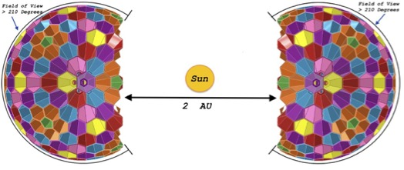

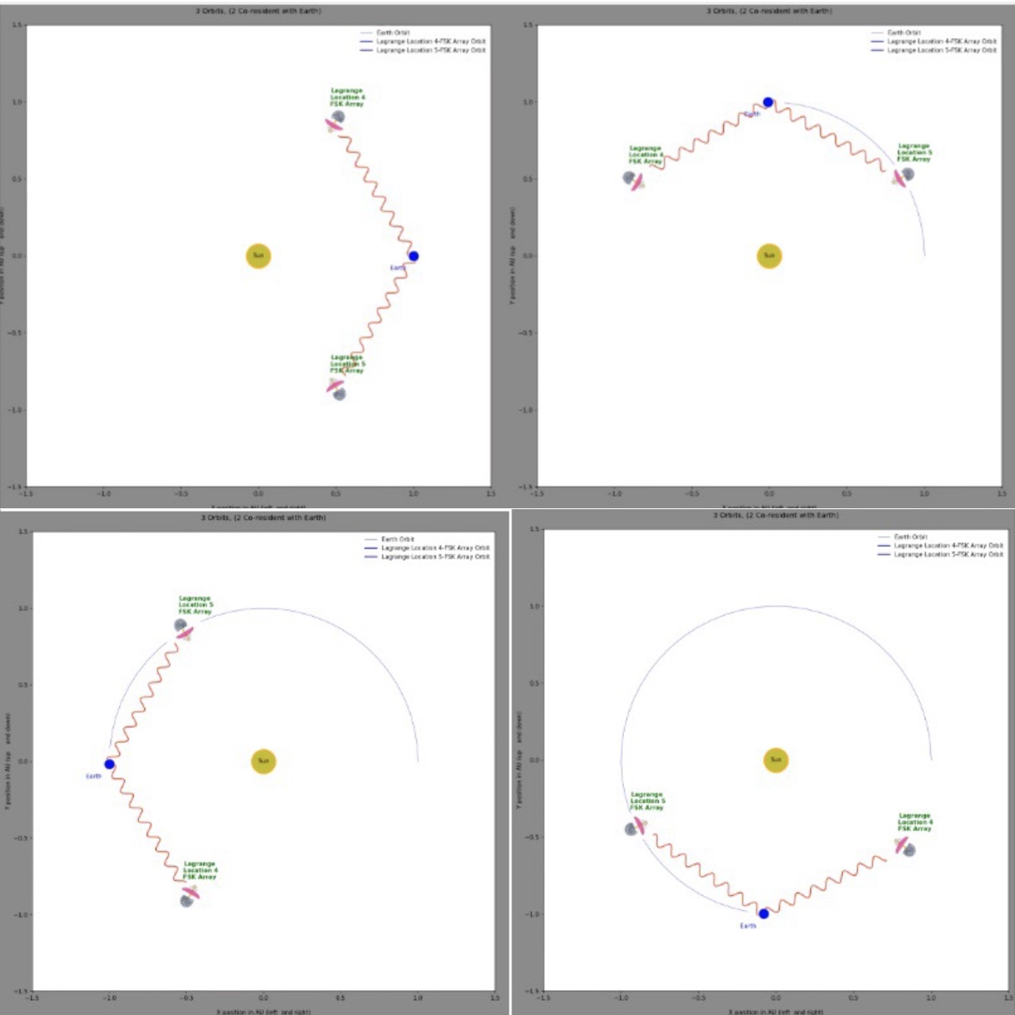
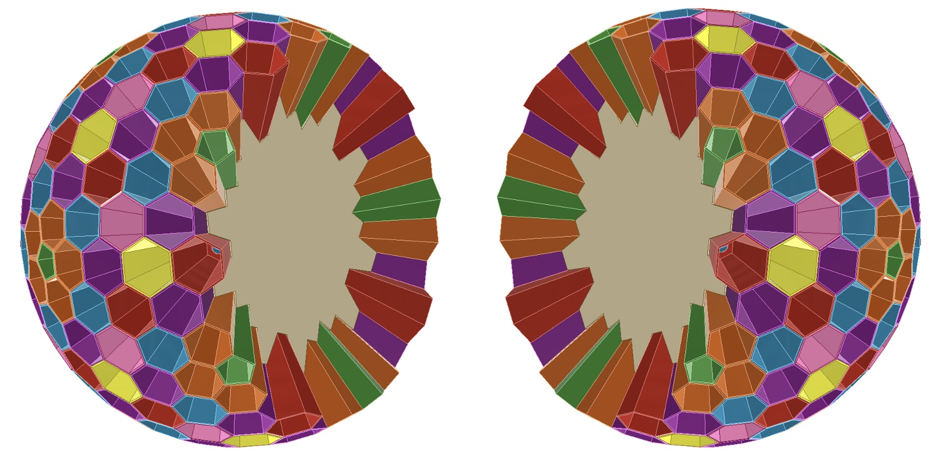
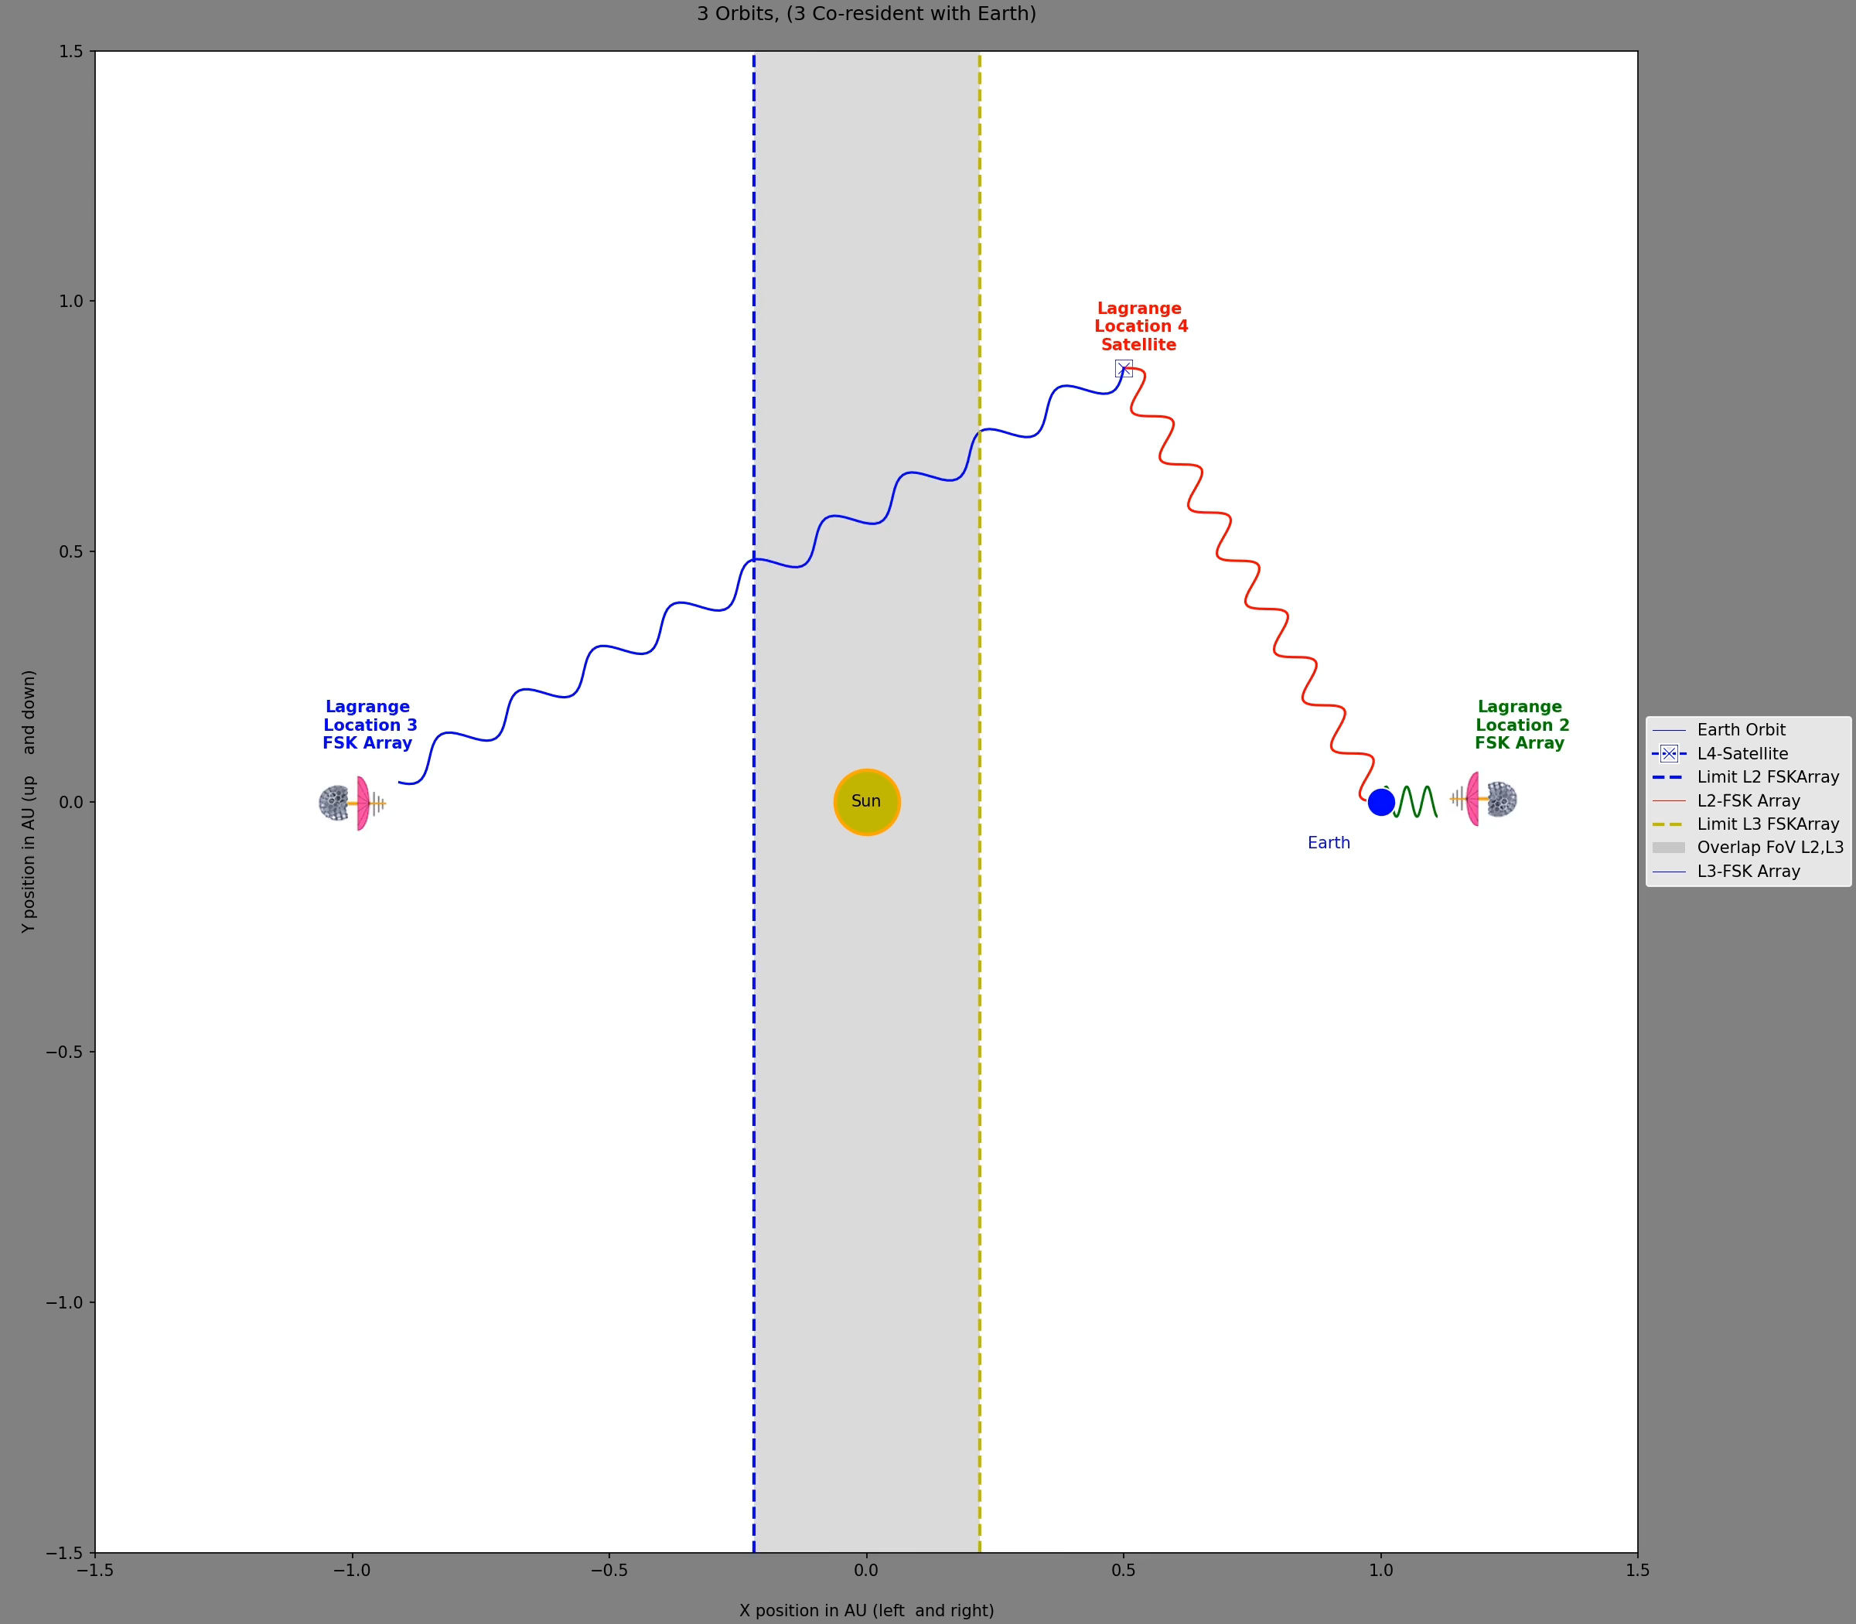
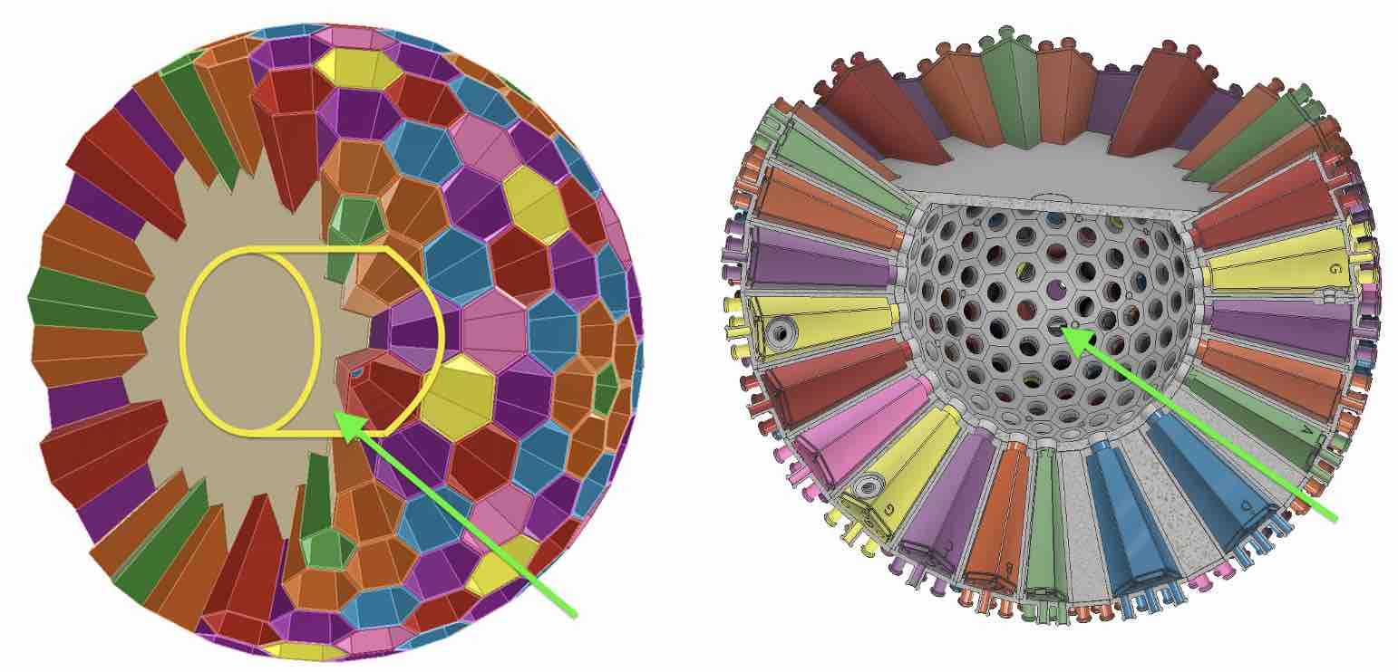
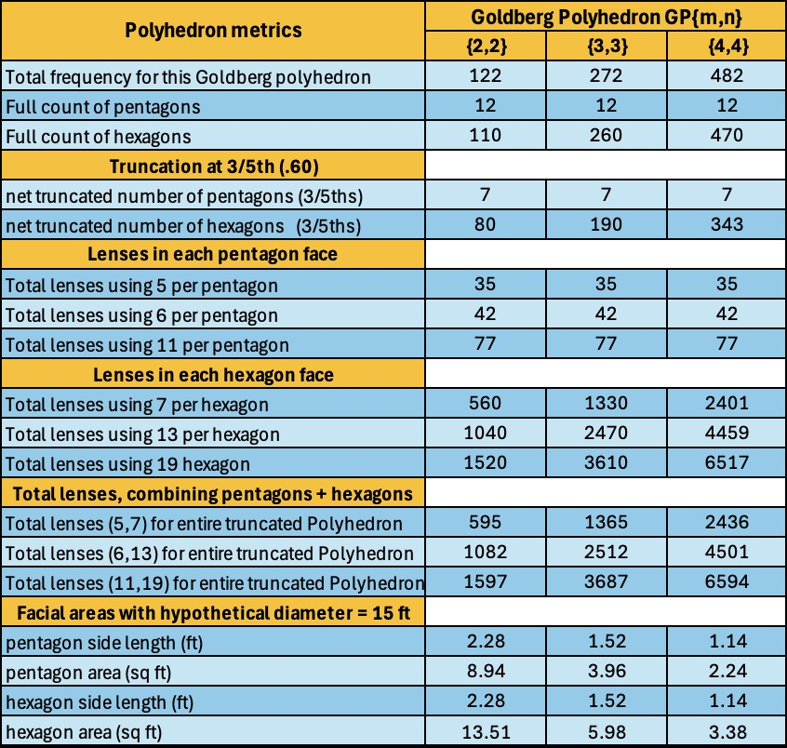
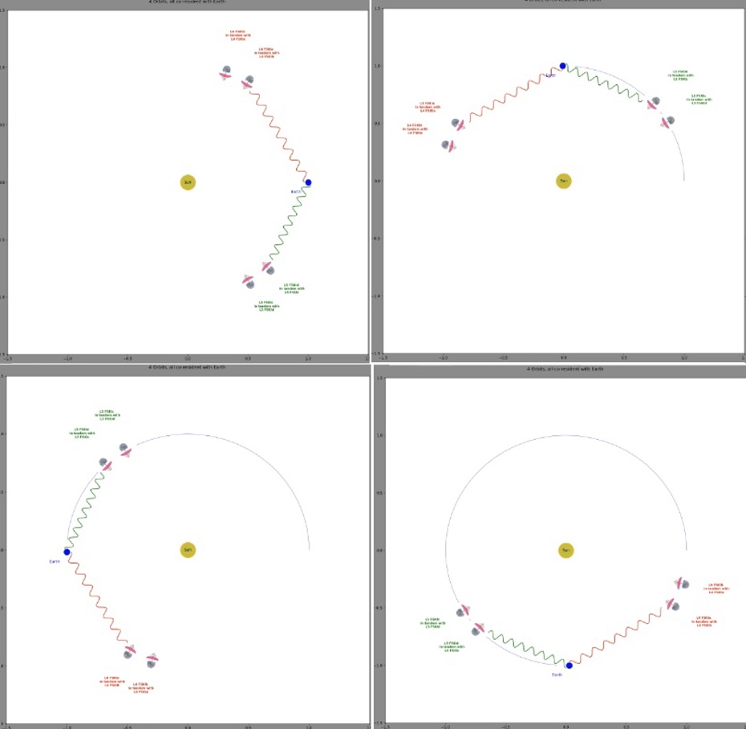
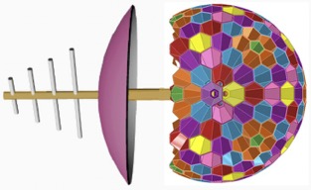
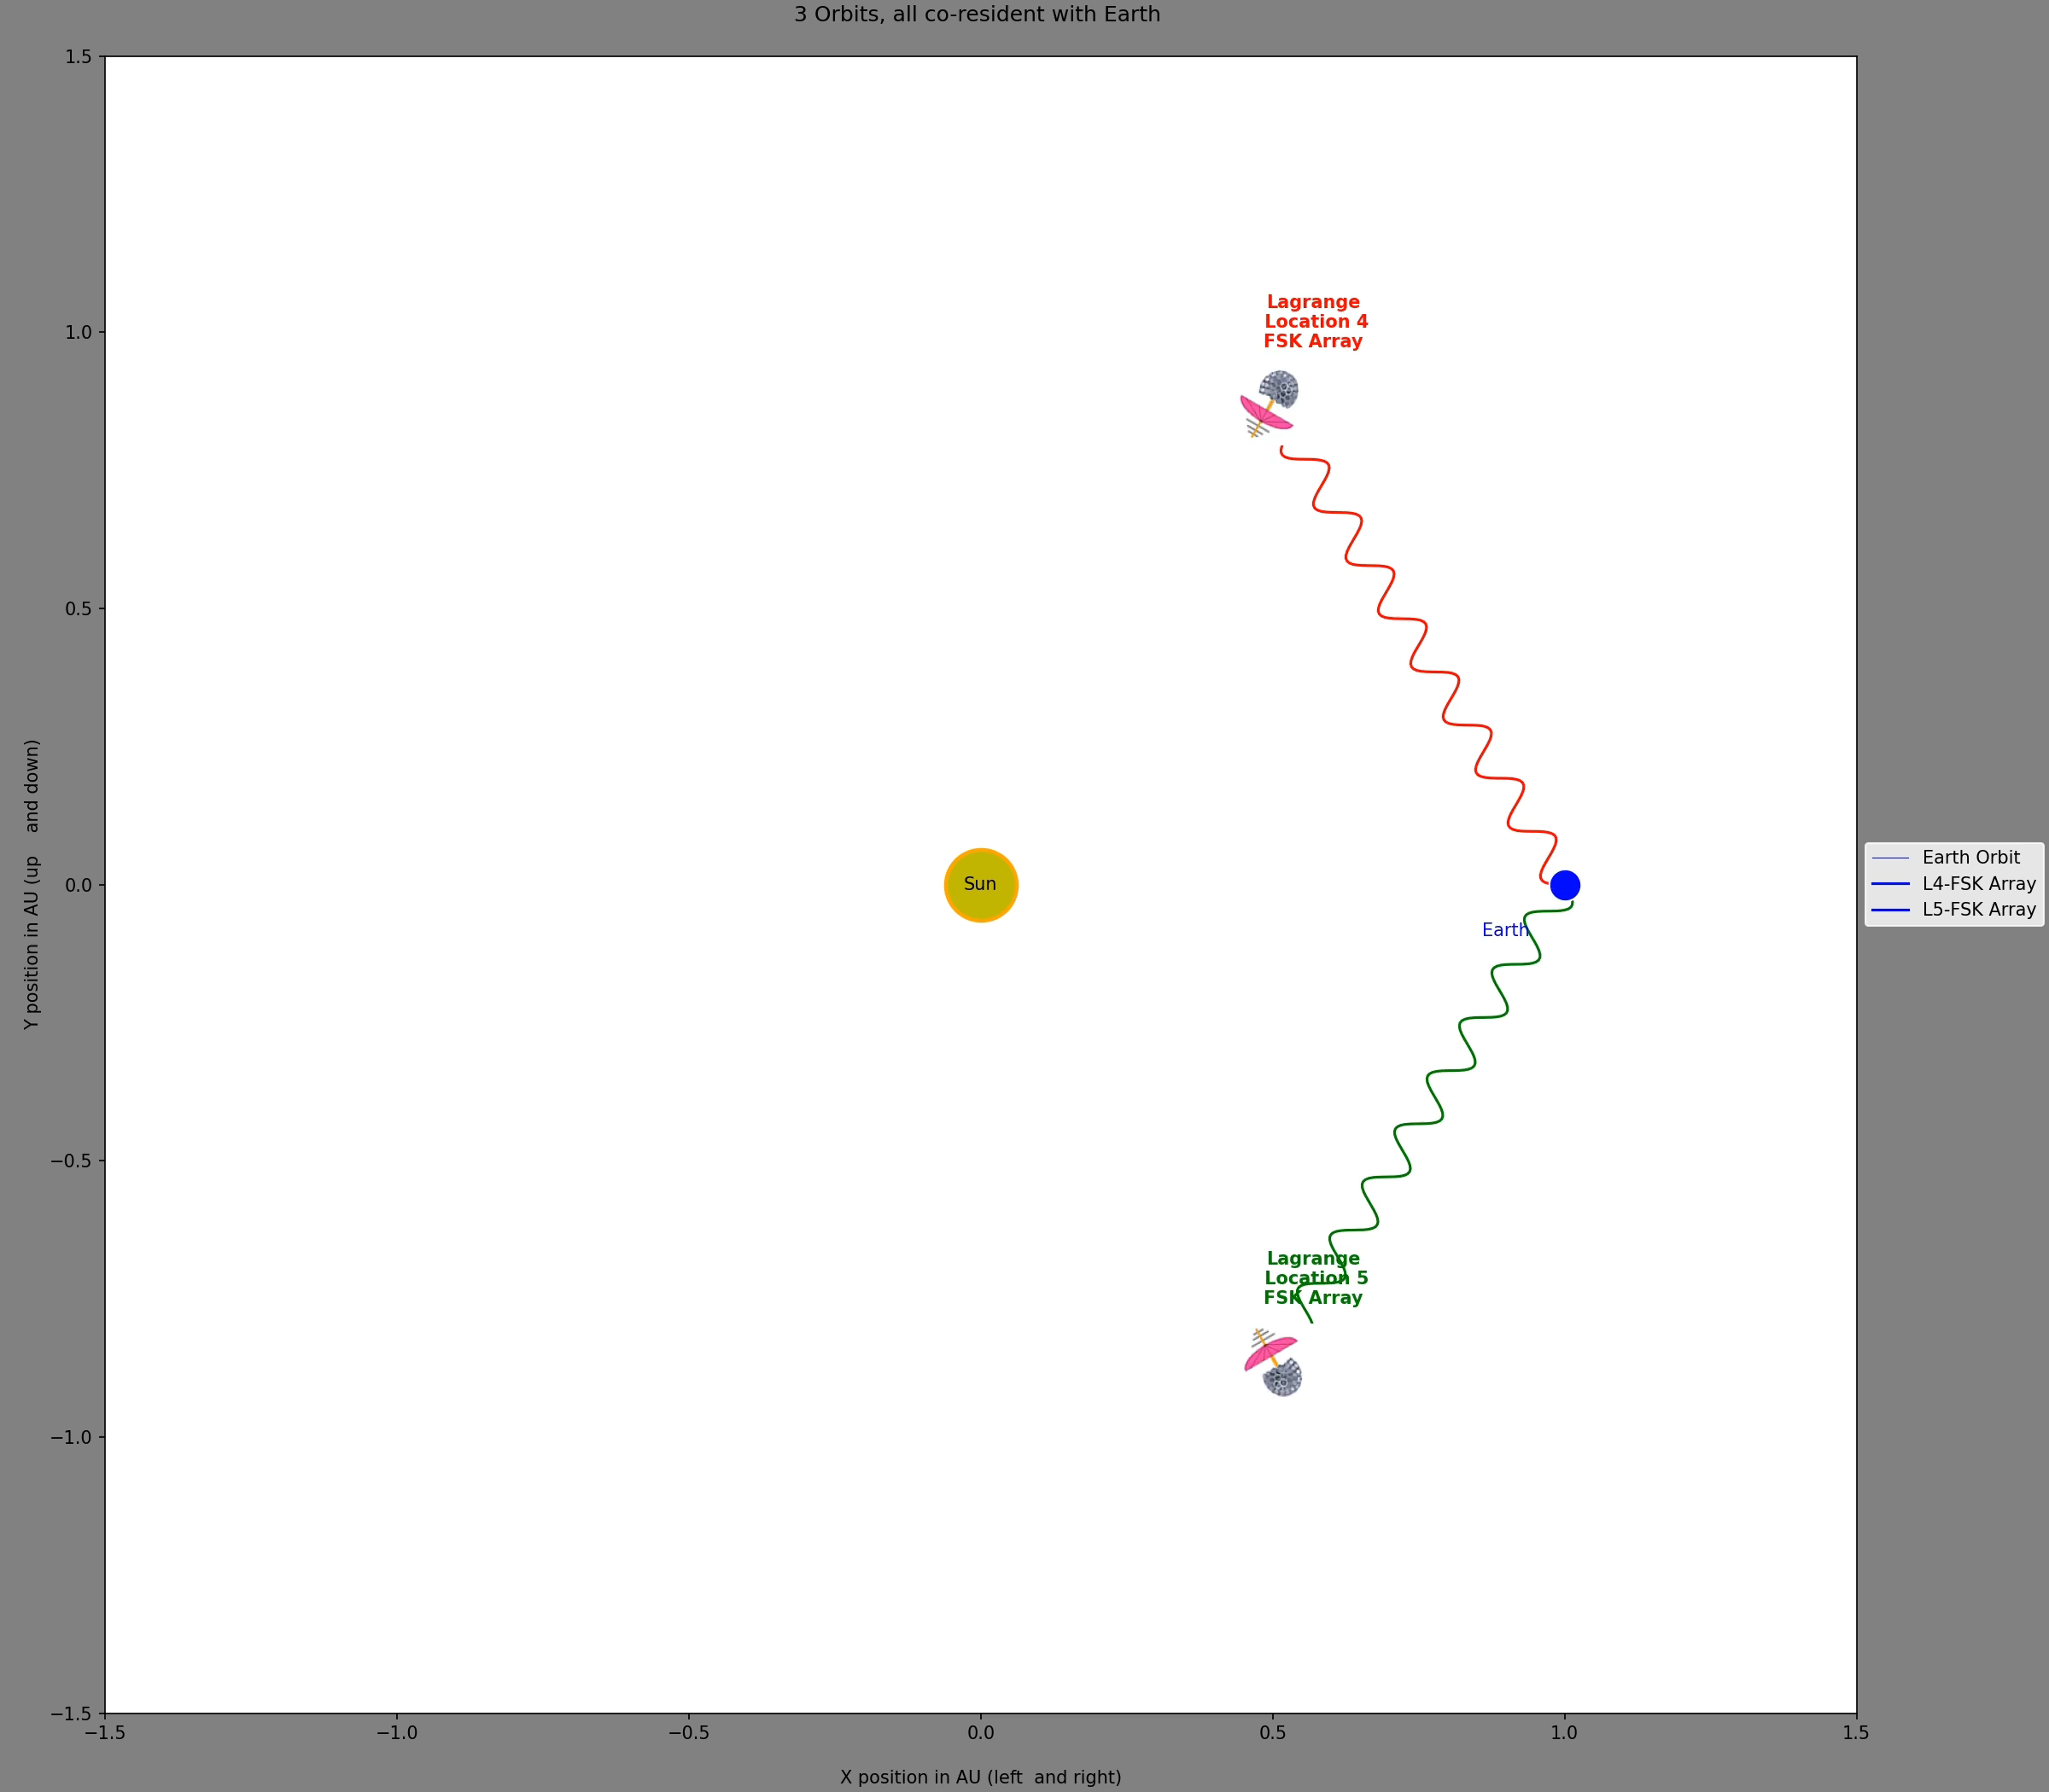
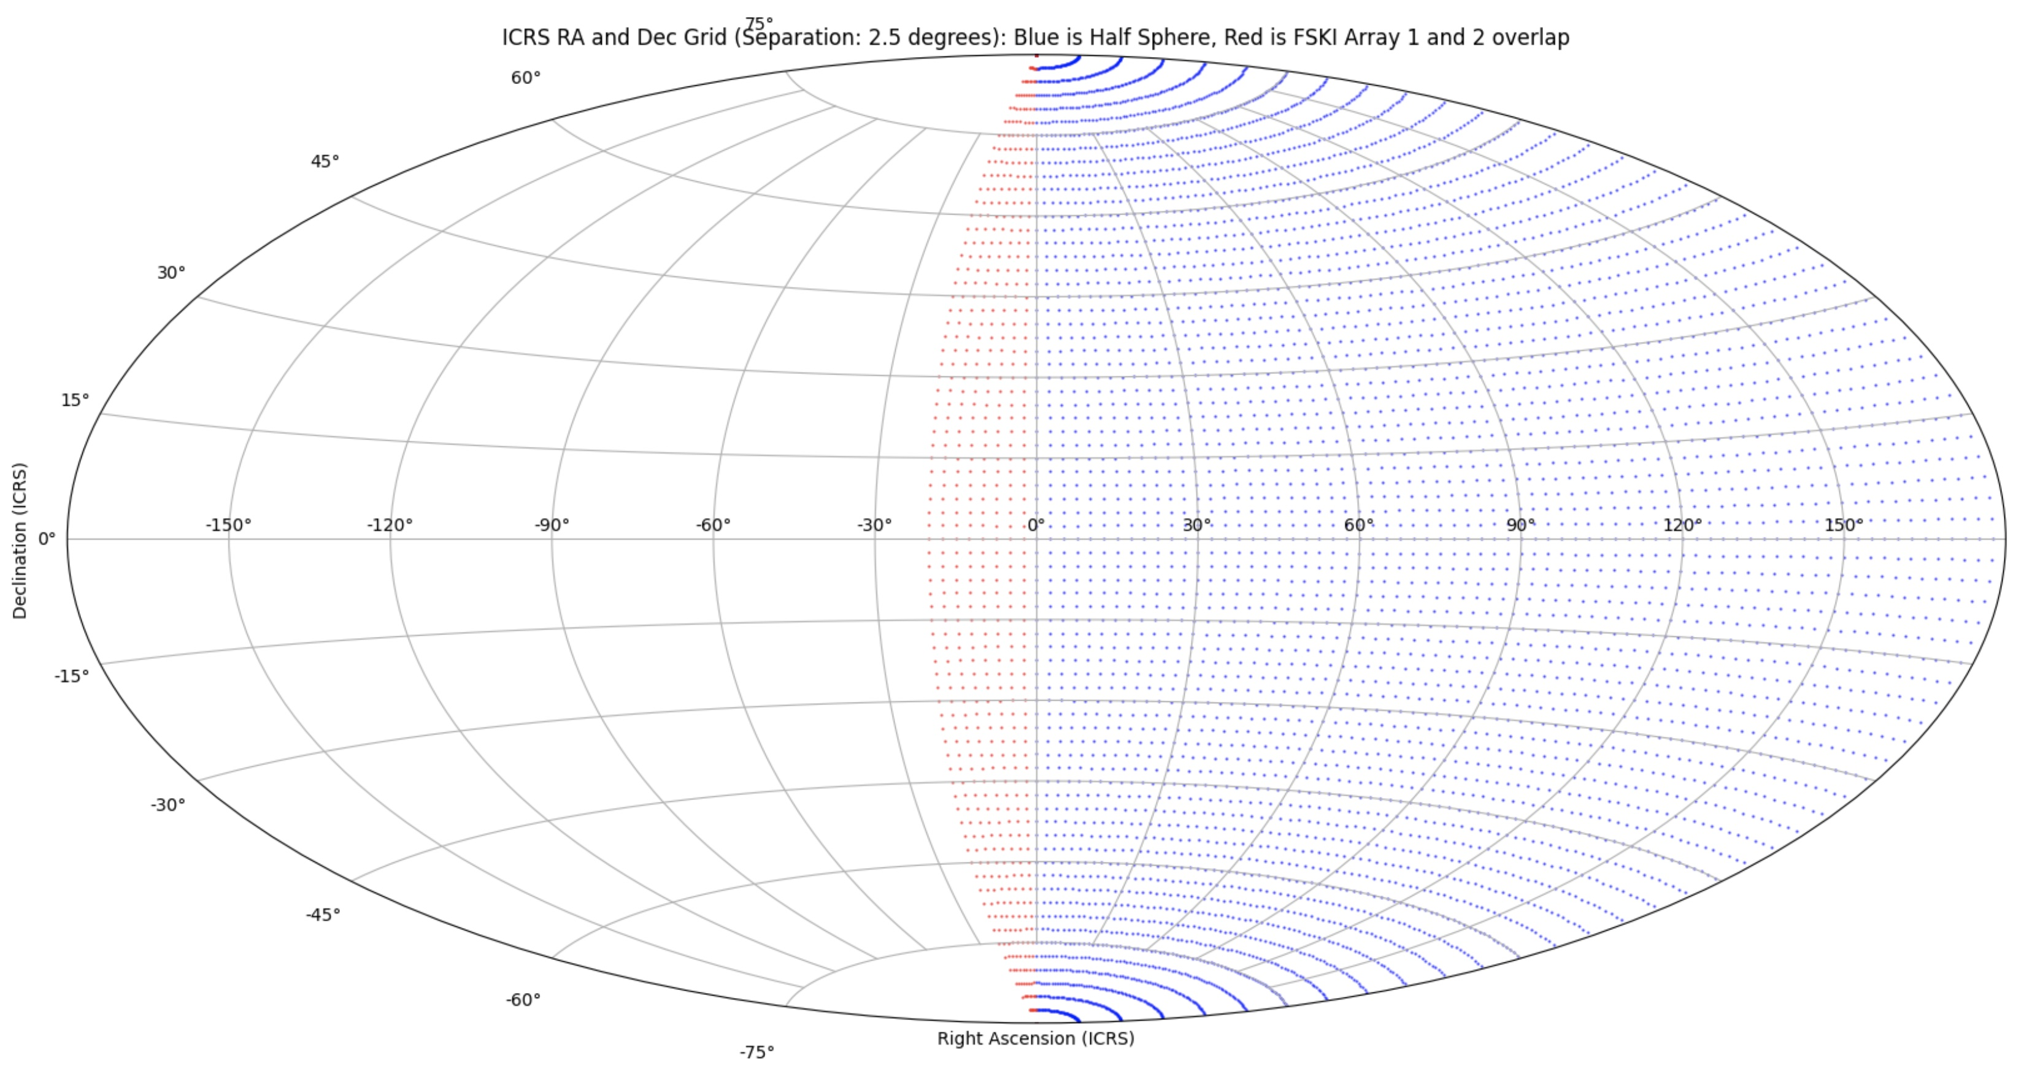
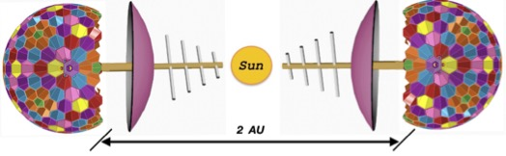
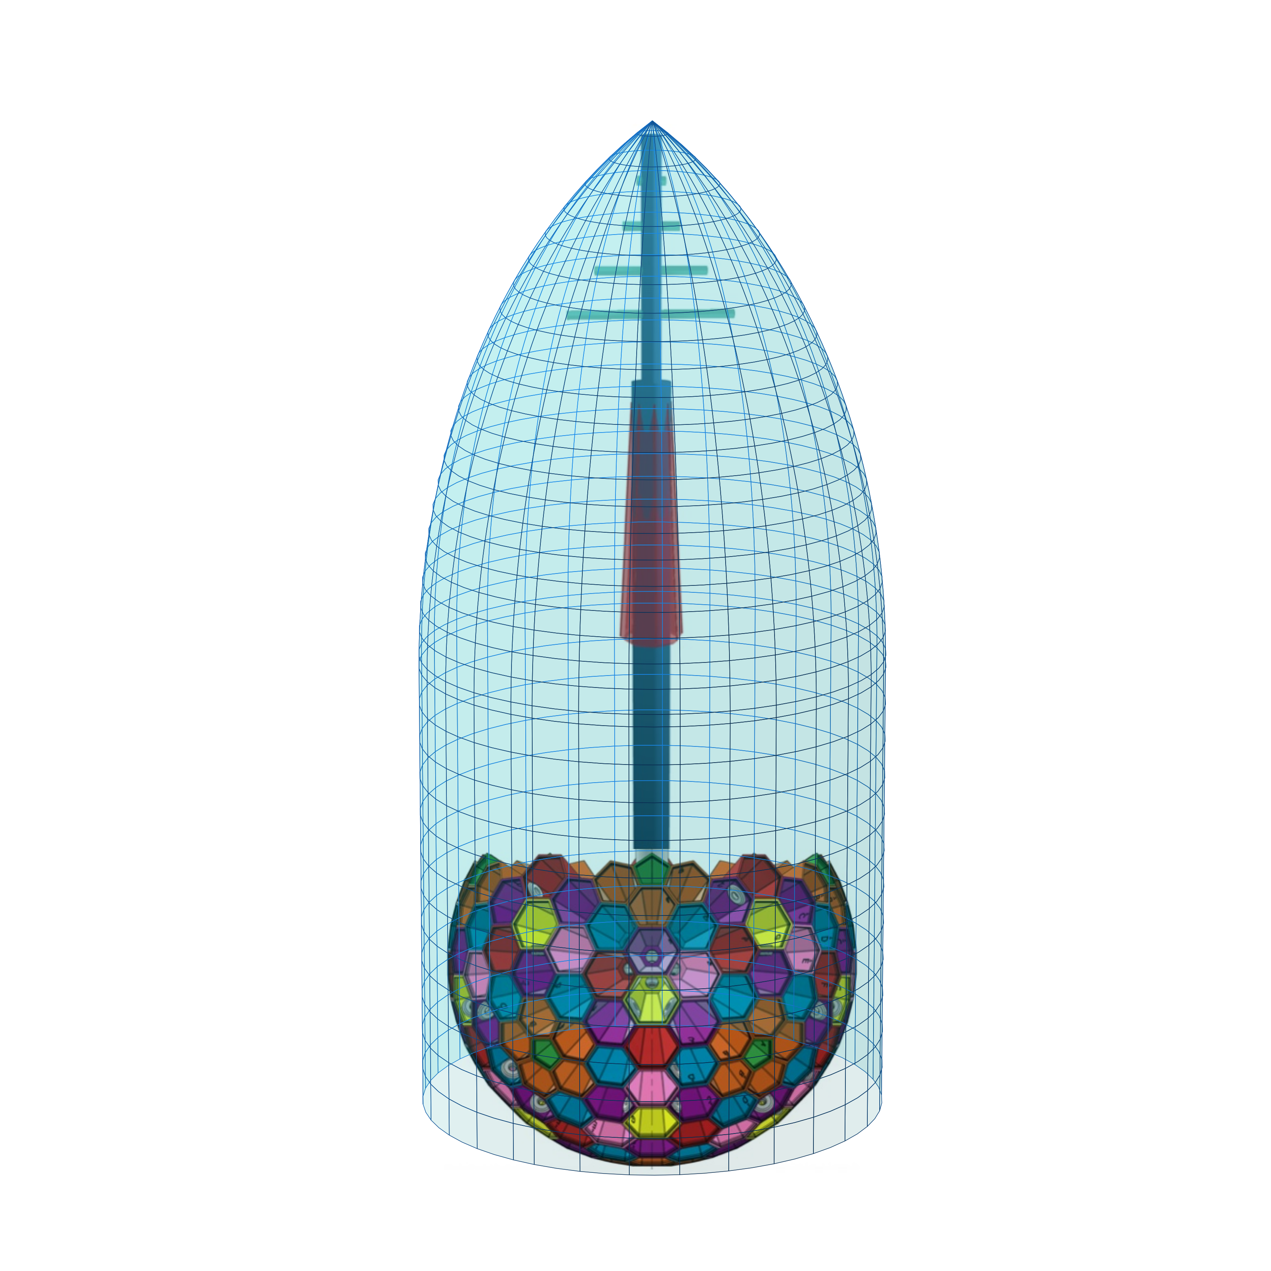
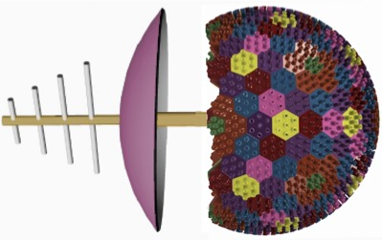
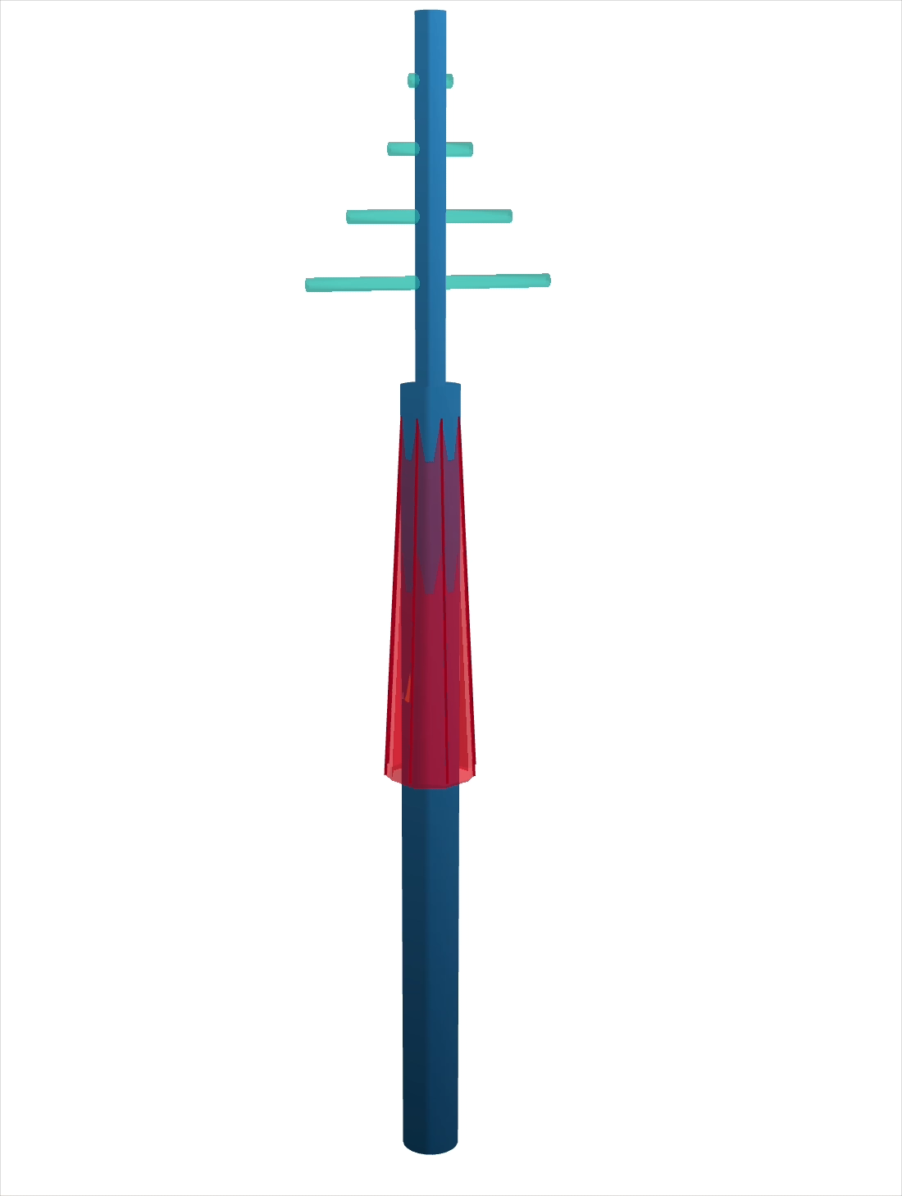
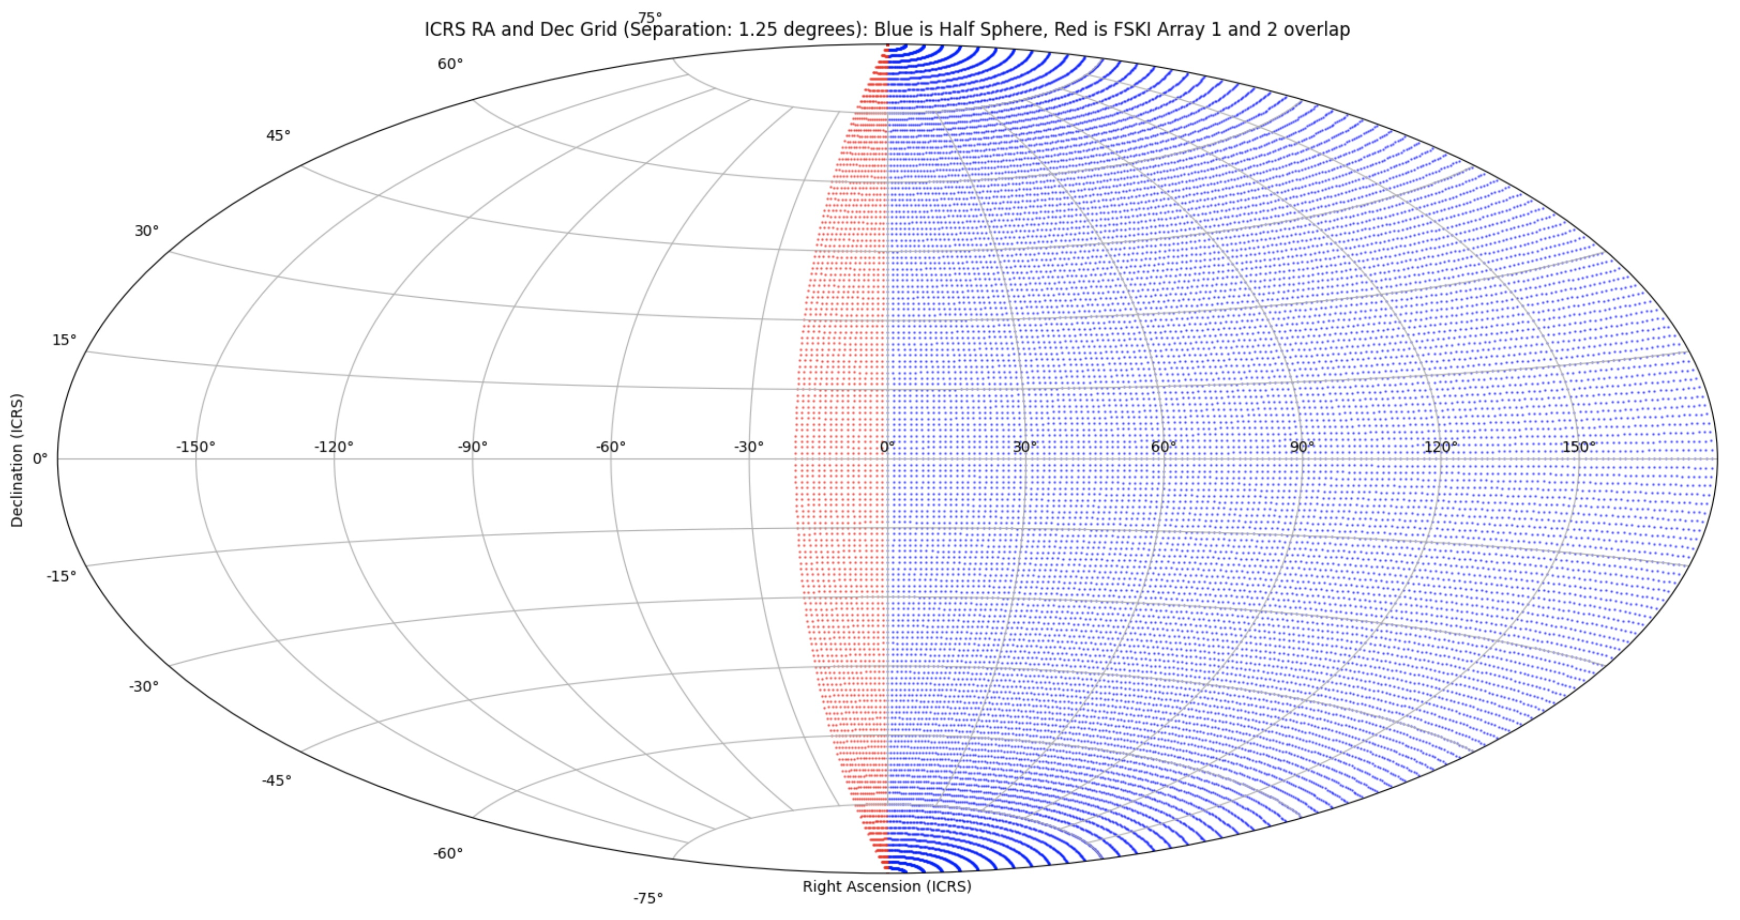
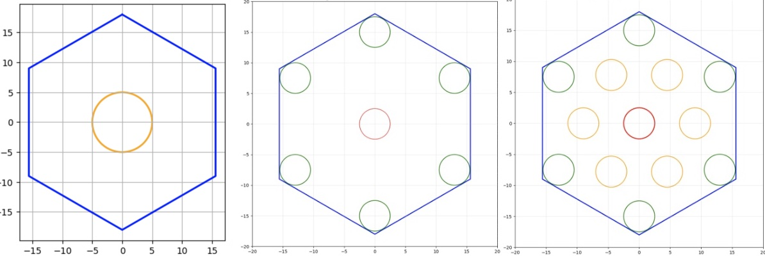
Photo of author, Fred Klich, student CU Boulder
Preamble
The Full Sky Kinematics and Imaging (FSKI) platform is a proposed astronomical system designed to overcome the limitations of traditional point-and-image telescopes. By utilizing a Goldberg polyhedron structure, the platform incorporates hundreds of tapered chambers that house multiple lenses to capture vast areas of the celestial sphere simultaneously. These modular spheres are intended to operate in coordinated pairs at stable Lagrange points in space or at high-latitude terrestrial locations to enable continuous, time-domain astronomy. The architecture leverages a central equipment bay and advanced sensors to process and transmit comprehensive data across the entire sky. This design aims to provide a scalable solution for surveying the cosmos with significantly higher efficiency than current narrow-field observatories. Supporting materials, including 3D prototypes and orbital animations, demonstrate the feasibility of deploying these units within standard rocket payload fairings.
Online github.com repository
All related files/images/animations/README’s for this project.
Click to preview two FSKI Solar orbital animations (w/sound)
Introducing a Platform for Full Sky Kinetics and Imaging [FSKI]
Figure 13: Terrestrial FSKI on a axis at 32 degrees latitude for terrestrial observation.
Figure 14: L2, L3, L4 deployment. Multiple-frame orbital path and a coms relay at L4.
Figure 15: L4, L5 deployment. Multiple-frame orbital path at stable Lagrange points without need for coms relay.
Figure 16: Tandem multiples at L4, L5. FSKI tandem pair to enhance sky coverage via a "fixed tilt" strategy.
Figure 17: Perspective Fairing Enclosure; also see Figure 0.
Introduction
Current imaging technology is constrained by the Field of View (FoV) provided by state-of-the-art CCD designs and associated pipelines.
The standard "point-and-image" strategy (planning, slewing, and acquiring targets sequentially) remains the default technique.
Advanced telescopes like Rubin and Nancy Grace Roman still rely on this repeating Right Ascension (RA) and Declination (Dec) target process.
Time-domain astronomy is currently limited by the time deltas required to repeat point-and-image cycles.
The Full Sky Kinematics and Imaging (FSKI) platform is designed to radically expand FoV capabilities.
The primary goal is to achieve full sky coverage through a specialized platform configuration and deployment.
FSKI enables a cadence that supports full sky time-domain astronomy.
Methodology
The platform utilizes a Goldberg polyhedron {3,3} design as a starting point.
The full configuration includes 12 pentagons and 260 hexagons, creating 272 tapered chambers.
For outer space deployment, polyhedrons are truncated to roughly 3/5ths (approx. 201 faces) to accommodate support equipment.
Each tapered chamber houses 1 to n lenses and associated telescope apparatus.
A central interior core serves as an equipment bay for image capture, packet assembly, and radio interface.
Onboard architectures include Ion thrusters, Attitude Control Subsystems (ACS), and solid-state recorders.
High-gain (Ka-Band) and medium-gain (S-Band) antennas facilitate science data downlink and maintenance.
A central post supports an umbrella-like solar shield to protect cryogenic supplies and sensors.
Deployment is optimized for Lagrange points (L2, L3, L4, and L5) or terrestrial locations.
Results
The 15-foot (4.6m) diameter design fits within standard payload fairings (PLF), such as those used for the James Webb Space Telescope.
Scalability metrics show total lens counts ranging from 1,365 to 6,594 depending on the polyhedron frequency and lenses per face.
Individual telescope assemblies are estimated to cover 2-4 square degrees.
L2 and L3 deployment creates a tandem pair that covers the full celestial sphere with intentional spherical overlap.
L4 and L5 deployment provides stable orbital tracking without requiring a direct solar-opposite communication relay.
Simulations demonstrate effective half-sphere sky coverage at target separations of 1.25 and 2.50 degrees.
Terrestrial configurations can provide horizon-to-horizon coverage using a mount to follow sky motion.
Discussion
Parallel and modular scalability is driven by the polyhedron diameter and facial frequency.
A "tilting strategy" allows tandem pairs to aim lenses at unique target sets, expanding the total "tapestry" FoV.
FSKI platforms can operate in tandem at distances of 200 kilometers without mutual interference.
Reducing the sphere size can facilitate triplet or quadruplet deployment strategies for even higher coverage factors.
Terrestrial deployment allows for two-tier exploration: the Earth daytime sky dome and the full nighttime celestial dome.
Platform effectiveness is enhanced by modern sensor designs, including stacked CMOS and curved focal plane arrays.
Size reduction and complexity simplification leverage historical trends seen in CubeSats and modern computing.
Conclusion
FSKI provides a revolutionary alternative to the traditional RA/Dec point-and-image limitation.
The design enables continuous monitoring of the full celestial sphere for time-domain science.
The platform's physical dimensions are compatible with existing launch technology, making deployment feasible.
Modular lens layouts and tandem pairing offer unprecedented scalability for future astronomical surveys.
Figure 0: Animation of Solar array
And Solar shield in outer space
The Goldberg polyhedron design serves as the geometric foundation for the Full Sky Kinematics and Imaging (FSKI) platform, providing a structured way to house thousands of individual telescopes for full celestial coverage.
Core Geometry and Starting Point
The design utilizes a Goldberg polyhedron {3,3} as its primary architectural framework. A fully populated version of this specific polyhedron consists of 272 tapered chambers, divided into 12 pentagons and 260 hexagons. These chambers are designed to house between 1 and n lenses and their associated telescope apparatus, with each lens aimed at a unique point in the sky.
Truncation and Space Deployment
While a full sphere is ideal for terrestrial use to achieve horizon-to-horizon coverage, platforms intended for outer space deployment are truncated.
3/5ths Coverage: For space operations, the polyhedron is typically truncated to approximately 3/5ths of a full sphere (roughly 201 faces for the {3,3} model).
Supplementary Space: The remaining 2/5ths of the sphere is left open/vacant to accommodate critical support components, such as the central equipment bay, power systems, fuel for station keeping, and communication antennas.
Interior Architecture: Each tapered chamber connects to a central interior core (equipment bay), which facilitates packet assembly for image data and interface with the high-gain antenna.
Scalability and Frequency
The platform's capability is directly tied to the "frequency" of the Goldberg polyhedron, which determines the number of available chambers.
Scalability Grid: The sources outline three primary Goldberg Polyhedron (GP) types:
  GP{2,2}: 122 total frequency (12 pentagons, 110 hexagons).
  GP{3,3}: 272 total frequency (12 pentagons, 260 hexagons).
  GP{4,4}: 482 total frequency (12 pentagons, 470 hexagons).
Lens Density: Total sky coverage is further scaled by the number of lenses per facial plate. For example, a GP{3,3} using a configuration of 11 lenses per pentagon and 19 per hexagon would house a total of 6,594 lenses.
Physical Size: A diameter of 15 feet (4.6m) is suggested for the polyhedron, as this size allows two truncated units to fit within a standard rocket payload fairing (PLF) like that of the Ariane 5.
Terrestrial vs. Orbital Implementation
In a terrestrial configuration, the polyhedron does not require truncation and can utilize all tapered chambers to track sky movement from east to west. In orbital deployment, the polyhedron design allows for a "tilting strategy" where tandem pairs of platforms are aimed at slightly different coordinates to create an expansive "tapestry" of the Field of View (FoV).
Progressive Series of Figures
The following figures sequentially illustrate the buildup to the FSKI platform’s design:
Figure 4: Goldberg polyhedron{3,3} with 12 pentagons and 260 hexagons, 272 tapered chambers.
Figure 5: A side-profile showing prior sphere truncated to 201 tapered lens compartments.
Figure 6: Two FSKI units facing diametrically opposite directions away from the Sun.
Figure 7: Vacant spaces incurred with the truncated polyhedron, revealing the unused 2/5ths of the polyhedron framed with a flat base wall.
Figure 8: A cross-section of interior core, highlighting the central equipment bay (outlined in yellow) and port holes to tapered chambers.
Figure 9: Detailed addition of central utility post, umbrella sunshield, high-gain antenna.
Figure 10: Abbreviated view of tandem pair for deployment in solar orbit.
Figure 11: FSKI full configuration with specific lens counts (e.g., n=5 for pentagons and n=7 for hexagons).
Figure 12: Embodiment of various lens configurations on the face of a hexagon (1, 7, 13 lenses on 18-inch hexagon.
Figure 1: Goldberg polyhedron metrics of scalability. A data table summarizing frequency, face counts (pentagons/hexagons), truncation metrics, and total lens calculations for different Goldberg polyhedron types.
Figure 2: A realization of sky coverage--1/2 of the sky dome at 2.50 degrees of target separation. An ICRS RA/Dec grid plot; blue for the half-sphere and red indicating FoV overlap.
Figure 3: A realization of sky coverage--1/2 of the sky dome at 1.25 degrees of target separation. A grid plot shows higher point density.

