Slide 1
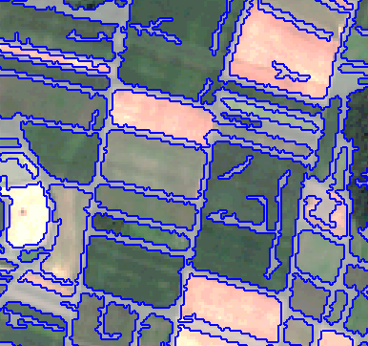
Field boundary delineation
IP OBIA (Prof. Tiede, Dr. Sudmanns)
-
A knowledge-based, transferable approach for field demarcation based on Sentinel-2
Felix Kröber, Sarah Poch

Slide 2
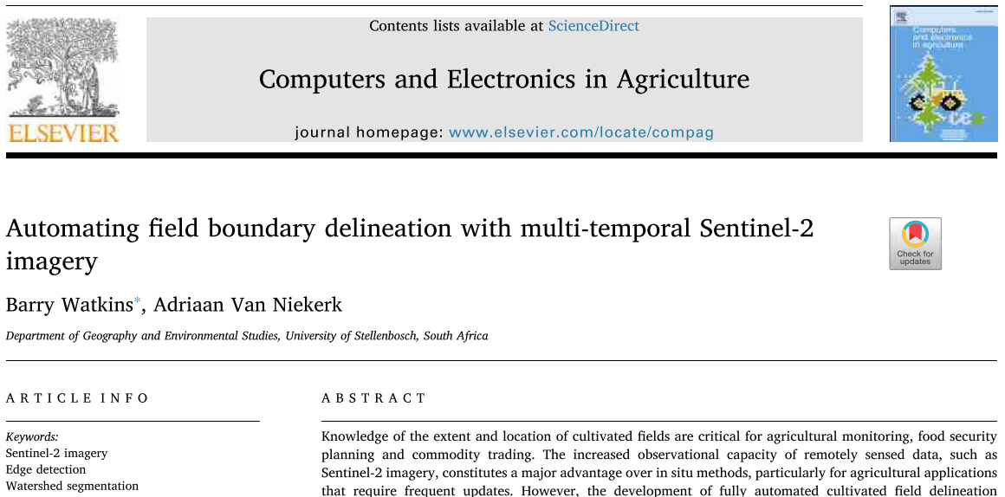
Project summary
Workflow
Idea & Aim
Data & Software
semi-automated, supervised delineation based on a few training samples
ready-to-use tool
transparent, knowledge-based approach
high degree of transferability - independent of AoI & structure of fields
S2 scenes during a vegetation period
eCognition solution for field delineation
canny-edge filtering & averaging
watershed segmentation with optimal parametrisation based on training samples provided by the user
python script for retrieving S2 L3 data for Germany
noise removal, i.e. merging/resizing of smaller objects
python script for object-based acc. assessment
adjustment of the degree of over-segmentation
sample-based field extraction & masking of non-agricultural land using temporal NDVI curves and geometrical/topological object features
export of results & accuracy assessment via area- and edge-based metrics
Basis &
References

