Slide 1
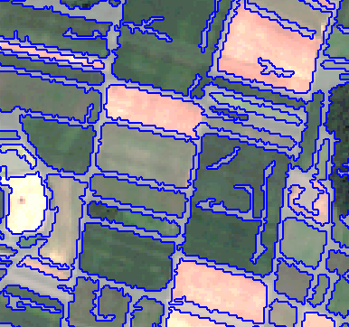
Field boundary delineation
IP OBIA (Prof. Tiede, Dr. Sudmanns)
-
A knowledge-based, transferable approach for field demarcation based on Sentinel-2
Felix Kröber, Sarah Poch

Slide 2
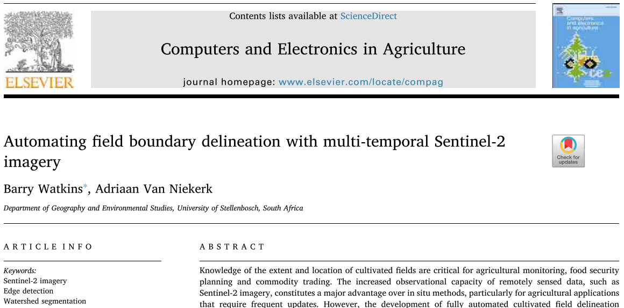
Project summary
Workflow
Idea & Aim
Data & Software
semi-automated, supervised delineation based on a few training samples
Field delineation
ready-to-use tool
transparent, knowledge-based approach
high degree of transferability - independent of AoI & structure of fields
S2 scenes during a vegetation period
eCognition Developer & Architect
II. Field extraction & masking of non-agricultural land
canny-edge filtering & averaging
watershed segmentation with optimal parametrisation based on user selected samples
knowledge-based temporal NDVI thresholding
sample-based classification approach
python script for retrieving S2 L3 sample data for Germany
noise removal & merging/resizing of smaller objects
Basis &
References

