Slide 1

Functional programming
Fedir Kryvytskyi
Unity S. A.

Slide 2
Functional programming
Functional programming is a programming paradigm — a style of building the structure and elements of computer programs—that treats computation as the evaluation of mathematical functions and avoids changing-state and mutable data.
It is a declarative programming paradigm, which means programming is done with expressions or declarations instead of statements.
Wikipedia

Slide 3
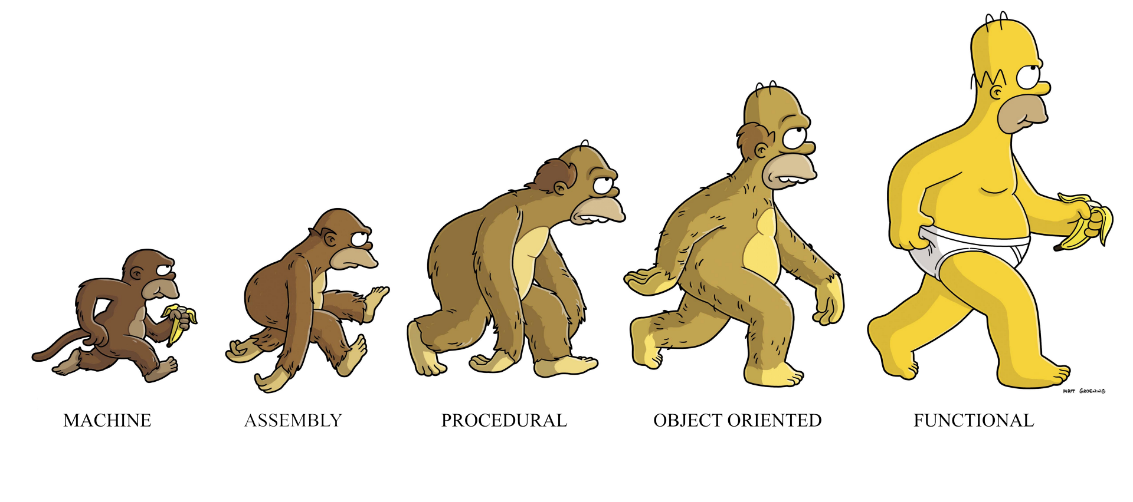
Functional VS Imperative

Slide 4
Core concepts in functional programming
Lambda Calculus
Immutability
No side-effects
Higher Order Functions

Slide 5
Functional VS Imperative
Imperative programming languages are those based on the Turing-machine model of computation.
The fundamental concepts in imperative programming languages (coming from the Turing Machine model) are:
store
variable - something it is possible to modify ("memory cell")
assignment
iteration

Slide 6
λ-calculus
Functional languages are based on a mathematical model of computation: the λ-calculus (Church, 1932; 1933).
The λ-calculus was introduced at approximately the same time as the Turing model (Turing, 1937).
Church’s thesis (Church, 1936) states that the class of effectively computable functions is the same as the class of functions that can be defined in the λ-calculus. Turing formalized machine computability and showed that the resulting notion of Turing computability is equivalent to λ-definability. So the power of both models is the same. Hence any computation can be expressed using a functional style only.

Slide 7
Functional VS Imperative
The relevant notions of functional programming are:
expression
recursion - different from the notion of iteration
evaluation - different from the notion of execution (when we evaluate a mathematical expression we do not modify anything)
variable - intended in a mathematical sense (unknown entity, abstraction from a concrete value)

Slide 8
Higher order functions
Higher-order functions are functions that can either take other functions as arguments or return them as results.
It is a mathematical concept, that closely related to computer science term “first-class functions”
First class functions is a specific implementation of high-order functions in programming languages

Slide 9
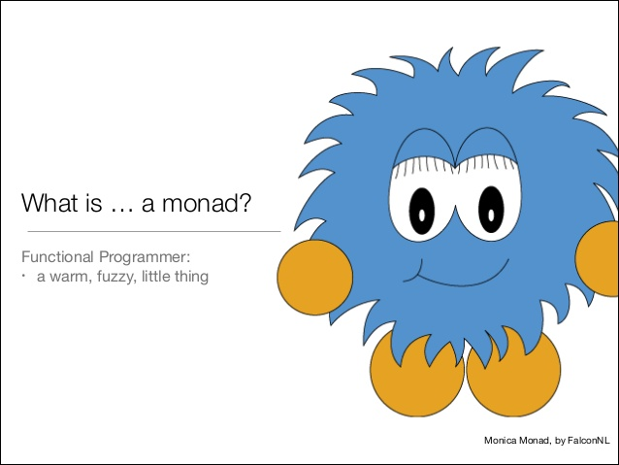
Monads

Slide 10
Monads
“..Monads are like burrito” - (unknown author)
“..It is like a small fish, that contains another, smaller fish” (Witold Adamus, author of php-slang library)
“..If you understand, what is Monad, then you automatically lose your ability to explain it” (Dariusz Pławecki)

Slide 11
Monads
So what is a monad, at least in functional programming?
Fundamentally, it's just a type m that has three particular functions defined on it:
return :: a -> m a
fmap :: (a -> b) -> m a -> m b
join :: m (m a) -> m a

Slide 12
Monads
The first two functions, return and fmap both serve a simple role: they allow transition from normal code a to code that uses m. return wraps a normal value, lifting it into the monad; fmap lifts normal functions to operate over these wrapped values.

Slide 13
Monads
The first two functions, return and fmap both serve a simple role: they allow transition from normal code a to code that uses m. return wraps a normal value, lifting it into the monad; fmap lifts normal functions to operate over these wrapped values.

Slide 14
Monads
The most important function is join, which captures a notion of "flattening" a structure. It allows to go from a nested m (m a) to a single m a, flatten out a level.
In other words, monads let you flatten them.

Slide 15
Purpose of Monads
One of the most important ideas in functional programming is composition.
The three functions of Monads allow m to be used as a customizable way to compose parts of program, more versatile than just function composition.

Slide 16
Sources
https://www.quora.com/What-are-monads-in-functional-programming-and-why-are-they-useful
https://en.wikipedia.org/wiki/Functional_programming
http://www.dipmat.unict.it/~barba/PROG-LANG/PROGRAMMI-TESTI/READING-MATERIAL/ShortIntroFPprog-lang.htm
https://github.com/php-slang/php-slang
https://github.com/garcher/functional_programming.git

