Slide 1
Advanced topics

Slide 2
Outline
Self-taught learning
Learning feature hierarchies (Deep learning)
Scaling up

Slide 3
Self-taught learning

Slide 4
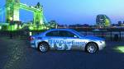
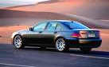
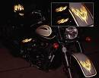





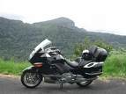
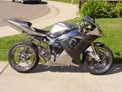



Supervised learning
Cars
Motorcycles
Testing:
What is this?
Notes:
Sometimes, most data wins. So, how to get more data? Even with AMT, often slow and expensive.

Slide 5






Semi-supervised learning
Unlabeled images (all cars/motorcycles)
Testing:
What is this?
Car
Motorcycle

Slide 6
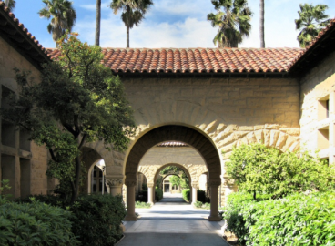
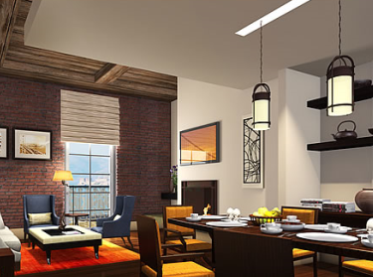
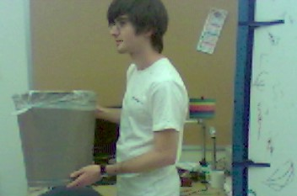
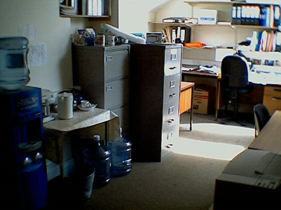
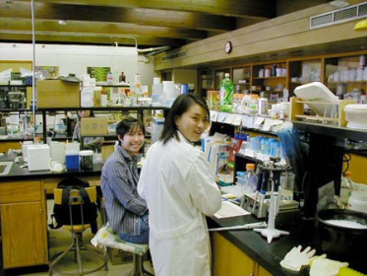
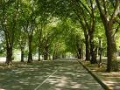
Self-taught learning
Unlabeled images (random internet images)
Testing:
What is this?
Car
Motorcycle

Slide 7
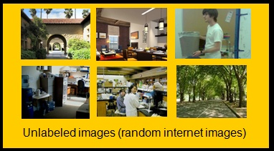
Self-taught learning
Sparse coding, LCC (Locally Constrained Linear Coding, etc.
φ₁, φ₂, …, φ_{k}
If have labeled training set is small, can give huge performance boost.
Use learned φ₁, φ₂, …, φ_{k} to represent training/test sets.
Using φ₁, φ₂, …, φ_{k}
a₁, a₂, …, a_{k}
Car
Motorcycle

Slide 8
Learning feature hierarchies/Deep learning

Slide 9
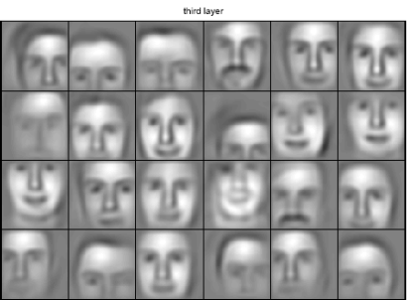

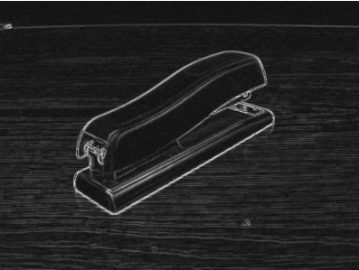
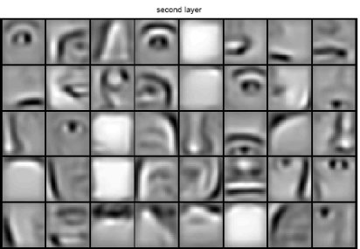
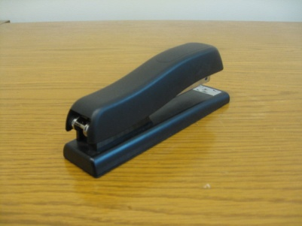
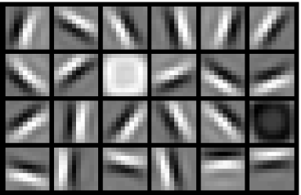


Why feature hierarchies - 1
object models
object parts
(combination
of edges)
edges
pixels

Slide 10
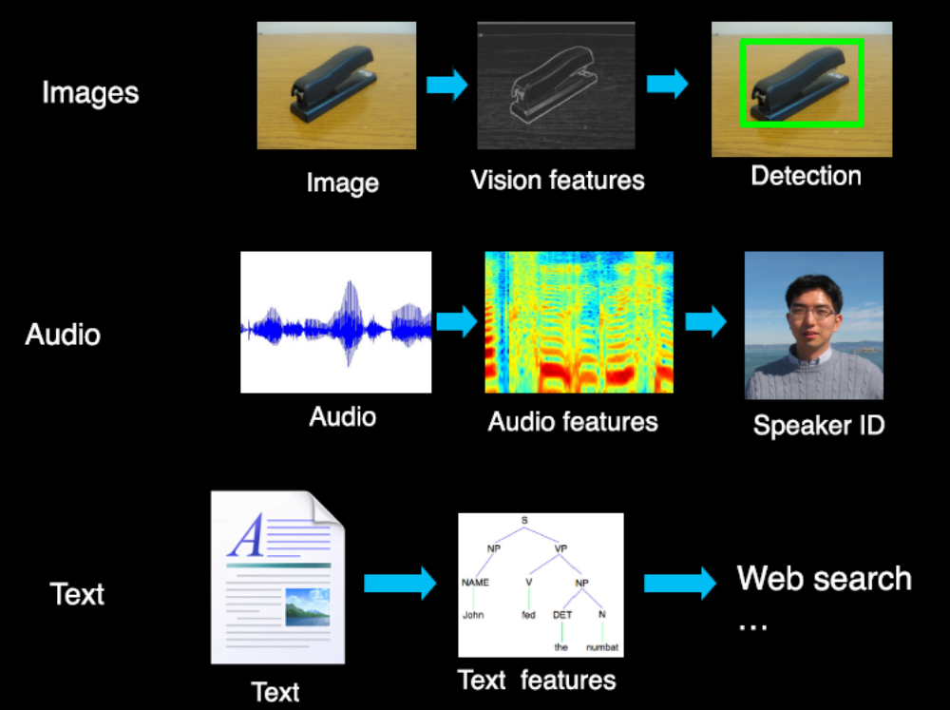
Why feature hierarchies - 2

Slide 11
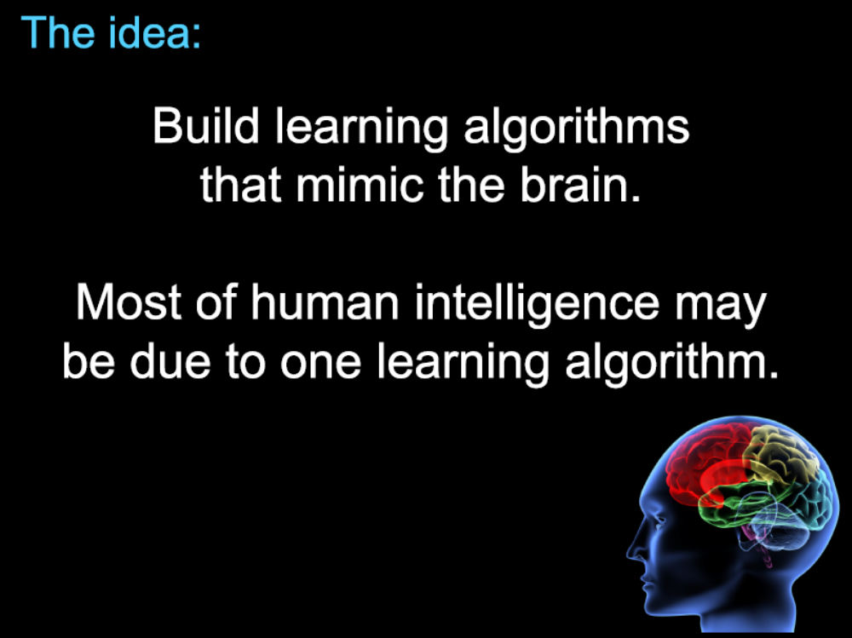
Learning From Human Brain - 1

Slide 12
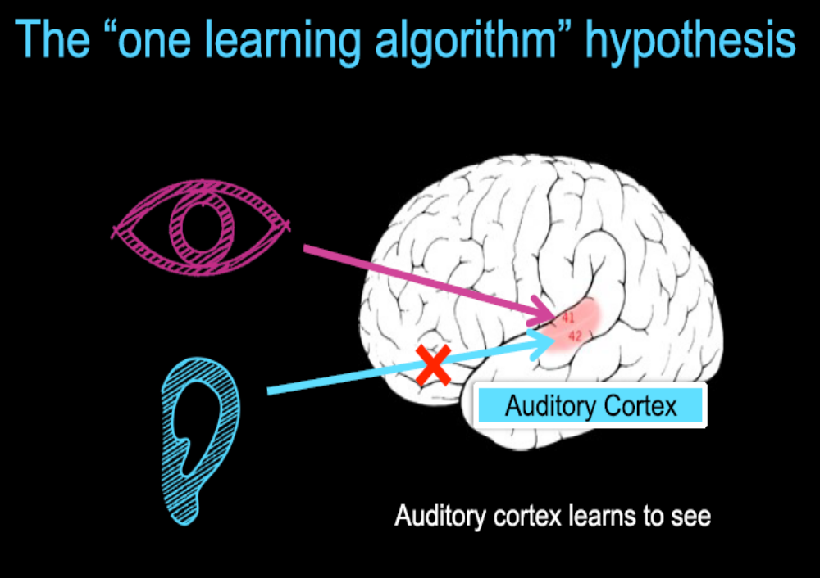
Learning From Human Brain - 2

Slide 13
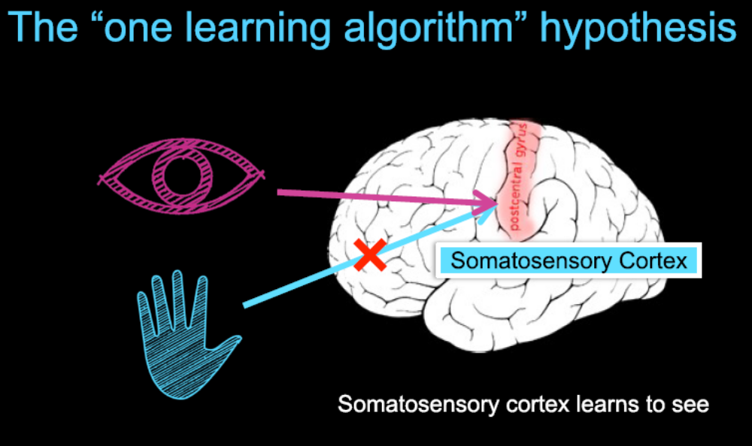
Learning From Human Brain - 3

Slide 14
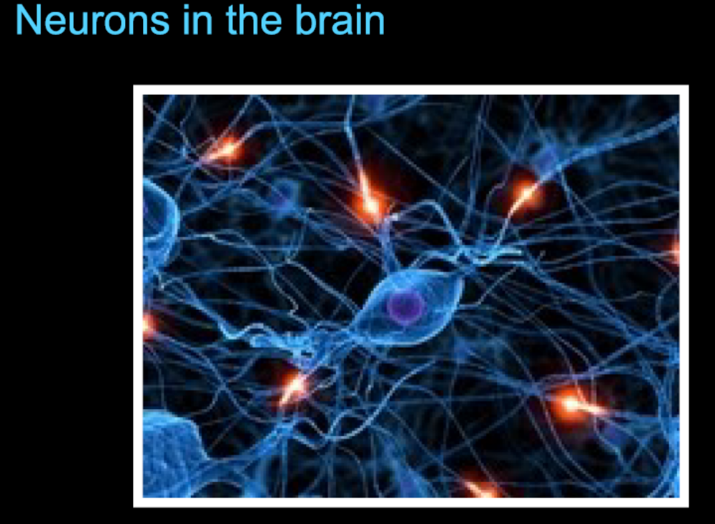
Neurons in the Brain

Slide 15
Deep learning algorithms
Stack sparse coding algorithm
Deep Belief Network (DBN) (Hinton)
Deep sparse autoencoders (Bengio)
[Other related work: LeCun, Lee, Yuille, Ng …]

Slide 16
Deep learning with autoencoders
Logistic regression
Neural network
Sparse autoencoder
Deep autoencoder

Slide 17


Logistic regression
Logistic regression has a learned parameter vector θ.
On input x, it outputs:
where
x₁
Draw a logistic
regression unit as:
x₂
x₃
+1

Slide 18

Neural Network
String a lot of logistic units together. Example 3 layer network:
x₁
a₁
x₂
a₂
a₃
x₃
Layer 3
+1
+1
Layer 1
Layer 3

Slide 19
Neural Network
Example 4 layer network with 2 output units:
x₁
x₂
x₃
+1
Layer 4
+1
+1
Layer 3
Layer 1
Layer 2

Slide 20
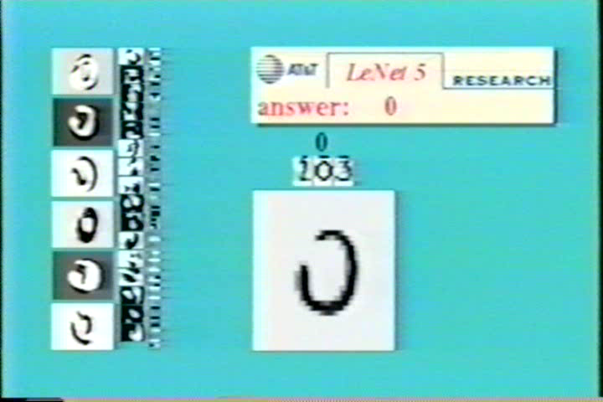
Neural Network example
[Courtesy of Yann LeCun]

Slide 21
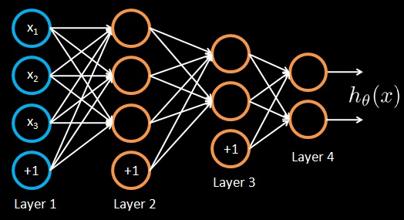

Training a neural network
Given training set (x₁, y₁), (x₂, y₂), (x₃, y₃ ), ….
Adjust parameters θ (for every node) to make:
(Use gradient descent. “Backpropagation” algorithm. Susceptible to local optima.)

Slide 22

Unsupervised feature learning with a neural network
Autoencoder.
Network is trained to output the input (learn identify function).
Trivial solution unless:
Constrain number of units in Layer 2 (learn compressed representation), or
Constrain Layer 2 to be sparse.
x₁
x₁
x₂
x₂
a₁
x₃
x₃
a₂
x₄
x₄
a₃
x₅
x₅
+1
x₆
x₆
+1
Layer 2
Layer 3
Layer 1

Slide 23
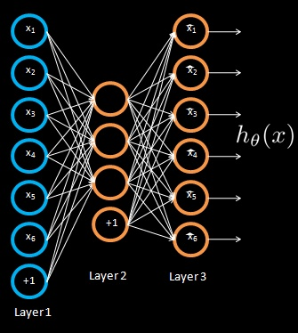

Unsupervised feature learning with a neural network
Training a sparse autoencoder.
Given unlabeled training set x₁, x₂, …
a₁
a₂
a₃
Reconstruction error term
L₁ sparsity term

Slide 24
Unsupervised feature learning with a neural network
x₁
x₁
x₂
x₂
a₁
x₃
x₃
a₂
x₄
x₄
a₃
x₅
x₅
+1
x₆
x₆
+1
Layer 2
Layer 3
Layer 1

Slide 25

Unsupervised feature learning with a neural network
x₁
x₂
a₁
x₃
a₂
x₄
a₃
x₅
+1
New representation for input.
x₆
+1
Layer 2
Layer 1

Slide 26
Unsupervised feature learning with a neural network
x₁
x₂
a₁
x₃
a₂
x₄
a₃
x₅
+1
x₆
+1
Layer 2
Layer 1

Slide 27

Unsupervised feature learning with a neural network
x₁
x₂
a₁
b₁
x₃
a₂
b₂
x₄
a₃
b₃
x₅
+1
+1
x₆
+1
Train parameters so that ,
subject to b_{i}’s being sparse.

Slide 28
Unsupervised feature learning with a neural network
x₁
x₂
a₁
b₁
x₃
a₂
b₂
x₄
a₃
b₃
x₅
+1
+1
x₆
+1
Train parameters so that ,
subject to b_{i}’s being sparse.

Slide 29
Unsupervised feature learning with a neural network
x₁
x₂
a₁
b₁
x₃
a₂
b₂
x₄
a₃
b₃
x₅
+1
+1
x₆
+1
Train parameters so that ,
subject to b_{i}’s being sparse.

Slide 30

Unsupervised feature learning with a neural network
x₁
x₂
a₁
b₁
x₃
a₂
b₂
x₄
a₃
b₃
x₅
+1
+1
New representation for input.
x₆
+1

Slide 31
Unsupervised feature learning with a neural network
x₁
x₂
a₁
b₁
x₃
a₂
b₂
x₄
a₃
b₃
x₅
+1
+1
x₆
+1

Slide 32

Unsupervised feature learning with a neural network
x₁
x₂
a₁
b₁
c₁
x₃
a₂
b₂
c₂
x₄
a₃
b₃
c₃
x₅
+1
+1
+1
x₆
+1

Slide 33

Unsupervised feature learning with a neural network
x₁
x₂
a₁
b₁
c₁
x₃
a₂
b₂
c₂
x₄
a₃
b₃
c₃
x₅
+1
+1
+1
New representation
for input.
x₆
+1
Use [c₁, c₃, c₃] as representation to feed to learning algorithm.

Slide 34
More on Sparsity
Image classification
by sparse coding

Slide 35
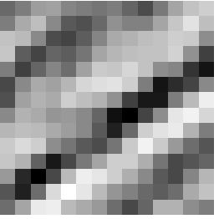
Feature learning problem
Given a 14x14 image patch x, can represent it using 196 real numbers.
Problem: Can we find a learn a better representation for this?

Slide 36
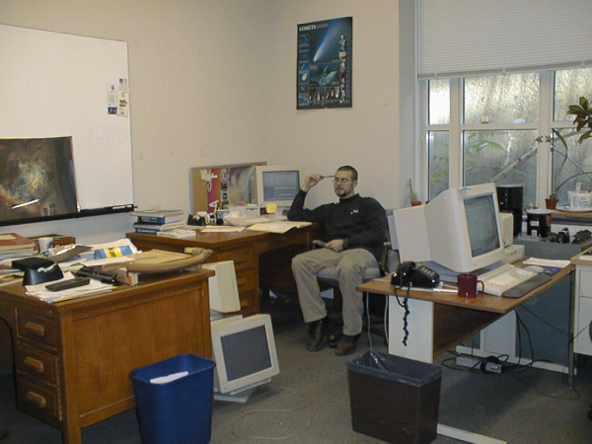





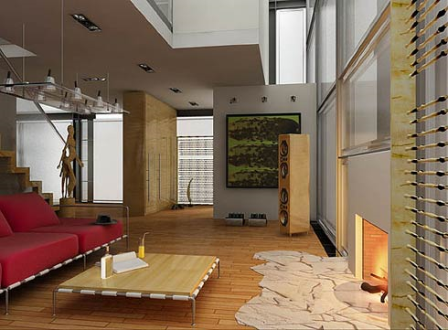
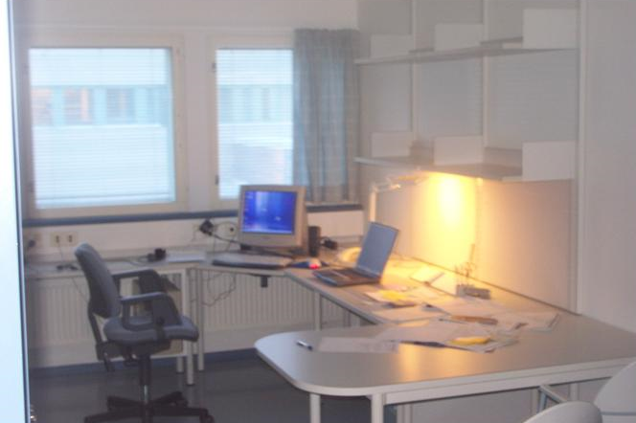
Unsupervised feature learning
Given a set of images, learn a better way to represent image than pixels.

Slide 37
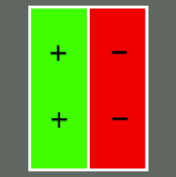
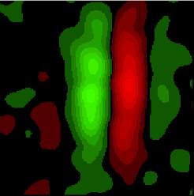
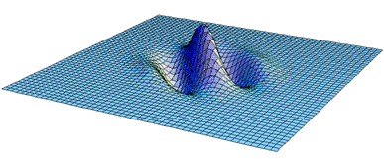
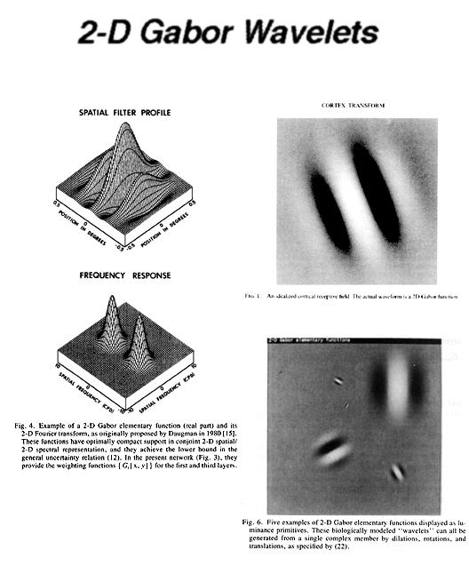
First stage of visual processing in brain: V1
The first stage of visual processing in the brain (V1) does “edge detection.”
Green: Responds to white dot.
Red: Responds to black dot.
Schematic of simple cell
Actual simple cell
Also used in image compression and denoising.
“Gabor functions.”
[Images from DeAngelis, Ohzawa & Freeman, 1995]
Notes:
http://www.ldeo.columbia.edu/4d4/wavelets/dm.html

Slide 38

Learning an image representation
Sparse coding (Olshausen & Field,1996)
Input: Images x⁽¹⁾, x⁽²⁾, …, x^{(m)} (each in R^{n x n})
Learn: Dictionary of bases φ₁, φ₂, …, φ_{k} (also R^{n x n}), so that each input x can be approximately decomposed as:
s.t. a_{j}’s are mostly zero (“sparse”)
Use to represent 14x14 image patch succinctly, as [a₇=0.8, a₃₆=0.3, a₄₁ = 0.5]. I.e., this indicates which “basic edges” make up the image.
[NIPS 2006, 2007]

Slide 39
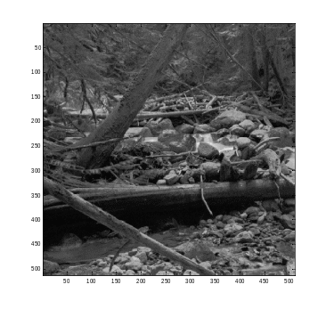
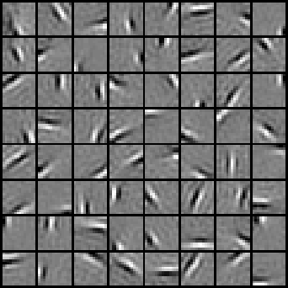
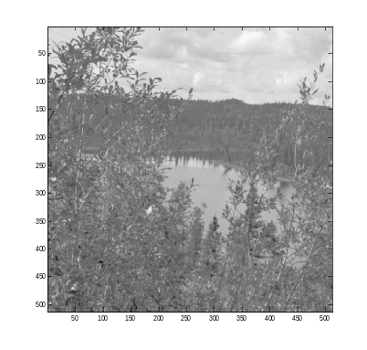
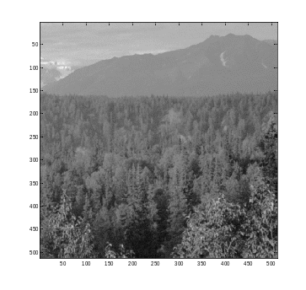






Sparse coding illustration
Natural Images
Learned bases (φ_{1 , …,} φ₆₄): “Edges”
Test example
≈ 0.8 * + 0.3 * + 0.5 *
x ≈ 0.8 * φ₄₂ + 0.3 * φ₃₆ + 0.5 * φ₆₃
[0, 0, …, 0, 0.8, 0, …, 0, 0.3, 0, …, 0, 0.5, …]
= [a₁, …, a₆₄] (feature representation)
Compact & easily
interpretable

Slide 40
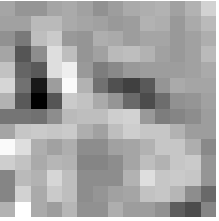
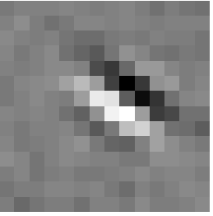






More examples
Represent as: [0, 0, …, 0, 0.6, 0, …, 0, 0.8, 0, …, 0, 0.4, …]
Represent as: [0, 0, …, 0, 1.3, 0, …, 0, 0.9, 0, …, 0, 0.3, …]
≈ 0.6 * + 0.8 * + 0.4 *
φ₁₅ φ₂₈ φ₃₇
≈ 1.3 * + 0.9 * + 0.3 *
φ₅ φ₁₈ φ₂₉
Method hypothesizes that edge-like patches are the most “basic” elements of a scene, and represents an image in terms of the edges that appear in it.
Use to obtain a more compact, higher-level representation of the scene than pixels.

Slide 41
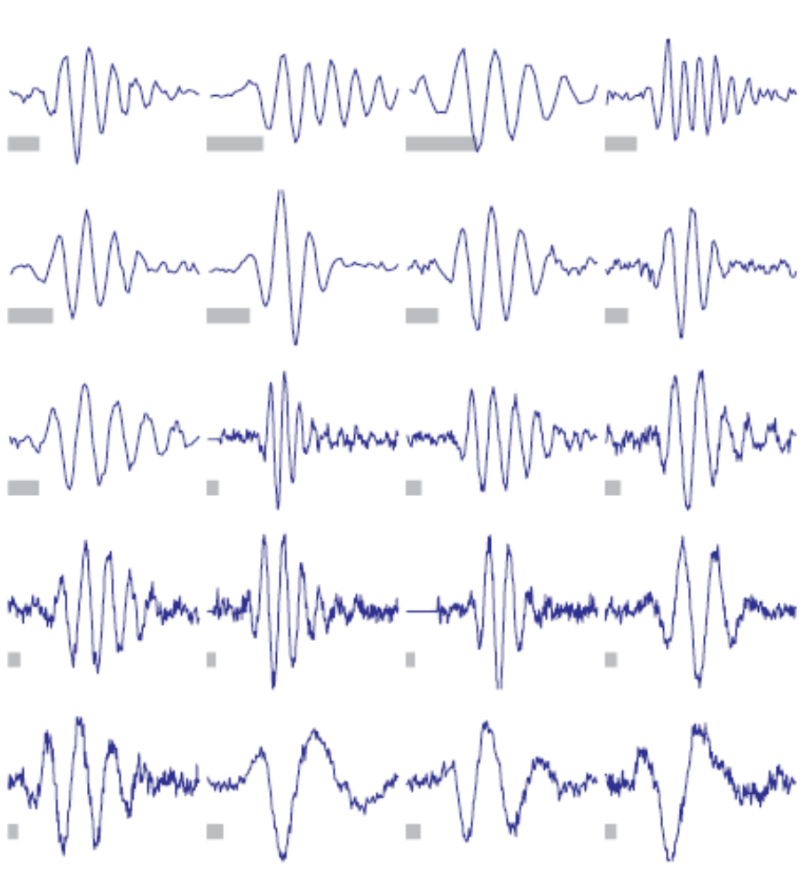
Digression: Sparse coding applied to audio
[Evan Smith & Mike Lewicki, 2006]
Notes:
Efficient Kernels
Here is a collection of revcor filters, some of which you saw earlier, recorded from cat auditory nerve fibers
For each optimized kernel function we’ll pick the revcor filter it best matches and overlaid them [click]

Slide 42
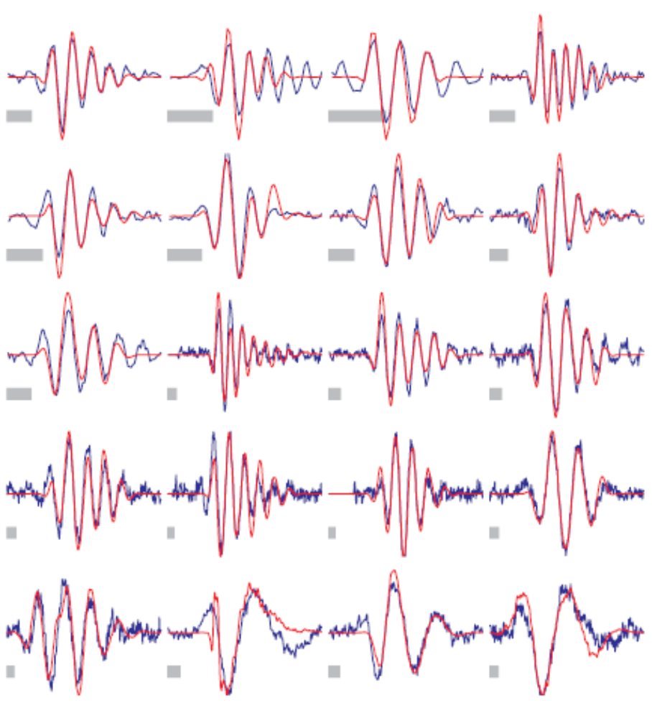
Digression: Sparse coding applied to audio
[Evan Smith & Mike Lewicki, 2006]
Notes:
Efficient Kernels
Here you can see that for nearly all of the optimized kernel functions, they closely match the detailed structure of an individual ANF revcor filter [click]

Slide 43


Sparse coding details
Input: Images x⁽¹⁾, x⁽²⁾, …, x^{(m)} (each in R^{n x n})
L₁ sparsity term
(causes most s to be 0)
Alternating minimization:
Alternately minimize with respect to φ_{ι}‘s (easy)
and a’s (harder).

Slide 44
Solving for bases
Early versions of sparse coding were used to learn about this many bases:
32 learned bases
How to scale this algorithm up?

Slide 45
Sparse coding details
Input: Images x⁽¹⁾, x⁽²⁾, …, x^{(m)} (each in R^{n x n})
L₁ sparsity term
Alternating minimization:
Alternately minimize with respect to φ_{ι}‘s (easy)
and a’s (harder).

