Slide 1

Ending the Tobacco era
Analysis of smoking trends and
policy impact based on
OECD data
Valentin Lacombe (5 CFU)
Flavia Petruso (8 CFU)
Nonparametric Statistics course Msc. Mathematical Engineering - Politecnico di Milano

Slide 2





Stakeholders and Goals
Analysis on behalf of the OECD
Policy makers of OECD nations
General public
Quantify the effect of national policies on tobacco
smoking, to orient policymakers towards the most
effective actions
Learn recent trends on smoking in the «Health at a Glance 2023» report
Characterise gender differences in the factors affecting smoking prevalence
Identify OECD countries more likely to reach the SDG3
(30% decrease from 2010 to 2025) under BAU (business as usual), and the ones needing more action

Slide 3



Dataset
WHO dataset on tobacco for the 37 OECD countries
Tobacco smoking prevalence (total, male, female) for 7 timepoints
Data on control and monitoring of tobacco smoking for 6 timepoints:
Factor variables: anti-tobacco campaigns, bans on tobacco products, protection from tobacco smoke, help to quit tobacco use, warning about tobacco dangers
Continuous variables: tax on final cigarette price, cigarette affordability
Other continuous variables from the OECD database
GDP per capita (constant PPP)
Education level: % of 25-64 population with tertiary education

Slide 4
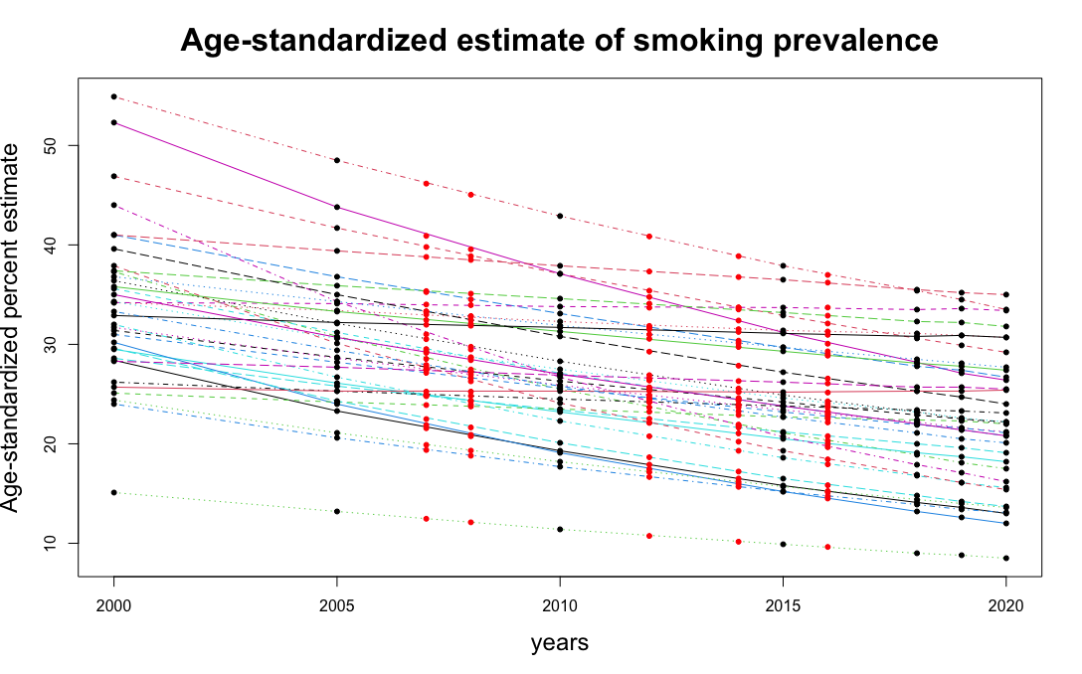

Dataset - preprocessing
Timepoint mismatch between the main covariates and the smoking estimates
Assumption: smoothnes of the smoking prevalence trend in time
Interpolation using B-splines to estimate the values for the missing years
measurements
estimated points
Alternative approach to assess reliability of the previous estimates
(to be tried soon):
penalised splines

Slide 5
Main methods
Exploratory data analysis, preliminary inference and hypothesis testing
Spearman Correlation to assess the correlation between variables
Permutational tests for paired univariate data to test gender differences in smoking prevalence for men and women for each year
«Rough» conformal prediction intervals (irrespectively of year or country) for smoking prevalence, both overall and for each gender
GAM (or GAMM) to estimate the prevalence of tobacco consumption based on the relevant variables. Possibly different models for males and females
Permutational tests to identify variables of relevance to the GAM
Conformal prediction intervals to predict the smoking tobacco prevalence in 2025 to see which countries will reach SDG3 (possibly quantile-based conformal prediction)

Slide 6
Dataset links and References
WHO dataset on tobacco, data selected for the 37 OECD countries
https://apps.who.int/gho/data/node.main.TOBMPOWER?lang=en
Other datatsets from OECD database
https://stats.oecd.org/

