Slide 1
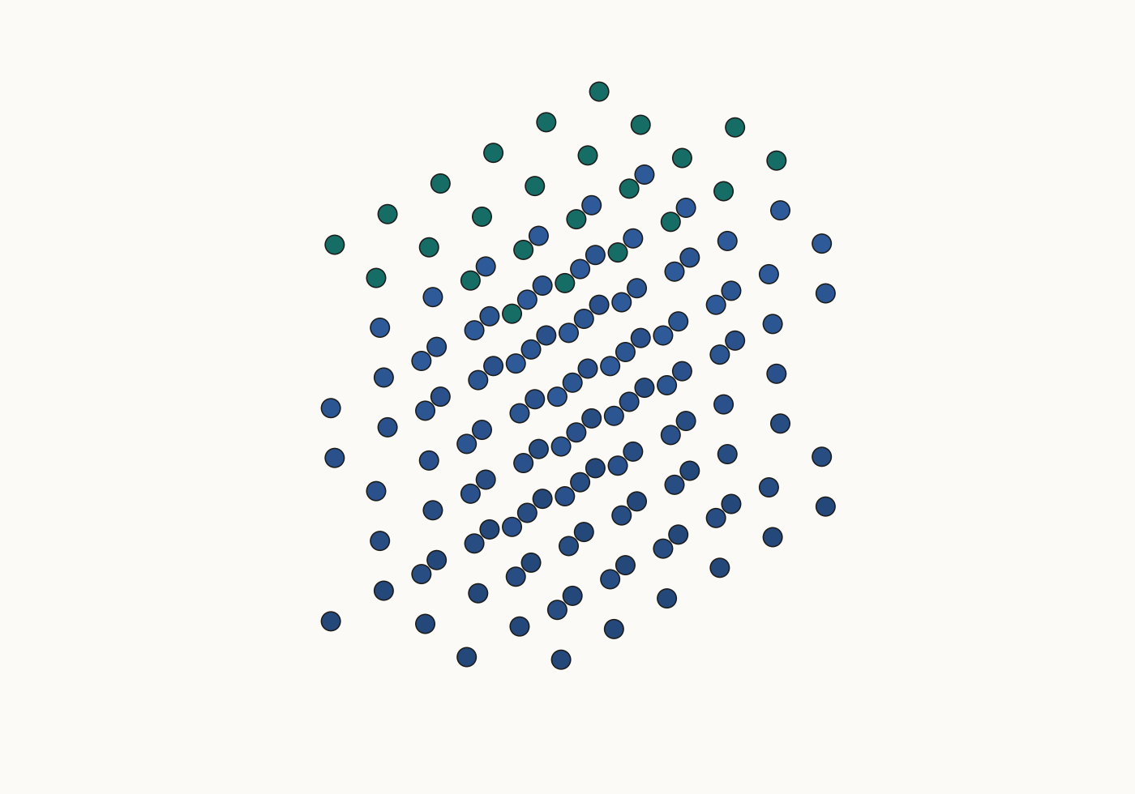
INTERFACE FORCE FIELD
OPENING
Interface
Force Field
From atoms to a testable material prediction
A visual guide to structure, simulation
and experimental evidence
Sean Florez · 3 October 2026
RHODIUM · A SOURCE-GROUNDED WALKTHROUGH
K21 · K21C
01 / 35
Notes:
This deck explains Interface Force Field (IFF) as a classical molecular-mechanics framework. The running example is face-centered cubic rhodium, with source-grounded ideal structures and numerical results from Kanhaiya et al. (2021). Camera motion and analytical two-atom illustrations explain concepts; they are not recorded material trajectories. Published predictions are replotted and are not newly rerun simulations. The aim is to understand how an atomic model becomes a claim that can be tested against experiment, including where the claim should be restricted. Pure-metal, alloy and agent-workflow examples have separate evidence boundaries.
EVIDENCE / SOURCES
K21: Kanhaiya, Kim, Im & Heinz (2021), Accurate simulation of surfaces and interfaces of ten FCC metals and steel using Lennard–Jones potentials
https://doi.org/10.1038/s41524-020-00478-1
Scope: Original article Tables 1–5 and Supplementary Methods. Published results, not independently rerun here.
K21C: Kanhaiya et al. (2021), Author Correction
https://doi.org/10.1038/s41524-021-00576-8
Scope: Corrects missing unit-cell and script files in Supplementary Data; no reported numerical table correction.

Slide 2
INTERFACE FORCE FIELD
OPENING
Begin with the decision
What would change if the predicted interface were wrong?
Question: what does it cost to expose a Rh surface?
Observable: (111) surface energy, γ111, in J/m².
Scope: pure fcc Rh, a defined face and thermodynamic state.
DEFINE THE OBSERVABLE BEFORE CHOOSING THE METHOD
K21
02 / 35
Notes:
Surface energy matters when evaluating exposed crystal faces, cleavage and interface formation. This is a narrow pedagogical material question, not a prediction of a complete product or catalyst. The paper parameterizes metal models using lattice and surface evidence at standard conditions. A surface energy should not be confused with adsorption free energy, liquid interface tension, reaction barrier or corrosion rate. Changing the decision usually changes the required estimator, conditions and validation evidence. We begin with pure fcc Rh to avoid introducing unsupported alloy or reaction generality.
EVIDENCE / SOURCES
K21: Kanhaiya, Kim, Im & Heinz (2021), Accurate simulation of surfaces and interfaces of ten FCC metals and steel using Lennard–Jones potentials
https://doi.org/10.1038/s41524-020-00478-1
Scope: Original article Tables 1–5 and Supplementary Methods. Published results, not independently rerun here.

Slide 3
INTERFACE FORCE FIELD
OPENING
Keep every link in the chain visible
A structure is an input. A validated claim is an outcome.
01
02
03
04
05
06
Structure
Model
Energy / force
Simulation
Observable
Evidence
composition · phase · cell
types · parameters · rules
Hamiltonian · gradient
minimize · integrate
estimator · conditions
fit · test · limit
Separate the input, model, calculation and evidence for every claim.
K21 · AGENT
03 / 35
Notes:
Coordinates and a cell specify a configuration. A Hamiltonian and parameter package specify how the model assigns energy to that configuration. Forces follow from derivatives. A numerical operation then explores configurations or time evolution. An observable is an estimator applied to the resulting configurations. Only comparison under a suitable evidence contract supports a qualified material claim. Each transformation requires enough provenance to reproduce it. The IFF Agent is meant to preserve that evidence chain rather than collapse a successful file export or calculation into scientific acceptance.
EVIDENCE / SOURCES
K21: Kanhaiya, Kim, Im & Heinz (2021), Accurate simulation of surfaces and interfaces of ten FCC metals and steel using Lennard–Jones potentials
https://doi.org/10.1038/s41524-020-00478-1
Scope: Original article Tables 1–5 and Supplementary Methods. Published results, not independently rerun here.
AGENT: IFF Agent workflow documentation (2026)
Implemented workflow documentation / original derivation
Scope: High-level explanation of the implemented evidence workflow and distinct model families. Implementation is separate from completion or scientific acceptance of a new package.

Slide 4
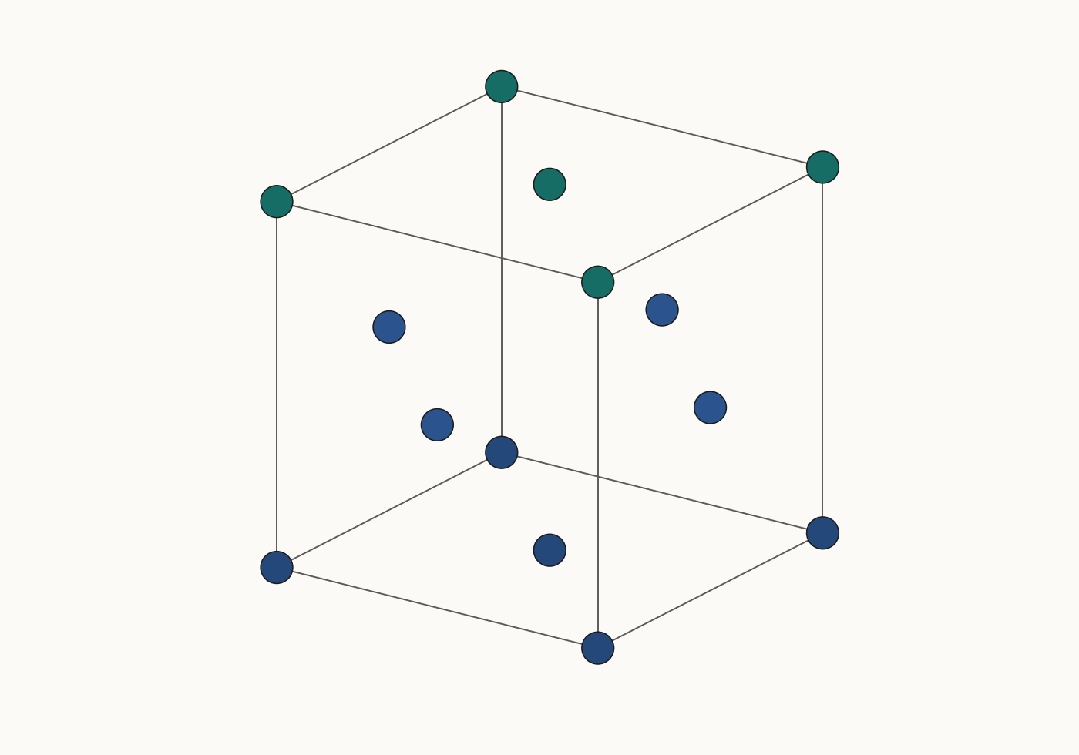
INTERFACE FORCE FIELD
01 · STRUCTURE & CHEMISTRY
Start with a real periodic crystal
Rhodium: fcc, Fm-3m, a = 3.8032 Å
Corrected supplementary CAR: one symmetry-unique Rh site.
Expand Fm-3m symmetry → 4 atoms per conventional cell.
Render equivalent boundary sites to show the cell clearly.
SOURCE GEOMETRY · STATIC IDEAL CELL
K21 · K21C
04 / 35
Notes:
The corrected public supplementary archive supplies rh_unit_cell_Fm3m.car. Its cubic cell has a=b=c=3.8032 Å and an Rh site at the origin under Fm-3m symmetry. This source is expanded into the four conventional fcc sites: (0,0,0), (0,1/2,1/2), (1/2,0,1/2), and (1/2,1/2,0). The illustration includes periodic equivalents on the cell boundary, so visible sphere count is not a cell atom count. The geometry is an ideal source-grounded construction, not a relaxed measured snapshot. The conventional-cell length agrees with the Rh five-cell reference in Table 2: 19.016 Å / 5.
EVIDENCE / SOURCES
K21: Kanhaiya, Kim, Im & Heinz (2021), Accurate simulation of surfaces and interfaces of ten FCC metals and steel using Lennard–Jones potentials
https://doi.org/10.1038/s41524-020-00478-1
Scope: Original article Tables 1–5 and Supplementary Methods. Published results, not independently rerun here.
K21C: Kanhaiya et al. (2021), Author Correction
https://doi.org/10.1038/s41524-021-00576-8
Scope: Corrects missing unit-cell and script files in Supplementary Data; no reported numerical table correction.

Slide 5
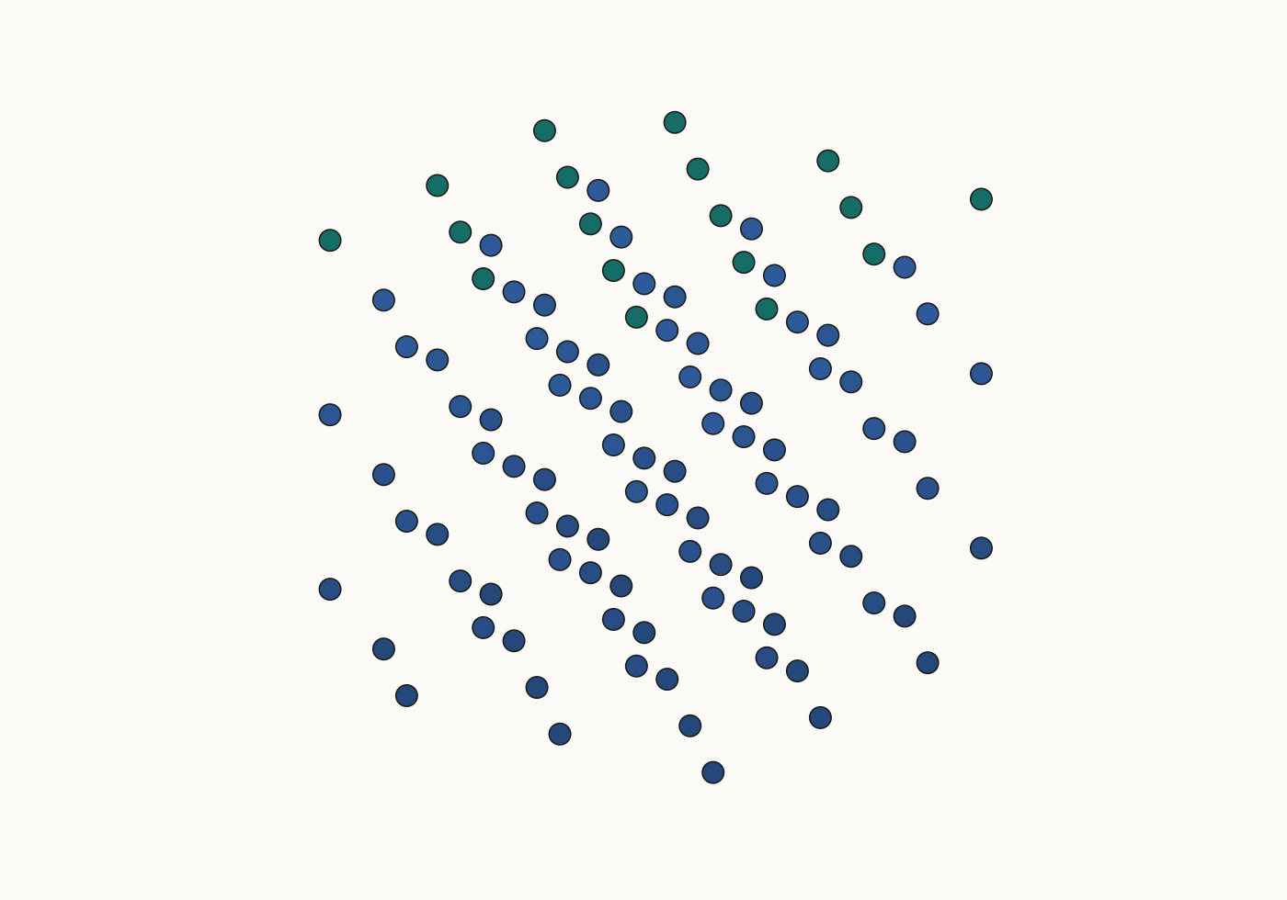
INTERFACE FORCE FIELD
01 · STRUCTURE & CHEMISTRY
A supercell changes scale, not chemistry
Replicate the cell while preserving periodic meaning.
3 × 3 × 3 conventional cells → 108 Rh atoms.
Bulk periodic boundaries reconnect opposing faces.
Paper lattice calculations used 5 × 5 × 5 cells, not this display.
DISPLAY SUPERCELL · NO NEW SIMULATION
K21 · K21C
05 / 35
Notes:
The visual supercell is built by repeating the source-derived conventional cell three times in each direction. It contains 108 atoms because 4 × 3³ = 108. It is smaller than the 500-atom, 5 × 5 × 5 fcc supercells used in the paper to calculate lattice parameters. Replication changes the finite model size without changing the element or ideal phase. Atom count alone does not establish convergence: long-wavelength modes, defects, correlations, cutoffs and periodic image effects can all change the required size. This image is a reproducible structural illustration, not a claim about simulation accuracy.
EVIDENCE / SOURCES
K21: Kanhaiya, Kim, Im & Heinz (2021), Accurate simulation of surfaces and interfaces of ten FCC metals and steel using Lennard–Jones potentials
https://doi.org/10.1038/s41524-020-00478-1
Scope: Original article Tables 1–5 and Supplementary Methods. Published results, not independently rerun here.
K21C: Kanhaiya et al. (2021), Author Correction
https://doi.org/10.1038/s41524-021-00576-8
Scope: Corrects missing unit-cell and script files in Supplementary Data; no reported numerical table correction.

Slide 6
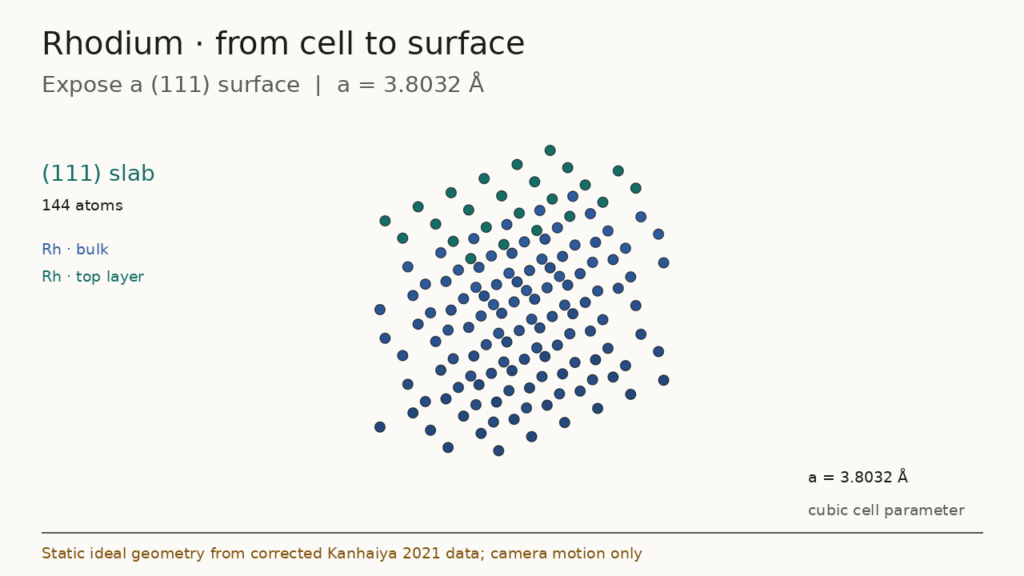
INTERFACE FORCE FIELD
01 · STRUCTURE & CHEMISTRY
A surface introduces a physical boundary
Cut the crystal along a named plane.
Rh(111): a triangular in-plane neighbor arrangement.
Constructed display slab: 6 × 4 × 6, 144 atoms.
State orientation, termination, vacuum and surface area.
Animation is included in the media companion.
(111) · IDEAL SLAB · TOP LAYER IN TEAL
K21 · K21C
06 / 35
Notes:
The display slab is constructed with ASE fcc111 from the corrected Rh lattice constant. It has 144 atoms, six layers and 7 Å vacuum on either side, and is not the research slab used to produce the published results. Bulk periodicity and surface boundary conditions answer different physical questions. In an ionic material, termination, stoichiometry and charge neutrality can make a surface construction substantially more consequential; the neutral elemental-metal example avoids those issues but does not make them optional elsewhere. The source archive also supplies oriented Rh surface cells, which we retain for geometry provenance. Playback shows only camera and construction-stage changes.
EVIDENCE / SOURCES
K21: Kanhaiya, Kim, Im & Heinz (2021), Accurate simulation of surfaces and interfaces of ten FCC metals and steel using Lennard–Jones potentials
https://doi.org/10.1038/s41524-020-00478-1
Scope: Original article Tables 1–5 and Supplementary Methods. Published results, not independently rerun here.
K21C: Kanhaiya et al. (2021), Author Correction
https://doi.org/10.1038/s41524-021-00576-8
Scope: Corrects missing unit-cell and script files in Supplementary Data; no reported numerical table correction.
Media companion: structure-walkthrough.mp4, .gif and -poster.png. Static visuals remain authoritative for interpretation.

Slide 7
INTERFACE FORCE FIELD
02 · MODEL & SIMULATION
Coordinates do not define the model
The same atomic positions can produce different predictions.
1
Geometry
species · coordinates · periodic cell
2
Chemical assignment
atom type · charge · bonded topology
3
Parameter package
functional form · coefficients · mixing
4
Numerical settings
cutoff · electrostatics · units · engine
K21 · AGENT
07 / 35
Notes:
A coordinate file does not determine atomic charges, which interaction terms apply or the coefficients in those terms. In the published pure-metal example, Rh is modeled by charge-neutral atoms with Lennard–Jones interactions. An alloy or mineral can require physically justified charge assignments and different conventions. Combining packages also requires compatible functional forms, cross interactions, units and exclusion rules. A renderer can show a plausible crystal while the actual Hamiltonian is wrong, so structure and parameter provenance must be checked separately. The current IFF Agent workflow explicitly maintains these distinctions and separates model-family branches.
EVIDENCE / SOURCES
K21: Kanhaiya, Kim, Im & Heinz (2021), Accurate simulation of surfaces and interfaces of ten FCC metals and steel using Lennard–Jones potentials
https://doi.org/10.1038/s41524-020-00478-1
Scope: Original article Tables 1–5 and Supplementary Methods. Published results, not independently rerun here.
AGENT: IFF Agent workflow documentation (2026)
Implemented workflow documentation / original derivation
Scope: High-level explanation of the implemented evidence workflow and distinct model families. Implementation is separate from completion or scientific acceptance of a new package.

Slide 8
INTERFACE FORCE FIELD
02 · MODEL & SIMULATION
IFF is classical molecular mechanics
Its role is a chemically interpretable, compatible model.
Classical models
Pair potentials, many-body models, bonded and reactive families
IFF
Materials and interfaces within specific supported conventions
K21 · L18SI
08 / 35
Notes:
IFF belongs within classical molecular mechanics, so IFF versus molecular mechanics is a category error. Useful comparisons are between specific models for a defined chemistry, state and observable. The cited metal work uses simple pair potentials, while other classical models such as EAM include many-body metallic effects and reactive families serve different purposes. Compatibility with an organic or biomolecular host force field does not guarantee every mixed interface is accurate; the host parameters and cross-interaction rules still affect the result. The presentation avoids the paper’s broad speed or accuracy slogans and instead uses observable-specific numerical evidence.
EVIDENCE / SOURCES
K21: Kanhaiya, Kim, Im & Heinz (2021), Accurate simulation of surfaces and interfaces of ten FCC metals and steel using Lennard–Jones potentials
https://doi.org/10.1038/s41524-020-00478-1
Scope: Original article Tables 1–5 and Supplementary Methods. Published results, not independently rerun here.
L18SI: Liu et al. (2018), original Supporting Information, Tables S1–S2 and discussion S18–S19
https://acs.figshare.com/articles/journal_contribution/Understanding_Chemical_Bonding_in_Alloys_and_the_Representation_in_Atomistic_Simulations/6531197
Scope: Original diagrams/plots here are newly drawn from cited facts; copyrighted source figures and source PDFs are excluded from the website bundle.

Slide 9
INTERFACE FORCE FIELD
02 · MODEL & SIMULATION
Sum only the applicable interactions
U(R; θ) is the model, with coordinates R and parameters θ.
Bonded
Electrostatic
Nonbonded
bonds · angles · dihedrals, when applicable
charges and their long-range convention
repulsion / attraction, such as Lennard–Jones
PURE RH EXAMPLE: NEUTRAL ATOMS + LJ
K21 · L18SI
09 / 35
Notes:
A generic classical Hamiltonian may contain bonded, electrostatic and nonbonded terms, with additional cross terms or many-body terms depending on the family. This is a menu rather than a prescription that all IFF systems use all listed terms. The pure Rh example in Kanhaiya et al. uses neutral atoms and the applicable Lennard–Jones form. Electrostatics becomes chemically important in the alloy example later in the deck. A model can hold topology or electronic response fixed, which limits phenomena such as bond breaking, polarization or changing oxidation state unless a suitable extension is explicitly included and validated.
EVIDENCE / SOURCES
K21: Kanhaiya, Kim, Im & Heinz (2021), Accurate simulation of surfaces and interfaces of ten FCC metals and steel using Lennard–Jones potentials
https://doi.org/10.1038/s41524-020-00478-1
Scope: Original article Tables 1–5 and Supplementary Methods. Published results, not independently rerun here.
L18SI: Liu et al. (2018), original Supporting Information, Tables S1–S2 and discussion S18–S19
https://acs.figshare.com/articles/journal_contribution/Understanding_Chemical_Bonding_in_Alloys_and_the_Representation_in_Atomistic_Simulations/6531197
Scope: Original diagrams/plots here are newly drawn from cited facts; copyrighted source figures and source PDFs are excluded from the website bundle.
DERIVED: Original derivation / explicitly illustrative visual
Implemented workflow documentation / original derivation
Scope: Mathematical definitions, ideal cell constructions and pedagogical illustrations. Not new material simulation evidence.

Slide 10
INTERFACE FORCE FIELD
02 · MODEL & SIMULATION
Two parameters have physical meaning
Rh: set the length scale and the well depth.
12–6 LJ
9–6 LJ
Rmin = 2.757 Å
ε = 7.84 kcal/mol
Rmin = 2.807 Å
ε = 6.38 kcal/mol
Rmin governs distance · ε governs well depth
TABLE 1 · EACH FAMILY IS A DISTINCT MODEL
K21
10 / 35
Notes:
Table 1 gives separate 12–6 and 9–6 Rh parameters. In the paper’s equations, the symbol sigma denotes the equilibrium nonbond distance, which this deck calls Rmin to avoid confusing it with the conventional LAMMPS lj/cut sigma. Epsilon is the energy well depth. Lattice and surface properties are coupled functions of both parameters, even though their dominant interpretations are length and cohesion. The 9–6 set is not obtained by copying the 12–6 values into a different formula, and it is not a demonstrated later revision of the 12–6 model. These values are reproduced for explanation, not adopted as a newly reviewed package.
Readable equations and values:
Rh 12-6: Rmin = 2.757 angstrom; epsilon = 7.84 kcal/mol. Rh 9-6: Rmin = 2.807 angstrom; epsilon = 6.38 kcal/mol.
EVIDENCE / SOURCES
K21: Kanhaiya, Kim, Im & Heinz (2021), Accurate simulation of surfaces and interfaces of ten FCC metals and steel using Lennard–Jones potentials
https://doi.org/10.1038/s41524-020-00478-1
Scope: Original article Tables 1–5 and Supplementary Methods. Published results, not independently rerun here.

Slide 11
INTERFACE FORCE FIELD
02 · MODEL & SIMULATION
Check the engine’s parameter convention
The word “sigma” can denote different distances.
Paper convention
U = ε[(Rmin/r)¹² − 2(Rmin/r)⁶]
LAMMPS lj/cut
U = 4ε[(σ/r)¹² − (σ/r)⁶]
Exact conversion
σ = Rmin / 2^(1/6) · ε unchanged
RH 12–6: Rmin 2.757 Å → σ ≈ 2.4562 Å
K21 · LJ
11 / 35
Notes:
A convention mismatch changes the potential even if a coefficient file appears syntactically valid. The paper’s 12–6 potential has its minimum at Rmin. LAMMPS lj/cut defines sigma at the zero crossing, with the minimum at 2^(1/6) sigma. Converting Rh therefore gives sigma approximately 2.4562 Å. The 9–6 expression in the paper has its own coefficient and mixing conventions and must not be converted using this 12–6 rule. Unit systems, cutoff handling, long-range corrections and mixing rules also matter. Export readback should compare energies, forces and affected observables from the exact consumed files.
Readable equations and values:
Paper 12-6: U = epsilon * ((Rmin/r)^12 - 2*(Rmin/r)^6).
LAMMPS lj/cut: U = 4*epsilon * ((sigma/r)^12 - (sigma/r)^6).
sigma = Rmin / 2^(1/6) = 2.4562077659 angstrom for Rh; epsilon unchanged.
EVIDENCE / SOURCES
K21: Kanhaiya, Kim, Im & Heinz (2021), Accurate simulation of surfaces and interfaces of ten FCC metals and steel using Lennard–Jones potentials
https://doi.org/10.1038/s41524-020-00478-1
Scope: Original article Tables 1–5 and Supplementary Methods. Published results, not independently rerun here.
LJ: LAMMPS documentation: lj/cut interaction convention
https://docs.lammps.org/pair_lj.html
Scope: Engine convention: U=4epsilon[(sigma/r)^12-(sigma/r)^6].

Slide 12
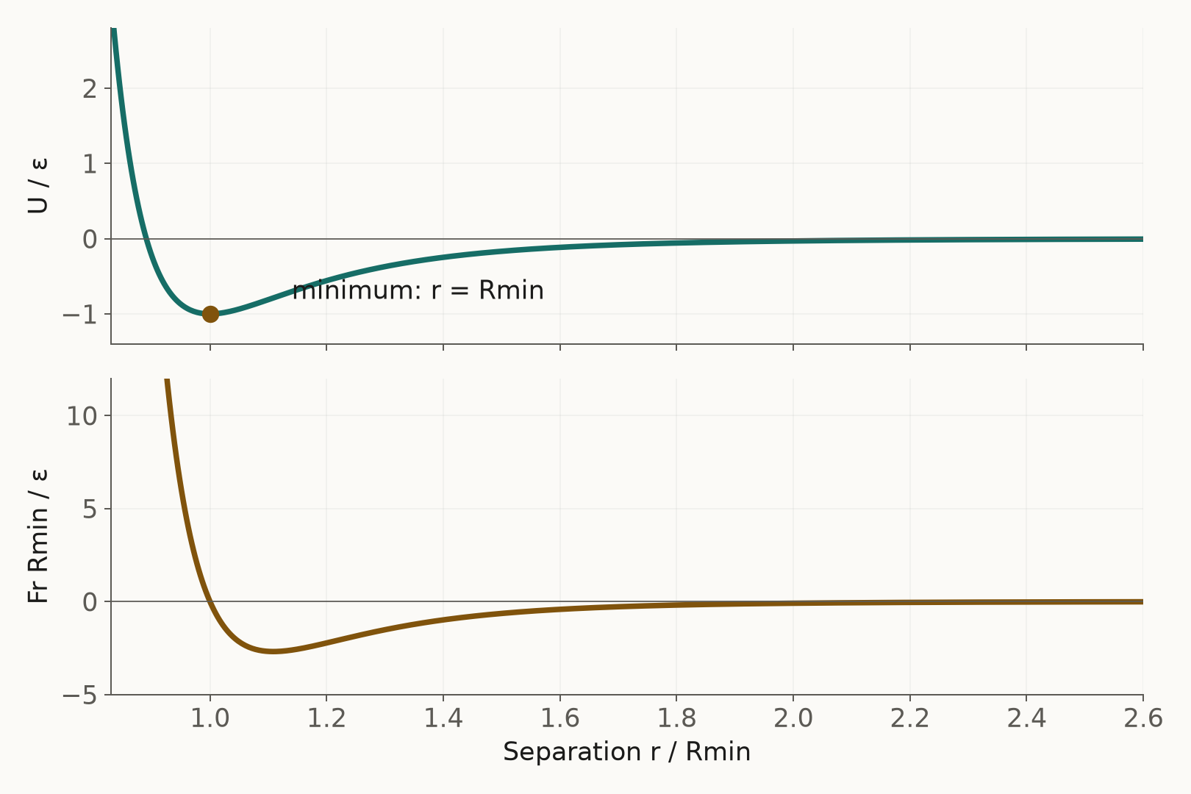
INTERFACE FORCE FIELD
02 · MODEL & SIMULATION
Forces are the slope of energy
Fi = −∇ri U(R; θ)
Too close: short-range repulsion dominates.
Past the minimum: attraction points back inward.
A pair minimum does not equal the bulk lattice constant.
ANALYTICAL 12–6 PAIR · REDUCED UNITS
K21
12 / 35
Notes:
For a two-atom separation r, the radial force is minus dU/dr. Under the Rmin convention the illustrative pair force is 12ε/Rmin[(Rmin/r)^13 − (Rmin/r)^7]. Positive radial force on the atom at positive r points outward; negative force points inward. A solid contains many interacting neighbors, so its equilibrium lattice spacing is determined by the total energy, not by a single pair minimum alone. The plotted curve is analytical in reduced units and is not an experimental result, a fitted force curve or an IFF trajectory. A finite-difference check of the derivative is included in validation.
Readable equations and values:
Force on atom i = minus the gradient of total potential energy with respect to its position.
Radial pair force = (12*epsilon/Rmin) * ((Rmin/r)^13 - (Rmin/r)^7). Positive points outward, negative inward.
EVIDENCE / SOURCES
K21: Kanhaiya, Kim, Im & Heinz (2021), Accurate simulation of surfaces and interfaces of ten FCC metals and steel using Lennard–Jones potentials
https://doi.org/10.1038/s41524-020-00478-1
Scope: Original article Tables 1–5 and Supplementary Methods. Published results, not independently rerun here.
DERIVED: Original derivation / explicitly illustrative visual
Implemented workflow documentation / original derivation
Scope: Mathematical definitions, ideal cell constructions and pedagogical illustrations. Not new material simulation evidence.

Slide 13
INTERFACE FORCE FIELD
02 · MODEL & SIMULATION
Minimization searches a local basin
Move toward a configuration with smaller residual forces.
Start from a structure and a fixed Hamiltonian.
Choose convergence tolerances and movable degrees of freedom.
A local minimum is neither a thermal ensemble nor a proof of truth.
local basin
configuration coordinate →
SCHEMATIC ENERGY LANDSCAPE · NO MATERIAL DATA
MD
13 / 35
Notes:
Energy minimization changes coordinates, and sometimes cell degrees of freedom, to seek a local energy minimum. Convergence criteria can include energy changes and force thresholds. The result depends on the initial basin, constraints and algorithm; it need not be the global minimum. A converged minimizer can still be solving an inappropriate physical model or a wrongly terminated slab. Temperature-dependent observables generally require more than a static minimum. The schematic basin on this slide is an explanatory drawing with no numerical material trajectory behind it.
EVIDENCE / SOURCES
MD: LAMMPS documentation: fix nve and minimize
https://docs.lammps.org/fix_nve.html
Scope: Velocity-Verlet NVE integration; minimization reference https://docs.lammps.org/minimize.html.
DERIVED: Original derivation / explicitly illustrative visual
Implemented workflow documentation / original derivation
Scope: Mathematical definitions, ideal cell constructions and pedagogical illustrations. Not new material simulation evidence.

Slide 14
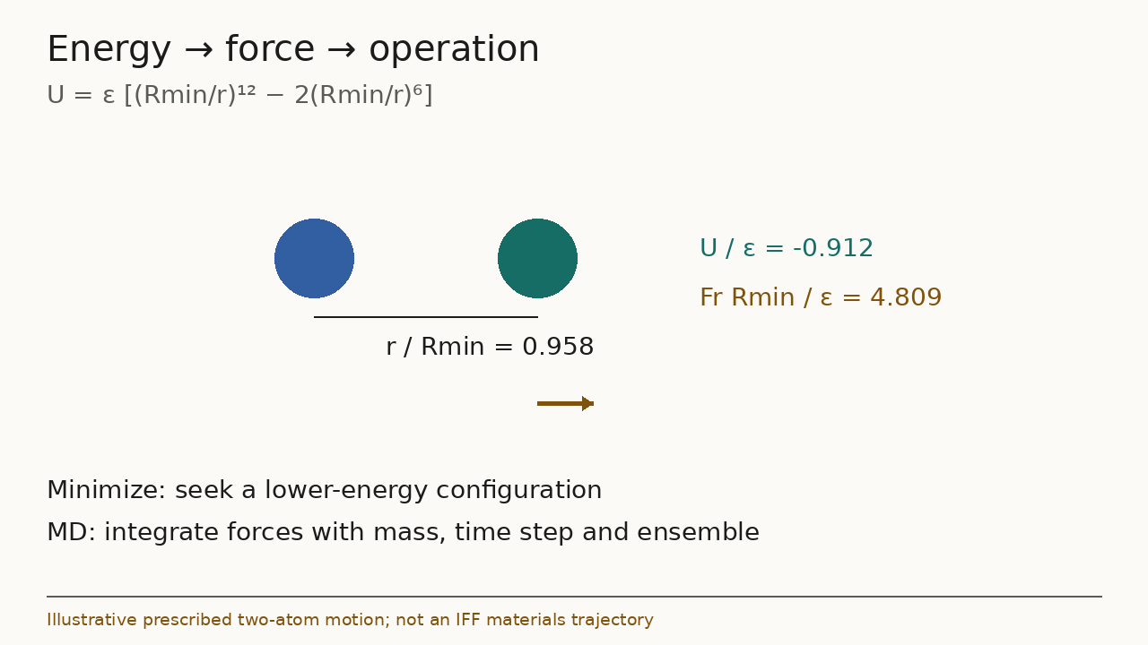
INTERFACE FORCE FIELD
02 · MODEL & SIMULATION
MD follows a time evolution
Mass and force determine acceleration; an ensemble defines state.
Newton: mi d²ri/dt² = Fi.
Time step, thermostat and barostat require explicit choices.
Equilibrate, then sample; inspect drift and correlations.
PLAYABLE TWO-ATOM ILLUSTRATION · NOT MATERIALS MD
MD · K21
14 / 35
Notes:
Molecular dynamics numerically integrates equations of motion. A common classical integrator is velocity Verlet. NVE, NVT and NPT ensembles address different constraints; thermostats and barostats affect how a target temperature and pressure are maintained. The FCC-metal paper used 1 fs steps and property-specific ensembles, described in its methods and SI. The embedded movie is prescribed analytical two-atom motion designed to show the force sign and different simulation operations. It does not integrate a Rh material trajectory, report a physical oscillation period or support a thermal prediction. Arrow direction follows the force sign; arrow length is clipped for display and is not a quantitative vector scale. A static poster remains visible if a presentation viewer cannot play the MP4.
Readable equations and values:
Mass of atom i times its second time derivative of position equals force on atom i: mi * d^2(ri)/dt^2 = Fi.
EVIDENCE / SOURCES
MD: LAMMPS documentation: fix nve and minimize
https://docs.lammps.org/fix_nve.html
Scope: Velocity-Verlet NVE integration; minimization reference https://docs.lammps.org/minimize.html.
K21: Kanhaiya, Kim, Im & Heinz (2021), Accurate simulation of surfaces and interfaces of ten FCC metals and steel using Lennard–Jones potentials
https://doi.org/10.1038/s41524-020-00478-1
Scope: Original article Tables 1–5 and Supplementary Methods. Published results, not independently rerun here.
Media companion: model-walkthrough.mp4, .gif and -poster.png. Static visuals remain authoritative for interpretation.

Slide 15
INTERFACE FORCE FIELD
02 · MODEL & SIMULATION
An observable needs a defined estimator
A trajectory is not yet the quantity you will compare.
Density
Structure
ρ = total mass / volume
g(r), coordination, lattice spacing
NPT state and sampling window
normalization and phase definition
Mechanical response
Transport
K = −V(∂P/∂V)T
D = lim MSD(t)/(6t)
isothermal / adiabatic distinction
diffusive regime and finite-size effects
K21
15 / 35
Notes:
These formulas illustrate distinct measurement contracts. Density depends on composition and volume; a distribution such as g(r) requires normalization; the isothermal bulk modulus requires an appropriate pressure-volume derivative; a diffusion estimate requires a diffusive long-time regime and correct unwrapping. The MSD expression here assumes three-dimensional isotropic diffusion and must be adjusted for other settings. Static elastic constants, finite-temperature isothermal moduli and measured acoustic adiabatic moduli are not automatically interchangeable. No transport or g(r) result is generated for this deck. Report units, state, estimator, sampling and uncertainty with every actual number.
Readable equations and values:
Density = total mass / volume.
Isothermal bulk modulus K = -V * (partial P / partial V) at fixed temperature.
Three-dimensional isotropic diffusion D = long-time mean squared displacement / (6*t), in a diffusive regime.
EVIDENCE / SOURCES
K21: Kanhaiya, Kim, Im & Heinz (2021), Accurate simulation of surfaces and interfaces of ten FCC metals and steel using Lennard–Jones potentials
https://doi.org/10.1038/s41524-020-00478-1
Scope: Original article Tables 1–5 and Supplementary Methods. Published results, not independently rerun here.
DERIVED: Original derivation / explicitly illustrative visual
Implemented workflow documentation / original derivation
Scope: Mathematical definitions, ideal cell constructions and pedagogical illustrations. Not new material simulation evidence.

Slide 16
INTERFACE FORCE FIELD
03 · EXPERIMENT & EVIDENCE
Cleave, then normalize the energy
Two equivalent new surfaces introduce a factor of two.
γ ≈ (Ecleaved − Eunified)/(2A).
Compare systems with consistent atom counts and cell geometry.
This energy estimator approximates free energy only under stated assumptions.
γ ≈ ΔE / 2A
K21 SI S3–S4 · CLEAVAGE AT 298.15 K
K21
16 / 35
Notes:
The paper compares unified and separated metal slabs with matched total atom counts and box dimensions using NVT simulations at 298.15 K. The energy difference is divided by the area of two newly created surfaces. The SI estimates the omitted entropy contribution to be small for these elemental-metal examples, within the stated experimental uncertainty. That approximation cannot be applied to every interface, adsorbate or temperature without justification. The display slab is an explanatory reconstruction rather than the actual research slab. Other geometries need their actual number of interfaces and area normalization, not a memorized universal factor of two.
Readable equations and values:
Surface energy gamma approximately equals (cleaved energy - unified energy) / (2*surface area), for two equivalent new surfaces under the stated assumptions.
EVIDENCE / SOURCES
K21: Kanhaiya, Kim, Im & Heinz (2021), Accurate simulation of surfaces and interfaces of ten FCC metals and steel using Lennard–Jones potentials
https://doi.org/10.1038/s41524-020-00478-1
Scope: Original article Tables 1–5 and Supplementary Methods. Published results, not independently rerun here.

Slide 17
INTERFACE FORCE FIELD
03 · EXPERIMENT & EVIDENCE
Match the experimental state
A comparison is meaningful only when definitions align.
Material
State
composition · crystal phase · purity · surface
temperature · pressure · environment
Measurement
Simulation
observable definition · protocol · uncertainty
ensemble · finite size · convergence · averaging
FITTED, MEASURED AND PREDICTED ARE DIFFERENT LABELS
K21 · AGENT
17 / 35
Notes:
A careful comparison reconciles experimental specimen, method, state and uncertainty with the model and estimator. The metal SI discusses the difference between polycrystalline experimental surface references and an ideal (111) face, and the small energy-versus-free-energy approximation. Table 5 includes multiple experimental mechanical references, so the deck identifies the selected ones instead of disguising them as a single definitive average. In the current IFF Agent workflow, primary-reference adoption precedes fitting and includes unresolved derivation rules or state definitions. An unexplained secondary number or a published model coefficient is not itself a primary experimental reference.
EVIDENCE / SOURCES
K21: Kanhaiya, Kim, Im & Heinz (2021), Accurate simulation of surfaces and interfaces of ten FCC metals and steel using Lennard–Jones potentials
https://doi.org/10.1038/s41524-020-00478-1
Scope: Original article Tables 1–5 and Supplementary Methods. Published results, not independently rerun here.
AGENT: IFF Agent workflow documentation (2026)
Implemented workflow documentation / original derivation
Scope: High-level explanation of the implemented evidence workflow and distinct model families. Implementation is separate from completion or scientific acceptance of a new package.

Slide 18
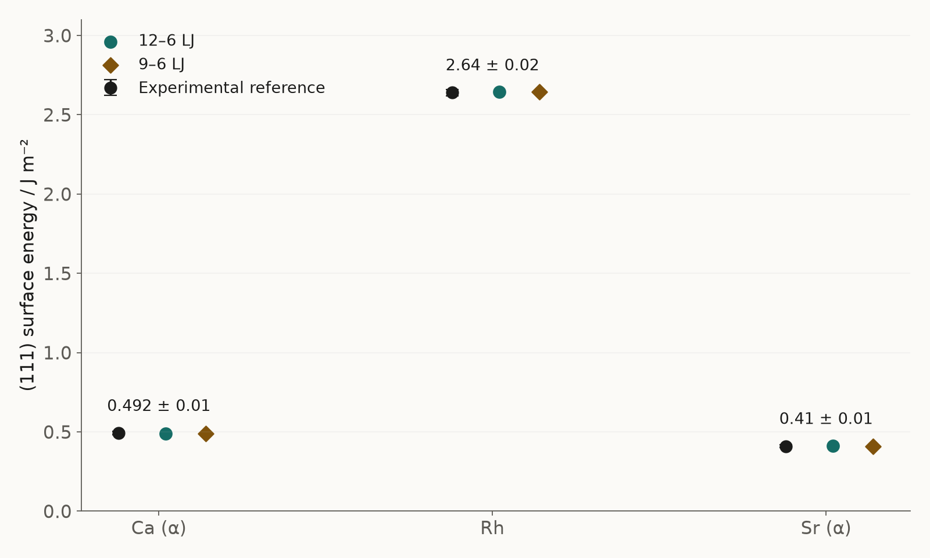
INTERFACE FORCE FIELD
03 · EXPERIMENT & EVIDENCE
Published fit: Rh matches its targets
Agreement on calibration quantities follows the fitting objective.
5-cell lattice: 19.016 → 19.016 Å (12–6); 19.014 Å (9–6).
Rh γ111 reference: 2.64 ± 0.02 J/m².
Both published Rh models: γ111 = 2.643 J/m².
TABLES 2–3 · 298 K · CALIBRATION, NOT INDEPENDENT VALIDATION
K21
18 / 35
Notes:
The paper assigns parameters from experimental density/lattice and surface-energy evidence. The Rh agreement shown here is therefore calibration agreement, not an independent validation score. The chart also shows Ca(alpha) and Sr(alpha) from Table 3 to make the published surface fits inspectable; all references and uncertainties are exactly transcribed. Table 2 contains five-cell lengths, so those lengths should not be misreported as single-cell lattice constants. The paper’s conditions are 298 K and atmospheric pressure for lattice calculations, with surface methods explained in the SI. These are published calculations; the deck does not claim a new rerun or fit.
Readable equations and values:
Rh five-cell lattice reference 19.016 angstrom; 12-6 result 19.016; 9-6 result 19.014.
Rh (111) surface reference 2.64 +/- 0.02 J/m^2; both model results 2.643 J/m^2. These are calibration comparisons.
EVIDENCE / SOURCES
K21: Kanhaiya, Kim, Im & Heinz (2021), Accurate simulation of surfaces and interfaces of ten FCC metals and steel using Lennard–Jones potentials
https://doi.org/10.1038/s41524-020-00478-1
Scope: Original article Tables 1–5 and Supplementary Methods. Published results, not independently rerun here.

Slide 19
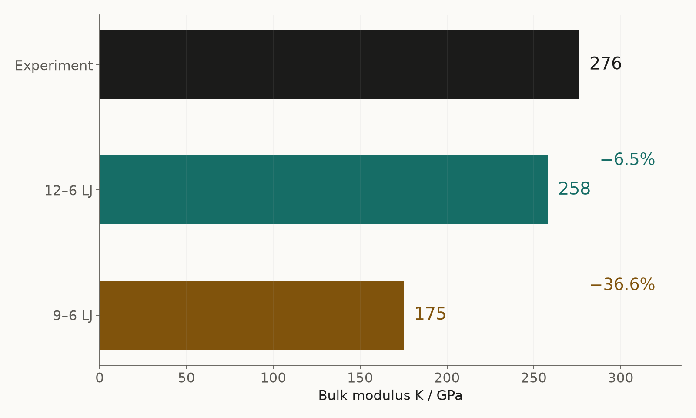
INTERFACE FORCE FIELD
03 · EXPERIMENT & EVIDENCE
Independent predictions reveal the limits
A good surface fit can coexist with a poor elastic prediction.
Rh K: experiment 276 GPa; 12–6 LJ 258; 9–6 LJ 175.
Relative deviations: −6.5% and −36.6%.
The pair-model elastic constraint limits what can be matched.
TABLE 5 · NON-FITTED K · SI PROTOCOL REPEATABILITY ≈ ±3%
K21
19 / 35
Notes:
Kanhaiya et al. report Rh bulk modulus predictions of 258 GPa and 175 GPa for the two LJ families. We use the 276 GPa experimental entry marked reference d in Table 5; the same table also lists 270, 271 and 269 GPa from other references. Percent deviations on this slide are calculated against the selected 276 GPa reference, not copied from a universal benchmark. These mechanical properties were not the density/surface calibration targets. The paper explains limits of central-force pair models, including the elastic relation C12/C44=1 for the pair framework and material-dependent performance. Do not describe this as a formal blinded campaign or universal IFF validation. Kanhaiya et al. SI S7-S8 reports approximately ±3% reproducibility of calculated elastic moduli and agreement of small-strain Discover and LAMMPS E/K protocols within 0% to ±3% (strain 0.001-0.01). This is computational protocol repeatability, not accuracy against experiment, a statistical confidence interval or the error of a reserved-property prediction. The Rh deviations from the selected 276 GPa experimental entry remain -6.5% and -36.6%.
Readable equations and values:
Rh bulk modulus: selected experiment 276 GPa; 12-6 model 258 GPa (-6.5%); 9-6 model 175 GPa (-36.6%).
EVIDENCE / SOURCES
K21: Kanhaiya, Kim, Im & Heinz (2021), Accurate simulation of surfaces and interfaces of ten FCC metals and steel using Lennard–Jones potentials
https://doi.org/10.1038/s41524-020-00478-1
Scope: Original article Tables 1–5 and Supplementary Methods. Published results, not independently rerun here.

Slide 20
INTERFACE FORCE FIELD
03 · EXPERIMENT & EVIDENCE
Alloys can add chemical polarity
Charge assignment follows chemistry, not the element name alone.
Liu SI: match Al–Ni alloy-formation evidence to model charges.
AlNi example: base charges ±0.39e in SI Table S2.
Charge transfer must preserve total neutrality.
Al +0.39e
Ni −0.39e
B2 topology · schematic · not a metric structure
BINARY ALLOY EXAMPLE · NO GENERAL HEA CLAIM
L18 · L18SI
20 / 35
Notes:
The original supporting information explains charge assignments using pure-metal pair potentials and experimentally measured alloy formation evidence. Table S2 uses ±0.39e base charges for AlNi. The SI’s extended-Born discussion also reports a feasible Al charge range of approximately +0.39e to +0.5e under its assumptions, so a single charge value must not be presented as a uniquely measured electron population. The topology diagram is schematic, not a source coordinate file or a fitted lattice reconstruction. The original SI supports this binary-alloy example. No numerical main-paper defect comparison, universal alloy predictor or high-entropy-alloy performance is inferred.
EVIDENCE / SOURCES
L18: Liu et al. (2018), Understanding Chemical Bonding in Alloys and the Representation in Atomistic Simulations
https://doi.org/10.1021/acs.jpcc.8b01891
Scope: Claims here are grounded in original SI S15–S19 and publisher SI metadata; no main-paper numerical comparison is presented.
L18SI: Liu et al. (2018), original Supporting Information, Tables S1–S2 and discussion S18–S19
https://acs.figshare.com/articles/journal_contribution/Understanding_Chemical_Bonding_in_Alloys_and_the_Representation_in_Atomistic_Simulations/6531197
Scope: Original diagrams/plots here are newly drawn from cited facts; copyrighted source figures and source PDFs are excluded from the website bundle.

Slide 21
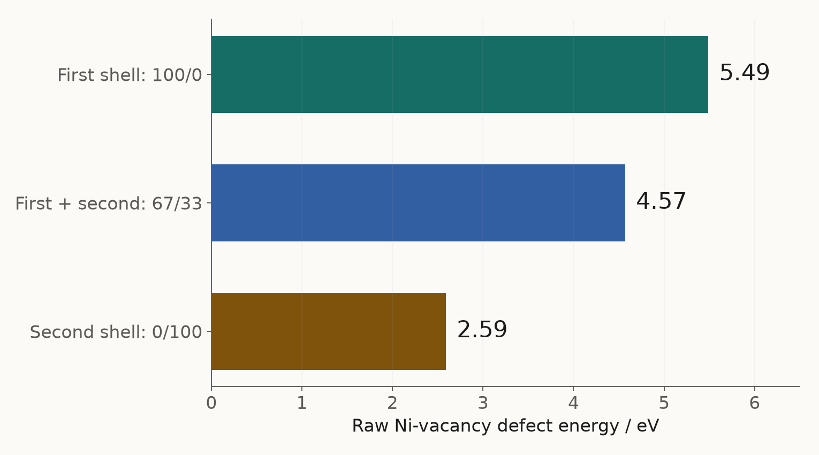
INTERFACE FORCE FIELD
03 · EXPERIMENT & EVIDENCE
A defect changes its local environment
Different charge hypotheses change the computed energy.
Ni vacancy in AlNi: redistribute the removed site’s charge.
SI Table S2 raw energies: 5.49, 4.57 and 2.59 eV.
Raw defect energies are not final formation free energies.
TABLE S2 · CHARGE-HYPOTHESIS SENSITIVITY
L18SI
21 / 35
Notes:
The three plotted values are from Table S2 for a Ni vacancy. They correspond to redistribution into the first neighbor shell (100/0), into first and second shells (67/33), and into the second shell (0/100). The table describes the first option as most likely and lists the others as alternative charge hypotheses. Its heading explicitly calls the numbers raw defect formation energy in MM. A final thermodynamic defect quantity needs appropriate reservoirs, charge-state terms and conditions; this chart is not a fresh validation or a final vacancy-formation-energy benchmark. It shows why a chemically justified local assignment is consequential. The plot is newly drawn from table facts and reproduces no source figure.
Readable equations and values:
AlNi Ni-vacancy raw defect energies in eV: first/second-shell redistribution 100/0 -> 5.49; 67/33 -> 4.57; 0/100 -> 2.59.
EVIDENCE / SOURCES
L18SI: Liu et al. (2018), original Supporting Information, Tables S1–S2 and discussion S18–S19
https://acs.figshare.com/articles/journal_contribution/Understanding_Chemical_Bonding_in_Alloys_and_the_Representation_in_Atomistic_Simulations/6531197
Scope: Original diagrams/plots here are newly drawn from cited facts; copyrighted source figures and source PDFs are excluded from the website bundle.

Slide 22
INTERFACE FORCE FIELD
03 · EXPERIMENT & EVIDENCE
Calibration and validation take different paths
Protect the independent test from every tuning decision.
Calibration
Independent test
references → fit parameters → verify targets
reserved property → forward prediction → compare
qualified for scope · limited · withheld
K21 · AGENT
22 / 35
Notes:
The implemented crystalline/ionic workflow separates primary reference selection, branch-specific fitting and independent evidence. Its fitting sequence adjusts the minimum-distance parameter to an adopted lattice reference and a common well-depth scale to adopted surface evidence, revisiting their coupling. Bulk modulus is reserved: it must not influence fit objectives, weights, parameter bounds, family selection or tuning. A failed reserved-property comparison restricts the claim. The FCC-metal literature example is separate from this implemented workflow; its non-fitted mechanical predictions were not rerun here.
EVIDENCE / SOURCES
K21: Kanhaiya, Kim, Im & Heinz (2021), Accurate simulation of surfaces and interfaces of ten FCC metals and steel using Lennard–Jones potentials
https://doi.org/10.1038/s41524-020-00478-1
Scope: Original article Tables 1–5 and Supplementary Methods. Published results, not independently rerun here.
AGENT: IFF Agent workflow documentation (2026)
Implemented workflow documentation / original derivation
Scope: High-level explanation of the implemented evidence workflow and distinct model families. Implementation is separate from completion or scientific acceptance of a new package.

Slide 23
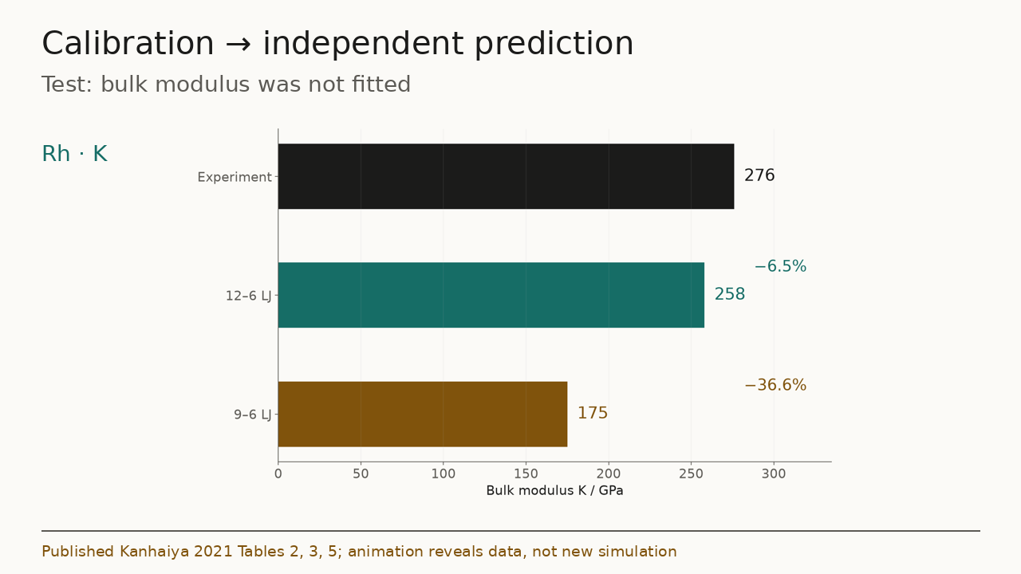
INTERFACE FORCE FIELD
03 · EXPERIMENT & EVIDENCE
A revised model needs fresh evidence
Once a test informs a revision, it is no longer untouched.
Changing parameters or model family creates a new candidate.
Retire reused test data into development evidence.
Reserve fresh observations for the next independent claim.
EVIDENCE HYGIENE · NO NEW FIT OR VALIDATED REVISION CLAIM
AGENT
23 / 35
Notes:
Changing model parameters, chemistry or functional form creates a new candidate. Test data that inform that change become development evidence; a fresh independent claim requires fresh evidence. The published 12-6 and 9-6 models are alternatives, not a temporal revision. The evidence movie reveals published comparisons before illustrating a possible new evidence contract. The implemented workflow reserves bulk modulus from fitting and family selection. No completed new revision or independent validation is claimed.
EVIDENCE / SOURCES
AGENT: IFF Agent workflow documentation (2026)
Implemented workflow documentation / original derivation
Scope: High-level explanation of the implemented evidence workflow and distinct model families. Implementation is separate from completion or scientific acceptance of a new package.
DERIVED: Original derivation / explicitly illustrative visual
Implemented workflow documentation / original derivation
Scope: Mathematical definitions, ideal cell constructions and pedagogical illustrations. Not new material simulation evidence.
Media companion: evidence-walkthrough.mp4, .gif and -poster.png. Static visuals remain authoritative for interpretation.

Slide 24
INTERFACE FORCE FIELD
04 · THE IFF AGENT
The IFF Agent carries the evidence chain
The workflow joins scientific choices to inspectable files.
01
02
03
04
Intake
References
Model
Contract
material · intended use
primary state & uncertainty
charges · four branches
fit / test · allocation
05
06
07
08
Run & fit
Validate
Export readback
Review & disposition
source-grounded structures
held-out + convergence
exact consumed bytes
qualified / limited / withheld
IMPLEMENTED EVIDENCE WORKFLOW · SCIENTIFIC ACCEPTANCE IS SEPARATE
AGENT
24 / 35
Notes:
The IFF Agent implementation connects intake, primary references, model assignment, a bounded fit/test contract, calculation and fitting, independent checks, exact export readback, and scientific review. It keeps CHARMM/AMBER, CVFF/OPLS, PCFF and PCFF-HQ as distinct model-family branches, preserving the potential of each family, coefficients, radius, mixing and export conventions. Runnable software and numerical execution do not establish correct chemical assignment or acceptance of a new scientific package.
EVIDENCE / SOURCES
AGENT: IFF Agent workflow documentation (2026)
Implemented workflow documentation / original derivation
Scope: High-level explanation of the implemented evidence workflow and distinct model families. Implementation is separate from completion or scientific acceptance of a new package.

Slide 25
INTERFACE FORCE FIELD
04 · THE IFF AGENT
Scientific decisions define the scope
References, model choices, test rules and final adoption stay explicit.
References
Model
primary experiments · state · derivation
physical charges · family · neutrality
Fit / test rules
Scientific adoption
variables · bounds · validation · resources
exact reviewed export · supported scope
IMPLEMENTED WORKFLOW · CONSEQUENTIAL SCIENTIFIC DECISIONS
AGENT
25 / 35
Notes:
The implemented workflow records reference selection, consequential charge/model choices, bounded fit/test rules and scientific adoption of an exact reviewed export. Family-specific conventions and neutrality remain explicit. Changes to references, chemistry or scientific scope require the relevant decision to be revisited. This explains the workflow design and implementation; it does not establish that a new material package has completed fitting, independent validation or adoption.
EVIDENCE / SOURCES
AGENT: IFF Agent workflow documentation (2026)
Implemented workflow documentation / original derivation
Scope: High-level explanation of the implemented evidence workflow and distinct model families. Implementation is separate from completion or scientific acceptance of a new package.

Slide 26
INTERFACE FORCE FIELD
04 · THE IFF AGENT
Inputs become a reproducible dossier
Each output should point back to the input and model revision.
Inputs
Outputs
composition / phase / state; intended observable; primary references; structural origin
branch-specific coefficients; structures and runnable inputs; readback comparisons; predictions, uncertainty and limits
ILLUSTRATIVE INPUT / OUTPUT CONTRACT · NOT A COMPLETED EXPORT
AGENT
26 / 35
Notes:
An illustrative input brief names composition, phase, interface, thermodynamic state, intended observable, primary references and structural origin. The expected dossier contains family-specific coefficients and conventions, source-grounded geometry, runnable inputs, calibration lineage, independent predictions, uncertainty, export readback and supported scope. It describes the implemented input/output contract and does not present a completed new scientific package.
EVIDENCE / SOURCES
AGENT: IFF Agent workflow documentation (2026)
Implemented workflow documentation / original derivation
Scope: High-level explanation of the implemented evidence workflow and distinct model families. Implementation is separate from completion or scientific acceptance of a new package.

Slide 27
INTERFACE FORCE FIELD
04 · THE IFF AGENT
Acceptance is more than execution
A runnable package still needs independent scientific evidence.
Execution
A completed run establishes a result under its stated inputs.
Scientific checks
Match fit targets, test reserved properties and verify convergence.
Disposition
Adopt a qualified or limited scope, or withhold the package.
SCIENTIFIC ACCEPTANCE REQUIREMENTS
AGENT
27 / 35
Notes:
Numerical execution and engineering checks do not establish scientific acceptance. A package needs adopted references and model choices, calibration evidence, independent validation, convergence, exact export readback and scientific review. The resulting claim may be qualified, limited or withheld. This describes an evidence standard and establishes no new accepted package.
EVIDENCE / SOURCES
AGENT: IFF Agent workflow documentation (2026)
Implemented workflow documentation / original derivation
Scope: High-level explanation of the implemented evidence workflow and distinct model families. Implementation is separate from completion or scientific acceptance of a new package.

Slide 28
INTERFACE FORCE FIELD
05 · METHODS & THE FULL LOOP
Choose the method for the decision
Compare specific models, chemistry and observables.
Classical / IFF
DFT
MLIP
REPRESENTATION
REPRESENTATION
REPRESENTATION
Defined potential and conventions
Electronic-structure approximation
Learned energy/force representation
USEFUL ROLE
USEFUL ROLE
USEFUL ROLE
Large-system sampling, interfaces
Bonding, electronic effects, reference calculations
Rich local environments and efficient sampling
WHAT TO CHECK
WHAT TO CHECK
WHAT TO CHECK
Applicability and missing physics
Functional, state and convergence
Training coverage and extrapolation
COMPLEMENTARY ROLES · NO UNIVERSAL SPEED / ACCURACY RANKING
K21 · MACE
28 / 35
Notes:
Classical potentials, DFT and MLIPs are useful for different questions. IFF is a classical framework with specific supported chemistry and conventions. DFT provides electronic-structure calculations but depends on the chosen functional and numerical setup; it is not an infallible experiment. An MLIP learns from data and can provide a rich potential representation, but coverage, extrapolation and calibration to the intended observable remain consequential. MACE is cited as a primary learned-potential example, not a claim that a particular released model is suitable for Rh or a general alloy. No unmatched atom-count, hardware, time-to-solution or accuracy benchmark is presented.
EVIDENCE / SOURCES
K21: Kanhaiya, Kim, Im & Heinz (2021), Accurate simulation of surfaces and interfaces of ten FCC metals and steel using Lennard–Jones potentials
https://doi.org/10.1038/s41524-020-00478-1
Scope: Original article Tables 1–5 and Supplementary Methods. Published results, not independently rerun here.
MACE: Batatia et al. (2022), MACE: Higher Order Equivariant Message Passing Neural Networks for Fast and Accurate Force Fields
https://arxiv.org/abs/2206.07697
Scope: A primary example of learned interatomic potentials; no transfer claim or universal benchmark ranking.

Slide 29
INTERFACE FORCE FIELD
05 · METHODS & THE FULL LOOP
Connect methods to an experimental loop
Use each calculation to change the next physical decision.
1 Question
2 Model
3 Prediction
define the target and baseline
classical / DFT / MLIP as needed
observable + uncertainty
4 Experiment
5 Decision
6 Evidence
measurement under matched state
retain · restrict · revise
reserve an independent test
AGENT
29 / 35
Notes:
A full loop should be authored around the actual material question rather than require every available method. Electronic calculations may inform a charge or chemical hypothesis; classical models or MLIPs may enable larger sampling; experiments define and test a physically meaningful target. Each method enters only if it can change a decision and can be checked against a credible baseline. Data used to improve a model are development evidence, while a fresh test supports the next independent claim.
EVIDENCE / SOURCES
AGENT: IFF Agent workflow documentation (2026)
Implemented workflow documentation / original derivation
Scope: High-level explanation of the implemented evidence workflow and distinct model families. Implementation is separate from completion or scientific acceptance of a new package.
DERIVED: Original derivation / explicitly illustrative visual
Implemented workflow documentation / original derivation
Scope: Mathematical definitions, ideal cell constructions and pedagogical illustrations. Not new material simulation evidence.

Slide 30
INTERFACE FORCE FIELD
05 · METHODS & THE FULL LOOP
Make the first question narrow and testable
A useful model comes with a defined boundary of trust.
Inputs
Outputs
material / phase / interface; decision and observable; primary data and uncertainty; source structures
an exact model package; reproducible predictions; fit-versus-test evidence; limitations and failure conditions
ATOMS → MODEL → OBSERVABLE → EVIDENCE → DECISION
AGENT
30 / 35
Notes:
A useful material brief identifies composition, phase, interface, the decision to be changed, an observable, primary experimental evidence and a defined state. After fitting and independent scientific qualification, a dossier should identify the exact model, reproducible predictions, uncertainty, failures and restrictions. This is an evidence standard, with educational literature examples in this presentation; it is not a promise of a currently accepted new parameterization.
EVIDENCE / SOURCES
AGENT: IFF Agent workflow documentation (2026)
Implemented workflow documentation / original derivation
Scope: High-level explanation of the implemented evidence workflow and distinct model families. Implementation is separate from completion or scientific acceptance of a new package.
DERIVED: Original derivation / explicitly illustrative visual
Implemented workflow documentation / original derivation
Scope: Mathematical definitions, ideal cell constructions and pedagogical illustrations. Not new material simulation evidence.

Slide 31
INTERFACE FORCE FIELD
APPENDIX
Appendix · equations and conventions
Always name the functional form before copying coefficients.
12–6 · Rmin convention
U = ε[(Rmin/r)¹² − 2(Rmin/r)⁶]
9–6 · Rmin convention
U = ε[2(Rmin/r)⁹ − 3(Rmin/r)⁶]
Electrostatics
Uij = qi qj / (4πε0 εr rij), with a defined long-range treatment
Forces and dynamics
Fi = −∇ri U; mi r̈i = Fi
K21 · LJ
31 / 35
Notes:
The two Lennard–Jones expressions follow Kanhaiya et al. equations 1 and 2 after renaming their equilibrium-distance sigma to Rmin. Both have minimum −epsilon at Rmin, but their curvature and repulsive shape differ. The Coulomb expression is a generic pair expression; periodic electrostatics requires the actual summation and boundary convention, and a dielectric factor must not be inserted without defining it. Bonded terms, cross terms, mixing rules, exclusions, units and cutoffs depend on the chosen force-field family. These equations alone do not define a runnable or qualified parameter package.
Readable equations and values:
12-6: U = epsilon * ((Rmin/r)^12 - 2*(Rmin/r)^6).
9-6: U = epsilon * (2*(Rmin/r)^9 - 3*(Rmin/r)^6).
Electrostatic pair energy Uij = qi*qj / (4*pi*epsilon0*epsilon_r*rij); actual long-range convention must be defined.
Force Fi = -gradient_i(U); mass mi * acceleration_i = Fi.
EVIDENCE / SOURCES
K21: Kanhaiya, Kim, Im & Heinz (2021), Accurate simulation of surfaces and interfaces of ten FCC metals and steel using Lennard–Jones potentials
https://doi.org/10.1038/s41524-020-00478-1
Scope: Original article Tables 1–5 and Supplementary Methods. Published results, not independently rerun here.
LJ: LAMMPS documentation: lj/cut interaction convention
https://docs.lammps.org/pair_lj.html
Scope: Engine convention: U=4epsilon[(sigma/r)^12-(sigma/r)^6].
DERIVED: Original derivation / explicitly illustrative visual
Implemented workflow documentation / original derivation
Scope: Mathematical definitions, ideal cell constructions and pedagogical illustrations. Not new material simulation evidence.

Slide 32
INTERFACE FORCE FIELD
APPENDIX
Appendix · the published data remain visible
Selected reference entries; do not hide failed predictions.
Metal | 5a expt / Å | 5a 12–6 / Å | γ111 expt / J m⁻² | γ111 12–6 | K expt / GPa | K 12–6 / GPa
Ca (α) | 27.942 | 27.947 | 0.492 ± 0.01 | 0.490 | 20 | 30
Rh | 19.016 | 19.016 | 2.64 ± 0.02 | 2.643 | 276 | 258
Sr (α) | 30.420 | 30.423 | 0.41 ± 0.01 | 0.411 | 12.0 | 24
Not fitted: bulk modulus K / GPa
K references are selected, not averaged.
SI S7-S8: repeatability about ±3%.
Protocol agreement is separate from accuracy.
K21
32 / 35
Notes:
This appendix reproduces the selected Ca, Rh and Sr table entries in a native editable table and bar chart. Lattice values are lengths for five conventional unit cells (5a), not single-cell constants. Surface-energy references and uncertainties come from Table 3. Bulk moduli use the explicitly selected Table 5 experimental entries: Ca 20 GPa (reference b), Rh 276 GPa (reference d), Sr 12.0 GPa (references c,d). Additional experimental entries are retained in the article; the deck does not average or discard them. Table 5 predictions use the authors’ mechanical procedure, so protocol and state equivalence need scrutiny before a new material claim. No new model tuning or simulation occurred. Kanhaiya et al. SI S7-S8 reports approximately ±3% reproducibility of calculated elastic moduli and agreement of small-strain Discover and LAMMPS E/K protocols within 0% to ±3% (strain 0.001-0.01). This is computational protocol repeatability, not accuracy against experiment, a statistical confidence interval or the error of a reserved-property prediction. The Rh deviations from the selected 276 GPa experimental entry remain -6.5% and -36.6%.
Readable equations and values:
Ca (α): five-cell lattice, experiment / 12-6 / 9-6 = 27.942 / 27.947 / 27.953 angstrom; surface energy, experiment +/- uncertainty / 12-6 / 9-6 = 0.492 +/- 0.01 / 0.49 / 0.49 J/m^2; bulk modulus, selected experiment / 12-6 / 9-6 = 20 / 30 / 21 GPa.
Rh: five-cell lattice, experiment / 12-6 / 9-6 = 19.016 / 19.016 / 19.014 angstrom; surface energy, experiment +/- uncertainty / 12-6 / 9-6 = 2.64 +/- 0.02 / 2.643 / 2.643 J/m^2; bulk modulus, selected experiment / 12-6 / 9-6 = 276 / 258 / 175 GPa.
Sr (α): five-cell lattice, experiment / 12-6 / 9-6 = 30.42 / 30.423 / 30.421 angstrom; surface energy, experiment +/- uncertainty / 12-6 / 9-6 = 0.41 +/- 0.01 / 0.411 / 0.41 J/m^2; bulk modulus, selected experiment / 12-6 / 9-6 = 12 / 24 / 16 GPa.
EVIDENCE / SOURCES
K21: Kanhaiya, Kim, Im & Heinz (2021), Accurate simulation of surfaces and interfaces of ten FCC metals and steel using Lennard–Jones potentials
https://doi.org/10.1038/s41524-020-00478-1
Scope: Original article Tables 1–5 and Supplementary Methods. Published results, not independently rerun here.

Slide 33
INTERFACE FORCE FIELD
APPENDIX
Appendix · what uncertainty must include
SI mechanical repeatability is approximately ±3%, separate from accuracy.
Sampling
Numerical
autocorrelation · independent blocks · equilibration
step / cutoff / size / slab / solver convergence
Experimental
Model
state · protocol · specimen · measurement error
chemical scope · missing physics · extrapolation
K21 · AGENT
33 / 35
Notes:
A plotted error bar can represent experimental uncertainty, sampling variation or a confidence interval; label which one it is. The calibration chart uses only the source-reported experimental uncertainties. It does not invent simulation error bars from rounded table values. Published model predictions are transcribed at their reported precision. Numerical convergence and systematic model error are different from statistical repeatability. For the ideal geometry and explanatory animations in this bundle, there is no sampling uncertainty because they are constructions rather than a measured simulation campaign. A held-out error does not become less important because a run is reproducible. Kanhaiya et al. SI S7-S8 reports approximately ±3% reproducibility of calculated elastic moduli and agreement of small-strain Discover and LAMMPS E/K protocols within 0% to ±3% (strain 0.001-0.01). This is computational protocol repeatability, not accuracy against experiment, a statistical confidence interval or the error of a reserved-property prediction. The Rh deviations from the selected 276 GPa experimental entry remain -6.5% and -36.6%.
EVIDENCE / SOURCES
K21: Kanhaiya, Kim, Im & Heinz (2021), Accurate simulation of surfaces and interfaces of ten FCC metals and steel using Lennard–Jones potentials
https://doi.org/10.1038/s41524-020-00478-1
Scope: Original article Tables 1–5 and Supplementary Methods. Published results, not independently rerun here.
AGENT: IFF Agent workflow documentation (2026)
Implemented workflow documentation / original derivation
Scope: High-level explanation of the implemented evidence workflow and distinct model families. Implementation is separate from completion or scientific acceptance of a new package.
DERIVED: Original derivation / explicitly illustrative visual
Implemented workflow documentation / original derivation
Scope: Mathematical definitions, ideal cell constructions and pedagogical illustrations. Not new material simulation evidence.

Slide 34
INTERFACE FORCE FIELD
APPENDIX
Appendix · primary references
Source details and changes are retained in the companion manifest.
Kanhaiya et al. (2021) · FCC-metal parameters, methods and results
Author Correction (2021) · restored structure and script data
Liu et al. (2018) · alloy bonding (primary paper citation)
Liu Supporting Information · S15–S19, Tables S1–S2
LAMMPS · lj/cut parameter convention
LAMMPS · velocity Verlet / minimization
Batatia et al. (2022) · MACE (retrieved v2, 2023)
IFF Agent workflow documentation (2026)
K21 · K21C · L18 · L18SI · LJ · MD · MACE · AGENT
34 / 35
Notes:
The manifest retains primary source locators and evidence classifications. Kanhaiya et al., current SI and corrected supplementary geometry support the metal example. The author correction restored missing geometry and scripts. The original Liu SI supports the binary-alloy example; only its numerical results are used, with no copied figures. LAMMPS supports engine conventions, MACE the learned-potential role. The IFF Agent section explains its implemented workflow; it supplies no new package validation.
EVIDENCE / SOURCES
K21: Kanhaiya, Kim, Im & Heinz (2021), Accurate simulation of surfaces and interfaces of ten FCC metals and steel using Lennard–Jones potentials
https://doi.org/10.1038/s41524-020-00478-1
Scope: Original article Tables 1–5 and Supplementary Methods. Published results, not independently rerun here.
K21C: Kanhaiya et al. (2021), Author Correction
https://doi.org/10.1038/s41524-021-00576-8
Scope: Corrects missing unit-cell and script files in Supplementary Data; no reported numerical table correction.
L18: Liu et al. (2018), Understanding Chemical Bonding in Alloys and the Representation in Atomistic Simulations
https://doi.org/10.1021/acs.jpcc.8b01891
Scope: Claims here are grounded in original SI S15–S19 and publisher SI metadata; no main-paper numerical comparison is presented.
L18SI: Liu et al. (2018), original Supporting Information, Tables S1–S2 and discussion S18–S19
https://acs.figshare.com/articles/journal_contribution/Understanding_Chemical_Bonding_in_Alloys_and_the_Representation_in_Atomistic_Simulations/6531197
Scope: Original diagrams/plots here are newly drawn from cited facts; copyrighted source figures and source PDFs are excluded from the website bundle.
LJ: LAMMPS documentation: lj/cut interaction convention
https://docs.lammps.org/pair_lj.html
Scope: Engine convention: U=4epsilon[(sigma/r)^12-(sigma/r)^6].
MD: LAMMPS documentation: fix nve and minimize
https://docs.lammps.org/fix_nve.html
Scope: Velocity-Verlet NVE integration; minimization reference https://docs.lammps.org/minimize.html.
MACE: Batatia et al. (2022), MACE: Higher Order Equivariant Message Passing Neural Networks for Fast and Accurate Force Fields
https://arxiv.org/abs/2206.07697
Scope: A primary example of learned interatomic potentials; no transfer claim or universal benchmark ranking.
AGENT: IFF Agent workflow documentation (2026)
Implemented workflow documentation / original derivation
Scope: High-level explanation of the implemented evidence workflow and distinct model families. Implementation is separate from completion or scientific acceptance of a new package.

Slide 35
INTERFACE FORCE FIELD
APPENDIX
Appendix · reuse and scientific limits
Literature evidence, original visuals, and explicit limitations.
Original assets
Scientific limits
Geometry renders, plots, diagrams and silent media; CSV data and production scripts. No additional reuse license is granted.
No new materials MD, parameter fit or adopted package; binary-alloy scope; source-derived geometry and illustrative motion.
K21 · K21C · L18SI · AGENT
35 / 35
Notes:
No additional reuse license is granted for original visuals, media, prose or authoring code. Third-party material retains its actual license and source attribution. The corrected Rh source CAR files and Kanhaiya article are CC BY 4.0; Liu SI is CC BY-NC 4.0 and is linked rather than distributed. The plots redraw attributed numerical facts and reproduce no source figures. Source-derived ideal geometry and prescribed motion are educational constructions. Published results were not rerun, and this presentation establishes no new materials trajectory, fitted parameter package or scientific adoption. Native Microsoft PowerPoint playback, other browser engines and remote delivery remain unverified.
EVIDENCE / SOURCES
K21: Kanhaiya, Kim, Im & Heinz (2021), Accurate simulation of surfaces and interfaces of ten FCC metals and steel using Lennard–Jones potentials
https://doi.org/10.1038/s41524-020-00478-1
Scope: Original article Tables 1–5 and Supplementary Methods. Published results, not independently rerun here.
K21C: Kanhaiya et al. (2021), Author Correction
https://doi.org/10.1038/s41524-021-00576-8
Scope: Corrects missing unit-cell and script files in Supplementary Data; no reported numerical table correction.
L18SI: Liu et al. (2018), original Supporting Information, Tables S1–S2 and discussion S18–S19
https://acs.figshare.com/articles/journal_contribution/Understanding_Chemical_Bonding_in_Alloys_and_the_Representation_in_Atomistic_Simulations/6531197
Scope: Original diagrams/plots here are newly drawn from cited facts; copyrighted source figures and source PDFs are excluded from the website bundle.
AGENT: IFF Agent workflow documentation (2026)
Implemented workflow documentation / original derivation
Scope: High-level explanation of the implemented evidence workflow and distinct model families. Implementation is separate from completion or scientific acceptance of a new package.
DERIVED: Original derivation / explicitly illustrative visual
Implemented workflow documentation / original derivation
Scope: Mathematical definitions, ideal cell constructions and pedagogical illustrations. Not new material simulation evidence.

