Slide 1
Ticket Booking Program
Made By : Edward Alvin - 2501963141
Benedictus Filbert Federico - 2502005263
Ferdinand Jacques - 2501982600
Andrew Tjandra - 2502069935

Slide 2
Program Goal
This program is made to compute the total cost of tickets bought by user and keep track of the stock of tickets based on the user’s destination.

Slide 3
Process
The process starts on the user’s designated travel destination, and will inform the user if it’s within the system’s list
Next the user will input the quantity of tickets to purchase.
The program compute the total cost

Slide 4
Inputs
This program needs 2 inputs.
They are : 1. Destination (a string)
2. Number of tickets (a positive integer)

Slide 5
Outputs
The program output is based on Price of ticket to destination and number of tickets purchased.
Formula for output : Price * quantity of tickets purchased

Slide 6
Error Handling
The destination entered must be in the destination list. If it is not in list, it prompts user to select 1 of 2 options : Cancel or Re-enter the destination.
The Number of tickets ordered must be a positive integer. If it is a negative integer, prompts user to select 1 of 2 options : Cancel or Re-enter the number of tickets ordered

Slide 7
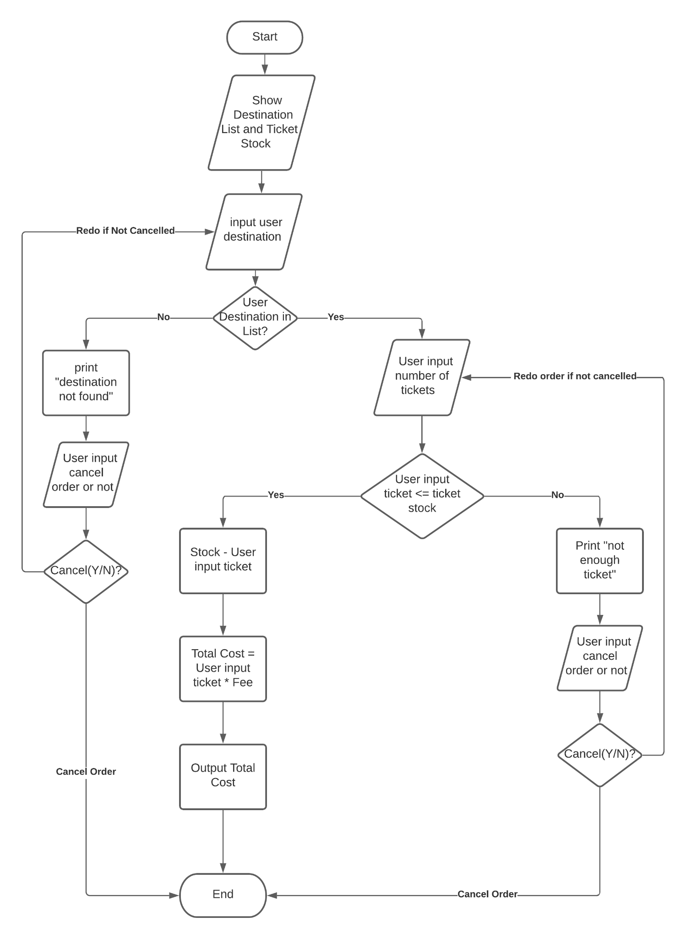

Slide 8
Testing Plan
Input | Output | Notes
“Cirebon”, 3 | 50000 * 3 = 150000 | Testing input according to requirements
“Yogyakarta”, 2 | 100000 * 2 = 200000 | Testing input according to requirements
“Surabaya”, 1 | 200000 * 1 = 200000 | Testing input according to requirements
“Bandung”, 2 | Prompts user to re-enter destination | Handling error

