Slide 1
Text Summarization
using Deep Learning

Slide 2
Motivation
Summarize long text
Generate new human-like gists

Slide 3
Key Approaches
Extractive Summarisation
Extract important sentences from original text with cosine similarity, e.g. TextRank Algorithm
Abstractive Summarisation
Generate new sentences from vocabulary learnt in original text

Slide 4
Datasets
Amazon Fine Foods Reviews, with over 500,000 reviews and summaries over 10 years
Extracted Source: https://www.kaggle.com/snap/amazon-fine-food-reviews
BBC articles with 2,225 text articles and human written summaries from 2004-2005
Used in the paper of D. Greene and P. Cunningham. "Practical Solutions to the Problem of Diagonal Dominance in Kernel Document Clustering", Proc. ICML 2006;
All rights, including copyright, in the content of the original articles are owned by the BBC, http://mlg.ucd.ie/datasets/bbc.html
Extracted Source: https://www.kaggle.com/namrarehman/bbc-articles?select=BBCarticles_csv.csv

Slide 5
Data Wrangling
Cleaning steps included:
convert to lower case, remove words within parentheses,
remove apostrophe ‘s, remove punctuation and stop words
Add start and end tokens to the reference summaries
Points to note:
By modifying Keras preprocessing tokenization filter, we can give unique tokens to place names, figures and percentages
While useful, this increases the vocabulary size of the model and number of trainable parameters
This has been excluded due to limited computation power

Slide 6
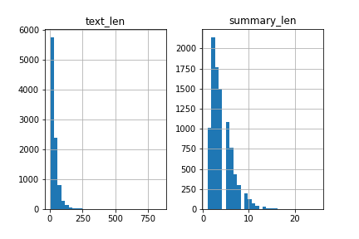
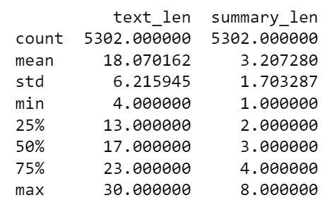
EDA - Amazon dataset
Set summary maximum word length = 8 (95th percentile)
Set text maximum word length = 30 (reduce computation time)

Slide 7
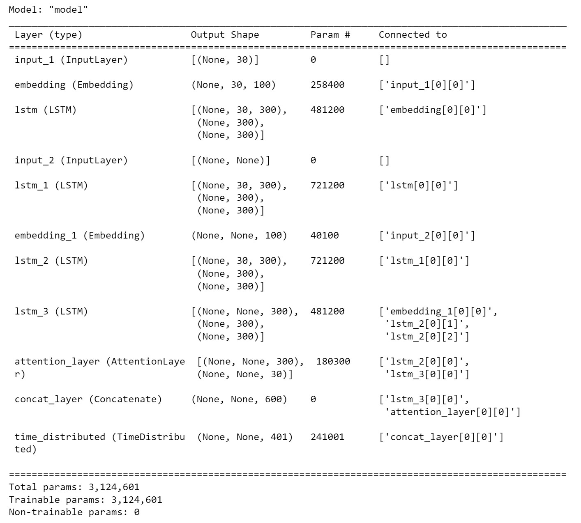
Seq2Seq Model
Seq2Sqe Model with encoders and decoders to handle different length input and output sequences.
3 LSTM layers
Decoder takes last encoder hidden states as input
Global Attention Layer added to consider all hidden states of encoder to derive context vector.
Model adapted from: https://www.analyticsvidhya.com/blog/2019/06/comprehensive-guide-text-summarization-using-deep-learning-python/

Slide 8
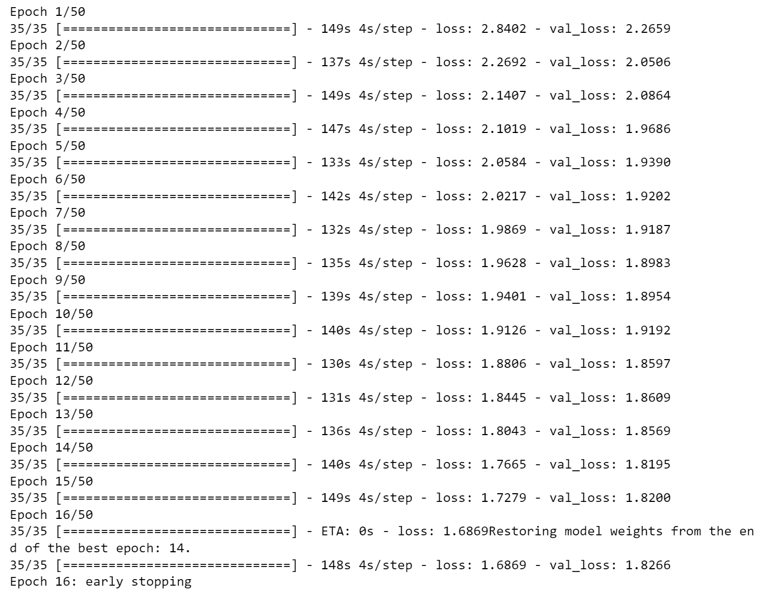
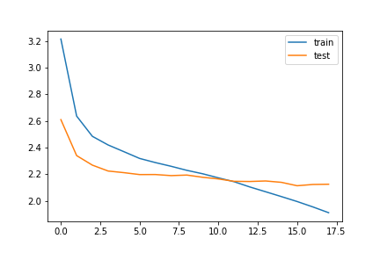
Model training
The model early stopping criteria was set at validation loss increases. This was reached at the 14th epoch with this dataset.

Slide 9
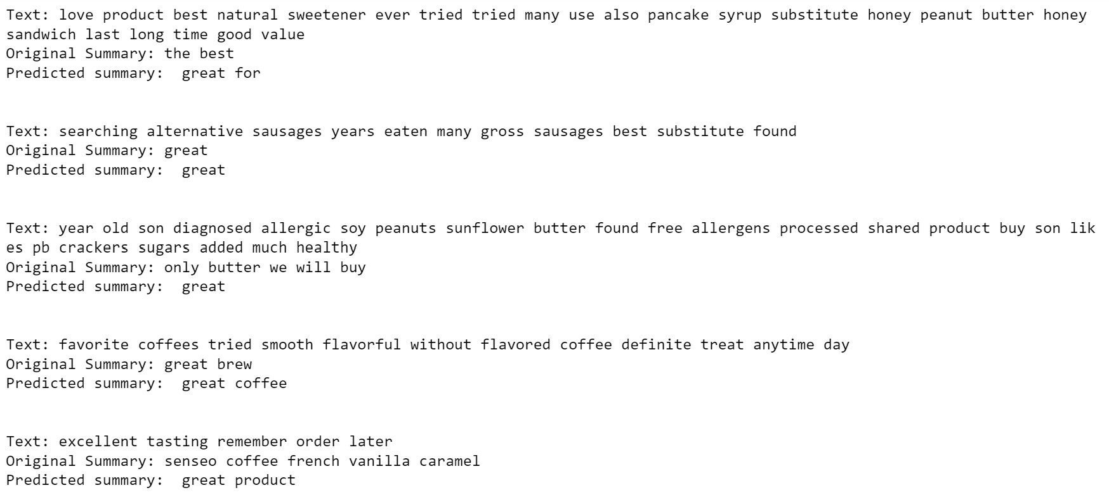
Results

Slide 10
Performance Metrics
BLEU (python nltk library):
Precision focused metric
Calculator n-gram overlap of reference and predicted texts
Word-position independent
Brevity penalty
ROUGE (python rouge library):
Recall focused metric
3 types: n-rouge (most common), l-rouge, s-rouge
Number of n-grams found in model and reference divided by number of n=grams in reference

Slide 11
Performance Evaluation Metrics
The training set produced fairly low BLEU scores (precision) of 0.0151 and ROUGE-2 scores (recall) of 0.0197. The testing set BLEU score was 0.009 and ROUGE-2 score was 0.033. The ROUGE-1 F1 score was about 0.5, so the current model is not much better than a 50-50 guess.
Dataset | BLEU | ROUGE-2
Testing Set | 0.009 | 0.033
Training Set | 0.0151 | 0.0197

Slide 12
Conclusion
The model was able to produce new summaries based on longer text inputs. These summaries however were very brief one word outputs on many cases, e.g. ‘great’.
The performance was limited by small training size and vocabulary to learn from.
As the compilation time was long, training the hyperparameters and increasing the training size was not viable.

Slide 13
Future Work
Use cloud clusters with more computational capacity:
1) Train on more complex datasets
2) Train on more data
3) Hyperparameter Tuning
5) Bidirectional LSTM model to capture the context from both directions within a sentence
4) Beam search decoder for the test sequence decoding instead of argmax

