Slide 1
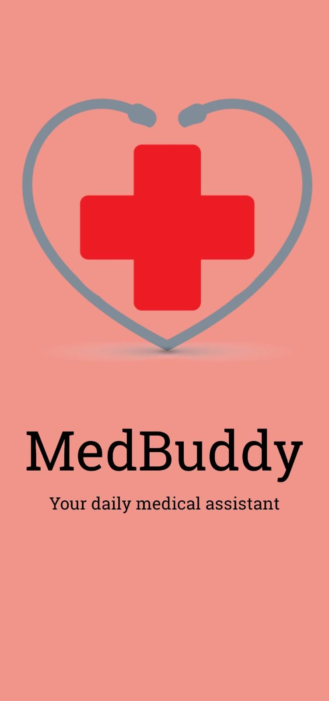
MedBuddy
Cojocaru Florin
Cotulbea Adrian

Slide 2
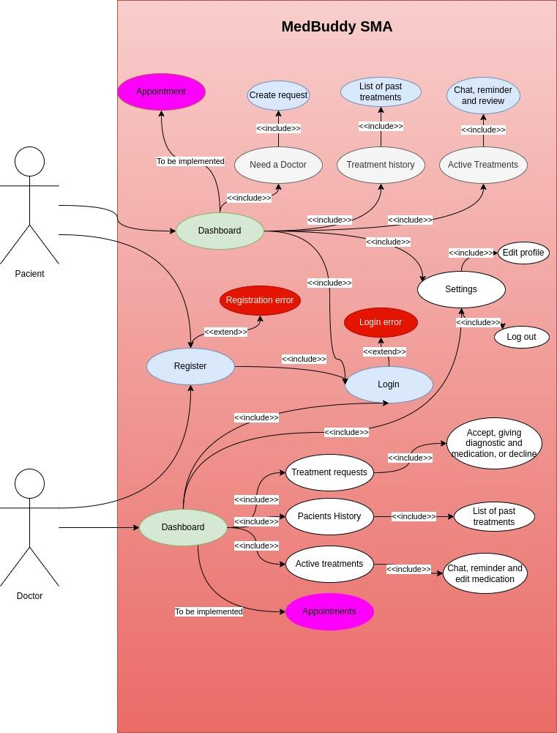
UML Diagram

Slide 3
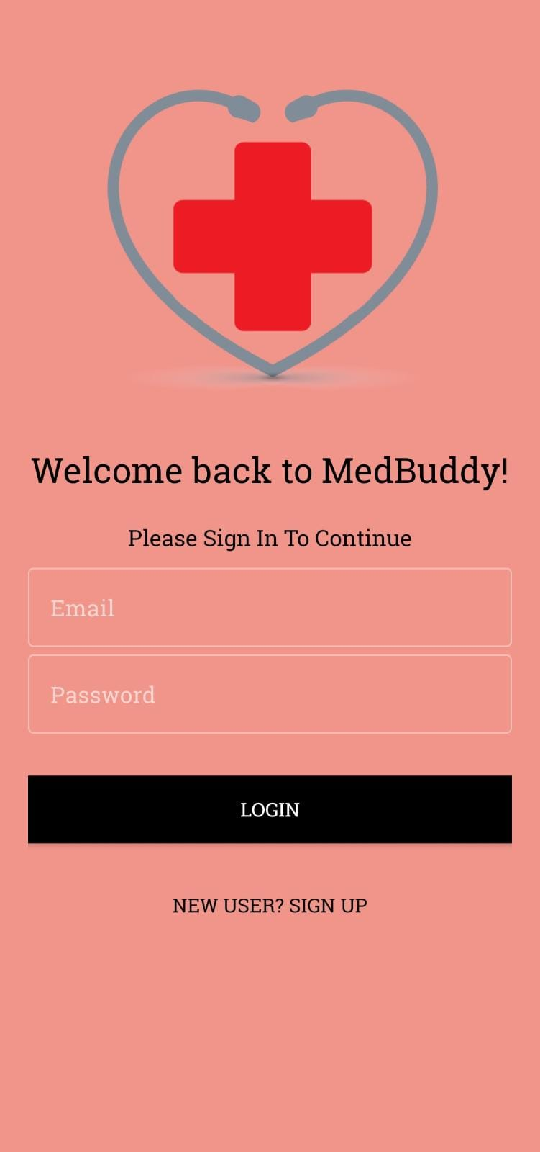
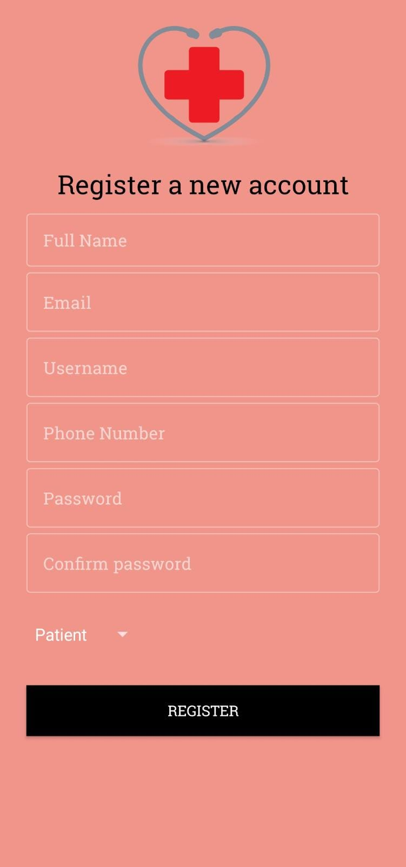
Authentication
Authenticate with Email
Email must be valid(has been checked with regular expression)
Phone number must have 10 digits
Password more than 7 characters and match with ConfirmPassword
select account role

Slide 4
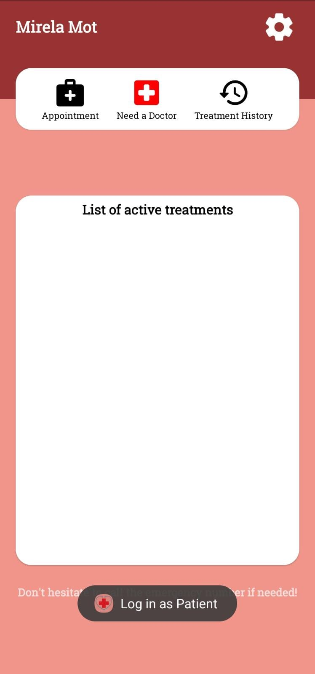
Patient Dashboard
Name of the patient logged
Make an appointment
Need a doctor request
Treatment history
List of Active Treatments
Settings Button
Confirmed login toast

Slide 5
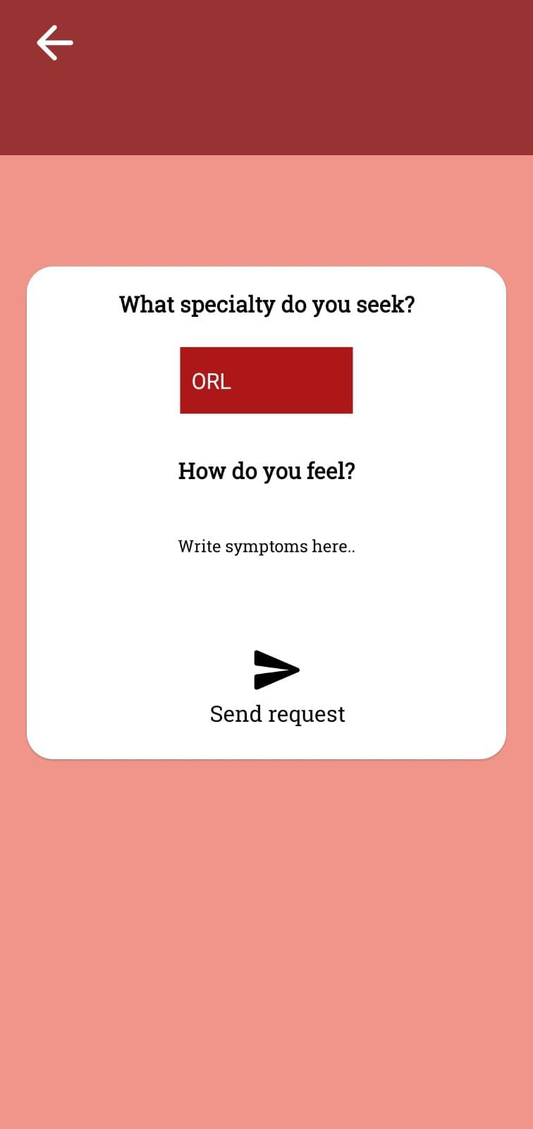
SendRequest
Choose the specialty of the medic you are looking for selecting from spinner view
Write what symptoms you have
Send the request to all the doctors with that specialty

Slide 6
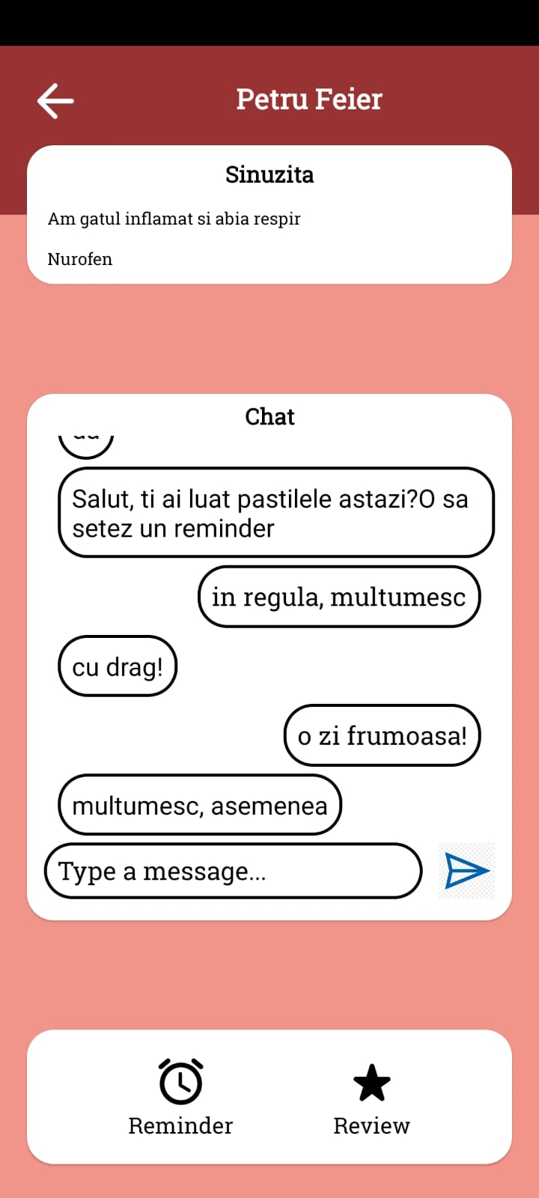
Patient Interaction
name of the doctor
diagnostic received by medic
symptoms given by patient
medication recommended by doctor
live chat with doctor
set up reminder
leave a review for the doctor

Slide 7
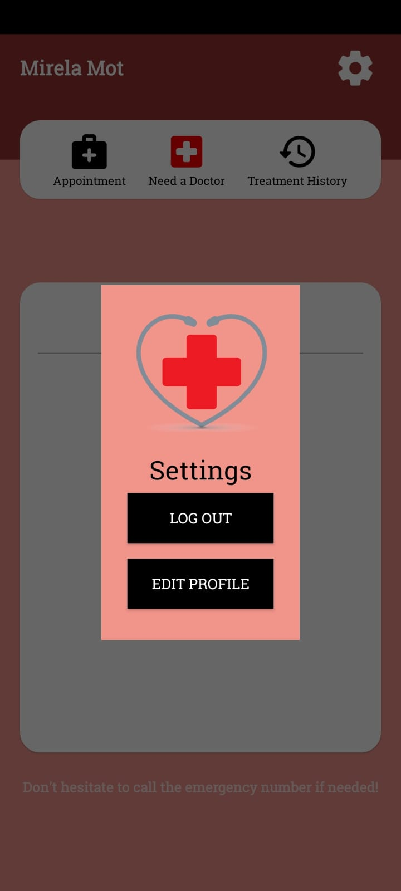
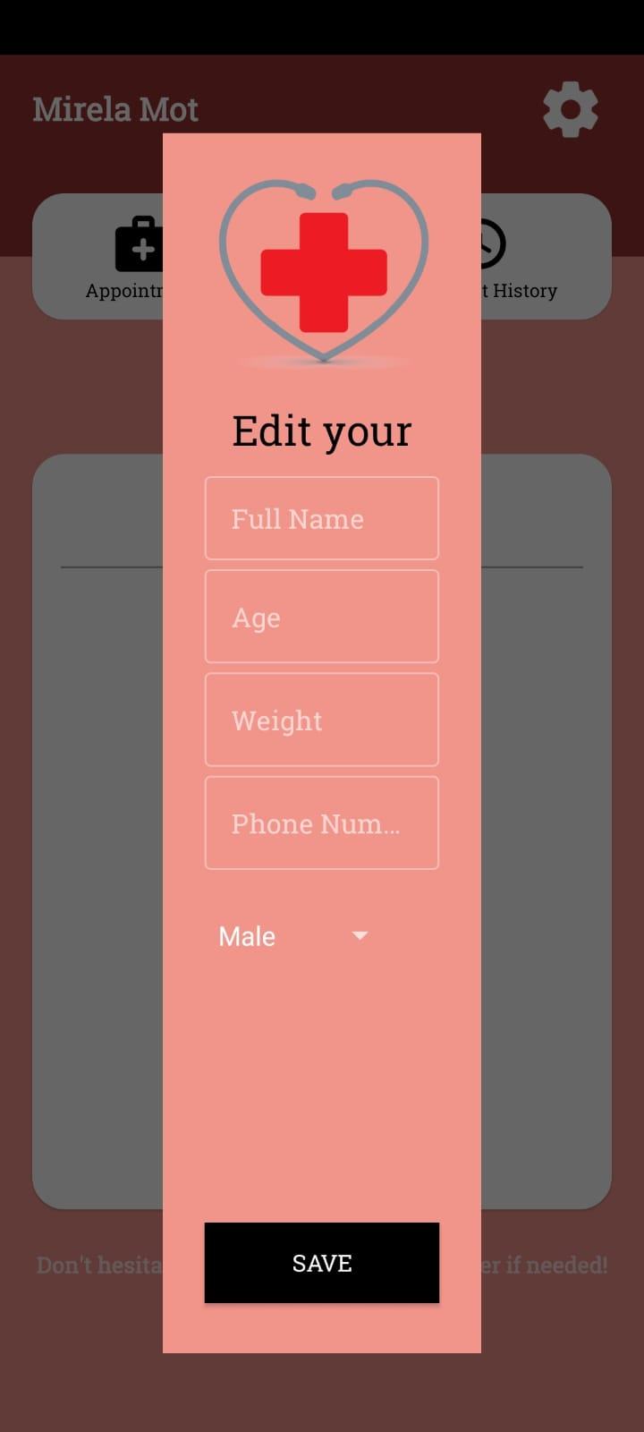
Settings Button
Pop up with settings, contains log out and edit profile buttons
Edit Profile only update those specific fields
Age must be between 18-99, phone number 10 digits and weight less than 4 digits

Slide 8
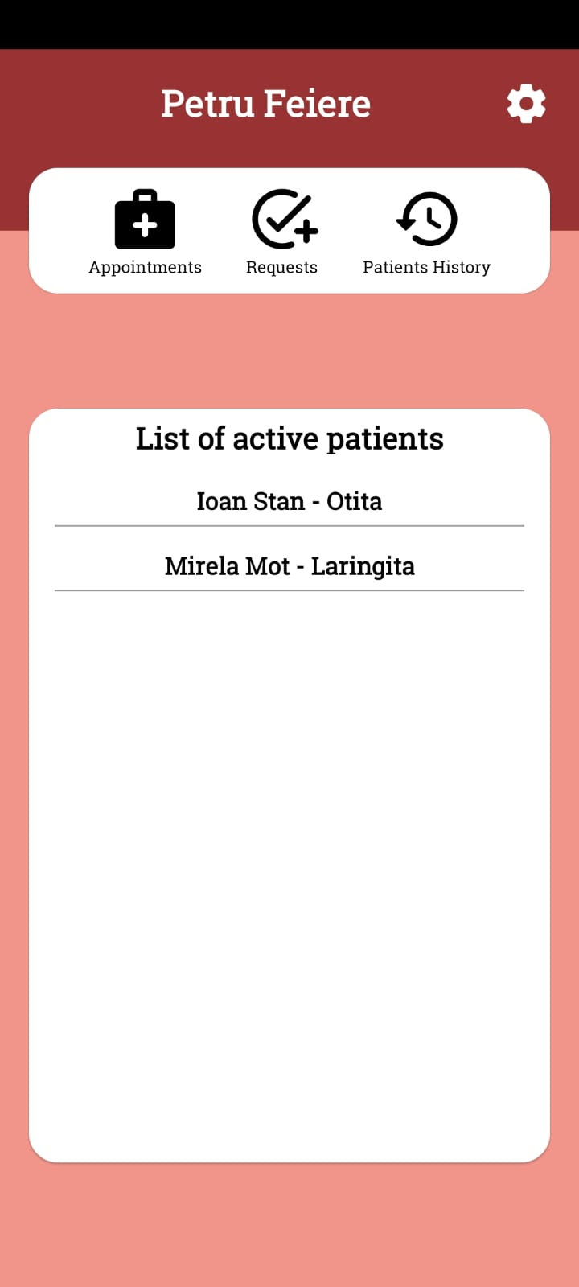
Doctor Dashboard
Appointments List
Pending requests
Patients History
List of active patients, name and diagnostic (clickable towards interaction)
Settings button

Slide 9
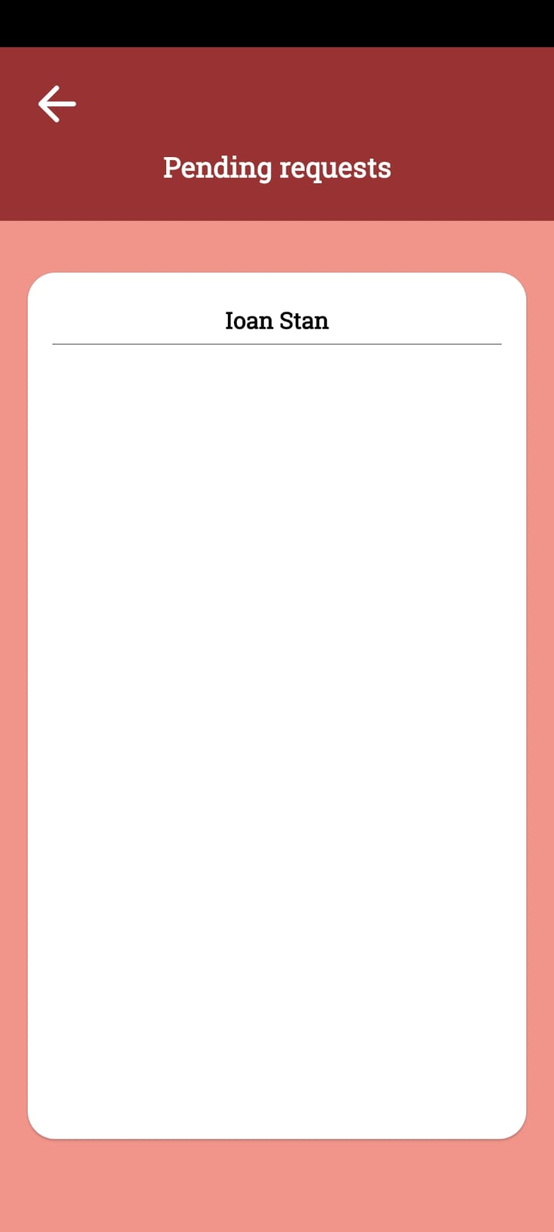
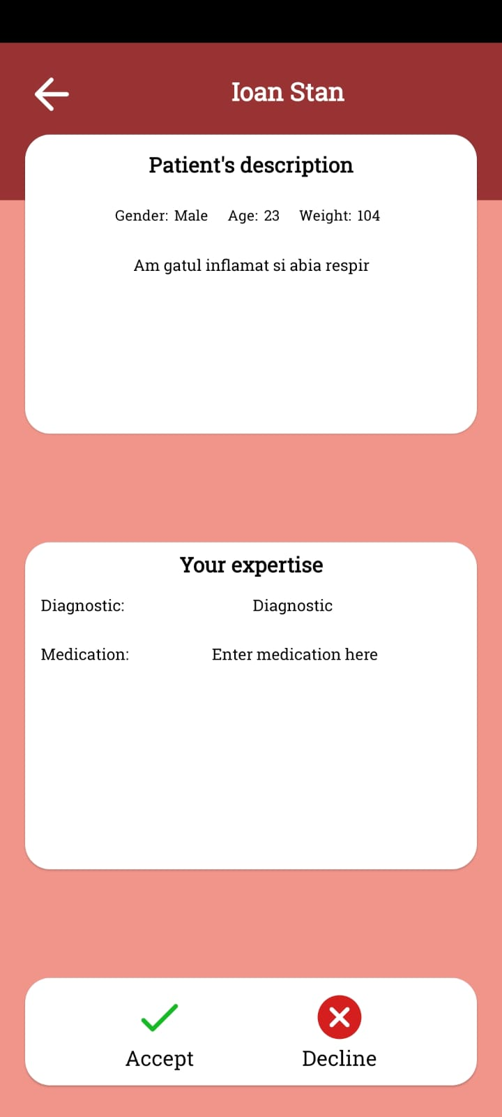
Receive Request
name of the patient
gender, age, weight
Medical expertise means diagnostic and medication
Medic can accept or decline the request

Slide 10
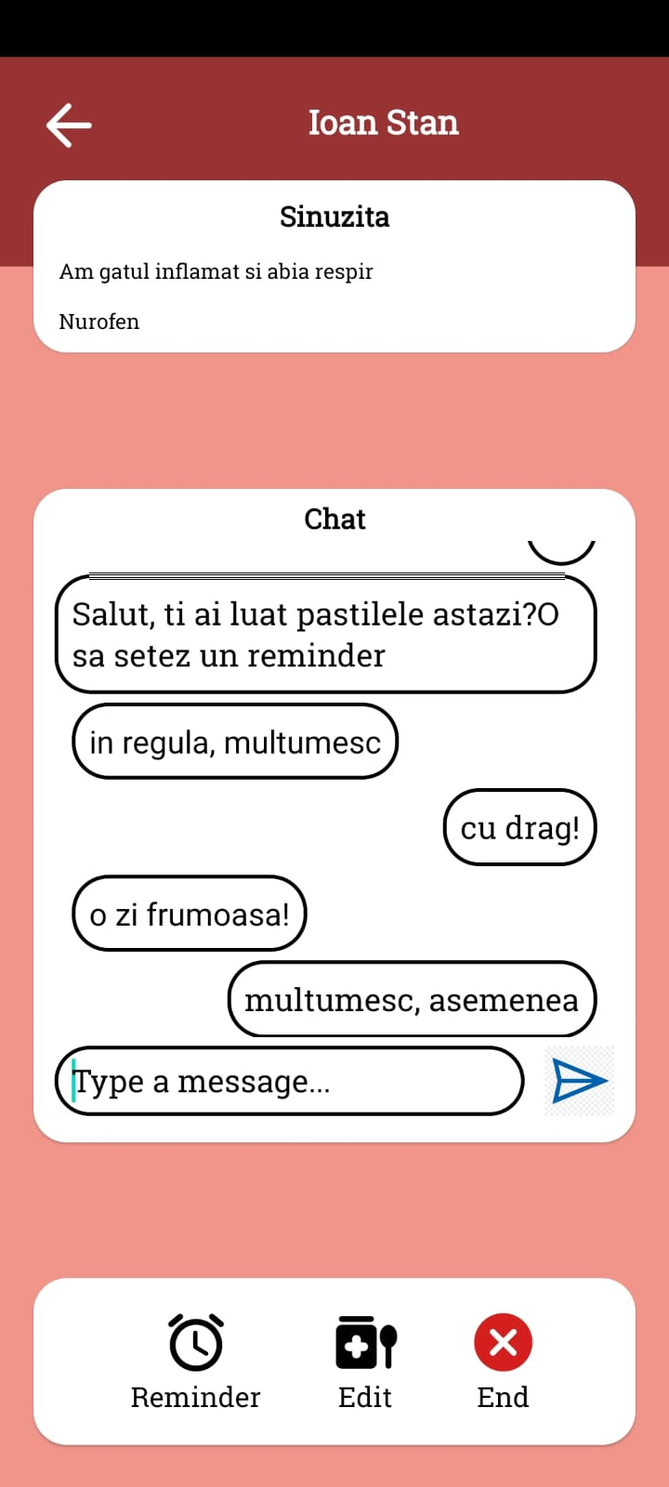
Doctor Interaction
name of the patient
Diagnostic
Symptoms
Medication
Live chat between patient and doctor
Reminder
Edit Medication
End Treatment

Slide 11
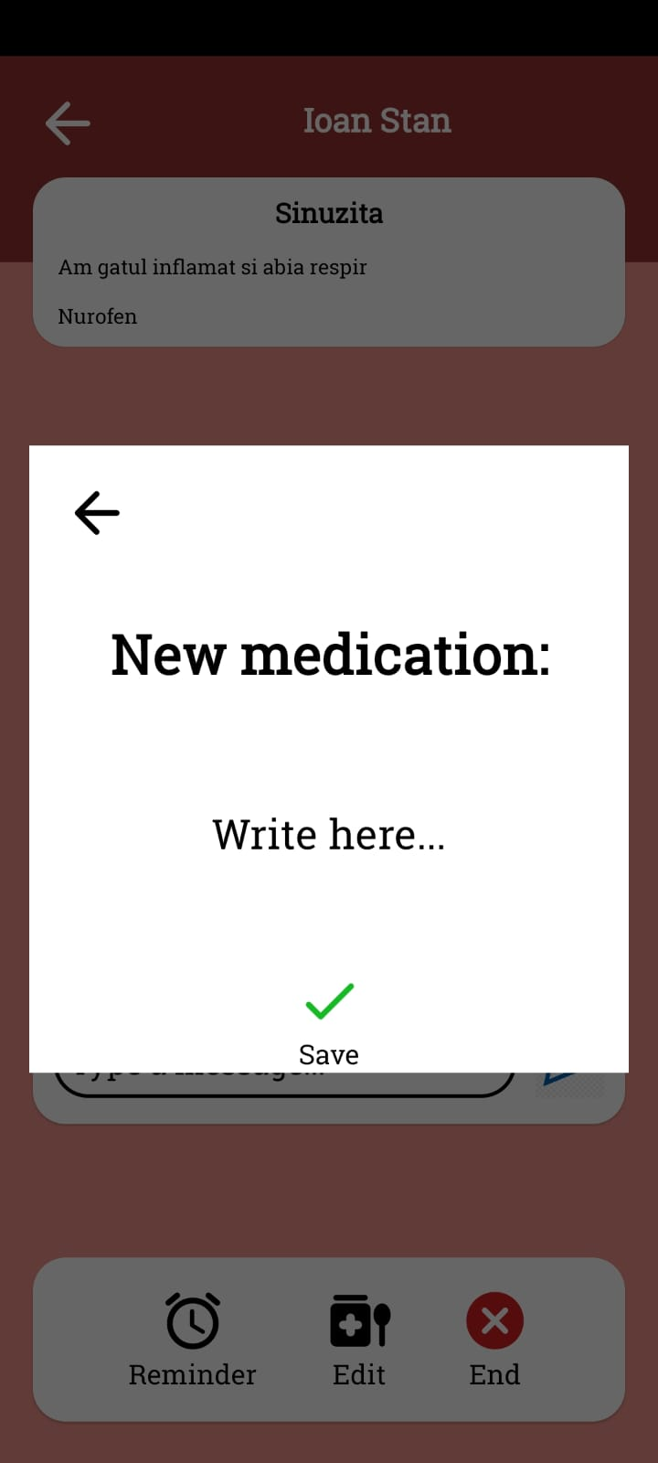
Edit medication
Doctor can edit medication according to treatment’s evolution

Slide 12
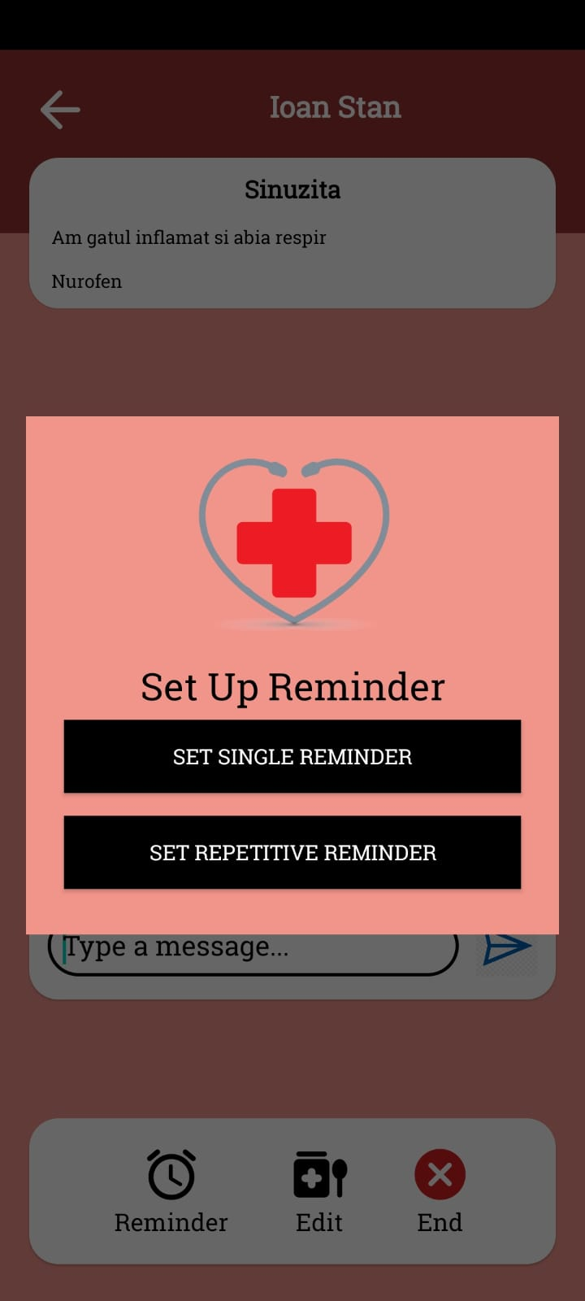
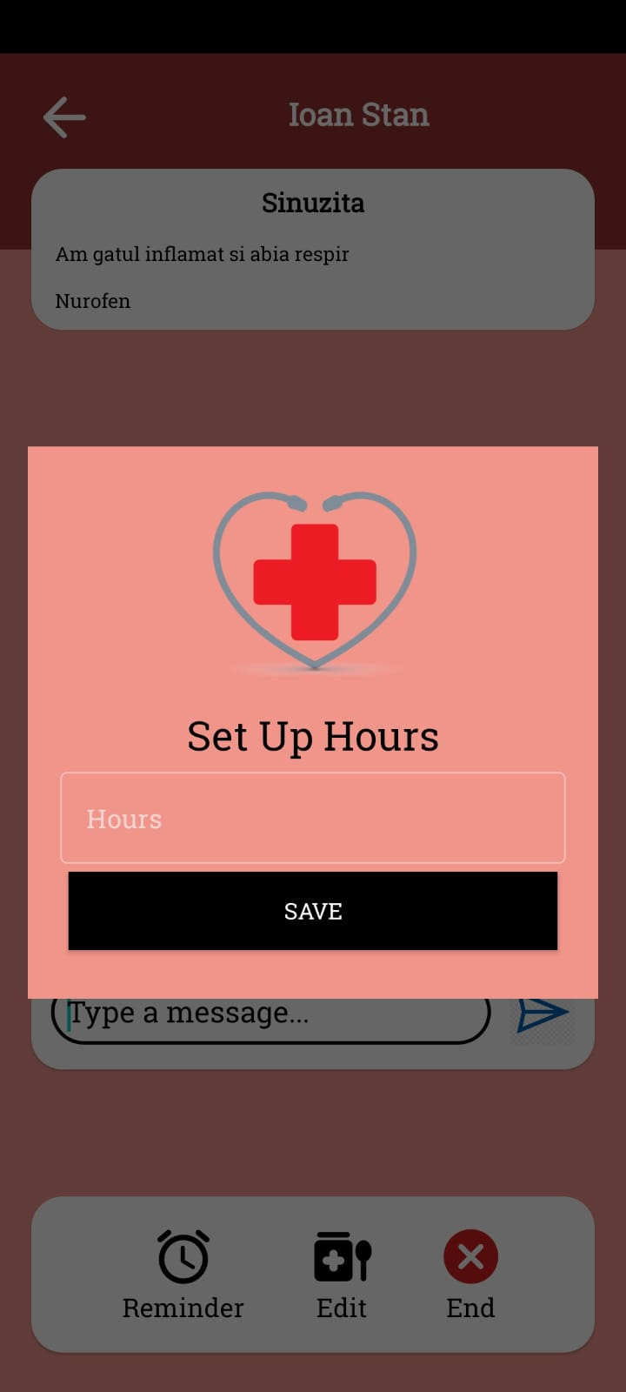
Reminder
Doctors can set two type of reminder, one single reminder, patient will receive a notification to take the medication, and repetitive reminder, patient will receive a notification to take the medication every “x” hours

Slide 13
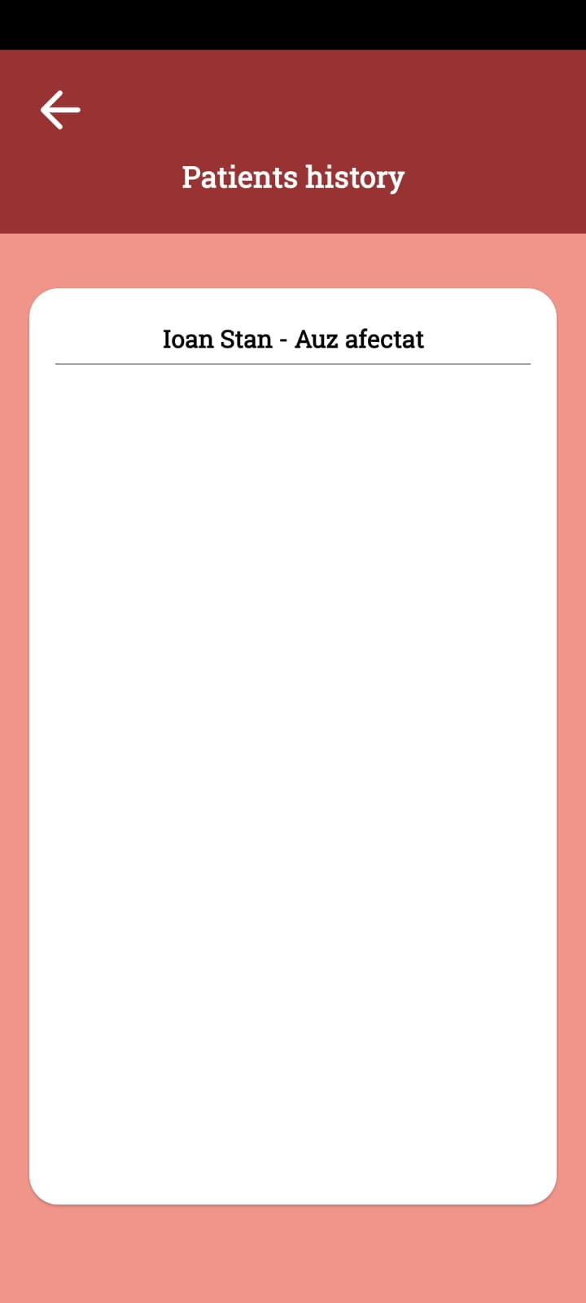
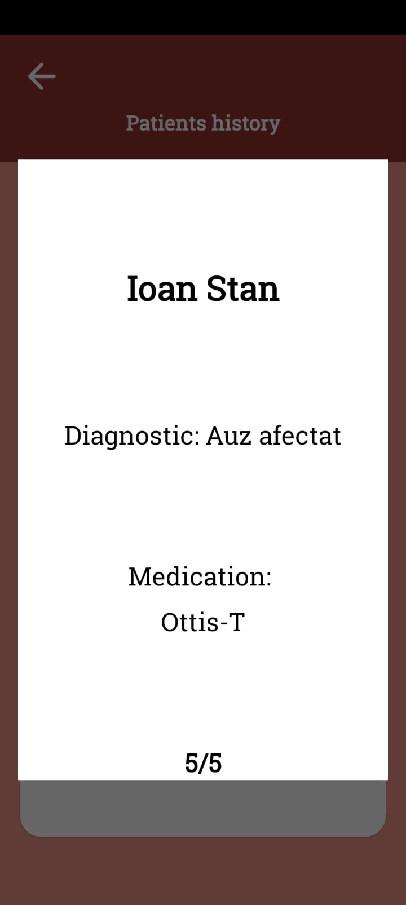
Patient History
After the end of an treatment, it will be moved to a history list of patients with name, diagnostic, medication and review from patient

Slide 14
Thank you!

