Slide 1
Webcam Application for High-Risk Independent Resident
UP2154598 Course: Computer Science Project code: PJE40

Slide 2
Topics We will Discuss:
What is this project about and what did it aim to do.
What were done and what work were left to do.
Methodologies and approaches
Problems during the development processes and solutions.
What do we actually get from this project.
A demo

Slide 3
Project Aim
This project is aiming to protect high-risk resident who live on their own.
High-risk could be anyone who are venerable that a fall could cause a severe injury or even death.
Hardware equipment as less as possible, as accessible as possible.
The monitor application should be able to detect a fall happened on the high-risk resident and able to inform someone that are responsible for this scenario.(i.e. Children, warden, neighbours, etc.)
Temperature has become another factor that causes high-risk resident’s death ( elderly mainly). The application should also be able to provide relevant text advise based on temperature and humidity level.

Slide 4
Constrains
This project only produce a prototype of the Monitor Application. The final outcome is still far away from commercialese and does not extend to any clinical compliance for any medical-grade devices.
This project is developed under consumer-grade hardware (CPU and webcam), and is not designed for multi-camera setups.
This project has strictly followed university’s Ethics Review, no personal identity or information will be uploaded and used in a harmful way.

Slide 5
Why Choose to Use Webcam?
Types of Fall Detection System | Detection Methods | Issues
Wearable Sensors | Using accelerometer to identify the motion | The user needs to wear this type of sensor all the time and place it around the correct part of the body
Acoustic Sensors | Classify the sounds of all fall | Could be easily affected by background noise
Floor Pressure Sensors | Either uses pressure sensor to detect the fall, or detect the vibration from the impact of fall | This field is still under research and some types of the floor pressure sensor need to be placed on the entire floor which increases the cost
Infrared Sensors | Uses infrared to detect the change of motion when a fall happened with carefully placed equipment | Need to be carefully select the places and specialised equipment is required
Radar Sensors | Uses radar to detect the change of motion when a fall happened with carefully placed equipment | Need to be carefully select the places and specialised equipment is required
Ultrasonic Sensors | Uses ultrasonic wave to detect the change of motion when a fall happened with carefully placed equipment | Need to be carefully select the places and specialised equipment is required
Image Sensors | Uses visual to detect falls directly | One of the most common types of fall detection method. However, some of them requires a depth camera as well as a normal camera

Slide 6
Why Choose to Use Webcam?
OpenPose, BlazePose, MediaPipe, etc. proof pose estimation is a possible.
Capable of achieving high accuracy rate.
Demand for high computational power
Depth camera is required.
We can define a fall as a set of poses.
An example of using pose estimation based on OpenPose

Slide 7
Custom CNN or Pre-Train Model?
Initially, a custom CNN was more preferable.
A research in 2017 prove it is working
Hardware
Low accuracy rate, long training time.
More than 15,000 RGB images were used.
3 Convolutional layers was chosen
One-third accuracy rate for validation, train loss of 1.2
Overfitting

Slide 8
Custom CNN or Pre-Train Model?
Due to time limit, YOLO11n from Ultralytics was selected.
It allows ONLY RGB images as an input. No need for depth camera.
Easy for setup, only need to define the pose of Lying by define the number of angles between some key points.
A set of 1500+ images were selected from custom CNN training set. YOLO11n can correctly identify more than 76% of the input photo correctly.

Slide 9
Environmental Advisory
A supervised neural network was trained to give the output based on temperature and humidity.
Trained dataset was labeled based on Heat Index (NOAA).
Low temperature was labeled if temperature is below 15°C
Gets temperature and humidity level from Weather API.
Temperature (°C) | Relative Humidity (%) | Advisory Messages
<15 or > 30 | < 40 or < 30 | Too dry, suggest use of moist lotion
< 15 | < 40 | Too cold, please turn the heating on.
< 12 | Any | Too cold, please wear more clothes and have a cup of hot drink!
15 – 27 | Any | Normal
27 - 43 | Any | (Depends on the Heat Index Level provided by NOAA) Caution! High temperature Extreme caution! High temperature Danger! High temperature, please avoid outdoor activities
> 43 | Any | Extreme danger! High temperature, please stay indoor until sunset!

Slide 10
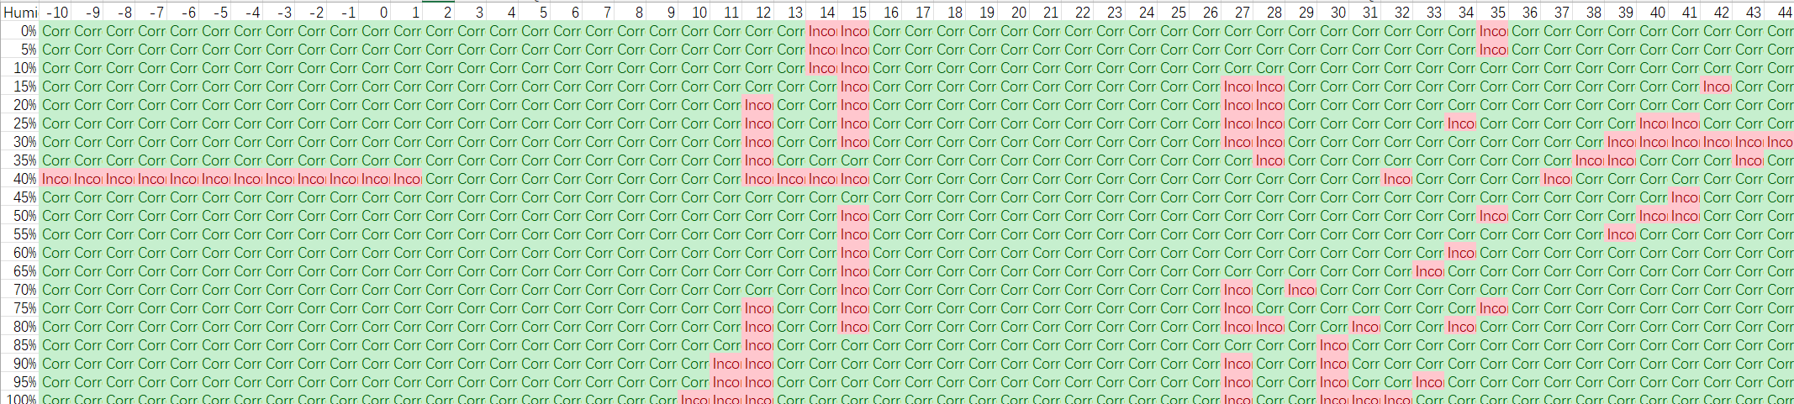
Environmental Advisory
91.5% accuracy rate during testing with total of 55 different temperature values (ranging from -10 °C to 44 °C) and different 21 relative humidity levels (ranging from 0% to 100% at 5% intervals)

Slide 11
Fall Detection
Fall detection is defined as two continuous frames input being identifies as “LYING” pose.
Lying pose is based on a pre-set data in the RuleBasedFallDetect.py that measures the angles between key points.
When the pose estimation model return “FALL”, it will trigger email alert system to send a pre-written email to inform relevant person.

Slide 12
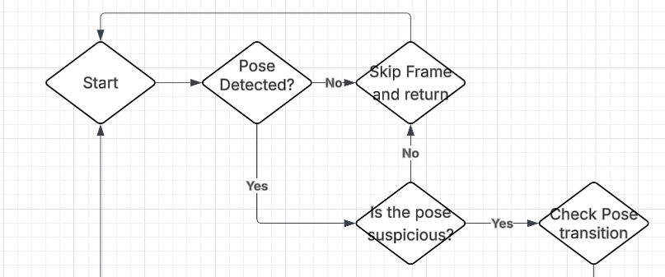
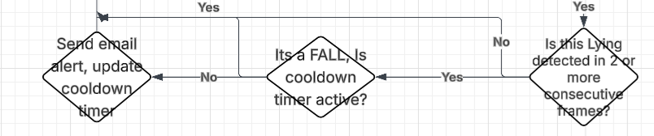
Fall Detection
A cooldown system is introduced to prevent “spamming” the receiver when a fall is happened.

Slide 13
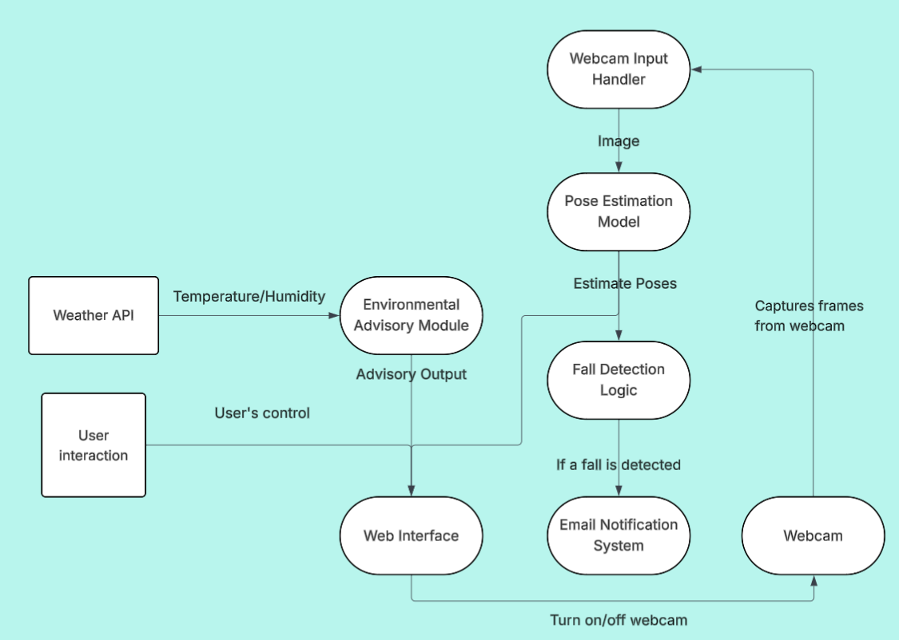
Web Page
The Monitor Application will be divided in to frontend and backend.
The backend system deals with the environmental advisory output and fall detection system.

Slide 14
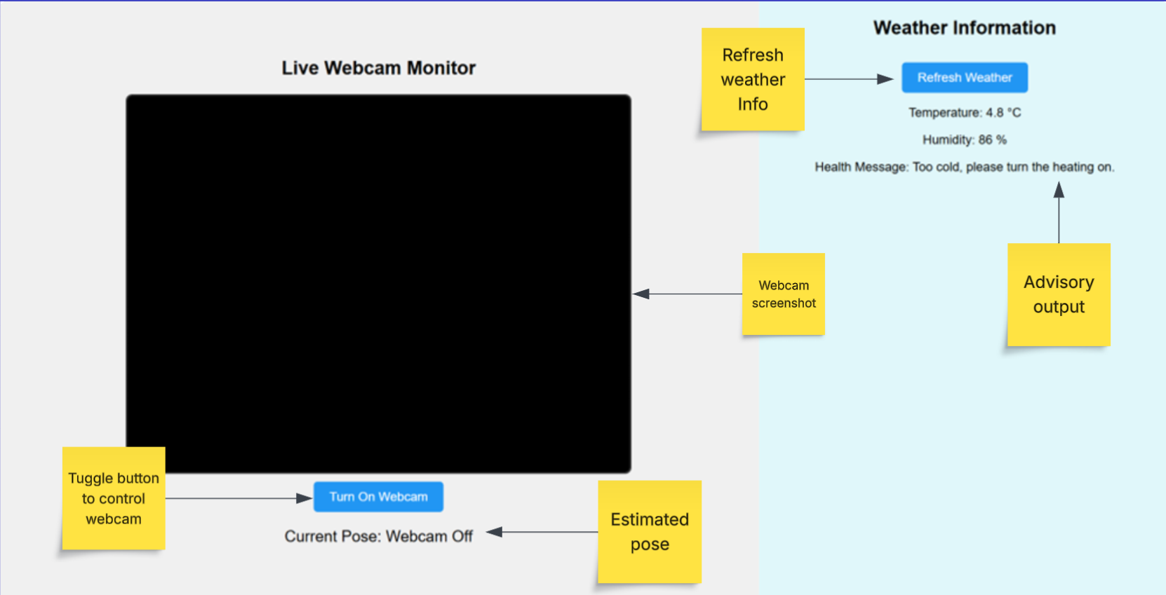
Web Page
Frontend gets the environmental output, webcam image and the pose estimated by the model.
It can also manually turn-off the webcam and refresh the weather information.

Slide 15
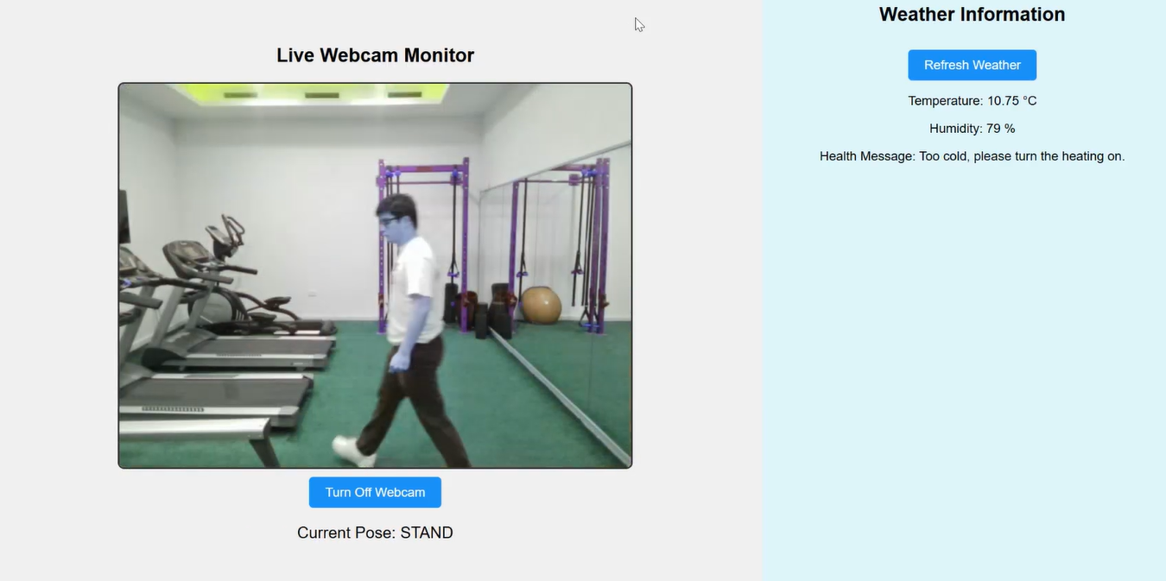
Final Outcome
Server ensured that it can only be access locally (127.0.0.1).
The frame rate was set to be 2FPS
Able to predict a fall and send the email alert!
Environmental advisory modulo works normally.

Slide 16
Problems and Solutions
Frame rate was set to be 2FPS
Screenshot function becomes weird at 4FPS
Failed to give a higher FPS
Model accuracy rate was 76%
Better than Custom CNN, but still could be improved.
Laptop with High-end GPU was crashed on April
Change the approach from livestream to pose estimation based on screenshot

Slide 17
Future Work
Still far from total complete…
Higher FPS or even capable to detect a fall in the livestream video
Higher accuracy
Log of activity time
Additional notification features
Reminder of taking the pills for elderly
Offline Advisory mode with external digital environment sensors

Slide 18
What I Have Learnt from This Project
Time management
Never rely on one single equipment and always have a back-up
Better understanding of the CNN and neural network

Slide 19
Thank you for listening!

