Slide 1
Summary

Slide 2
Summary
Automata

Slide 3
Finite Automata
(single) start state
alphabet Σ = {0,1}
0,1
1
states
0
(several) accept states
transition for each symbol
0,1
read input one symbol at a time; follow arrows; accept if end in accept state

Slide 4
Finite Automata
Non-deterministic variant: NFA
Regular expressions built up from:
  unions
  concatenations
  star operations
Main results: same set of languages recognized by FA, NFA and regular expressions (“regular languages”).

Slide 5
Pushdown Automata
input tape
finite control
0
1
1
0
0
1
1
1
0
1
0
0
1
0
1
q₀
New capabilities:
can push symbol onto stack
can pop symbol off of stack
0
(infinite) stack
1
1
0
:

Slide 6
Context-Free Grammars
A → 0A1
A → B
B → #
start symbol
terminal symbols
non-terminal symbols
production

Slide 7
CFL-> PDA
PDA-> CFL

Slide 8
Pushdown Automata
Main results: same set of languages recognized by NPDA, and context-free grammars (“context-free languages”).
L (P)? N(P)?
and DPDA’s weaker than NPDA’s…
again, L (P)? N(P)?

Slide 9
Non-regular languages
Pumping Lemma: Let L be a regular language. There exists an integer p (“pumping length”) for which every w ∈ L with |w| ≥ p can be written as w = xyz such that
  for every i ≥ 0, xy^{i}z ∈ L , and
  |y| > 0, and
  |xy| ≤ p.
Reason?
Suppose y=abc
y= dddd

Slide 10
Pumping Lemma for CFLs
CFL Pumping Lemma: Let L be a CFL. There exists an integer p (“pumping length”) for which every w ∈ L with |w| ≥ p can be written as w = uvxyz such that
  for every i ≥ 0, uv^{i}xy^{i}z ∈ L , and
  |vy| > 0, and
  |vxy| ≤ p.
  Reason?

Slide 11
Summary
Turing Machines and decidability

Slide 12
Turing Machines
input tape
…
0
1
1
0
0
1
1
1
0
1
0
0
finite control
read/write head
q₀
New capabilities:
  infinite tape
  can read OR write to tape
  read/write head can move left and right

Slide 13
Deciding and Recognizing
accept
reject
loop forever
input
machine
TM M:
  L(M) is the language it recognizes by final state
  if M rejects every x ∉ L(M) it decides L
  set of languages recognized by some TM is called Turing-recognizable or recursively enumerable (RE)
  set of languages decided by some TM is called Turing-decidable or decidable or recursive

Slide 14
Extension
  Multiple track
  Multiple tape
  State with Buffer
  Nondeterministic
  。。。

Slide 15
The Halting Problem
Definition of the “Halting Problem”:
HALT = { <M, x> | TM M halts on input x }
Is HALT decidable?

Slide 16
The Halting Problem
Theorem: HALT is not decidable (undecidable).
Proof:
  Suppose TM H decides HALT
    if M accept x, H accept
    if M does not accept x, H reject
  Define new TM H’: on input <M>
    if H accepts <M, <M>>, then loop
    if H rejects <M, <M>>, then halt
  consider H’ on input <H’>:
    if it halts, then H rejects <H’, <H’>>, which implies it cannot halt
    if it loops, then H accepts <H’, <H’>>, which implies it must halt
  contradiction. Thus neither H nor H’ can exist

Slide 17
H’ is the opposite of the diagonals:
Entry i,j is the value of H on input <M_{i}, <M_{j}>>
<M1> <M2> <M3> <M4> … <H’>
M1 A R A R
M2 A A A A
M3 R R R R
M4 A A R R
…
H’ R R A A ?

Slide 18
Decidable, RE, coRE…
co-HALT
{a^{n}b^{n} : n ≥ 0 }
some language
co-RE
decidable
all languages
regular languages
context free languages
RE
{a^{n}b^{n}c^{n} : n ≥ 0 }
HALT
some problems (e.g HALT) have no algorithms

Slide 19
Definition of reduction
A
B
f
yes
yes
reduction from language A to language B
f
no
no

Slide 20
Using reductions
Used reductions to prove lots of problems were:
  undecidable (reduce from undecidable)
  non-RE (reduce from non-RE)
    or show undecidable, and coRE
  non-coRE (reduce from non-coRE)
    or show undecidable, and RE
Reduction Direction!

Slide 21
Summary
Complexity

Slide 22
Complexity
Complexity Theory = study of what is computationally feasible (or tractable) with limited resources:
  running time
  storage space
  number of random bits
  degree of parallelism
  rounds of interaction
  others…
main focus
not in this course

Slide 23
Time and Space Complexity
Definition: the time complexity of a TM M is a function f:N → N, where f(n) is the maximum number of steps M uses on any input of length n.
Definition: the space complexity of a TM M is a function f:N → N, where f(n) is the maximum number of tape cells M scans on any input of length n.

Slide 24
Complexity Classes
Definition: TIME(t(n)) = {L : there exists a TM M that decides L in space O(t(n))}
P = ∪_{k ≥ 1} TIME(n^{k})
EXP = ∪_{k ≥ 1} TIME(2^{nk})
Definition: SPACE(t(n)) = {L : there exists a TM M that decides L in space O(t(n))}
PSPACE = ∪_{k ≥ 1} SPACE(n^{k})

Slide 25
Complexity Classes
Definition: NTIME(t(n)) = {L : there exists a NTM M that decides L in time O(t(n))}
NP = ∪_{k ≥ 1} NTIME(n^{k})
Theorem: P ≠ EXP
P ⊂ NP ⊂ PSPACE ⊂ EXP
Don’t know if any of the containments are proper.

Slide 26
Poly-time reductions
Type of reduction we will use:
  “many-one” poly-time reduction (commonly)
  “mapping” poly-time reduction (book)
f poly-time computable
YES maps to YES
NO maps to NO
A
B
f
yes
yes
f
no
no

Slide 27
Hardness and completeness
Definition: a language L is C-hard if for every language A ∈ C, A poly-time reduces to L; i.e., A ≤_{P} L.
can show L is C-hard by reducing from a known C-hard problem
Definition: a language L is C-complete if L is C-hard and L ∈ C

Slide 28
Complexity classes
EXP
coNP
PSPACE
decidable languages
P
NP

Slide 29
Decidability and Closure Property

Slide 30
RL
CFL
TM
Parallel Production
Clean、CYK
TM Construction

Slide 31
Closure Property
Use known statement to Prove unknown argument
Closure of complexity class
Consider operation between languages in different classes

Slide 32
Models

Slide 33
Transition System
  Semantic Basis
  Definition
  Equivalence
  Temporal Logic

Slide 34
Petri Net
  Concurrency
  Token Game
  Model a concurrency System
  Relation Between PN and TS

Slide 35
Timed Automata Definition
  Continuous time domain
  When should we use such model?
  Invariant, Guard, Reset?
Model a real system!

Slide 36
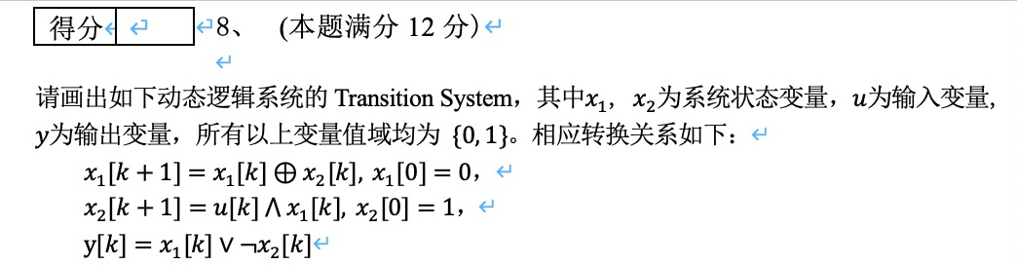

Slide 37
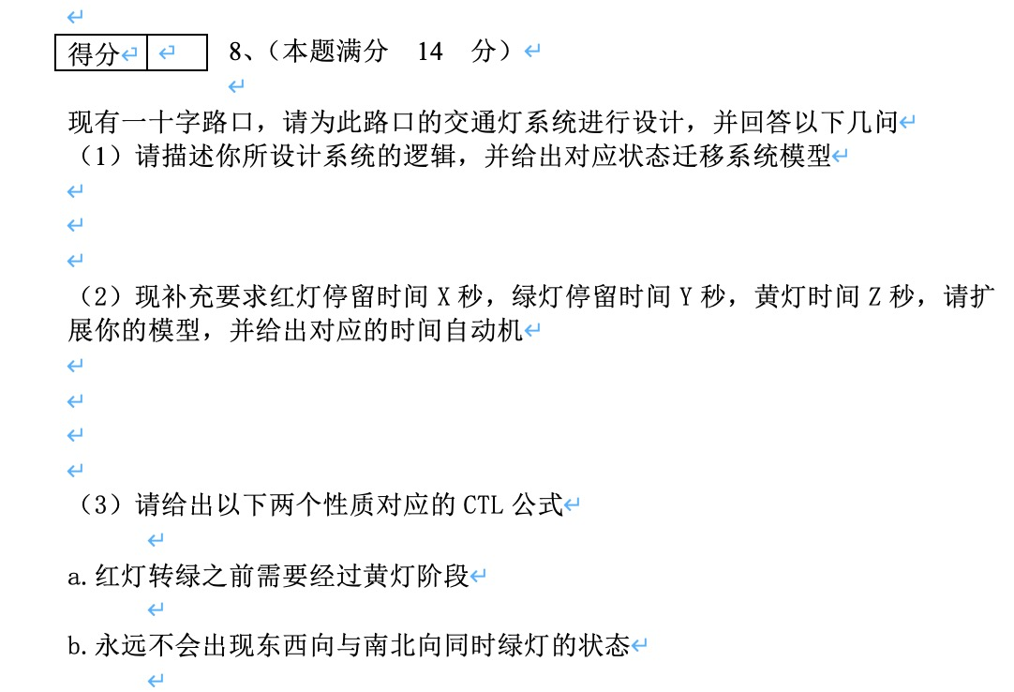

Slide 38
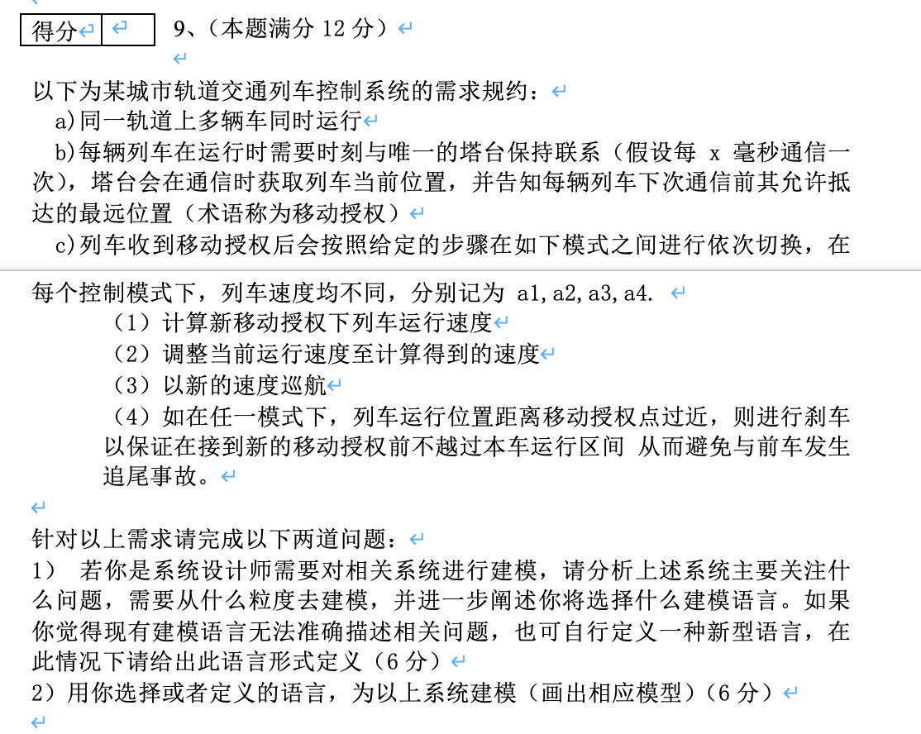

Slide 39
Recruitment
bulei@nju.edu.cn
No.308, CS Building

