Slide 1
Petri Nets
Lei Bu

Slide 2

Dining Philosphier
4 States， 5 transitions

Slide 3
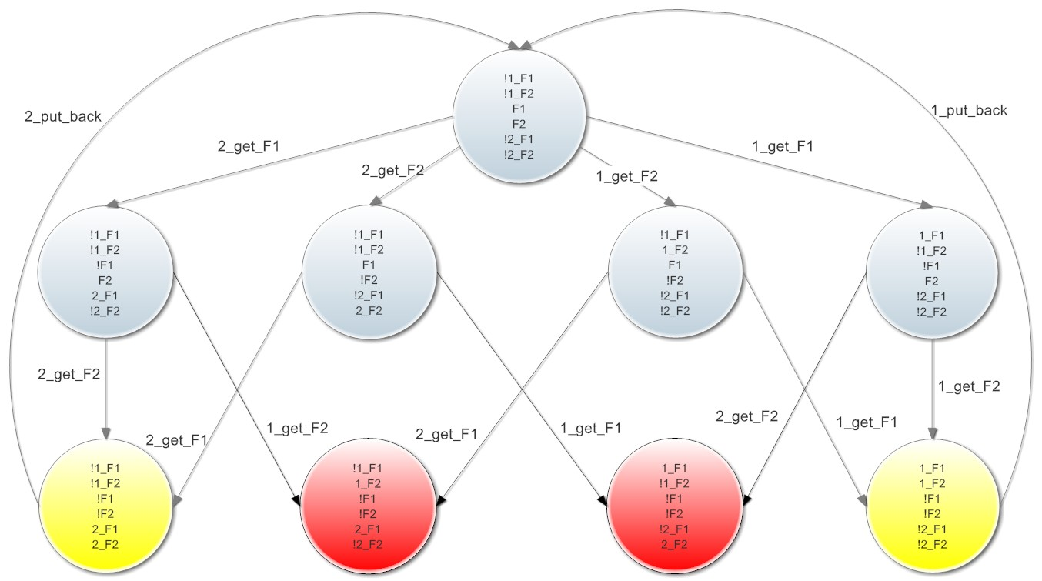
9 States 14 Transitions

Slide 4
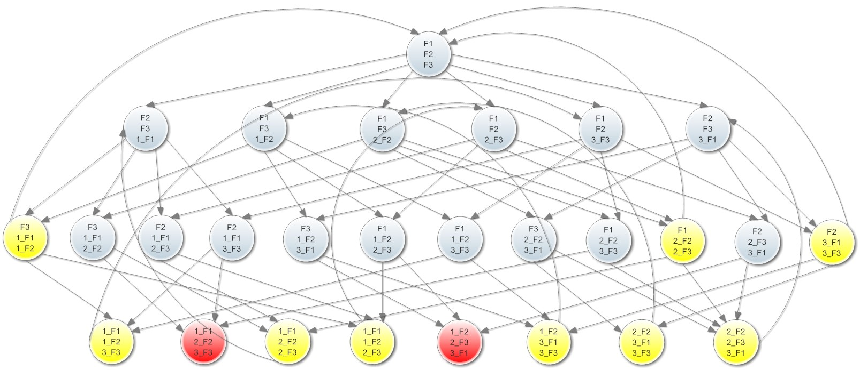
27 States， 56 Transitions

Slide 5
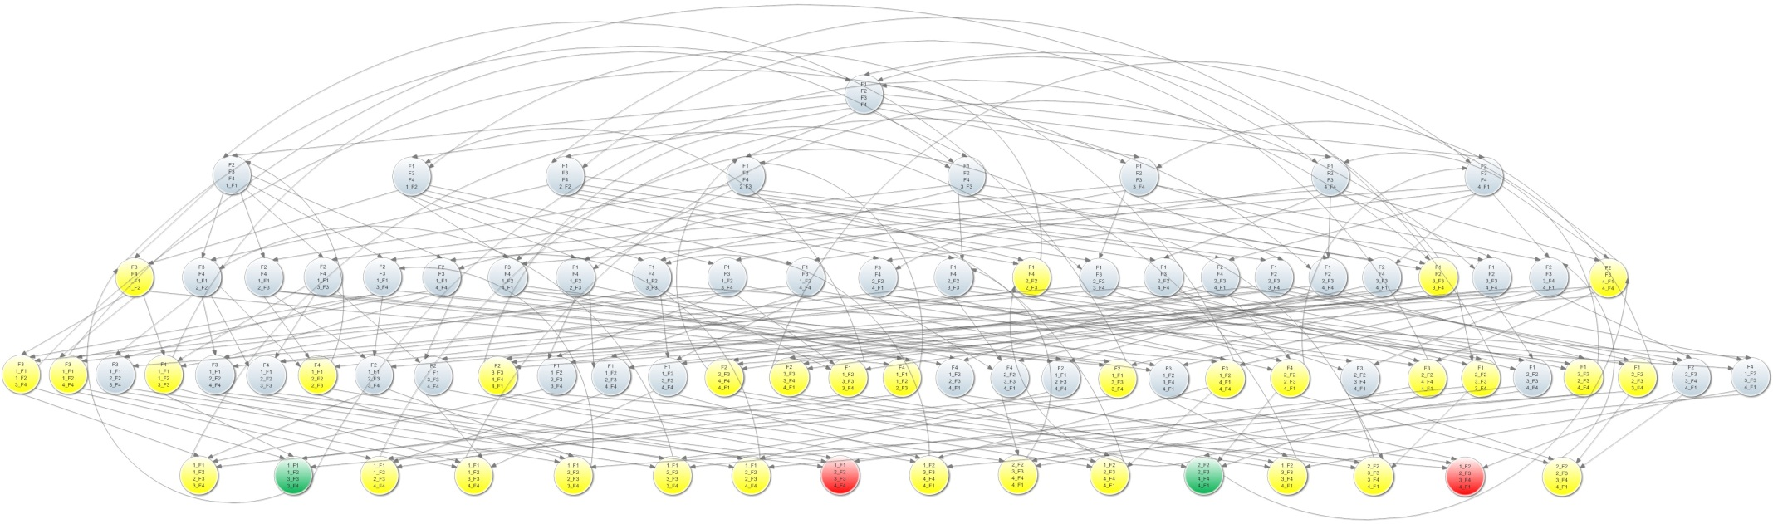
81 States， 252 Transitions
Notes:
1+8+24+32+16=81
8+8×6+24×4+32×2+4+16+16=252

Slide 6
From automata to Petri Net
automata are a theoretical and idealised model
they reflect a Newtonian world-view:
space & time as an absolute frame of reference
clockwork view of processes within this frame
Carl Adam Petri has made an attempt to combine automata from
theoretical CS, and pragmatic expertise from engineers: Petri Net
state is distributed, transitions are localised
local causality replaces global time
subsystems interact by explicit communication
Notes:
- theoreticians can think about automata
- engineers can (sort of) build them
- but ask a physicist whether they are a realistic model..

Slide 7
Petri nets-Motivation
In contrast to state machines, state transitions in Petri nets are asynchronous. The ordering of transitions is partly uncoordinated; it is specified by a partial order.
Therefore, Petri nets can be used to model concurrent distributed systems.
Many flavors of Petri nets are in use, e.g.
Activity charts(UML)
Data flow graphs and marked graphs

Slide 8
History
1962: C.A. Petri’s dissertation (U. Darmstadt, W. Germany)
1970: Project MAC Conf. on Concurrent Systems and Parallel Computation (MIT, USA)
1975: Conf. on Petri Nets and related Methods (MIT, USA)
1979: Course on General Net Theory of Processes and Systems (Hamburg, W. Germany)
1980: First European Workshop on Applications and Theory of Petri Nets (Strasbourg, France)
1985: First International Workshop on Timed Petri Nets (Torino, Italy)

Slide 9
Introduction
Petri Nets: Graphical and Mathematical modeling tools
graphical tool
visual communication aid
mathematical tool
state equations, algebraic equations, etc
concurrent, asynchronous, distributed, parallel, nondeterministic and/or stochastic systems

Slide 10
Informal Definition
The graphical presentation of a Petri net is a bipartite graph
There are two kinds of nodes
Places: usually model resources or partial state of the system
Transitions: model state transition and synchronization
Arcs are directed and always connect nodes of different types
Tokens are resources in the places

Slide 11
Example
p2
t2
p1
t1
p4
t3
p3

Slide 12
Definition of Petri Net
C = ( P, T, I, O)
Places P = { p₁, p₂, p₃, …, p_{n}}
Transitions T = { t₁, t₂, t₃, …, t_{n}}
Input I : T → P^{r} (r = number of places) •t
Output O : T → P^{q} (q = number of places) t •

Slide 13
marking µ : assignment of tokens to the places of Petri net µ = µ₁, µ₂, µ₃, … µ_{n}
p2
t2
p1
t1
p4
t3
p3

Slide 14
Applications
performance evaluation
communication protocols
distributed-software systems
distributed-database systems
concurrent and parallel programs
industrial control systems
discrete-events systems
multiprocessor memory systems
dataflow-computing systems
fault-tolerant systems
etc, etc, etc

Slide 15
Basics of Petri Nets
Petri net consist two types of nodes: places and transitions. And arc exists only from a place to a transition or from a transition to a place.
A place may have zero or more tokens.
Graphically, places, transitions, arcs, and tokens are represented respectively by: circles, bars, arrows, and dots.
Below is an example Petri net with two places and one transaction.
p₁
t₁
p₂

Slide 16
State
The state of the system is modeled by
marking the places with tokens
A place can be marked with a finite
number (possibly zero) of tokens

Slide 17
Fire
A transition t is called enabled in a certain marking, if:
For every arc from a place p to t, there exists a distinct token in the marking
An enabled transition can fire and result in a new marking
Firing of a transition t in a marking is an atomic operation
state transition of form (1, 0) → (0, 1)
p₁ : input place p₂: output place
p₁
t₁
p₂

Slide 18
Fire (cont.)
Firing a transition results in two things:
Subtracting one token from the marking of any place p for every arc connecting p to t
Adding one token to the marking of any place p for every arc connecting t to p

Slide 19
Firing example
2H₂ + O₂ → 2H₂O
2
t
H₂
2
H₂O
O₂

Slide 20
Firing example
2H₂ + O₂ → 2H₂O
2
t
H₂
2
H₂O
O₂

Slide 21
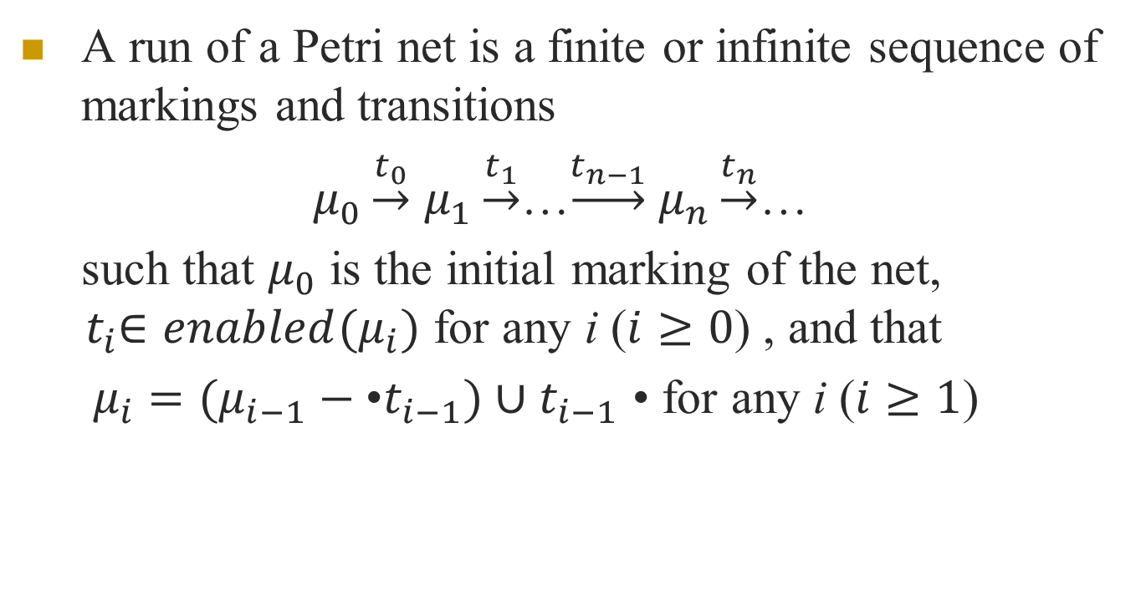
Run-1 Safe PN
A run of a Petri net is a finite or infinite sequence of markings and transitions
$μ_{0}\underset{→}{t_{0}}$ $μ_{1}\underset{→}{t_{1}}$…$\underset{→}{t_{n−1}}$ $μ_{n}\underset{→}{t_{n}}$…
such that $μ_{0}$ is the initial marking of the net, ${ t}_{i}∈enabled(μ_{i})$ for any i ($i≥0$) , and that
$μ_{i}=(μ_{i−1}−\text{•}t_{i−1})∪t_{i−1}$ • for any i ($i≥1$)

Slide 22
Properties of Petri Nets
Sequential Execution Transition t₂ can fire only after the firing of t₁. This impose the precedence of constraints "t₂ after t₁."
Synchronization Transition t₁ will be enabled only when there are at least one token at each of its input places.
Merging Happens when tokens from several places arrive for service at the same transition.
p₁
t₁
p₂
t₂
p₃
t₁

Slide 23
Fork

Slide 24
Properties of Petri Nets -continued
Concurrency t₁ and t₂ are concurrent. - with this property, Petri net is able to model systems of distributed control with multiple processes executing concurrently in time.
t₁
t₂

Slide 25
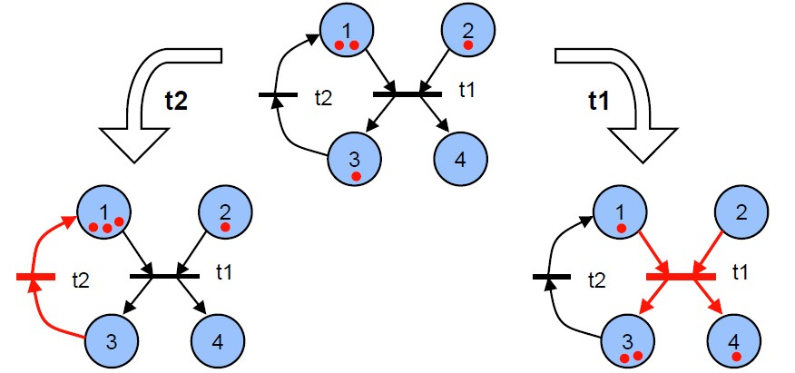
Non-Deterministic Evolution
The evolution of Petri nets is not deterministic
Any of the activated transactions might fire

Slide 26
Properties of Petri Nets -continued
Conflict t₁ and t₂ are both ready to fire but the firing of any leads to the disabling of the other transitions.
t₁
t₂
t₁
t₂

Slide 27
Properties of Petri Nets -continued
Conflict - continued
the resulting conflict may be resolved in a purely non-deterministic way or in a probabilistic way, by assigning appropriate probabilities to the conflicting transitions.
there is a choice of either t₁ and t₂, or t₃ and t₄
t₁
t₂
t₃
t₄

Slide 28
Some definitions
source transition: no inputs
sink transition: no outputs
self-loop: a pair (p,t) s.t. p is both an input and an output of t
pure PN: no self-loops
Weighted PN: arcs with weight
ordinary PN: all arc weights are 1’s
infinite capacity net: places can accommodate an unlimited number of tokens
finite capacity net: each place p has a maximum capacity K(p)
strict transition rule: after firing, each output place can’t have more than K(p) tokens
Theorem: every pure finite-capacity net can be transformed into an equivalent infinite-capacity net

Slide 29
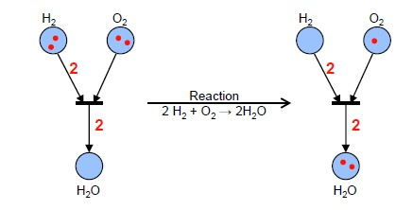
Weighted Edges
Associating weights to edges:
– Each edge fi has an associated weight W(fi)
(defaults to 1)
– A transition t is active if each place pi connected
through an edge fi to t contains at least W(f) tokens.

Slide 30
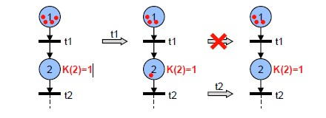
Finite Capacity Petri Net
Each place pi can hold maximally K(pi) tokens
A transition t is only active if all output places pi of t cannot exceed K(pi) after firing t.
Pure finite capacity Petri Nets can be transformed into equivalent infinite capacity Petri Nets (without capacity restrictions).
Equivalence: Both nets have the same set of all possible firing sequences

Slide 31
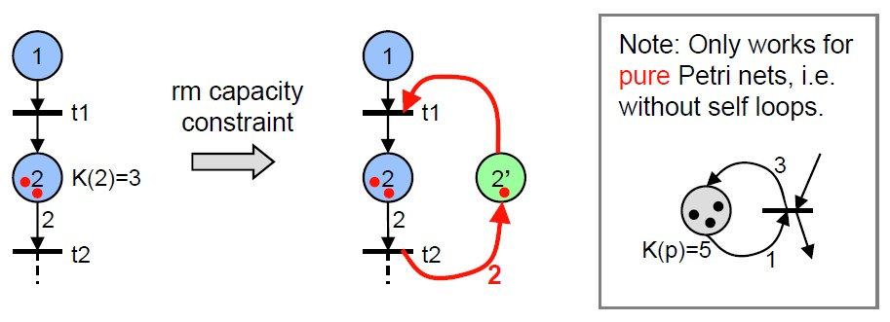
Removing Capacity Constraints
For each place p with K(p) > 1, add a complementary place p’ with initial marking M0(p’) = K(p) – M0(p).
For each outgoing edge e = (p, t), add an edge e’ from t to p’ with weight W(e).
For each incoming edge e = (t, p), add an edge e’ from p’ to t with weight W(e).
Notes:
左边消耗的右边补
左边新增的右边出
画图展示系统被破坏 transition被永远disable

Slide 32
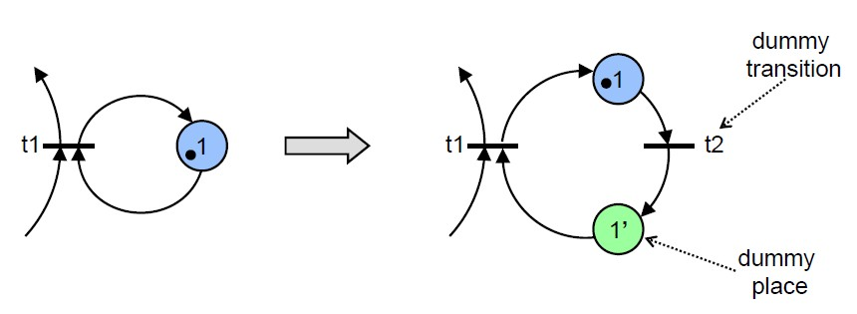
Resolving Self-Loops
The algorithm to remove capacity constraints works if the Petri net has no self loops (is pure).
No Problem! Rewrite the Petri net without self loops:

Slide 33
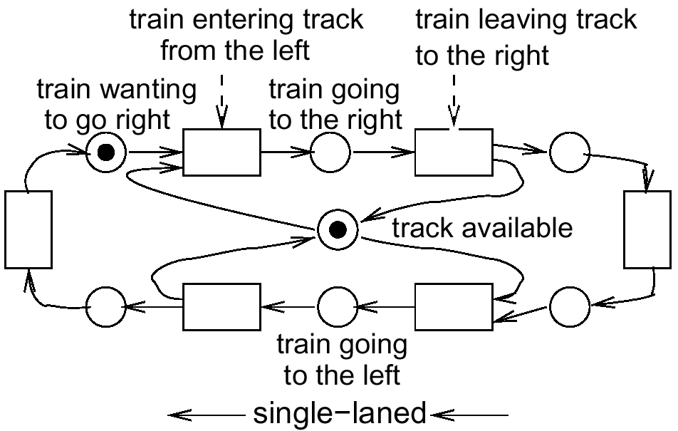
Example: Synchronization at single track rail segment
Preconditions

Slide 34
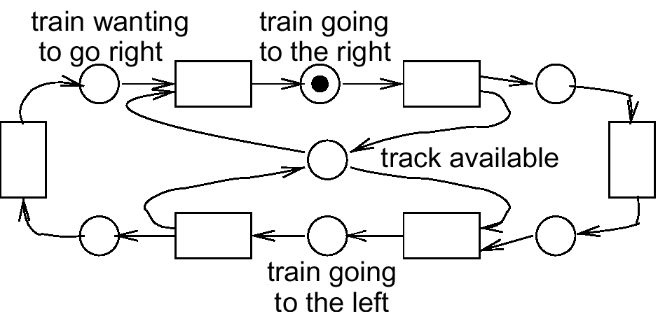
Playing the “token game”
use normal view mode!

Slide 35
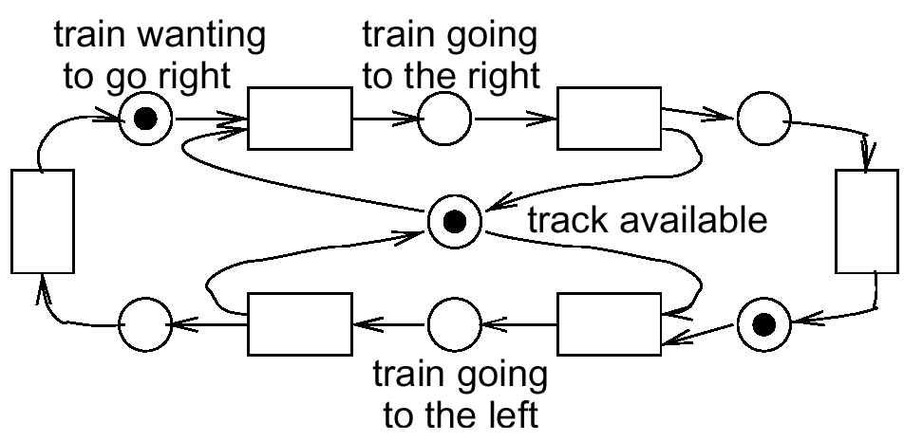
Conflict for resource track

Slide 36
Modeling communication protocols
ready
to send
ready
to receive
buffer
full
send
msg.
receive
msg.
proc.1
wait
for ack.
proc.2
msg.
received
receive
ack.
send
ack.
buffer
full
ack.
received
ack.
sent

Slide 37
Example: In a Restaurant
Waiter
free
Customer 1
Customer 2
Take
order
Take
order
wait
Order
taken
wait
eating
eating
Tell
kitchen
Serve food
Serve food

Slide 38
Example: In a Restaurant (Two Scenarios)
Scenario 1:
Waiter takes order from customer 1; serves customer 1; takes order from customer 2; serves customer 2.
Scenario 2:
Waiter takes order from customer 1; takes order from customer 2; serves customer 2; serves customer 1.

Slide 39
Example: In a Restaurant (Scenario 1)
Waiter
free
Customer 1
Customer 2
Take
order
Take
order
wait
Order
taken
wait
eating
eating
Tell
kitchen
Serve food
Serve food

Slide 40
Example: In a Restaurant (Scenario 2)
Waiter
free
Customer 1
Customer 2
Take
order
Take
order
wait
Order
taken
wait
eating
eating
Tell
kitchen
Serve food
Serve food

Slide 41
Example: Vending Machine
Take 15c bar
Deposit 10c
15c
5c
Deposit 5c
Deposit 5c
Deposit
5c
0c
Deposit
5c
Deposit 10c
10c
20c
Deposit 10c
Take 20c bar

Slide 42
Example: Vending Machine (3 Scenarios)
Scenario 1:
Deposit 5c, deposit 5c, deposit 5c, deposit 5c, take 20c snack bar.
Scenario 2:
Deposit 10c, deposit 5c, take 15c snack bar.
Scenario 3:
Deposit 5c, deposit 10c, deposit 5c, take 20c snack bar.

Slide 43
Example: Vending Machine
Take 15c bar
Deposit 10c
15c
5c
Deposit 5c
Deposit 5c
Deposit
5c
0c
Deposit
5c
Deposit 10c
10c
20c
Deposit 10c
Take 20c bar

Slide 44
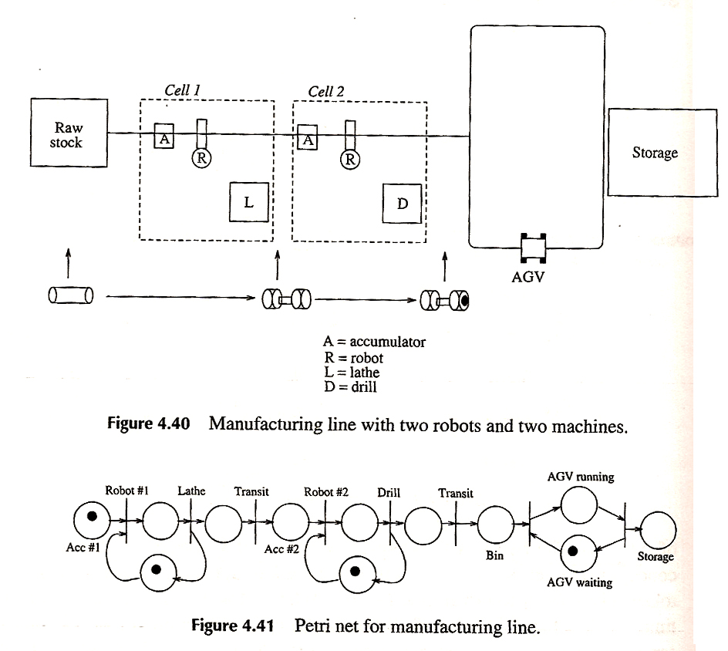
Example: manufacturing line

Slide 45
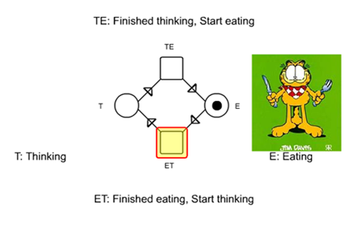
Example: Four Philosophers
First: Building a model for one philosopher

Slide 46
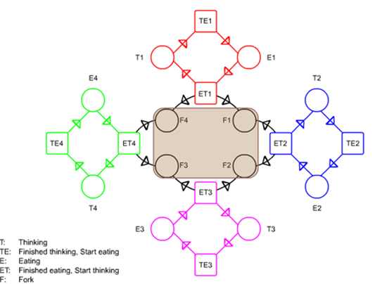
Building complete model for Four philosophers

Slide 47
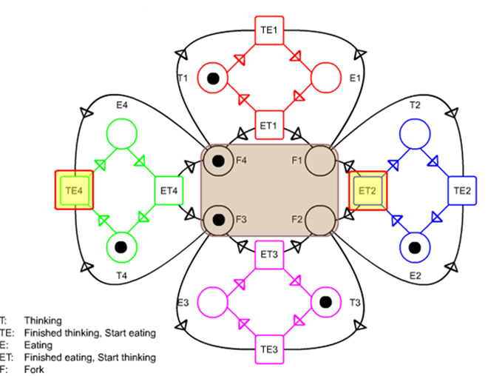
Make it work!

Slide 48
81 States， 252 Transitions
Notes:
1+8+24+32+16=81
8+8×6+24×4+32×2+4+16+16=252

Slide 49
Behavioral properties (1)
Properties that depend on the initial marking
Reachability
Mn is reachable from M0 if exists a sequence of firings that transform M0 into Mn
reachability is decidable, but exponential
Boundedness
a PN is bounded if the number of tokens in each place doesn’t exceed a finite number k for any marking reachable from M0
a PN is safe if it is 1-bounded

Slide 50
Behavioral properties (2)
Liveness
a PN is live if, no matter what marking has been reached, it is possible to fire any transition with an appropriate firing sequence
equivalent to deadlock-free
Reversibility
a PN is reversible if, for each marking M reachable from M0, M0 is reachable from M
relaxed condition: a marking M’ is a home state if, for each marking M reachable from M0, M’ is reachable from M

Slide 51
Behavioral properties (3)
Persistence
a PN is persistent if, for any two enabled transitions, the firing of one of them will not disable the other
then, once a transition is enabled, it remains enabled until it’s fired

Slide 52
Behavioral properties (4)
Fairness
bounded-fairness: the number of times one transition can fire while the other is not firing is bounded
unconditional(global)-fairness: every transition appears infinitely often in a firing sequence

Slide 53
Analysis methods (1)
Coverability tree
tree representation of all possible markings
root = M0
nodes = markings reachable from M0
arcs = transition firings
if net is unbounded, then tree is kept finite by introducing the symbol ω
Properties
a PN is bounded iff ω doesn’t appear in any node
a PN is safe iff only 0’s and 1’s appear in nodes
a transition is dead iff it doesn’t appear in any arc
if M is reachable form M0, then exists a node M’ that covers M

Slide 54
Coverability tree example
M0=(100)
p1
t3
p2
t1
t0
t2
p3

Slide 55
Coverability tree example
M0=(100)
t1
p1
t3
M1=(001)
“dead end”
p2
t1
t0
t2
p3

Slide 56
Coverability tree example
M0=(100)
t1
t3
p1
t3
M1=(001)
“dead end”
M3=(1ω0)
p2
t1
t0
t2
p3

Slide 57
Coverability tree example
M0=(100)
t1
t3
p1
t3
M1=(001)
“dead end”
M3=(1ω0)
t1
p2
t1
t0
M4=(0ω1)
t2
p3

Slide 58
Coverability tree example
M0=(100)
t1
t3
p1
t3
M1=(001)
“dead end”
M3=(1ω0)
t1
t3
p2
t1
t0
M4=(0ω1)
M3=(1ω0)
“old”
t2
p3

Slide 59
Coverability tree example
M0=(100)
t1
t3
p1
t3
M1=(001)
“dead end”
M3=(1ω0)
t1
t3
p2
t1
t0
M4=(0ω1)
M6=(1ω0)
“old”
t2
t2
p3
M5=(0ω1)
“old”

Slide 60
Coverability tree example
100
M0=(100)
t1
t3
t1
t3
M1=(001)
“dead end”
M3=(1ω0)
001
1ω0
t1
t3
t1
t3
0ω1
M4=(0ω1)
M6=(1ω0)
“old”
t2
t2
M5=(0ω1)
“old”
coverability graph
coverability tree

Slide 61
Reduction Rules
Analysis of Petri nets tedious, especially for large, complex nets
Often, the complexity for analysis increases exponentially with the size of the Petri net
Solution: Simplify the net while retaining the properties to analyze.
In our case, the properties in question are
Liveness
Safeness
Boundedness
6 of the simplest reduction rules are shown in the sequel

Slide 62
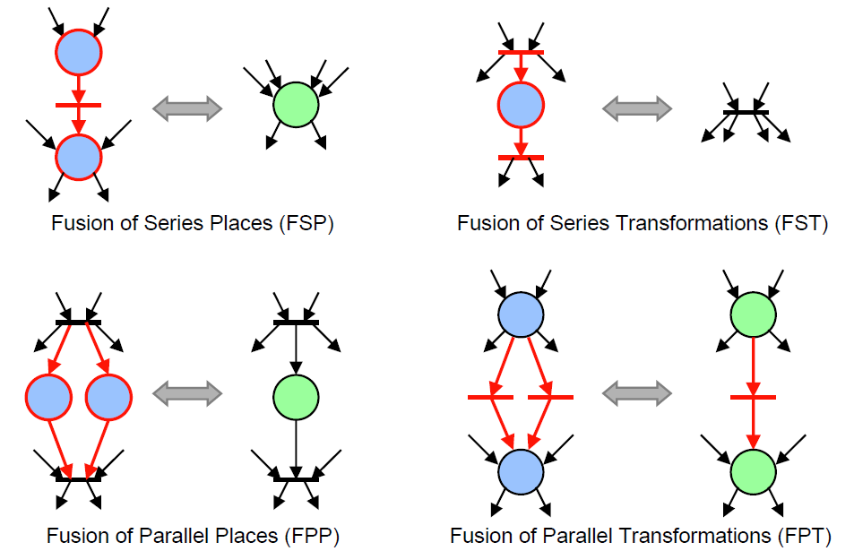
Reduction Rules

Slide 63
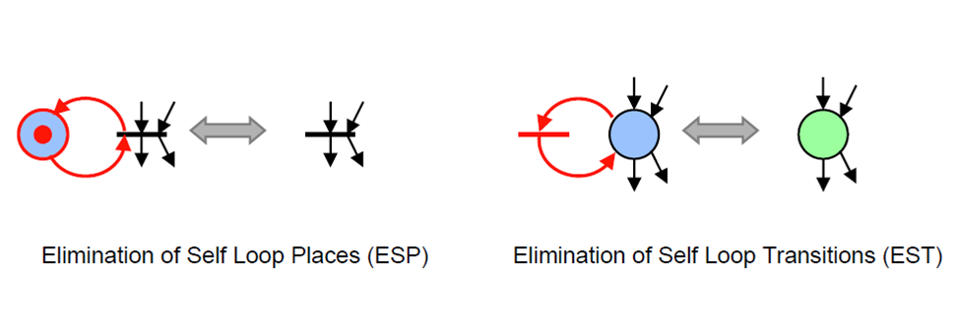
Reduction Rules

Slide 64
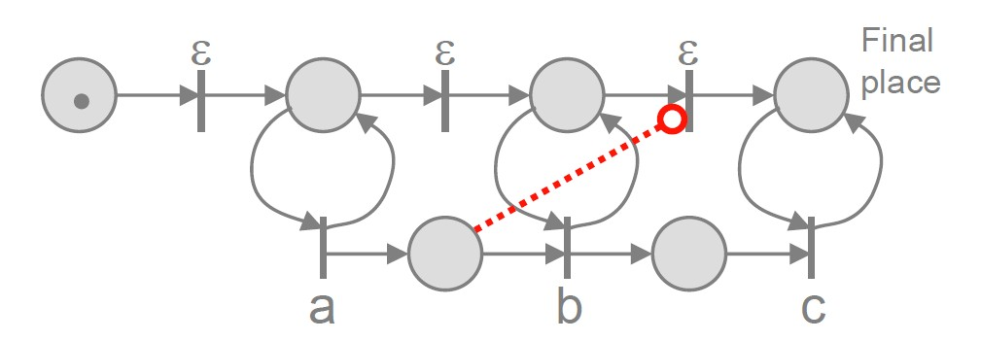
Common Extensions
Colored Petri nets: Tokens carry values (colors)
Any Petri net with finite number of colors can be
transformed into a regular Petri net.
Continuous Petri nets: The number of tokens can be real.Cannot be transformed to a regular Petri net
Inhibitor Arcs: Enable a transition if a place contains no tokens. Cannot be transformed to a regular Petri net

Slide 65
Time Extension
The previous examples model the sequences of events that can take place in the system;
For example, they tell us that "the resource must be occupied before being released", or that "a new low-priority request can be issued only after the resource is released",
But, it does not say anything about time distances
e.g. how soon is the resource granted after a low-priority request? how long can a process keep the resource occupied? how often is a new request issued?
to be able to model these properties, we need to introduce a quantitative notion of time into the formalism

Slide 66
Petri Net with Time
Time Petri nets are classical Petri Nets where to each transition t a time interval [a; b] is associated.
The times a and b are relative to the moment at which t was last enabled.
Assuming that t was enabled at time c, then t may fire only during the interval [c + a; c + b] and must fire at the time c + b at the latest, unless it is disabled before by the firing of another transition.
Firing a transition takes no time.

Slide 67
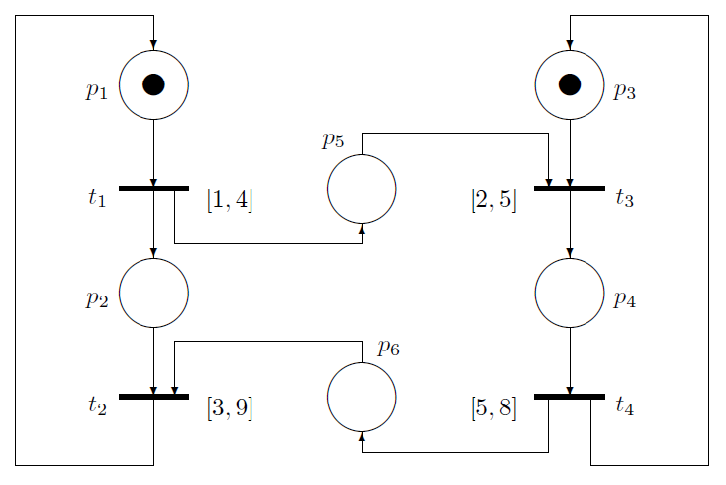

Slide 68
The philosophy of this kind of time dependent Petri net is: when a transition becomes enabled it may not fire at once (in general) but during a certain time interval and at the end of the interval there is a force to fire.
If the upper bound of the interval is at infinity, then the second characteristic, the obligation to fire, is lost. That is why we consider only time intervals whose upper bounds are finite numbers.

Slide 69
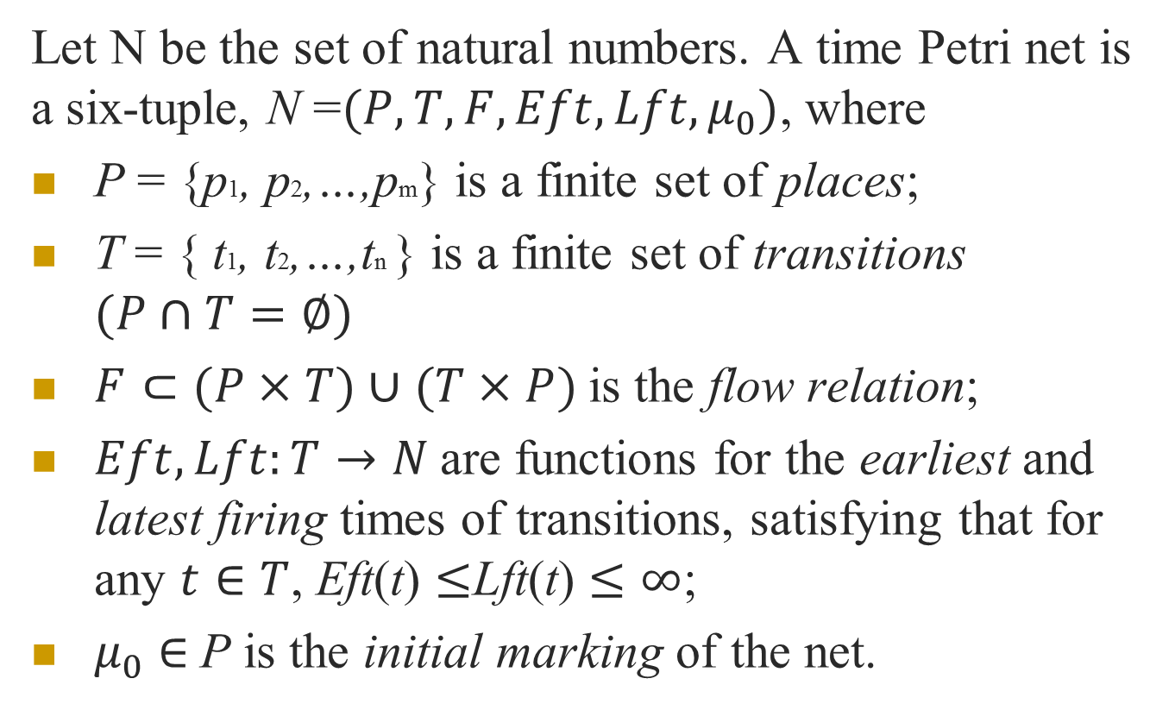
Let N be the set of natural numbers. A time Petri net is a six-tuple, N =$(P,T,F,Eft,Lft,μ_{0})$, where
P = {p1, p2,…,pm} is a finite set of places;
T = { t1, t2,…,tn } is a finite set of transitions $(P∩T=∅)$
$F⊂(P×T)∪$ $(T×P)$is the flow relation;
$Eft,Lft:T→N$are functions for the earliest and latest firing times of transitions, satisfying that for any $t∈T$, Eft(t) $≤$Lft(t) $≤∞$;
$μ_{0}$ $∈$P is the initial marking of the net.

Slide 70
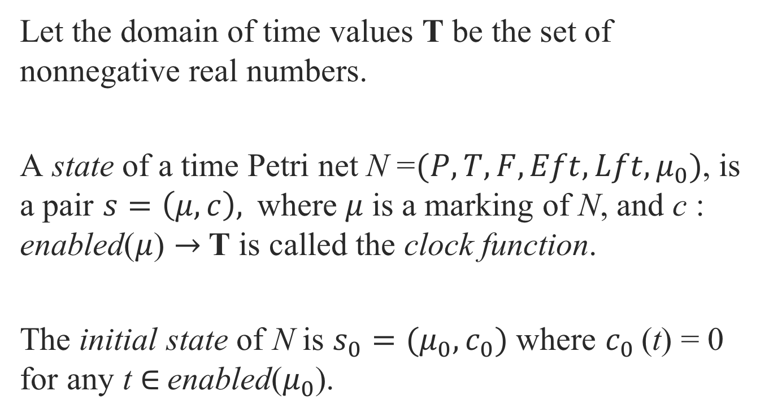
Let the domain of time values T be the set of nonnegative real numbers.
A state of a time Petri net N =$(P,T,F,Eft,Lft,μ_{0})$, is a pair $s=\left(μ,c\right),$where$μ$ is a marking of N, and c : enabled($μ$) $→$T is called the clock function.
The initial state of N is $s_{0}=(μ_{0},c_{0})$ where $c_{0}$(t) = 0 for any t $∈$enabled($μ_{0}$).

Slide 71
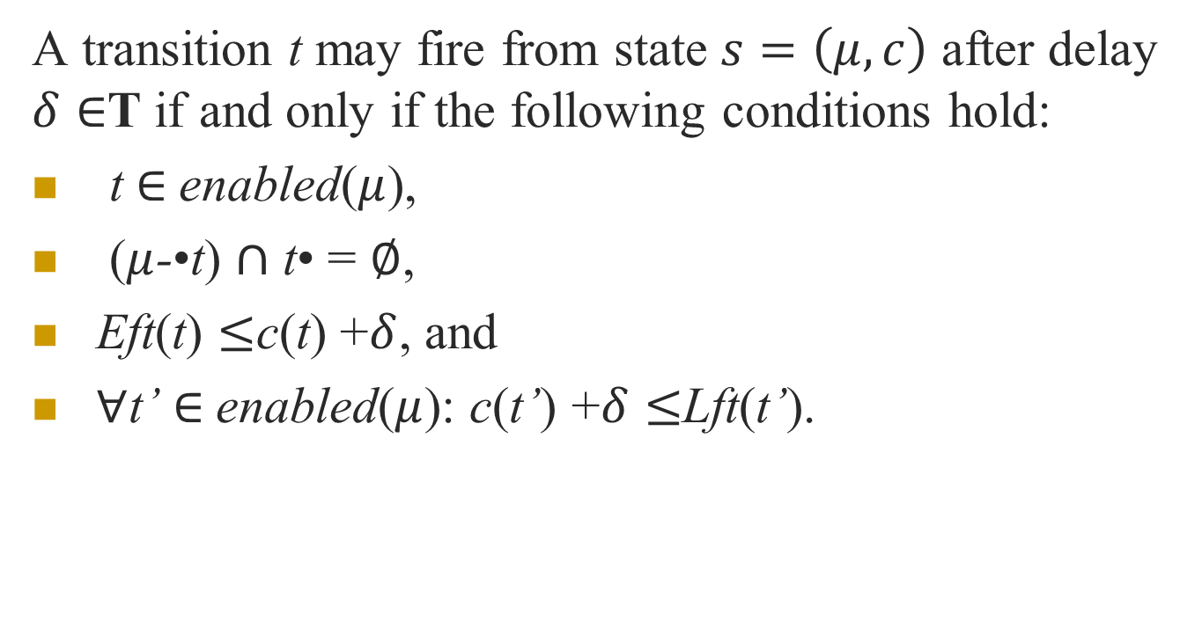
A transition t may fire from state $s=\left(μ,c\right)$ after delay $δ∈$T if and only if the following conditions hold:
t $∈$enabled($μ$),
($μ$-$\text{•}$t) $∩$ t$\text{•}$ = $∅$,
Eft(t) $≤$c(t) +$δ$, and
$∀$t’ $∈$enabled($μ$): c(t’) +$δ≤$Lft(t’).

Slide 72
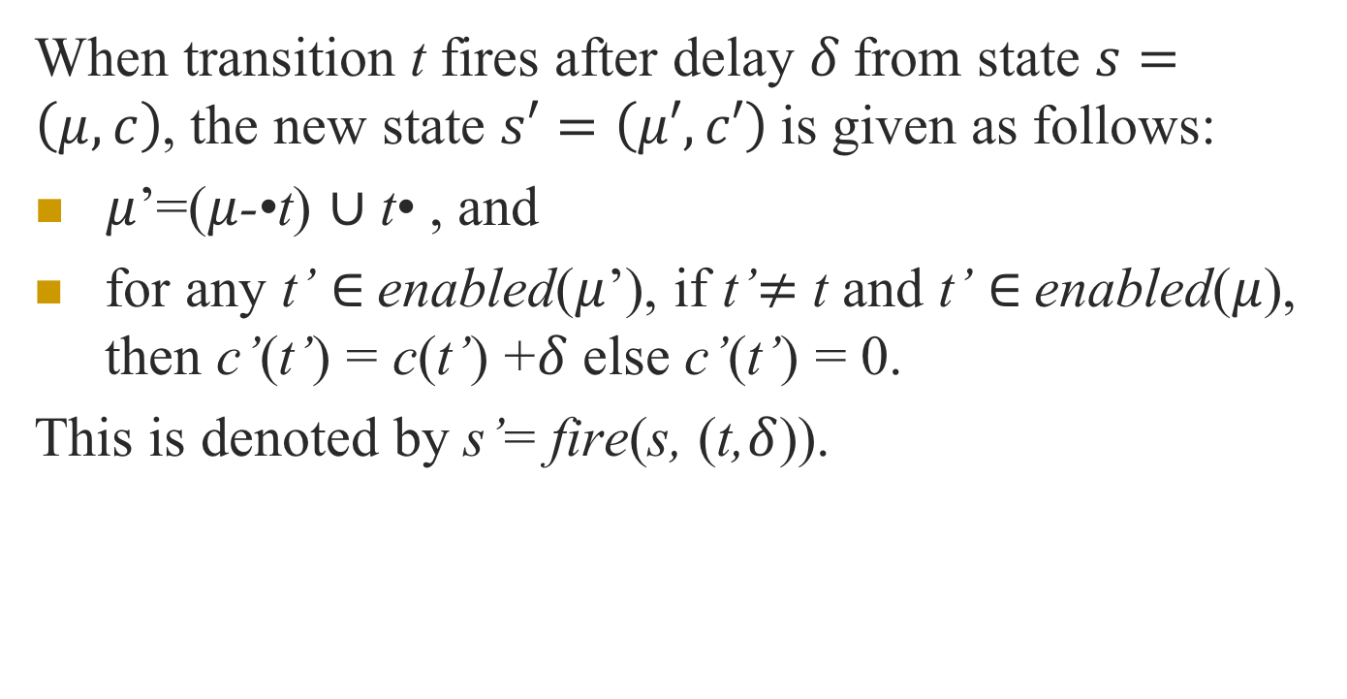
When transition t fires after delay $δ$from state $s=\left(μ,c\right)$, the new state $s′=\left(μ′,c′\right)$is given as follows:
$μ$’=($μ$-$\text{•}$t) $∪$ t$\text{•}$ , and
for any t’ $∈$enabled($μ$’), if t’$≠$ t and t’ $∈$enabled($μ$), then c’(t’) = c(t’) +$δ$ else c’(t’) = 0.
This is denoted by s’= fire(s, (t,$δ$)).

Slide 73
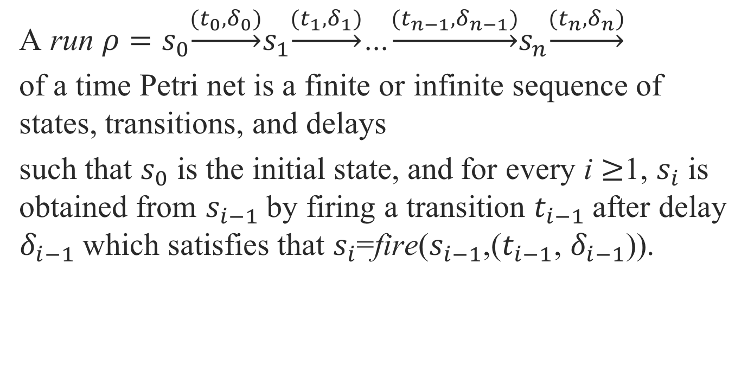
A run $ρ=s_{0}\underset{→}{(t_{0},δ_{0})}s_{1}\underset{→}{(t_{1},δ_{1})}$…$\underset{→}{(t_{n−1},δ_{n−1})}s_{n}\underset{→}{(t_{n},δ_{n})}$
of a time Petri net is a finite or infinite sequence of states, transitions, and delays
such that $s_{0}$ is the initial state, and for every i $≥$1, $s_{i}$ is obtained from $s_{i−1}$by firing a transition $t_{i−1}$after delay $δ_{i−1}$which satisfies that $s_{i}$=fire($s_{i−1}$,($t_{i−1}$, $δ_{i−1}$)).

Slide 74
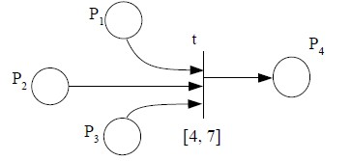
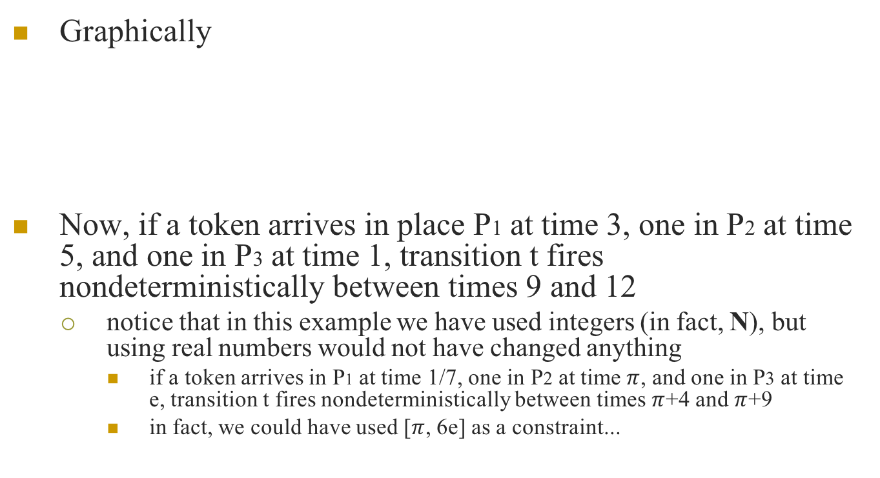
Graphically
Now, if a token arrives in place P1 at time 3, one in P2 at time 5, and one in P3 at time 1, transition t fires nondeterministically between times 9 and 12
notice that in this example we have used integers (in fact, N), but using real numbers would not have changed anything
if a token arrives in P1 at time 1/7, one in P2 at time$π$, and one in P3 at time e, transition t fires nondeterministically between times$π$+4 and$π$+9
in fact, we could have used [$π$, 6e] as a constraint...

Slide 75
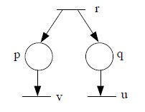
Simultaneous Firing
With untimed PNs, the notion of simultaneous firing (for non-conflicting transitions) was irrelevant
–for example, consider the following fragment of PN:
after r fires, producing a marking that we call M, it does not matter whether it is u or v that fires first from M: from the point of view of the untimed model, the firing sequence u, v does not mean that u fires at time t, and v first at a later time t' > t, since there is no notion of time!
•untimed PNs represent sequences of firings, but these are logical sequences, not temporal ones

Slide 76
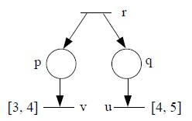
However, in the timed model simultaneity can occur, in the sense that two firings are associated with the same instant
–let us now consider the previous fragment of PN, and add time:
now, if r fires at time 10, both u and v can fire at time 14, so both firing sequences <r, 10>, <u, 14>, <v, 14> and<r, 10>, <v, 14>, <u, 14> are admissible
notice that the firings of u and v are associated with the same time instant, so they are in effect simultaneous

Slide 77
In the previous example, there was no logical ordering between u and v: they could occur at the same time, but neither had to fire before the other
this was represented by the fact that both the <r, 10>, <u, 14>, <v,14> and the <r, 10>, <v, 14>, <u, 14> sequences are admissible
However, there could be a different form of simultaneity, one which however entails logical ordering

Slide 78
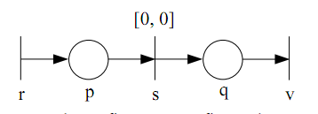
Let us consider the following fragment of TPN:
in this case, when r fires, s must fire at the same time (that is, the firing of r and the one of s must be associated with the same temporal instant)
that is, sequences are of the form <r, T>, <s, T>
however, there is a logical precedence between r and s, in the sense that, in all firing sequences, the firing of r must precede the one of s
i.e. sequence <s, T> <r, T> is not admissible

Slide 79
Transitions in which the lower bound is 0 (such as transitions above) are called zero-time transitions, since they can occur at the same time in which they are enabled, without delay
zero-time transitions, if not treated carefully, can give rise to the so-called Zeno-behavior

Slide 80
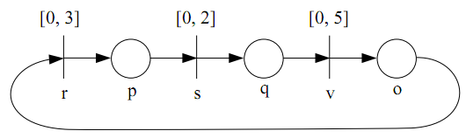
a Zeno behavior is one in which time does not advance
Let us consider the following fragment of TPN:
the following sequence of firings is admissible (for any T in which place p contains a token): <s, T>, <v, T>, <r, T>, <s, T>, <v, T>, <r, T>, <s, T>, ...
in such a sequence time is not advancing (even if the sequence grows!), which is physically impossible

Slide 81
One might argue that zero-time transitions in the real world cannot occur, so we should avoid them entirely
however, even if they are not physically feasible, from the point of view of modeling they are often useful,
for example to model cases in which the difference in time between two transitions is negligible with respect to the main dynamics of the system

Slide 82
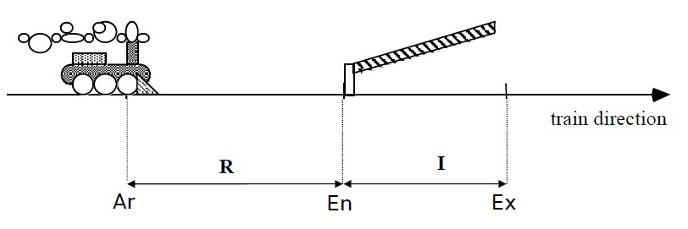
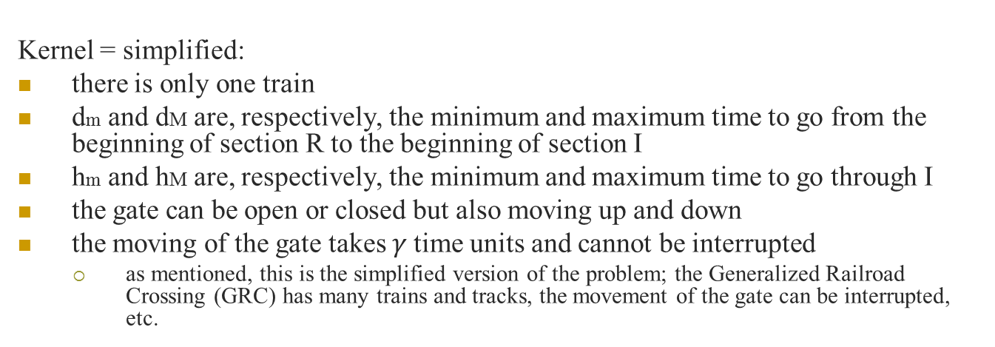
Example: Kernel Railorad Crossing
Kernel = simplified:
there is only one train
dm and dM are, respectively, the minimum and maximum time to go from the beginning of section R to the beginning of section I
hm and hM are, respectively, the minimum and maximum time to go through I
the gate can be open or closed but also moving up and down
the moving of the gate takes $γ$time units and cannot be interrupted
as mentioned, this is the simplified version of the problem; the Generalized Railroad Crossing (GRC) has many trains and tracks, the movement of the gate can be interrupted, etc.

Slide 83
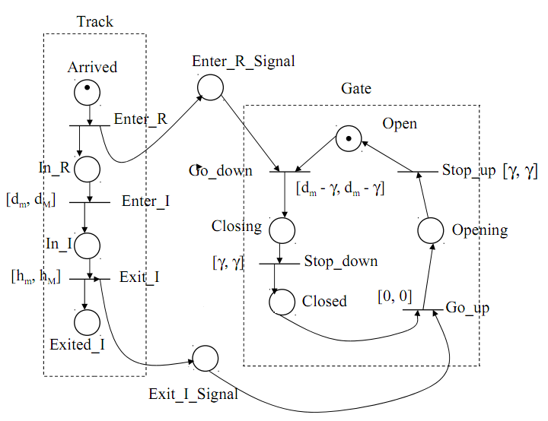
Does this model guarantee that the gate will always be closed if a train is in section I?

Slide 84
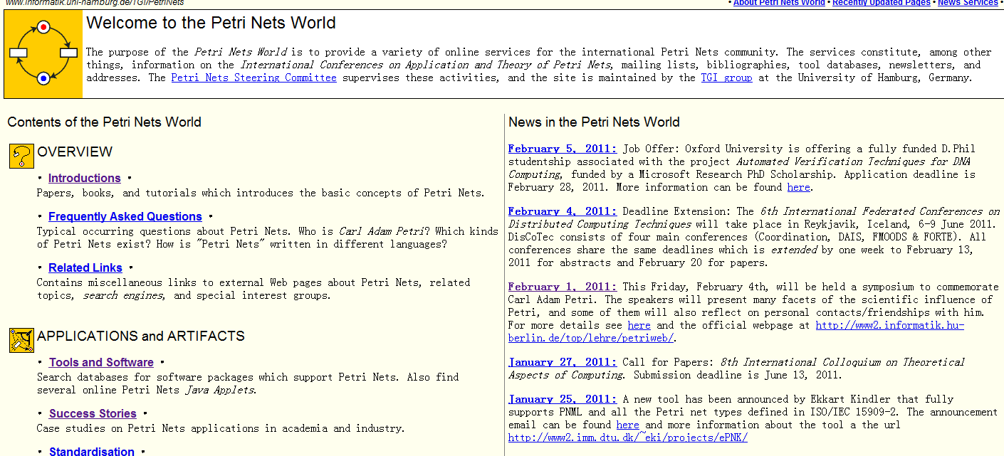
Petri Net World
http://www.informatik.uni-hamburg.de/TGI/PetriNets/

