Slide 1
Multi-Layer Perceptron

Slide 2
Multilayer Perceptron (MLP)
y₁
y₂
y_{q-1}
y_{q}
…
output layer
MLP: modeling a relationship between input x and output y
z_{k}
Result of learning: modified set of weights
…
hidden layer 2
w_{kj}
z_{j}
…
hidden layer 1
Learning in MLP: the process of modifying weights
…
Input layer
x₁
x₂
x_{p-1}
x_{p}

Slide 3
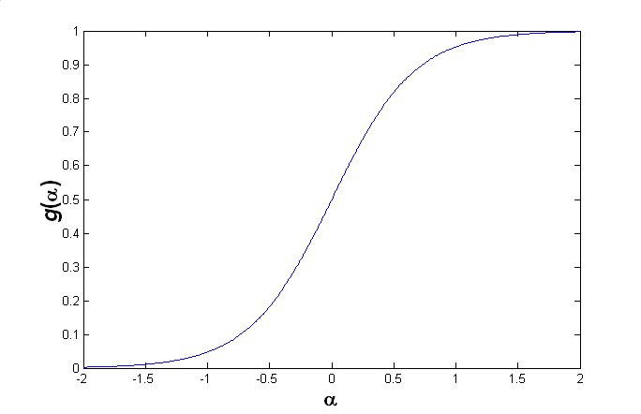
Inside of a Neuron
o_{k}
g(·)
o_{k}: output of neuron k
a_{k}: input of neuron k
a_{k}
Σ
w_{kj}
Activation function : i.e. sigmoid
_{j}
Local-sum function : i.e. dot-product
Notes:
Non-linear문제를 풀어보려고 g()에 넣음..(w의 summation)

Slide 4
Learning
Finding optimal parameters so that the risk of the model is minimized
An empirical risk in MLP
N : # of training data
d: target of training data
y: output of MLP
Notes:
Risk-> error

Slide 5
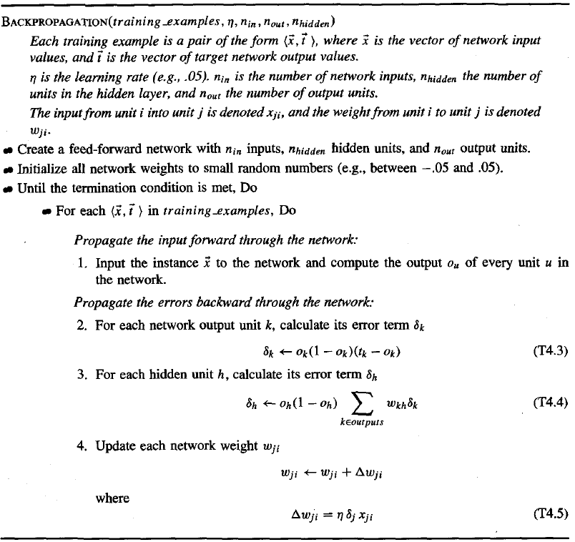
Notes:
에러를 Destination에서 조정하고 그 다음 안쪽 layer weight 조정
2번이 weigh조정. 마지막 돌아올때 weigh조정은 4번이 조정..
은닉층-> u, ouput노드 k

Slide 6
Forward Propagation (1)
y₁
y₂
y_{q-1}
y_{q}
…
z_{k}
…
w_{kj}
z_{j}
…
…
x₁
x₂
x_{p-1}
x_{p}

Slide 7
Forward Propagation (2)
y₁
y₂
y_{q-1}
y_{q}
…
z_{k}
…
w_{kj}
z_{j}
Meaning of forward propagation : Calculation of each z_{k} using z_{j} of lower layer
…
…
x₁
x₂
x_{p-1}
x_{p}

Slide 8
Forward Propagation (3)
y₁
y₂
y_{q-1}
y_{q}
…
z_{k}
…
w_{kj}
z_{j}
…
Risk calculation
…
x₁
x₂
x_{p-1}
x_{p}

Slide 9
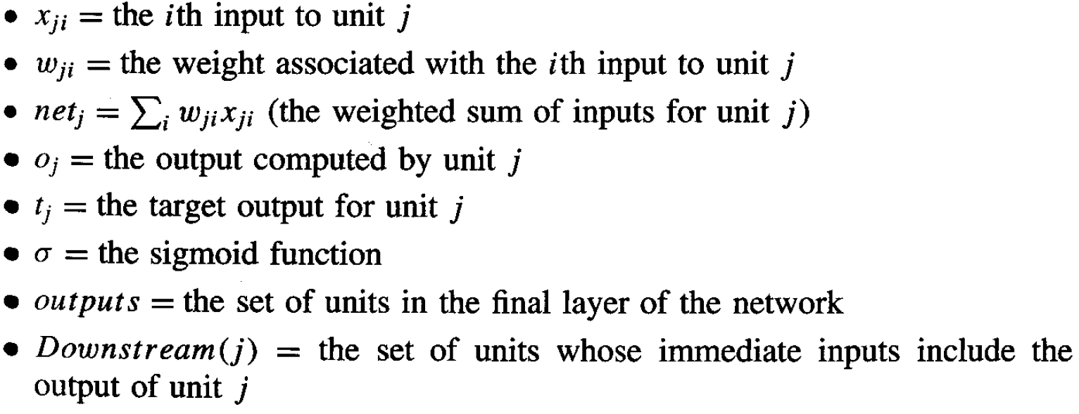
Symbols

Slide 10
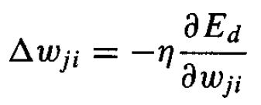
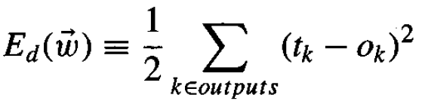
Backpropagation (1)
For each training example d, every weight w_{ji} is updated by
Notes:
O(k)는 g(x)안에 숨어있음. -> Chain rule로 미분

Slide 11
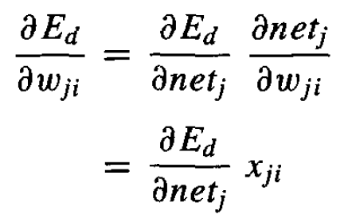
Backpropagation (2)
Notes:
Net(j) = Sum(w(i)x(i))

Slide 12
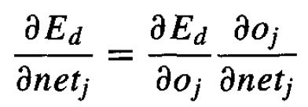


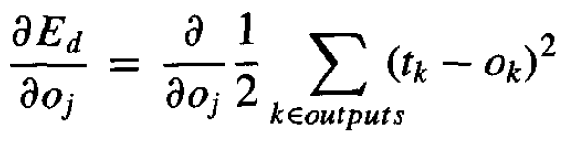
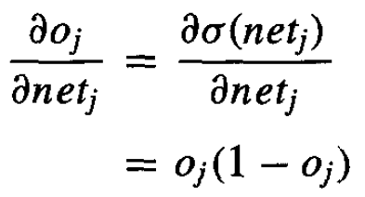
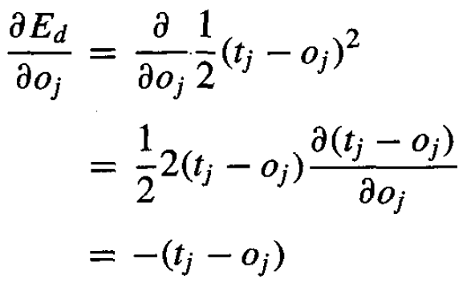
Output Unit (1)
Notes:
g’(x) -> g(x)(1-g(x))

Slide 13
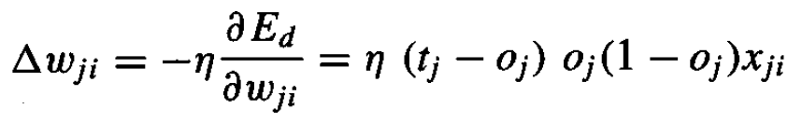
Output Unit (2)
In output layer,

Slide 14
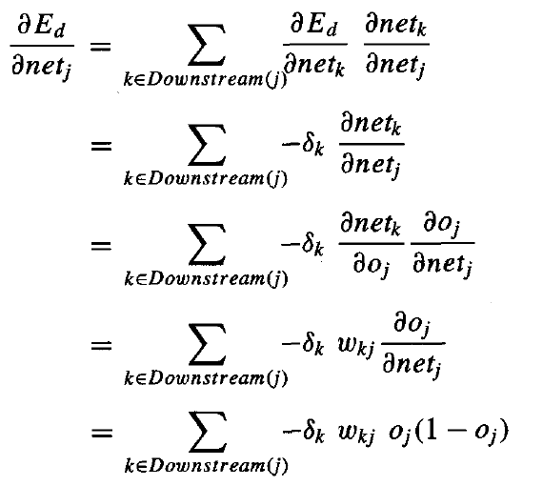
Hidden Unit (1)
Notes:
Downstream(j)->내려가는거..?

Slide 15



Hidden Unit (2)
In hidden Layers,

Slide 16
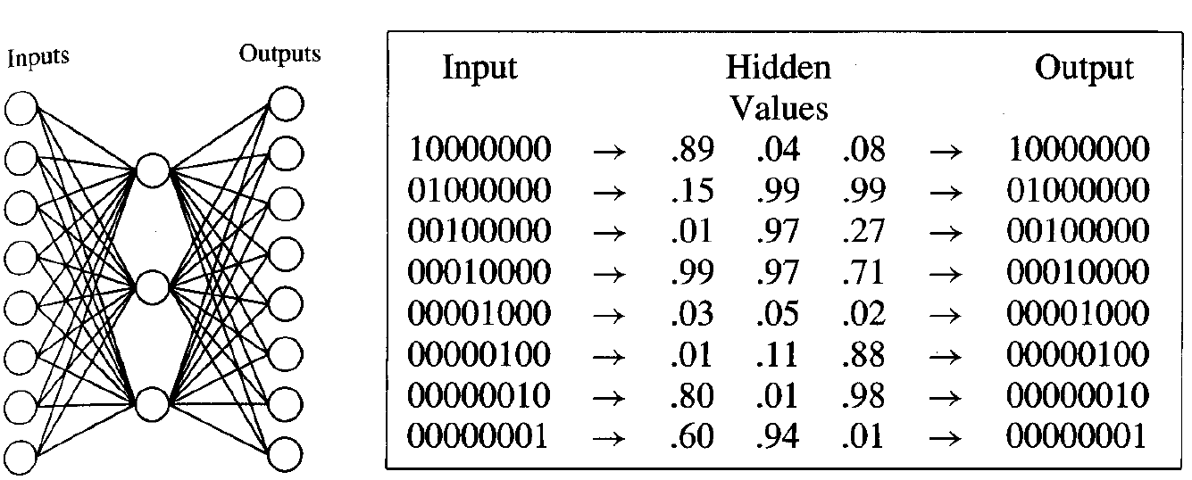
Hidden Layer Representation
Notes:
시험은 유도해라….
Hidden layer는 2개정도만 쌓으면 모든 함수가 다 포함된다.(수학적으로..)
Hidden layer는 값을 추상화(숫자의 특성을 뽑아서 맵핑시키려고..)려고 한다. 레이어가 많아지면 외우려고 함..

Slide 17
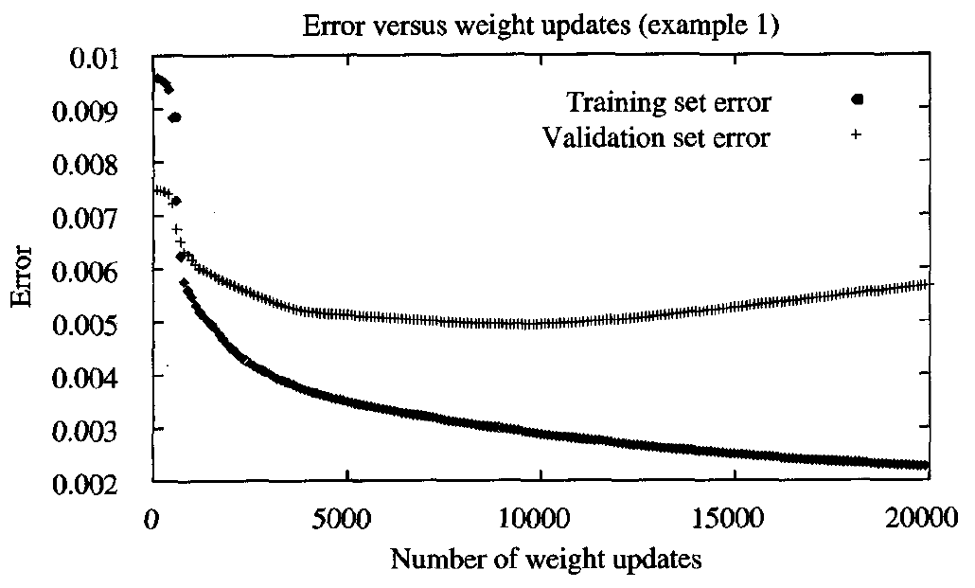
Overfitting
Notes:
적당히 루프돌고 멈춰라..!

