Slide 1

Intelligent Attacking Agent Training Framework
Welcome to the cutting-edge world of network security innovation. The IH3A framework represents a groundbreaking approach to training intelligent agents capable of evading network detection.

Slide 2
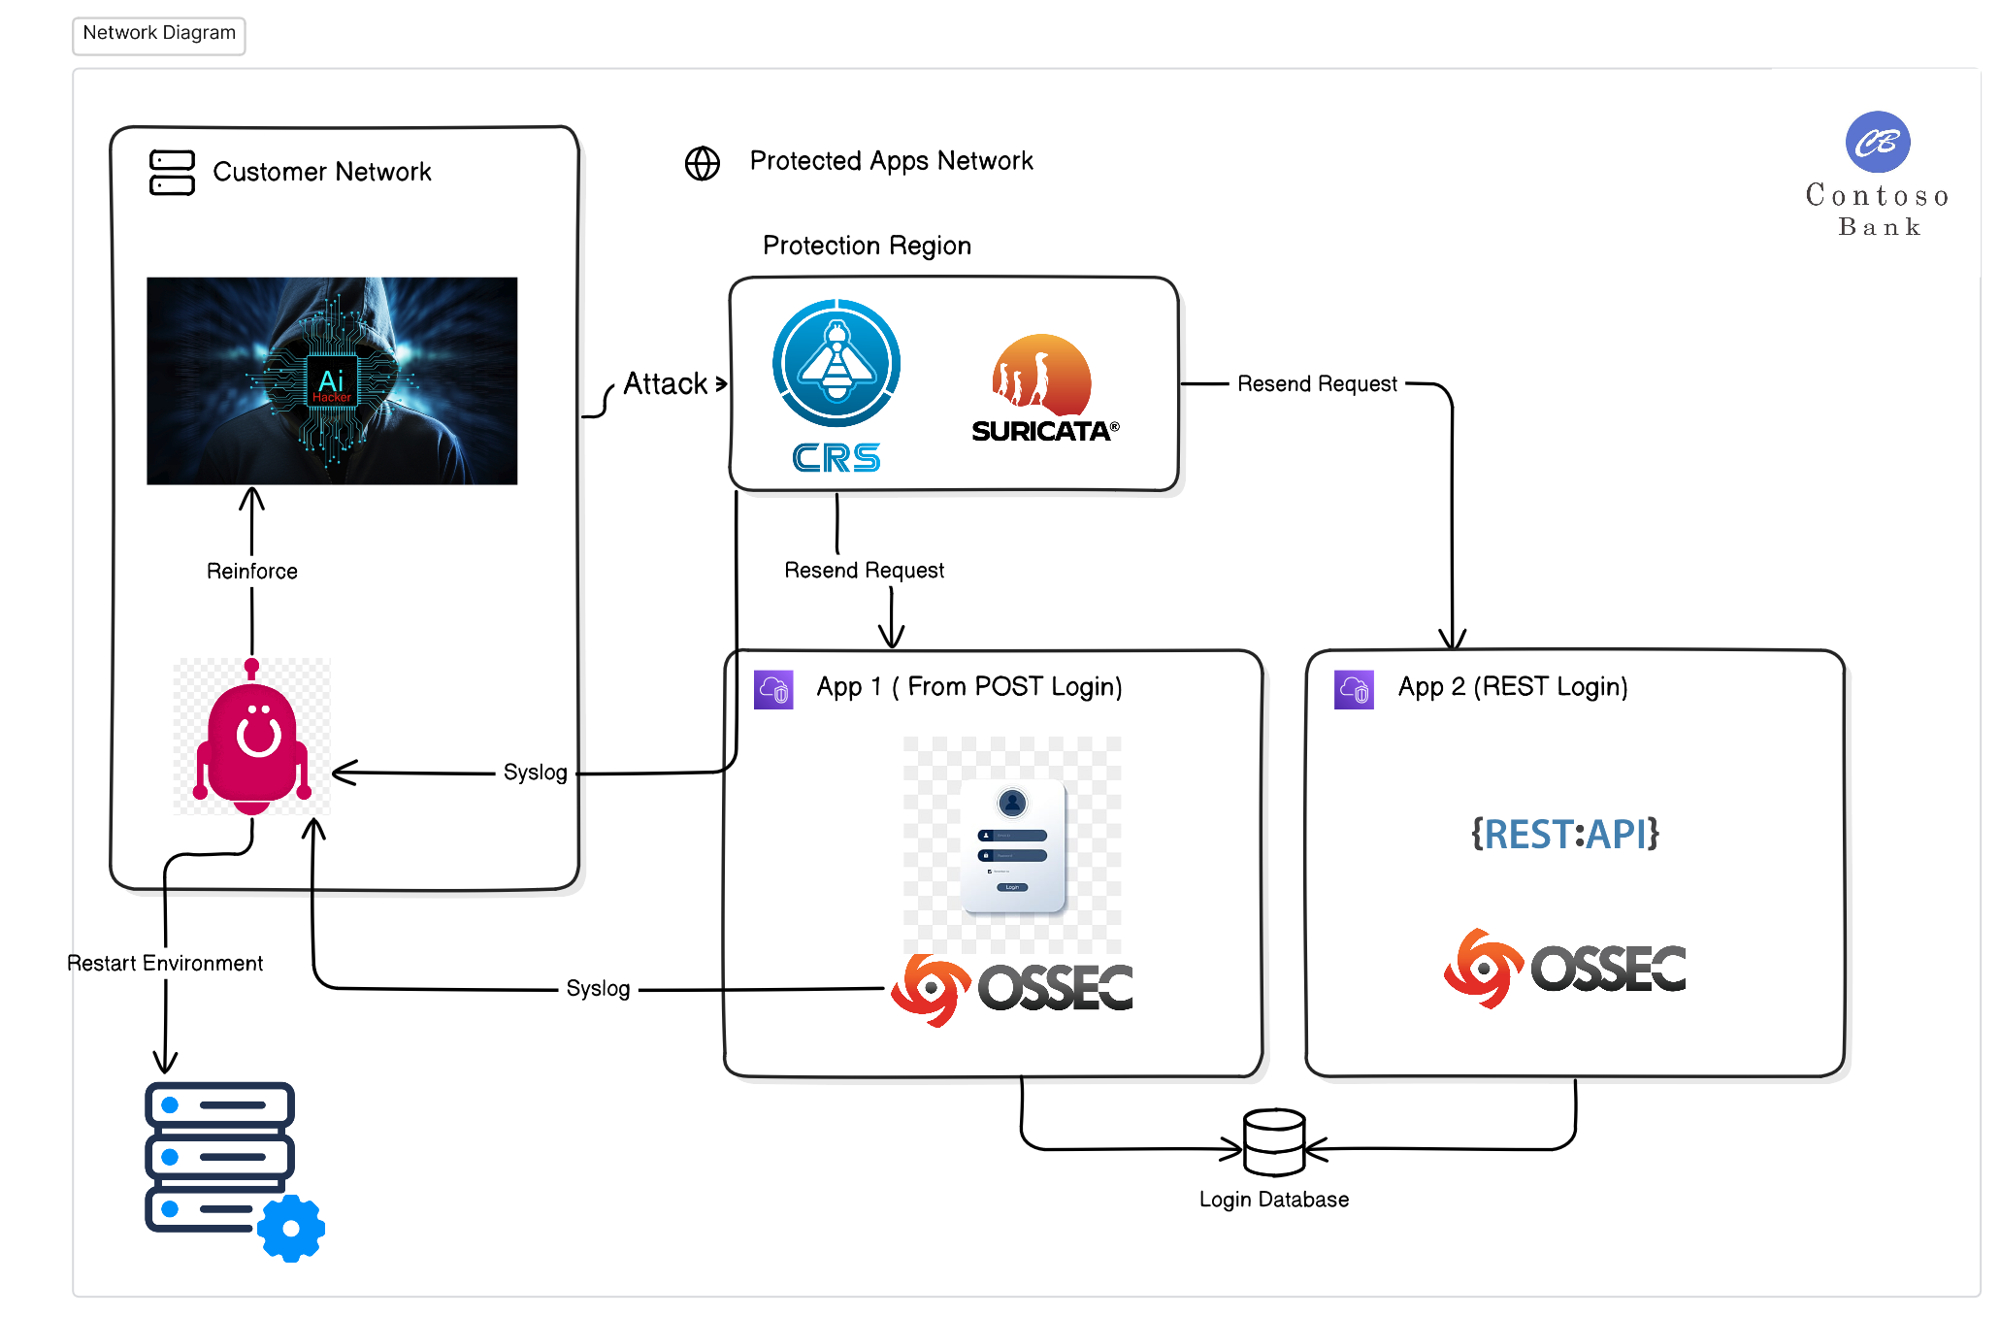
The Framework
This framework will provide the necessary tools to train any kind of agent based on reinforced learning models. The main idea is to provide a platform for training agents giving them the information they need from the environment. AI agents will be able to parametrize their attack until they are able to bypass any type of defense.
We are going to build a PoC using password brute-force attacks to 2 different kinds of web targets while they are being defended by a WAF, an IDS and a HIDS.

Slide 3
The Client Layer: Powering Intelligent Agents
The Client Layer's architecture is designed to handle complex attack scenarios while providing real-time feedback to the agent. This feedback loop is crucial for the agent's continuous improvement and adaptation to evolving defense mechanisms. By leveraging advanced machine learning algorithms, the agent can quickly analyze defensive responses and adjust its strategies accordingly.
The agent may use standard reinforcement learning models, agentic AI frameworks, or other compound or RAG LLM implementations. For this project, we will develop a reinforcement learning (RL) agent using policy-optimization models.
1
Attack Execution
The agent initiates various types of network attacks based on learned parameters and strategies.
2
Environment Management
Specialized tools monitor and control the testing environment, ensuring consistent and reliable training conditions.
3
Feedback Processing
Real-time analysis of defensive responses informs the agent's learning process and strategy adjustments.
4
Model Optimization
Continuous refinement of the reinforcement learning model based on performance metrics and success rates.

Slide 4



The Defensive Layer: Multifaceted Protection
The Defensive Layer is a key component of IH3A, utilizing a range of security tools to challenge and refine the intelligent agent's capabilities. In our PoC we include OSSEC, Suricata, and ModSecurity, create a realistic defensive environment.
Each tool provides detailed notifications via SysLog or API, offering valuable feedback to the Agent Helper for performance assessment and learning. This integration of multiple defense technologies ensures the agent is trained against various detection and prevention strategies, mimicking real-world cybersecurity scenarios.
OSSEC
Suricata
ModSecurity
Host-based Intrusion Detection System (HIDS) that provides comprehensive log analysis, file integrity checking, and real-time alerting.
High-performance Network Intrusion Detection System (NIDS) capable of real-time intrusion detection, inline intrusion prevention, and network security monitoring.
Web Application Firewall (WAF) that provides protection against various web application attacks, including SQL injection and cross-site scripting.

Slide 5
The Testing Layer: Simulating Real-World Scenarios
The Testing Layer serves as the battleground for our intelligent agent, providing a simulated victim network that closely mimics real-world environments. This layer is meticulously designed to offer a diverse range of attack surfaces and network configurations, challenging the agent to adapt and evolve its strategies continually.
Within this layer, we've implemented two distinct web applications, each with unique characteristics and vulnerabilities. WebApp1 utilizes a basic Form login with cookies, offering no additional protection. In contrast, WebApp2 employs a REST API with JWT for authentication and implements a temporary user lockout mechanism after five failed login attempts. These varied scenarios ensure that the agent learns to navigate different security implementations effectively.
Target
WebApp1
WebApp2
Authentication Method
Form Login with Cookies
REST API with JWT
Session Management
Cookie-based
Token-based
Additional Security
None
5-attempt lockout
API Structure
Traditional
RESTful

Slide 6




IH3A Agent: The Core of Intelligent Hacking
The Intelligent Hacking Auto Attacking Agent (IH3A) stands at the forefront of our framework, embodying the cutting-edge of adaptive cyber-attack simulation. This sophisticated agent is designed to execute attacks based on pre-defined parameters while continuously learning and adjusting its strategies in response to defensive measures.
The agent's performance is evaluated using a multifaceted scoring system that considers three key metrics: the number of attacks executed before detection, attack success rate, and attack duration. This comprehensive evaluation ensures that the agent not only learns to evade detection but also optimizes for efficiency and effectiveness in its operations.
Parameter Initialization
Attack Execution
Feedback Analysis
Strategy Adjustment
IH3A launches attacks against the simulated network, carefully monitoring defensive responses.
The agent processes feedback from the RLHelper, analyzing detection patterns and attack outcomes.
Based on the analysis, IH3A dynamically adjusts its attack parameters to improve evasion and success rates.
The agent starts with a set of pre-defined attack parameters based on initial training data.

Slide 7




RLHelper: Bridging Intelligence and Infrastructure
The RLHelper component serves as a crucial intermediary between the IH3A agent and the simulated network environment. Composed of two primary applications – the Management API and the SyslogServer – this helper system ensures seamless communication and data management throughout the training process.
The Management API plays a vital role in maintaining the integrity of the training environment. It provides functionality to reset the database, update data to prevent learning exploitation, and restart web services as needed. This ensures that each training iteration presents a fresh, challenging scenario for the agent. The SyslogServer, on the other hand, is a custom-built solution designed for high-speed, low-latency communication with the IH3A agent, utilizing shared memory for near-instantaneous message delivery.
Dynamic Database Management
Real-Time Synchronization
Intelligent Password Generation
Syslog and API Metrics gathering
Ensures fresh, realistic data for each training iteration, preventing agent exploitation of known patterns.
Facilitates immediate communication between defensive systems and the IH3A agent for rapid learning and adaptation.
Creates diverse, context-aware passwords to simulate real-world user behaviors and security practices.
Collects and analyzes agent performance data to guide optimization and evaluate training effectiveness.

Slide 8
Future Directions and Challenges
As we continue to develop and refine the IH3A framework, several challenges and opportunities for future expansion present themselves. One of the primary challenges lies in optimizing the learning speed of the agent. Given the nature of reinforcement learning, which requires substantial amounts of data, we must innovate ways to accelerate the training process without compromising the quality of learning.
1
Accelerated Learning Techniques
2
Expanded Attack Vectors
Explore advanced reinforcement learning algorithms and parallel processing methods to reduce training time while maintaining learning quality.
Develop simulation environments for a wider range of cyber attacks, including SQL injection, cross-site scripting, and advanced persistent threats.
3
LLM Integration
4
Real-world Integration
As this version just focus mainly on RL models, this same focus could be use to train LLM models as agentic AI frameworks, or other compound or RAG LLM implementations
Explore partnerships with cybersecurity firms to test and validate the IH3A framework against real-world network configurations and threats.

