Slide 1

Intelligent Attacking Agent Training Framework
Welcome to the cutting-edge world of network security innovation. The IH3A framework represents a groundbreaking approach to training intelligent agents capable of evading network detection.

Slide 2
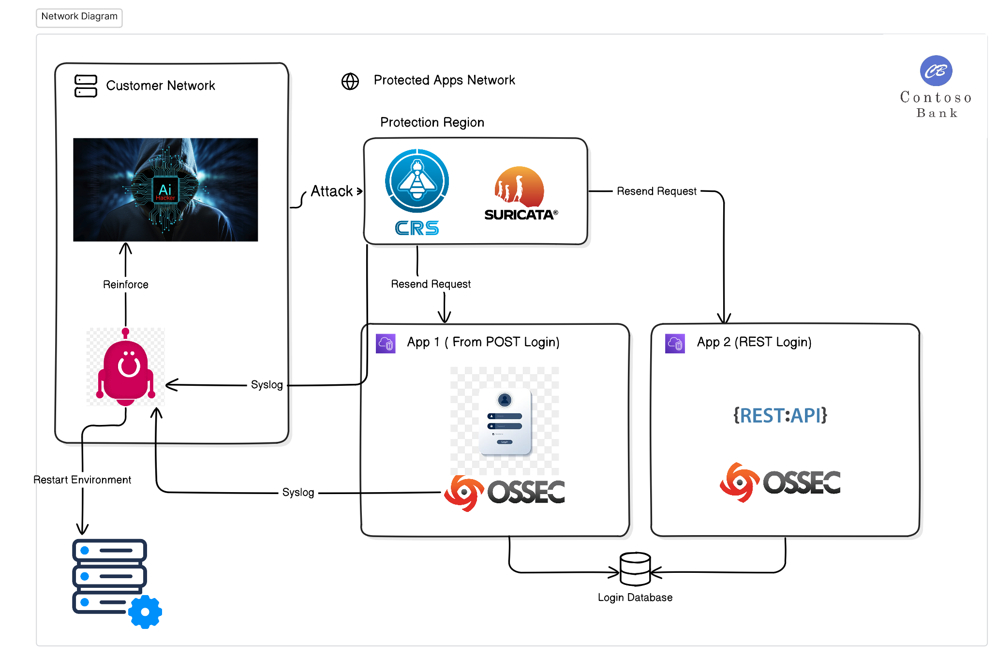
The Framework
At the heart of the IH3A framework lies the Client Layer, responsible for executing attacks and managing the intelligent agent's learning process. This layer incorporates cutting-edge reinforcement learning models, specifically policy-optimization techniques, to create a highly adaptive and efficient agent.

Slide 3
The Client Layer: Powering Intelligent Agents
The Client Layer's architecture is designed to handle complex attack scenarios while providing real-time feedback to the agent. This feedback loop is crucial for the agent's continuous improvement and adaptation to evolving defense mechanisms. By leveraging advanced machine learning algorithms, the agent can quickly analyze defensive responses and adjust its strategies accordingly.
The agent may use standard reinforcement learning models, agentic AI frameworks, or other compound or RAG LLM implementations. For this project, we will develop a reinforcement learning (RL) agent using policy-optimization models.
1
Attack Execution
The agent initiates various types of network attacks based on learned parameters and strategies.
2
Environment Management
Specialized tools monitor and control the testing environment, ensuring consistent and reliable training conditions.
3
Feedback Processing
Real-time analysis of defensive responses informs the agent's learning process and strategy adjustments.
4
Model Optimization
Continuous refinement of the reinforcement learning model based on performance metrics and success rates.

Slide 4
The Defensive Layer: Multifaceted Protection
The Defensive Layer forms a critical component of the IH3A framework, encompassing a diverse array of security mechanisms designed to challenge and refine the intelligent agent's capabilities. This layer leverages industry-standard tools such as OSSEC, Suricata, and ModSecurity to create a robust and realistic defensive environment.
Each defensive tool is meticulously configured to send detailed notifications via SysLog or API consumption, providing rich feedback to the Agent Helper. This information is crucial for accurately assessing the agent's performance and guiding its learning process. The integration of multiple defensive technologies ensures that the agent is trained against a variety of detection and prevention strategies, mirroring real-world cybersecurity landscapes. Our implementation include the following defensive mechanisms:
OSSEC
Suricata
ModSecurity
Host-based Intrusion Detection System (HIDS) that provides comprehensive log analysis, file integrity checking, and real-time alerting.
High-performance Network Intrusion Detection System (NIDS) capable of real-time intrusion detection, inline intrusion prevention, and network security monitoring.
Web Application Firewall (WAF) that provides protection against various web application attacks, including SQL injection and cross-site scripting.

Slide 5
The Testing Layer: Simulating Real-World Scenarios
The Testing Layer serves as the battleground for our intelligent agent, providing a simulated victim network that closely mimics real-world environments. This layer is meticulously designed to offer a diverse range of attack surfaces and network configurations, challenging the agent to adapt and evolve its strategies continually.
Within this layer, we've implemented two distinct web applications, each with unique characteristics and vulnerabilities. WebApp1 utilizes a basic Form login with cookies, offering no additional protection. In contrast, WebApp2 employs a REST API with JWT for authentication and implements a temporary user lockout mechanism after five failed login attempts. These varied scenarios ensure that the agent learns to navigate different security implementations effectively.

Slide 6




IH3A Agent: The Core of Intelligent Hacking
The Intelligent Hacking Auto Attacking Agent (IH3A) stands at the forefront of our framework, embodying the cutting-edge of adaptive cyber-attack simulation. This sophisticated agent is designed to execute attacks based on pre-defined parameters while continuously learning and adjusting its strategies in response to defensive measures.
The agent's performance is evaluated using a multifaceted scoring system that considers three key metrics: the number of attacks executed before detection, attack success rate, and attack duration. This comprehensive evaluation ensures that the agent not only learns to evade detection but also optimizes for efficiency and effectiveness in its operations.
Parameter Initialization
Attack Execution
Feedback Analysis
Strategy Adjustment
IH3A launches attacks against the simulated network, carefully monitoring defensive responses.
The agent processes feedback from the RLHelper, analyzing detection patterns and attack outcomes.
Based on the analysis, IH3A dynamically adjusts its attack parameters to improve evasion and success rates.
The agent starts with a set of pre-defined attack parameters based on initial training data.

Slide 7




RLHelper: Bridging Intelligence and Infrastructure
The RLHelper component serves as a crucial intermediary between the IH3A agent and the simulated network environment. Composed of two primary applications – the Management API and the SyslogServer – this helper system ensures seamless communication and data management throughout the training process.
The Management API plays a vital role in maintaining the integrity of the training environment. It provides functionality to reset the database, update data to prevent learning exploitation, and restart web services as needed. This ensures that each training iteration presents a fresh, challenging scenario for the agent. The SyslogServer, on the other hand, is a custom-built solution designed for high-speed, low-latency communication with the IH3A agent, utilizing shared memory for near-instantaneous message delivery.
Dynamic Database Management
Real-Time Synchronization
Intelligent Password Generation
Syslog Metrics gathering
Ensures fresh, realistic data for each training iteration, preventing agent exploitation of known patterns.
Facilitates immediate communication between defensive systems and the IH3A agent for rapid learning and adaptation.
Creates diverse, context-aware passwords to simulate real-world user behaviors and security practices.
Collects and analyzes agent performance data to guide optimization and evaluate training effectiveness.

Slide 8
WebApps: Diverse Testing Grounds
The WebApps component of our framework provides a rich, varied environment for testing and refining the IH3A agent's capabilities. Two distinct web applications have been developed, each presenting unique challenges and security configurations to ensure comprehensive training across different scenarios.
WebApp1 represents a traditional web application using a basic Form login with cookie-based session management. This setup, while common, lacks advanced security features, providing an opportunity for the agent to learn fundamental attack strategies. In contrast, WebApp2 employs a more modern architecture, utilizing a REST API with JWT (JSON Web Tokens) for authentication. Additionally, it implements a temporary lockout mechanism after five failed login attempts, simulating real-world security practices and challenging the agent to develop more sophisticated evasion techniques.
Feature
WebApp1
WebApp2
Authentication Method
Form Login with Cookies
REST API with JWT
Session Management
Cookie-based
Token-based
Additional Security
None
5-attempt lockout
API Structure
Traditional
RESTful

Slide 9
Future Directions and Challenges
As we continue to develop and refine the IH3A framework, several challenges and opportunities for future expansion present themselves. One of the primary challenges lies in optimizing the learning speed of the agent. Given the nature of reinforcement learning, which requires substantial amounts of data, we must innovate ways to accelerate the training process without compromising the quality of learning.
Looking ahead, we envision expanding the framework to encompass a broader range of attack types beyond brute force attempts. This expansion will require the development of more sophisticated simulation environments and the integration of additional defensive technologies. Furthermore, we aim to enhance the realism of our password generation algorithms, potentially incorporating machine learning models to create context-aware, user-type-specific passwords that more accurately reflect real-world scenarios.
1
Accelerated Learning Techniques
2
Expanded Attack Vectors
Explore advanced reinforcement learning algorithms and parallel processing methods to reduce training time while maintaining learning quality.
Develop simulation environments for a wider range of cyber attacks, including SQL injection, cross-site scripting, and advanced persistent threats.
3
Enhanced Password Realism
4
Real-world Integration
Implement AI-driven password generation that considers user demographics, language patterns, and common password creation behaviors.
Explore partnerships with cybersecurity firms to test and validate the IH3A framework against real-world network configurations and threats.

