Slide 1
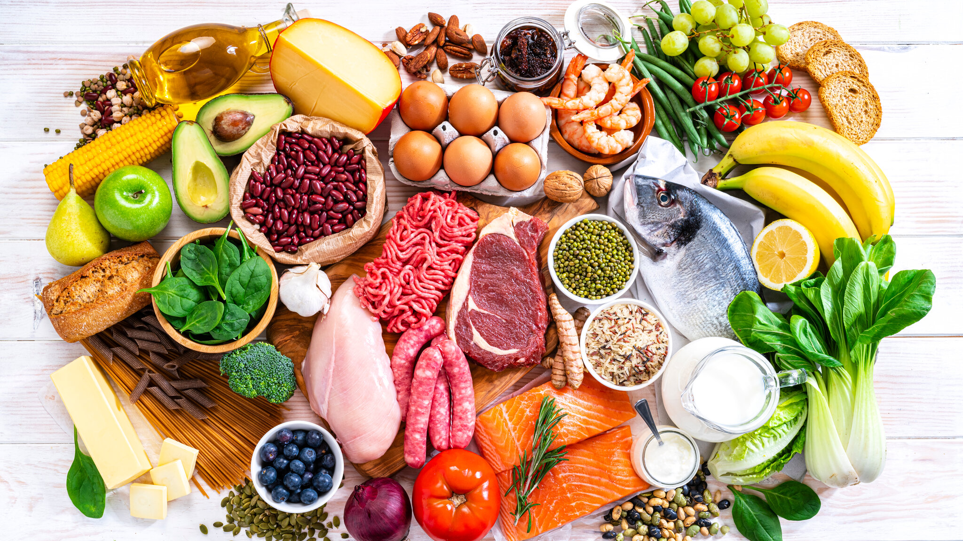
Re-Fridgerate
The Food Recommender

Slide 2

Have you ever opened your fridge and not known what to prepare?

Slide 3

Methodology
Web Scraping using BeautifulSoup
EDA, Cleaning & Wrangling
Sentiment Analysis

Slide 4

Minimum Viable Product
User inputs 3 ingredients in his/her fridge
This is cross-referenced with our dataset of scraped data
Recommender returns top 5 recipes in terms of sentiment score that contain at least these 3 ingredients.

Slide 5

Future Iterations
Getting all reviews for each recipe for more accurate Sentiment Analysis
Add more recipes to our dataframe
Return output cleaner and with an image and a clickable url
Return extra ingredients needed with a message

Slide 6

Demonstration time…

Slide 7

Challenges
Time management!
Scraping multiple pages – dealing with error messages and gathering lots of recipes.

Slide 8
Thank You!
Special thanks to Anna, Novi and Nayib and of course, the teaching team!

Slide 9

Anyone else feeling hungry?

