Slide 1
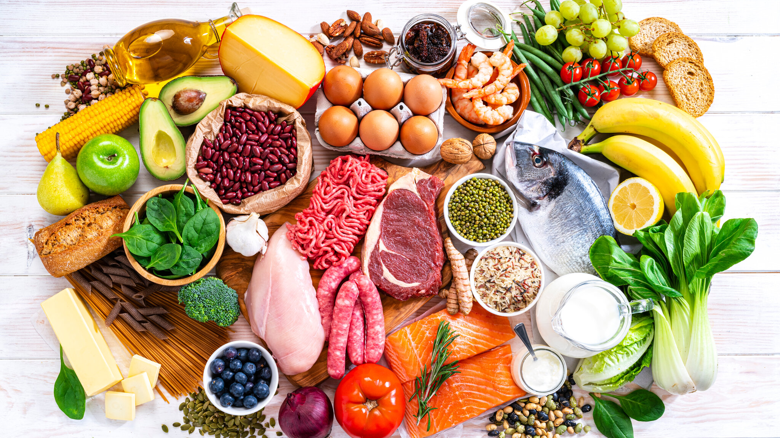
Re-Fridgerate
The Food Recommender

Slide 2
Have you ever opened your fridge and not known what to prepare?

Slide 3
Minimun Viable Product

Slide 4
Methodology

Slide 5
Future Iterations

Slide 6
Demonstration

Slide 7
Challenges

