Slide 1
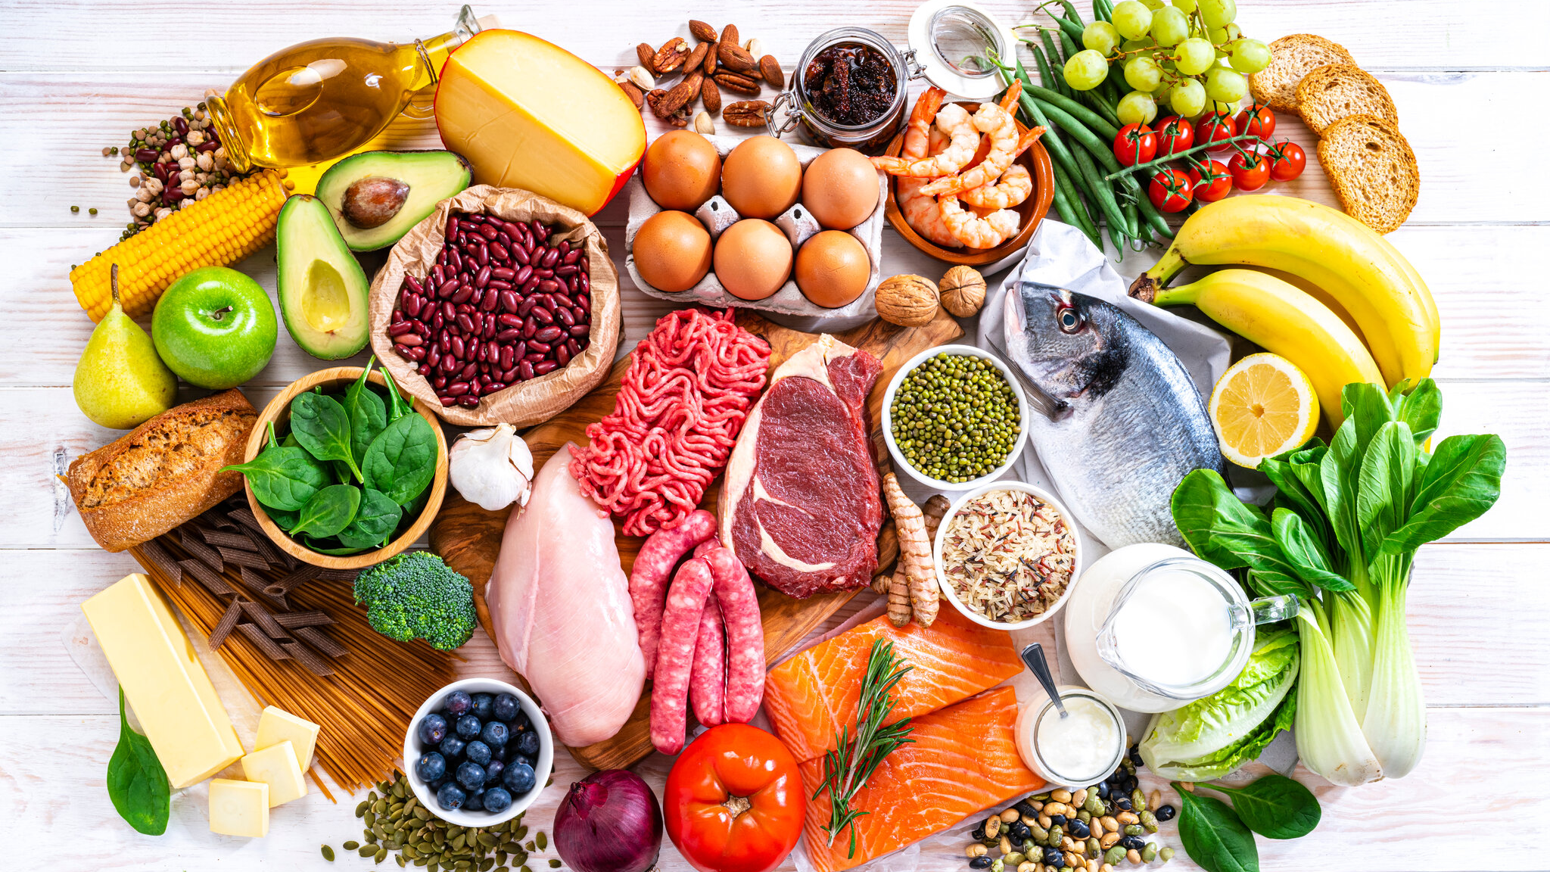
Re-Fridgerate
The Food Recommender

Slide 2

Have you ever opened your fridge and not known what to prepare?

Slide 3

Minimun Viable Product

Slide 4

Methodology

Slide 5

Future Iterations

Slide 6

Demonstration

Slide 7

Challenges

Slide 8
Thank You!
Special thanks to Anna, Novi and Nayib!

