Slide 1
AI Large Language Model General Course
Large Language Models Made Simple &
Your First Local Deployment with FlagOS
Notes:
This course focuses on AI large language models, aiming to explore their core principles and introduce local deployment methods based on FlagOS. The era of large language models has arrived; they are like librarians of a super library, storing and understanding human knowledge. Mastering the core principles of large language models enables us to understand how they achieve various powerful functions. Local deployment of large language models based on FlagOS can meet specific scenario requirements, improve usage efficiency and data security. Let us embark on this journey of exploring large language models together.

Slide 2









Have you ever used the following?
Conversation
Writing
Q&A
But they are just AI that can "converse"
Notes:
Many of you may have used DeepSeek or ChatGPT. They can engage in conversation, writing, and Q&A, with functions that seem powerful. In our daily work and life, we are accustomed to using them to get information and seek advice. But in reality, they are just AI that can "converse." This means they mostly provide suggestions at a passive response level, unable to actively execute tasks, and have certain limitations.

Slide 3
Case 1: Late-Night Office Dialogue Assistant
2 AM
"Help me generate a complete report package, including PPT outline and data analysis"
10 minutes
Material generation completed
Notes:
At 2 AM in the office, employees face immense work pressure. At this moment, conversational AI assistants demonstrate powerful capabilities. An employee requests "Help me generate a complete report package, including PPT outline and data analysis," and within just 10 minutes, the AI completes the material generation. Moreover, it also drafts 6 email replies. This fully reflects the significant role of conversational AI in improving work efficiency, providing timely support when employees are exhausted late at night, enabling work to proceed efficiently.

Slide 4
Limitations of Conversation: Can Only Give Advice, Cannot Take Action
Conversational AI
Action-Oriented AI
Provides Advice
Executes Automatically
From "Asking AI How to Write an Email"
to "AI Itself Sends Emails, Books Meeting Rooms, Organizes Data, ..."
Notes:
Conversational AI, while widely used, has clear limitations—it can only provide advice but cannot directly take action. Just like when we ask it how to write an email, it gives us ideas and methods, but cannot actually write and send the email for us. Action-oriented AI, however, represents a qualitative leap, capable of automatically executing tasks. From sending emails and booking meeting rooms to organizing data, action-oriented AI can complete all of these independently. This means we've shifted from merely asking AI for advice to letting AI directly carry out work, greatly improving efficiency and expanding the boundaries of AI applications.

Slide 5
Case 2: Intelligent Agents Represented by OpenClaw
Step 1: Search
Step 2: Filter
Step 3: Generate
Find relevant materials
Extract key information
Write complete report
Step 4: Analyze
Step 5: Send
Step 6: Complete
Data visualization
Automatic email notification
Task closed-loop
"Help me research the latest AI industry trends, generate a report and send it to the team"
📖 AI Agent (Intelligent Agent) | AI that can autonomously execute tasks - not just chatting, but capable of calling tools to complete actions
-> AI Agent automatically completes the entire process
Notes:
Intelligent agents represented by OpenClaw demonstrate the powerful capability of AI to autonomously execute tasks. When receiving the instruction to "research the latest AI industry trends, generate a report and send it to the team," it acts step by step. First, it searches for relevant materials, broadly finding information, then filters out key information to prepare for report generation. Next, it writes a complete report and performs data visualization analysis. Finally, it sends automatic email notifications to complete the task closed-loop. This shows that AI Agent is not just an AI that can chat - it can call tools to complete actual actions, achieving automatic task execution and opening a new era of AI moving from providing suggestions to autonomous action.

Slide 6
AI's Brain
Conversational Applications
AI Agent
DeepSeek/ChatGPT/Write Reports
OpenClaw/Digital Employees/Autonomous Execution
Application Layer - Covered
Advanced Layer - Current
Whether conversational or action-oriented, behind them all is the same"Brain"
Large Model
Notes:
Previously, we introduced conversational applications, such as DeepSeek and ChatGPT - conversational AI capable of writing reports, which belong to the application layer. Now we move to the advanced layer, focusing on AI Agents represented by OpenClaw - intelligent agents that can autonomously execute tasks like digital employees. Although conversational applications and AI Agents differ in functionality - one emphasizing dialogue and interaction, the other highlighting autonomous task execution - they both rely on the same "brain": the large model. The large model serves as a powerful central hub, providing core support for different types of AI applications.

Slide 7
Course Structure
1
"Omnipotent" AI
2
How Does AI Actually Work?
The Era of Large Models Has Arrived
Large Model Inference
3
How to Become an "Omnipotent" AI?
4
Computing Power Behind Large Models
Large Model Training
Open Source AI System Software Stack: FlagOS
5
Hands-on Demo
Appendix
How to Run Large Models Locally with FlagOS
Reference and Learning Resources
Acknowledgments
Thanks to Those Who Supported This Course
Notes:
This course focuses on large models and consists of five main parts. First, we introduce "omnipotent" AI and the arrival of the large model era; then we explore the principles behind AI implementation, namely large model inference; next, we explain how to train an "omnipotent" AI; afterwards, we analyze the computing power behind large models and the open source AI system software stack FlagOS; finally, we conduct hands-on demonstrations. The appendix provides reference resources, and we conclude by thanking all contributors.

Slide 8
PART 1
"Omnipotent" AI
The Era of Large Models Has Arrived
Notes:
Previously, we learned about AI application cases and related principles in dialogue and task execution. Now, we will enter a new chapter—"Omnipotent" AI: The Era of Large Models Has Arrived. Large models are like librarians in a super library. What charm and capabilities do they possess? Let us explore this together.

Slide 9

What is a Large Model?
Imagine a super library that stores almost all the knowledge and information in human history.
A large model is like the librarian of this library, who not only remembers all the content but also understands the connections and patterns among them.
Parameter Scale for Deepseek-V3
671 Billion
Parameters | Adjustable variables in the model, similar to the connection strength of neurons in the brain
Notes:
To understand large models, imagine a super library that contains almost all the knowledge and information in human history. A large model is like the librarian of this library, who can not only remember all the content but also discern the connections and patterns within it. The parameter scale of a large model reaches 671 billion. These parameters are adjustable variables in the model, like the connection strength between neurons in the brain, and they determine the large model's ability to master and apply knowledge. The larger the parameter scale, the more precisely the large model can understand and process complex information, providing us with more accurate and valuable services.

Slide 10
The Magic of Generative AI
Text Generation
Image Generation
Articles, code, poetry, emails...
Painting, design, photography, illustration...
Audio Generation
Video Generation
Music, voiceover, sound effects, speech...
Animation, short films, special effects, editing...
📖 Multimodal | Capable of simultaneously understanding and generating text, images, audio, video, and other types of content
Notes:
Generative AI is like an all-powerful magician with amazing capabilities. In the realm of text generation, it can create articles, code, poetry, emails, and more—whether it's rigorous academic papers or beautiful poetry, it can produce them effortlessly. In terms of image generation, painting, design, photography, and illustration are all within its reach, meeting various creative needs. For audio generation, music, voiceovers, sound effects, and speech can all be easily produced, adding unique auditory experiences to works. In the video generation domain, animation, short films, special effects, and editing can also be perfectly presented. This multimodal capability enables generative AI to simultaneously understand and generate text, images, audio, video, and other types of content, greatly expanding its application scope and value.

Slide 11
Core Principle: The Prediction Game
The core capability of large models is "word chaining" — predicting the next most likely word
Artificial
Intelligence
is
defined
as
Candidate 1 ✓
Candidate 2
Candidate 3
computer
a type of
by
Probability: 45%
Probability: 30%
Probability: 25%
📖 Autoregressive Generation | Predicting the next word based on previously generated content | 每次基于已生成内容预测下一个词
Notes:
The core principle of large models is like a prediction game, essentially "word chaining" — predicting the next most likely word. Taking "Artificial Intelligence is defined as" as an example, there are three candidate words: "computer", "a type of", and "by", with probabilities of 45%, 30%, and 25% respectively. "Computer" has the highest probability and is most likely to be the next word. This prediction method is called autoregressive generation, where each prediction is based on previously generated content to predict the next word. This principle may seem simple, but it gives large models powerful capabilities, enabling them to generate coherent and logical text, which is key to many applications like text generation.

Slide 12
Long-Distance Dependency Understanding
He raised a cat , and that cat , during his loneliest days when he worked overtime every night until late and was almost depressed, stayed by his side quietly the whole time, and was really adorable .
cat
cat
adorable
Subject
Reference
Description
The model can understand long-distance semantic relationships
Book Self-Attention Mechanism: Allows the model to automatically associate context words when processing each word
Notes:
The impressive capability of large models lies not only in 'word chaining,' but more importantly in their ability to understand long-distance semantic associations. For example, in 'He raised a cat, and that cat silently accompanied him during his loneliest days and was really adorable,' the model can understand that the two 'cats' refer to the same entity, and can also associate 'adorable' with 'cat.' This demonstrates long-distance dependency understanding. This capability is achieved through the self-attention mechanism, which allows the model to automatically associate context words when processing each word, thus precisely grasping the semantics - like giving the model an eye that can see the whole picture.

Slide 13
Multi-Layer Stacking: Transformer Architecture
Layer 1: Surface Features
Part of speech, syntactic structure
Layer 5: Phrase Understanding
Short semantic units
Layer 10: Sentence Understanding
Complete semantics
Layer 20: Abstract Reasoning
Logic, emotion, intent
Each layer extracts higher-level features based on the previous layer
📖 Transformer | The core architecture of large models, where each layer consists of multi-head attention and feed-forward networks stacked together
Notes:
The Transformer architecture of large models is multi-layer stacked, with each layer extracting higher-level features based on the previous layer. At Layer 1, the model focuses on surface features such as part of speech and syntactic structure, which form the foundation for understanding text. By Layer 5, the model can understand short semantic units and begin to grasp local semantic information. When reaching Layer 10, the model achieves sentence understanding and masters complete semantics, marking an important milestone. By Layer 20, the model possesses abstract reasoning capabilities and can understand logic, emotion, and intent, enabling large models to handle complex tasks. This progressive layer-by-layer architecture allows large models to gradually deepen their understanding of language, much like how we acquire knowledge - from basics to depth - ultimately developing powerful semantic understanding and processing capabilities.

Slide 14
How Do Large Models Work?
We just learned about the capabilities of large models:
Text Generation
Multimodal Capabilities
Conversational Applications
Agent Workflows
So, how exactly do large models work?
The process of applying large models is essentially the process of large model inference
Let's break it down with practical examples
Notes:
Previously, we learned that large models possess powerful capabilities including text generation, multimodal abilities, conversational applications, and Agent workflows. So how do large models actually operate? In reality, the process of applying large models is essentially the process of large model inference. Next, we will use concrete examples to deeply analyze the workflow of large models and see how it progresses step by step from input information to output results.

Slide 15
PART 2
How Does AI Actually Do It?
Large Model Inference
Notes:
Previously, we learned about the text generation and multimodal capabilities of large models. Now we focus on the question 'How does AI actually do it?' to deeply explore the mysteries of large model inference. Large model inference is an important process of using large models to process information and generate results. Its implementation is like a precise computation. Next, we will gradually break down the large model inference process and unveil the mystery behind AI.

Slide 16
Overview of Large Model Inference Process
1
2
3
4
Input Processing
Layer-by-Layer Computation
Prediction
Generation
Text to Numbers
Understanding Semantics
Calculating Probabilities
Iterative Looping
Notes:
The large model inference process can be summarized into four key steps. The first step is input processing, which essentially converts text into numbers. This serves as the foundation for all subsequent calculations, preparing the model to understand semantics. The second step is layer-by-layer computation, aimed at understanding semantics. The large model, through the multi-layer stacking of the Transformer architecture, progressively extracts abstract reasoning from surface-level features, continuously deepening its understanding of the input content. The third step is prediction, which involves calculating probabilities. Based on the already generated content, the large model predicts the most likely next word to appear. This embodies the core capability of "word concatenation." The fourth step is generation, using an iterative loop approach. The above steps are repeated continuously to generate new content until specific conditions are met. These four steps are interconnected, collectively forming the inference process of large models.

Slide 17
Step 1 Input Processing
→
Step 2 Layer-by-Layer Computation
→
Step 3 Prediction
→
Step 4 Generation
Step 1 Input Processing: Text → Numbers
1.1 Tokenization
1.2 Embedding
1.3 Positional Encoding
1.4 Final Representation
Split Text
Convert to Vectors
Add Position
Add Vectors
Unified Example:"What is AI?"
Notes:
The first step in large model inference is input processing, which converts text into numbers. This process consists of four key steps. First is tokenization, which splits text into tokens, like breaking sentences into meaningful small units. Next is embedding, mapping tokens to high-dimensional vectors to capture semantic, syntactic, and contextual features. Then comes positional encoding, providing the model with word order information to distinguish identical words at different positions. Finally, the final representation combines semantic features and positional information. Taking "What is AI?" as an example, after these four steps, the input is converted into a machine-readable numerical representation.

Slide 18
Step 1 Input Processing
→
Step 2 Layer-by-Layer Calculation
→
Step 3 Prediction
→
Step 4 Generation
Step 1.1 Tokenization
Split sentences into Tokens and look up the vocabulary to get Token IDs
"What is AI?"
What
is
AI
?
ID: 1234
ID: 567
ID: 8901
ID: 234
Mainstream Vocabulary Size
Try tokenization on this website:
https://tiktokenizer.vercel.app/
Enter any text and you will see how it is split into tokens
100K+
Each Token corresponds to a unique numeric ID
Token
📖 Token | The basic unit of text processing in large models, which can be a word, subword, or character; Tokenization | The process of splitting raw text into Token sequences; BBPE (Byte-Level Byte Pair Encoding) | A tokenization method that applies the BPE algorithm at the byte level, effectively handling multiple languages and special characters
Notes:
In the first step of large model inference - input processing, tokenization is a crucial initial step. It splits sentences into Tokens and looks up the vocabulary to get Token IDs. As shown in the example "What is AI?", it is split into the Tokens "What", "is", "AI", "?", each corresponding to a unique numeric ID. The mainstream vocabulary size reaches over 100,000 Tokens, and each Token has a dedicated ID, ensuring that the large model can accurately identify and process text. A Token is the basic unit of text processing in large models, and tokenization is the process of splitting raw text into Token sequences. You can visit https://tiktokenizer.vercel.app/ to experience tokenization and intuitively see how text is split into tokens.

Slide 19
Step 1 Input Processing
→
Step 2 Layer-by-Layer Computation
→
Step 3 Prediction
→
Step 4 Generation
Step 1.2 Vectorization
Map Tokens to high-dimensional vectors to capture semantic features
AI
Token
Embedding
High-dimensional Vector
The higher the dimension, the greater the model's capacity to capture subtle semantic features, but the higher the computational cost as well
📖 Embedding | A technique that maps Tokens to numerical vectors; Vector | An ordered set of numbers representing features
Notes:
During the input processing stage of large model inference, after tokenization is complete, the next step is vectorization. This step maps Tokens to high-dimensional vectors to capture semantic features. Different dimensions of the high-dimensional vector correspond to different features. Dimensions 1-512 represent semantic features, which quantify the inherent meaning of words; dimensions 513-1024 are syntactic features, reflecting the grammatical rules of words in sentences; dimensions 1025-4096 are contextual features, capturing the meaning of words in specific contexts. Through vectorization, the original Tokens are transformed into high-dimensional vectors with greater information-carrying capacity, laying the foundation for subsequent semantic understanding by the model.

Slide 20
Step 1 Input Processing
→
Step 2 Layer-by-Layer Computation
→
Step 3 Prediction
→
Step 4 Generation
Step 1.3 Positional Encoding
Provides word order information to the model, distinguishing identical words at different positions
"What is AI?"
"Is What AI"
What
Position 1
Is
Position 1
is
Position 2
What
Position 2
AI
Position 3
AI
Position 3
Word Vector + Position Vector = Final Vector
📖 Positional Encoding | A technique that provides word order information to the model
Notes:
In the input processing stage of large model inference, positional encoding is a crucial step that provides word order information to the model, enabling it to distinguish identical words at different positions. Taking "What is AI?" and "Is What AI" as examples, the same words have different meanings due to different word orders, and positional encoding allows the model to recognize this difference. Specifically, positional encoding assigns a position vector to each word, which is added to the word vector to obtain the final vector. This enables the model to consider positional information during input processing, thereby understanding semantics more accurately. Positional encoding technology significantly enhances the model's ability to grasp text order and semantics.

Slide 21
Step 1 Input Processing
->
Step 2 Layer-by-Layer Computation
->
Step 3 Prediction
->
Step 4 Generation
Step 1.4 Final Representation
Fusing semantic features with positional information to form the final input representation
+
=
Word Vector
Positional Vector
Final Vector
Semantic Features
Sequential Information
Complete Representation
Step 1 Complete! Input successfully converted to machine-understandable numerical representation
Notes:
In the input processing stage of the large model inference workflow, after tokenization, vectorization, and positional encoding, we arrive at the critical final representation step. This step fuses the semantic features carried by word vectors with the sequential information contained in positional vectors, thereby forming the final vector. This fusion is significant - it gives the input information a complete representation, just like putting a 'complete coat' on the information, enabling the machine to better understand it. At this point, Step 1 input processing is successfully completed, with input converted to machine-understandable numerical representation, laying a solid foundation for subsequent layer-by-layer computation, prediction, and generation.

Slide 22
Step 1 Input Processing
->
Step 2 Layer-by-layer Computation
->
Step 3 Prediction
->
Step 4 Generation
Step 2 Layer-by-layer Computation: Understanding Semantics
2.1 Multi-angle Understanding
2.2 Deep Processing
2.3 Progressive Layering
2.4 Cache Acceleration
Through multi-layer neural network computation, the model progressively understands the input's semantics, grammar and contextual relationships
Notes:
After completing input processing, the model enters Step 2, the layer-by-layer computation stage, which aims to understand the semantics of the input. This stage mainly includes four aspects. Multi-angle understanding uses the Self-Attention mechanism to let each word attend to all other words, enabling comprehensive semantic understanding. Deep processing uses the feedforward network to perform independent nonlinear transformations on each word, extracting high-level semantics and abstracting surface forms into more meaningful representations. Progressive layering relies on multi-layer stacking, starting from surface features and progressively extracting higher-level features, ultimately achieving understanding of complete semantics and abstract reasoning. Cache acceleration uses KV caching to avoid redundant computations, significantly improving generation speed. Through multi-layer neural network computation, the model can progressively understand the input's semantics, grammar, and contextual relationships.

Slide 23
Step 1 Input Processing
→
Step 2 Layer-by-Layer Computation
→
Step 3 Prediction
→
Step 4 Generation
Step 2.1 Multi-Perspective Understanding
Through the Self-Attention mechanism, each word can "see" all other words
Processing "What is AI?"
What
is
AI
← is
→ What
→ What
← AI
← AI
→ is
Q (Query)
K (Key)
V (Value)
Query
Key
Value
📖 Self-Attention | Words attend to each other; Multi-Head Attention | Multiple self-attentions in parallel; QKV (Query-Key-Value) | Three core matrices used in the self-attention mechanism to compute attention weights and output
Notes:
During the model's layer-by-layer computation process, the multi-perspective understanding step is crucial. It leverages the Self-Attention mechanism to allow each word to "see" all other words. Taking "What is AI?" as an example, "What" can relate to "is" and "AI", "is" can attend to both "What" and "AI", and the same applies to "AI". The Self-Attention mechanism uses three core matrices—Q (Query), K (Key), and V (Value)—to compute attention weights and output. This mechanism enables the model to more comprehensively capture relationships between words, just as we consider the interactions of various words when understanding sentences. This multi-perspective understanding approach lays the foundation for subsequent deep processing and progressive layering in the model.

Slide 24
Step 1 Input Processing
->
Step 2 Layer-by-Layer Computation
->
Step 3 Prediction
->
Step 4 Generation
Step 2.2 Deep Processing
AI
AI
Concept Extraction and Abstraction
Feed Forward
At this stage, the model performsindependent, deep processing on each word's representation.
Input Vector
Feed Forward Network
Output Vector
Surface Form:
"What is AI"
Input Features
Output Features
Basic Semantics
High-Level Abstraction
Abstract Representation:
"User is asking for the definition of a technical concept"
Book Feed Forward Network | Performs independent nonlinear transformation on each word to extract high-level semantics
Notes:
In the AI layer-by-layer computation process, deep processing is a crucial step. This step uses a feed forward network to process input vectors, transforming the basic semantics contained in input features into high-level abstractions in output features. The feed forward network performs independent nonlinear transformations on each word to extract high-level semantics. For example, facing the surface form "What is AI", the model performs independent and deep processing, ultimately extracting the abstract representation "User is asking for the definition of a technical concept." This process achieves a leap from concrete to abstract, enabling the model to better understand the input content.

Slide 25
Step 1 Input Processing
→
Step 2 Layer-by-Layer Computation
→
Step 3 Prediction
→
Step 4 Generation
Step 2.3 Progressive Layering
Through multi-layer stacking, progressively extract higher-level features
Layer 1
Identify nouns and verbs
Surface Features
Part of speech, grammar
Layer 5
Phrase comprehension
Understand phrase relationships
Short semantic units
Sentence comprehension
Layer 10
Complete semantics
Grasp sentence main idea
Abstract reasoning
Logic, emotion, intent
Layer 20
Infer deeper meanings
📖 Multi-Layer Stacking | Stack multiple layers in series to progressively extract higher-level features
Notes:
In the layer-by-layer computation stage of the AI model processing flow, the "progressive layering" step is crucial. It extracts higher-level features progressively through multi-layer stacking. From Layer 1 to Layer 20, the model achieves a leap from surface features to abstract reasoning. At Layer 1, the model primarily identifies nouns and verbs, understanding parts of speech and grammar; by Layer 5, it begins to understand phrase relationships and comprehend phrases; at Layer 10, it can grasp the main idea of sentences and achieve sentence comprehension; by Layer 20, it can perform abstract reasoning, identifying logic, emotion, and intent, and inferring deeper meanings. The significance of multi-layer stacking lies in the fact that each layer further refines and abstracts based on the previous layer, enabling the model to have a deeper and more comprehensive understanding of the input content.

Slide 26
Step 1 Input Processing
→
Step 2 Layer-by-Layer Computation
→
Step 3 Prediction
→
Step 4 Generation
Step 2.4 KV Cache Acceleration
Cache historically computed Keys and Values to avoid redundant calculations and significantly increase generation speed
Without KV Cache
With KV Cache
Generate 1st word
Generate 1st word
Compute all history
Store K,V → Cache
Generate 2nd word
Generate 2nd word
Re-compute all history
Read cache + Compute new word
Generate 3rd word
Generate 3rd word
Re-compute again...
Read cache + Compute new word
Higher generation speed
📖 KV Cache (Key-Value Cache) | Cache Key and Value matrices of historical words to avoid redundant calculations and accelerate generation
Notes:
During the model's layer-by-layer computation process, KV cache acceleration is a key component for improving efficiency. Without KV cache, generating each word requires re-computing the entire history, resulting in substantial redundant operations with 100% time consumption. With KV cache, the first word generation stores K and V in the cache, and subsequent word generations only need to read the cache and compute the new word, reducing time consumption to just 20%. KV cache significantly increases generation speed by avoiding redundant calculations, making model execution more efficient. It's like equipping the model with a memory assistant that can quickly retrieve past information, avoiding unnecessary repetitive work and thereby improving overall operational efficiency.

Slide 27
Step 1 Input Processing
→
Step 2 Layer-by-Layer Calculation
→
Step 3 Prediction
→
Step 4 Generation
Step 3 Prediction: Calculating Probabilities
3.1 Word Selection Strategy
3.2 Technical Implementation
Chain-of-Thought Reasoning
Probability Sampling
Based on the semantic features extracted from previous steps, calculate each candidate word'sprobability distribution, and then select an appropriate word
Notes:
After completing the layer-by-layer calculation, the model enters the prediction phase, which requires calculating probabilities. Prediction involves two aspects: word selection strategy, which employs chain-of-thought reasoning; and technical implementation, which utilizes probability sampling. Based on the semantic features extracted from previous steps, the model calculates the probability distribution for each candidate word. Chain-of-thought reasoning enables the model to generate intermediate reasoning steps before providing the final answer, improving accuracy for complex questions. For technical implementation, Softmax converts scores to probabilities, and Top-k/p Sampling controls generation diversity, ultimately selecting an appropriate word.

Slide 28
Step 1 Input Processing
→
Step 2 Layer-by-Layer Computation
→
Step 3 Prediction
→
Step 4 Generation
Step 3.1 Word Selection Strategy
Use Chain of Thought (CoT) to let the model generate intermediate reasoning steps before giving the final answer
Input
"What is AI? Let's think step by step"
Step 1: AI stands for Artificial Intelligence
Step 2: It refers to machines simulating human intelligence
Step 3: This includes learning, reasoning, and problem-solving
Output
AI is the simulation of human intelligence in machines...
CoT Response ✓
Regular Response
Step 1 → Step 2 → Step 3 → Answer
📖 Chain of Thought (CoT) | Chain of Thought, letting the model generate intermediate reasoning steps to improve accuracy on complex problems
Notes:
In the word selection strategy phase of large model prediction, the Chain of Thought (CoT) method plays an important role. It enables the model to generate intermediate reasoning steps before providing the final answer. Taking 'What is AI? Let's think step by step' as an example, the model first clarifies that AI stands for Artificial Intelligence, then points out that it refers to machines simulating human intelligence, including learning, reasoning, and problem-solving, and finally concludes that AI is the simulation of human intelligence in machines. Compared to regular responses, CoT responses can more clearly demonstrate the thinking process, improving the model's accuracy in handling complex problems. This approach of step-by-step reasoning before reaching conclusions makes the model's responses more logical and persuasive.

Slide 29
Step 1 Input Processing
->
Step 2 Layer-by-Layer Computation
->
Step 3 Prediction
->
Step 4 Generation
Step 3.2 Technical Implementation
Candidate Word Probability Distribution
Artificial
AI
a
an
45%
30%
15%
10%
Softmax
Top-k/p Sampling
Convert scores to probabilities
Control generation diversity
📖 Softmax | A function that converts scores to probabilities; Top-k/p Sampling | A sampling strategy that controls generation diversity
Notes:
In the prediction phase of the large model workflow, technical implementation involves candidate word probability distribution. Here are several candidate words and their probabilities: 'AI' accounts for 45%, 'Artificial' for 30%, 'a' for 15%, and 'an' for 10%. The Softmax function is used to convert scores to probabilities. Meanwhile, to control generation diversity, the Top-k/p Sampling strategy is adopted. These two complement each other: the Softmax function provides the probability foundation for subsequent sampling, while Top-k/p Sampling filters among numerous candidate words to ensure that the generated content both follows the probability distribution and exhibits diversity.

Slide 30
Step 1 Input Processing
→
Step 2 Layer-by-Layer Computation
→
Step 3 Prediction
→
Step 4 Generation
Step 4 Repeated Generation: Iterative Loop
1
First Prediction
2
Second Prediction
Repeat Continuously
Input:
Input:
The model loops until a complete answer is generated.
"What is AI?"
"What is AI? Artificial"
Final Output:
"Artificial Intelligence is..."
Prediction Result:
Prediction Result:
Artificial
Intelligence
📖 Autoregressive Generation | Each time, predict the next word based on already generated content, and iterate continuously
Notes:
In the large model workflow, the generation phase uses autoregressive generation, where the next word is predicted iteratively based on already generated content. Taking the question "What is AI?" as an example, the first prediction result is "Artificial", then "Artificial" is added to the input for the second prediction, yielding the result "Intelligence". This continuous prediction process is like building a knowledge tower, where each newly generated word is a brick that progressively constructs a complete answer. The model continues to loop until a complete and accurate answer is generated, finally outputting complete content such as "Artificial Intelligence is..."

Slide 31
Part 2 Process Summary
Input Text
Step 1
Step 2
Step 3
Input Text
Prompt
Output Text
Input Processing
Layer-wise Computation
Prediction
Tokenization -> Vectorization -> Positional Encoding
Multi-perspective Understanding -> Deep Processing -> Multi-layer Stacking
Chain of Thought -> Probability Calculation -> Sampling
"What is AI?"
"Artificial Intelligence is..."
Notes:
Let's summarize the workflow of large language models. Taking "What is AI?" as an example, the first step is input processing: tokenizing the input text, converting it to vectors, and applying positional encoding—just like assigning each word its proper position for subsequent processing. Next comes the layer-wise computation stage, where the input information undergoes multi-perspective understanding, deep processing, and multi-layer stacking, enabling the model to gain a deeper understanding of the information. Finally, in the prediction stage, chain-of-thought reasoning is applied, the probability of each candidate word is calculated, and a suitable word is selected through sampling. After these steps, the model outputs a response like "Artificial Intelligence is..."

Slide 32
Where does the large model's capability come from?
From AI applications we have understood AI's capabilities
From large model workflows we have understood the foundation of AI's powerful capabilities
is the large model's reasoning ability
So where does the large model's powerful reasoning capability come from?
Notes:
Through AI applications, we have come to know AI's capabilities, and from large model workflows, we have learned that behind AI's powerful abilities lies the large model's reasoning capability. So, where exactly does the large model's powerful reasoning capability originate? This is a question worth exploring in depth. Investigating its source helps us further understand the operational mechanisms of large models, uncover more of their potential, and provide stronger theoretical support and practical guidance for AI development and applications.

Slide 33
PART 3
How to Become an "Omnipotent" AI?
Large Model Training
Notes:
Previously, we understood the workflow and reasoning capabilities of large models. So how can we make AI "omnipotent"? This involves large model training. Large model training is a key part of enhancing AI capabilities - it's like training interns, requiring gradual learning and growth. Next, let's look at the main process of large model training together.

Slide 34



Overview of Major Steps in Large Model Training
DataCollection
SFT
Collect TrainingData
Architecture Design
Supervised Fine-tuning
Large Model ArchitectureDesign
Vocabulary Construction
Pre-training
RLHF
ThroughTokenization BuildVocabulary
Learn General Knowledge
Human Feedback
Training a large model is like developing an intern: first learn basic knowledge, then specialized training, and finally adjust based on feedback
Notes:
The main process of large model training can be compared to developing an intern, going through 6 stages: data collection, vocabulary construction, architecture design, pre-training, supervised fine-tuning, and adjustment based on feedback. Pre-training, supervised fine-tuning, and adjustment based on feedback are the main stages of training. In the pre-training stage, the model learns general knowledge like an intern, learning general language representations on large-scale data, laying the foundation for subsequent development. The SFT stage, or supervised fine-tuning, is like specialized training for an intern, allowing the model to focus on specific tasks and domains, improving its performance in specific scenarios. The RLHF stage introduces human feedback, just like adjusting an intern working style based on actual work feedback, enabling the model to continuously optimize to better meet human needs and expectations. These three stages are interconnected, working together to enable large models to possess powerful capabilities.

Slide 35
Step 1 Data Collection
Training Data Scale by Mainstream LLM
Trillions +
Token
Including web pages, books, papers, code, and other types of text data
Notes:
The first step in training large models is data collection, which serves as the foundation of the entire training process. The training data scale reaches trillions of tokens, providing rich materials for model learning. The data types cover web pages, books, papers, code, and other text formats. Web page data has real-time nature and diversity, allowing the model to access current popular information; books contain systematic knowledge systems; papers represent professional research achievements; code reflects specific logic and rules. Multiple types of data complement each other, enabling the model to learn comprehensive and complex language patterns and knowledge.

Slide 36
Step 2 Build Vocabulary
Vocabulary Example
100K+
the
is
AI
of
ID: 1
ID: 2
ID: 3
ID: 4
Token
to
...
learn
intelligent
ID: 5
ID: 99999
ID: 100000
Vocabulary Size
Token Statistics
Frequency Sorting
Assign IDs
📖 Vocabulary | The set of all tokens and their IDs that the model can recognize
Notes:
The second step in training a large language model is building the vocabulary, which is a fundamental and critical task. The vocabulary is like a dictionary for the large language model, containing all tokens the model can recognize along with their corresponding IDs. When building the vocabulary, token statistics are first gathered to count the occurrence frequency of various words, then the words are sorted by frequency, and finally each word is assigned a unique ID. This vocabulary is massive, containing over 100K tokens, covering common words like "the," "is," and "AI," as well as specialized terms like "learn" and "intelligent." With this vocabulary, the large language model can convert input text into numerical IDs that computers can understand, laying a solid foundation for subsequent training and computation.

Slide 37
Step 3 Architecture Design
+
Transformer
MoE
Core Architecture
Mixture of Experts
Transformer
MoE (Optional)
• Standard architecture for current large language models
• Mixture of Experts system
• Self-Attention mechanism
• Only activates partial parameters
• Multi-layer stacking design
• Improves computational efficiency
• Supports parallel computation
• Supports larger models
📖 MoE (Mixture of Experts) | Conditional computation architecture, only activates partial parameters
Notes:
The third step in large model training is architecture design, which primarily involves Transformer and MoE. Transformer, as the core architecture, has become the standard configuration for today's large language models. With its Self-Attention mechanism, it can precisely capture relationships between words in text; the multi-layer stacking design enhances the model's representational capacity; and its parallel computation capability significantly accelerates training speed. MoE is an optional Mixture of Experts system that serves as a conditional computation architecture, activating only a portion of parameters. This approach effectively improves computational efficiency and supports the construction of larger-scale models. In summary, Transformer establishes the foundational capabilities of large models, while MoE provides assistance for performance enhancement and scale expansion when needed.

Slide 38
Step 4 Pre-training
Pre-training Task: Predict Next Words
The
keys
on
the
table
...
are
prob: : 55%
is
prob: : 12%
were
prob: : 10%
Training Data
Training Cost
Trillion-level
Millions of Dollars
Tokens
GPU/TPU Computing Power
📖 Pre-training | Training on large-scale unlabeled data to learn general language representations
Notes:
The fourth step in training large models is pre-training, and its core task is to predict masked words. For example, given "AI is [MASK] of computer science", the model must infer the most suitable word-here, "a" has a probability as high as 85%. Pre-training requires trillion-level Tokens of training data, covering various text types such as web pages and books. Training at such a massive scale is costly, requiring millions of dollars and relying on GPU/TPU computing power to complete. Pre-training is conducted on large-scale unlabeled data. Its purpose is to enable the model to learn general language representations, much like an intern learning general knowledge, laying the foundation for subsequent specialized training and fine-tuning.

Slide 39
Step 5 Supervised Fine-Tuning
Before Fine-Tuning
After Fine-Tuning
User: Hello
User: Hello
AI: Hello is a common greeting, typically used for...
AI: Hello! Nice to meet you. How can I help you? 😊
Too academic
Friendly and natural
Use high-quality instruction-response pairs to train the model to respond in ways that meet human expectations
📖 SFT (Supervised Fine-Tuning) | Fine-tune the model using labeled instruction-response data pairs to align it with human intentions
Notes:
The fifth step in large model training is supervised fine-tuning, which is important for making model responses more aligned with human expectations. As shown in the example, before fine-tuning, the AI's response is too academic - when a user says "Hello", it merely explains that "Hello" is a common greeting. After fine-tuning, the response becomes friendly and natural, such as "Hello! Nice to meet you. How can I help you?" Supervised fine-tuning uses high-quality instruction-response data pairs to fine-tune the model, aligning it with human intentions. This is like giving the model a "navigation" so that when responding, it can move in the direction humans expect, thereby better meeting user needs.

Slide 40
Step 6 RLHF
Write a poem about spring
Poem A:
Optimization Objective
"The spring breeze brushes my face, willow branches sway,
Peach blossoms in the sun fill the garden with fragrance."
High score
Generate more
human-preferred responses
Reward Model
Learn human preferences
Helpful
Poem B:
Honest
"Spring is here,
flowers have bloomed."
Harmless
Low score
📖 RLHF (Reinforcement Learning from Human Feedback) | Reinforcement learning based on human feedback, used to align with human preferences
Notes:
In the sixth step of large model training, RLHF (Reinforcement Learning from Human Feedback), the purpose is to make the model generate content that better aligns with human preferences. Taking writing a spring poem as an example, a poetic verse like "The spring breeze brushes my face, willow branches sway, Peach blossoms in the sun fill the garden with fragrance" receives a high score, while a simple expression like "Spring is here, flowers have bloomed" receives a low score. The reward model learns human preferences to optimize the objective, enabling the model to generate responses that are helpful, honest, and harmless, so that the model's content better meets human needs and truly aligns with human preferences.

Slide 41
Chain-of-Thought Capability Development
Training models to learn step-by-step reasoning
1
Understand the Problem: Clarify requirements and given conditions
2
Analyze Steps: Break down the problem into sub-problems
3
Solve Step-by-Step: Address each sub-problem sequentially
4
Verify the Answer: Check the correctness of the result
Pre-training Stage
Fine-tuning Stage
Large-scale reasoning text data
Step-by-step annotated data
📖 CoT Training Mechanism | Through reasoning text in pre-training and step-by-step data in fine-tuning, jointly develop the model step-by-step reasoning capability
Notes:
Developing the model chain-of-thought capability essentially means teaching it to reason step-by-step. The specific steps include understanding the problem, analyzing steps, solving step-by-step, and verifying the answer. Understanding the problem requires precisely grasping the problem requirements and given conditions, which forms the foundation of reasoning. Analyzing steps involves breaking down complex problems into sub-problems to reduce reasoning difficulty. Solving step-by-step addresses each sub-problem sequentially to advance the reasoning process. Finally, verifying the answer ensures the correctness of the result. During the development process, the pre-training stage uses large-scale reasoning text data to help the model initially become familiar with reasoning patterns. The fine-tuning stage employs step-by-step annotated data to further strengthen its step-by-step reasoning capability. Through these two training stages, the model can better master step-by-step reasoning methods and enhance its chain-of-thought capability.

Slide 42
Course Summary
AI Applications
Large Model Capabilities
Inference Process
Training Process
⇅
Above the Iceberg
Below the Iceberg
Large model applications we see
Computing infrastructure supporting large models
What is supporting large models?
Notes:
This course focuses on large models, covering AI applications, large model capabilities, inference processes, and training processes. The large model applications we see are like the part above the iceberg—the visible portion. The computing infrastructure supporting large models is like the part below the iceberg—though not directly visible, it plays a crucial role. So, what exactly is supporting large models? This is a question we need to think deeply about. Computing infrastructure is the cornerstone of large model operation, providing powerful computational capabilities for model training and inference. Only by deeply understanding the supporting factors behind it can we better promote the development and application of large models.

Slide 43
PART 4
Computing Power Behind Large Models
Open Source AI System Software Stack: FlagOS
Notes:
Previously, we learned about the training process of large models and the development of chain-of-thought capabilities, understanding the powerful functions of large models. Next, we will focus on the computing power behind large models. The open source AI system software stack FlagOS being introduced here is the key enabler for large model operation. So, what is the ecosystem positioning and role of FlagOS? Let us explore further.

Slide 44
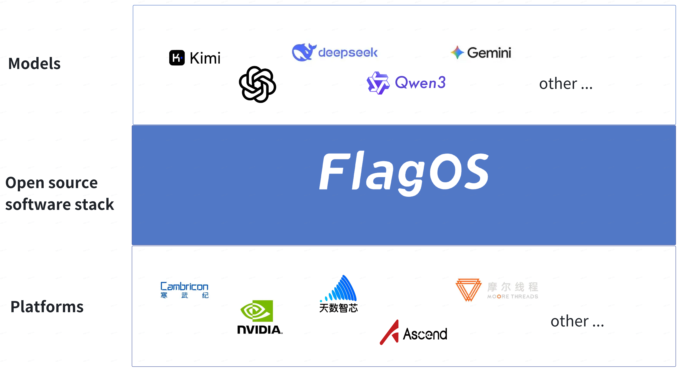
FlagOS Ecosystem Position
Ecosystem Enablement
Megatron-EL
vLLM-plugin-FL
TransformerEngine-FL
Core Libraries
FlagGems: High-performance General-purpose AI Operator Library
FlagTree: Unified AI Compiler
FlagScale: Unified Parallel Training and Inference Framework
FlagCX: Unified Communication Library
Tools
KernelGen: AI-powered Operator Development Tool
FlagRelease: Large Model Release Platform
FlagPerf: AI Hardware Evaluation Engine
Notes:
FlagOS holds an important position in the ecosystem, with its architecture consisting of three parts: ecosystem enablement, core libraries, and tools. The ecosystem enablement includes Megatron-EL, vLLM-plugin-FL, and TransformerEngine-FL, which provide foundational support for the FlagOS ecosystem's operation. The core libraries are the key components of FlagOS. FlagGems, as a high-performance general-purpose AI operator library, can efficiently handle AI computing tasks; FlagTree, a unified AI compiler, can overcome chip "dialect" barriers; FlagScale, a unified parallel training and inference framework, improves training and inference efficiency; FlagCX, a unified communication library, ensures efficient communication within the system. The tools section is also significant. KernelGen is an AI-powered operator development tool that accelerates operator development; FlagRelease is a large model release platform that facilitates model distribution; FlagPerf, as an AI hardware evaluation engine, can precisely evaluate hardware performance.

Slide 45
PART 5
Hands-on: How to Run Large Models Locally Based on FlagOS
Running Qwen3-4B on Huawei NPU
Notes:
Now we enter the hands-on session to explore how to run large models locally on Huawei NPU based on FlagOS, using Qwen3-4B as an example. This hands-on exercise is significant: on one hand, it allows us to more intuitively experience the operational mechanism of large models; on the other hand, we can experience the advantages of FlagOS when running large models locally. Huawei NPU provides powerful computing support for large model execution, while Qwen3-4B is an outstanding model in the large model field. By combining the two and leveraging FlagOS capabilities, we can achieve efficient and stable local large model execution, laying the foundation for subsequent application development and research.

Slide 46
Hands-on Deployment: Creating a Chatbot viaFlagOSCreating a Chatbot
Environment Check and Model Installation
vLLM Cross-Chip Unified Plugin Installation
01
04
Huawei Ascend provides computing hardware, open-sourceQwen3-4Bmodel provides"brain"
vLLM plugin connects"brain",FlagOS and computing hardware
02
FlagGems High-Performance Operator Library Installation
05
Configure and Start Inference Service
FlagGems operators for training and inference
Server
03
FlagTree Cross-Chip Unified Compiler Installation
06
Client Configuration and Chat
FlagTree translates chip-specific"dialects" into"common language"
AnythingLLM client and knowledge base
Notes:
This hands-on deployment creates a chatbot via FlagOS, consisting of six steps. First, perform environment check and model installation to ensure data security; then install the FlagGems operator library for computation and FlagTree compiler to unify chip languages; next, install the vLLM plugin to connect all components; after that, configure and start the inference service, and finally perform client configuration and chat. Each step is interconnected.

Slide 47
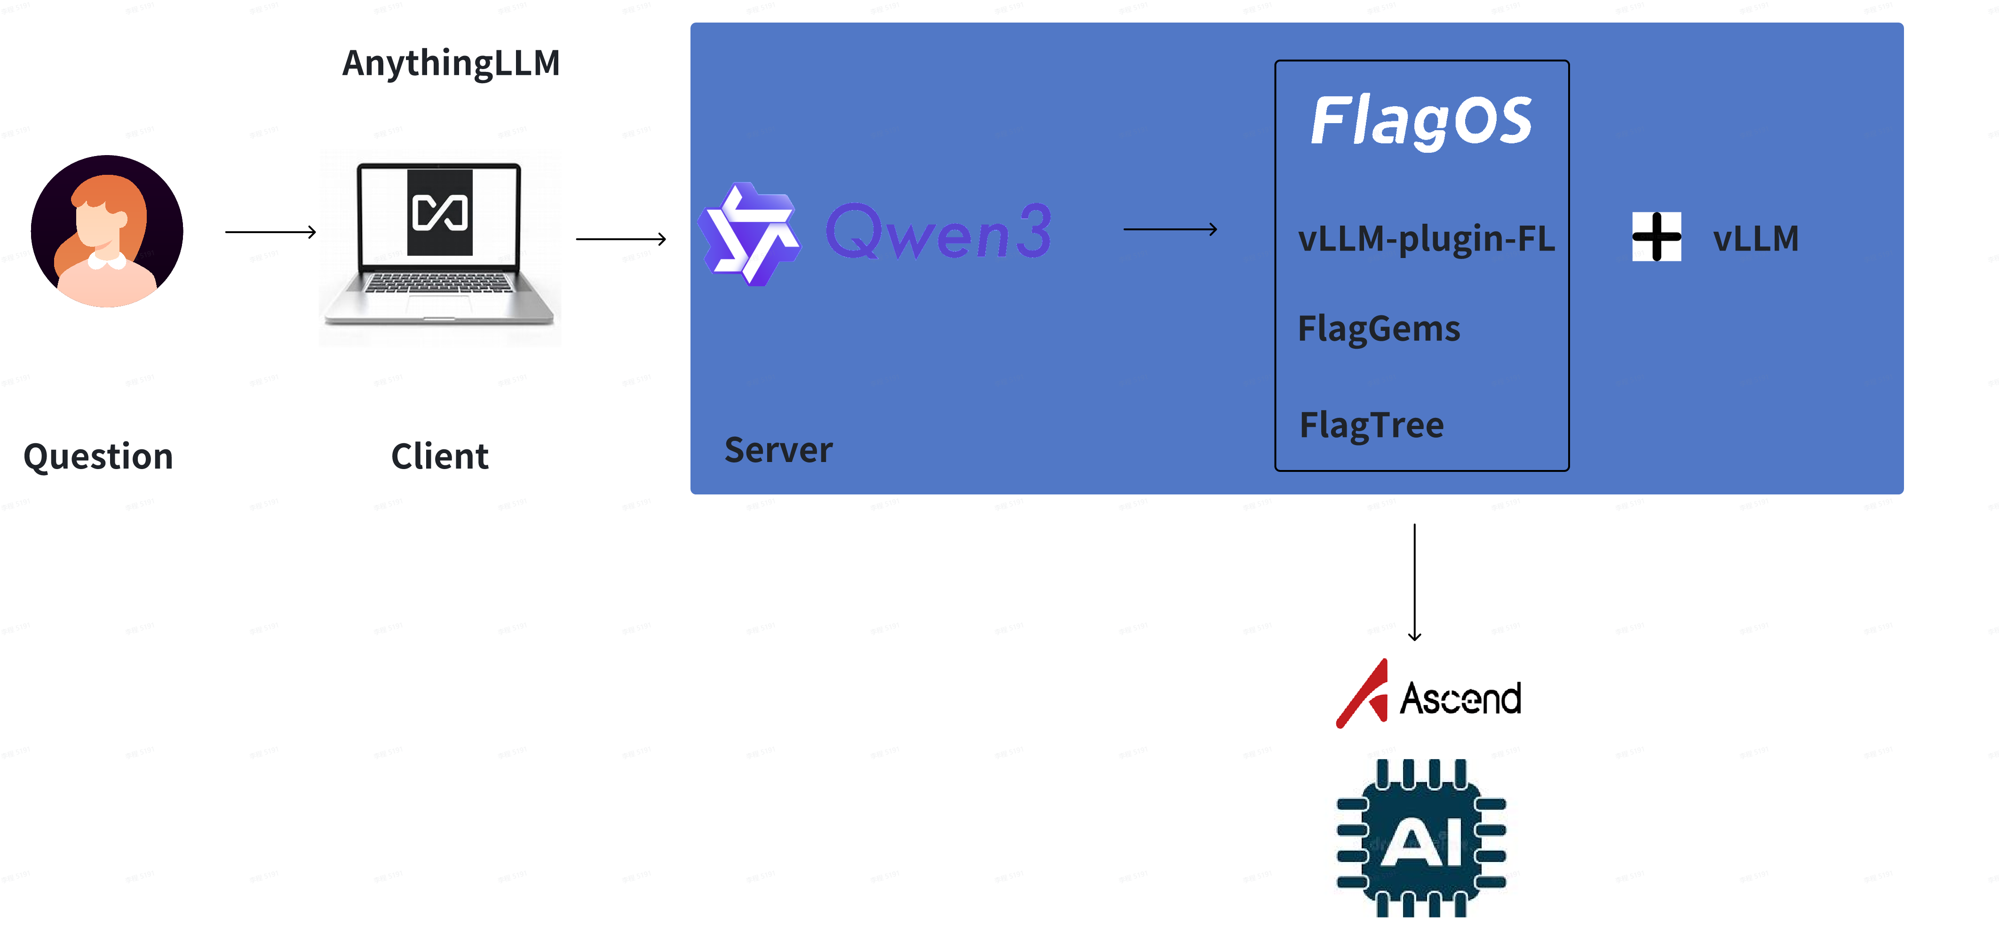
Practical Deployment: ThroughFlagOSCreating a Chatbot
Notes:
During the practical deployment of creating a chatbot through FlagOS, we encountered a situation where importing content is not supported, but this is also a common challenge in technical practice. This reminds us that practical implementation is not always smooth sailing and we may face various unknown issues. However, this is exactly where the charm of technical exploration lies—every obstacle is a key node on the path to success. We need to remain patient, actively solve problems, and ensure the subsequent steps of building the chatbot proceed smoothly.

Slide 48
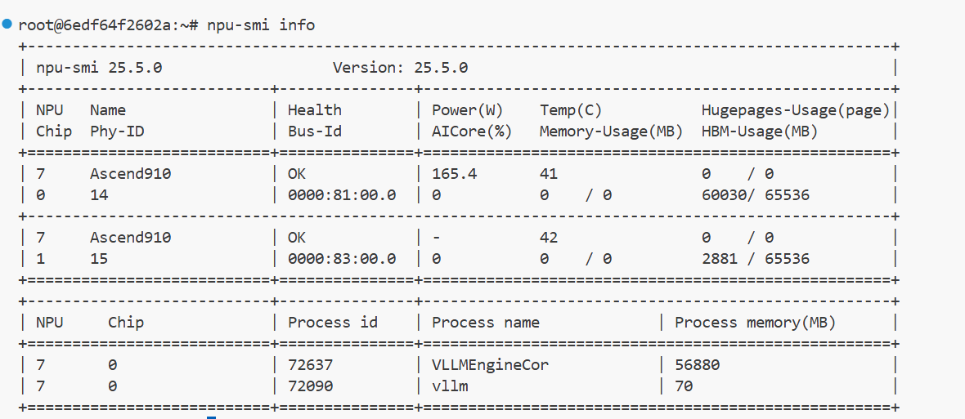
Step 1: Environment Check and Model Download
01
Check NPU Status
02
Download Qwen3-4B Model to Root Directory
npu-smi info
pip install modelscope
modelscope download --model Qwen/Qwen3-4B --local_dir ./Qwen3-4B
Data Security Advantage
Downloading open-source model weights, not API calls. Data stays completely local, no privacy concerns.
Both Ascend cards show normal status, temperature and power consumption are within safe limits, NPU version is compatible, chip health status OK
Notes:
The first step in creating a conversational AI is environment check and model download. First check the NPU status using the 'npu-smi info' command. If both Ascend cards show normal status, with temperature and power consumption within safe limits, NPU version compatible, and chip health OK, you have a solid hardware foundation. Meanwhile, downloading open-source model weights instead of using API calls ensures data stays completely local, adding a layer of data security without privacy concerns. Then use 'pip install modelscope' to install the tool, and 'modelscope download --model Qwen/Qwen3-4B --local_dir ./Qwen3-4B' to download the Qwen3-4B model to the root directory, preparing for subsequent operations.

Slide 49
Step 2: FlagGems High-Performance Operator Library Installation
1
pip install -U scikit-build-core==0.11 pybind11 ninja cmake
Install Dependencies
Zero Code Changes
Build Toolchain
Auto-Enable
git clone https://github.com/flagos-ai/FlagGems
2
Clone Repository
Get Source Code
pip install --no-build-isolation -e .
3
Install Package
Development Mode
pytest test_unary_pointwise_ops.py #Runningpytestalready enablesFlagGemsoperators
4
Verify Installation
Run Tests
Passing operators prove FlagGems is running correctly pip show flag_gems
Notes:
In the hands-on practice of running large models locally based on FlagOS, the second step is to install the FlagGems high-performance operator library. This step consists of four key stages. First, install dependencies via the build toolchain, using the command 'pip install -U scikit-build-core==0.11 pybind11 ninja cmake'. Next, clone the repository to get the source code from 'https://github.com/flagos-ai/FlagGems'. Then, install the package in development mode using 'pip install --no-build-isolation -e .'. Finally, verify the installation by running tests with 'pytest test_unary_pointwise_ops.py' to enable FlagGems operators. If operators pass, use 'pip show flag_gems' to confirm FlagGems is running correctly. This process requires zero code changes and enables automatically.

Slide 50
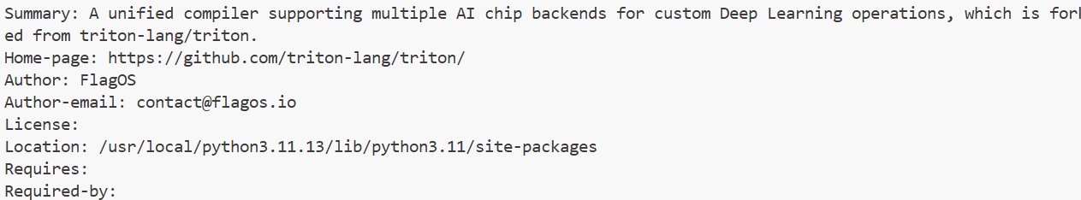
Step 3: FlagTree Cross-Chip Unified Compiler Installation
RES="--index-url=https://resource.flagos.net/repository/flagos-pypi-hosted/simple --trusted-host=https://resource.flagos.net"
python3 -m pip install flagtree==0.4.0+ascend3.2 $RES
Download from FlagOS official resource repository, pre-compiled for Huawei Ascend 3.2
Verify Installation
pip show flagtree
Confirm version number and installation path are correct
Notes:
Next, proceed with the FlagTree cross-chip unified compiler installation. Download from the FlagOS official resource repository using specific commands. This compiler is pre-compiled for Huawei Ascend 3.2. Specifically, first set the resource address variable RES, then install using python3 -m pip install flagtree==0.4.0+ascend3.2 $RES. After installation, verify by using the pip show flagtree command to confirm the version number and installation path are correct. This step is critical as it ensures the compiler is properly installed and ready for subsequent use, laying the foundation for creating chatbots.

Slide 51
Step 4: vLLM-Plugin-FL Cross-Chip Unified Plugin Installation
1
git clone https://github.com/flagos-ai/vllm-plugin-FL
Clone Plugin Repository
2
pip install -r requirements.txt
Install Dependencies
3
pip install --no-build-isolation -e .
Install Plugin
Notes:
In the practical deployment of creating a conversational bot through FlagOS, Step 4 is to install the vLLM-Plugin-FL cross-chip unified plugin. This step is crucial as it enables the tight integration of the "brain", FlagOS, and computing hardware. The specific operation consists of three steps. First, clone the plugin repository using the command "git clone https://github.com/flagos-ai/vllm-plugin-FL" to obtain the required plugin code. Second, execute "pip install -r requirements.txt" to install dependencies and prepare the environment for the plugin to run. Third, use "pip install --no-build-isolation -e ." to install the plugin. After completing these three steps, the plugin will work properly, laying the foundation for the smooth operation of subsequent inference services.

Slide 52
Step 5: Configure and Start Inference Service
Environment Variable Configuration
Start Inference Service
Key Variable 1
vllm serve --model /root/Qwen3-4B --served-model-name qwen --enforce-eager --port 30000
export VLLM_PLUGINS=fl
--model Model weights path
--served-model-name Service external name
--enforce-eagerDisableCUDA Graph(NPU compatible)
--port Service runs on30000 port
Tells vLLM to use FlagOS backend plugin
Key Variable 2
Inference Service Started
Display Platform plugin fl is activated
export TRITON_ALL_BLOCKS_PARALLEL=1
Successful Startup Indicator
Platform plugin fl is activated
Enables Triton parallel optimization to improve inference speed
Service Status: Running
When the inference service starts, it automatically launchesFlagGemsoperators, which can be queried via cat /tmp/flaggems_enable_oplist.txt to view activatedFlagGemsoperators
Listening Address: 127.0.0.1:30000
Huawei NPU has been transformed into an AI inference server!
Notes:
Configuring and starting the inference service is a crucial step, where environment variable configuration involves two key variables. The first variable "export VLLM_PLUGINS=fl" tells vLLM to use the FlagOS backend plugin, laying the foundation for service operation. The second variable "export TRITON_ALL_BLOCKS_PARALLEL=1" enables Triton parallel optimization, significantly improving inference speed. After starting the inference service, if "Platform plugin fl is activated" is displayed, it indicates successful startup. At this point, the service status is running, and the listening address is 127.0.0.1:30000, meaning the Huawei NPU has successfully transformed into an AI inference server. When the inference service starts, it also automatically launches FlagGems operators, which can be queried using "cat /tmp/flaggems_enable_oplist.txt" to view the activated operators.

Slide 53
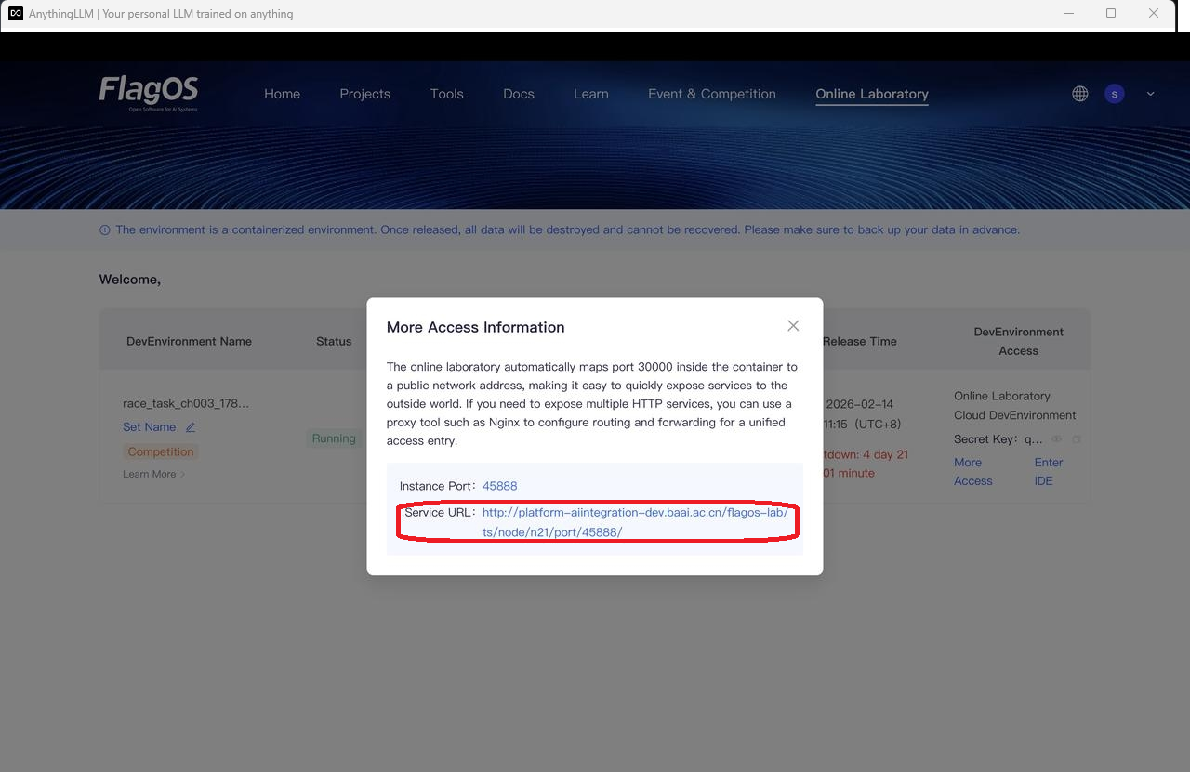
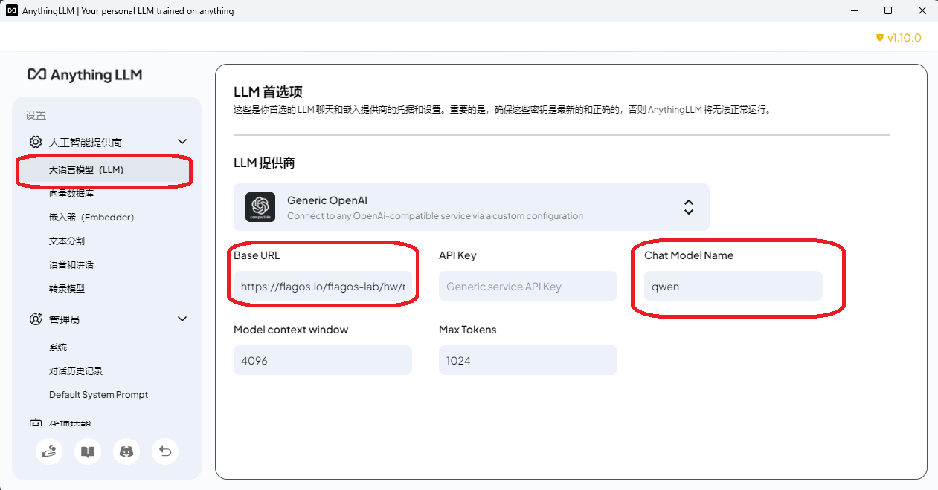
Step 6: Client Configuration and Conversation
Configure Model Address and Name
Base URL = Service URL/v1
vllm serve --model /root/Qwen3-4B --served-model-name qwen --enforce-eager --port 30000
Chat Model Name = qwen
Notes:
After completing the previous installation and configuration steps, we arrive at Step 6—Client Configuration and Conversation. This step requires configuring the model address and name. Run "vllm serve --model /root/Qwen3-4B --served-model-name qwen --enforce-eager --port 30000" to specify the model weights path, service name, disable CUDA Graph for NPU compatibility, and the service port. Additionally, set Base URL to Service URL/v1 and Chat Model Name to qwen. These configurations enable the client to establish a valid connection with the model and initiate smooth conversations, laying the foundation for subsequent interactions with the model.

Slide 54
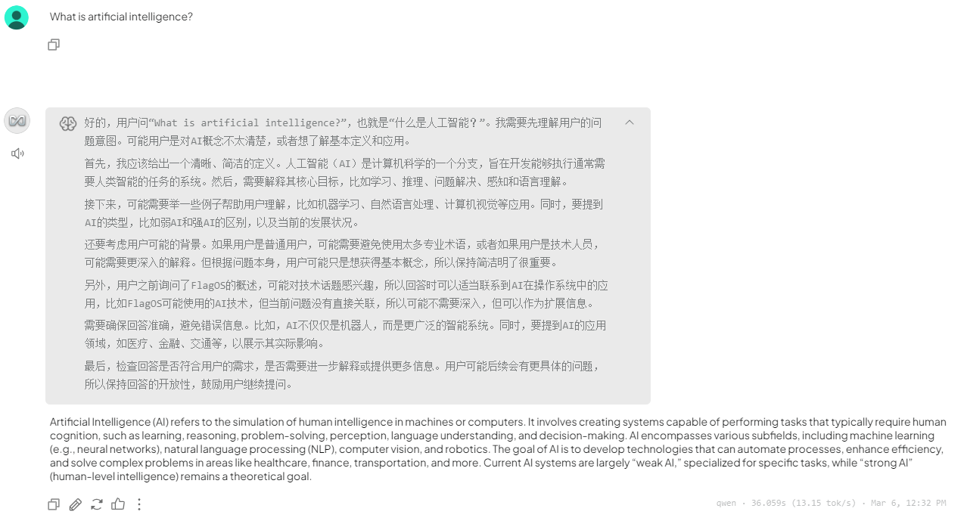
Step 6: Client Configuration and Dialogue
Notes:
Earlier, we completed environment checks, model downloads, installation of relevant libraries and plugins, and the configuration and startup of the inference service. Now we come to Step 6 – Client Configuration and Dialogue. This step is crucial as it allows us to actually experience interacting with the model. After configuring the client, we can start a dialogue with the model – let us wait and see what interesting interactions we will have.

Slide 55
Core Value Brought by FlagOS
Autonomous and Controllable
Development Efficiency
Break free from dependency on APIs and ecosystems, with all data deployed locally.
No need to rewrite operators for NPUs. One codebase runs across platforms, reducing development costs.
Performance Assurance
Future Extensibility
Triton language deliversnear hand-written CUDA performance, while maintaining code readability and maintainability.
The same code can run on more domestic chips in the future. The community ecosystem continues to expand.
FlagOS: A unified, open-source system software stack designed for various AI chips
It makes domestic computing power truly usable, easy to use, and powerful, paving the way for autonomous and controllable AI infrastructure in China.
Notes:
FlagOS is designed for various AI chips as a unified, open-source system software stack that makes domestic computing power usable, easy to use, and powerful, laying the foundation for autonomous and controllable AI infrastructure in China. Its core values are significant: First, autonomous controllability: breaking free from dependency on APIs and ecosystems, with local data deployment ensuring data security. Second, improved development efficiency: no need to rewrite operators for NPUs, one codebase running across platforms, reducing development costs. Third, performance assurance: Triton language delivers performance close to hand-written CUDA while maintaining code readability and maintainability. Fourth, future extensibility: the same code can run on more domestic chips, with the community ecosystem continuing to expand.

Slide 56
Reference Resources and Tools
Interactive Understanding of Transformer Architecture
Large Model Architecture Visualization
Animated Demonstration of Attention Mechanism
Word Embedding Visualization
poloclub.github.io/transformer-explainer
bbycroft.net/llm
prvnsmpth.github.io/animated-transformer
https://projector.tensorflow.org/
FlagOS Documentation
Experience How Text is Tokenized
docs.flagos.io
https://tiktokenizer.vercel.app/
Notes:
To help everyone learn and research more effectively, here is a collection of reference resources and tools. The interactive Transformer architecture resources allow you to gain a deeper understanding of the principles and mechanisms of the Transformer architecture through hands-on interaction. The large model architecture visualization tool intuitively displays complex large model architectures, making them easier to understand. The animated Attention mechanism demonstration presents the Attention mechanism through vivid animations, transforming abstract concepts into something easy to grasp. The word embedding visualization tool helps you intuitively see the distribution and relationships of word embeddings. The FlagOS documentation is essential material for understanding the FlagOS system software stack. There is also a tool to experience how text is tokenized, allowing you to personally experience the text processing workflow. Making good use of these resources and tools can improve the efficiency of your learning and research.

Slide 57
Acknowledgments to the following individuals for their support of this course
Cao Zhou
Chen Jingyi
Teng Qiming
Liu Yunling
Wang Yunbo
Li Cheng
Liu Guang
Zhao Zhiqiang
Tao Jian
Jieran Zhang
Shi Lijuan
Zhu Qigang
Notes:
Dear friends, today we have gained a deep understanding of the installation process of the FlagOS system software stack and the core value it brings. From environment checks and model downloads to client configuration and dialogue, every step demonstrates FlagOS's powerful capabilities and broad prospects. It brings advantages such as autonomy and controllability, efficient development, performance assurance, and future scalability to the development of domestic computing power, making domestic computing power truly usable, easy to use, and effective. Here, I would like to extend special thanks to Cao Zhou, Teng Qiming, Wang Yunbo, and others who supported this course. It is through their efforts that we have the opportunity to deeply learn about FlagOS. At the same time, I hope everyone will take action and actively try using FlagOS to jointly promote the autonomous and controllable development of China's AI infrastructure. Looking ahead, we have every reason to believe that FlagOS will play an even greater role in the domestic chip field and contribute to the rise of China's AI industry. Let us work together to meet the challenges and opportunities of the AI era! Thank you all for your attention!

