Slide 1
  Rainbow Forth
  Bradley Nelson
  bnels123@gmail.com
  January 26th, 2008

Slide 2
Disclaimer
This is my first Forth implementation
I have undoubtedly made bad design choices
Chuck would no doubt be horrified with the ugliness of my design

Slide 3
Overview
The colorForth Dialect
Design Choices
Tools
Implementation
Demo!
Language Exploration
Future Directions

Slide 4
The colorForth Dialect
Created by Chuck Moore circa 2000?

Slide 5
colorForth Features
Stand-alone! Includes operating system.
Compact! 2K bytes for core software.
Fast! Optimized object code.
Simple! Applications stored as source. No object library.
Innovative! Text compressed and pre-parsed.
Unique! 27-key Dvorak keyboard.

Slide 6
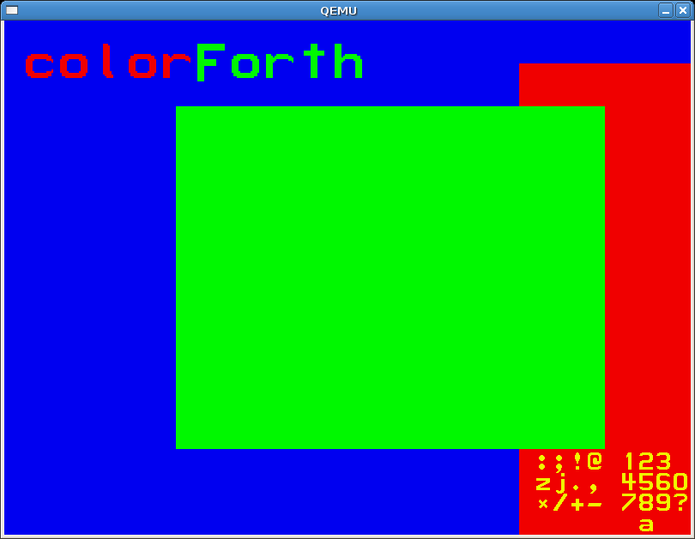
colorForth Startup Screenshot

Slide 7
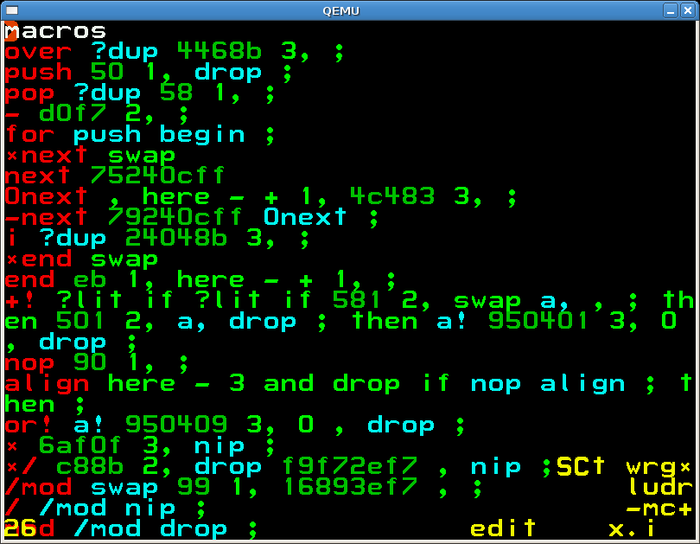
colorForth Editor Screenshot

Slide 8
colorForth Colors
comment
create
execute
compile
inline
variable

Slide 9
colorForth vs Traditional Forth
word --> ( word )
word --> : word | create word
word --> [ word ]
word --> word
word --> ' word compile,
word --> variable word

Slide 10
colorForth Advantages
No look-ahead needed for parsing
All places that create words are marked
Fewer line noise characters
Easier to understand compiler
Color replaces parsing for both humans and compiler

Slide 11
colorForth Drawbacks
Non-standard
Parser is less changeable than Forth
Incompatible with conventional operating systems
Dvorak scares off QWERTY users

Slide 12
  Introducing...
  Rainbow Forth

Slide 13
Differences from colorForth
64x16 ASCII source blocks
Invisible color tags after each word
No shadow blocks
C compatible register choices
Bootstrapped from C instead of Assembly
More conventional word definitions
QWERTY keyboard input
literal is not called on yellow-green transition
Hexadecimals are marked with 'h'
Linux and Windows support (not bootable)

Slide 14
Major Design Choices
Source Block Format
Memory Layout
Dictionary Format
Registers
Bootstrapping Method

Slide 15
Source Block Format
64 x 16 = 1,024 Blocks
Spaces indicate color as a suffix
32 is white, 255-250 are red-magenta
Spacial control is retained (and no waste)
Example:
square n--n**2 dup * ;
square_n--n**2_dup_*_;_

Slide 16
Memory Layout
C Call Stack for RSTACK
Small DSTACK
Code Heap (for dictionary words)
Data Heap (for variables and allot)

Slide 17
Dictionary Format
Linked list of Dictionary Entries
Dictionary Entry
  Next Word
  Code Address
  Data Address
  Is Macro?
  Smudged
  Name Length
  Name Characters

Slide 18
Register Usage
EAX - scratch
EBX - Top of Stack
ECX - scratch
EDX - scratch
ESI - unused
EDI - Execution Context Pointer
EBP - Data Stack Pointer
ESP - Return Stack Pointer

Slide 19
Bootstrapping Method
Implement editor in C
Implement minimal compiler harness in C
No assembler in compiler harness
Dictionary structure defined in C
Harness executes Forth words to generate code
Harness passes entry points for OS to Forth

Slide 20
Tools
Subversion
Debian Linux
Cygwin
Sourceforge.net

Slide 21
Subversion
Version control system
Successor to CVS and RCS
Keeps a snapshot of each change
Allows Internet collaboration
Checkout a copy with:
svn checkout http://rainbowforth.svn.sourceforge.net/svnroot/rainbowforth
Keep it up to date with:
svn up
Submit changes with:
svn commit (requires sourceforge.net account)

Slide 22
Debian Linux
Popular Linux Distribution
Install developer tools with simple commands:
aptitude install gcc make ncurses-dev

Slide 23
Cygwin
Unix-like environment on Windows
Includes GNU C compiler
Includes GNU Make
Includes Subversion client
Native Windows applications supported
Great for cross platform builds

Slide 24
Sourceforge.net
Free hosting for Open Source or Public Domain Projects
Bug Tracker
Subversion Server

Slide 25
Implementation
Overview
Color Console
Editor
Compiler Harness
System Call Access

Slide 26
Implementation Overview
< 2,000 total lines of C
< 600 lines in compiler harness
No register assumptions made
Dictionary format is fixed
22 blocks in core system

Slide 27
Color Console
Ncurses on Linux
WIN32 Console API on Windows
Wrap in a common interface
Supports Color, Underline/Reverse Video

Slide 28
Editor
Block at a time
Saves as you go
Arrow keys move cursor
PgUp and PgDn move between blocks
Ins, Del, Backspace
Cut (Ctrl-X), Copy (Ctrl-C), Paste (Ctrl-V)
Ctrl-G to just to a block number
Ctrl-R to run a block
F2-F8 to select color
Ctrl-Q / Escape to Quit

Slide 29

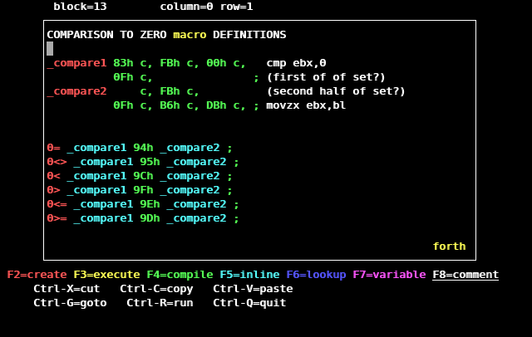
Editor Interface

Slide 30
Compiler Harness
C code compiles by calling a few Forth words
These Forth words are defined using a small set of built-in words
Small table of C entry points allow Forth to access system resources

Slide 31
Harness Required Words
execute-forth
literal
compile,
variable

Slide 32
Harness Supplied Words
macro
forth
smudge
unsmudge
b,
windows?
load
thru
heap-dump
word-dump

Slide 33
Harness Supplied Entry Points
load
print_number
key
emit
library_load
library_symbol

Slide 34
System Calls
Windows Raw System Calls
Linux Raw System Calls
Windows Dynamic Libraries
Linux Dynamic Libraries

Slide 35
Windows Raw System Calls
How you call them changes in each version
It varies by processor version!
  int 2Eh (intel pre-pentium II, amd pre-64-bit)
  sysenter (intel 32/64-bit)
  syscall (amd 64-bit)
Call number goes in EAX, but the numbers change!
  NtWriteFile (0xC8 on WinNT4, 0xED on Win2000, 0x112 on WinXP, 0x11C on Win2003, 0x164 on Vista)

Slide 36
Linux Raw System Calls
int 80h call the system
Call number goes in EAX
  read=0, write=1, open=2, close=3, etc...
Parameters go in ECX, EDX, ESI, EDI, EBP
Return value in EAX

Slide 37
Windows Dynamic Libraries
HANDLE LoadLibrary(const char *name);
GetProcAddress(HANDLE, const char *name);
For example:
MessageBeep(int style);
lives in USER32.DLL

Slide 38
Linux Dynamic Libraries
void *dlopen(const char *name, int flags);
void *dlsym(void *h, const char *name);
For example:
double cos(double);
lives in libm.so

Slide 39
Demo
  DEMO

Slide 40
Language Exploration
Lookup color
Auto-literals
CREATE DOES>
Do we need macros/cyan?
Should macro be one-shot?
How to handle Strings?
push pop vs >R R>

Slide 41
Lookup Color
Need a way to get address of a word
One primary/secondary color left blue
Should go on compile time stack
Example:
output-emit
to-printer printer-emit literal output-emit ! ;
to-screen screen-emit literal output-emit ! ;
emit output-emit @ execute ;

Slide 42
Auto-literals
Should yellow-green transition compile a literal?
Example:
~pi 22 7 / ; (colorForth)
~pi 22 7 / literal ; (Rainbow Forth)
Assumes compile time calculations are more common than state changing words
Useful in 2 out of about 20 current uses

Slide 43
CREATE DOES>
  : defining-word create allocation does> action ;
  defining-word instance-name
  defining-word allocation does> action ;
  instance-name defining-word

Slide 44
CREATE DOES> example
  : pair create , , does> dup cell+ @ swap @ ;
  5 7 pair p
  pair , , does> cell+ @ swap @ ;
  5 7 p pair

Slide 45
Do we need macros/cyan?
Macros allow inline code without direct compiler support
Cyan highlights that something special is going on
Someone using a word doesn't need to guess what color (green usually is right)
Macros and regular words can coexist
max 2dup < if nip else drop then ;
is more awkward than
max 2dup < if nip else drop then ;

Slide 46
Should macro be one-shot?
macro and forth have state, much like hex and decimal
Maybe macro should be one-shot like immediate?
Or separate one-shot word :macro?

Slide 47
How to handle constant Strings?
Add a new color?
Get strings only from blocks or data files?
Parse quotes?
Reuse red compile words !!!!
Example:
hi HelloWorld! last-name literal ;

Slide 48
push pop vs >R R>
Looks less like line-noise
Matches assembler push/pop intuition
Doesn't look like a comparison
No shift key
But >R R> is shorter

Slide 49
Future Directions
Peephole Optimizer
Rewrite editor in colorForth
Bootable Version
Cross Platform Graphics Wrapper

