Slide 1
Open Government Platform (OGPL)
Update
Nov 15, 2011

Slide 2
Agenda
Project Plan and Responsibilities (Revisited)
Functional Requirements Documents
  Towards Signoff
Product Development Update & Early Snapshots
  DMS : USA
  Website & URM : India
Team and Schedule
  Teams in place today
  Current schedule and key milestones
Open Issue Discussion

Slide 3
Project Plan – Responsibilities (Revisited)
USA
Development of DMS Component with new metadata template
Integration of DMS and New website
Establishment of code collaboration tool (GitHub)
Development of release packaging
Creation of outreach materials and marketing OGPL
Tech Documentation
India
Development of Website component along with integral metrics & charts
Development of URM component along with Metrics
Integrate existing communities with website
Support release packaging components
Develop new version of Communities module (Phase 2)
Tech Documentation

Slide 4
Functional Requirements Docs
GitHub created and being used by joint team
  Code delivery
  Documents
Functional Requirements Documents have been delivered, feedback & comments being exchanged
  USA – DMS
  India – Website & URM
  Nov 18th final signoff expected

Slide 5
Product Update and Early Snapshots - USA
Work on OGPL-DMS development progressing according to schedule
  Committed draft version 0.2 functional requirements document to GitHub
  Incorporated the Open Government Metadata Schema (draft version 3.01)
  Completed basic DMS functionalities: entering datasets into DMS via web forms and file uploads, approval workflow process, business user roles defined, user management, document library.
  Target is November 30

Slide 6
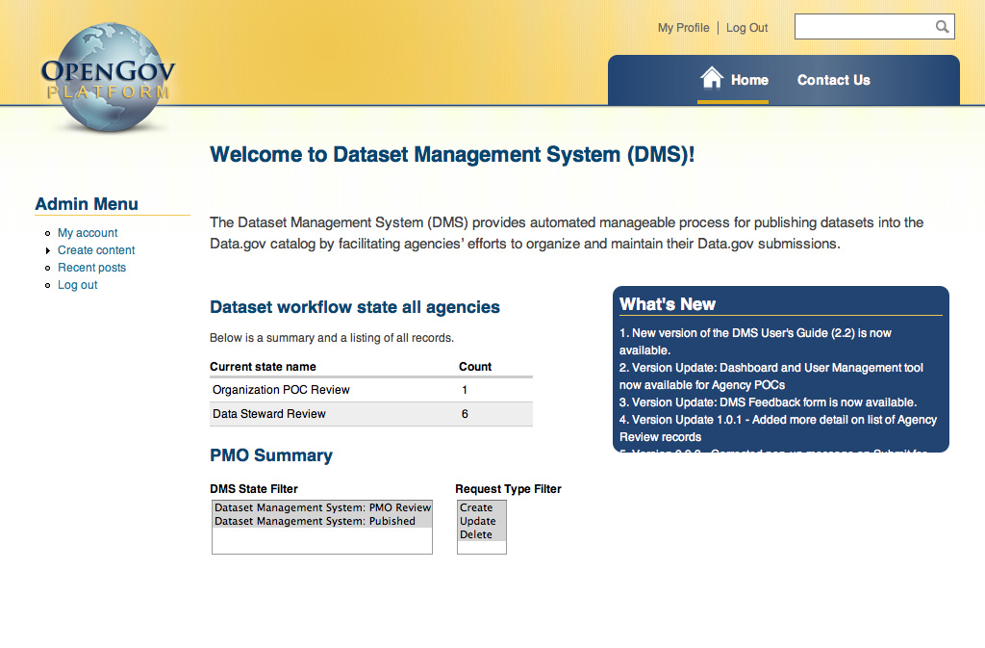
Product Update and Early Snapshots - USA

Slide 7
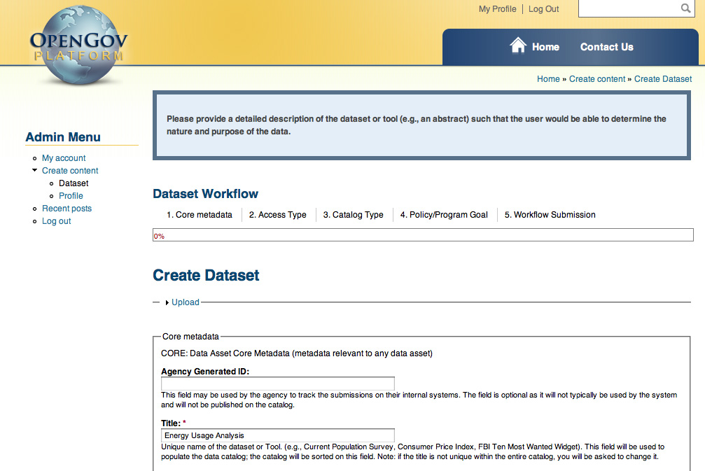
Product Update and Early Snapshots - USA

Slide 8
Product Update and Early Snapshots - India
Development on OGPL-Website and URM is progressing as scheduled
  Draft version 0.3 of functional requirement document uploaded to GitHub – Ready to be signed-off
  Development of Website CMS functionalities – In progress
  UI Development for Website – In progress
  Website & URM Staging Environment setup – Completed
  Test plan as per functional requirement – Under Review

Slide 9












Project Schedule (Revisited)
 | October | November | December | January | February | March
DMS
Documentation
Conduct Outreach
Integrate Modules
Release Package
Beta
Website with metrics. & charts
URM
Documentation
Support
Subject to Approvals
Legend :
Coding
Program Effort

Slide 10
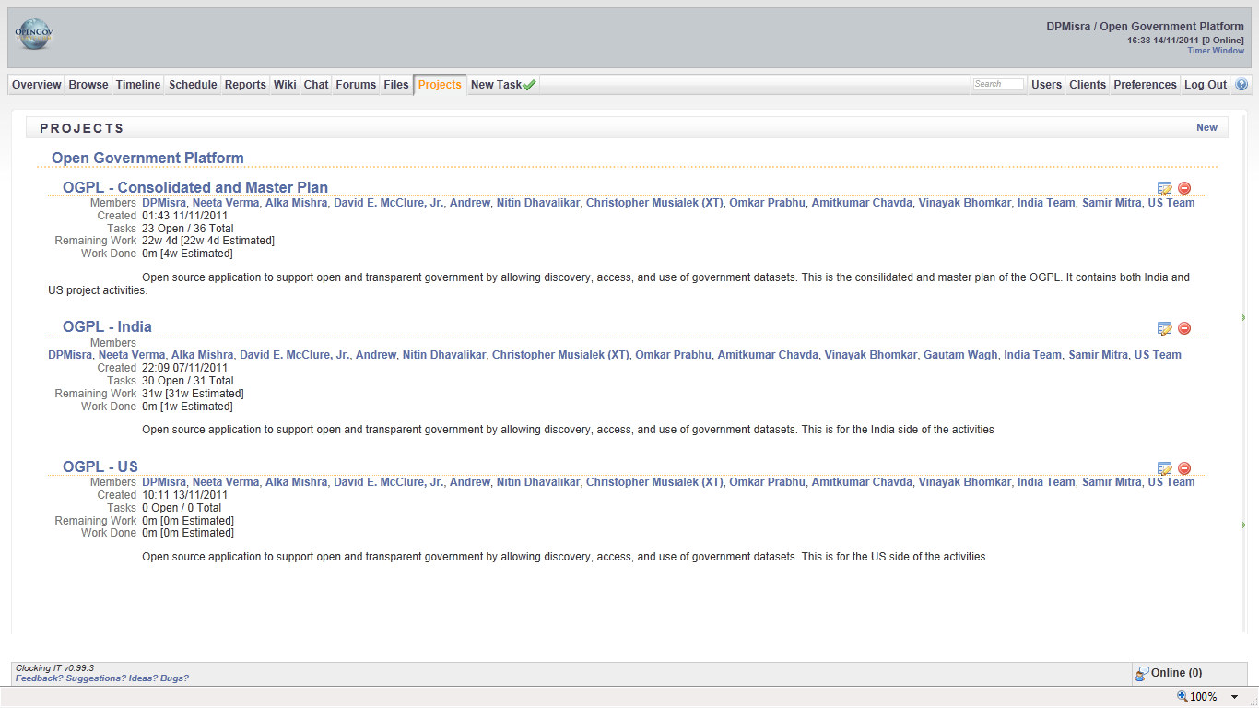
Open Source Project Management Tool
Project planning moved to web-based tool, common to entire team

Slide 11
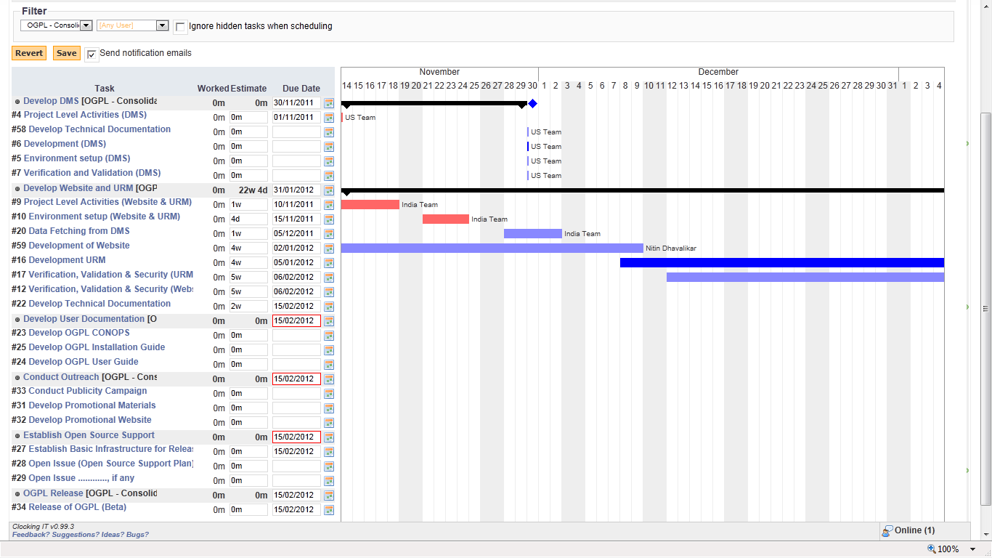
Project Schedule – Master Plan

Slide 12
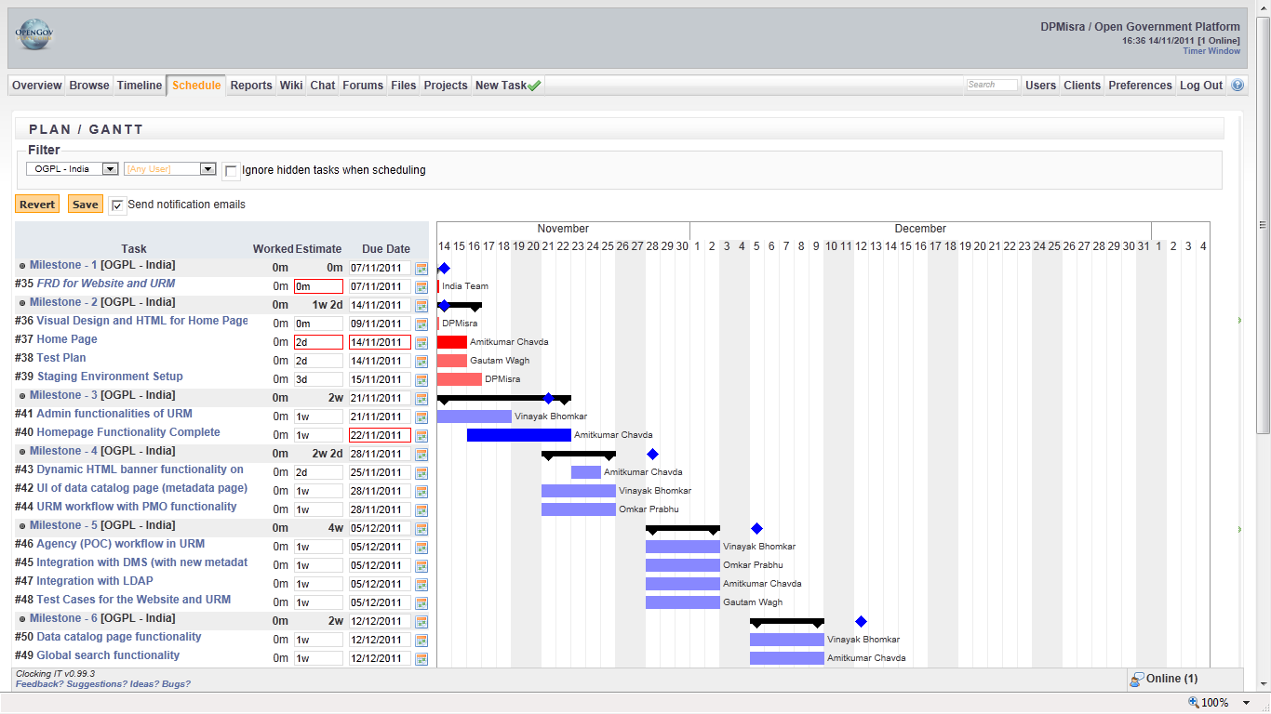
Project Schedule – India Team

Slide 13
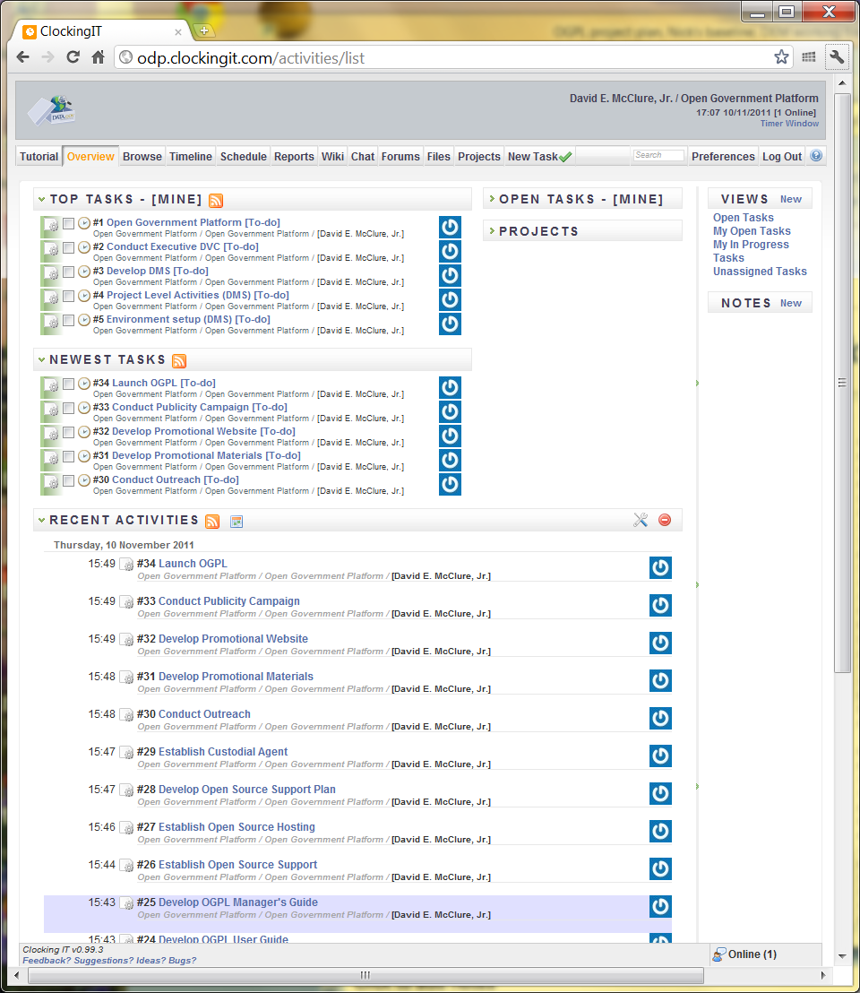
Project Schedule – US Team
 |  | Task_Name | Start | Finish
 | 1 | Open Government Platform | 9/22/11 | 2/29/12
 | 1.1 | Conduct Executive DVC | 9/22/11 | 10/7/11
 | 1.2 | Develop DMS | 9/22/11 | 11/30/11
 | 1.2.1 | Project Level Activities (DMS) | 9/22/11 | 9/30/11
 | 1.2.2 | Environment setup (DMS) | 9/22/11 | 9/27/11
 | 1.2.3 | Development (DMS) | 9/22/11 | 11/2/11
 | 1.2.4 | Verification and Validation (DMS) | 11/2/11 | 11/30/11
 | 1.3 | Develop Website | 12/1/11 | 12/21/11
 | 1.3.1 | Project Level Activities (Website) | 12/1/11 | 12/9/11
 | 1.3.2 | Environment setup (Website) | 12/1/11 | 12/1/11
 | 1.3.3 | Development (Website) | 12/1/11 | 12/21/11
 | 1.3.4 | Verification and Validation (Website) | 12/1/11 | 12/21/11
 | 1.4 | Develop URM | 9/22/11 | 11/30/11
 | 1.4.1 | Project Level Activities (URM) | 9/22/11 | 9/30/11
 | 1.4.2 | Environment setup (URM) | 9/22/11 | 9/27/11
 | 1.4.3 | Development (URM) | 9/22/11 | 11/2/11
 | 1.4.4 | Verification and Validation (URM) | 11/2/11 | 11/30/11
 | 1.5 | Integrate OGPL Components | 12/22/11 | 1/11/12
 | 1.5.1 | Integrate Website | 12/22/11 | 1/11/12
 | 1.5.2 | Integrate DMS | 12/22/11 | 1/11/12
 | 1.5.3 | Integrate URM | 12/22/11 | 1/11/12
 | 1.6 | Develop Documentation [Audience, how extensive, etc. TBD] | 10/7/11 | 2/1/12
 | 1.6.1 | Develop OGPL CONOPS | 10/7/11 | 10/21/11
 | 1.6.2 | Develop OGPL User Guide | 1/12/12 | 2/1/12
 | 1.6.3 | Develop OGPL Manager's Guide | 1/12/12 | 2/1/12
 | 1.7 | Establish Open Source Support | 10/3/11 | 2/28/12
 | 1.7.1 | Establish Open Source Hosting | 10/17/11 | 1/17/12
 | 1.7.2 | Develop Open Source Support Plan | 10/17/11 | 10/31/11
 | 1.7.3 | Establish Custodial Agent | 1/13/12 | 2/7/12
 | 1.8 | Conduct Outreach | 9/22/11 | 2/29/12
 | 1.8.1 | Develop Promotional Materials | 1/12/12 | 2/1/12
 | 1.8.2 | Develop Promotional Website | 1/12/12 | 2/1/12
 | 1.8.3 | Conduct Publicity Campaign | 2/2/12 | 2/29/12
 | 1.9 | Launch OGPL | 2/29/12 | 2/29/12

Slide 14
Product Team Today
USA Team
  Project Director – 1
  Program Manager – 1
  UI – as needed
  Software Engineering – 4.5 FTE
  Test and QA – 0.75 FTE
  Analysts – 1 FTE
India Team
  Project Director - 1
  Program Manager – 1
  Technical Architect – 1
  UI - 2
  Software Engineering - 4
  Test and QA - 2
  Analysts - 2

Slide 15
Open Issue Discussion
Documentation
  Who are the Users targeted?
  Recommend we focus on technical documentation:
    Install guide
    Users Guide
  How do we combine efforts to produce common technical documentation for our users?
Deployment
  Hosted and stand-alone
Announcement of OGPL
  Let’s showcase product at announcement
  When and where

