Slide 1


Efficient View-Based 3D Reflection Symmetry Detection
Bo Li, Henry Johan, Yuxiang Ye, Yijuan Lu

Slide 2
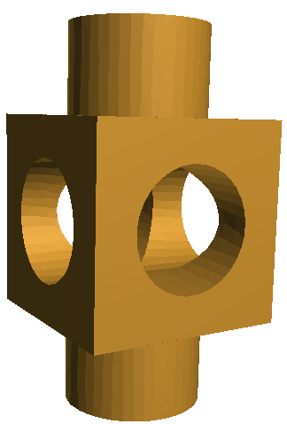
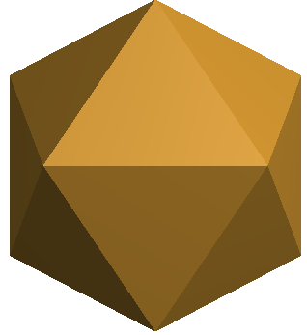
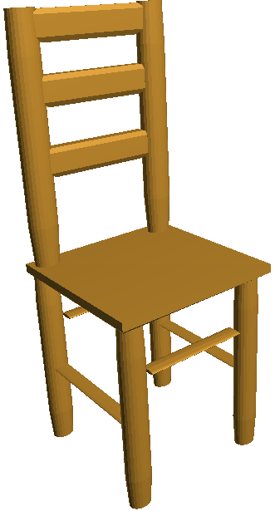
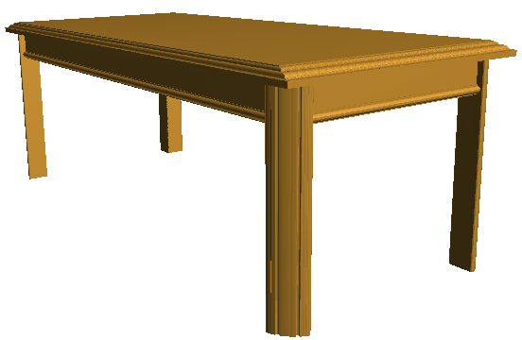
3D Reflection Symmetry
Among different types of symmetry, reflection symmetry is the most important and commonly studied
3D reflection symmetry [Chaouch and Verroust-Blondet 2009]:
Cyclic symmetry: several mirror planes passing through a fixed axis
Dihedral symmetry: several mirror planes passing through a fixed axis with one perpendicular to the axis
Rotational symmetry: look similar after rotation, e.g., different platonic solids, like tetrahedron, octahedron, icosahedron and dodecahedron
Unique symmetry: only one mirror plane, for instance, many natural and most man-made objects
Cyclic
Dihedral
Rotational
Unique

Slide 3
Motivation
Existing algorithms still have room for improvement w.r.t
Simplicity, Efficiency, Degree of freedom
Most existing symmetry detection methods are geometry-based
Computational efficiency is greatly influenced by the number of vertices of a model
We propose a novel and efficient view-based detection algorithm
Our target is to detect 3D reflection symmetry on the surface of 3D models (we do not consider the internal parts of the models)
Motivated by the symmetric patterns of the viewpoint entropy distribution of symmetric models
Find symmetry plane(s) by matching the viewpoints of the sample views of a symmetric model based on their entropy values
Pros: more accurate (symmetry planes’ positions), efficient (speed), and robust (number of vertices and parameter settings)
Notes:
Pros: more accurate (in terms of both the positions of detected symmetry planes and sensitivity to minor symmetry differences), efficient, robust (e.g. to the number of vertices and parameter settings such as view sampling), and versatile in finding symmetry planes of diverse models.

Slide 4
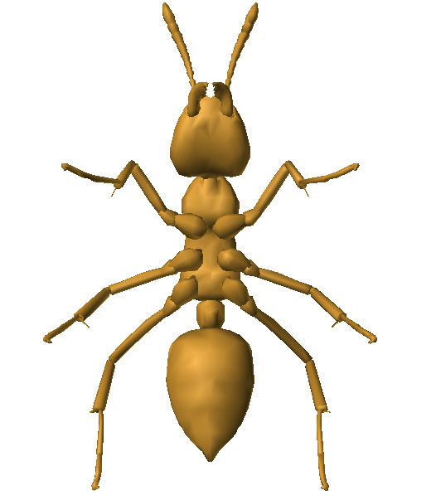
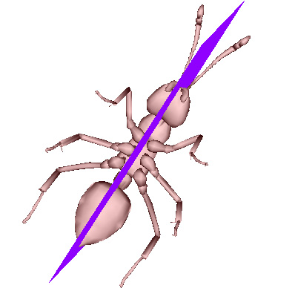
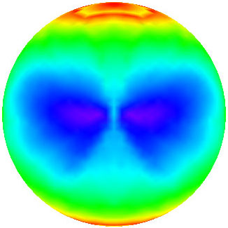
Our View-Based Symmetry Detection
ant model
viewpoint entropy distribution
detected symmetry plane
Symmetry in viewpoint entropy distribution corresponds to the symmetry of the 3D model

Slide 5
Related Work
Symmetry Detection: to search the (partial or full) symmetry planes of a 3D model (recent survey in [Mitra et al. 2012])
They can be classified according to feature employed:
Pairing point features: sample points, extract their features, matching
[Mitra et al. 2006]: adopted a stochastic clustering and region-growing approach
[Cailliere et al. 2008]: same framework of pairing and clustering, but utilized 3D Hough transform to extract significant symmetries
Pairing line features: extract feature lines, matching, symmetry validation [Bokeloh et al. 2009]
Using 2D image features: use specific image(s) to deduce symmetry
Single 2D image of a volumetric shape [Sawada and Pizlo 2008, Sawada 2010]
CAD line drawing [Zou and Lee 2005, 2006]: edge connection topology analysis
Other approaches: generalized moments [Martinet et al. 2006], intrinsic reflection symmetry axis transform [Xu et al. 2009, 2012], symmetry invariant functions [Wang et al. 2014]
Notes:
Pros: more accurate (in terms of both the positions of detected symmetry planes and sensitivity to minor symmetry differences), efficient, robust (e.g. to the number of vertices and parameter settings such as view sampling), and versatile in finding symmetry planes of diverse models.

Slide 6
Related Work
Symmetry Applications: As an important shape feature, it is useful for many applications:
Medical image symmetry detection: 3D MRI [Tuzikov et al. 2003]
Shape matching: [Kazhdan et al. 2004] [Podolak et al. 2006]
3D model alignment: [Tedjokusumo and Leow 2007] [Sfikas et al. 2011]
Shape processing and analysis: [Golovinskiy et al. 2009]
Symmetrization: [Mitra et al. 2006]
Viewpoint selection: [Podolak et al. 2006]
3D segmentation: [Podolak et al. 2006] [Wang et al. 2014]
Notes:
Pros: more accurate (in terms of both the positions of detected symmetry planes and sensitivity to minor symmetry differences), efficient, robust (e.g. to the number of vertices and parameter settings such as view sampling), and versatile in finding symmetry planes of diverse models.

Slide 7
Our Symmetry Detection Algorithm
Step 1. 3D model normalization based on CPCA [Vranik 2004]
Purpose: to reduce the search space for symmetry planes
Benefit: symmetry planes will pass the origin
CPCA: better efficiency, accuracy, and robustness
Step 2. Viewpoint sampling and entropy distribution generation
Sample candidate symmetric viewpoints
Compute viewpoint entropy values
Step 3. Symmetry detection based on iterative feature pairing
Viewpoint matching
Accumulate symmetry evidences
Symmetry validation

Slide 8
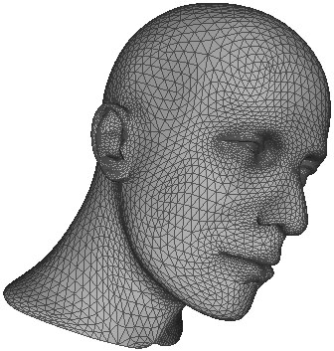
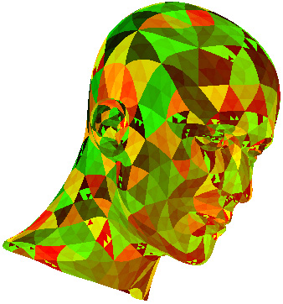
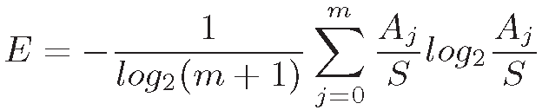
Step 2: Viewpoint Entropy Computation
Viewpoint entropy: an information theory-related measurement, proposed by [Vázquez et al. 2001], to depict the amount of information a view contains
Formulation
Based on Shannon entropy
Incorporate the projection area of each visible face and the number of visible faces
Orthogonal projection-based definition: [Takahashi et al. 2005]
A_{j} : the visible projection area of the j-th (j=1, 2, · · · , m) face of a 3D model
A₀: the background area
S : the total area of the window where the model is rendered:

Slide 9
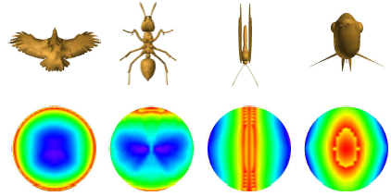
Step 2: View Sampling and Entropy Distr.
Viewpoint sampling: Loop subdivision on a regular icosahedron L₀
Subdivide L₀ n times and denote the resulting mesh as L_{n}
Set the cameras on L_{n}, looking at the origin and use orthogonal projection
blue: large entropy
green: mid-size entropy
red: small entropy
Viewpoint entropy distribution examples
1st row —models after alignment with CPCA
2nd row—respective viewpoint entropy distribution

Slide 10
Our Symmetry Detection Idea
Relationship between a 3D model and its viewpoint entropy distribution sphere
Perfectly the same symmetry plane
Idea: Symmetry detection of a 3D model ⬄ Finding the symmetry plane of its entropy distribution sphere based on a set of viewpoints
Avoid high computational cost of direct matching among its geometrical properties
Attributes of our view-based symmetry detection algorithm
Highly sensitive to small differences in the model, since
Viewpoint entropy is computed based on the projection of each face of a model
Significantly reduce the computational cost, since
Each viewpoint simultaneously captures the properties of many vertices and faces

Slide 11
Step 3: Iterative Feature Pairing
Efficient matching based on iterative feature pairing:
Iteratively select a matching pair of viewpoints to generate a symmetry plane
Verify all the rest matching pairs to see whether they are symmetric as well w.r.t the symmetry plane or at least in the symmetry plane
Notes to the algorithm:
Views corresponding to the viewpoints that are located on the symmetry plane do not need to match each other; there are at most 2^{n+2} such vertices
Numerical problems prevent perfectly matching among view pairs
Relax condition: if the total number (matches) of matched viewpoints w.r.t a candidate symmetry plane is at least N − 2^{n+2}, then it is confirmed as a symmetry plane

Slide 12
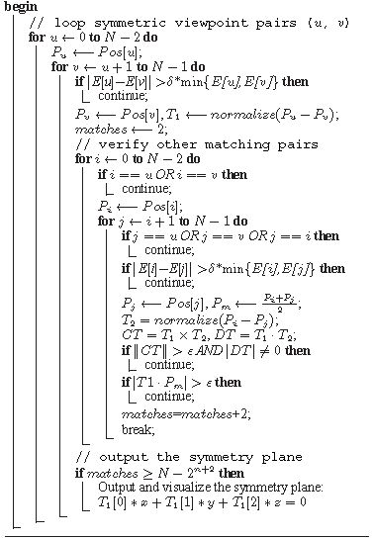
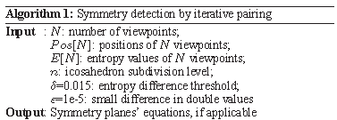
Step 3: Iterative Feature Pairing
Notes to the Algorithm 1
δ: a threshold controlling the strictness of symmetry definition
Smaller: strict symmetry
Larger: rough symmetry
||CT|| >ε AND |DT| ≠ 0:T₁ and T₂ is neither parallel nor perpendicular
P_{m}: the midpoint of the line segment connecting points P_{i} and P_{j}
Computational complexity: O(N⁴)

Slide 13
Experiments and Discussions
Evaluation w.r.t dataset-level performance
Time efficiency
Accuracy of symmetry planes
Symmetry planes detection rate
Evaluation w.r.t robustness
Robustness to view sampling
Robustness to number of vertices

Slide 14
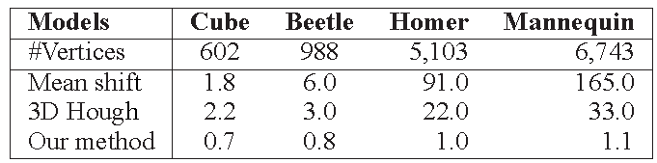
Time Efficiency
Compare ours with two state-of-the-art approaches
Mean shift [Mitra et al. 2006]
3D Hough [Cailliere et al. 2008]
Focus: change of the running time w.r.t the increase in #vertices
Finding: ours has better efficiency in terms of scalability to #vertices
Timing information (in seconds) comparison of our methods and other two state-of-the-art approaches

Slide 15
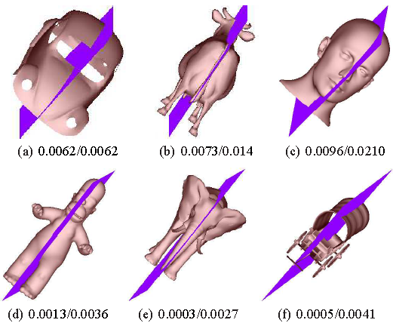
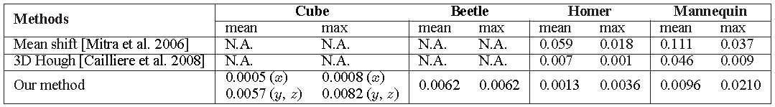
Symmetry Detection Accuracy
Symmetry detection results with mean/max error measures
Better accuracy than Mean Shift and 3D Hough
Symmetry detection results with mean/max error

Slide 16
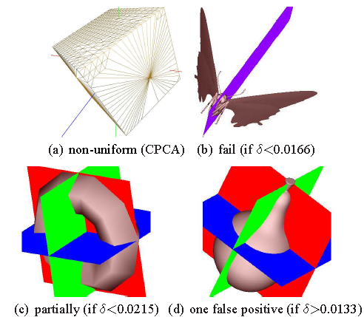
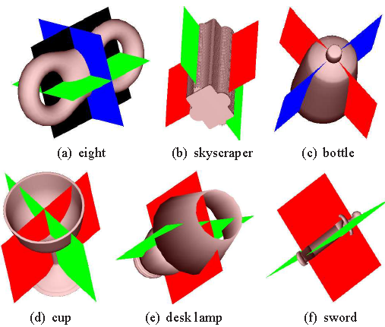
Multiple Symmetry Planes
Can detect multiple symmetry planes
E.g. Eight, Skyscraper, Bottle, Cup, Desk Lamp, and Sword
Some unsuccessful cases
Failed or partially failed examples
Example of multiple symmetry planes

Slide 17
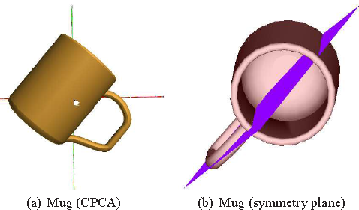
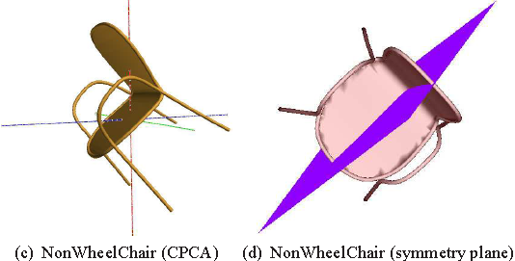
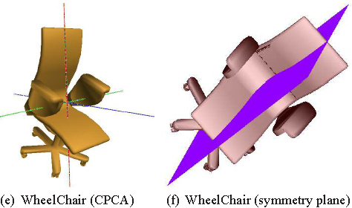
Symmetry Detection w.r.t CPCA Accuracy
Test CPCA alignment accuracy on symmetry detection
Successfully detect the symmetry planes even if the models cannot be perfectly aligned with CPCA
Detection rates for models that cannot be accurately aligned by CPCA: Mug: 7/8, NonWheelChair: 18/19, WheelChair: 6/7

Slide 18

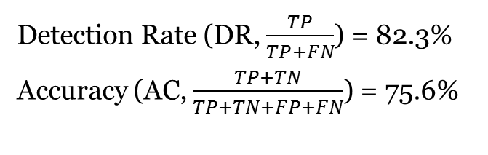
Symmetry Planes Detection Rate
Dataset-level symmetry detection performance
True Positive (TP): detect a symmetry plane of a symmetric model
False Positive (FP): detect a symmetry plane of an asymmetric model
True Negative (TN): do not detect any symmetry plane of an asymmetric model
False Negative (FN): fail to detect a symmetry plane of a symmetric model
Overall symmetry detection performance of our algorithm based on the first 200 models of the NIST benchmark
Detection Rate (DR, $\frac{TP}{TP+FN}$) = 82.3%
Accuracy (AC, $\frac{TP+TN}{TP+TN+FP+FN}$) = 75.6%

Slide 19
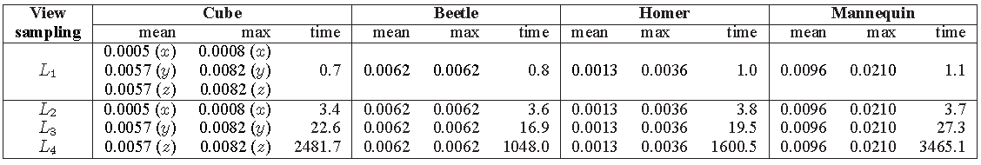
Robustness to View Sampling
Use different levels of subdivided icosahedron L_{n} for the view sampling
Increase the view sampling often cannot increase the accuracy
L₁: stable accuracy while significantly less time; so we adopt it
Mean/max errors and timing comparison of our algorithm with different view sampling

Slide 20
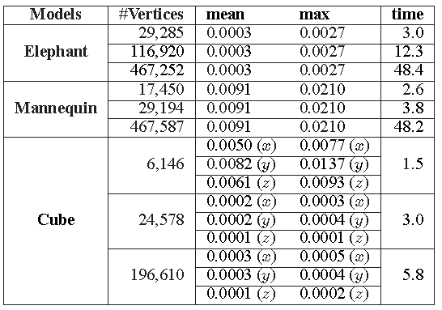
Robustness to Number of Vertices
Findings
Stably and accurately detect the symmetry planes
Increase in computational time is often significantly lower than the increase in the number of vertices
Mean/max errors and timings comparison w.r.t the robustness to different #vertices

Slide 21
Conclusions and Future Work
Conclusions
Symmetry in viewpoint entropy distribution corresponds to the symmetry of the 3D model
Propose an efficient and novel view-based symmetry detection method
Demonstrate a good performance in accuracy and efficiency
Validate good robustness, detection rate, and flexibility on a dataset level
Future work
Combine CPCA with Minimum Projection Area (MPA)
Develop an automatic and adaptive strategy to select an appropriate entropy difference threshold δ for respective models or classes
Apply our symmetry detection algorithm on
3D model alignment
Best view selection

Slide 22
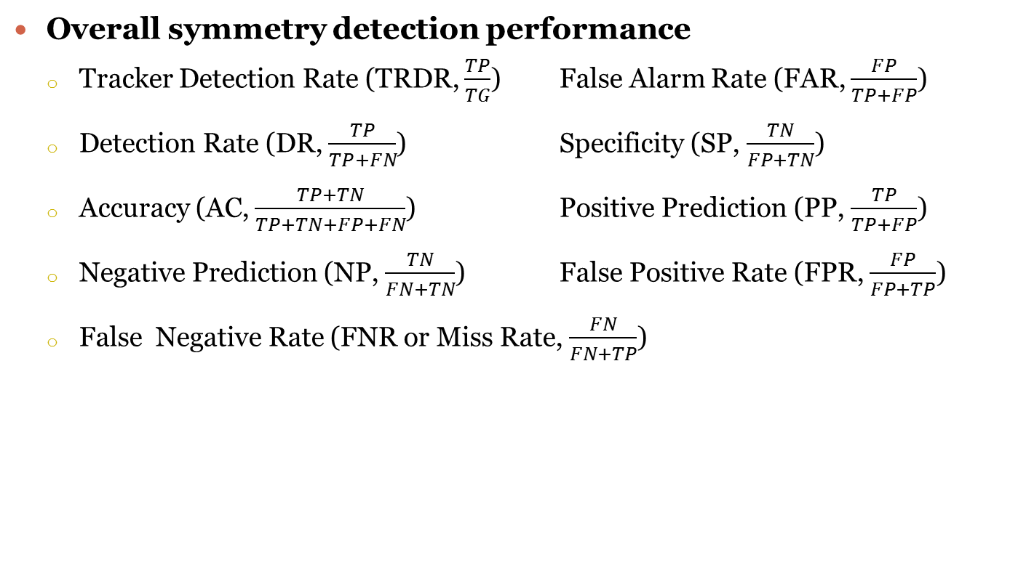
Symmetry Planes Detection Rate (Cont.)
Overall symmetry detection performance
Tracker Detection Rate (TRDR, $\frac{TP}{TG}$) False Alarm Rate (FAR, $\frac{FP}{TP+FP}$)
Detection Rate (DR, $\frac{TP}{TP+FN}$) Specificity (SP, $\frac{TN}{FP+TN}$)
Accuracy (AC, $\frac{TP+TN}{TP+TN+FP+FN}$) Positive Prediction (PP, $\frac{TP}{TP+FP}$)
Negative Prediction (NP, $\frac{TN}{FN+TN}$) False Positive Rate (FPR, $\frac{FP}{FP+TP}$)
False Negative Rate (FNR or Miss Rate, $\frac{FN}{FN+TP}$)
Overall symmetry detection accuracy of our algorithm based on the first 200 models of the NIST benchmark
Notes:
TG: total number of symmetry planes in the Ground Truth models.
TF: total number of detections (including both trues and falses) TF=TP+FP+TN+FN.

Slide 23
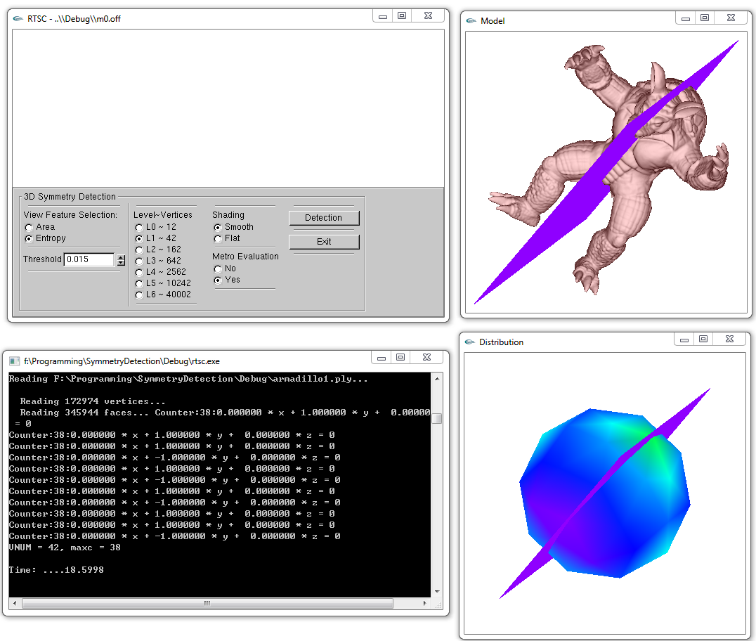
User Interface

