Slide 1
Loan Approval Prediction
AI for Engineers (UCS321) — MST Mini Project, Problem 5
[YOUR NAME] | [ROLL NUMBER]

Slide 2
Problem
Predict whether a bank approves or rejects a loan application.
Binary classification: Approved (1) vs Rejected (0).
Goal: build an accurate, honest, explainable model — and find out
which applicant features actually drive the decision.

Slide 3
Data
4,269 loan applications, 13 columns.
No missing values, no duplicate rows.
Features: income, loan amount, loan term, CIBIL (credit) score,
education, self-employment, 4 asset-value columns.
Target: loan_status — 62% Approved / 38% Rejected.

Slide 4
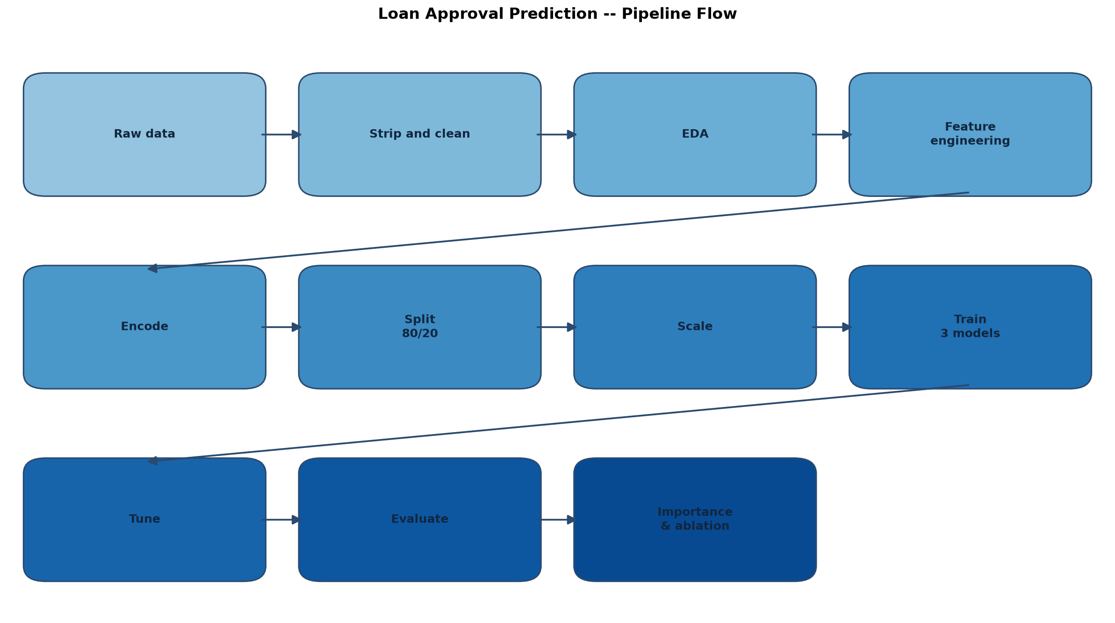
Pipeline Flow

Slide 5
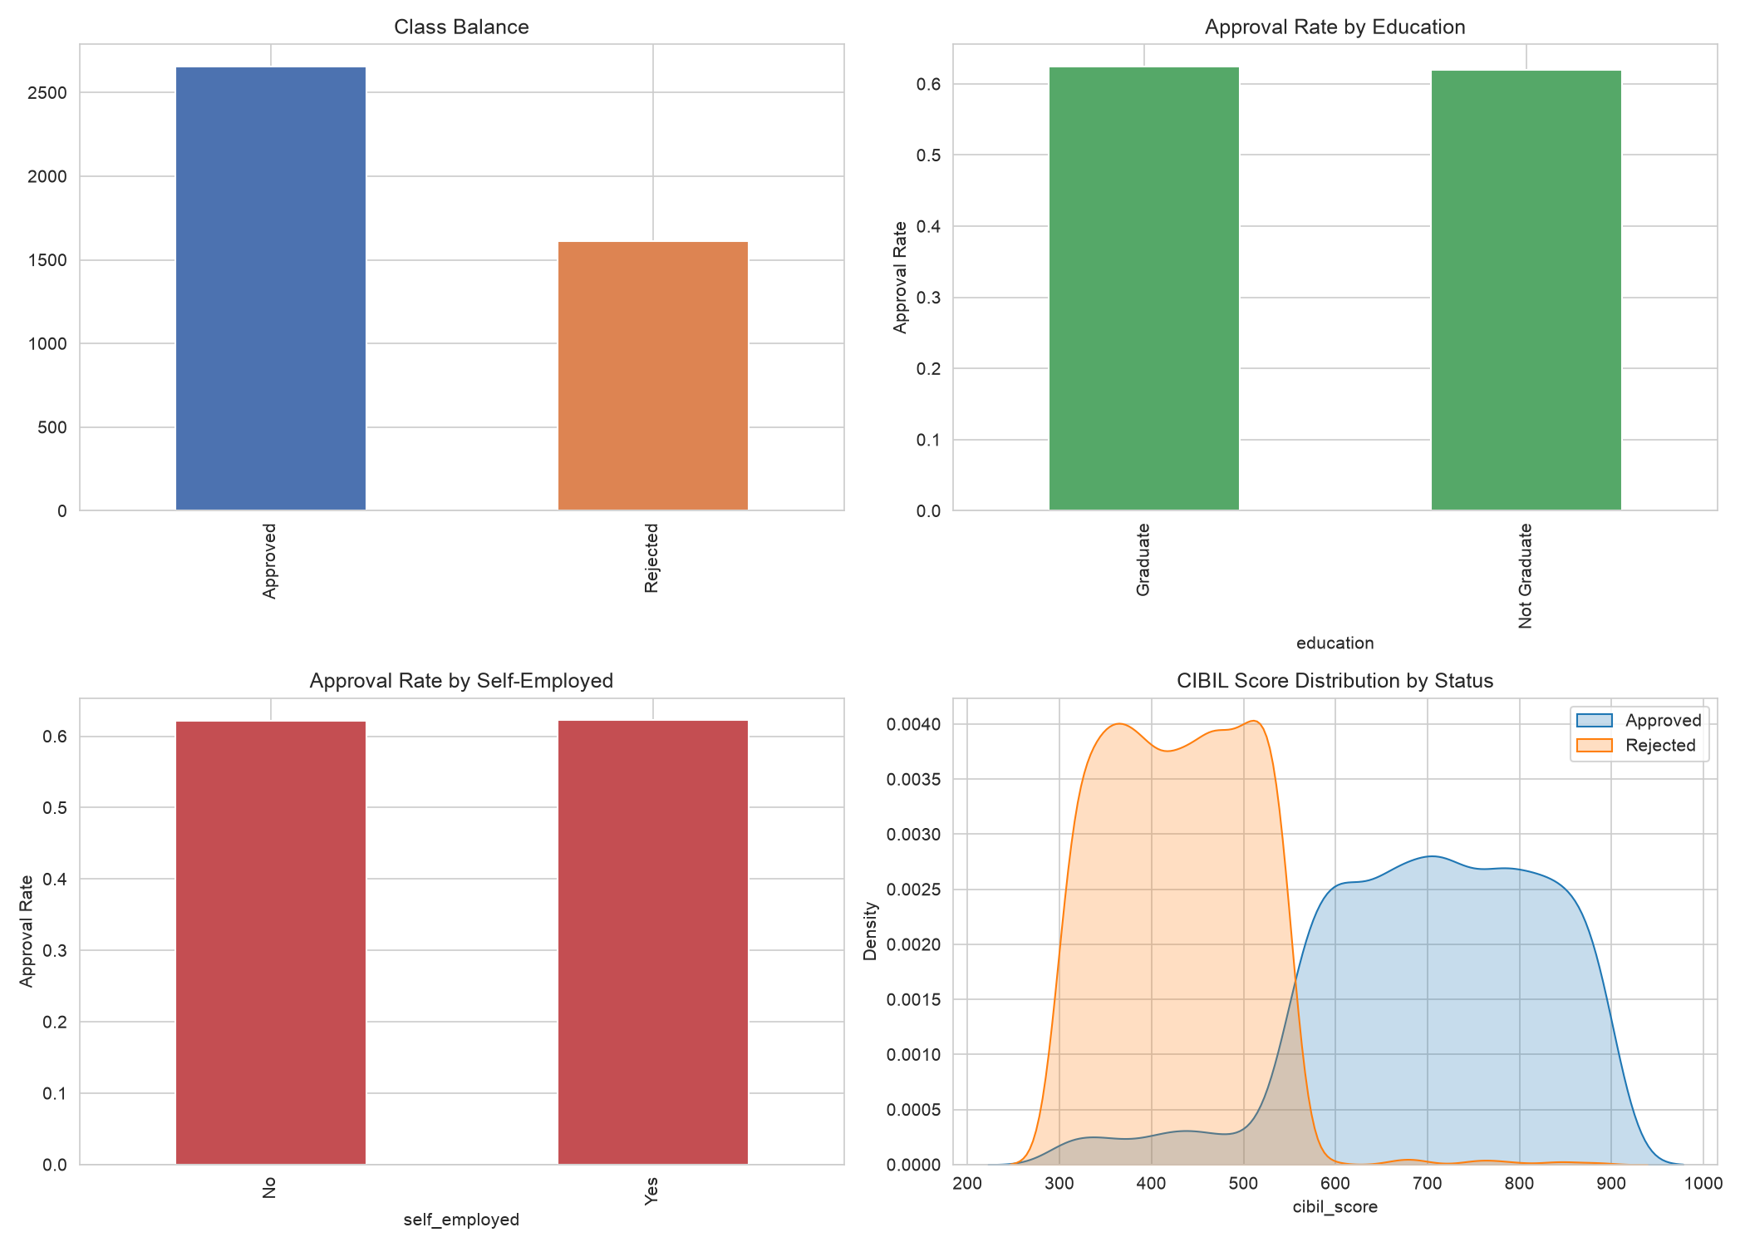
Exploratory Data Analysis

Slide 6
Models
Logistic Regression — simple, interpretable baseline.
Decision Tree (max_depth=4) — captures non-linear splits, explainable.
Random Forest (300 trees) — ensemble, tuned with GridSearchCV.
All trained in a Pipeline (StandardScaler + classifier), class_weight='balanced',
random_state=42 everywhere for reproducibility.

Slide 7
Results
Model | Test Acc | F1 | ROC-AUC
Logistic Regression | 0.9356 | 0.9470 | 0.9785
Decision Tree | 0.9988 | 0.9991 | 0.9985
Random Forest | 0.9977 | 0.9981 | 1.0000
Random Forest (tuned) | 0.9965 | 0.9972 | 1.0000
Honesty flag: accuracy > 95% — investigated, not hidden.
cibil_score alone (threshold rule) gets 95.4% accuracy.
Ablation: removing cibil_score drops F1 from 0.997 to 0.662 (-33.7%).

Slide 8
Conclusion
Best model: Decision Tree / tuned Random Forest (near-tied, F1 ≈ 0.997–0.999).
cibil_score is the dominant driver of approval — confirmed by two
independent importance methods and an ablation study.
Dataset is likely synthetic/simplified: near-deterministic score threshold.
Limits: no fairness audit, possible proxy bias via education/employment.
Future work: XGBoost, SMOTE, real bank data, formal fairness audit.

