Slide 1

Session 6: Skills for the Live
Educate the Educator
CyberStakes

Slide 2
Final Session Agenda
Overview of last year’s Live event
This year’s Live event
Feedback from instructors

Slide 3
Last Year’s Live Event in Numbers
6 events over 2.5 days
4 team events: teams of 3
Breaking Binaries (8h)
Cracking Crypto (8h)
Reversing (3h)
Attack/Defense (14h)
2 individual events
Lock-picking (heats of 7min/round)
The Bomb (head-to-head 10min/round)
27 Cadets and Midshipmen (9 from each academy)

Slide 4
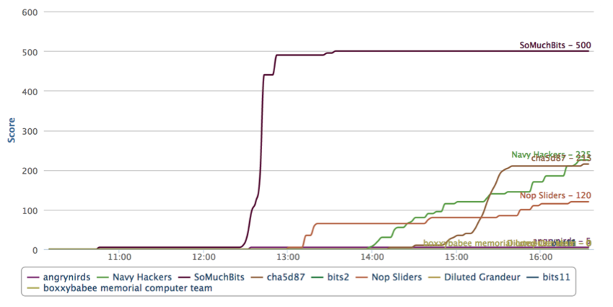
Event #1: Breaking Bin
Goal: Find as many crashing bugs and exploits as possible in over 1000 (real life) Linux binaries
Skills: Deploy fuzzers and build custom ones, practice exploits
Team | Accomplishments
Gold | 100 new bugs
Silver | 40 new bugs, 1 exploit
Bronze | 43 new bugs
Notes:
This year

Slide 5
Event #1: Breaking Bin
Skills. Every team should be able to:
Deploy fuzzing campaigns (peach, radamsa, etc)
Script and automate the fuzz-crash-submit cycle
Exploit local overflows
Exploit overflows with ROP
Notes:
Winners were the best at scripting and automation, not exploitation

Slide 6

Fuzzing
Fuzzing is a popular, simple and effective way to find bugs:
Ex: a movie
Seed file
Termin-ation
Fuzzer
Mutated Input
Program
Crash
Ex: a movie player
Ex: zzuf, Peach, BFF
Notes:
Free stock images from:
http://www.sxc.hu/photo/642736
http://www.123freevectors.com/ladybug-vector-image/#.UjsdJWR4ZfI

Slide 7
Fuzzers
Blind fuzzers
Examples: zzuf (fuzz backward), radamsa, etc
Readily available
Requires a seed input
Mostly hands-off; works by “randomly” mutating a seed
Protocol fuzzer
Example: peach
Requires a specification
Specialized application => less useful for CTF
Custom
“On-demand” (e.g., command line fuzzer shown)
Sometimes done in CTF on the fly

Slide 8
Fuzzers
Blind fuzzers
Examples: zzuf (fuzz backward), radamsa, etc
Readily available
Requires a seed input
Mostly hands-off; works by “randomly” mutating a seed
Protocol fuzzer
Example: peach
Requires a specification
Specialized application => less useful for CTF
Custom
“On-demand” (e.g., command line fuzzer shown)
Sometimes done in CTF on the fly
Please know how to fuzz a directory of programs for the Live event

Slide 9
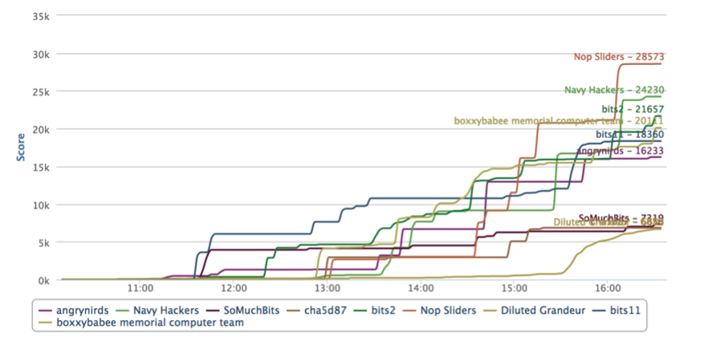
Event #2: Cracking Crypto
Goal: Given 6.5K password hashes, crack as many as possible
Skills: Cryptography, cracking, scheduling
Team | Accomplishments
Gold | 1316 passwords across 7 algorithms
Silver | 999 passwords across 7 algorithms
Bronze | 1503 passwords across 5 algorithms

Slide 10
Event #2: Cracking Crypto
Skills. Every team should be able to:
Customize and run hashcat / password cracking campaigns
Comprehend symmetric/asymmetric crypto concepts, modular arithmetic, discrete math
Script using a crypto library, automate submissions
Use an SMT solver
Resource management
Notes:
Winners were the best at scripting and automation.

Slide 11
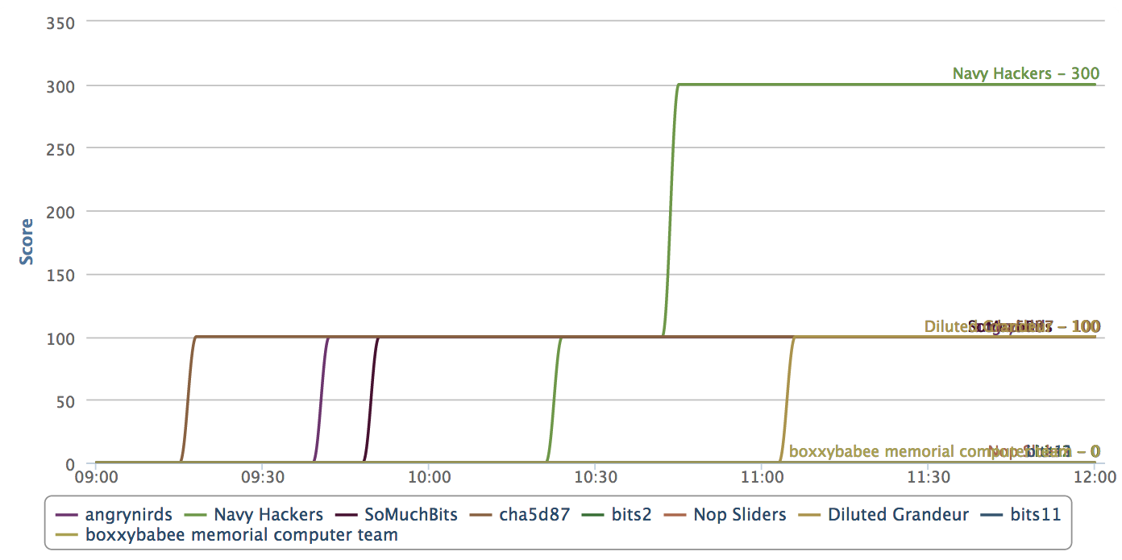
Event #3: Reversing Challenge
Goal: Given a set of binaries, find as many hidden keys as possible
Skills: Reversing, decompiling, debuggers, instrumentation tools
Team | Accomplishments
Gold | Cracked 2 binaries in 1h21min
Silver | Cracked 1 binary in 15min
Bronze | Cracked 1 binary in 39min

Slide 12
Event #3: Reversing Challenge
Skills. Every team should be able to:
Disassemble/read a binary
Handle bad disassembly (misaligned instructions, etc)
Understand the semantics of basic assembly instructions (or know where to find them)
Use runtime analysis tools, from debuggers to instrumentation tools
Reason about assembly generated from typical C/C++ programs

Slide 13
Event #4: The Bomb
Goal: Exploit a binary faster than an opponent (head-to-head) with 10min time limit
Skills: Rapid reversing and exploitation

Slide 14
Event #4: The Bomb
Skills. Every participant should be able to:
Perform basic reversing: objdump a binary, understand what the program does
Exploit standard buffer overflows
Quickly script an exploit payload

Slide 15
Event #5: Lock-Picking
Goal: Lock-pick 3 different locks within a time limit (7min per lock)
Skills: Lock-picking, security mindset
Exercise:
On more/different locks
Improve speed

Slide 16
Event #6: Attack/Defense CTF
Goal: Defend your system while attacking your adversary
Skills: Reversing, exploitation, patching
Strategy + Tactics

Slide 17
Strategy 0: Enable Defenses
When the competition begins, start up any available defenses
Idea: Enable NX/DEP: execstack –c <binary>
Caveat: make sure it does not break functionality

Slide 18
Strategy 1: Patch First
When you find a vulnerability, make sure you have it patched before you send the exploit over the wire
Caveat 1: Time spent patching could be time getting flags. Work on both fronts.
Caveat 2: Make sure your patch is in place (happened more than once last year)
Caveat 3: Be careful with “unconventional” patches

Slide 19
Strategy 2: Hide your Exploit
You just crafted an exploit. If you send it as is, it could be picked up by other teams.
Idea 1: Send decoy packets along with the real exploit
Caveat: they can still block your exploit by checking for “/bin/sh” or shellcode patterns
Idea 2: Hide your shellcode using encoders (metasploit comes with encoding tools)
Caveat: development time + size constraints
Idea 3: Send your exploit only to weaker teams that (you hope) will not pick up the exploit
Caveat: you may be losing valuable points by not getting flags from all teams.

Slide 20
Strategy 3: Persistence & Backdoors
Once you exploit a service, you are capable of running arbitrary commands (for a while). What should you run?
Idea 1: Keep a service running, connecting back regularly to get flags
Caveat: if the service goes down + patched at the same time, no alternative
Idea 2: Install a service that restarts periodically, e.g., crontab
Idea 3: Disrupt the functionality of the service to stop the defending team from scoring points
Caveat: the defendants will be more motivated to stop you
Idea 4: Have your backdoor submit flags – removes the burden of opening a connection back to your computer
Caveat: may be easier to identify/block

Slide 21
Strategy 4: Monitor Traffic
Other teams are sending you valuable attacks. Use them for offense and defense
Idea 1: Look for common patterns – unprotected shellcode in incoming packets
Caveat: encoders & decoys
Idea 2: Hook library calls (a la LD_PRELOAD) and identify suspicious patterns and block them or log them to identify the attack
Caveat: do not confuse with SLA traffic

Slide 22
Strategy 5: Reversing Attacks & Reflection
You just recovered an exploit from the wire. What to do?
Idea 1: do not run it in your server. No caveat
Idea 2: change IP addresses/ports and start sending it to other teams
Caveat: be careful you properly reflected
Idea 3: reverse it, identify what backdoors it installs, and remove them!
Caveat: time

Slide 23
Strategy 6: Vulturing & Disrupting Attacks
Use backdoors installed by others. Especially when unprotected
Idea 1: Perform nmap on others’ (and your own!) computers
Idea 2: Make sure you protect your backdoors (e.g., encrypt, password, don’t gzip ☺)
Caveat: only works if the backdoor needs to connect back to submit a flag
Idea 3: Try to disrupt the functionality of any backdoor listeners on opponents’ computers

Slide 24
Strategy 7: Cleaning up
Your service is compromised. Invest time in cleaning up
Idea 1: while true; do pkill –s 9 –u <serviceuser>; done is a primitive first step
Caveat: it will work only against non-weaponized exploits
Idea 2: Periodically check your system (e.g., read your crontab) and check for tricks
Idea 3: Reboot your computer. Silly, but stops a vast number of userland attacks
Caveat: all your services will have downtime

Slide 25
Strategy 8: Team Setup
You have three people per team. How do you put them together?
Idea 1: avoid putting all (example) reversing people in one team
Caveat: good in reversing, but other skills?
Idea 2: put together people that have experience working with each other

Slide 26
Event #6: Attack/Defense CTF
Skills. Every team should be able to:
Patch a vulnerable service
Clean up a compromised service
Field persistent exploits that cannot be easily stolen or reflected by other teams
Perform network monitoring to detect or prevent exploits
Script and work around changes to the environment or applied strategy

Slide 27
This Year’s Live Event
Events we are considering:
Attack/Defense CTF (team) – 12hours
Web CTF – part of attack defense (team)
Attack/Defense CTF (mixed) – 6hours
Breaking Bin (team)
Reversing Challenge (individual)
Rapid Exploitation (individual)
Network forensics (team)
Host forensics (team)
Lock-Picking (individual)

Slide 28
Feedback?

Slide 29
Hands-on

Slide 30
inp=`perl –e '{print "A"x8000}'`
for program in /usr/bin/*; do
for opt in {a..z} {A..Z}; do
timeout –s 9 1s $program -$opt $inp
done
done
1009 Linux programs. 13 minutes. 52 new bugs in 29 programs.

Slide 31
END

