Slide 1

Binary Patching
Educate the Educator
CyberStakes

Slide 2
Goal of Binary Patching
Given a program P
generate a new program P’
without access to the source code
such that P’ has slightly different behavior
0101011011010010001011100010
0101011010010010001011100010

Slide 3
Tools
Disassembler (IDA is my favorite)
Hex-editor (010editor is my favorite)
Assembler
online tools for standard platforms (x86, ARM, etc.)
online documentation [and patience] for non-standard ones (Java, Python, etc.)

Slide 4
Difficulties
Cannot:
change the size of the program
introduce new complex behavior
Can
overwrite instructions
change constants

Slide 5
Common Scenarios
Anti anti-debugging
e.g., removing ptrace calls, changing conditional jumps
Making exploit development easier
e.g., making a forking server single threaded
Patching vulnerabilities
correcting bad behavior for services you must run

Slide 6
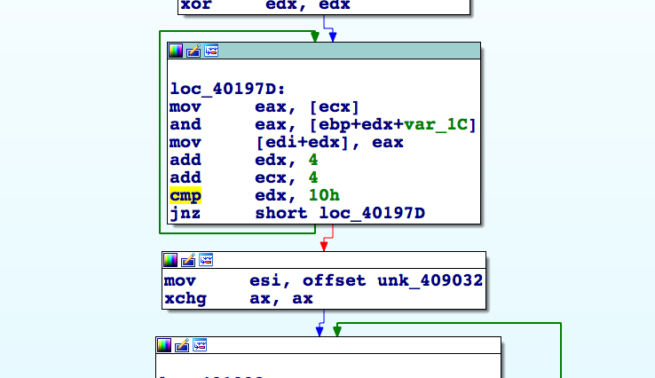
Workflow
select instruction

Slide 7
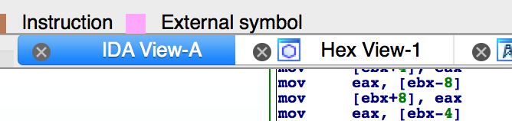
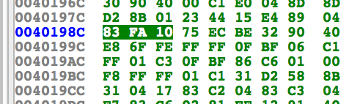
Workflow
opcodes will be highlighted

Slide 8
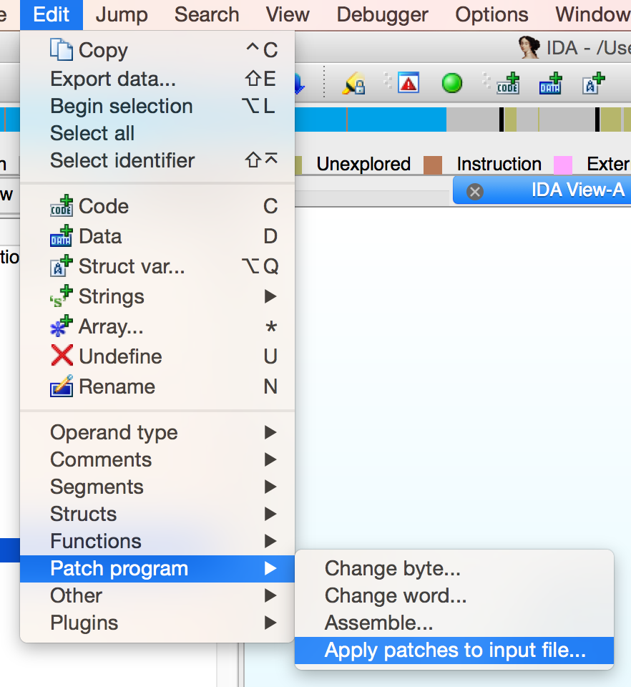
Workflow
Press F2, manually change, press F2 again; apply patches
Search for bytes in hex editor and modify
For x86, IDA does offer an assemble function. But it is experimental!

Slide 9
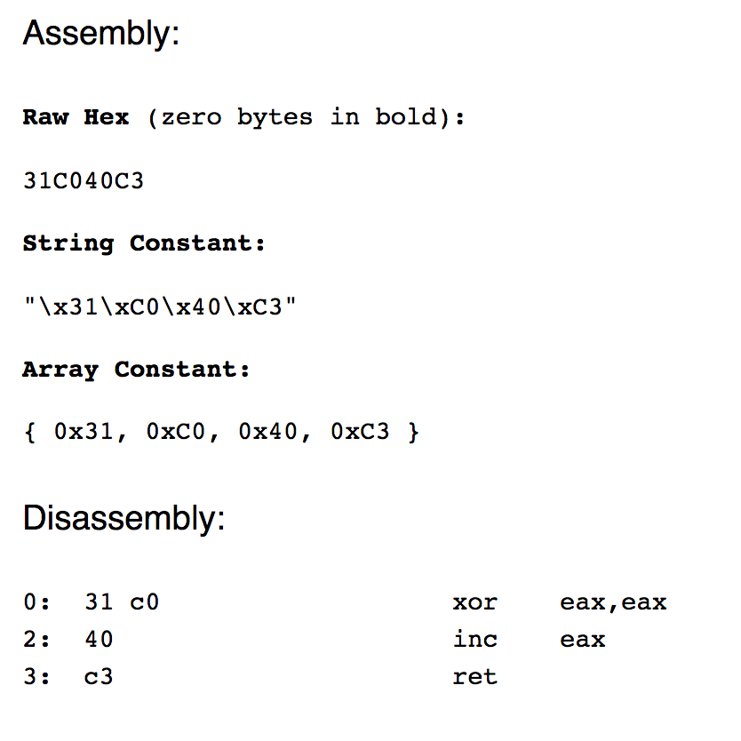
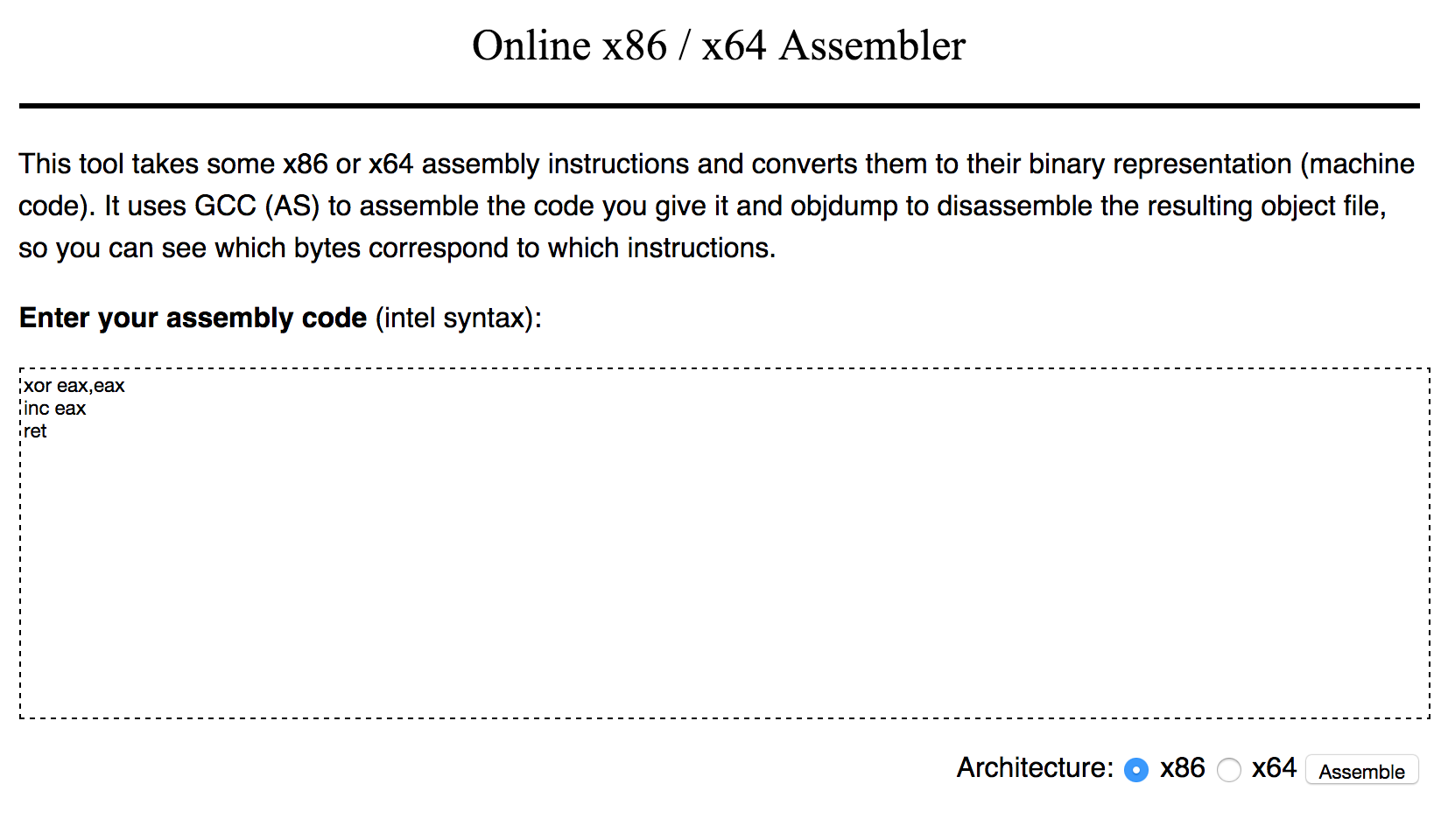
Workflow
https://defuse.ca/online-x86-assembler.htm

Slide 10
LD_PRELOAD
Allows hooking of library functions in Linux
Complex functionality can be introduced
Used primarily for defensive patching
eg. makeshift IPS on read calls in binary
Won’t work for statically compiled binaries
but Intel’s PIN can potentially be used

Slide 11
LD_PRELOAD
Simple example:
ld.c: int sleep(int n) { return 0; }
gcc -shared -ldl -fPIC ld.c -o ld.so
LD_PRELOAD=./ld.so ./original_binary
Can rewrite behavior of any external function (eg. sleep, read, malloc)

Slide 12
Questions?

Slide 13
END

