Slide 1
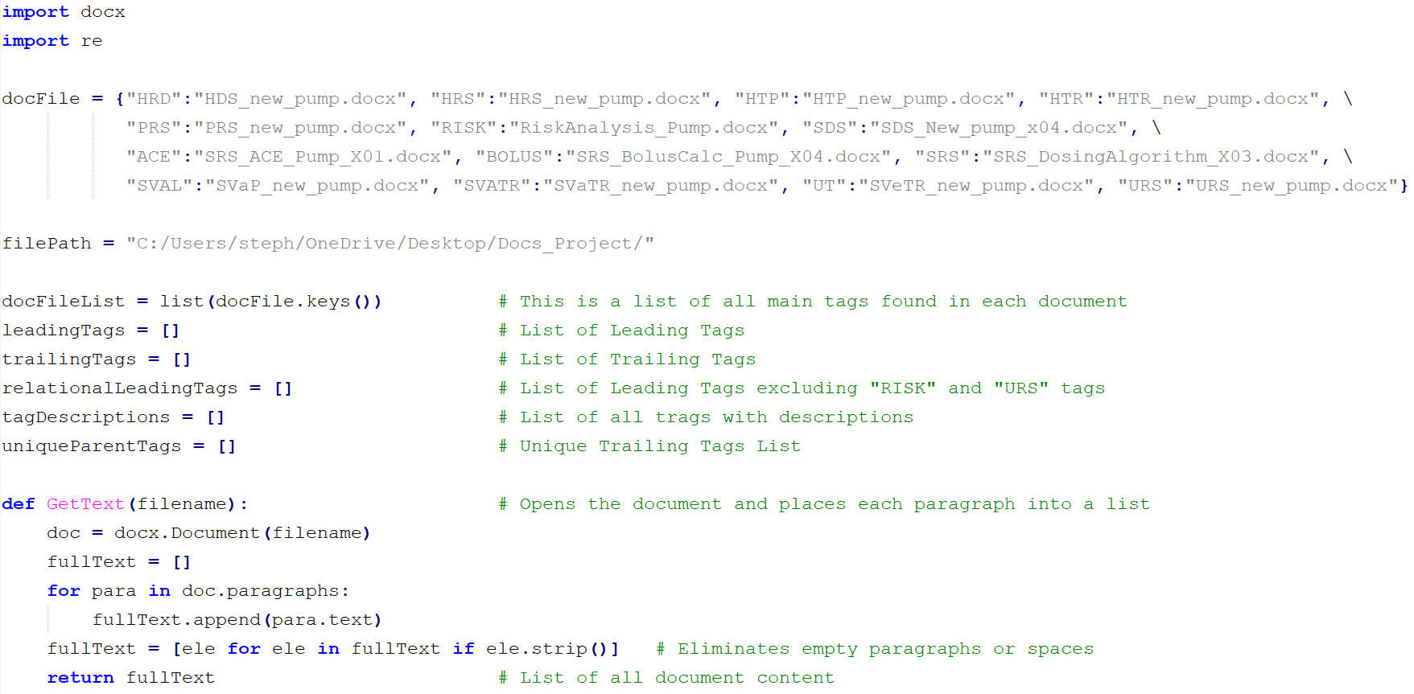
Dictionary containing all tags and documents where they can be found
This section will be replaced by a function that reads information in from an external file.

Slide 2
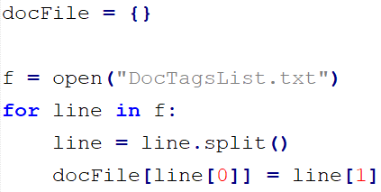
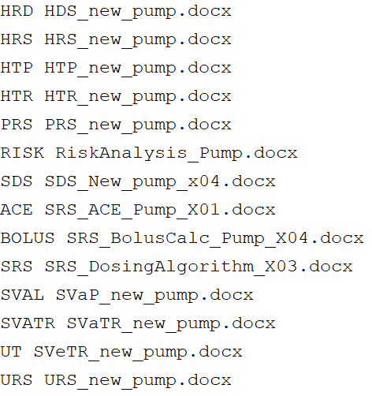
Dictionary Replacement code
The dictionary above is replaced by the code snippet below that reads values from a text file
DocTagsList.txt content
Splits each line into a list and uses the first index as a key and the second index as a value for the dictionary docFile

Slide 3
Creates a list of all tags found in the docFile dictionary used to verify valid tags

Slide 4
These are lists used in functions below to hold different tags and tag descriptions

Slide 5
Function that reads a document and returns a list containing each line of text

Slide 6
List comprehension used to strip empty string data

Slide 7
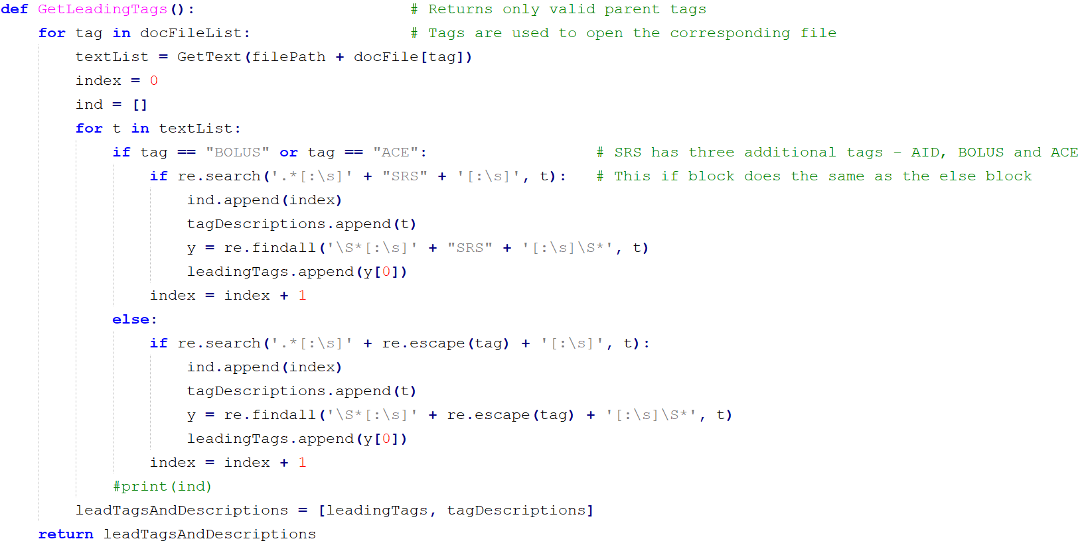
Iterates through list of all tags

Slide 8
Uses tag as key to access corresponding document value from the docFile dictionary

Slide 9
Iterates through the list returned by GetText( ) function containing line text

Slide 10
The SRS tag has 3 subtags (AID, BOLUS and ACE). The if statement runs only when BOLUS and ACE are found

Slide 11
These two blocks of code are identical except that one looks for SRS:BOLUS and SRS:ACE and the other looks for any tag

Slide 12
Does a regular expression search for a pattern starting with characters followed by either a colon or space, followed by the SRS tag, and followed by a colon or space.

Slide 13
Adds the index to the ind list for the tag used in the search pattern in the textList.

Slide 14
Adds the leading tag with description corresponding trailing tags to the tagDescription list

Slide 15
The findall( ) function returns the pattern to be searched

Slide 16
The pattern should match a non-whitespace character, followed by either a space or a colon, followed by the tag name, followed by a space or a colon and ending in a non-whitespace character.
A non-whitespace character is any letters of symbols that is not a space. The search stops when it sees a space.

Slide 17
Pulls the element out of the list by using y[0] and appends the leading tag found to the leadingTags list.

Slide 18
Creates a composite list (two lists in one) containing both the leading tags and corresponding tag descriptions and returns them.

Slide 19
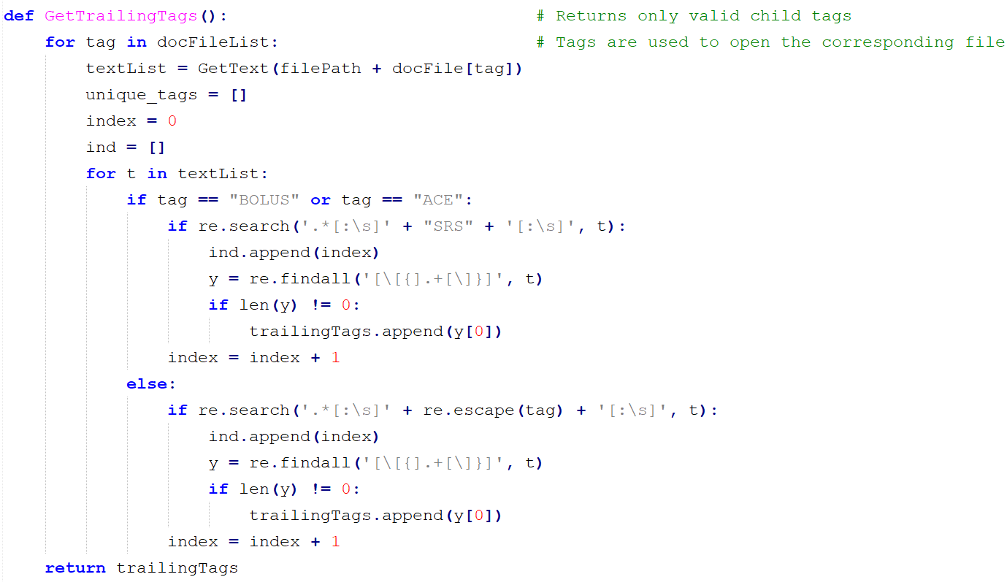
This function goes through the exact same process as the GetLeadingTags document with slight changes.

Slide 20
The pattern search starts with either a bracket of curly brace, followed by any number of characters, and ending with either a bracket or curly brace.

Slide 21
The trailing tags found get added to the trailingTags list and returned by the function

Slide 22
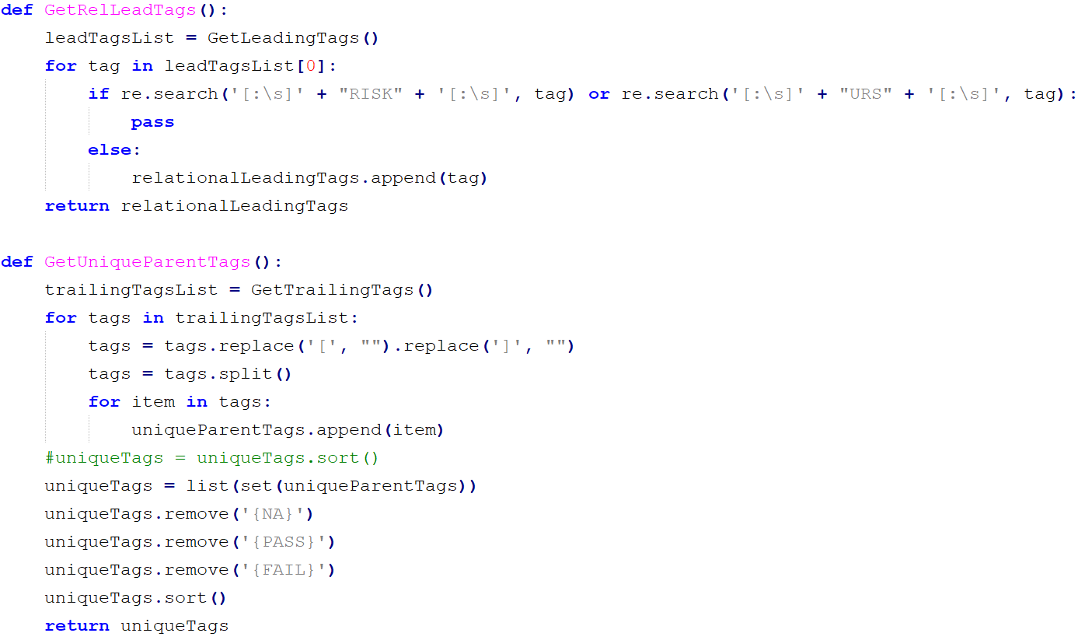
This function creates a Leading Tags list but excludes the RISK and URS tags because they do not have any parent tags associated with them.

Slide 23
This function calls the GetLeadingTags function and saves the list of Leading tags to the leadTagsList list.

Slide 24
This line searches the RISK and URS tags and excludes them from being saved into the relationalLeadingTags list.

Slide 25
This function creates a unique list of all the trailing tags found

Slide 26
This function calls the GetTailingTags( ) function and stores the trailing tags into the tralingTagsList

Slide 27
Iterates through all the trailing tags and deletes the opening and closing brackets.

Slide 28
This splits the tags into individual tags entries if there are multiple tags found

Slide 29
Saves each item into a separate list named uniqueParentTags

Slide 30
Uses the set( ) method to eliminate all duplicate tags.

Slide 31
Deletes NA, PASS and FAIL from the tags list

Slide 32
Sorts and returns the list in alphabetical order

Slide 33
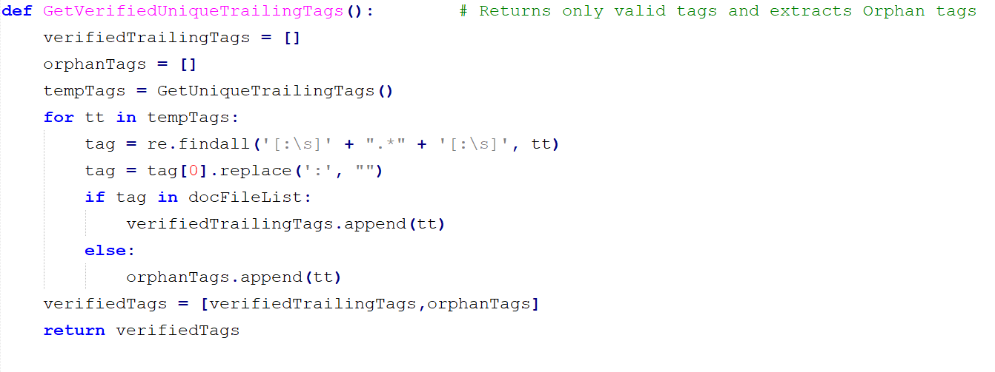
Calls sorted unique trailing tags list

Slide 34
Gets tag string from list and deletes colons from each end.

Slide 35
Checks each tag against a valid list named docFileList and adds the valid tags to a list otherwise appends the tags to and orphan tag list
Returns both the verified tags list and orphan list

