Slide 1
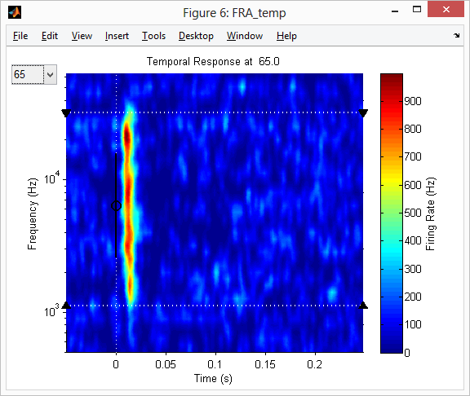
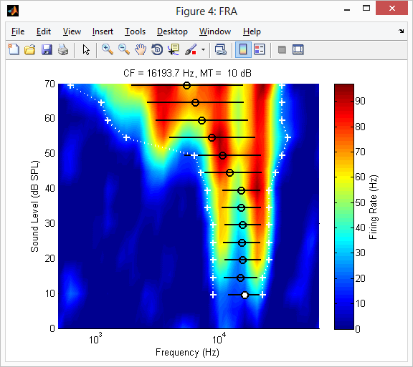
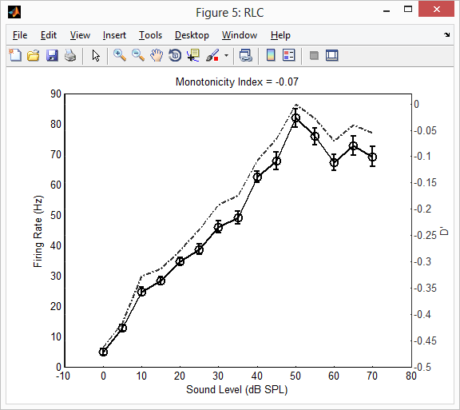
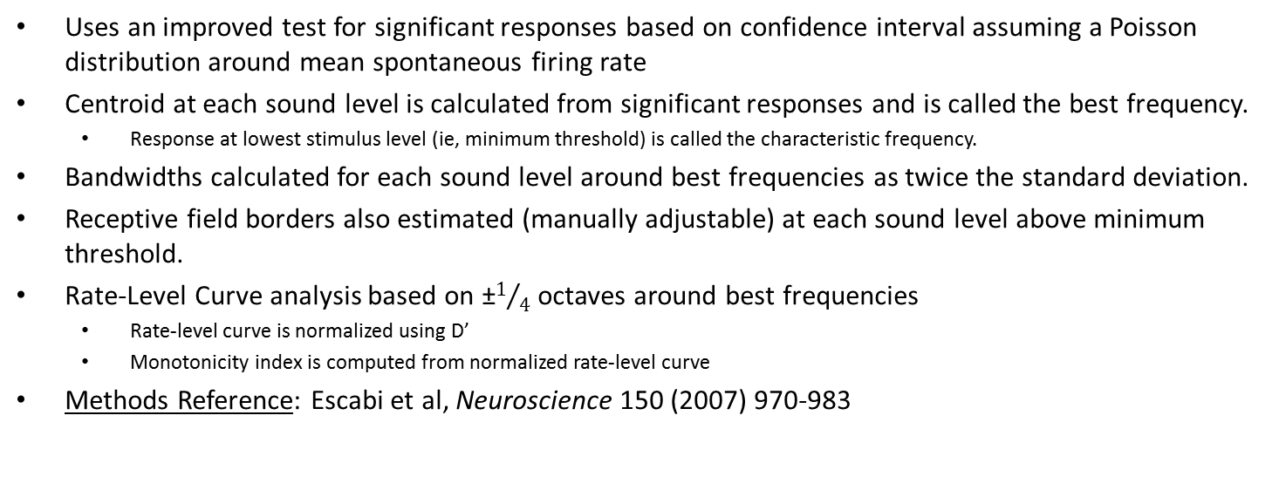
DB_FRA_Analysis_GUI
Uses an improved test for significant responses based on confidence interval assuming a Poisson distribution around mean spontaneous firing rate
Centroid at each sound level is calculated from significant responses and is called the best frequency.
Response at lowest stimulus level (ie, minimum threshold) is called the characteristic frequency.
Bandwidths calculated for each sound level around best frequencies as twice the standard deviation.
Receptive field borders also estimated (manually adjustable) at each sound level above minimum threshold.
Rate-Level Curve analysis based on ±$1/4$ octaves around best frequencies
Rate-level curve is normalized using D’
Monotonicity index is computed from normalized rate-level curve
Methods Reference: Escabi et al, Neuroscience 150 (2007) 970-983
Stolzberg 2014

Slide 2
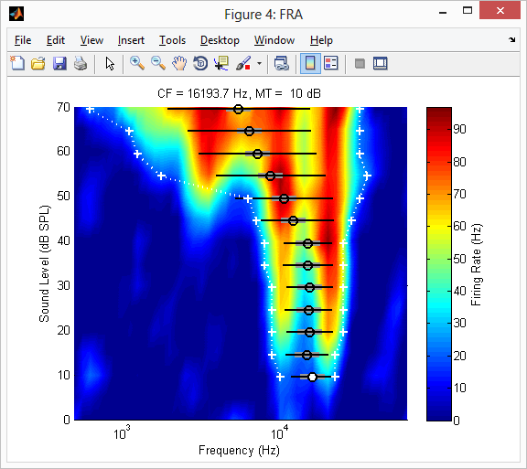
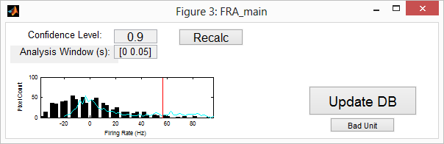
GUIs
FRA Analysis Results
Control Window
Rate-Level Curve and Monotonicity Index
FRA Temporal Response

Slide 3
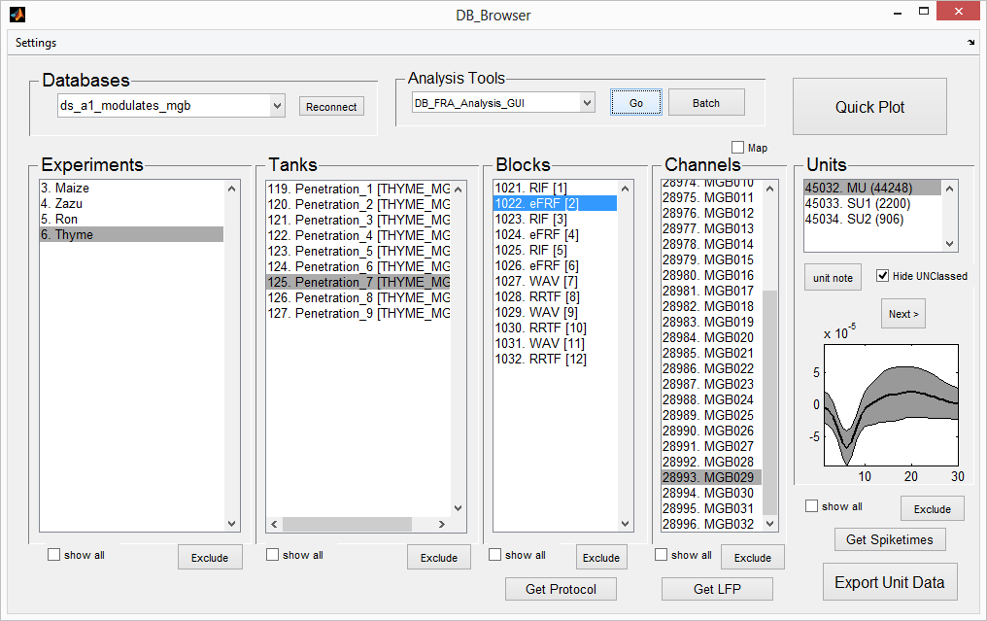
Use DB_Browser to locate unit for analysis
Add “DB_FRA_Analysis_GUI” to “Analysis Tools”
Click “Settings” -> “Analysis Tools”
Click “Add Tool”
Enter “DB_FRA_Analysis_GUI” (without quotes)
Select protocol from “Available” list and click “Add >>”
Click “Done”
The block may need to be reselected in DB_Browser
DB_FRA_Analysis_GUI should be available in the drop-down list in Analysis Tools

Slide 4
Control Window
Recompute FRA analysis based on confidence level and analysis window.
Note: any manual adjustments will be discarded.
Window to compute mean firing rate
relative to stimulus onset.
Must have 2 values.
0.0 < value < 1.0
Click to update unit_properties table on database with analysis results (including any manual adjustments)
Distribution of spontaneous firing rates (black bars)
Distribution of FRA firing rates (cyan line)
Click to update unit_properties table on database indicating displayed unit is not good. No other values are updated.

Slide 5
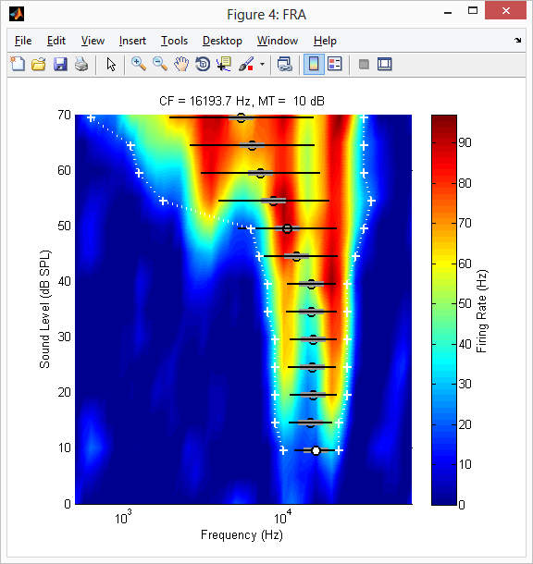
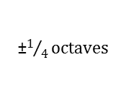
FRA analysis
FRA is computed by taking mean firing rate over analysis window (set in control window) and smoothing using a Savitzky-Golay filter over both dimensions.
Clicking on FRA plot will adjust minimum threshold and recompute features
Note: minimum threshold can only be adjusted to a higher level
Uses the function: FRA_Analysis to compute features
Best Frequency (centriod)
white-filled is characteristic frequency/minimum threshold
Bandwidth = 2∙σ
±$1/4octaves$
Adjustable frequency bandwidth range

Slide 6
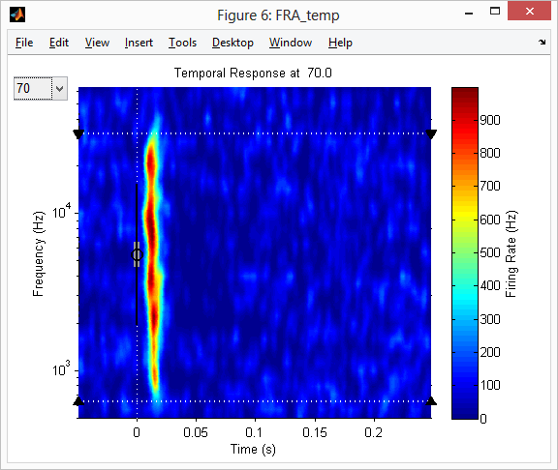
Temporal response map
Plots slice of FRA map at one sound level against time
Clicking on FRA plot will adjust high or low frequency borders
Procedure:
Data is binned at each frequency
Bins are divided by bin size (1 ms) and number of stimulus repetitions to compute mean firing rate
Mean firing rate map is smoothed with a 2 dimensional gaussian kernel (5 freq x 10 ms) and rescaled
Select intensity level to display
Same measures as FRA plot
Stimulus onset

Slide 7
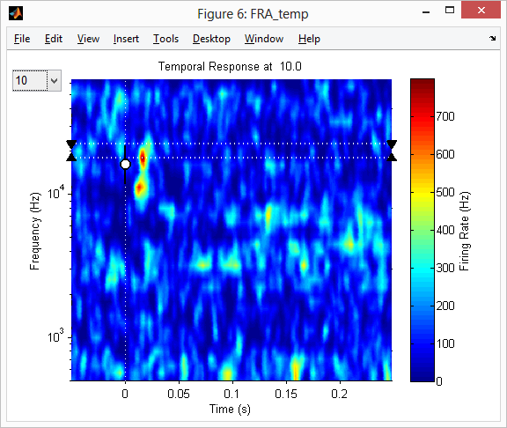
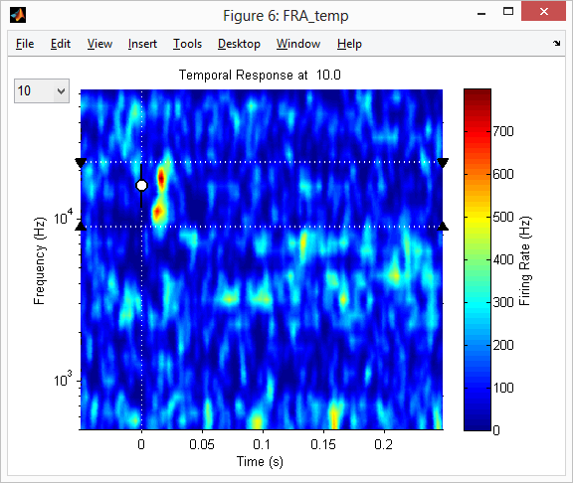

Manually adjusting receptive field borders
Clicking temporal response will adjust both this plot and FRA plot
Automated analysis
Manually adjusted analysis

Slide 8

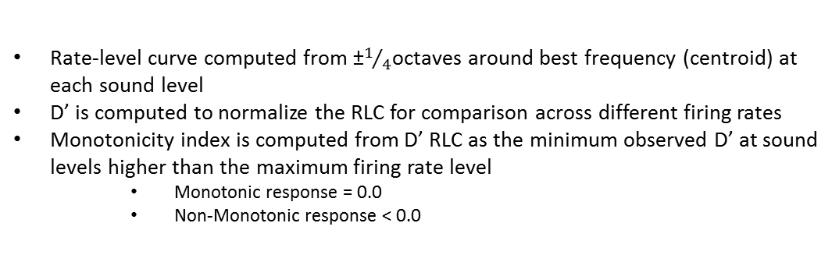
Rate-Level Curve
Rate-level curve computed from ±$1/4$octaves around best frequency (centroid) at each sound level
D’ is computed to normalize the RLC for comparison across different firing rates
Monotonicity index is computed from D’ RLC as the minimum observed D’ at sound levels higher than the maximum firing rate level
Monotonic response = 0.0
Non-Monotonic response < 0.0
Normalized with D’
Mean firing rate
±standard error of the mean

