Slide 1
LAKAZ
Notice. Respond.
Bring home.
A band, a home beacon and an app for families
caring for older relatives in Mauritius.
1
Notes:
Our first user is a family carer supporting an older relative who lives independently and may wander or need help. The wearer may struggle with a smartphone. LAKAZ means home in Kreol. The prototype does not diagnose conditions or dispatch emergency services. Life Powered by Tech, Middlesex University Mauritius, 13–14 November 2026.
Source: supplied LAKAZ pitch brief, 14 November 2026. Demo identities are fictional.

Slide 2
SOS, departure and return
Needs help
→
Left home
→
Help coming
→
At home
Double-click for help. Leave home. Return safely.
Alerts and popups show the event and its server time.
Home shows how long the wearer has been away.
PHONE GPS STAND-IN
Phone GPS + Wi-Fi/hotspot power the demo.
2
Notes:
The band uses BLE signal strength thresholds and delays to detect departure and return. Double click sends help_requested. Events go via HTTPS to Supabase, with retries reusing their event IDs. Home uses red for help, amber for away, blue for acknowledged and green for safe. Walk away with band and GPS phone, then return. GPS is provided by a phone carried alongside the band, through a laptop server. A production band would need its own connectivity and GPS.
Source: supplied LAKAZ pitch brief, 14 November 2026. Demo identities are fictional.

Slide 3
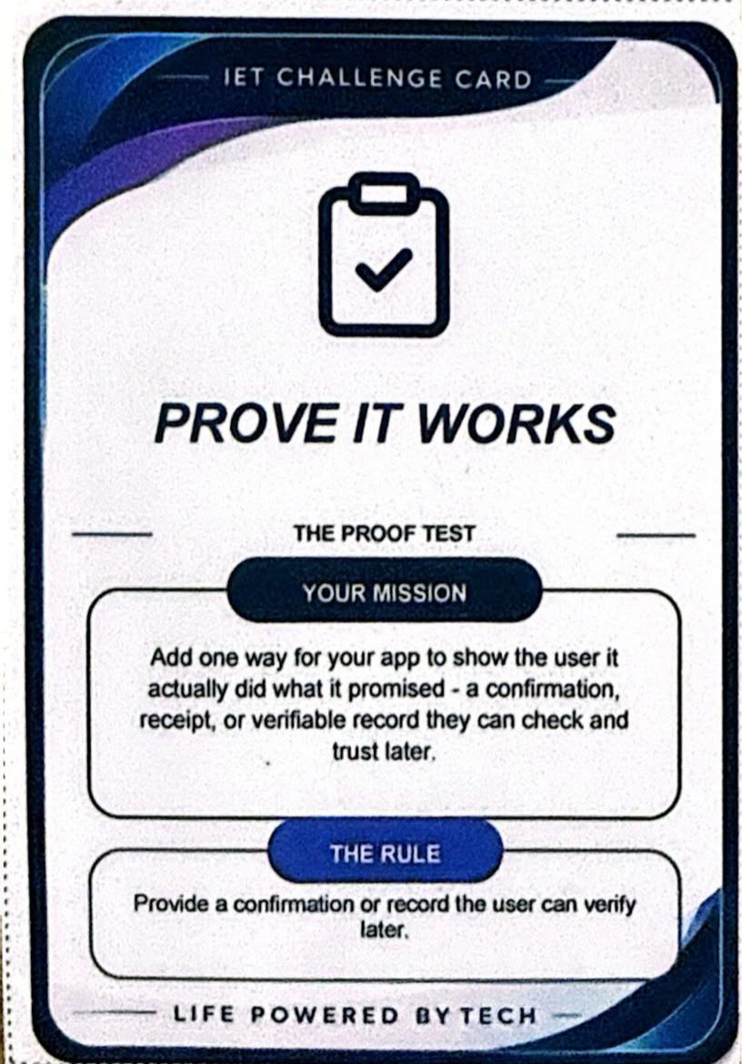
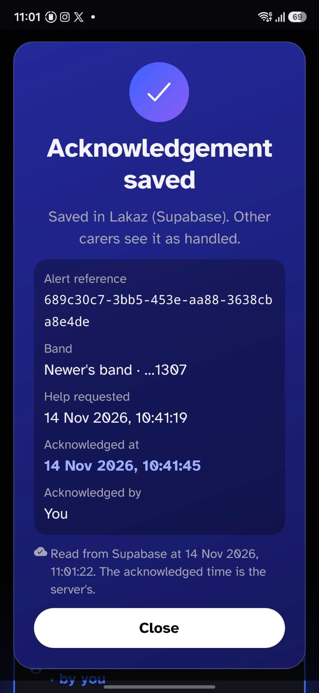
The surprise card — Prove It Works
The card
Provide a record the user
can verify later.
Our proof
Acknowledge → refresh → reopen.
The saved time stays the same.
3
Notes:
Judge line: After we drew the Prove It Works card, we added a receipt the carer can open after acknowledging a help alert. It shows which alert they acknowledged and when. We will refresh Lakaz and reopen the same receipt so you can see the acknowledgement was saved. The server keeps the first acknowledgement. Resolve the incident with She is safe after checking on the wearer. Device credentials stay separate from carer login and row-level security restricts linked bands.
Source: supplied LAKAZ pitch brief, 14 November 2026. Demo identities are fictional.

Slide 4
Mauritian data. Three languages.
169
English
Français
Kreol Morisien
health facilities · 9 districts
Filter the official directory
by district.
Switch language in Profile.
4
Notes:
Find a health facility uses the Open Data Mauritius dataset from the Mauritius Digital Promotion Agency, CC BY-SA 4.0, portal updated 30 September 2024. Supplied counts are 169 facilities in nine districts. Checked examples include Moka 14, Plaines Wilhems 32 and Flacq 30. Source https://data.govmu.org/dataset/locations-hospitals-clinics-medi-clinics-area-health-centres-and-community-health-centres . The directory is read-only for signed-in carers. Explain large text and accessible controls. All three languages are available in the app.
Source: supplied LAKAZ pitch brief, 14 November 2026. Demo identities are fictional.

Slide 5
Family response and escalation
Working today
Linked carers acknowledge alerts and close incidents.
SAMPLE
Primary carer → another carer → verified responders
5
Notes:
Automatic timed escalation and closed-app push remain planned. The sample ladder demonstrates passing an unanswered alert to another carer and then verified community responders. Today alerts appear while the app is open. The core demo includes creating an account, Add a person with band code LKZ-1307, Home with prepared fresh history, SOS, receipt persistence, departure/return, phone GPS and facility lookup. Rehearse the account and band setup in advance.
Source: supplied LAKAZ pitch brief, 14 November 2026. Demo identities are fictional.

Slide 6
What comes next
Finding and supporting
Band and voice features
Family and friends’ safe zones
Community responder network
Unusual movement detection
Safe-route monitoring
Skin detection
Heart-rate sensor
AI voice assistance
6
Notes:
All seven items are roadmap proposals. Safe zones currently have sample screens. Movement detection and route monitoring need reliable location and agreed rules. Skin detection explores whether the band is worn. Heart-rate sensing needs suitable hardware and validation, with no diagnostic claims. AI voice assistance could guide users in the three languages. Proposed rollout is a small family pilot through a care organisation in Mauritius. Possible operators include home-care agencies or NGOs. Kit, cellular and backend costs still need estimation; no figures were supplied. Team: Fahim and Zuhayr app; Shihad and Inshiraah backend; Kavish hardware. ESP32, Supabase and Expo/React Native/TypeScript. AI tools disclosed include Codex, Claude Code and Gemini.
Source: supplied LAKAZ pitch brief, 14 November 2026. Demo identities are fictional.

