Slide 1

Modern & Personal Communication Solution
No message left behind

Slide 2
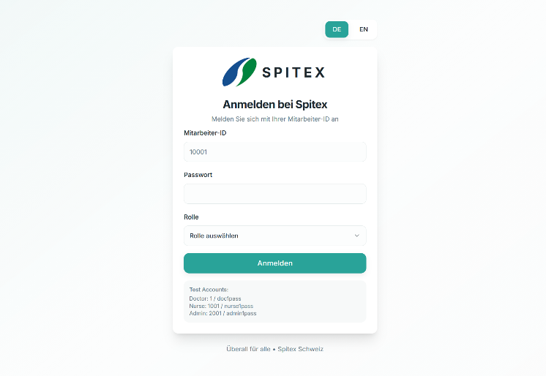
Role-Based Authentification
Spitex personnel
Family Doctors
Admininstration

Slide 3
Easy Patient Overview
1
Name/Address
displayed for quick access
2
Current patient conditions
Individualized approach
3
Only staff/doctors assigned to the patient
Protecting the Patient’s privacy
4
Visible and managed request
from Doctors/Nurses
From and to each Doctor and Care Giver

Slide 4
E-Mail Converting
Letter is received
Nurse sees message and attached files
Workflow
Simplified
Dr. sends E-Mail
Converts & Sends as a chat message

Slide 5
Chat Features
Information Channels
To-Do Tracking System
Private chat for Care Givers with each Patient/Doctor combination
The request have a due date and completion status
Easy File Sharing
Templates For Files Creation
Files can be easily attached and sent in chat
Nurses can easily create .xlsx/.txt/.pdf
Files via template in chat
Importance Markers
Individual Central Data Storage
Every request can be marked as urgent or not
All sent files in chat are accessible in personalized for each client storage

