Slide 1
Terrarium Simulation
Inspiration
• The behaviour of ant colonies
• The predator-and-prey videos shown in class
What will be modeled
• Agent reproduction and death
• Agent generation based on need
• Resource competition
• Survival behaviour
• Pathfinding
• Per-agent behaviour triggered by environmental hints
This will be achieved through use of multiple agent classes, some of which will be described today. (Questions welcome)

Slide 2
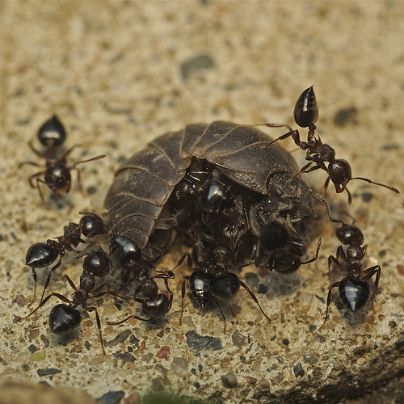
Workers
Workers are key to the model. They provide a supporting role for all other agents in the system.
Workers are responsible for
gathering resources (food and
water), which are necessary for
the survival and growth of their
colonies.
However, they are also the primary
food of some of the other agents in
the system, making their behaviour
and numbers critical to achievng a
sustainable ecosystem.
imarsman.blogspot.com

Slide 3
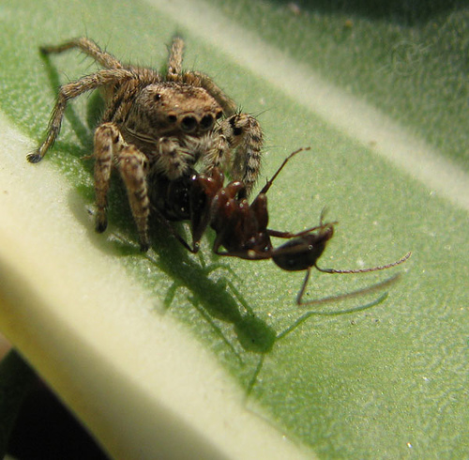
Threats
Threats are a means of keeping the ant-like colonies from expanding unchecked. They also drive emergent patterns.
Threats have only one goal:
consuming the ant-like agents so
that they may reproduce.
There are a few variants planned,
and each one will be uniquely
configurable, meaning that they
can be used to simulate natural
selection.
Primarily, though, they will cause
disruptions in the behaviour of
workers, prompting yet another
agent class to act.
flickr.com/photos/anuragbhateja/2049688530/

Slide 4
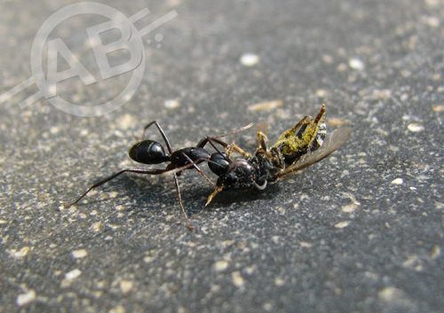
Warriors
Warriors exist to protect workers. They do this by scaring away threats. They also repel other colonies' workers, creating territories and borders of sorts within the system.
Warriors respond to
perceived threats and
attacks on their colony-
mates.
They will gravitate towards
where they are needed,
which will refocus the
flow of the system
dynamically, and cause
dramatic patterns to emerge.
flickr.com/photos/anuragbhateja/2014812599/

Slide 5
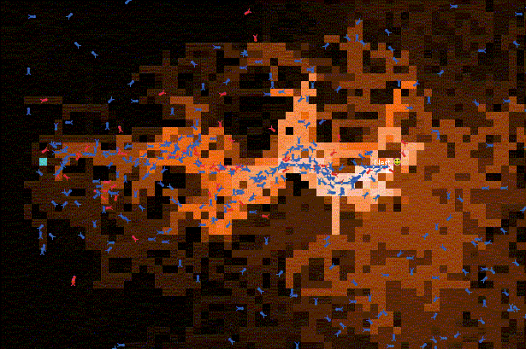
Pheromones
Pheromones will be used to allow agents to communicate information about the environment in a vague manner.
The pheromone
map will carry
information about
food, water, and
danger.
To complicate
matters a little,
some threats will
read and write to
the map to better
trap their prey.
it.uu.se/edu/course/homepage/ai/

Slide 6
Summary
  This project will focus on interactions between agents.
Eventually, the system should reach a point at which a stable ecosystem forms, given sane parameters. (Insane ones will be just as attention-worthy, though)
Over time, populations will become distributed and concentrated in a manner suited to the needs of their colonies.
The goal of this project is to inspire future work and provide a better understanding of emergent concepts, rather than directly further the pool of existing research.
See http://hamsterx.homelinux.org/~flan/CPSC_565.pdf

