Slide 1
Drift an imperative programming environment for the cloud

Slide 2
Overview
Rich Hickey
    Value of values
    Language of the system
Cuneiform
Unix / Bash
Datomic
Git

Slide 3
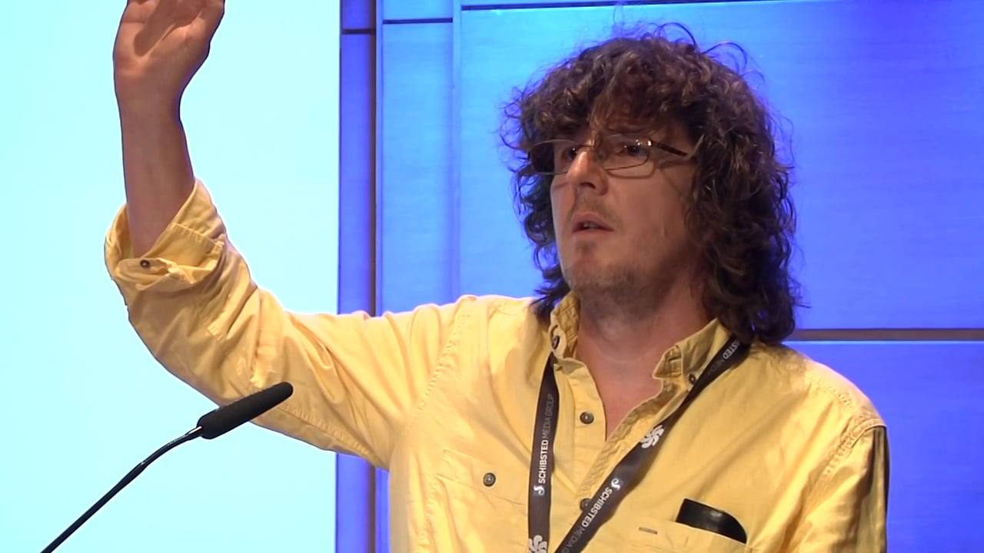
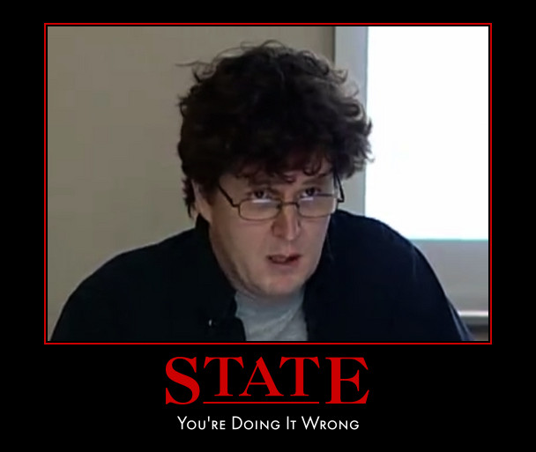

Rich Hickey

Slide 4
Rich Hickey
started out as a music producer
Java/C++ programmer for over a decade
'saw the light' with Lisp
creator of Clojure
creator of Datomic
now CTO of Cognitect

Slide 5
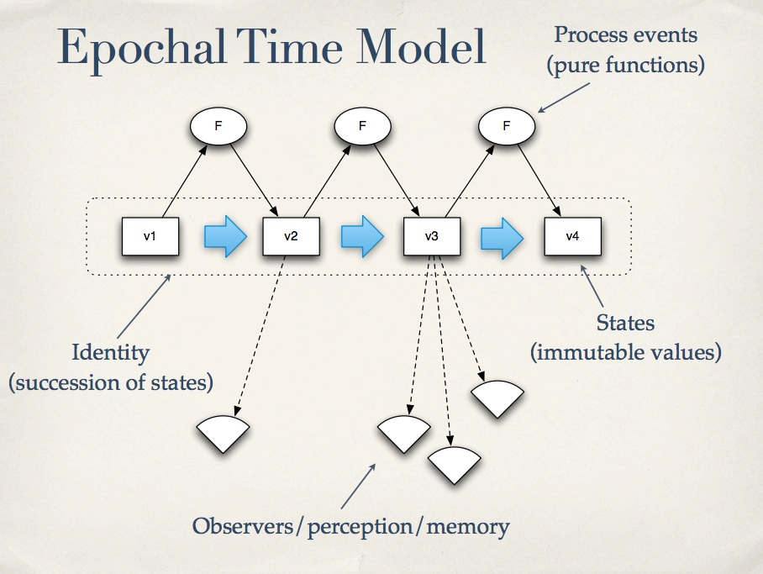
Value of values
introduces his concepts of values and places
place:
    mutable
    writes overwrite current state
    no history
value:
    more like a fact
    immutable
    can create history of facts

Slide 6
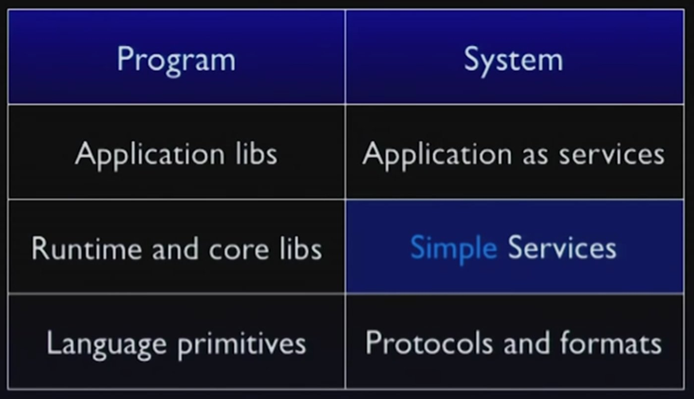
Language of the System
develop systems rather than programs
use tools designed to write programs
'systems language':
    concepts?
    invariants?
    properties?
    protocols?

Slide 7
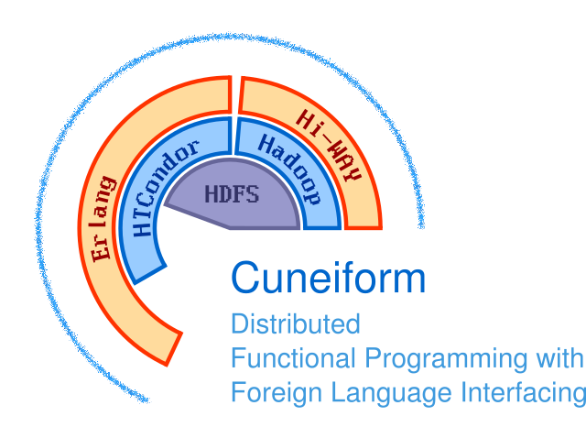
Cuneiform
workflow specification language
functional
    immutable
    lazy
    second order functions
forreign function interface
distributed (parallel?)
© Jörgen Brandt, HU-B.WBI

Slide 8
Cuneiform
deftask untar (<list(File)> : tar(File)) in bash *{
tar xf $tar
list=`tar tf $tar`
}*
txt = untar(tar: 'corpus.tar');
csv = wc(txt: txt);
result = groupby(csv: csv);
result;

Slide 9
Cuneiform
program implicitly forms a tree
like in Lips or λ-calculus
every 'task invocation' must be bound to a name
query operator finally triggers tree reduction and 'execution'

Slide 10
Unix
“If I had more time,
I would have written a shorter letter.”

Slide 11
Unix
advantage: full stack
    shell: oblivious coordination
    C: oblivious calculation
    kernel: API, fs, memory, sockets, …
my linux is a 'system':
    running processes
    data they consume/produce
    means to spawn and orchestrate them
    why isn't 'Bash' considered a coord/workflow language?

Slide 12
Bash
stdout
$ cat
default conf for basic unit: stdin, stdout, stderr
$ cat foo.txt
overwrite default conf with string (file?)
who knows it's a file?
$ cat foo.txt > bar.txt
write output to file? or bind output to a new name?
What about `foo bar`, $ and A | B ?
stdin
cat
stderr
cat
foo.txt
cat
foo.txt
bar.txt

Slide 13
Bash
Bash | Functional
& | - (lazy)
| | function composition
>, >> | name binding
< | -
$ | eval

Slide 14
Bash
can keep the language (or most of it)
Problem: FS is shared mutable state
→ need immutable FS …
(the file system as a value...)

Slide 15
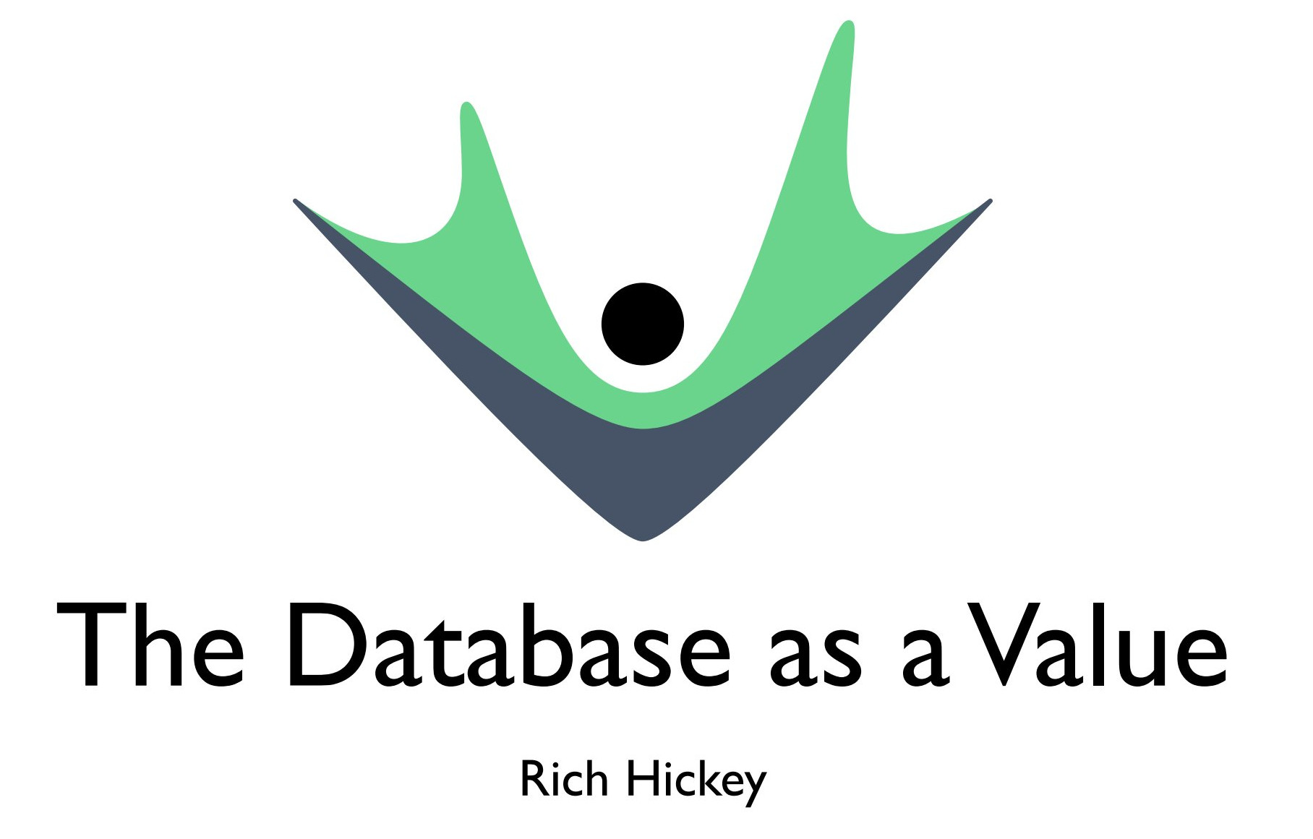
Datomic
first functional DB
ACID but no CRUD
append-only log of 'facts'
can be implemented by any stateful DB/store
Entity | Attribute | Value | Transaction
421 | :student/email | foo@bar.com | 12345
421 | :student/email | new@bar.com | 12346

Slide 16
Git
used as: version control system
users change files in-place
system keeps full history of all 'states'
internal structure looks like an immutable FS
based on hash trees (Merkle trees)
“Problem”: destructive ops → merge conflicts...

Slide 17
Drift
interactive system shell & language like bash
→ start and orchestrate services (task + data view)
stateful virt. FS that is actually immutable
  → extensive cashing between sessions
FS which is 'streaming by default'
  → emulated using 2 diff. message queues
interactive graph visualization of the system
  → using Petri Net syntax

