Slide 1
Clickjacking
Attacks and Defenses

Slide 2
Background
Clickjacking is a malicious technique of tricking a Web user into clicking on something different to what the user perceives they are clicking on.
Get Free IPad
Like
Notes:
A clickjacking site contains at least two

Slide 3
Existing Clickjacking Attacks
Compromising target display integrity
Compromising pointer integrity
Compromising temporal integrity
Notes:
Three ways of forcing user into issing input commands

Slide 4
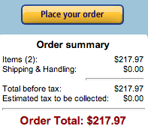
Compromising target display integrity
Get Free IPad
Hiding the target element
Opacity value and Z-index vale
Decoy un-clickable
http://robertnyman.com/css3/pointer-events/pointer-events.html
Partial overlays
Cover receipt and amount
Cropping
Crop the target element to show a piece of the element
Like
Notes:
COVER
No overlapping

Slide 5
Compromising Pointer integrity
CursorJacking
Display a fake cursor
Hide the default cursor
http://koto.github.com/blog-kotowicz-net-examples/cursorjacking/
Strokejacking
Blinking cursor
Invisible sensitive element
Visible fake input field

Slide 6

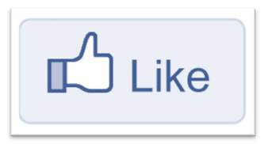
Compromising Temporal integrity
Manipulate UI element after the user decided to click, but before the actual click occurs.
Notes:
Previous two sections manipulated visual context trick user into sending input to wrong UI
Manipulate UI element after the user decided to click, before the actual click
Double Click

Slide 7
EXISITING anti-clickjacking defense
User Confirmation
Degrades user experience
UI Randomization
Not robust
Opacity Overlay Policy
Too strong
Framebusting
Some application need to be embedded
Can be evaded
Notes:
1.Facebook
2. Randomize UI layout.It’s hard for attacker to predict the location of the button Express checkout dialogAsk user to keep clicking until successuflly guessing the location
4. Javascript code guarantee top-level document

Slide 8
EXISITING anti-clickjacking defense
Visibility Detection on Click
Can only address to hiding element strategy
UI delay for cross-origin interactions
User experience
No method to address to point integrity attacks
Notes:
Allow rendering transparent frames, block events on these elements
The length of the UI delay is clearly a tradeoff beteen the user experience penalty and protection from timing attacks
There is no reason for a benign application to expect users to click a transparent element

Slide 9
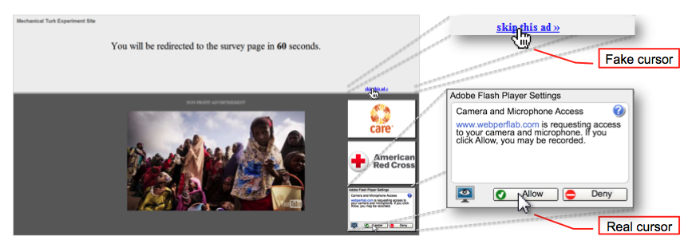
New Attack Variants #1
Attack Technique: Cursor spoofing
Attack Success: 43%

Slide 10
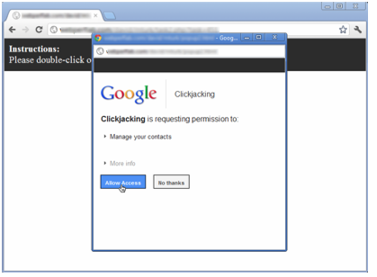
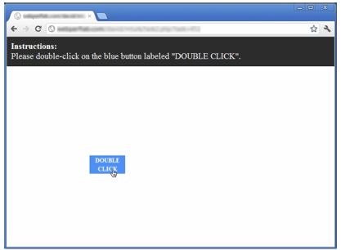
New Attack Variants #2
Attack Technique: Popup Window
Attack Success: 47%
Framebusting
Notes:
authorzie

Slide 11
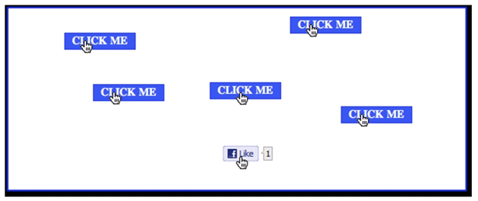
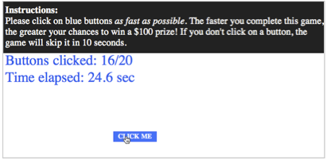
New Attack Variants #3
Attack Technique: Cursor Spoofing + Fast-paced Clicking
Attack Success: 98%
Notes:
Play the game with a facked cursor t
Control user’s attention
The game envorgage users to clock buttons as fast as poosible and the buttons aare shown at random location. Later point in the game, a like button will apear in the real curson;s position, it is highly possble user will clict it because users attention is on other buttons

Slide 12
InContext Defense
Design Goals
Does not require user prompts
Provides point integrity protection
Supports target elements that require arbitrary third-party embedding
Does not break existing sites

Slide 13
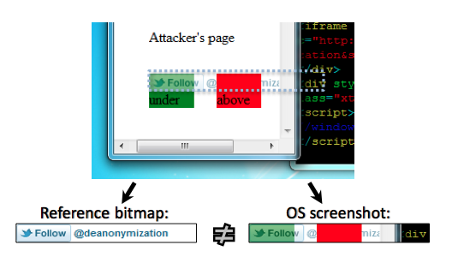
InContext Defense
Ensuring Visual Integrity
Find the Sensitive Element
Application indicate which UI element is sensitive
Dynamic OS-level screenshot comparison
Notes:
Determine whether the sensitive element looks different in the page
Static reference bitmap
The browser draws the sensitive element on a blank surface
No animated contents
No good
How about automated content?

Slide 14
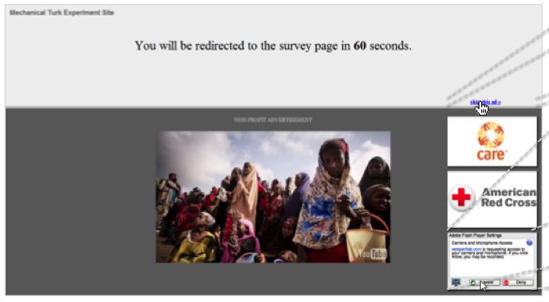
InContext Defense
Ensuring visual integrity of pointer
• Remove cursor customization
- Attack success: 43% -> 16%

Slide 15
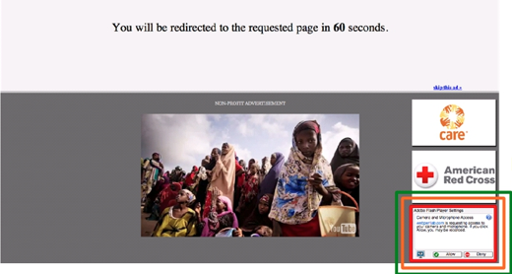
InContext Defense
Ensuring visual integrity of pointer
• Freeze screen around target on pointer entry
- Attack success (margin=20px): 4%
Notes:
Use animation to distract user from

Slide 16
InContext Defense
• Mute the speaker when a user interacts
with sensitive elements
- Attack success: 43%
- Attack success (Mute + Freeezing): 2%
Notes:
Freezing M=20px

Slide 17
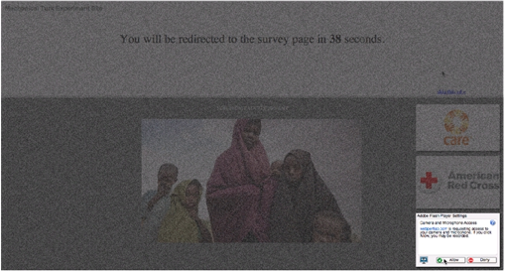
InContext Defense
Ensuring visual integrity of pointer
• Lightbox effect around target on pointer entry
- Attack success: 43%
- Attack success ( Lightbox + Freezing + Mute): 2%

Slide 18
InContext Defense
No programmatic cross-origin keyboard focus changes
Notes:
To stop strokejacking attacks, once the sensitive UI element acquires keyboard focus, InContext disallows programmatic changes of keyboard focus to other origins.

Slide 19
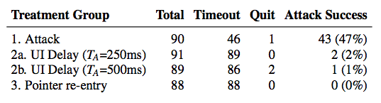
InContext Defense
Ensuring Temporal Integrity
UI delay after pointer entry
Point re-entry on a newly visible sensitive element
When a sensitive UI element first appears or is moved to a location where it will overlap with the current location of the pointer, user needs to re-entry
Padding area around sensitive element

Slide 20
Evaluation Method
Recruit people from Amazon to do tests
Total of 3521 participants, 2064 of which are valid participants
The evaluation results are reliable.
Only evaluate three attacks, not large-scale.

Slide 21
Comparison
Measurement
The USENIX paper provides more attacking scenarios and defense cases.
The AsiaCCS paper presents a first, large-scale attempt to demonstrate that clickjacking is prevalent and serious.
Deployment
Both are deployed in browser.
ClickIDS is a plugin, InContext can be implemented as a plugin.
Introduce New Attacks?
The USENIX paper introduces three new attacks.

Slide 22
Comparison
Defense Mechanism
InContext is more Complete (Pointer, Cropping, strokejacking)
InContext only address to elements labeled by application itself as sensitive. Less user experience penalty
Evaluation
USENIX paper’s authors recruit people from Amazon to evaluate InContext’ effectiveness. More accurate. But only test a few attacks
The AsiaCCS uses tools to simulate users’ behaviors to evaluate ClickIDS’s effectiveness in large scale. Large scale, but not accurate. This method will introduce FP.
Notes:
Only clickable events and overlapping

Slide 23
Conclusiton
The paper discussed current clickjacking techniques and existing anti-clickjacking defenses
The paper proposed three new attack variants that can evade current defenses
The evaluation results show that our attacks are highly effective (success rates 43% to 98%)
The paper proposed InContext defense mechanism, which be can very effective against clickjacking

