Slide 1
Signing Me onto Your Accounts through Facebook and Google
A Traffic-Guided
Security Study of Commercially Deployed Single-Sign-On Web Services
Presented by Chris Moran and Yiyang Yang

Slide 2
Contents
Background
Prior Work
Threat Model
Facebook Demo
Method
Successful Attacks
Conclusion

Slide 3
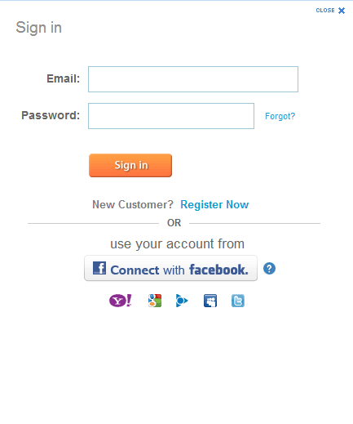
Background
Single sign-on
Enter username and password once and can access multiple applications and websites

Slide 4
Background
Web SSO 3 parties:
1. User(web browser)
2. ID Provider(a.k.a, IdP, e.g., Google, Facebook)
3. Relying Party/Resource Provider(a.k.a, RP, e.g., sears)

Slide 5
Web SSO
User
RP
IdP
1. Access Resource
2. Redirect with Authentication Request
3. Ask for Password
4. User Login
5. Redirect with Secret Token
6. Ensure Authentication and Provide Service

Slide 6
Browser Relayed Message
SSO process can be thought as sequence of Browser Relayed Messages(BRM)
Request 1 | Reply 1 | Request 2 | Reply 2 | Request 3 | Reply 3 | Request 4 | Reply ...
BRM 1
BRM 2
BRM 3

Slide 7
BRM Example
BRM:
HTTP 3xx redirection response
Response including a form for automatic submission
Response with a script or a Flash object to make a request
src = a.com
dst = Facebook.com/a/foo.php
Set-cookie: sessionID = 123456
Arguments: x = 123 & user = john
Cookies: fbs = abc1234 & foo = 4321asd

Slide 8
Prior Work
Prior research focus on protocol analyzing
No prior study on commercially deployed web SSO systems
Protocol research not applicable
SSO based on API, SDK or sample code
Vulnerabilities depend on actual system
RP misuse

Slide 9
Threat Model
(A)
Bob faking Alice
Alice: Benign user
Bob: Attacker
Purpose: Bob sign in as Alice
3 scenarios:
RP
IdP
(B)
(C)
Alice
Alice
Bob's page
Bob faking RP
IdP
RP
IdP

Slide 10
OAuth Demo!

Slide 11
Facebook BRMs, part 1
BRM1, my site to Facebook
source: http://ec2... (200)
dest: https://www.facebook.com/login.php
args
api_key, provided by fb for my app
redirect_url, must be same domain
state, php session variable
BRM2, Facebook login
source: facebook.com/login.php (200)
dest: facebook.com/login.php
args
username, password
next page, after redirect
all previous args

Slide 12
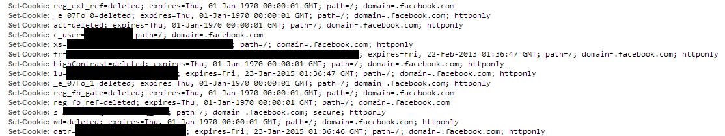
Facebook BRMs, part 2
BRM3, redirect & permission dialog
src: facebook.com/login.php (302)
dest: permissions.request
args: a whole bunch of cookies

Slide 13
Facebook BRMs, part 3
BRM4
source:facebook/permissions.request (200)
dest: facebook/permissions.request
args
user did grant permission
BRM5
source: https://facebook.permissions.request (302)
dest: http://ec2.../auth.php
args
state from BRM1
code, used to retrieve token from facebook

Slide 14
Complete picture, Facebook login
User
EC2
Facebook
index.php
index.php - 200
login.php
login.php - 200
login.php w/ user name, etc.
login.php - 302
permissions.request
permissions.request - 200
permissions.request, user ok'ed
permissions.request - 302
exchange code & client secret for token
auth.php w/ code
auth.php - 200

Slide 15
Complicated!
Lots of different variables
GET Parameters
HTTP Headers
Cookies
Uncertainties Server Side
Facebook
My App

Slide 16
BRM Analyzer
Simplifies understanding
Performs blackbox analysis
Labels inputs
Method
2 Users
#1 makes 2 login requests from 2 different machines
#2 make a single login request

Slide 17
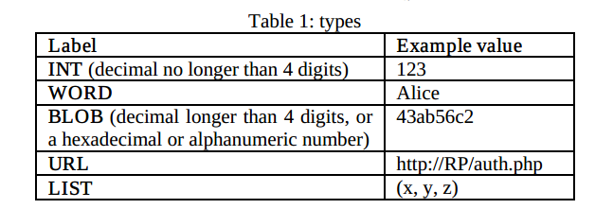
Syntactic Labels

Slide 18
Semantic Label Examples
Type | User1-Machine1 | User1-Machine2 | User2-Machine1
User Unique (UU) | A | A | B
Machine Unique (MU) | A | B | A
Session Unique (SU) | A | B | C

Slide 19
Semantic Labels
Browser Generated (BG)
Value that didn't appear in response, but is in next request
Sig?
BLOB that contains "sig"
pChain
Path of element through whole exchange
Newly-Created (NC)
Sig
Verified signature element
Sec
Secret to current session, necessary for auth
Must Be (!)

Slide 20
Adversary Labels
(C)
Alice
Bob's page
(A)
Bob faking Alice
RP
IdP
A: All elements readable, elems not covered by sig are writable
B
BRM sent to Bob
argument or cookie read
BRM made by Bob
dst, arg, or set-cookie writable
C: dst or argument in BRM writable
RP
IdP
(B)
Alice
Bob faking RP
IdP

Slide 21
Successful Attacks
Google ID
Facebook
JanRain
Freelancer, etc.

Slide 22
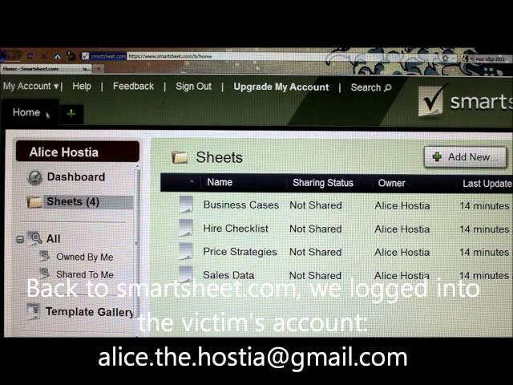
Google ID Attack
Link

Slide 23
Deployment of Google ID
BRM1:src=RP dst=http://IdP/accounts/o8/ud ↓
Arguments:
openid.ns[WORD]↓ & openid.claimed_id[UU] ↓ & openid.identity[UU] ↓ & openid.return_to[URL]{RP/b/openid} ↓ &
openid.realm[URL]{RP/b/openid} ↓ &
openid.assoc_handle[BLOB] ↓ & openid.openid.ns.ext1[WORD] ↓ &
openid.ext1.type.email[WORD] ↓ & openid.ext1.type.firstname[WORD] ↓ &
openid.ext1.type.lastname[WORD] ↓ & openid.ext1.required[LIST] ↓
Google ID is based on OpenID.
Abstract trace for scenario (A) is shown here.
Important elements
Openid.ext1.required in BRM1
Openid.sig in BRM3
Openid.signed in BRM3
Openid.ext1.required is propagate to Openid.signed
BRM2:src=IdP↓ dst=http://!IdP/openid2/auth
Arguments: st[MU][SEC] ↓
BRM3: src=!IdP dst=https://RP/b/openid↓
Arguments:
openid.ns[WORD] ↓ & openid.mode[WORD] &
openid.response_nonce[SEC] & openid.return_to[URL] ↓ & openid.assoc_handle[BLOB] ↓ &
openid.identity[UU] & openid.claimed_id[UU]&
openid.sig[SIG] &
openid.signed[LIST] ↓ & openid.opEndpoint[URL]{IdP/accounts/o8/ud}↓ &
openid.ext1.type.firstname[WORD] ↓ &
openid.ext1.value.firstname[UU] &
openid.ext1.type.email[WORD] ↓ &
openid.ext1.value.email[UU] &
openid.ext1.type.lastname[WORD] ↓ &
openid.ext1.value.lastname[UU]
protected by openid.sig
Notes:
The first case is the deployment of Google ID, which is the case that the previous video showed.
Google ID is based on…
This is the abstract trace for scenario (A)
Of course there are many details, but we can focus on a few important elements: BRM1 has an element called openid.ext1.required, which is a list. This list is propagated to openid.signed in BRM3. The element openid.sig is the signature element in BRM3, which protects many elements of the message.

Slide 24


Deployment of Google ID (cont.)
A simplified illustration of the SSO scheme
(BRM2: unimportant, ignored in this talk)
Alice’s browser
BRM1: realm= the RP’s identity required=(email,firstname,lastname)
BRM3: signed=(email,firstname,lastname) email=“alice@a.com” firstname=“Alice” lastname=“Smith” signature=“HRU436ETQ95TR939”
Google ID service
Relying party website
Notes:
How does the scheme normally work? Let’s see this simplified illustration.
First, BRM1 is sent to the IdP. The realm is the RP’s identity, and required element indicates the elements that the RP wants the IdP to sign.
Then, the IdP sends and receives BRM2, which is not important in our discussion.
Then, the IdP sends BRM3 back to the RP, containing the values of email, firstname and lastname of the user. Also, the element signed indicates the elements being covered by the signature element.

Slide 25
The attack
Reality: many RP websites use email address to identify users.
Suppose Bob knows Alice’s email address.
BRM3: signed=(firstname,lastname) signature=“HRU436ETQ95TR939” firstname=“Bob” lastname=“Johnson”email=“alice@a.com”
Google’s signature correct ≠ All data on the message verified
BRM1: realm= the RP’s domain required=(email,firstname,lastname)
Bob’s browser
BRM3: signed=(firstname,lastname) signature=“HRU436ETQ95TR939” firstname=“Bob” lastname=“Johnson”
BRM1: realm= the RP’s domain required=(email,firstname,lastname)
Relying party website
Google ID service
Google’s signature verified.
Welcome, user “alice@a.com”!
Notes:
Now I tell you what you saw in the video; Google and OpenID foundation both published security advisories to address this issue.

Slide 26
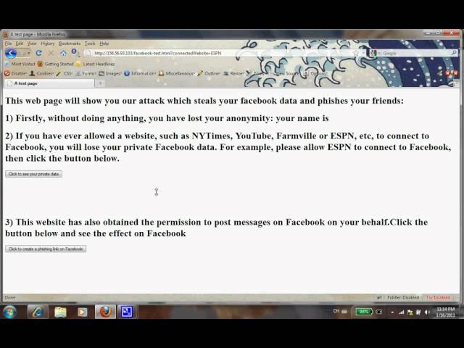
Facebook Exploit
Link

Slide 27
Facebook Connect (Facebook’s SSO)
Abstract trace for scenario (B) is shown here.
app_id, representing the RP’s identity, is writable by Bob.
result, the secret for authentication is sent to Bob in BRM3.
Isn’t there an obvious vulnerability?
In BRM1, set app_id value to be the app_id of the target RP;
In BRM3, Bob will receive the result corresponding to the target RP
Now, Bob would be able to login to the target RP.
Does this obvious attack work?
Hi Facebook,
I am NYTimes.com
BRM1:src=Bob.com dst=http://!IdP/permissions.req
Arguments: app_id[BLOB] ↓ & cb[SEC][BG] &
next[URL]{
http://!IdP/connect/xd_proxy.php↓?
origin[BLOB] ↓ & transport[WORD] ↓
} & … & … & … (other 13 elements )
Facebook generates result to allow login to NYTimes.com
BRM2:src=!IdP dst=http://!IdP/xd_proxy.php↓
Arguments: origin[BLOB]↓ & transport[WORD]↓ &
result[SEC]↑ & … & … (other 4 elements)
BRM3:src=!IdP↓ dst=http://Bob.com/login.php
Arguments: origin[BLOB]↓ & transport[WORD]↓ &
result[SEC]↑ & … & … (other 3 elements )
result is passed to Bob.com
Notes:
When I looked at the trace, it seems that there was an obvious vulnerability.

Slide 28
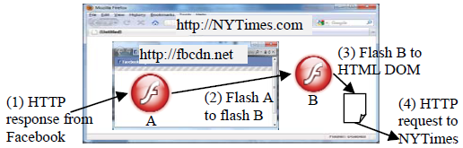

How Facebook SSO really works
The naïve attack did not succeed, because Facebook relies on the client-side same-origin-policy to pass the secret securely.
One of the client-side mechanisms is Adobe Flash
Below is the benign scenario
Both Flash A and Flash B are loaded from Facebook (fbcdn.net)
The secret is sent from Flash A to B (the same-domain communication)
Flash B makes sure that the secret is only sent to an HTML DOM in the intended domain (corresponding to the previous declared app_id)
http://bob.com
Notes:
Don’t mention that facebook developer did not know the cross domain feature

Slide 29
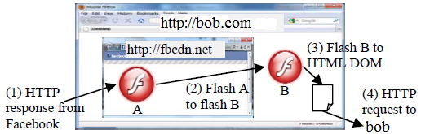
The vulnerability
Adobe Flash can only do same domain communication? A wrong assumption
“Unpredictable domain communication”
As long as Flash A is willing to send, and Flash B is willing to receive, they can communicate in different domains.
So Flash B can come from bob.com, and thus obtain the secret from Flash A.
Unpredictable domain comm.
Notes:
We reported the issue to Facebook. After confirming the problem, Facebook applied a fix on the same day.

Slide 30
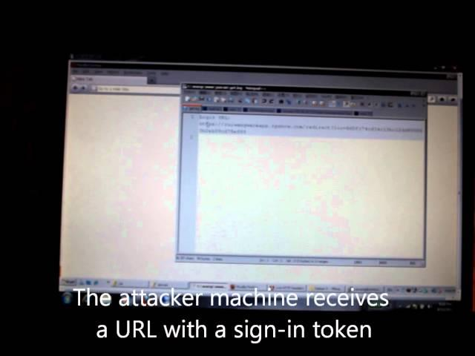
JanRain
Video
Link

Slide 31
About JanRain
Wrapper service for SSO
Google
Facebook
Twitter
More complicated browser interaction
7 BRMs!
Website for those interested

Slide 32
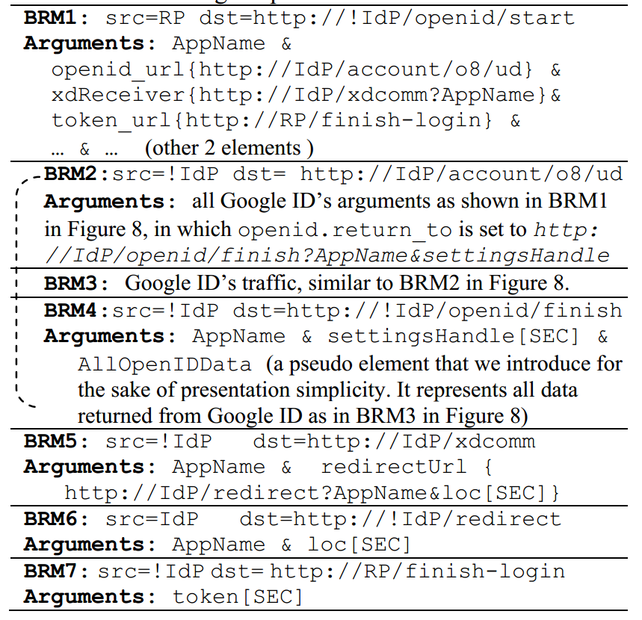
JanRain exploit explained
First attempt
Try to change token_url
JanRain checks against Whitelist, twice
http://bob.com
New strategy
Change flow
Get loc value

Slide 33
continued...
BobApp
2 part
Bob
Does BRM1
Gets settingshandle
Alice
Visit bob's site
Use handle w/ RP-APP in BRM2
Bob plays 2-5
http://Bob/xdcomm
http://Bob/xdcomm

Slide 34
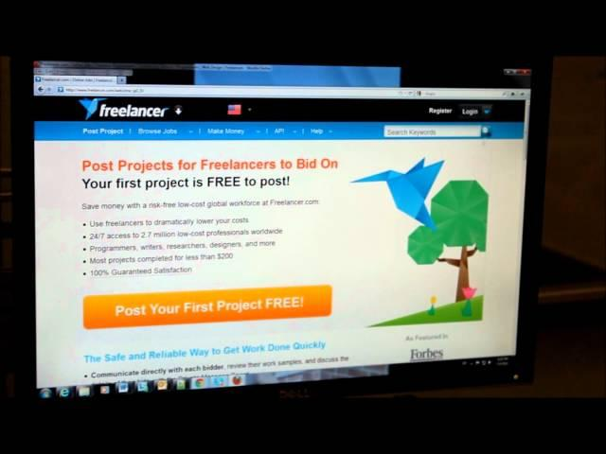
Freelancer Attack
Link

Slide 35
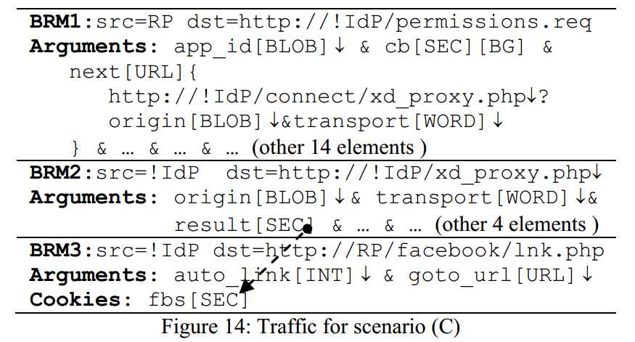
Freelancer Attack Explained
Linking is 3 step process
Spoof 1&2 by visiting change-settings page
Do final POST from attacker's browser without referrer header

Slide 36
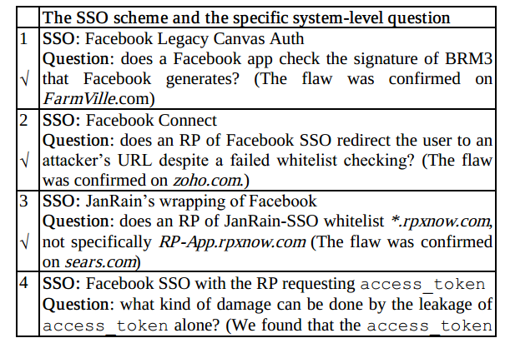
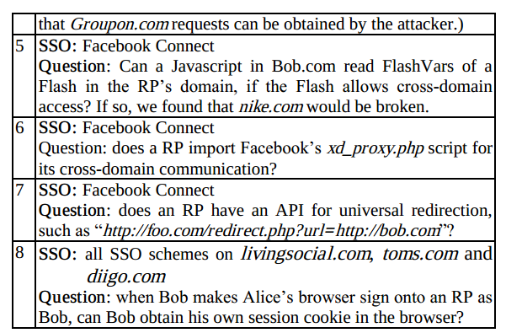
Other flaws

Slide 37
Contributions
BRM Anaylzer
Allowed researchers to focus on flaws of design rather than understanding the design itself
Very successful
Found flaws in largest providers of SSO
Flaws patched quickly

Slide 38











Impact
Acknowledgements from many companies
Security advisories published
News coverage
and many others
Notes:
Don’t mention monetary reward.

Slide 39
Discussion
Future work?
Tools for developers of SSO
Change in underlying protocols?
Prevention?
2 stage authentication?
Better example code from providers?
How did developers fix security flaws?

Slide 40
Thanks for listening!
Some slides used from paper's authors' presentation. Can be found here.

