Slide 1
A Methodology for Empirical Analysis of Permission-Based Security Models and its Application to Android

Slide 2
Outline
Introduction
Related Work
Android Permission Model
Dataset
Self-Organizing Maps (SOM)
Component Plane Analysis
Conclusion & Discussion

Slide 3
Introduction (Keywords)
Access Control System
Access Control Lists (ACLs)
List of permissions attached to an object
Ex. (Alice, delete)
Permission-based security models
Provide controlled access to various system resources.
! Spiteful Permissions are Not involved.
Notes:
Access control system is a security system based on access control list allows a subject to perform an action (read, write, run) on a object. Access control lists is a list of permissions attached to an object. Access control lists allows a subject to perform an action on an object only if the subject has been assigned the necessary permissions. For example, if a ACL containts (Alice, delete), this would give Alice permission to delete file.
Permission-based security models provide controlled access to various system resources. So both ACL and Permission-based security models allow administrators and operating systems to restrict actions on specific resources.
However, one of the main problem of ACL and Permission-based Security models is that, they are designed by developer or administrator who may not always know all possible use cases in future. As a result there are possible spiteful permissions are not involved in ACL.

Slide 4
Introduction
Permission-Based Security Models
Google’s Android OS
Google Chrome’s extension system
In contact, Firefox extensions
Run all extension code with same OS-level privileges as the browser itself
Blackberry OS
Blackberry APIs with control access
Reading phone logs, modifying system setting
Notes:
There are many widely deployed systems which use permissions. For example, google’s android os for mobile devices. Android requires that developers declare in a manifest a list of permissions which user must accept prior to installing an application. Android uses this permission model to restrict access to advanced or dangerous functionality on the device. The user decides whether or not to allow an application to be installed based on the list of permissions included by the developer.
Similar to Android OS, the Google Chrome web browser use a permission-based architecture in its extension system. Extension developers create a manifest where specific functionality (e.g. reading bookmarks, opening tabs) required by the extension. Then the manifest is read at extension install time to better inform the user of what the extension is capable of doing, and reduce the privilege that extension are given.
In contract , Firefox extensions ,which do not have this permission architecture, run all extension code with the same OS-level privileges as the browser itself.
Blackberry OS enforces through signature validation that an application has been granted permissions to access the controlled APIs.

Slide 5
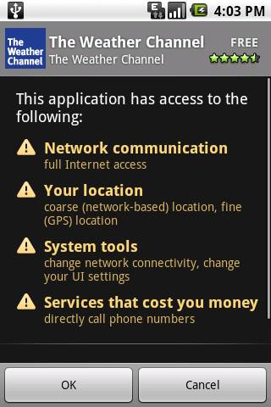
Introduction (Android OS)
Android uses ACLs extensively to mediate inter-process communication and to control access to special functionality on the devices
Text messages, vibrator, GPS receiver.
Inter-process Communication (IPC)
Technique communication between at lease two process
Advantages
Prevent malware
Inform user what applications are capable of doing once installed
Notes:
The paper is focus on the empirical analysis of permission-based model included in Android OS.
Inter-process communication is the technique used in communication between at least two process. In order to make different process to get and send resource.
Android uses ACLs extensively to mediate IPC and control access to special functionality on the device (such as text messages, vibrator, GPS receiver).
Android developers must request permission to use these special features in a standard format which is parsed at install time. The OS then responsible for allowing or denying use of specific resources at run time.

Slide 6
Introduction (Main Objectives)
Empirical analysis
Objectives
Investigate how the permission-based system in Android is used in practice
Identify the strengths and limitations of the current implementation
Android applications
80,000 apps, at July 2010
Developed by large software companies and hobbyist
Not controlled as tightly as other mobile application stores
More variety in terms of requested permissions
Notes:
The main objectives of empirical analysis are…
1)(whether the design expectations meet real-world usage characteristics)
2) to identify the strengths and limitations of the current implementation.
Because, as July 2010, there are over 80,000 applications available for Android, many of which are free and written by both large software development companies and hobbyist. Also the android market is not controlled as tightly as other mobile application stores. For example Apple App store will check all the apps before putting it on the market while Android does not, additionally, apps will not checked immediately after user upload it, thus user has the risk download spiteful apps after it upload. This implies the applications may exhibit more variety in terms of requested permissions along with other behavioral characteristics which might not occur in a close environment.

Slide 7
Outline
Introduction
Related Work
Android Permission Model
Dataset
Self-Organizing Maps (SOM)
Component Plane Analysis
Conclusion & Discussion

Slide 8
Related Work
[1] Enck et al. describe the design and implementation of a framework to detect potentially malicious applications based on permissions requested by Android applications.
[2] Barth et al. analyzed 25 browser extensions for Firefox and identified that 78% are give more privileges than necessary
[1] W. Enck, M. Ongtang, and P. D. McDaniel. On Lightweight Mobile Phone Application Certification. In E. Al-Shaer, S. Jha, and A. D. Keromytis, editors, ACM Conference on Computer and Communications Security, pages 235–245. ACM, 2009.
[2] A. Barth, A. P. Felt, P. Saxena, and A. Boodman. Protecting Browsers from Extension Vulnerabilities. In Proceedings of the 17th Network and Distributed System Security Symposium (NDSS 2010).

Slide 9
Outline
Introduction
Related Work
Android Permission Model
Dataset
Self-Organizing Maps (SOM)
Component Plane Analysis
Conclusion & Discussion

Slide 10
Android Permission Model
Android Applications are written in Java syntax and each run in a custom virtual machine known as Dalvik.
Any third party application can define new Functionality. (self-defined)
Every application written for the Android platform must include an XML-formatted file named “AndroidManifest.xml”
Permissions are enforced by Android at runtime, but must be accepted by the user at install time.
Notes:
Dalvik: a light-weight replacement for the standard Java Virtual Machine.
By running each applications inside a virtual machine, spiteful applications are isolated therefore malicious actions are not affecting other applications and OS.
Any third party application can define new Functionality, thus other applications can request this functionality by requesting specific permission.
This essential part of the Android security model contains (along with other metadata such as minimum OS requirements) the permission declarations that the application is requesting access to.( android.permission.*)
Permissions are also described in a more friendly language at install time. These descriptions attempt to give a brief, technical explanation of the permission, but do not disclose what the developer intend to use access to those resource for.

Slide 11
Outline
Introduction
Related Work
Android Permission Model
Dataset
Self-Organizing Maps (SOM)
Component Plane Analysis
Conclusion & Discussion

Slide 12
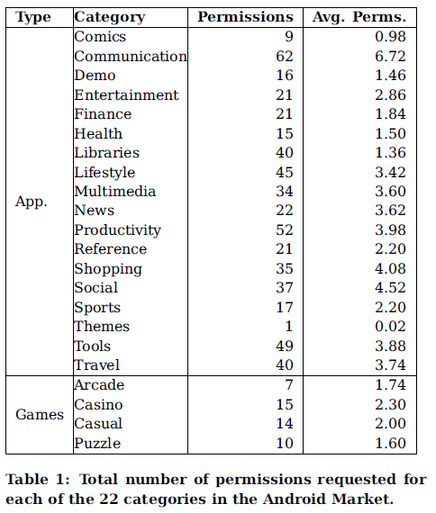
Dataset
Notes:
The dataset used for empirical study consist of 1,000 applications, the top 50 free applications downloaded in December 2009 from each of the 22 categories in the Android market. In the market, Google makes a distinction between applications and games. Both of these main categories are further subdivided.
The fourth column presents the average number of permissions requested by application in each category.
For example, The Communication category is by far the most diverse, with 62 permissions requested. This category also had the highest number of permissions per application. The themes category was the least diverse containing 49 applications which request no additional permissions and one which requested access to internet.

Slide 13
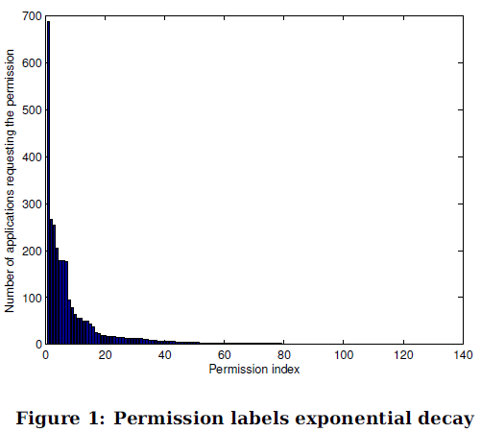
Notes:
Dataset includes 119 distinct permission requests, out of which 38(31.93%) were to self-defined permissions. Y-axis denotes the number of applications that request the permission and x-axis denotes the permission index. Permissions are ordered according to the their request counts. For example, the a.p.INTERNET permission (indexed as 1) was requested by 686 applications (62.36% of all applications).
The distribution of permissions in Figure 1 demonstrates that the frequency of permission requests decays rapidly, and there is a long tail of permissions that are only requested by one or two applications in the dataset.

Slide 14
Dataset (Analysis)
Duplicate permission error
Request permission that do not exist
E.g. Txeet app
Wrong: a.p.ACCESS_COURSE_LOCATION
Real: a.p.ACCESS_COARSE_LOCATION
Signature Permissions
E.g. a.p.BRICK
Notes:
During data set analysis, they observe that developers requested the same permission twice in their application. Another observation is that applications request permissions that do not exist. For example, the Txeet app requested access to the a.p.ACCESS_COURSE_LOCATION permission. The developer was likely attempting to declare a.p.ACCESS_COARSE_LOCATION permission. If the Txeet app attempts to make use of coarse location features, android will throw a security exception and deny access to location data since the permission is incorrect.
Some applications request a.p.BRICK permission which theoretically allows an application to completely disable the device. While a.p.BRICK permissions controls access to calls that can disable the device, so third party applications cannot make use of this permissions because android restrict use of related function calls to application signed by the same private key as the running Android OS. Thus these kind of permissions are called signature permissions,

Slide 15
Outline
Introduction
Related Work
Android Permission Model
Dataset
Self-Organizing Maps (SOM)
Component Plane Analysis
Conclusion & Discussion

Slide 16
Self-Organizing Maps (SOM)
SOM is a type of neural network that is trained using unsupervised learning to produce a low-dimensional, relational view of a high complex dataset.
Characteristics:
SOM provides a 2-dimensional visualization of the high dimensional data
The component analysis of SOM can identify correlation between permissions.
Notes:
The paper use self-organizing maps, SOM is a type of neural network algorithm that is trained using unsupervised learning to produce a low dimensional, relational view of a highly complex dataset.
Unsupervised learning is a algorithm in machine learning, it aimed to trying to find hidden structure in unlabeled dataset.

Slide 17
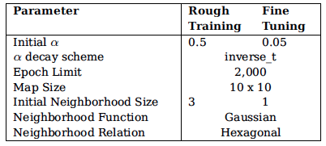
Self-Organizing Maps (SOM)
The Training algorithm can be summarized in four basic step
1) initializes the SOM before training.
2) determines the best matching neuron, which is the shortest Euclidean distance to the input pattern
3) involves adjusting the best matching neuron and its neighbors so that the region surrounding the best matching neuron become closer to the input pattern.
4) repeat steps 2 – 3 until the convergence criterion is satisfied.
Notes:
The training algorithm can be summarized in four basic steps. Step 1 initializes the SOM before training. Step 2 determines the best matching neuron, which is the shortest distance to the input pattern. Step 3 involves adjusting the best matching neuron and its neighbor so that the region surrounding the best matching neuron become closer to the input pattern. Step 4 Repeat steps 2 - 3 until the convergence criterion is satisfied. The convergence criterion utilized in SOM is in terms of epochs, which define how many times all input vectors should be fed to the SOM for training.
The training is conducted in two stages. In rough training, the learning rate (i.e., \alpha(t)) is set to a higher value, hence has the potential to cause greater changes in SOM. On the other hand, in fine tuning, the learning rate is reduced to facilitate incremental changes in neurons.

Slide 18
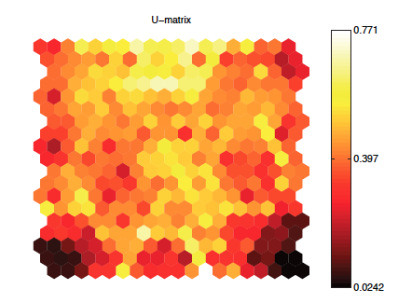
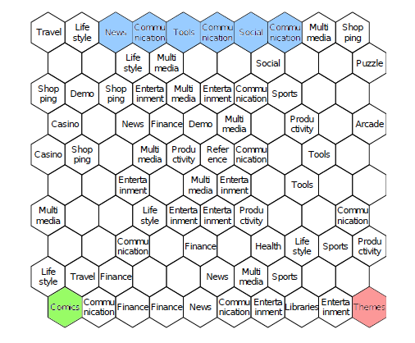
Self-Organizing Maps (SOM)
Notes:
The figure is the U-matrix representation of the SOM for Android permissions. This representation employs a heat colormap to show the distance between weight vectors of the neurons. The heat colormap ranges from black through shades of red and yellow to white. White implies high value and black implies low value. Therefor, if the distance between neighboring neurons is small, the region is draw with dark color. Conversely, if the distance between neighboring neurons is large, a light shade is used. For example, at the top left hexagon represents the neuron associated with travel category. And the adjacent neuron associated with the lifestyle category is the third hexagon from the top left since the hexagon between the two neuron is introduced to express distance between them.
As we can see, in general, applications are sparsely populated that there are more light region than dark in the permission space. Except the dark shaded regions in the lower right and left corner.
Given that SOM places similar input pattern in the same region, this indicates that applications from the same category do not necessary “behave” similar (do not request similar permission).
Also, applications requesting similar sets of permissions (from multiple categories) are clustered together which implies that applications from different categories can request similar sets of permissions. This also reflects that fact that the categories defined by Google are based on semantic activity class rather than the technical features used to implement them.
Communication is the most diverse category, as shown in Table 1. Therefore, applications in this category implement a diverse set of functionality, which consequently causes the Communication category to represented by numerous neurons of the SOM.

Slide 19
Outline
Introduction
Related Work
Android Permission Model
Dataset
Self-Organizing Maps (SOM)
Component Plane Analysis
Conclusion & Discussion

Slide 20
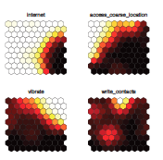
Component Plane Analysis
Internet
Access_coarse_location
Vibrate
Write_contacts
Notes:
In order to identify the frequency of use and the correlations between the permission, they also perform a component plane analysis of the SOM, that they represent the component distribution in individual dimensions. Each dimensions represents a permission. The figure at left is a example of the component plane analysis for 4 permissions. The first one is internet…
In this representation, light shades represent the frequent use of the permission whereas the dark shades represent the infrequent use.

Slide 21
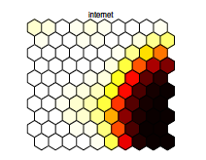
Component Plane Analysis
a.p.INTERNET
Theme
Productivity
Notes:
The figure shows the component plane for the a.p.internet permission. Light shades indicate the regions in which the permission is requested. The lower right region in this figure represents the few applications which do not request the internet permission, mainly the applications in the Theme and productivity categories.

Slide 22
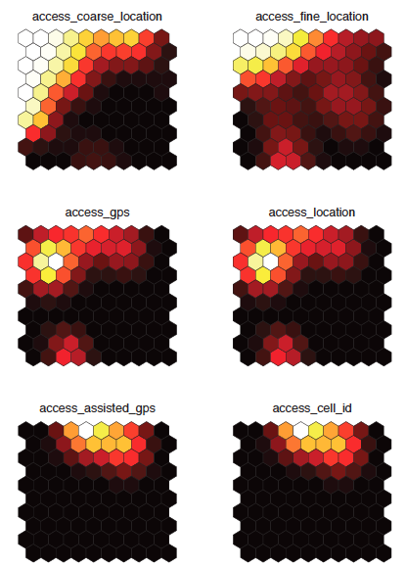
Component Plane Analysis
Travel, shopping, communication, and lifestyle
Notes:
The analysis of component planes can show correlations between permissions. Specially, two permissions are likely to be correlated, if the component plane visualization are similar. For example, the component plane visualization of access_coarse_location and access_fine_location shows that both permissions are requested on the upper left region of the map, this region corresponds to Travel, shopping, communication, and lifestyle.
Furthermore, the component plane visualization of access_assisted_GPS and access_cell_ID are very similar, they are highly correlated. And this is expected because assisted GPS is relies on the cell tower ID for location.

Slide 23
Outline
Introduction
Related Work
Android Permission Model
Dataset
Self-Organizing Maps (SOM)
Component Plane Analysis
Conclusion & Discussion

Slide 24
Conclusion & Discussion
A small subset of the permissions are used very frequently where a large subset of permissions were used be very few applications.
Finer-grained permissions vs. Complexity
Possible enhancement to Android
Hierarchy
a.p.SEND_SMS, a.p.WRITE_SMS → a.p.SMS.*
a.p.INTERNET → a.p.INTERNET.ADVERTISING(*.admob.com)
Grouping self-defined permissions
Notes:
We note that having finer-grained permissions in a permission-based system enables users to have detailed control over what actions are allowed to take place. Whether it is beneficial to provide finer granularity will
depend on many factors within a particular environment, as it increases complexity and thus may have, for example, usability impacts on designers and end-users.
For example, a.p.SEND_SMS and a.p.WRITE_SMS are two independent permission labels, instead of being grouped, for instance, under a.p.SMS.*.
One example would be a free application that displays ads from domains belonging to Admob. Currently a developer would include the ad code snippet, and request the a.p.INTERNET permission. This permission allows the application to communicate over any network and retrieve any data from any server in the world. A more fine grained hierarchical permission scheme could enable the developer to request the a.p.INTERNET.ADVERTISING(*.admob.com) permission which could limit network connectivity to only download ads in static HTML from subdomains of Admob.
In the current flat permission model, new developerintroduced permissions will likely be used infrequently and independently of other permissions. Logically grouping all self-defined permissions under one category could help inform users that these permissions are not part of the core (Google-defined) set.

Slide 25
Questions?

